Slide 1
Hazardous Energy Control
(lockout/tagout)
29 CFR 1910.147
The material was produced under grant number Grant SH-99019-SH0 (from the Occupational Safety and Health Administration, U.S. Department of Labor). It does not necessarily reflect the views or policies of the U.S. Department of Labor, nor does the mention of trade names, commercial products, or organizations imply endorsement by the U.S. Government.
Notes:
The material was produced under grant number Grant SH-99019-SH0 (from the Occupational Safety and Health Administration, U.S. Department of Labor). It does not necessarily reflect the views or policies of the U.S. Department of Labor, nor does the mention of trade names, commercial products, or organizations imply endorsement by the U.S. Government.

Slide 2
WE WILL COVER:
OSHA Information
OSHA’s Lockout/Tagout (LOTO) Standard
Effective Hazardous Energy Control Methods
Elements of an Energy Control Program
Notes:
During this module, we will cover general information on OSHA, the requirements in OSHA’s lockout/tagout standard, the required elements of an energy control program, and how to effectively control hazardous energy. Ask the class what their experience with LOTO looks like. Based upon their own history and experience, why do they think lockout/tagout is important? Have they ever witnessed an incident involving lack or improper execution of LOTO? Are they maintenance personnel? Are they authorized to do LOTO? Are they training other employees in how to do LOTO?

Slide 3
OBJECTIVES
Upon the successful completion of this module, participants will be able to:
  Discuss the importance of lockout/tagout
  Identify sources of hazardous energy
  Identify hazards associated with poor execution of lockout/tagout
  Describe the methods of energy control (e.g. lockout, tagout, block and bleed)
  Describe the requirements of the energy control program (e.g. energy control procedures, employee training, periodic inspections)
Notes:
We will begin with an introduction on lockout/tagout, including what lockout/tagout it, why it is important, and what is the purpose of the standard. We will review and identify various hazardous energy sources that may be used to power equipment or machinery. We will identify hazards associated with poor execution of LOTO, and we will discuss how energy is properly controlled. We will review OSHA’s requirements for energy control programs, including equipment-specific procedures, periodic inspections, and employee training.

Slide 4


EMPLOYER RIGHTS AND RESPONSIBILITIES
Employers have the responsibility to, at a minimum, comply with the OSH Act
Employers must perform their due diligence to find and correct safety and health hazards
New 2015 version
Notes:
Employers must also:
Perform tests in the workplace, such as air sampling or noise monitoring, as required by some OSHA standards.
Provide hearing exams or other medical tests required by OSHA standards (if applicable).
Post injury/illness information so that employees can see them.
Prominently display the official OSHA "Job Safety and Health - It's the Law" poster that describes rights and responsibilities under the OSH Act; new poster issued in 2015, however, either poster is still acceptable.
AND employers MAY NOT retaliate or discriminate against workers for using their rights under the OSH Act to report hazards that could lead to or have caused a work-related injury or illness.
Graphic: This slide has a picture of the old OSHA poster and the 2015 version of the OSHA poster.

Slide 5
WORKERS’ RIGHTS
Workplace free of recognized hazards
Report safety and health concerns and/or injuries and illnesses without retaliation
  File a discrimination complaint under Section 11 (c) of the OSH Act, which prohibits discharge or discrimination by “any person” against any employee for OSHA-related activity;
  File a complaint if punished or discriminated against for acting as a “whistleblower” under the additional federal laws for which OSHA has jurisdiction.
Receive appropriate training in a language and vocabulary that workers understand
Notes:
Employers have the responsibility to provide a safe workplace free from serious hazards and must follow all OSHA safety and health standards.
Employers must find and correct safety and health problems as their due diligence under the OSH Act. OSHA requires that employers first try to eliminate or reduce hazards by making feasible changes in working conditions rather than relying on personal protective equipment - a.k.a. PPE (e.g. masks, gloves, earplugs); and if an employer provides PPE, then the employer must train the employees on WHEN and HOW to use the PPE.
Any training given by the employer must be in a language that the employees can understand. An example is when an employer is giving training on procedures for how to de-energize or re-energize a piece of equipment by locking out or tagging out (LOTO) the various energy sources to prevent employee entrapment or other hazards from released energy.
Temporary workers are also entitled to the same protection against retaliation as full-time workers. Employers may not take action against employees for participating in protected workplace activities (i.e., filing a complaint, voicing concerns about workplace hazards to supervisors, etc.). Workers also can inform OSHA of other whistleblower items that OSHA enforces, which currently (2014) is 22 different whistleblower statutes covering a variety of workplaces. For more information visit whistleblowers.gov.
The whistleblower document is included in Resource Section.

Slide 6
WORKERS’ RIGHTS (CONT.)
Request an OSHA inspection at your facility (confidential)
Participate in an OSHA inspection
Speak to OSHA inspector in private
See OSHA citations
Request medical records, tests that measure hazards and injury/illness log
Notes:
Workers can participate during an OSHA inspection. They may speak with an inspector in private without retaliation from an employer. Workers can see the OSHA citations and request medical records, tests that measure hazards and the OSHA log.
Section 11(c) of the OSH Act prohibits discharge or discrimination by any person against any employee for OSHA-related activity AND authorizes the Secretary to investigate and seek all appropriate relief against any such person. Retaliatory lay-offs or failure to refer a worker who engages in protected activity under OSHA would be grounds for the Secretary to seek remedial - including injunctive - relief in district court.
Employers may not take action against employees for participating in protected workplace activities (i.e. filing a complaint, voicing concerns about workplace hazards to supervisors, etc.). Workers also can inform OSHA of other whistleblower items that OSHA enforces, which currently (2019) is 23 different whistleblower statutes covering a variety of workplaces. For more information visit whistleblowers.gov.

Slide 7
INTRODUCTORY LOTO QUIZ
What is the purpose of LOTO?
When does LOTO apply?
What are the primary sources of energy in the work environment?
What are the components of a LOTO program?
How often do you have to audit LOTO procedures?
3
Notes:
Questions to ponder as we start to discuss LOTO in detail. We need to understand these basic questions to know the importance of LOTO. “Lockout/tagout” refers to specific practices and procedures to safeguard employees from the unexpected energization or startup of machinery and equipment, or the release of hazardous energy during service or maintenance activities.

Slide 8
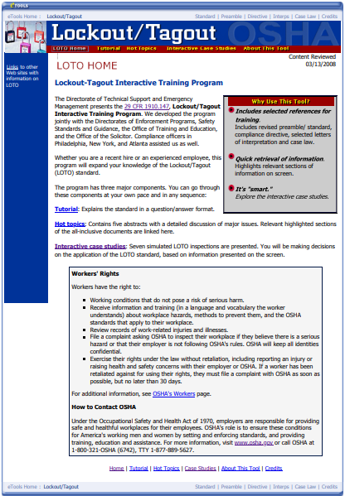
LOCKOUT TAGOUT STANDARD
1910.147(a) Scope, Application and Purpose
1910.147(b) Definitions
1910.147(c) General
1910.147(d) Application of Control
1910.147(e) Release from LOTO
1910.147(f) Additional Requirements
Notes:
1910.147 is OSHA’s standard for LOTO. The standard is broken up in the following way: scope, application and purpose, definitions, general requirements, application of energy control, release from LOTO, and additional requirements. We have included a screenshot here of OSHA’s LOTO eTool. You can easily access this etool on OSHA’s website. The eTool does a great job at explaining the concept of hazardous energy control, and the procedures that must be taken in order to properly control any hazardous energy prior to doing any servicing or maintenance work on equipment.
Graphic: Screenshot of OSHA’s LOTO eTool home page.
OSHA’s Lockout/Tagout eTool: https://www.osha.gov/dts/osta/lototraining/index.html

Slide 9
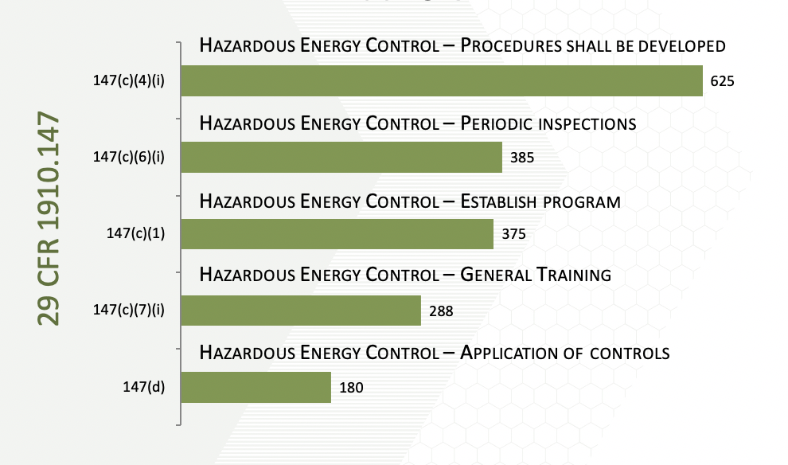
Hazardous Energy Control [1910.147]
FY 2017
FREQUENTLY CITED
HAZARDS
Notes:
The items most frequently cited under the standard are the following items: machine specific procedure, periodic inspections, LOTO program, training, and application of controls. We will discuss all of these items in the slide show presentation.
Graphic: Chart showing the 2017 General Industry Subpart J most frequently cited serious violations.

Slide 10
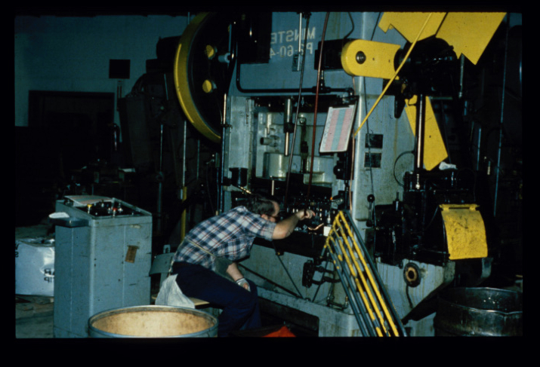
LOCKOUT/TAGOUT: What is it?
Lockout Tagout = Verified Energy Control with Communication
Notes:
What is LOTO? Essentially, LOTO is verified energy control with communication. Breaking the term “lockout/tagout” down: lockout is the verified energy control, and tagout is the communication portion.
When does LOTO apply? LOTO applies any time an employee performs maintenance or servicing on equipment or machinery, and any time an employee bypasses a guard or works in a hazardous area-or what we call a danger zone. Again-LOTO applies whenever servicing or maintenance is performed, and whenever a guard must be removed and an employee is working in a hazardous area.
OSHA’s LOTO standard covers servicing and maintenance of machinery and equipment that could become unexpectedly energized. Not referring to locking/tagging something out of service, but rather when servicing or maintenance needs to be performed on machinery.
Photo: Employee performing maintenance on a mechanical power press.

Slide 11
ACTIVITIES COVERED UNDER 1910.147
Servicing and maintenance of equipment or machinery
Normal production operations where:
  Employees by-pass guard(s)
  Employees place any part of their body in a hazardous area
Notes:
LOTO covers the servicing and maintenance of machines and equipment in which the unexpected energization or start up of the machines or equipment, or release of stored energy could cause injury to workers. This standard establishes the minimum performance requirements for the control of such hazardous energy.
LOTO also applies to servicing or maintenance during normal production operations when employees bypass a machine guard or place any part of their body in a hazardous area. Employees should never be exposed to machine hazards, whether while doing servicing or maintenance or during normal production operations.

Slide 12
ACTIVITIES NOT COVERED UNDER 1910.147
Construction, agriculture, and maritime
Normal production operations
  Subpart O
Cord-and-plug under the control of employee
  Written procedure still required
Exposure to electrical conductors
  Subpart S and electrical safety-related work practices
Notes:
The general industry standard does not apply to maritime, but maritime most certainly has a standard. The construction standard does not mention a LOTO standard, but workers certainly have to have equipment rendered inoperable before working on the equipment.
Bullet #2 suggests an alternative for LOTO is when the machine is protected by some other means, such as machine guarding.
Bullet #3-Cord and plug connected equipment is exempt when the worker has direct control over the cord of the equipment.
Bullet #4 There are electrical safe work practices to protect workers, but sometimes you have to lockout machine electrical conductors as well. The standards 1910-330 through 360 would apply and the consensus standard (2018 NFPA 70E) discusses the best work practices.
Cord and plug connected equipment is conditionally exempt provided the worker has control over the end of the cord. It would be best practice to go ahead and install an attachment plug as a precaution.

Slide 13
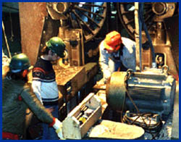
WHY USE LOCKOUT/TAGOUT?
To Prevent “Unexpected”:
  Energizing
  Start-up
  Movement
  Release of Stored Energy
“Unexpected” Movement
Leads to Serious Injury
Notes:
LOTO is used to prevent the unexpected energization, start-up, moving, or release of stored energy while employees are performing servicing or maintenance on equipment, or when they bypass a guard. Exposure to such unexpected movements may lead to serious injury or death.
Photo: three employees doing maintenance work on a piece of machinery.

Slide 14
INCIDENT REPORTS
An employee was beginning to repair a leaking pneumatic fitting of an abrasive blasting machine. He shut off the blasting machine and disconnected the media hose before walking to another building to get a wrench to remove the worn fitting. While the employee was away from the machine, a coworker turned the machine back on and walked back to his work area. When the employee returned and was lying in front of the fitting, the coworker triggered the valve to open. The employee was injured when the machine was not locked out and it re-energized.
An employee was performing maintenance on a Foltex feeder. The employee forgot to lock out the machine before starting with preventive maintenance. The employee's glove got caught and was pulled into a sprocket. The employee's right index finger was amputated.
What are your thoughts about what happened here? What went wrong?
Notes:
Both incidents could have been prevented if lockout/tagout was performed. Unfortunately, this type of incident is quite common. This is where communication is also very essential. If proper LOTO was performed, employees would be unable to flip the switch because there would be a lock on it, and they would know from the tag who is working on the equipment.
2nd incident: it sounds like the machine was still on while the maintenance employee was working on it. The machine should not be powered while performing servicing or maintenance. LOTO not only ensures that equipment is powered down prior to servicing or maintenance, but it also ensures that it can’t be powered back up while employees are working on it.
Source: OSHA Accident Report Detail (https://www.osha.gov/pls/imis/accidentsearch.accident_detail?id=93469.015 and https://www.osha.gov/pls/imis/accidentsearch.accident_detail?id=97001.015).

Slide 15
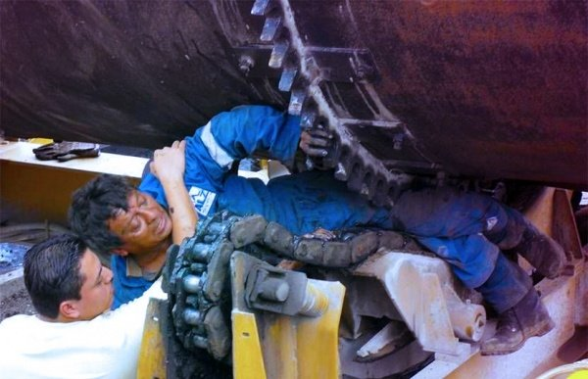
LOCKOUT/TAGOUT DANGERS
Every Year Lockout/Tagout is one of the top ten most violated standards in industry.
Each year 150-200 people die and 50,000 or more are injured due to a failure to control the release of hazardous energy.
Notes:
Not only is LOTO one of the top ten most violated standards in general industry, but the failure to control the release of hazardous energy is responsible for the deaths of 150-200 people per year, as well as 50,000 or more injuries per year. This slide causes us to realize that we aren’t just talking about statistics here. We are talking about real people, who are husbands, wives, daughters, sons, mothers, and fathers. If lockout/tagout was properly applied, these employees would not have lost their lives on the job. The injuries and fatalities that result from either a lack of performing LOTO or from inadequately performing LOTO are 100% preventable when the proper procedures are put into place. Oftentimes the maintenance employees themselves are not deliberately choosing to not follow LOTO. Rather, their companies do not have a formal LOTO program in place, employees have not received the adequate training they need in order to effectively perform LOTO, or they may feel rushed by their employer to get the job done quickly so that production can resume. It is the employer’s responsibility to develop an effective LOTO program and to prioritize employee safety when servicing or maintenance needs to be performed on equipment.
Photos: This employee was caught between a large chain and sprocket system due to lockout/tagout failure.
Source: https://www.osha.gov/OshDoc/data_General_Facts/factsheet-lockout-tagout.pdf

Slide 16
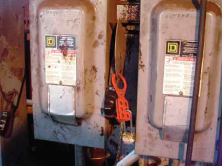
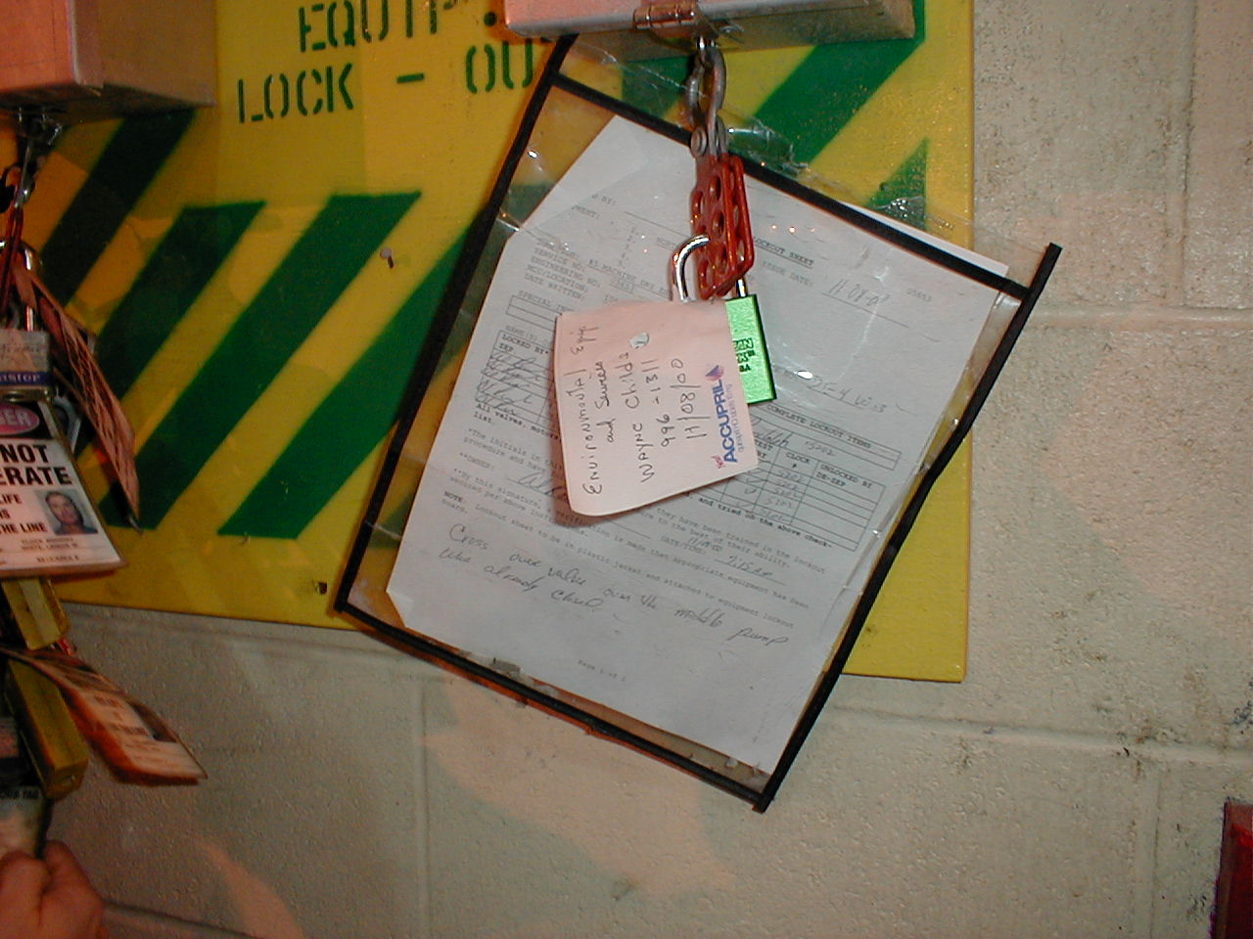
WHY DOES A LOCKOUT/TAGOUT PROGRAM FAIL?
I can get this done much faster
It’s too much trouble
Loss of respect for equipment
I didn’t know we had a Lockout/Tagout Program
LOTO …. Huh?
Notes:
There are many different reasons why a LOTO program may fail. Have any of you come across these statements when addressing LOTO?
I can get this done much faster-For example, employees may think it’s not worth it to go through all the steps just to clear a jam. It would be a lot faster if they just turn the machine off and stick the hand in the machine and clear the jam.
It’s too much trouble-it’s too much trouble to go over to the breaker, and apply a lock and tag, or if you have many different energy sources, to isolate each of the energy sources.
I didn’t know we had a LOTO program-this is quite common. It is up to the employer to ensure that employees receive the proper training they need to perform LOTO, and it’s also important that employers are on board with keeping their employees safe and that they have a disciplinary system in place to address when employees don’t perform LOTO, or don’t perform it adequately. Having a disciplinary system in place is essential when it comes to having an effective LOTO program. You can have everything in writing, you can have a written program and procedures, but if there is no enforcement regarding following the procedures, then employees may be more likely to cut corners, especially when they are pressed for time.
LOTO…huh? Some employees don’t know what LOTO even is. This is a problem, especially if they are servicing or maintenance employees.
Top photo: Two disconnects. The disconnect on the left has a hasp with a lock affixed to it. There is not tag. Make sure you use both locks and tags.
Bottom photo: This is an example of an insufficient tag. A post-it note cannot be used as a tag. Tags need to be durable and standardized.

Slide 17
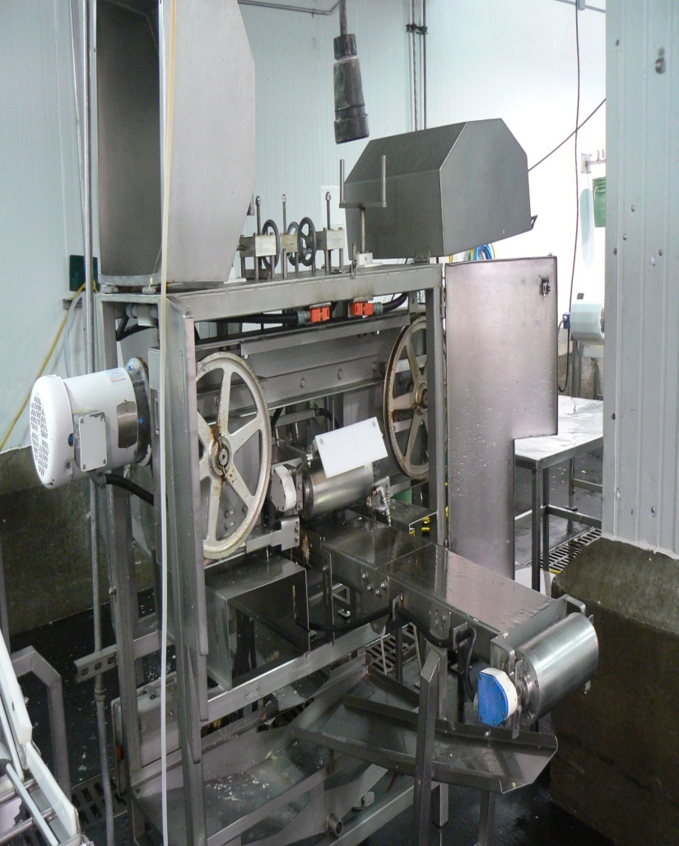
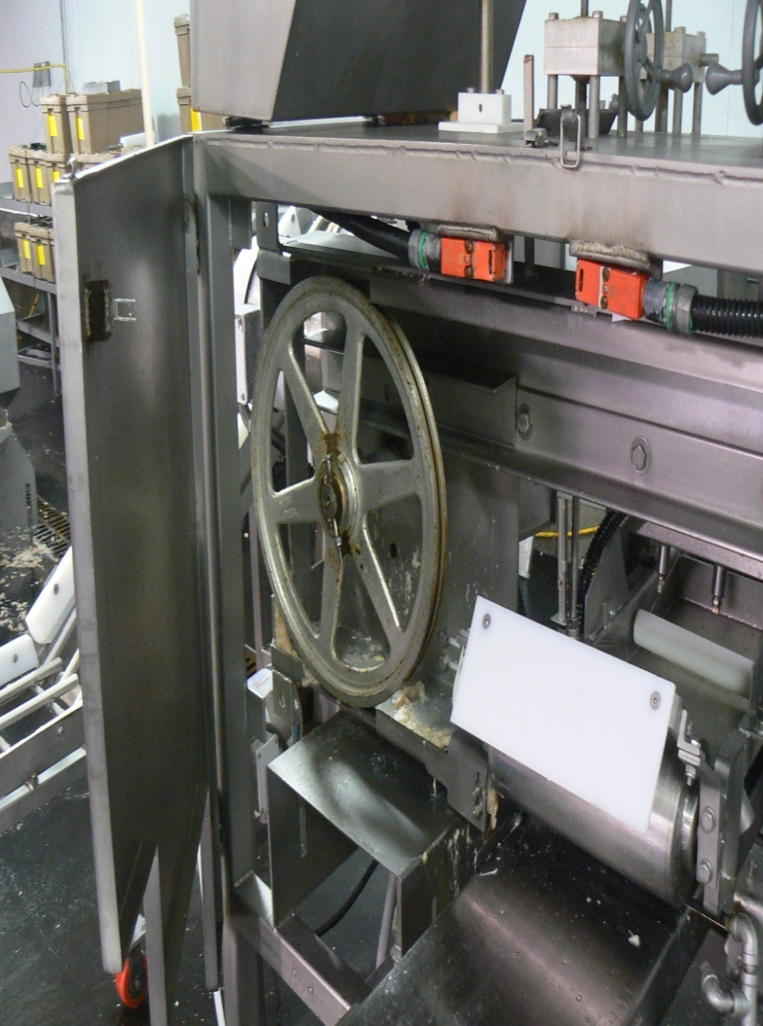
IS THIS EQUIPMENT LOCKED OUT?
Notes:
Photos: Left photo—food processing equipment that has moving parts; Right photo—close-up of food processing equipment showing the guard opened and moving parts accessible. If we open the guard to do servicing or maintenance, we would have to LOTO the machinery.

Slide 18
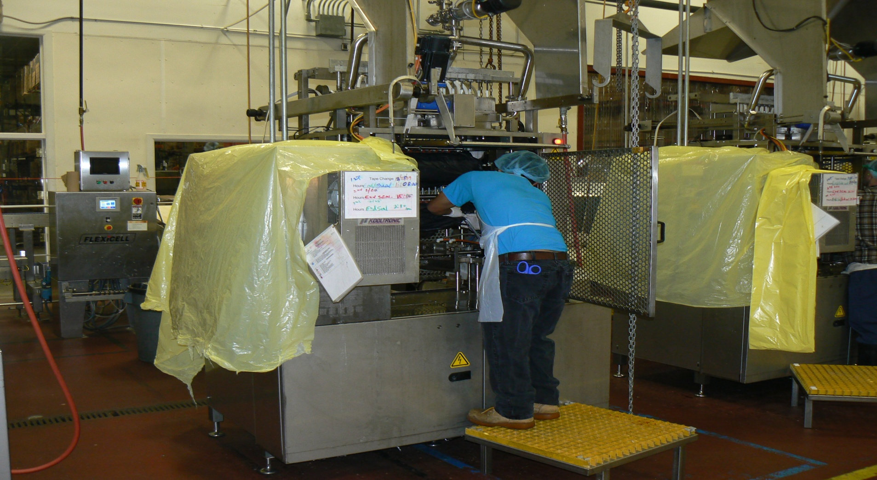
LOCKED OUT?
Notes:
No! The employee in the picture is preparing the plant for the sanitation crew. He is covering the sensitive parts of the machinery, but he opened the machine and inserted part of his body without locking and tagging out the equipment.
Photo: food processing equipment with most of it covered in yellow plastic to protect the sensitive parts of the machines. In center is employee leaning into machine that has NOT been locked or tagged out.

Slide 19
WHO’S COVERED?
Authorized Employee:
  The person who services or performs maintenance on machines and equipment.
Affected Employee:
  The person who operates or uses a machine or piece of equipment which is being serviced.
Other Employee:
  The person who works in an area where lockout/tagout procedures are being used.
Notes:
The OSHA standard distinguishes between three different groups of employees, all of whom are covered under the LOTO standard. First are the authorized employees. These are the employees who are performing servicing or maintenance on machines and equipment. Authorized employees are those who will be performing LOTO. It is important that companies identify in their written program who the authorized employees are.
Second are the affected employees. These are the employees who are operating or using the machines or equipment that may need to be serviced or maintained. However, affected employees do NOT perform LOTO. For example, you have a press operator. The press operator is going to be the affected employee. If you have a maintenance employee who performs some work on the press, they will be considered an authorized employee.
Lastly, other employees are those who are working in the area where LOTO procedures may be used.

Slide 20




ENERGY TYPES
Electrical
Mechanical
Hydraulic
Pneumatic
Chemical
Thermal
Other
Notes:
There are several different types of energy. These include electrical, mechanical, hydraulic, pneumatic, chemical, thermal energy, springs, gravity…Because there are multiple types of energy, it’s important to evaluate your machinery to determine whether there is more than one energy source. Sometimes machines will be powered by both electrical and pneumatic energy, and if this is the case, then both those energy sources need to be controlled.
Graphics: shows several different types of energy, including electrical, mechanical, and thermal energy.

Slide 21

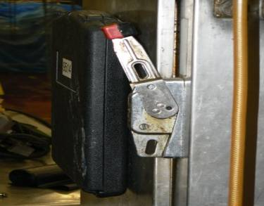
LOCKOUT VS. TAGOUT
If capable of being locked out:
  Prefer lockout
  Tags allowed, if employer can demonstrate FULL EMPLOYEE PROTECTION
Machine Modifications
  If you alter a machine you must make the machine capable of accepting a lock.
Notes:
In all cases, if a machine can be locked out, the worker must lock out the machine. If the only means to safeguard the machine is tag out, the worker must take additional steps to ensure workers are protected to the equivalency of LOTO. Addition steps are needed to provide full employee protection. If alterations or modification are made the machine, the employer must upgrade the system to ensure the equipment can be locked out.
Pictures: Top: Shows means that can be used to LOTO equipment, such as a valve with a tag stating “Danger; Hands Off; Do not Operate” and Bottom: an electrical disconnect with a place to add a lock.

Slide 22
FULL EMPLOYEE PROTECTION?
Tags attached at the same location as locks
Full compliance with all tagout provisions in 29 CFR 1910.147
Additional means when necessary
  e.g., removal of a valve handle
Notes:
The slide explains exactly is meant by full employee protection. A worker can’t rely solely on the tag alone; other steps must be taken to protect personnel.
Picture: Illustrates a tag on a valve stating “Danger; Hands Off; Do not Operate”

Slide 23

SERVICING AND MAINTENANCE INCLUDES:
Setting up
Adjusting
Inspecting
Modifying
Installing
15
Notes:
The standard applies to the control of hazardous energy when employees are involved in service or maintenance activities such as constructing, installing, setting up, adjusting, inspecting, modifying, and maintaining or servicing machines or equipment. These activities include lubricating, cleaning or unjamming machines, and making adjustments or tool changes, where the employees may be exposed to hazardous energy. Set up usually occurs before manufacturing on a machine.
Graphic: The clip art reveals a mechanical device, such as a valve.

Slide 24

LOCKOUT TAGOUT REQUIREMENTS
Written program which includes specific written procedures
Training of employees (not just maintenance!)
Periodic review of procedures
Notes:
There are three vital components of a lock out tag out program (Hazardous Energy Control Program).
A written program outlines the scope, activities, and accountability for controlling the energy.
Training includes many more people than maintenance. Others in the plant need at least awareness training.
Periodic reviews are necessary to determine if there is a problem with the procedure and execution of the procedure.
Clip Art: Indicates a pen in the hand to write procedures for LOTO.

Slide 25
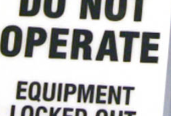
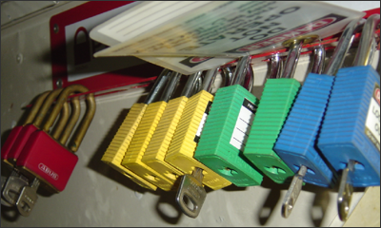
LOCKOUT TAGOUT PROGRAM
Your hazardous energy control plan must specifically outline the scope, purpose, authorization, rules, and techniques to be utilized for the control of hazardous energy.
The plan must also include your methods to enforce compliance.
Notes:
The written LOTO program must specifically outline the scope, purpose, authorization, rules, and techniques that must be utilized for the control of hazardous energy. The written program describes how the different requirements in the OSHA LOTO standard will be met, and thereby how employees will effectively control hazardous energy. For example, the written program will include sections on employee training, the periodic review of the equipment-specific procedures, group LOTO procedures, what to do if you have contractors who will be performing LOTO on-site, the specific steps that must be followed when performing LOTO, etc. The plan must include your methods to enforce compliance. It is very important that these methods are followed. Not only is it important that everything in the written program is being done, but it’s just as important that you have some sort of disciplinary system in place to ensure employees continue to follow what is covered in the written program.
Photo 1: Snapshot of a tag used for lockout/tagout.
Photo 2: Various locks that are used for lockout/tagout.

Slide 26
ENERGY CONTROL PROCEDURE
Must clearly and specifically outline:
  Intended use of procedure
  Specific procedural steps
  Specific testing requirements
  Means to enforce compliance
Notes:
Enforcement is very vital to a LOTO program. Train authorized personnel and hold them accountable for following the procedures. The procedural steps will direct and guide authorized personnel in taking steps to implement LOTO.

Slide 27

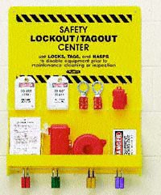
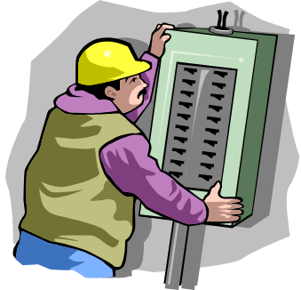
ENERGY CONTROL PROCEDURE - STEPS
Notification of employees
Preparation for shutdown
Machine or equipment shutdown
Machine or equipment isolation
Lockout/tagout device application
Stored energy
Verification of isolation
Release from lockout/tagout
Notes:
The elements listed in the slide are all components of an energy control procedure. We will discuss each of these items.
Top graphic: clip art of a pencil and journal.
Lower left photo: photo of a lockout/tagout station.
Lower right graphic: clip art of an employee working at a circuit breaker.

Slide 28
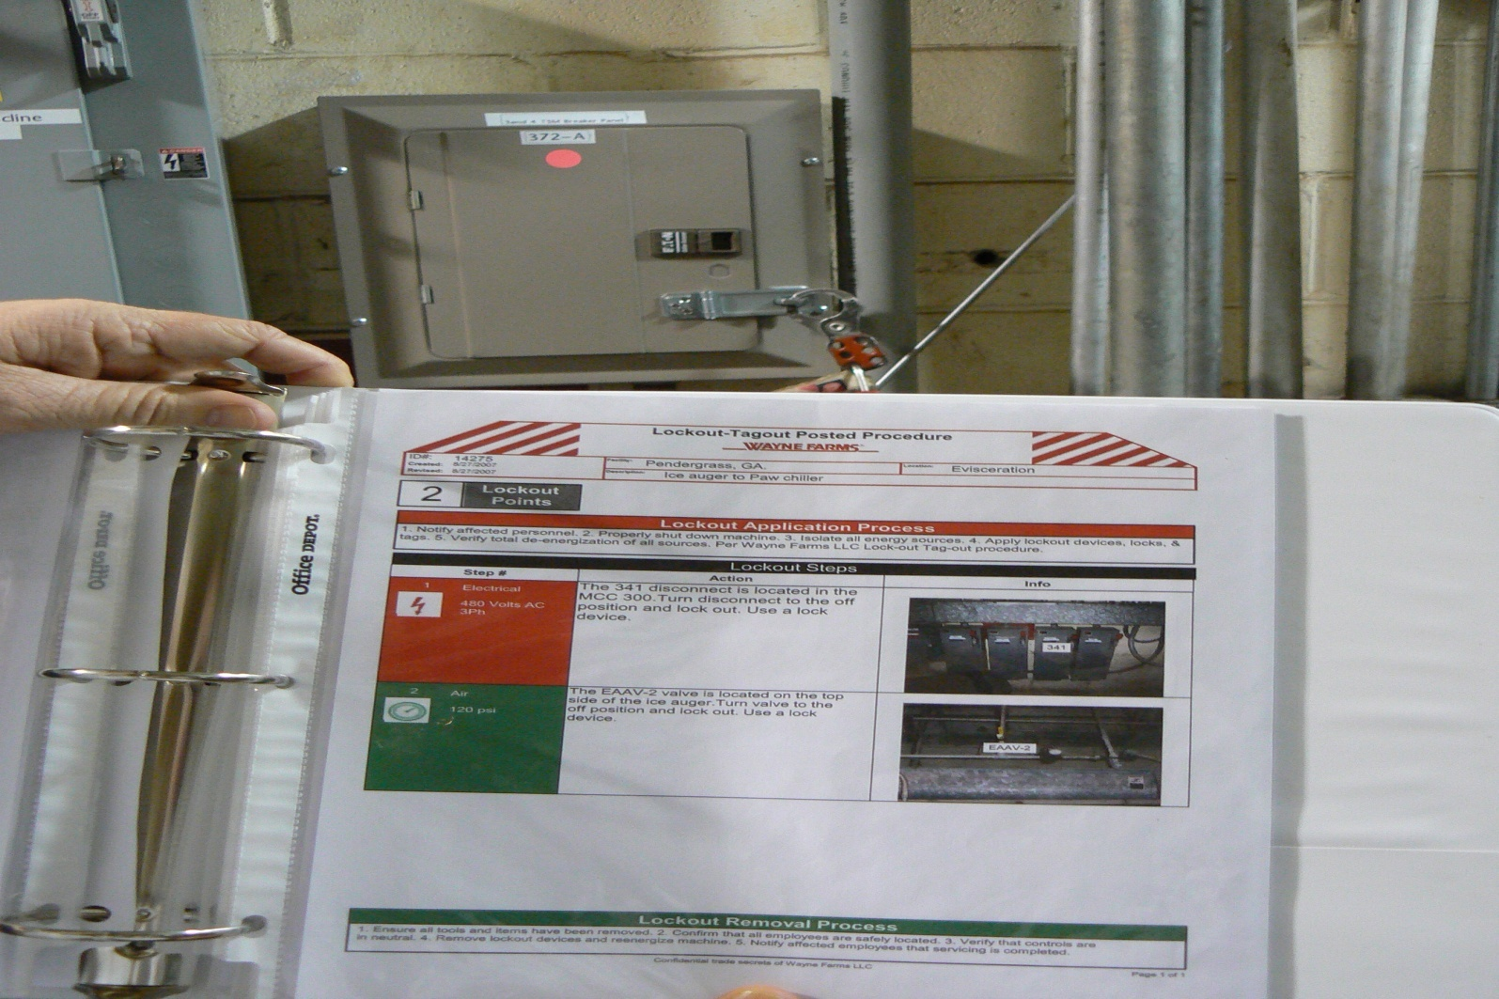
EQUIPMENT-SPECIFIC
PROCEDURES
21
Notes:
Machine specific energy control procedures are necessary for the machinery. The procedure outlines steps to shutdown the equipment, verify the absence of energy, and bring the equipment back on line.
Photo: of binder containing machine-specific procedure steps and photos.

Slide 29
ENERGY CONTROL PROCEDURE
Step 1 - Notification of Employees
Notify all affected employees working on or around the equipment or machinery, that servicing and maintenance is about to occur.
  Before controls are applied, and again before they are removed
Notes:
It is very important to coordinate LOTO activities. One of the most important activities is to notify personnel of impending lock out of machines to ensure that personnel activities do not create additional hazards. Personnel need to be clear of the machinery.

Slide 30
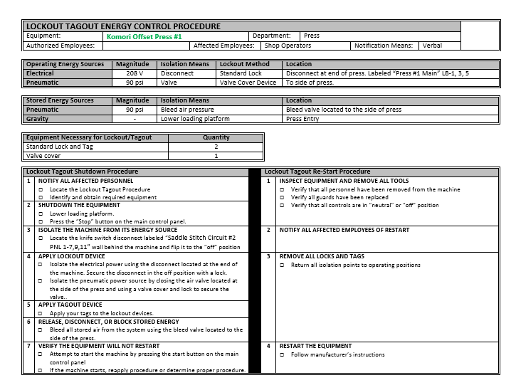
ENERGY CONTROL PROCEDURE
Step 2 - Preparing for Shutdown
Procedure – do you know it?
Equipment – do you have it?
Know types and magnitude of energy sources
Know hazards posed by energy sources
Know how to control the hazards
Who’s involved
Caution: Employees who operate circuit breakers, disconnects, or other electrical devices must be trained and qualified.
Notes:
Authorized personnel must take the necessary steps prior to shutdown. They need the knowledge and skills necessary for the safe application, use, and removal of energy-isolating devices. They also need training in the following: hazardous energy source recognition; the type and magnitude of the hazardous energy sources in the workplace; and energy-control procedures, including the methods and means to isolate and control those energy sources.
Picture: a sample energy control procedure.

Slide 31
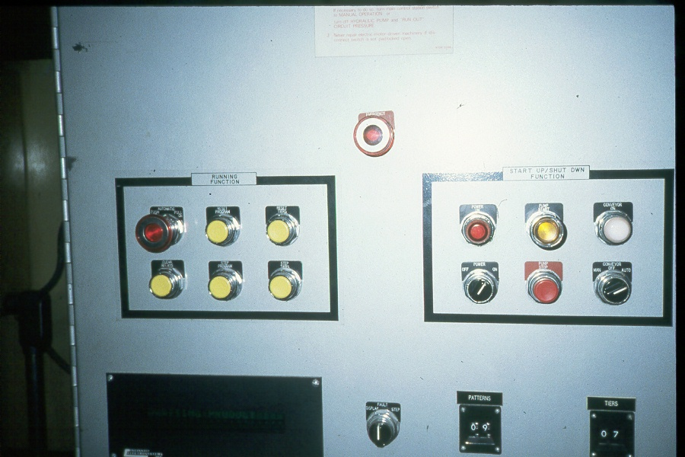
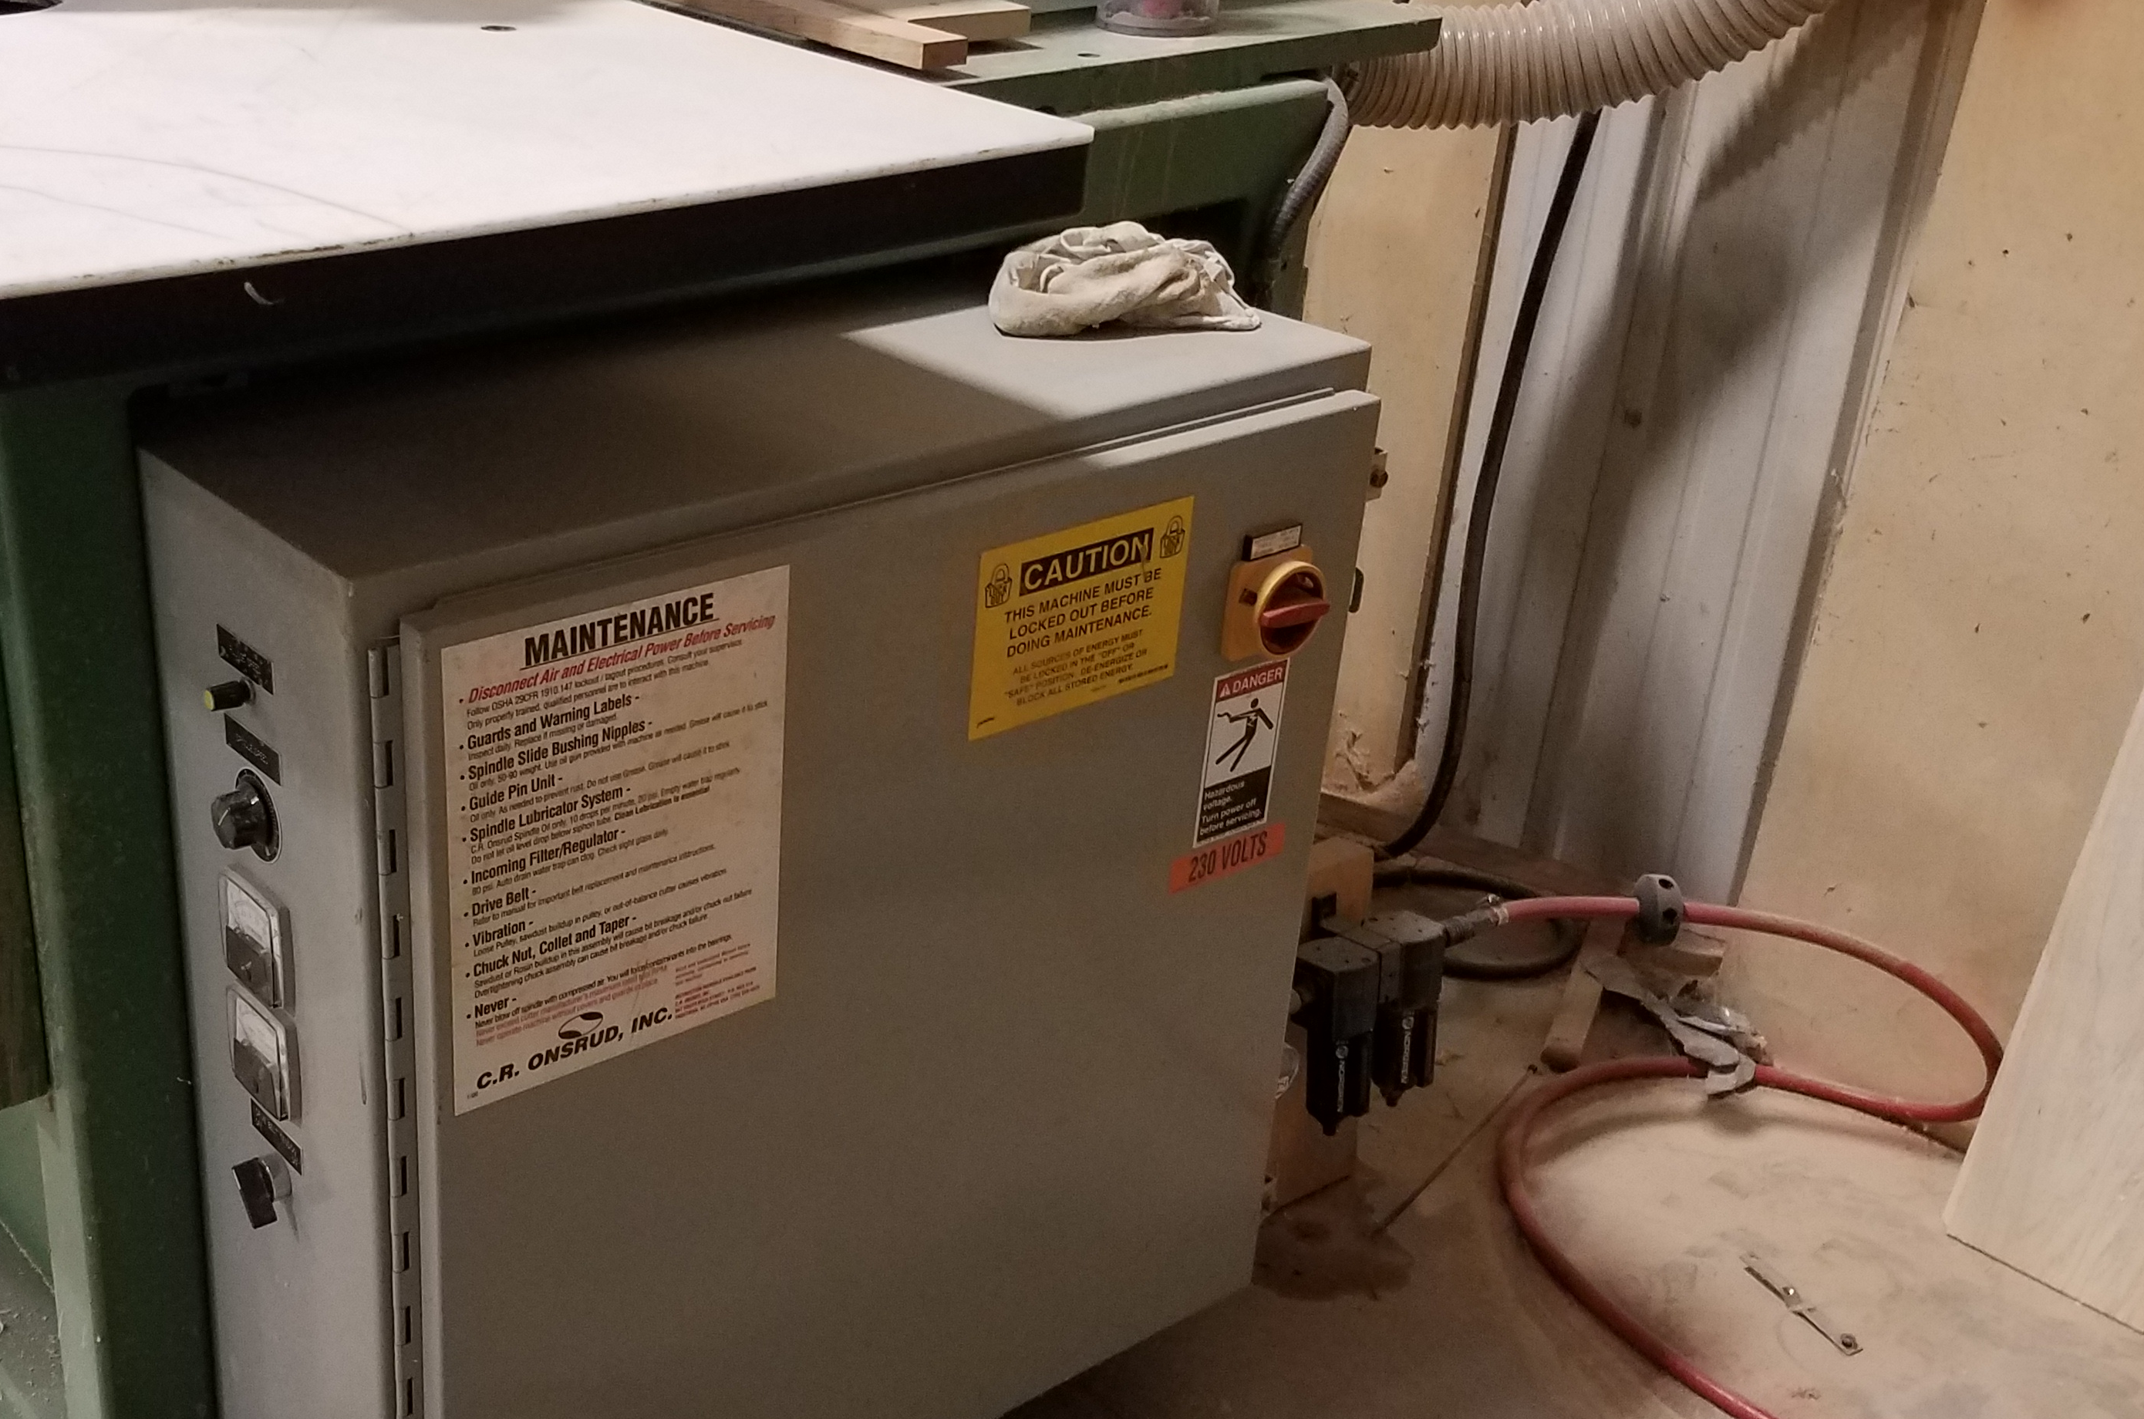
ENERGY CONTROL PROCEDURE
Step 3 - Machine or Equipment Shutdown
Turn off or shut down equipment using the procedures for that machine.
Orderly shutdown to avoid increased hazard.
  Note: There is still power to the machine!
Notes:
Specific steps or actions may be necessary to shut down the equipment. If the manufacturer has specific instructions, follow the information to safely shut down the equipment. The machine(s) or equipment must be turned off or shut down using normal stopping means, such as using the stop button(s) at the production control center. An orderly shutdown must be conducted to avoid any additional or increased hazards to employees as a result of equipment de-energization.
Top photo: A control panel on a machine. This is where the machine is shut down. However, it is not where the energy is isolated.
Bottom photo: The on/off switch for a machine. This is where the machine is shut down. However, it is not where the energy is isolated.

Slide 32
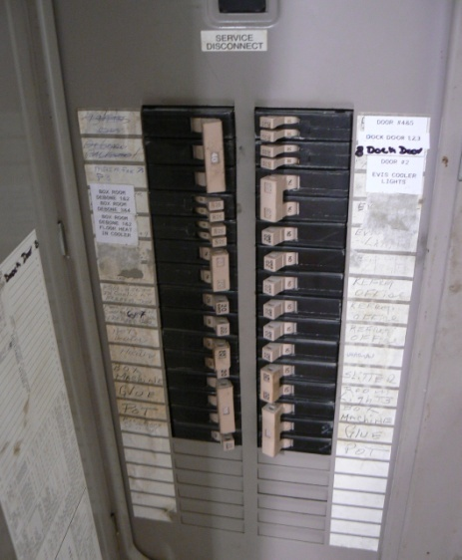
ENERGY CONTROL PROCEDURE
Step 4 - Machine or Equipment Isolation
Isolate each energy source
  What does “isolate” mean?
  What is an energy isolation device?
Disconnects vs. on/off buttons
Circuit breakers vs. e-stops
Notes:
The primary way to prevent the release of hazardous energy during service and maintenance activities is by using energy-isolating devices such as manually operated circuit breakers, disconnect switches, and line valves and safety blocks. Lockout requires use of a lock or other lockout device to hold the energy-isolating device in a safe position to prevent machinery from becoming reenergized. All energy isolating devices used to control the energy to the machine or equipment must be physically located and placed in the "off" position to disconnect the machine or equipment from its energy source and de-energize it. Control circuitry does not provide a physical barrier that controls hazardous energy and, therefore, is not an energy isolation device. For example, push buttons, selector switches, and interlocking gates are not energy isolation devices and are not permissible substitutes for energy isolation devices under the standard.
Photo: A circuit breaker schedule on the door of a panel board. The information from the schedule may be used to find the breaker, but the employee would still have to perform verification. There have numerous injuries where workers have put total confidence in the schedule and were surprised to still find the equipment was still energized.

Slide 33
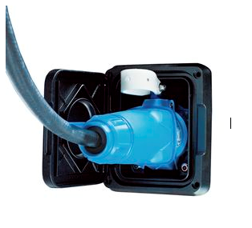
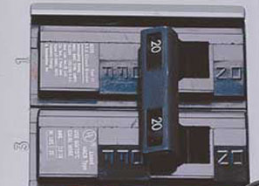
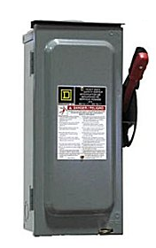
ENERGY ISOLATING DEVICES
Electrical Energy
Electrical
Energy
Fuses
Breakers
Predetermined
lockout
points
Disconnects
Plug
Notes:
There are many different types of energy isolating devices. For electrical energy there are fuse breakers, disconnects, and plugs. With plugs, there is a section in the standard that exempts cord and plug equipment, as long as the person who is doing work on the equipment has absolute control over the plug while doing servicing or maintenance, and the plug is the only energy source for the equipment. If necessary, there are clamps that can be used to go over the plug. They can be secured with a lock and tag, which prevent someone from powering the equipment while it is being worked on.
Left photo: An example of a plug.
Top right photo: An example of a switch on a circuit beaker.
Bottom right photo: An electrical disconnect (gray metal box with handle) is shown in the picture to serve as a precaution to workers. The disconnect and circuit breakers should only be operated by someone that is qualified.

Slide 34
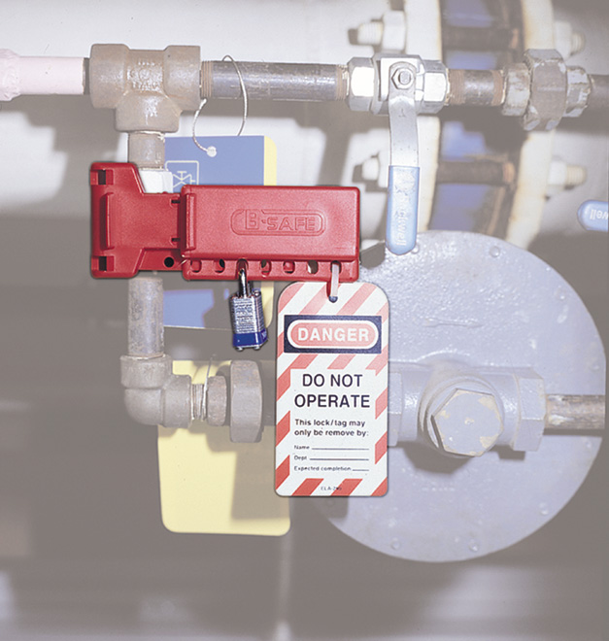
ENERGY ISOLATING DEVICES
Other Energy
Ball Valves
and
Gate Valves
Pneumatic
Hydraulic
Natural gas
Chemical
Notes:
Other types of energy include pneumatic energy, hydraulic energy, chemical energy, and natural gas. The energy isolating devices for these types of energy sources are typically going to be ball valves, gate valves, or line valves. Make sure these valves are turned into the position that prevents the machines from being reenergized. There are plenty of different lockout devices that allow you to isolate these energy sources.
Photo: An example of a lockout device on a line valve. Both the lock and tag are affixed to the energy isolating device.

Slide 35

LINE BREAKING
Means the intentional opening of a pipe, line, or duct that is or has been carrying flammable, corrosive, or toxic material, an inert gas, or any fluid at a volume, pressure, or temperature capable of causing injury.
Notes:
This slide explains what a line break is.
Graphic: Clip Art illustrates a valve that has been intentionally opened to allow product to flow through the pipe. The pipe may have been used to carry flammable, corrosive, or toxic materials.

Slide 36
LINE BLANKING OR BLINDING
Means the absolute closure of a pipe, line, or duct by fastening of a solid plate that completely covers the bore and that is capable of withstanding the maximum pressure of the pipe, line, or duct with no leakage beyond the plate.
Notes:
In order to implement line blanking or blinding the pipe must be closed off with a solid plate that covers the bore. The plate must be capable of withstanding the maximum pressure with no leaks.

Slide 37
DOUBLE BLOCK AND BLEED
Means the closure of a line, duct, or pipe by closing and locking or tagging two in-line valves and by opening and locking or tagging a drain or vent valve in the line between the two closed valves.
Notes:
Double block and bleed is a technique used to control materials that flow through pipes.

Slide 38
TEST YOUR KNOWLEDGE
True or False
Push buttons, selector switches and other control circuit type devices are energy isolating devices.
False
Notes:
The answer is false. Make sure to shut the power off at the pushbuttons, but this is not where the energy is going to be isolated.
Photo: A control panel on a machine. This is where the machine will be shut off, but not where the energy will be isolated.

Slide 39
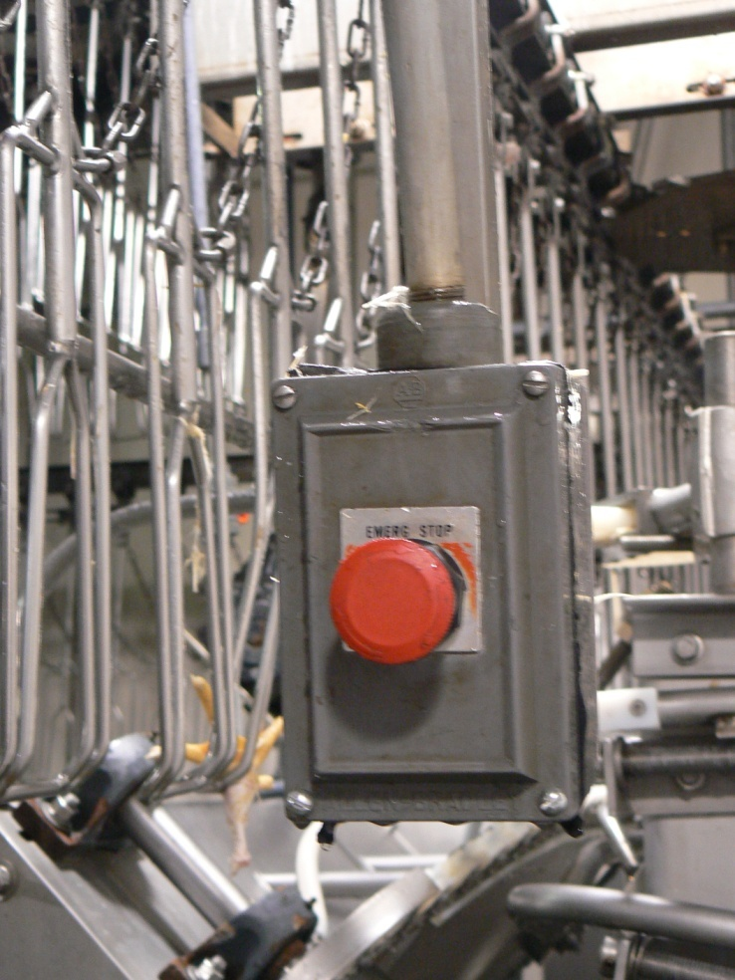
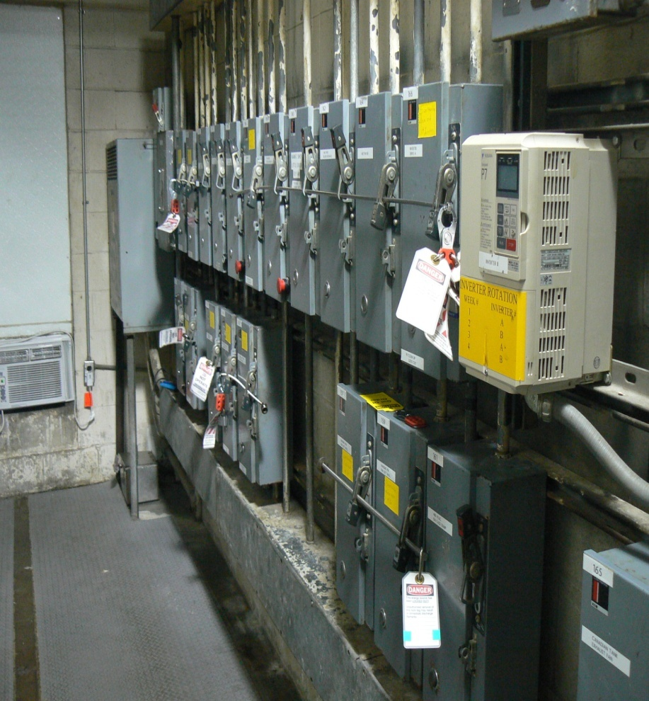


ENERGY ISOLATION
32
Notes:
Photos: The two pictures illustrate the proper way to LOTO equipment. The first picture (left) illustrates not to use a control circuit, such as an emergency stop, to control hazardous energy. A control circuit is subject to failure and does not have control reliability. The photo on the right shows locks applied to the electrical disconnects which is an approved method as indicated with “thumbs up” clipart below the photo.

Slide 40
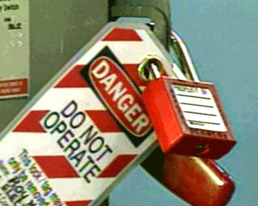
ENERGY CONTROL PROCEDURE
Step 5 – Lockout or Tagout Device Application
Apply lockout device and tag to each energy source
Affixed by Authorized Employee
One lock per person
One key per lock
This includes:
  Supervisors
  Contractors
Supervisors cannot lockout on behalf of their crew.
Standard Lock
Notes:
After the machine is isolated from the energy source, the next step is to apply the lockout and tagout devices. A few important things to note here:
-A lockout device and tag need to be applied to each energy source. Therefore, if you have multiple sources of energy powering one machine, you will need to apply a lock and tag at the energy-isolating devices for each energy source. The locks and tags must be affixed by an authorized employee. An authorized employee cannot ask another employee to affix their locks and tags for them. Also, you must follow the one lock one person principle. Each authorized employee must have their own lock, and they must be the only ones who have the key to that lock. Nobody else should have a key to their lock. These requirements also include supervisors and contractors. Supervisors cannot lockout on behalf of their crew. If their crew members are the ones who are going to be performing maintenance or servicing, the crew members themselves must apply their own locks and tags to the applicable energy isolating devices.
Photo: An example of a standard lock and tag affixed to an electrical disconnect. Here we can see that only one employee is working on the deenergized equipment, since there is only one lock and one tag.

Slide 41

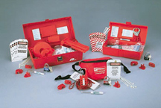
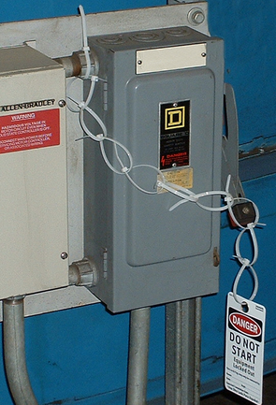
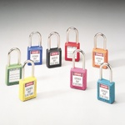
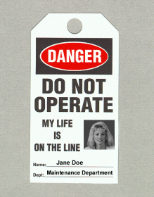
LOCKOUT TAGOUT DEVICES
Hardware Requirements (1)
Durable
Standardized
Substantial
Identifiable
Notes:
LOTO equipment has to be procured to adequately control the energy sources. We have to ensure the equipment is: durable, standardized, substantial, and identifiable. The equipment has to be standardized to ensure that it is recognized as a LOTO lock. We can’t use the lock for other purposes, but LOTO. Tags have to be identifiable to ensure we know who placed LOTO tag on the equipment. LOTO hardware must be used only for the purpose in which it is intended. The equipment may not be used for anything else.
Pictures (Clockwise): Photo of several different LOTO kits. The kits contain equipment that is necessary to LOTO equipment. The top picture shows an assortment of locks and lockout hardware (including locks, tags, and valve covers) that are to control hazardous energy. The picture on the right of the disconnect switch shows insufficient LOTO. Zip-ties can be used when affixing tags, but they must not be used as a means of lockout. The middle picture shows tags with standardized verbiage and a picture of the worker. The lower left picture shows various locks that may be used for lockout.

Slide 42
LOCKOUT TAGOUT DEVICES
Hardware Requirements (2)
Provided by the employer
Singularly identified
Only devices used for control
Not used for other purposes
Notes:
LOTO equipment must be procured to adequately control the energy sources. We have to ensure the equipment is: durable, standardized, substantial, and identifiable. The equipment has to be standardized to ensure that it is recognized as a LOTO lock. We can’t use the lock for other purposes, but LOTO. Tags must be identifiable to ensure we know who placed LOTO tag on the equipment. LOTO hardware must be used only for the purpose in which it is intended. The equipment may not be used for anything else.
Pictures (Clockwise): Photo of several different LOTO kits. The kits contain equipment that is necessary to LOTO equipment. The top picture shows an assortment of locks and lockout hardware (including locks, tags, and valve covers) that are to control hazardous energy. The picture on the right of the disconnect switch shows insufficient LOTO. Zip-ties can be used when affixing tags, but they must not be used as a means of lockout. The middle picture shows tags with standardized verbiage and a picture of the worker. The lower left picture shows various locks that may be used for lockout.

Slide 43
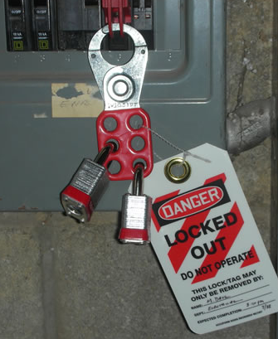
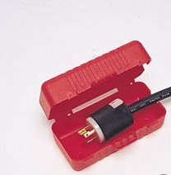
LOCKOUT TAGOUT DEVICES
Hasps and Plug Covers
Hasp
Plug Cover
Notes:
Left photo: A hasp connected to a circuit breaker. The circuit breaker is effectively locked out. It looks like more than one authorized employee is working on the equipment that is connected to this breaker because there are two locks here. Since there are two authorized employees working on the equipment, there should be two tags as well. Hasps are good to use when more than one person is working on equipment, because they allow for multiple employees to apply locks and tags.
Right photo: A plug cover. This cover can be locked out. These covers need to be used when an authorized employee doesn’t have autonomous control over the plug while performing any servicing or maintenance, or when the plug is not the only source of energy to the machine.

Slide 44
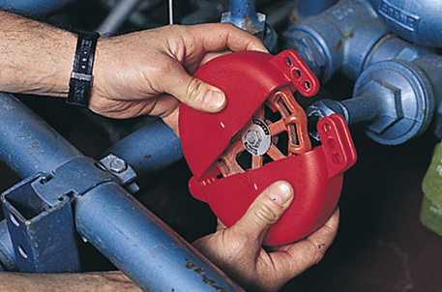
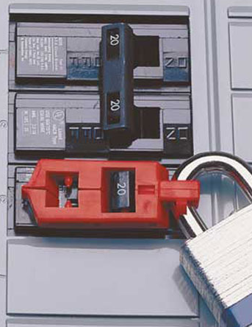
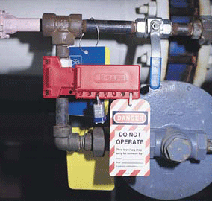
LOCKOUT TAGOUT DEVICES
Valve Covers and Single Pole Device
Valve Cover
Single Pole
Ball Valve Cover
Notes:
Left photo: A single pole device, which keeps the circuit switch in the off position. This can only be used when one authorized employee is working on a piece of equipment or machinery, because it only allows for one lock to be applied. It also looks like a standard master lock is used here, which may be an issue if this type of lock is used for other purposes in the work environment. It’s hard to tell in the photo, but it may be that a tag was not affixed here.
Lower right photo: A ball valve cover, which is securing the valve in a position that will prevent the release of any energy. It looks like they are just using a generic master lock.
Upper right photo: A valve cover. This cover prevents employees from coming and twisting the valve when it is locked out.

Slide 45
LOCKOUT TAGOUT DEVICES
Hardware Requirements (3)
Durable – be able to withstand environment
Standardized – color, size, etc.
  Tags : print and format
Substantial – no accidental removal
  Tag attachment means:
    Withstand at least 50 pounds of force
    Not re-usable
    Self locking
    Attachable by hand
Notes:
LOTO devices need to be durable, they need to be standardized. One way to standardize them is by color, having locks that are a particular color, and designating those locks as LOTO locks. The format of the tags must also be standardized.
LOTO devices need to be substantial to prevent their accidental removal. Tag attachment means must be able to withstand at least 50 pounds of force, they must not be re-usable, they must be self-locking, and they must be attachable by hand.
Photo: This is an example of insufficient lockout/tagout. The company used zip-ties to “lock out” the disconnect. Zip-ties are a good way to attach tags, but not to lockout energy isolating equipment.

Slide 46
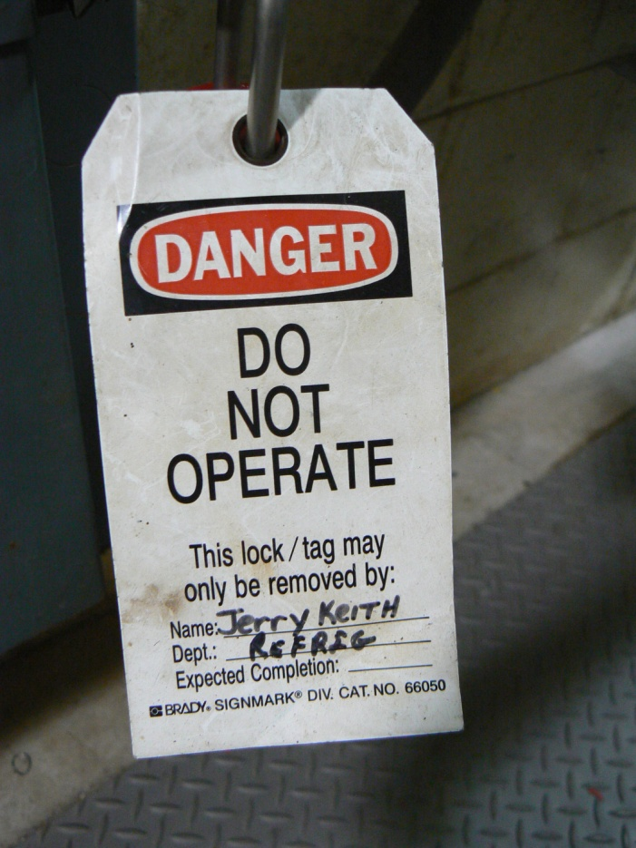
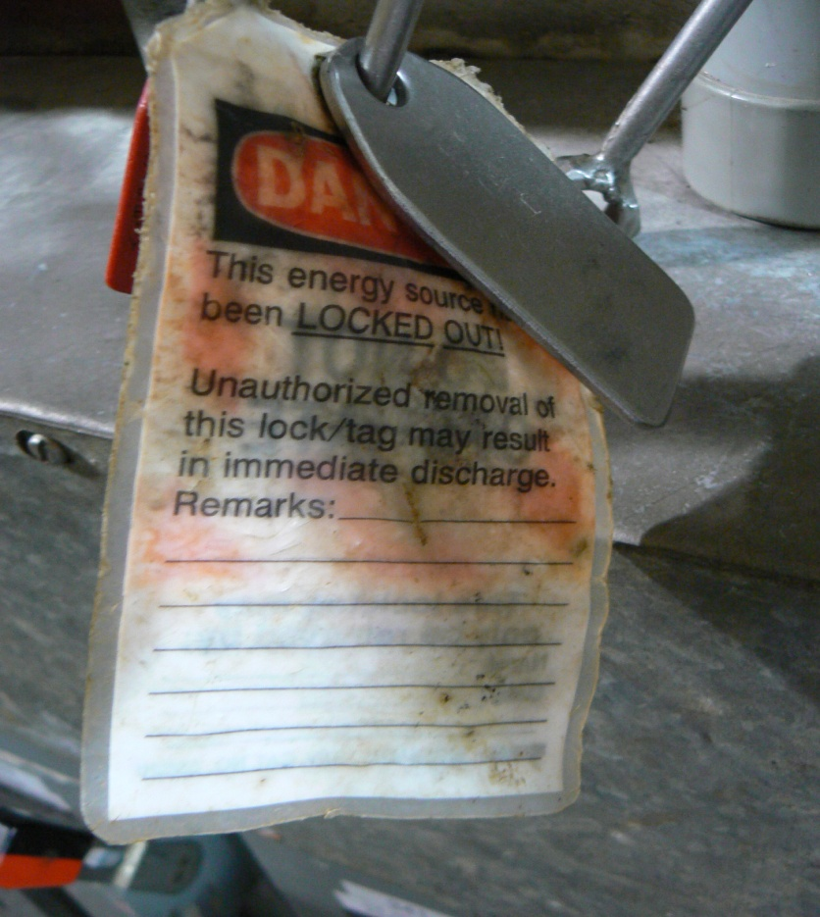
DURABLE?
41
Notes:
Tags must be durable and able to withstand the work environment.
Left: A tag in good condition
Right: A tag that has been damaged. This tag did not withstand the work environment.

Slide 47
LOCKOUT TAGOUT DEVICES
Hardware Requirements (4)
Identifiable – identify the employee who applied
  Tags must include legend such as DO NOT START
Notes:
Tags must identify the employee who applied the tag itself, and they must include a legend such as “Do not start” or “do not operate.”
Photo: This photo demonstrates a sufficient tag that can be used when performing lockout/tagout. The tag has the name of the employee and their department.

Slide 48
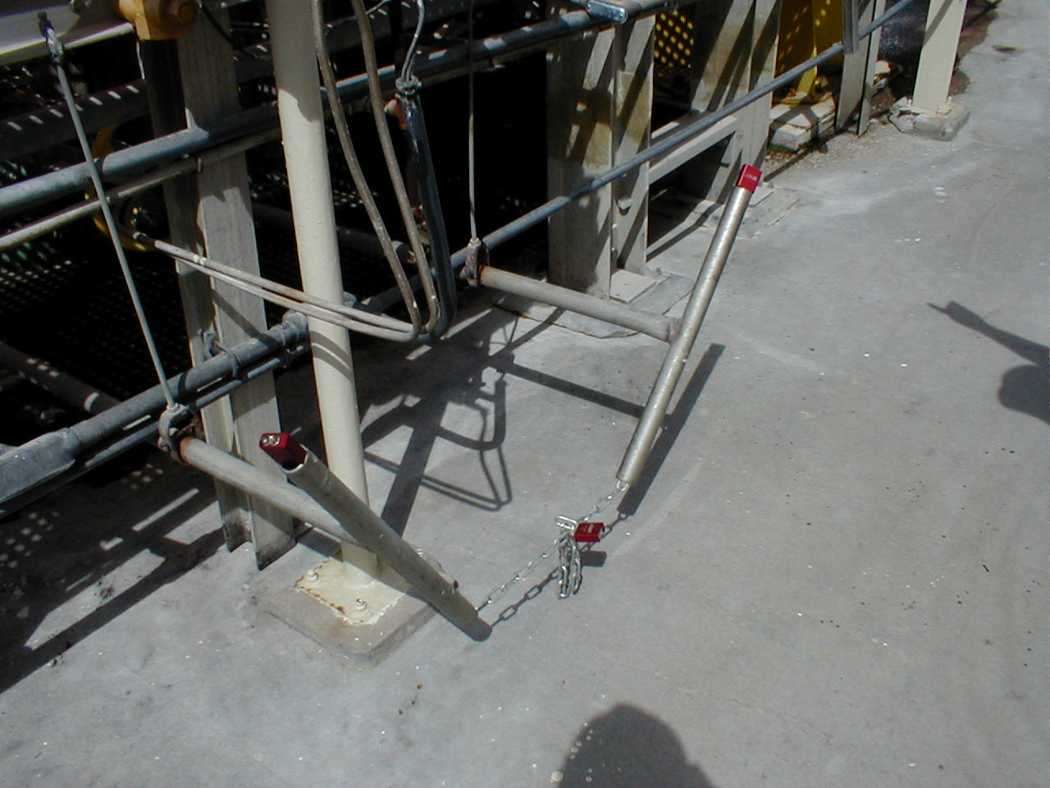
SUFFICIENT LOCKOUT/TAGOUT?
Notes:
LOTO has to be done to ensure that no materials may flow through pipes.
Photo: The picture illustrates valve handles that have been locked. However, it is still possible to move or rotate the valve handles.

Slide 49
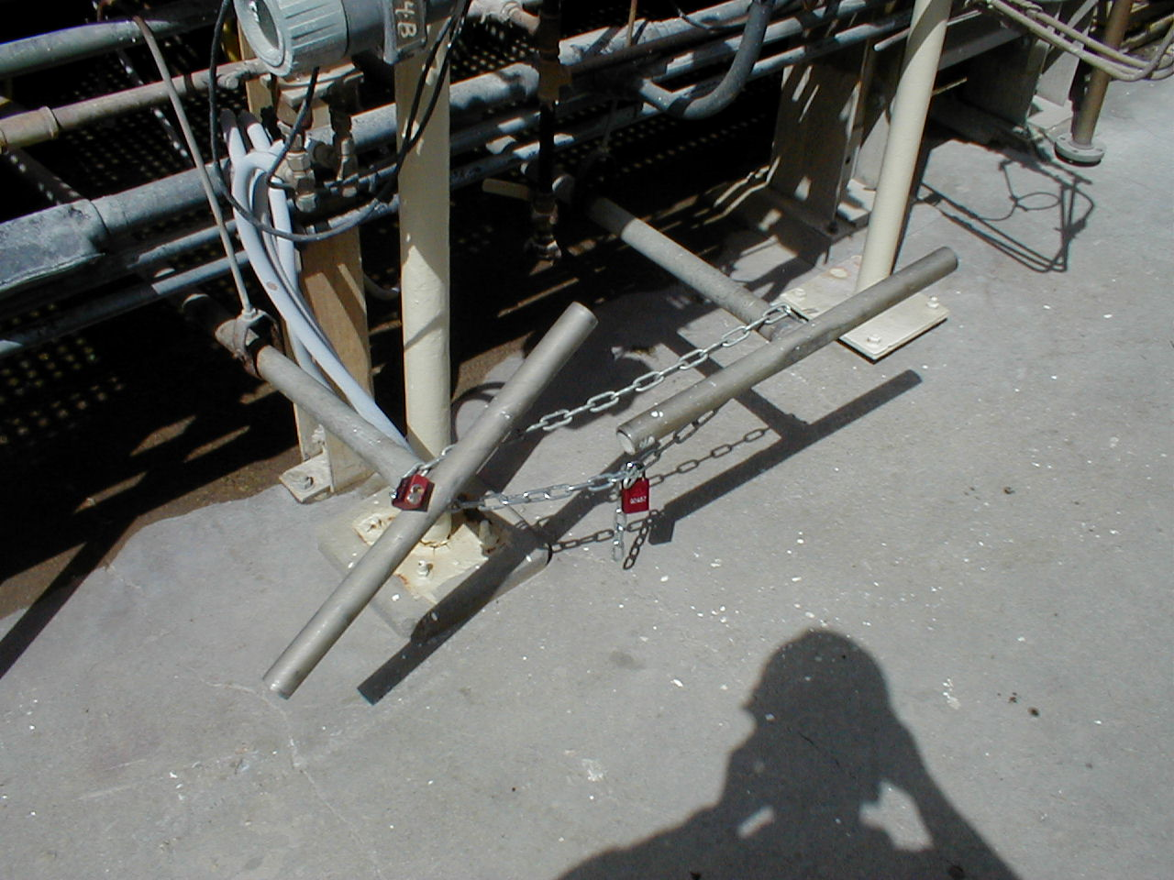
HOW ABOUT NOW?
Notes:
Photo: This picture illustrates another position of the valve handles and locks. However, it still does not prevent the handles from being turned.

Slide 50

EFFECTIVE LOCKOUT/TAGOUT?
Notes:
Is attaching a tag to a key sufficient? No! It looks like this is the key that powers the machine, and therefore the machine has not yet been isolated from the energy source. And there is nothing in place here that would prevent someone from turning that key.
Photo: This photo demonstrates inadequate LOTO. The tag was affixed to a key that is still inserted into machine.

Slide 51
WHAT ABOUT THIS TAG?
Notes:
The employer needs to ensure the appropriate hardware has been procured to do the work.
Photo: This picture illustrates a lock (not sure if it is standardized or not; does not appear to be a LOTO lock) and a post-it note has been used as a tag. The post-it note is not adequate because it would not be durable, identifiable, standardized, and self locking.

Slide 52
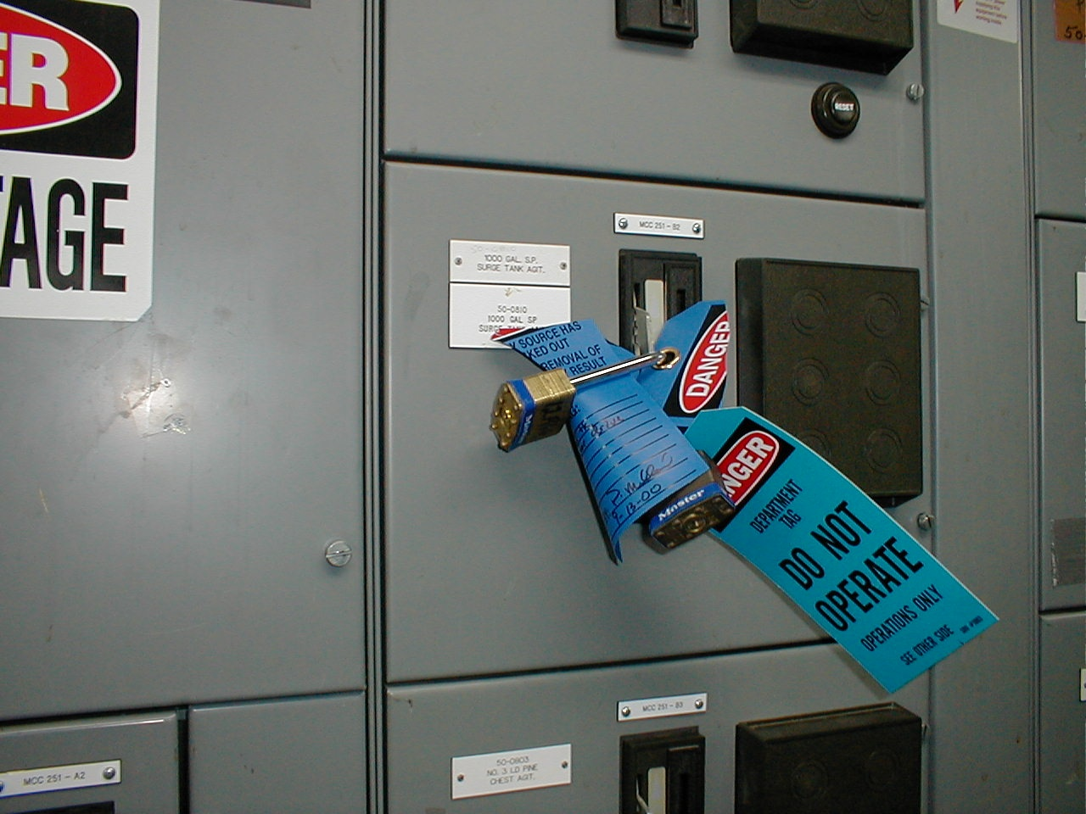
TAG SUFFICIENT?
Notes:
Photo: The picture shows two locks and two tags that have been placed on a switchgear. The locks are common Master locks, which may not be adequate. Locks for lockout must be used only for that purpose. The locks and the tags need to standardized and identifiable for that purpose.

Slide 53

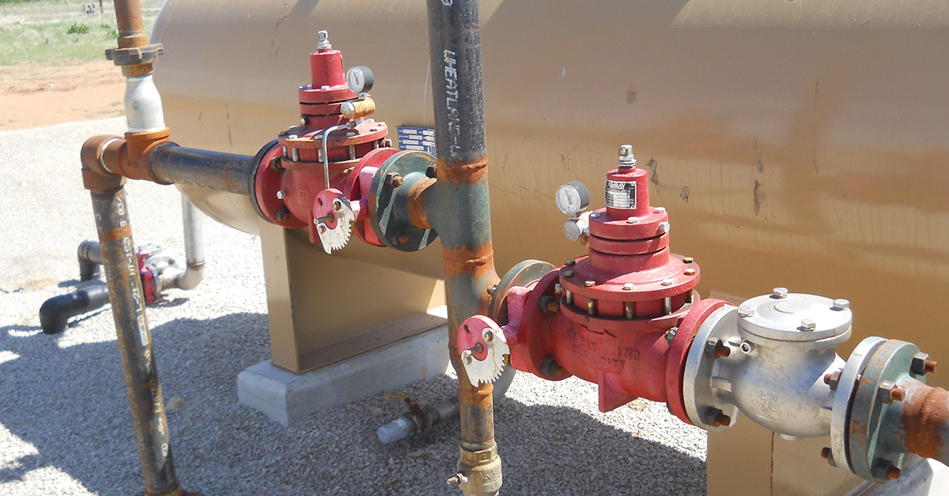
ENERGY CONTROL PROCEDURE
Step 6 – Stored Energy
Does this machine have “stored” energy?
Examples:
  Pressure Differential – air, hydraulic, vacuum
  Moving parts such as a ram
  Springs
  Gravity
Be sure to release, disconnect or block ALL stored energy
Continue to verify if there is a chance of re-accumulation
Notes:
Stored energy takes the form of many different devices, such as springs, gravity, and capacitors. We must secure all sources of energy to protect personnel. Do not overlook the stored energy sources.
You must consider whether a machine has any stored energy. The problem with stored energy is that it can still be released after performing lockout/tagout. Examples of stored energy can be a pressure differential, moving parts such as a ram, springs, or gravity. It may be that you will need to chock part of your equipment to prevent it from coming down due to gravity. If it is determined that the machine has stored energy, make sure to release, disconnect, or block all stored energy prior to performing any work on the machine. If the possibility exists for the re-accumulation of stored energy to hazardous levels, the authorized employee must regularly perform verification steps to detect any re-accumulation before it has the potential to cause an injury.
Top photo: An example of a spring. Evaluate machinery to see whether there are any springs. Springs are an example of stored energy, and will need to be released prior to any work being done.
Bottom photo: An example of a line that may be carrying stored energy, such as hydraulic energy. This energy would need to be opened (line breaking), closed via a solid plate (line blanking or blinding), or the two in-line valves would need to be closed by locking and tagging out, and the line between the two valves would need to be drained or vented and locked and tagged out (double block and bleed).

Slide 54
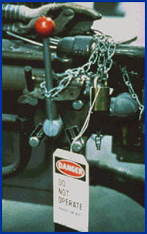
ENERGY CONTROL PROCEDURE
Step 7 – VERIFICATION OF ISOLATION
Prior to servicing or maintenance, authorized employee must verify machine has been de-energized
Is it done correctly?
ALWAYS verify!
Review your checklist:
  Proper communication
  Everyone involved is on the same page
  Machine will not run
  All controls back to proper position before beginning work
Notes:
Prior to starting work on machines or equipment that have been locked or tagged out, the authorized employee shall verify that isolation and de-energization of the machine or equipment have been accomplished.
Before an authorized proceeds, it is very to important verification has been done to ensure the energy has been isolated. Lack of verification of the isolation of energy sources has resulted in many fatalities and injuries. Verification can also be accomplished using monitoring instruments such as a voltmeter to test electrical circuits to determine that there is no electrical energy available to the machine or equipment. Similar testing equipment could be used to check for the presence of other energy types and sources. In order to verify that all potentially hazardous energy has been isolated, the authorized employee may need to use a combination of verification methods. The appropriate combination will depend upon the type of machinery or equipment involved, the complexity of the system, or other factors.
Photo: This photo demonstrates improper lockout/tagout. Simply wrapping a chain around the on/off lever is not going to effectively isolate the energy. If verification of isolation was performed here, the employee may have found that the energy was not properly locked and tagged out.

Slide 55
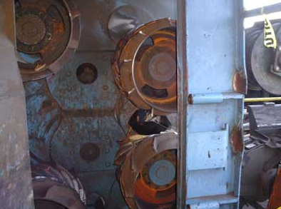
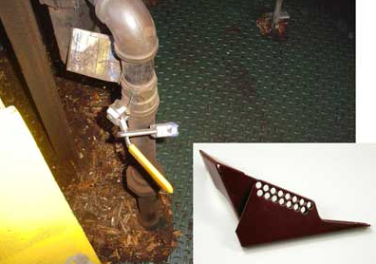
FATALITY REPORT
A millwright was fatally injured when he was pinned between the feed rolls of a de-barker as he was welding additional metal to the teeth on the feed rolls. The victim had locked out two electrical disconnects before beginning his work, but he had not locked out all electrical disconnects and had not shut off and locked out the air line to the machine. As the victim welded, he leaned forward and placed his head between the upper and lower feed rolls to reach areas that required more metal. The air pressure on the rolls automatically cycled and the feed rolls closed over the victim’s head.
Notes:
This photo describes a fatality that may have been prevented if verification of isolation was performed. If the employee had turned the de-barker on to verify that the energy was isolated, he would have likely realized that the energy was not properly isolated, because the de-barker would have likely turned on. Employees typically do not deliberately skip this step. Oftentimes they do not know this step is part of the LOTO procedure, because it isn’t included on the written LOTO procedure. Review your written LOTO procedures to ensure that verification of isolation is included, and train employees on the importance of this step.
Top photo: This photo illustrates the feed rolls of the south debarker where the victim had been welding metal onto the debarker teeth.
Bottom photo: This photo illustrates the air line that supplied the debarker and is not properly locked out [courtesy of SCOSHA]. The insert illustrates an example of a ball valve lockout device that can be used to lock out the pneumatic airline. The manufacturers’ directions for installing any lockout device must be followed.
Source: NIOSH FACE Report (https://www.cdc.gov/niosh/face/in-house/full200602.html#:~:text=On%20January%2017%2C%202006%2C%20a,teeth%20on%20the%20feed%20rolls)

Slide 56
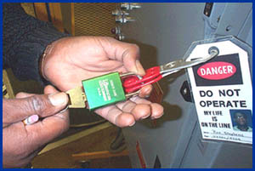
ENERGY CONTROL PROCEDURE
Step 8 – Release From Lockout or Tagout (1)
  Inspect work area to ensure removal of non-essentials
  Employees safely positioned and notified
  Lockout/tagout removal (by employee who applied)
  Restart
Notes:
Employees who work on deenergized machinery may be seriously injured or killed if someone removes lockout/tagout devices and reenergizes machinery without their knowledge. Thus, it is extremely important that all employees respect lockout and tagout devices and that only the person(s) who applied these devices remove them.
Before removing lockout or tagout devices, the employees must take the following steps in accordance with the specific provisions of the energy-control procedure: inspect machines or their components to assure that they are operationally intact and that nonessential items are removed from the area; and check to assure that everyone is positioned safely and away from machines.
Photo: Employee using a key to remove his lock from a hasp. Removal of locks and tags must be performed by the individual who initially applied the lock.

Slide 57
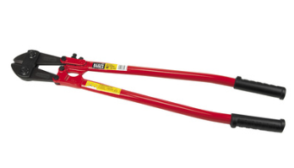
ENERGY CONTROL PROCEDURE
Step 8 – Release From Lockout or Tagout (2)
  Lock/Tag removal if authorized employee is not available:
  Verify that authorized employee is not at facility
  Make reasonable efforts to inform him or her
  Ensure that he/she knows of removal upon re-entering
  This procedure must be included in the written program.
Notes:
If an authorized employee leaves their locks and tags on a piece of equipment and they are not available for lock/tag removal, the locks and tags can only be removed if the company verifies that the authorized employee is not at the facility, the company makes a reasonable effort to inform them that their locks and tags were left on the equipment and they need to be removed, and the company notifies the employee of the lock and tag removal once they return to the facility. These steps do need to be included in your company’s written lockout/tagout program.
Photo: Pliers that may be used to remove a lock from an energy isolating device if necessary. Before the lock is removed, the steps listed in this slide must be met.

Slide 58
PERIODIC INSPECTION
Performed at least annually
Lockout – include review with authorized employees
Tagout – include review with authorized and affected employees
Certification record kept:
  Identify machine or equipment
  Date of inspection
  Employees performing and included in inspection
Why???
  Review Modifications
  Verification of accuracy
  Confirm successful execution by all authorized employees
  Opportunity for Q&A
Notes:
LOTO procedures must be inspected periodically (at least annually) to ensure that they are being followed and that they remain effective in preventing employee exposure to hazardous energy. A review in the office or a meeting does not meet that requirement. A qualified person (an authorized employee not involved with the process) must evaluate another qualified person that is executing the procedure.

Slide 59

TRAINING & RETRAINING
Authorized employees
  Recognition of hazardous energy
  Type and magnitude of hazardous energy
  Methods of isolating energy
  How to verify isolation
Affected – Purpose and use of procedure
Other – Procedure and Prohibition from tampering
Tagout provisions
Notes:
Employees need to be trained to ensure that they know, understand, and follow the applicable provisions of the hazardous energy control procedures. The training must cover at least three areas: aspects of the energy control program; elements of the energy control procedure relevant to the employee’s duties or assignment; and the various requirements of the OSHA standards related to lockout/tagout.
Affected employees must receive training in the purpose and use of energy-control procedures. They also need to be able to do the following: recognize when the energy-control procedure is being used, understand the purpose of the procedure, and understand the importance of not tampering with lockout or tagout devices and not starting or using equipment that has been locked or tagged out.
All other employees whose work operations are or may be in an area where energy-control procedures are used must receive instruction regarding the energy-control procedure and the prohibition against removing a lockout or tagout device and attempting to restart, reenergize, or operate the machinery.
If employees perform tagout, they need to receive training on the limitations of tagout systems. Employees must understand tags are warning devices and do not provide the same physical restraint that is provided by a lock, as well as the requirement that when a tag is attached to an energy isolating means, it is never to be removed without authorization or ignored. Employees must be trained on the requirement for tags to be understandable by all authorized, affected, and other employees, and that tags and their attachment means must be durable and able to withstand the environmental conditions of the workplace. Employees must understand that tags may evoke a false sense of security. Tags must also be securely attached to energy-isolating devices so that they cannot be detached during use.
Graphic: Clip art shows the information as thoughts from an employee.

Slide 60
TRAINING & RE-TRAINING
Re-training is required when:
Change in job assignment
Change in machine or process
Change in lockout/tagout procedure
Inadequacies revealed in periodic review
Notes:
Retraining is vital to LOTO program, especially if there are changes in the procedures or equipment. Retraining is also needed when the results of the audit indicate a worker has problems with the execution of the procedure.

Slide 61
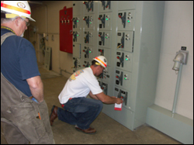
TRAINING & RE-TRAINING
Certification
Certify that the training has been conducted and kept up to date:
  Employee names
  Date(s) of training
Notes:
Evidence of training is necessary. The information on the certificate needs to include: name of trainee, name of trainer, topics of training, and date of the training.
Photo: This photo shows one employee observing another employee performing lockout/tagout.

Slide 62

OUTSIDE CONTRACTORS
Whenever outside servicing personnel are to be engaged in activities covered by the scope and application of this standard:
  The on-site employer and the outside employer shall inform each other of their respective lockout or tagout procedures.
Notes:
When outside servicing personnel are engaged in activities covered by this standard, the on-site employer and the outside employer shall inform each other of their respective lockout or tagout procedure.
Photo: Two employees reviewing a document. It is important to ensure that on-site employers and outside employers are aware of each other’s lockout/tagout procedures. If you are an on-site employer, ensure temporary workers or outside contactors are aware of your company’s lockout/tagout program, and the requirements covered in the program.

Slide 63

TESTING OR POSITIONING MACHINES
Clear the machine of tools and materials
Remove employees from the area
Remove lockout/tagout devices
Energize and proceed with testing/positioning
De-energize and re-apply energy control measures
Notes:
OSHA allows the temporary removal of lockout or tagout devices and the reenergization of the machine only in limited situations for particular tasks that require energization — for example, when power is needed to test or position machines, equipment, or components. However, this temporary exception applies only for the limited time required to perform the particular task requiring energization.
The procedures must provide maximum safety coverage for employees when the equipment or machinery must be energized during the course of servicing. Employee exposure to hazards is high during these transition periods. To ensure workplace safety, the following sequence must be followed when testing or repositioning a machine or piece of equipment: clear the machines or equipment of tools and materials; remove employees from the machine or equipment area; remove the lockout or tagout devices as specified; energize and proceed with testing or positioning; deenergize all systems, isolate the machine or equipment from the energy source, and reapply lockout or tagout devices as specified. OSHA permits the removal of lockout/tagout devices and the reenergization of equipment only during the time necessary for the testing or positioning of the machine, equipment, or component, and only when reenergization is essential to accomplishing the servicing task.
Photo: An employee testing a machine.

Slide 64
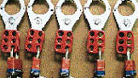
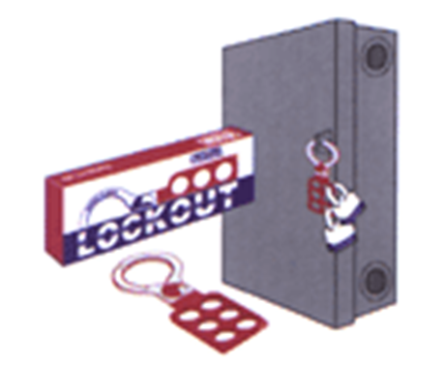
GROUP LOCKOUT TAGOUT
Personal lock or tag (usually)
Lockbox or master tag system with principal authorized employee
“Shall utilize a procedure which affords a level of protection equivalent to that provided by the implementation of a personal lockout or tagout device”
Notes:
Each employee must affix their own lock to the hasp on the energy isolation device. Procedures for group lockout tagout must be discussed in the hazardous energy control plan. An authorized employee may represent a group and have primary responsibility for the group.
Top photo: Hasps that may be used for group lockout/tagout
Bottom photo: A lock and two hasps to demonstrate a group lockout tagout in progress.

Slide 65


GROUP LOCKOUT
Each exposed employee must be provided the same level of protection…Each person must be protected by their own lock!
59
Notes:
Each authorized person performing work must still apply their individual lock to the machine, equipment or device.
Photos: These photos illustrate personnel are conducting a group lockout. Note at least two or more locks and tags on the equipment (electrical disconnect)

Slide 66
MINOR SERVICING EXEMPTION
Activities which are routine, repetitive, and integral to the use of the equipment for production are not covered by this standard if alternative measures provide effective protection.
Activity must be conducted during normal production operations
Activity must be routine (regular course of procedure in accordance with established practices), repetitive (regularly repeated as part of production), and integral (essential to the production process).
61
Notes:
Work involving minor tool changes and adjustments or other minor servicing activities that are routine, repetitive, and integral to the use of the production equipment and that occur during normal production operations are not covered by the lockout/tagout standard. This exception is limited, however, and applies only when the employer provides and requires alternative measures to ensure effective, alternative protection.

Slide 67

LOCKOUT TAGOUT RESOURCES
Lockout-Tagout eTool @
OSHA Lockout/Tagout eTool
Tutorial
Hot Topics
Interactive Case Studies
Standards
Letters of Interpretation
Compliance Directive
Notes:
This slide directs you to the LOTO eTool that is available at www.osha.gov. The eTool provides information on the standard and tutorials.
Graphic: A screenshot of OSHA’s LOTO eTool homepage.
OSHA’s Lockout/Tagout eTool: https://www.osha.gov/dts/osta/lototraining/index.html

Slide 68
REVIEW
What are the 8 steps that must be followed when performing Lockout/Tagout?
When is re-training required?
How often must periodic inspections of the lockout/tagout procedures be performed?
When would the minor servicing exception apply?
Notes:
This slide is a review of some of the different topics that were covered during the module.
Answers:
Question 1:
Notification of employees
Preparation for shutdown
Machine or equipment shutdown
Machine or equipment isolation
Lockout/tagout device application
Stored energy
Verification of isolation
Release from lockout/tagout
Question 2:
Retraining is required when an employee has a change in their job assignment, there is a change in the machine or process, there is a change in the lockout/tagout procedure, or when inadequacies are observed and revealed during the periodic review.
Question 3:
Periodic inspections must be performed at least once every year.
Question 4: The minor servicing exception would apply when minor servicing activities, which are routine, repetitive, and integral to production, take place during normal production operations AND alternative measures of protection are provided.

Slide 69
SUMMARY
Written program including written procedures for each machine
Training of employees
Periodic review of program
ENFORCEMENT
Notes:
This slide summarizes the basics of a hazardous energy control plan. Written procedures are important to direct the activities of the hazardous energy control at the facility. The basic must outline the scope, authority, and responsibility of implementing LOTO. Items that need to be included are: steps to isolate the equipment, verification of isolation, steps to release the equipment, interaction with contractors, group LOTO, shift changes, lock removal, training, machine specific procedures, and periodic inspections. The policy must be enforced to be effective!

