Slide 1
Machine Guarding
OSHA 10-hour Outreach Training General Industry

Slide 2
Introduction
Possible machinery-related injuries include:
Crushed fingers or hands
Amputations
Burns
Blindness
A good rule to remember is:
Any machine part, function, or process which may cause injury must be safeguarded.

Slide 3
Introduction
Lesson objectives:
Identify the main causes of machinery accidents.
Recognize basic machinery parts that expose workers to hazards.
Recognize workplace situations involving machinery that requires guarding.
Identify the requirements for safeguards.
Identify types of machine guards including types of devices used to safeguard machines.

Slide 4
Machinery Accidents
Examples of how machine accidents can occur:
Reaching-in to “clear” equipment
Not using Lockout/Tagout
Unauthorized persons doing maintenance or using the machines
Missing or loose machine guards

Slide 5

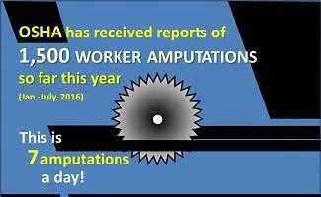
Machinery Accidents
Amputations:
Unguarded/inadequately safeguarded machinery
Materials handling activities
Source: OSHA
Activities involving stationary machines
Source: OSHA

Slide 6
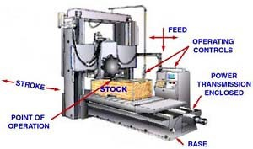
Basic Machinery Parts and Hazards
Three fundamental machine areas:
Point of operation
Power transmission device
Operating controls – mechanical or electric power control
Source: OSHA

Slide 7
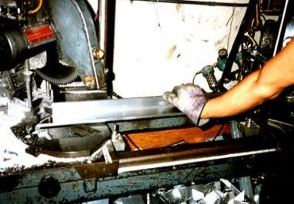
Basic Machinery Parts and Hazards
Point of operation:
Where work is performed on material
Examples
  Cutting
  Shaping
  Boring
  Forming
Source: OSHA DTE

Slide 8
Basic Machinery Parts and Hazards
Power transmission device:
Parts that transmit energy to the part of the machine performing work
Examples
Flywheels
Pulleys
Belts
Connecting rods
Couplings
Cams
Spindles
Chains
Cranks
Gears

Slide 9
Basic Machinery Parts and Hazards
Hazardous motions and actions:
Motions
  How the machine part moves
  Examples: rotating, in-running nip points, reciprocating, and transversing
Actions
  Operation that the machine part performs
  Examples: cutting, punching, shearing, bending

Slide 10
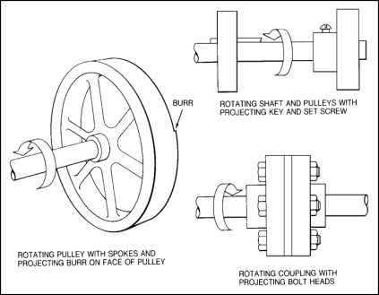

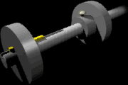
Basic Machinery Parts and Hazards
Rotating parts with hazardous projections
Source of graphics: OSHA

Slide 11

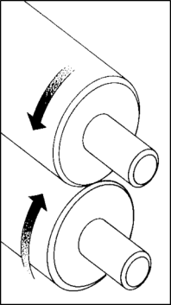


Basic Machinery Parts and Hazards
Common nip points on rotating parts
Source of graphics: OSHA

Slide 12
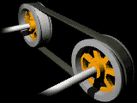
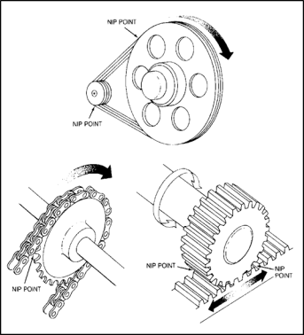

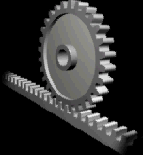
Basic Machinery Parts and Hazards
Nip points between rotating elements and parts with longitudinal motions
Source of graphics: OSHA

Slide 13


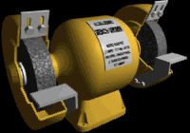
Basic Machinery Parts and Hazards
Nip points between rotating machine components
Source of graphics: OSHA

Slide 14

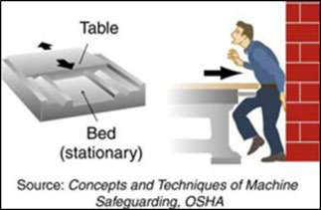
Basic Machinery Parts and Hazards
Reciprocating motions:
  Back-and-forth
  Up-and-down
Source: OSHA

Slide 15
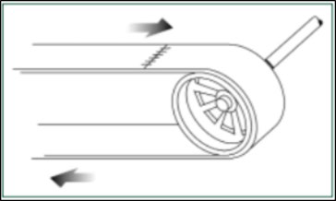
Basic Machinery Parts and Hazards
Transverse motion – movement in straight, continuous line
Source of graphics: OSHA

Slide 16

Basic Machinery Parts and Hazards
Cutting action – may involve rotating, reciprocating, or transverse motion
Source: OSHA

Slide 17
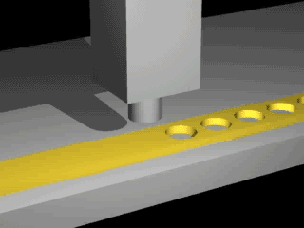
Basic Machinery Parts and Hazards
Punching action – power applied to a slide (ram) for purpose of blanking, drawing, or stamping metal or other materials
Source: OSHA

Slide 18

Basic Machinery Parts and Hazards
Shearing action – applying power to a slide or knife in order to trim or shear metal or other materials.
Source: OSHA

Slide 19
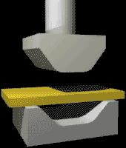
Basic Machinery Parts and Hazards
Bending action – applying power to draw or stamp metal or other materials
Source: OSHA

Slide 20
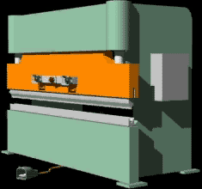
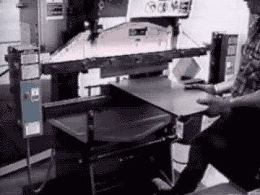
Machinery That Requires Guarding
Machines that require point of operation guarding:
Guillotine cutters
Shears
Alligator shears
Power presses
Milling machines
Power saws
Jointers
Portable power tools
Forming rolls and calenders
Source of graphics: OSHA

Slide 21

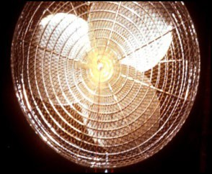
Machinery That Requires Guarding
Exposure of fan blades:
  Guard when periphery of blades is less than 7’ above the floor or working level
  Guards with openings no larger than ½”
Source of graphics: OSHA

Slide 22
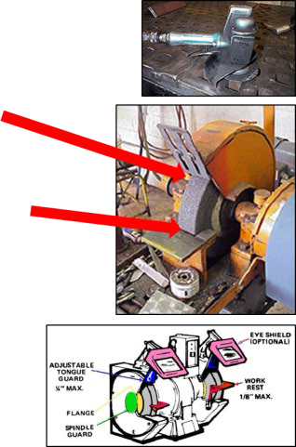
Machinery That Requires Guarding
Abrasive wheel machinery:
  Adjustable tongue guard to within ¼” of wheel
  Work rest with maximum opening of 1/8”
  Cover spindle end, nut, flange projections
Source of graphics: OSHA

Slide 23
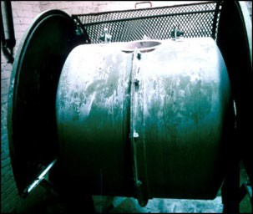
Machinery That Requires Guarding
Revolving barrels, containers, and drums:
Guard by an enclosure which is interlocked with drive mechanism
Guards with openings no larger than ½”
Source: OSHA

Slide 24
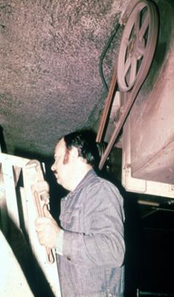
Machinery That Requires Guarding
Power-transmission apparatus:
Shafting, flywheels, pulleys, belts, chain drives, etc.
Unguarded belt and pulley
Unguarde and pulley
d belt
Less than 7 feet from the floor or working platform must be guarded
Source: OSHA

Slide 25
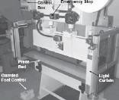
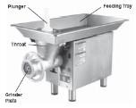
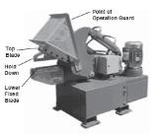
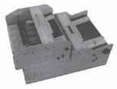
Machinery That Requires Guarding
Machinery associated with amputations – examples:
Mechanical power presses
Power press breaks
Powered and non- powered conveyors
Printing presses
Roll-forming and roll-bending machines
Shearing machines
Food slicers
Meat grinders
Meat-cutting band saws
Drill presses
Milling machines
Grinding machines
13. Slitters
Source of graphics: OSHA

Slide 26
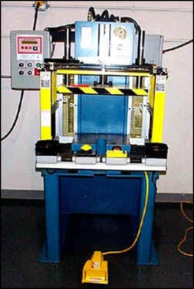
Requirements for Safeguards
Safeguards must meet these minimum general requirements:
Prevent contact
Be secured
Protect from falling objects
Create no new hazards
Create no interference
Allow safe lubrication
Source: OSHA

Slide 27
Types of Machine Safe Guards
Safeguarding machinery:
Primary methods
  Guards
  Devices
Ensure employee protection
  Properly designed, constructed, and installed
  Used and maintained in good operating condition

Slide 28
Types of Machine Safe Guards
Secondary methods
  Probe detection and safety edge devices
  Awareness devices
  Safeguarding methods
    Safe distance
    Safe holding
    Safe opening
  Safe work practices
Safe work procedures
Complementary equipment

Slide 29
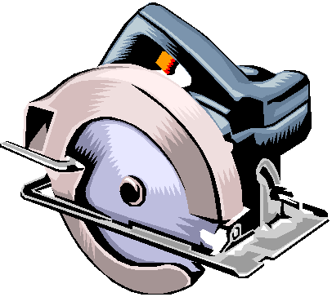
Types of Machine Safe Guards
Guards:
Preferable to other control methods
Provide physical barrier that prevents contact with dangerous machine parts
Four general types
  Fixed
  Interlocked
  Adjustable
  Self-adjusting
Source: OSHA

Slide 30
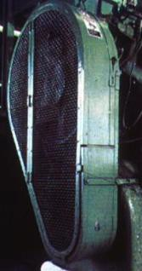
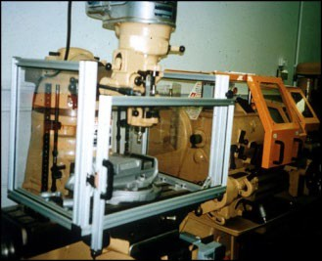
Types of Machine Safe Guards
Fixed guard:
Provides a barrier
Permanent part of the machine, preferable to all other types of guards.
Source of photos: OSHA

Slide 31
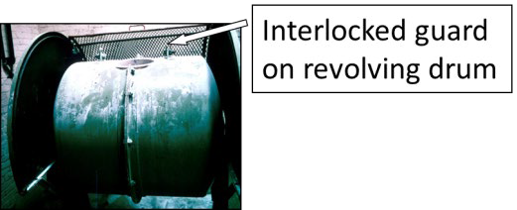
Types of Machine Safe Guards
Interlocked guards:
Shuts off or disengages power, stops moving parts, and prevents starting of machine when guard is open
May use electrical, mechanical, hydraulic, or pneumatic power, or combination
Source: OSHA

Slide 32
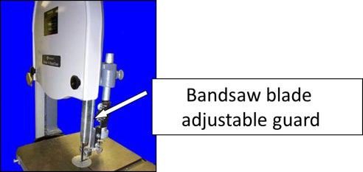
Types of Machine Safe Guards
Adjustable guards:
Shuts off or disengages power
Stops moving parts
Prevents starting of machine when guard is open
Source: OSHA

Slide 33
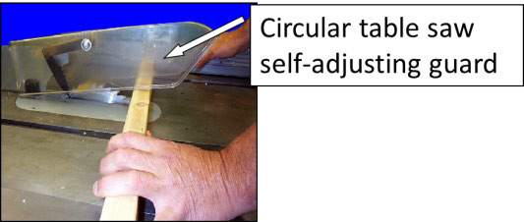
Types of Machine Safe Guards
Self-adjusting guards:
Openings of barriers determined by movement of the stock
Places barrier between danger area and operator
Source: OSHA

Slide 34
Types of Machine Safe Guards
Devices:
Controls or attachments that prevent inadvertent access by employees to hazardous machine areas
Examples
Presence sensing
  Photoelectric
  Radiofrequency
  Electromechanical
Pullback
Restraint
Safety trip controls
Two-hand control
Two-hand trip
Gate

Slide 35
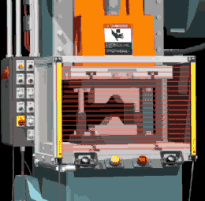
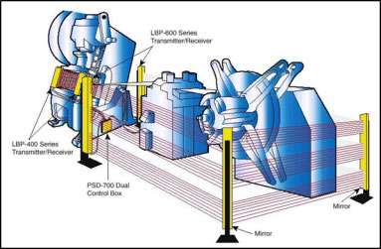
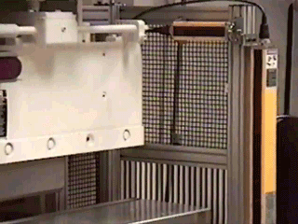
Types of Machine Safe Guards
Presence-sensing devices:
Photoelectric
Radiofrequency
Electromechanical
Source: OSHA

Slide 36
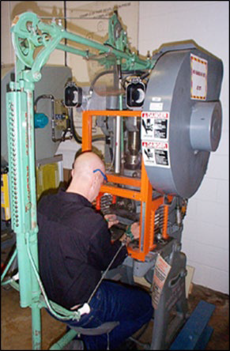
Types of Machine Safe Guards
Pullback devices:
Utilize a series of cables attached to operator
Automatically withdraws hands from point of operation when slide/ram begins to descend
Source: OSHA

Slide 37
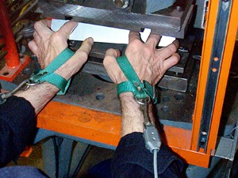
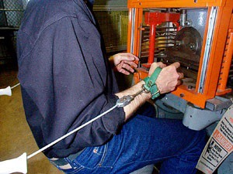
Types of Machine Safe Guards
Source: OSHA
Source: OSHA
Hands in die, feeding
Point of operation exposed
Pullback device attached and properly adjusted
Die closed
Hands withdrawn from point of operation by pullback device

Slide 38
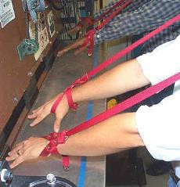
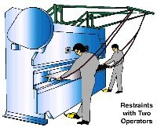
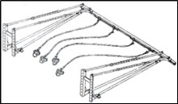
Types of Machine Safe Guards
Restraint devices:
Utilize cables/straps attached to operator’s hands and a fixed point
No extending/retracting action involved
Hand-feeding tools may be necessary
Source of graphics: OSHA

Slide 39
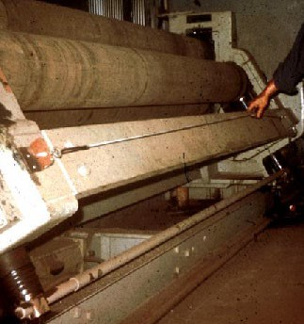
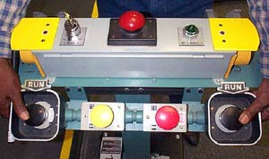
Types of Machine Safe Guards
Safety trip controls:
Deactivates the machine in an emergency situation
Examples
  Pressure-sensitive bar
  Safety tripod
  Safety tripwire
Positioning is critical; must stop machine before body reaches danger area
Source of graphics: OSHA

Slide 40
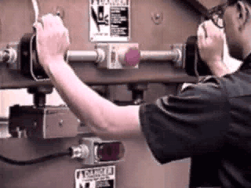
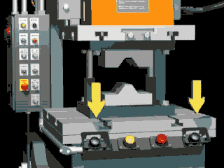
Types of Machine Safe Guards
Two-hand controls:
Deactivates the machine in an emergency situation
Pressure-sensitive
Positioning is critical; must stop machine before body reaches danger area
Source of graphics: OSHA

Slide 41
Types of Machine Safe Guards
Gate devices:
Moveable barrier that protects operator at point of operation before machine cycle can be started
Must be interlocked so machine cannot begin cycle unless gate guard is in place
Must be closed before machine can function
Types
  “A” Gate
  “B” Gate

Slide 42
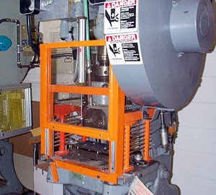
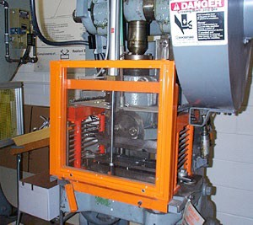
Types of Machine Safe Guards
Gate Open
Gate devices:
Gate Open
Moveable barrier that protects operator at point of operation before machine cycle can be started
Must be interlocked so machine cannot begin cycle unless gate guard is in place
Must be closed before machine can function
Source of graphics: OSHA
Gate Closed
Gate Closed

Slide 43
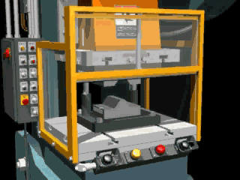

Types of Machine Safe Guards
Type “A” Gate Operation
Type “B” Gate Operation
Source of graphics: OSHA

Slide 44
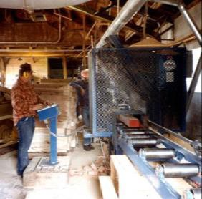
Additional Safeguarding
Location/distance:
The dangerous moving part of a machine must be so positioned that those areas are not accessible or do not present a hazard
Feeding process safeguarded by maintaining safe distance to protect worker
Operator’s controls located safe distance from machine
Source: OSHA

Slide 45
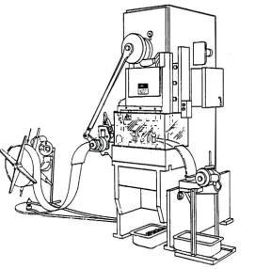
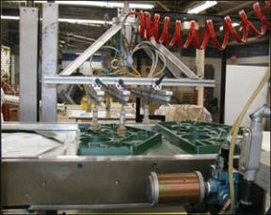
Additional Safeguarding
Transparent Enclosure Guard
Stock Feed Roll
Completed Work
Feeding and ejection methods:
Automatic/
semi-automatic feed
Automatic/
semi-automatic ejection
Robots
Source of graphics: OSHA

Slide 46



Additional Safeguarding
Miscellaneous aids:
Awareness barriers
Protective shields
Hand-feeding tools
Source of graphics: OSHA

Slide 47

Identify the Hazard
Unguarded lower blade and arbor end of radial saw.

Slide 48

Identify the Hazard
Guard removed from chain rail exposing pins on the spiked chain and sprocket mechanism.

Slide 49
Summary
Safeguards are essential for protecting workers from needless and preventable machinery-related injuries
The point of operation, as well as all parts of the machine that move while the machine is working, must be safeguarded
A good rule to remember is:
Any machine part, function, or process which may cause injury must be safeguarded

Slide 50
Knowledge Check
All machines consist of three fundamental areas, including .
  Flywheels, connecting rods, and transverse moving parts
  Point of operation, power transmission device, and operating controls
  Reciprocating parts, rotating parts, and on/off switch
  Feed mechanisms, auxiliary machine parts, and nip points
Answer: b. point of operation, power transmission device, and operating controls

Slide 51
Knowledge Check
Rotating, in-running nip points, reciprocating, and transversing are types of hazardous .
  motions
  actions
  guards
  devices
Answer: a. motions

Slide 52
Knowledge Check
Cutting, punching, shearing, and bending are types of hazardous .
  motions
  actions
  guards
  devices
Answer: b. actions

Slide 53
Knowledge Check
Which of the following explains how a guard protects workers?
  Stops the machine when a worker enters the danger area
  Restrains the worker from entering the danger area
  Creates distance to keep the worker from entering the danger area
  Provides a barrier to prevent access to the danger area
Answer: d. Provides a barrier to prevent access to the danger area

Slide 54
Knowledge Check
Which of the following is an example of a safeguarding device?
  Protective shield
  Hand-feeding tool
  Safety trip control
  Awareness barrier
Answer: c. Safety trip control

