Slide 1
Lockout/tagout considerations with industrial robots
The material was produced under grant number SH-99019-SH0 from the Occupational Safety and Health Administration, U.S. Department of Labor. It does not necessarily reflect the views or policies of the U.S. Department of Labor, nor does mention of trade names, commercial products, or organizations imply endorsement by the U.S. Government.
Notes:
The material was produced under grant number SH-99019-SH0 from the Occupational Safety and Health Administration, U.S. Department of Labor. It does not necessarily reflect the views or policies of the U.S. Department of Labor, nor does mention of trade names, commercial products, or organizations imply endorsement by the U.S. Government.

Slide 2
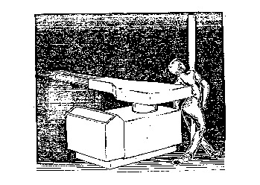
Tragedy can occur when lockout/tagout doesn’t happen
At approximately 1:00 PM, the victim entered the working area of the robot by either climbing over/through the safety rail or by walking through one of the unguarded gaps between the safety rail and related die-casting equipment.
The victim was discovered when a fellow employee, who worked at an adjacent die-cast work station heard an air hose steadily hissing. The accident site could not be seen from the neighboring work station but the fellow employee stated that he heard this continual hissing noise for 10 to 15-minutes.
Notes:
Slide is a detailed account of an industrial accident involving not utilizing lockout/tagout procedures with the robot. Read scenario and discuss with class. Make the point that many tragedies involving robots occur when the robot is not in production mode but in some type of maintenance or set up mode.

Slide 3
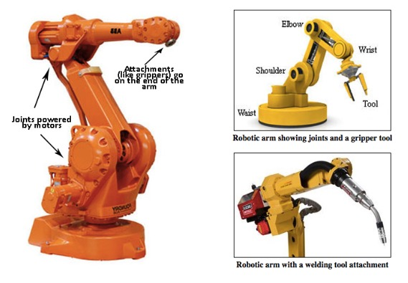
TYPICAL PARTS OF AN INDUSTRIAL ROBOT
Notes:
These are typical parts of an industrial robot:
Picture on the left shows:
Joints powered by motors
Attachments (like grippers) go on the end of the arm
Picture on the right top shows a robotic arm showing joints and a gripper tool:
The waist is at the bottom, then the shoulder half way up, the elbow is at the top, then the wrist and the tool
Picture on the right bottom shows a robotic arm with a welding tool attachment.

Slide 4
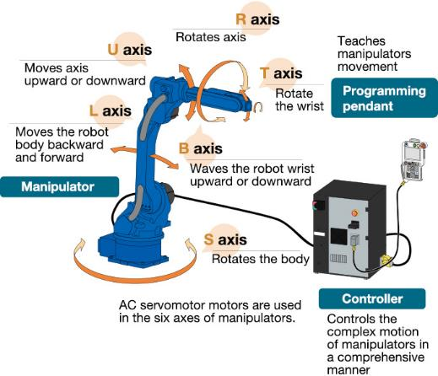
ROBOT COMPONENTS
Industrial robots have four major components: the mechanical unit, power source, control system, and tooling.
Notes:
Industrial robots have four major components: mechanical unit, power source, control system and tooling.
The picture shows the different axes and what each one does: L, U, R, T, B and S axes – Axes allow the robot to move along different planes (in different directions).
The manipulator is an electronically controlled mechanism, consisting of multiple segments, that performs tasks by interacting with its environment (robot arm).
The controller controls the complex motion of the manipulators (robot arms) in a comprehensive manner.
The programming pendant teaches manipulators movement. It is how the operator programs the robot.

Slide 5
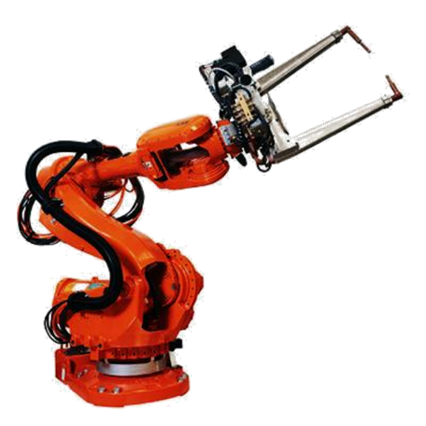
Robotics Hazards
Mechanical
Electrical
Thermal
Noise
Vibration
Radiation
Material or Substance
Ergo
Environmental
Combination
Notes:
Different robotic hazards that need to be considered when working with robots: mechanical, electrical, thermal, noise, vibration, radiation, material or substance, ergo, environmental or a combination of any of the above.
End-effector An accessory device or tool specifically designed for attachment to the robot wrist or tool mounting plate to enable the robot to perform its intended task. (Examples may include gripper, spot-weld gun, arc-weld gun, spray- paint gun, or any other application tools.)
R15.06-2012 ANNEX A more information

Slide 6
When Do Accidents Occur?
Operation-Not usually
Teaching/Programing/Verification-YES
Intervention-YES
  Maintenance
  Repair
  Testing
  Set-up
  Adjustment
  Dropped Parts
Notes:
R15.06-2012
5.5.2 Access for interventions
Ask the class when do accidents usually occur with robots?
Accidents usually occur when teaching, programing and verification (when the robot is being set up to run a program).
Accidents also occur during intervention. This can include maintenance, repair, testing, set-up, adjustment and dropped parts. Many times LOTO should be used during these tasks but are not which can lead to an accident. Employees enter the danger area and the robot is activated which can lead to a struck by event possibly pinning the employee against a fixed structure. This can easily lead to a fatality.

Slide 7
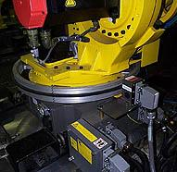
RESTRICTIVE DEVICES
A device that restricts the maximum space by stopping or causing to stop all robot motion and is independent of the control program and the task programs.
Electronic Sensor
Notes:
Restrictive devices: A device that restricts the maximum space by stopping or causing to stop all robot motion and is independent of the control program and the task programs.

Slide 8
Risk Assessment (1)
Risk Assessment process yields the performance level or criteria for protection.
The primary method for industry to safeguard personnel around automated systems and robots.
  Must be performed correctly.
Safeguarding methods start with risk assessment process.
Notes:
A risk assessment is required to ensure that robots are set up and operated safely. The risk assessment will determine the performance level or criteria for protection of the employees.
A risk assessment is the primary method of safeguarding personnel around automated systems and robots, if performed correctly.
Safeguarding methods start with the risk assessment process - the risk assessment process with help determine what safeguarding methods are required to ensure the safety of employees around robots.

Slide 9
Risk Assessment (2)
Many of the B11 Series have Risk Assessment incorporated in the consensus standards that refer the employer to the following:
  ANSI B11.TR3 Risk Assessment and Risk Reduction
  ANSI/RIA R15.06-2012
Notes:
Resources for performing a proper risk assessment:
ANSI B11.TR3 Risk Assessment and Risk Reduction - https://webstore.ansi.org/Standards/AMT/ANSIB1119TR3RiskAssessment
ANSI/RIA R15.06-2012 - https://www.robotics.org/bookstore-prod.cfm?category_id=118&product_id=426

Slide 10
Risk Assessment (3)
Risk is a measurement of the frequency and severity of an event.
The risk factor incorporates exposure and avoidance, then determines the Performance Level (PL) or Safety Integration Level (SIL) of guarding methods and equipment required.
NOTE: Safety-Related Parts Control Systems can also be called SRP/CS
Notes:
Risk is a measurement of the frequency and severity of an event.
Performance level - a discrete level used to specify the ability of safety-related parts of control systems to perform a safety functions under foreseeable conditions.
Performance Levels (PL) and categories as described in ISO 13849-1:2006, 4.5.1
Safety integration level – a measure of how likely it is that a dangerous failure will occur in a system.
Safety Integrity Levels (SIL) and hardware fault tolerance requirements as described in IEC 62061:2005, 5.2.4.
Safety-Related Parts Control Systems can also be called SRP/CS – The part of the control system of a machine that prevents a hazardous condition from occurring. It can be a separate dedicated system or it may be integrated with the normal machine control system.

Slide 11
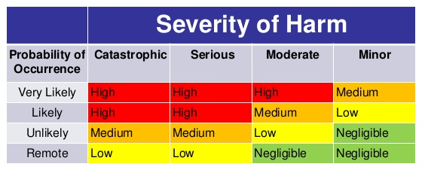
Risk Matrix
Notes:
Risk matrix table plotting the severity of an event occurring on one axis, and the probability of it occurring on the other.

Slide 12
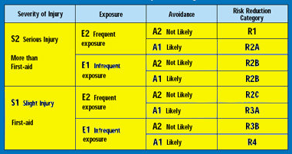
Risk Reduction Category
Notes:
Risk reduction category table.

Slide 13
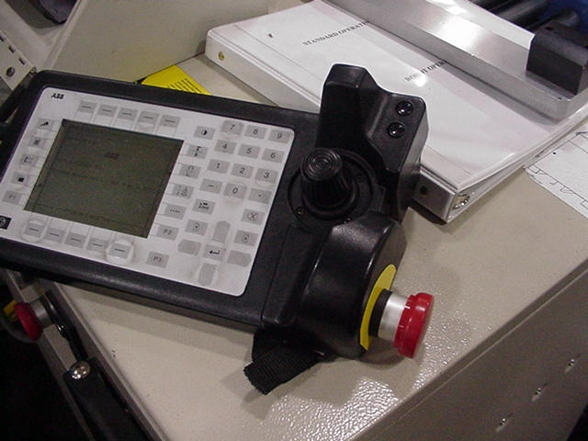
Teaching Pendant
13
Notes:
A picture of a teaching pendant.
These can be wired or wireless. The device allows its controller to work with robots without the need for tethering to a fixed terminal. Teach pendants offer a variety of settings to control robots and are also utilized to design new capabilities and features.

Slide 14
Teach (1)
Method that allows programing with the programmer within the hazard area
Less than 10 inches (250mm) per second speed
E-Stop on pendant
Clearance Requirements
Notes:
Teaching a robot is mainly through positional data. A teach pendant with controls to drive the robot in a number of coordinate systems is used to manually drive the robot to its desired location. These locations are then stored and can be revisited within the robot program.

Slide 15
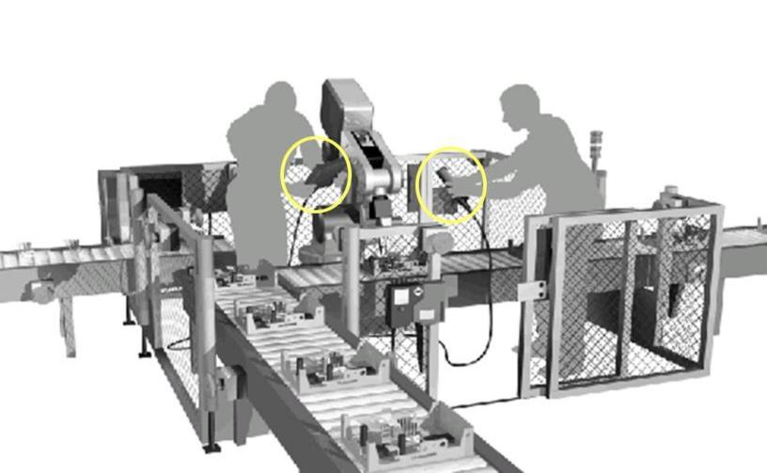
TEACH (2)
Person A
with a teaching pendant
Person B
with a grip switch
More than one person in the safeguarded space with an enabling device
15
Notes:
This diagram shows two employees. Employee A is using the teaching pendant, and Employee B is holding onto a grip switch. Both employees are within the robot work envelope.

Slide 16
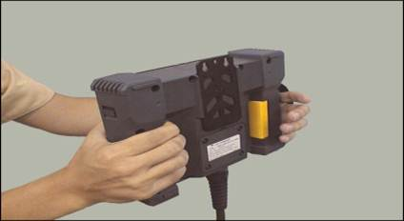
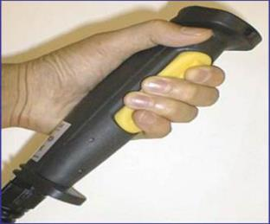
Teach (3)
Additional persons allowed for teaching – with enabling device
Prior testing of motion controls and safeguarding
A manually operated device which when continuously activated, permits motion.
16
Notes:
Existing pendants or teaching control devices used inside the safeguarded space and not equipped with an enabling device or function must be retrofitted. Retrofit to the three position switch is not required, and should not be done unless the installation is ergonomically accomplished. Pendants with a motion function which requires continuous activation to allow robot motion also meet the intent of this requirement.

Slide 17
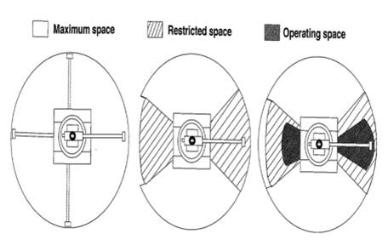
TEACH (4)
Clearance (slow speed)
18-20 inch clearance in operating space from areas of building, structures, utilities, other machines and equipment that may create trapping or a pinch point
Note: Teacher can be in operating space to teach/APV, but no trapping hazards within 18-20 inches
Note: If clearance not provided, additional safeguarding is required
17
Notes:
This slide shows an overhead and side view of robot envelopes. Stress the difference between a maximum envelope, restricted envelope, and operating envelope.

Slide 18
Control Devices (1)
The main control panel is located outside the robot system work envelope in sight of the robot.
Readily accessible emergency stops (palm buttons, pull cords, etc.) are located in all zones where needed.
  These are clearly situated in easily located positions and the position identifications are a prominent part of personnel training.
  Emergency stops override all other controls.
Notes:
Control devices control the movement of the robot.

Slide 19
Control Devices (2)
Automatic stop capabilities are provided for abnormal robot component speeds and robot traverses beyond the operating envelope.
All control devices are clearly marked and labeled as to device purpose. Actuating controls are designed to indicate the robot's operating status.
Controls that initiate power or motion are constructed and guarded against accidental operation.
Notes:
This slide describes certain aspects of control devices.

Slide 20
Control Devices (3)
Each robot is equipped with a separate circuit breaker that can be locked only in the "off" position.
User-prompt displays are used to minimize human errors.
The control system for a robot with lengthy start-up time is designed to allow for the isolation of power to components having mechanical motion from the power required to energize the complete robot system.
Notes:
Each robot has a separate circuit breaker that can be utilized for LOTO.

Slide 21
Control Devices (4)
Control systems are selected and designed so that they prevent a robot from automatically restarting upon restoration of power after electrical power failure. The systems also prevent hazardous conditions in case of hydraulic, pneumatic or vacuum loss or change.
A robot system is designed so that it could be moved manually on any of its axes without using the system drive power.
Notes:
5.6.3.4.2 Personnel shall be protected from start and restart of the robot cell when they are inside the safeguarded space, in accordance with ISO 14118.

Slide 22
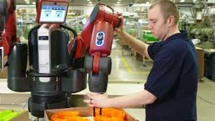
Collaborative Robots (1)
Notes:
This shows a picture of a collaborative robot.

Slide 23
Collaborative Robots (2)
Safety Monitored Stop
  Contact Stops
Hand Guiding
  Push Back
Speed and Separation Monitoring
  Visual Recognition
Power and Force Limiting
Notes:
Safety monitored stop – the robot stops before the operator enters the collaborative workspace.
Hand guiding – the robot allows a limited amount of its motion control to be released allowing the operator to manually move the robot to various positions.
Speed and separation monitoring – maintains a certain minimum separation distance during operation. Contact between a moving robot and operator is prevented by limiting robot speed and maintaining an adequate separation distance.
Power and force limiting – robots designed with limited power and force to prevent or reduce injury or damage if contact occurs.

Slide 24
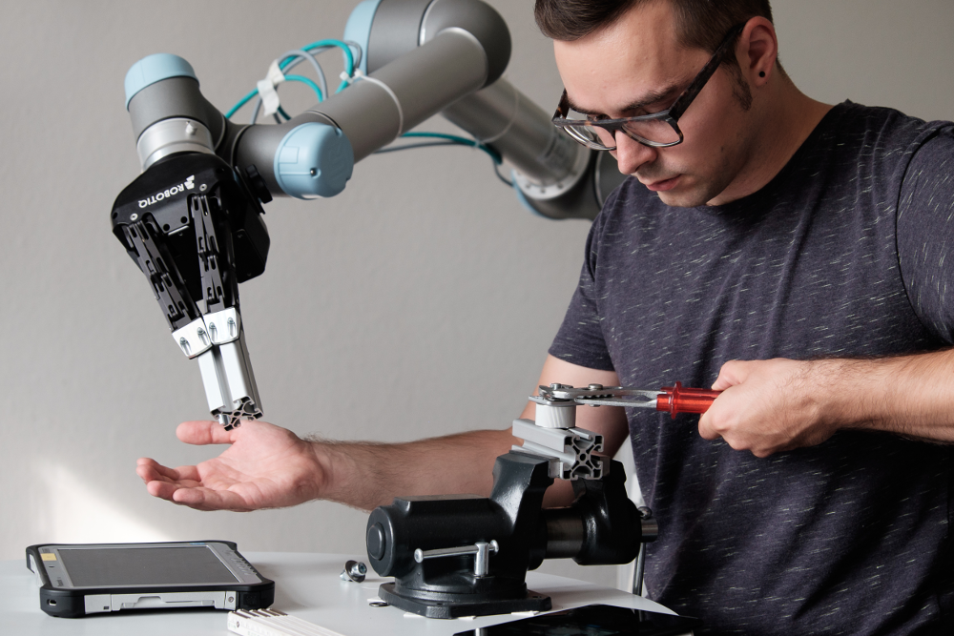
COLLABORATIVE ROBOTS (3)
RIA TR R15.606-2016 – Technical Report for Industrial Robots and Robot Systems – Collaborative Robots
ISO/TS 15066 – Technical Specification – Robots and Robotic Devices – Collaborative Robots
Notes:
Resources:
RIA TR R15.606-2016 – Technical Report for Industrial Robots and Robot Systems – Collaborative Robots
https://www.robotics.org/bookstore-prod.cfm?category_id=118&product_id=441
ISO/TS 15066 – Technical Specification – Robots and Robotic Devices – Collaborative Robots
https://www.iso.org/standard/62996.html

Slide 25
QUESTIONS?
Notes:
Any questions?

