Slide 1
Introduction to Industrial Hygiene
10-hour General Industry Outreach Training

Slide 2

Introduction
Health hazards on the job site
Protect yourself; protect your family
Source: OSHA

Slide 3
Introduction
Lesson objectives:
Identify types of health hazards in the workplace.
Describe strategies to control chemical hazards.
Describe strategies to control biological hazards.
Describe strategies to control physical hazards.
Describe strategies to control ergonomic hazards.

Slide 4

Introduction
Industrial Hygiene – the science of protecting the health and safety of workers through:
Anticipation,
Recognition,
Evaluation, and
Control
…of workplace conditions that may cause workers’ injury or illness.
Source: OSHA

Slide 5
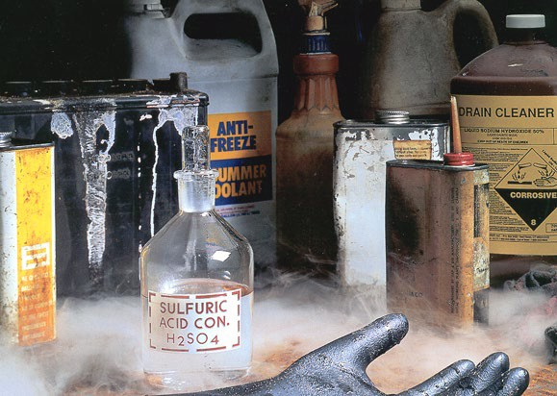
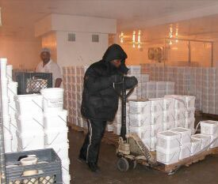
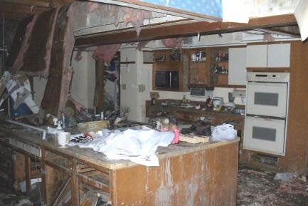
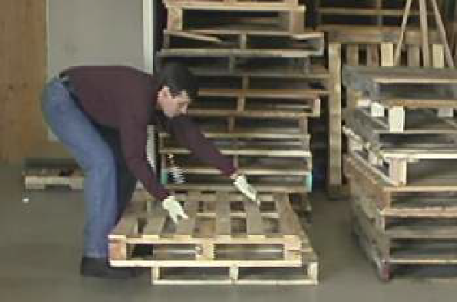
Types of Health Hazards
Common workplace health hazards:
Chemical Physical
Biological
Ergonomic
Source of photos: OSHA

Slide 6
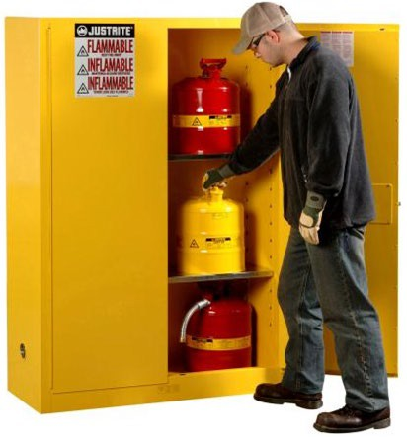
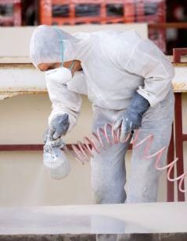
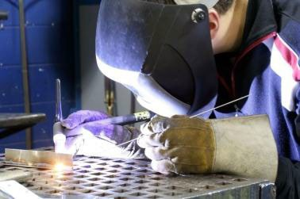
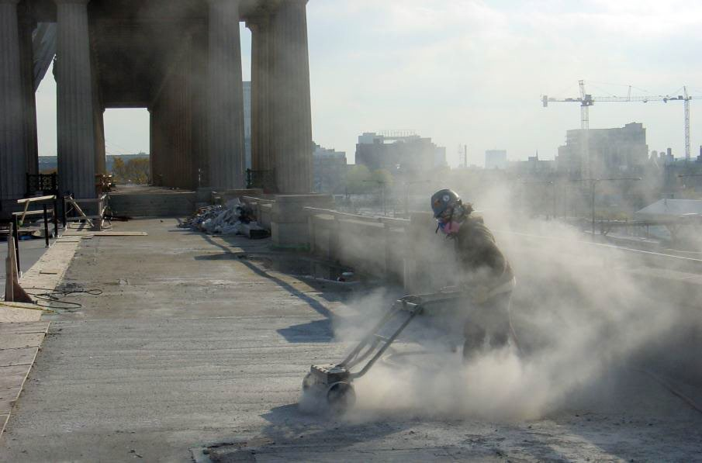
Chemical Hazards and Controls
Forms
Solids
Liquids
Gases and vapors
Multiple chemical hazards
Aerosols - dust, mist, fumes
Spraying mist
Welding fumes
Dust particulates
Source of photos: OSHA

Slide 7
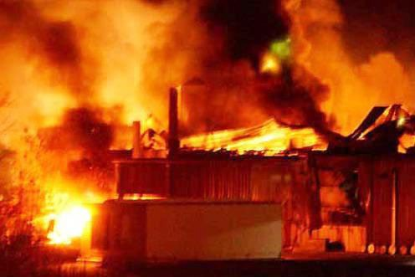
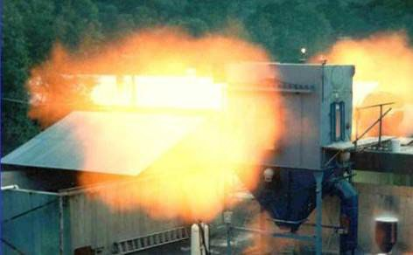
Chemical Hazards and Controls
Effects of chemical exposures:
Health Risks
Heart Ailments | Lung Damage | Sterility
CNS Damage | Kidney Damage | Burns
Cancer | Liver Damage | Rashes
Safety Risks
Fire | Explosion | Corrosion
Source of photos: OSHA

Slide 8
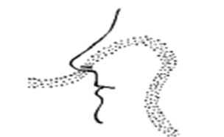
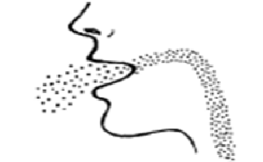

Chemical Hazards and Controls
Exposure entry routes:
Inhalation:
Breathed in
(most common route)
Ingestion:
Swallowing via eating or drinking
Absorption:
Drawn through skin or eye surface
Source of graphics: OSHA
*Injection:
Penetration through the skin

Slide 9
Chemical Hazards and Controls
Warning Signs of Potential Chemical Exposure:
Dust, mist, smoke in the air
Accumulation of particulates (dust) on surfaces
Unusual tastes and/or smells
Eye, nose, throat, upper respiratory, and/or skin irritation

Slide 10
Chemical Hazards and Controls
Examples of chemical exposure symptoms:
Eye, nose, throat, upper respiratory, skin irritation
Flu-like symptoms
Difficulty breathing
Fatigue
Loss of coordination
Memory difficulties
Sleeplessness
Mental confusion

Slide 11
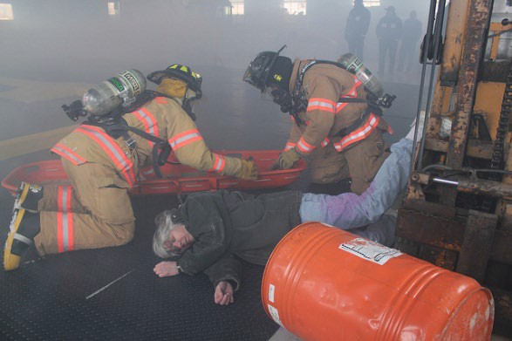
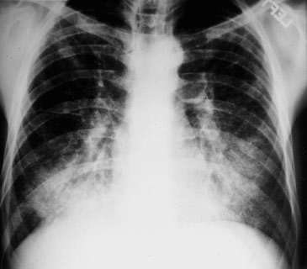
Chemical Hazards and Controls
Types of health effects:
Exposure Condition |  | Exposure | Example
ACUTE | Immediate | Short-term, high concentration | H₂S exposure within a confined space
CHRONIC | Delayed; generally for years | Continuous; for long periods of time | Asbestosis
Acute
Chronic
Source: U.S. Army Corps of Engineers
Source: OSHA

Slide 12



Chemical Hazards and Controls
What is toxicology?
The science that studies the poisonous or toxic properties of substances
Source of graphics: OSHA Hazard Communication Pictograms

Slide 13
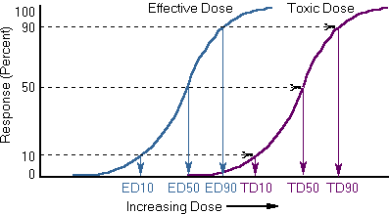
Chemical Hazards and Controls
Toxic effects:
Dose
  Concentration – amount
  Duration of Exposure – time
Source: OSHA

Slide 14
Chemical Hazards and Controls
Toxic chemicals disrupt the normal functions of the body. Effects can be:
  Local - at the site of exposure
  Systemic
    Affects the entire body
    Target organs - organs or systems where symptoms of exposure appear

Slide 15
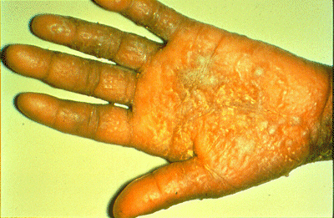
Chemical Hazards and Controls
Local (direct) effects:
Irritation (dryness, redness, cracking) - fiberglass
Corrosion (chemical burn) - acid
Upper Respiratory Track Infection – inhaling particles
Source: Occupational Dermatoses (CDC)

Slide 16
Chemical Hazards and Controls
Systemic effects:
Hepatotoxins
  Cause liver damage
  Carbon tetrachloride, nitrosamines
Nephrotoxins
  Cause kidney damage
  Uranium, halogenated hydrocarbons
Neurotoxins
  Cause nerve damage
  Mercury, lead, carbon disulfide

Slide 17
Chemical Hazards and Controls
Hematotoxins
  Cause blood system damage
  Carbon monoxide, cyanides
Anesthetics
  Depress nervous system
  Hydrocarbons, propane, isopropyl ethers

Slide 18
Chemical Hazards and Controls
Factors affecting exposures:
form and innate chemical activity
dosage, especially dose-time relationship
exposure route
age
sex
ability of chemical to be absorbed
metabolism
distribution within the body
excretion
presence of other chemicals

Slide 19
Chemical Hazards and Controls
Interactions with multiple chemicals:
Additive effects 2 + 2 = 4
Synergistic effects 2 + 3 > 5
Potentiation effects 2 + 0 > 2
Antagonistic effects 4 + 6 < 10

Slide 20
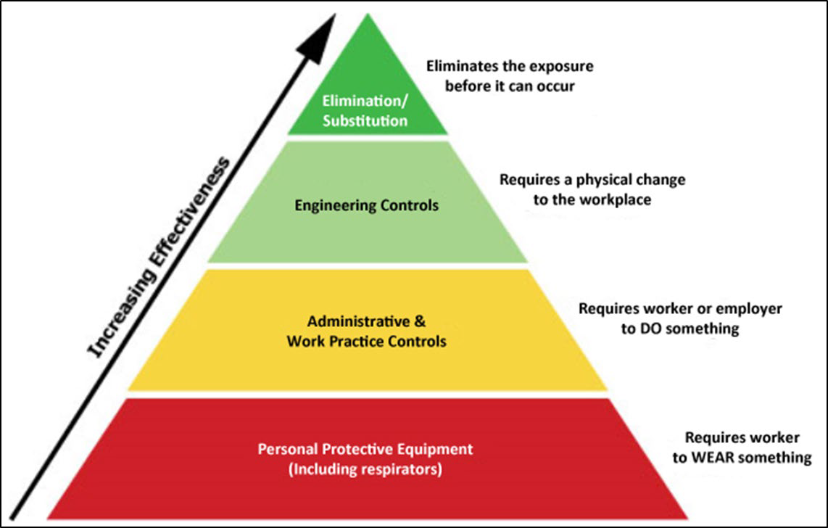
Chemical Hazards and Controls
Hierarchy of control:
Source: OSHA

Slide 21

Chemical Hazards and Controls
Elimination and substitution
Source: OSHA

Slide 22
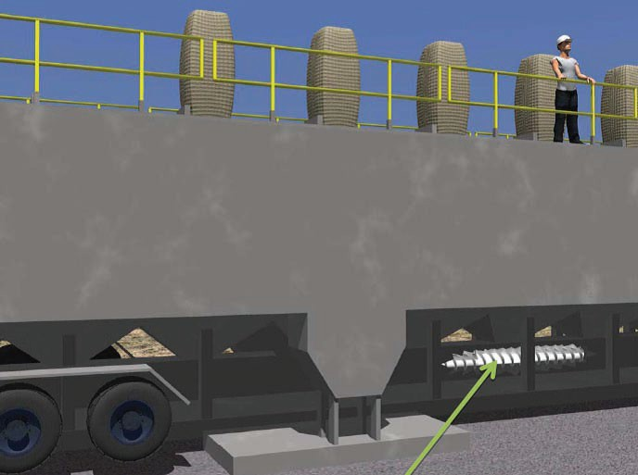
Chemical Hazards and Controls
Engineering controls
  Ventilation – local (hood) / general (dilution)
  Process and equipment modification
  Isolation/automation
Example: Replacing transfer belts with screw augers on sand movers used in hydraulic fracturing will help contain sand and reduce dust release (lowering exposure to silica).
Source: NIOSH

Slide 23
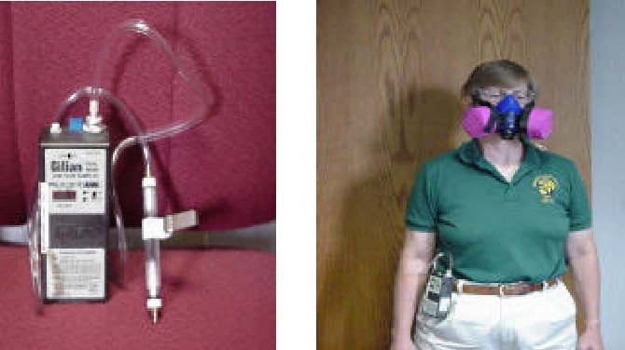
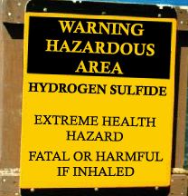
Chemical Hazards and Controls
Administrative controls
  Establish written programs & policies
  Training
  Monitor/measure exposure levels
  Inspections and maintenance
  Restricted area signage
  Develop SOPs
Source of photos: OSHA

Slide 24
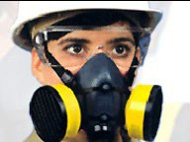
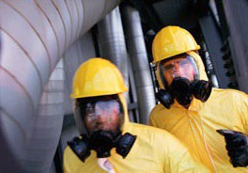
Chemical Hazards and Controls
PPE
  Respirators
  Gloves
  Safety glasses
  Long clothing
Source of photos: OSHA

Slide 25
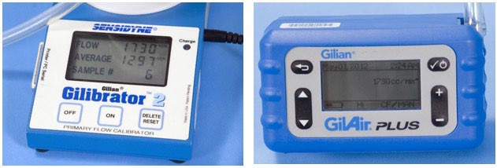
Chemical Hazards and Controls
Worksite analysis – assessing exposures:
Air monitoring – personal and area
Noise monitoring
Observation – PPE use and work practices
Ventilation measurements
Wipe samples – surfaces and personnel
Source: OSHA

Slide 26
Chemical Hazards and Controls
PELs, or permissible exposure limits:
  OSHA’s regulations that establish the acceptable amount or concentration of a substance in the workplace
  Intended to protect workers from adverse health effects related to hazardous chemical exposure

Slide 27
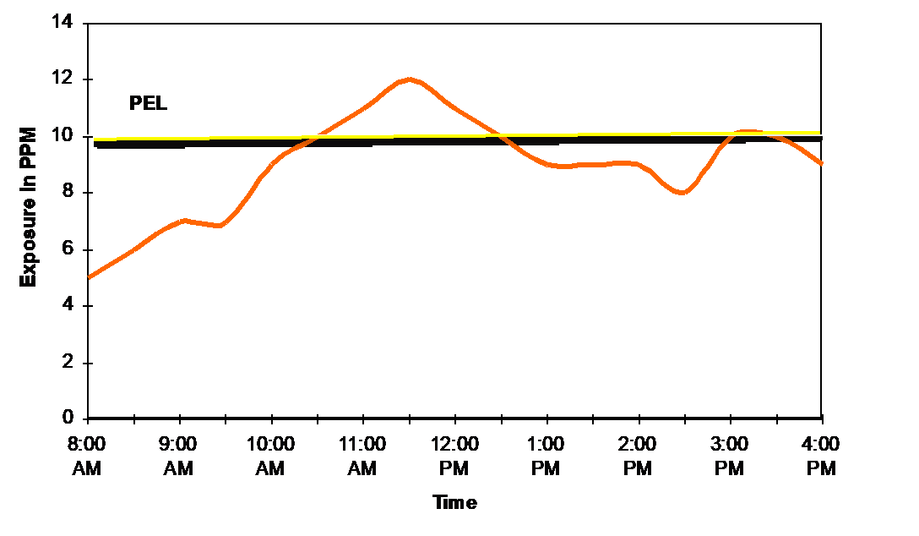
Chemical Hazards and Controls
Exposure limits:
TWA = Time - Weighted Average
Levels vary over the shift duration
These limits protect from chronic diseases

Slide 28
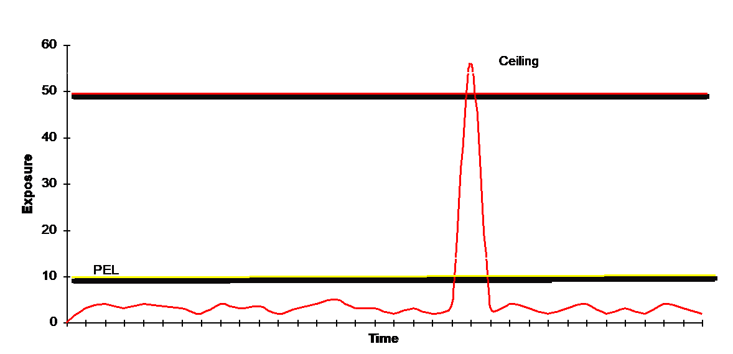
Chemical Hazards and Controls
“C” = ceiling limit:
Level never to be exceeded during the work shift
Protect from acute disease or health effects

Slide 29
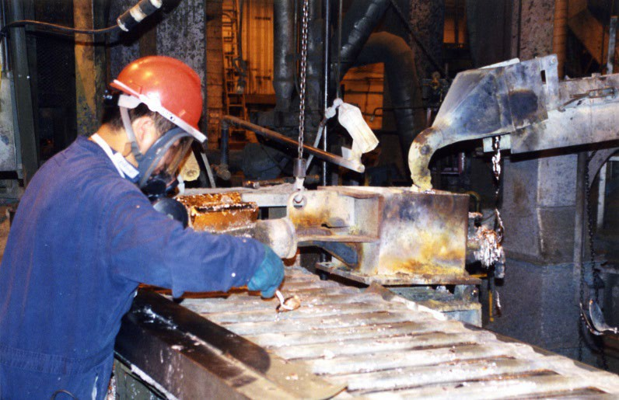
Chemical Hazards and Controls
Substance-specific standards:
Established by OSHA to identify specific requirements
Potentially exposed workers must be monitored and protected
Source: NIOSH

Slide 30
Chemical Hazards and Controls
Components of substance specific standards: (in general)
  Air monitoring
  Control of exposure
    Engineering controls
    Work practices
    Respiratory protection
  Medical surveillance / removal (lead)
  Recordkeeping
  Worker training

Slide 31
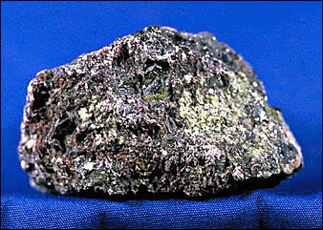
Chemical Hazards and Controls
Hexavalent chromium:
Toxic form of chromium;
Known to cause cancer
Compounds are man-made and widely used
Major source of exposure during “hotwork” on stainless steel and other alloy steels containing Cr(VI)
Source: OSHA

Slide 32
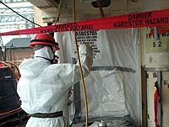
Chemical Hazards and Controls
Asbestos:
Mineral fibers – chrysotile, amosie, crocidolite, tremolite, anthophylite, actinolite, and chemically treated/ altered forms
Known carcinogen;
Source: OSHA
can cause chronic lung disease, as well as lung and other cancers
Used in numerous building materials and vehicle products
Exposure potential during construction and ship repair; as well as manufacturing of products containing asbestos

Slide 33
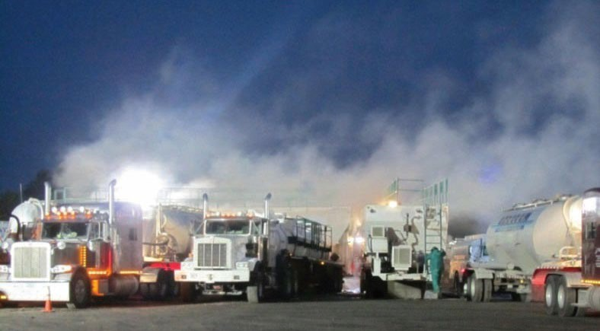
Chemical Hazards and Controls
Silica:
Important industrial material found abundantly in the earth’s crust; most common form is quartz
Can cause lung diseases, including silicosis and lung cancer, as well as kidney disease
Exposure to respirable crystalline silica
  Inhalation of small particles in air
  Common with operations such as cutting, sawing, and drilling
Source: NIOSH

Slide 34
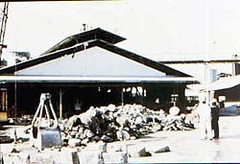
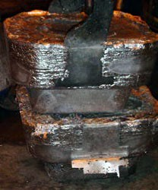
Chemical Hazards and Controls
Lead:
Blue-gray, heavy metal occurring naturally in Earth’s crust
Can harm many of the body’s organ systems; variety of ailments
Exposure
– Inhalation and/or ingestion of airborne particles containing lead
– Occurs in most industry sectors, including manufacturing, wholesale trade, transportation, construction, remediation, and even recreation
Source of photos: OSHA

Slide 35
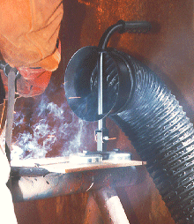
Chemical Hazards and Controls
Welding fumes:
Content depends on components of base metal, coatings, and/or filler materials; and welding temperatures
Potential health effects
– Acute exposure: eye, nose, and throat irritation; dizziness; nausea
Source: OSHA
Prolonged exposure: lung damage; various types of cancer, including lung, larynx, and urinary tract
Certain fumes and gases can lead to additional health issues

Slide 36
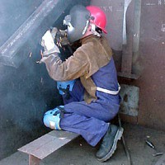
Chemical Hazards and Controls
Exposure to welding fumes affected by:
  Welding process
  Materials used
  Location (outside, enclosed space)
  Work practices
  Air movement
  Use of ventilation
Source: OSHA

Slide 37
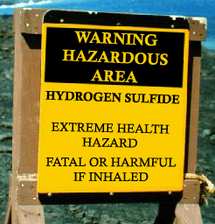
Chemical Hazards and Controls
Toxic atmospheres:
Confined spaces – storage tanks, process vessels, bins, boilers, ventilation or exhaust ducts, sewers, underground utility vaults, tunnels, pipelines, open-top spaces more than 4’ in depth (pits, tubs, vaults)
Hazardous atmospheres
  Oxygen-deficient
  Hydrogen sulfide
  Carbon monoxide
Source: OSHA

Slide 38
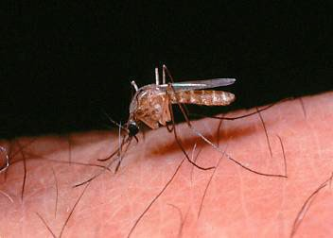
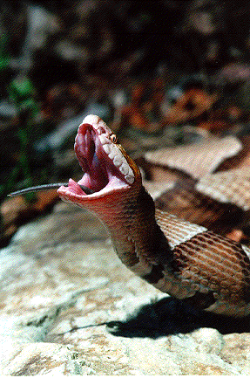
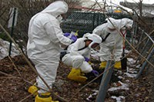



Biological Hazards and Controls
Insects Animals
Contaminated Soil
Source: OSHA
Source: OSHA
Source: CDC
Poisonous Plants
Water/Sewage
Bloodborne Pathogens
Source: OSHA
Source: OSHA
Source: OSHA

Slide 39
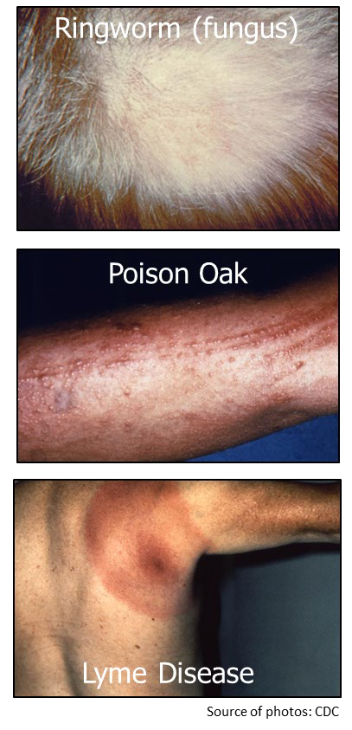
Biological Hazards and Controls
Possible effects of exposure to biological hazards:
Mild, allergic reactions
Serious medical conditions
Death
Most virulent and prevalent biological agents

Slide 40


Biological Hazards and Controls
Protection against biological hazards:
Practice universal precaution with:
  Blood
  Bodily fluids
Practice personal hygiene
Provide proper first aid
  Cuts/Scratches
Vaccinations
Wear proper PPE/clothing
Source of photos: OSHA

Slide 41


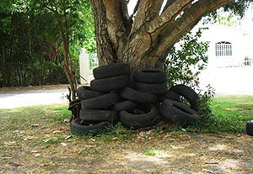
Biological Hazards and Controls
Practice precaution with:
  Animals
  Insects
Use insect repellent
Provide proper ventilation or other appropriate environmental controls
Certain species of fruit bats are thought to be the natural reservoir for Ebola virus. EHF outbreaks are believed to start as a result of contact with infected animals or animal carcasses.
Source: OSHA; photo courtesy of National Park Service, U.S. Dept. of Interior.
The best way to protect yourself from Zika, as well as other mosquito-borne illnesses, is to prevent mosquito bites by using insect repellent, wearing long sleeves and pants, and reducing mosquito breeding grounds, such as standing water. Source: OSHA; photos courtesy of CDC.

Slide 42




Physical Hazards and Controls
Types of physical hazards:
Temperature
Vibration
Radiation
Noise
Source of photos: OSHA

Slide 43
Physical Hazards and Controls
Effects of exposure to physical hazards:
Temperature | Radiation | Vibration | Noise
Rash; Cramps | Burns | Fatigue | Interferences
Exhaustion | Sickness | Strains | Stress
Stroke | Aging | Carpal Tunnel | Tinnitus
Hypothermia | Cancer | HAVS | Headaches
Frostbite | DNA Mutations | Raynaud’s | Hearing Loss

Slide 44
Physical Hazards and Controls
Exposure to heat:
Health Effects | Cause | Symptoms
Rash; Cramps | Heavy sweating | Red cluster of bumps/blisters; Muscle pains or spasms
Exhaustion | Loss of body fluids/salts | Dizziness, light-headedness, weakness, heavy sweating, pale skin, sick to stomach
Stroke | Rapid body temperature rise | ≥104F body temperature. Red, hot, dry skin; dizziness; confusion; unconscious

Slide 45
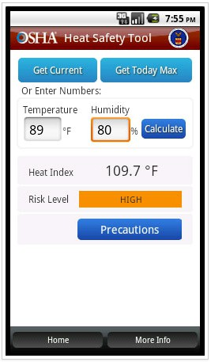
Physical Hazards and Controls
OSHA’s Heat Safety Tool
Heat Index App

Slide 46
Physical Hazards and Controls
Protection against heat:
Engineering | Administrative | PPE
Air conditioning Ventilation Cooling fans Local exhaust ventilation Reflective shields Insulation Eliminate steam leaks | Emergency plan Acclimatization Adequate water Work/rest cycles Avoid hottest times; adjust work demands Rotate job functions Buddy system Monitoring | Insulated PPE, in some work places Thermal clothing (cool vests)
Eliminate or substitute hazard, whenever feasible

Slide 47
Physical Hazards and Controls
Exposure to cold:
Health Effects | Cause | Symptoms
Hypothermia | Body temperature drops ≤95F | Uncontrolled shivering; slurred speech; memory loss; blue/purple skin
Frostbite | Exposed to ≤0F air | Pale, cold, waxy-white skin; tingling; stinging

Slide 48
Physical Hazards and Controls
Protection against cold:
Engineering | Administrative | PPE
Heaters Shield work areas (windbreaks) | Warm liquids Adjust work schedule Buddy system Monitoring Frequent breaks in warm areas Acclimatization | Layered clothing Hat or hood, face cover, gloves Clothing out of fabric that retains insulation even when wet Insulated and waterproof boots
Eliminate or substitute hazard, whenever feasible

Slide 49
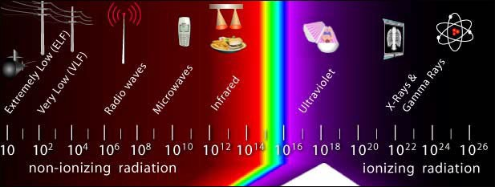
Physical Hazards and Controls
Exposure to radiation:
Source: OSHA

Slide 50
Physical Hazards and Controls
Protection against radiation:
Engineering | Administrative | PPE
Enclose/Shield work areas to minimize stray radiation Interlocked doors on devices that can produce acute thermal injuries Remote operation of radiation-producing devices | Clearly mark controlled spaces Minimize exposure times Location/ installation of devices Proper maintenance | RF/MW protective suits, including head and eye protection Safety glasses, goggles, welding helmets, or welding face shields with appropriate filter lenses
Eliminate or substitute hazard, whenever feasible

Slide 51
Physical Hazards and Controls
Exposure to vibration:
Health Effects | Early Signs and Symptoms | Later Signs and Symptoms
Circulatory disturbances, such as VWF and HAVS Sensory nerve damage Muscle, bone, and joint injury | Intermittent tingling of one or more fingers Blanching of fingertips Pain in fingers | Loss of sense of touch; numbness Blanching of entire fingers Loss of grip strength Sever pain Carpal tunnel syndrome Pain and loss of strength in arms Loss of finger dexterity or coordination

Slide 52
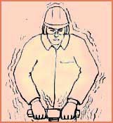
Physical Hazards and Controls
Protection against vibration:
Engineering | Administrative | PPE
Vibration reduction equipment Vibration dampeners or shields to isolate source of vibration from employee | Proper positioning and grip; let the machine do the work Job rotation Limit duration of task Proper maintenance | Anti-vibration gloves
Eliminate or substitute hazard, whenever feasible

Slide 53
Physical Hazards and Controls
Exposure to noise:
Health Effects | Signs and Symptoms
Tinnitus Permanent hearing loss Physical stress Psychological stress | Ears feel stuffed up Ringing in the ears Limited ability to hear high frequency sounds, understand speech, and communicate

Slide 54
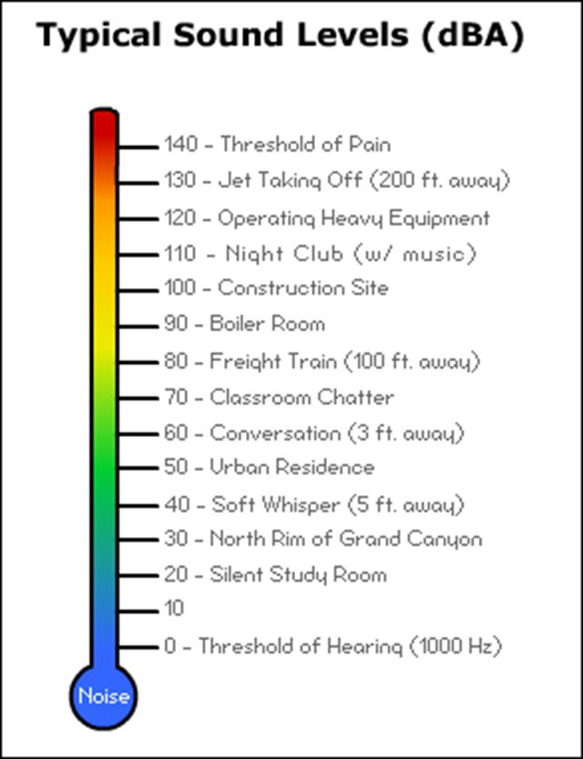
Physical Hazards and Controls
Noise – prolonged exposures to
85 dB can lead to hearing loss
Source: OSHA

Slide 55
Physical Hazards and Controls
Protection against noise:
Engineering | Administrative | PPE
Use low-noise tools and machinery Place a barrier between noise source and worker Enclose or isolate noise Weld parts rather than rivet Use acoustical materials Install silencers, mufflers, or baffles | Increase distance between source and worker Alter work schedule Limit time of noise exposure Provide quiet areas for breaks | Ear plugs Ear muffs Hearing bands
Eliminate or substitute hazard, whenever feasible

Slide 56


Physical Hazards and Controls
When to wear hearing protection
  Noise or sound level exceeds 90 dBA (OSHA)
  Recommended when exceeds 85 dBA (NIOSH)
What to wear
  Personal comfort preference
  Long-term/Single use (plugs)
  Short-term/On and off (muffs)
  Consider NRR
Source of photos: OSHA
56
Created by OTIEC Outreach Resources Workgroup

Slide 57

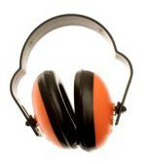
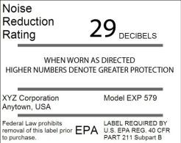
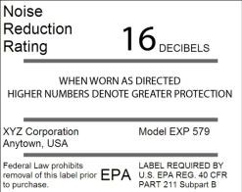
Physical Hazards and Controls
Dual hearing protection:
Formable Ear Plugs Listed NRR = 29
Adjusted NRR (29 – 7) = 22
Earmuffs Listed NRR = 16
Adjusted NRR for Dual Protection = 5
22 (adjusted NRR) + 5 (Dual Protection NRR) = 27
Source of graphics: OSHA
57
57
Created by OTIEC Outreach Resources Workgroup

Slide 58
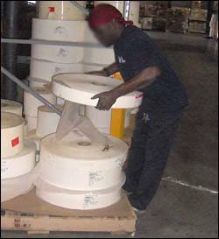
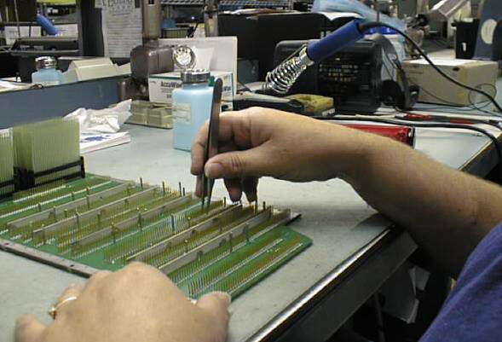

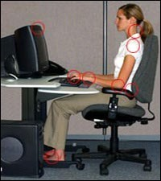


Ergonomic Hazards and Controls
Source of photos: OSHA

Slide 59
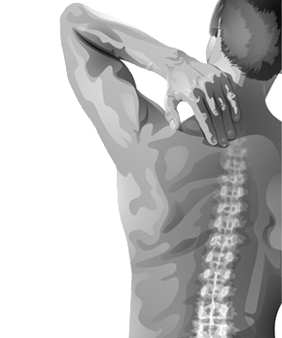
Ergonomic Hazards and Controls
Effects of exposure to ergonomic hazards:
Musculoskeletal Disorders (MSDs)
  Exposure to ergonomic risk factors for MSDs increases a worker's risk of injury
    Repetition
    High force
    Awkward postures
  Work-related MSDs are among the most frequently reported causes of lost or restricted work time.
Source: OSHA

Slide 60



Ergonomic Hazards and Controls
Risk factors for MSDs:
Overexertion
Repetitive tasks
Awkward posture/positions
Localized pressure
Cold temperatures
Vibration
Combined exposure
Source of photos: OSHA

Slide 61

Ergonomic Hazards and Controls
Protection against ergonomic hazards:
Use ergonomically designed tools
Use correct work practices
  Proper lifting techniques
Ask for help when handling:
  Heavy loads
  Bulky/Awkward materials
Properly fitting PPE
Source: NIOSH

Slide 62
Discussion
What are examples of health hazards at your worksite?
How are they controlled?

Slide 63
Knowledge Check
Which of the following is an example of an industrial hygiene health hazard?
  Chemical hazards
  Economic hazards
  Electrical hazards
  Fall hazards
Answer: a. Chemical hazards

Slide 64
Knowledge Check
Which of the following is an example of a physical health hazard?
  Asbestos
  Noise
  Silica
  Lead
Answer: b. Noise

Slide 65
Knowledge Check
Which of the following controls is an example of an engineering control for protection against chemicals?
  Ventilation
  Respirators
  Training
  Signage
Answer: a. Ventilation

Slide 66
What questions do you have?
Thank You!

