Slide 1
Hazardous Materials
OSHA 10-hour Outreach Training General Industry

Slide 2
Introduction
Lesson objectives:
Identify types of hazardous materials and how exposures can occur.
Identify hazards associated with hazardous materials, including injuries that may occur.
Describe methods for eliminating physical hazards of hazardous materials.
Describe methods for eliminating health hazards of hazardous materials.

Slide 3

What’s in it for you?
Source: Construction Safety Council, used with permission.

Slide 4
Exposure to Hazardous Materials
What are hazardous materials?
Group of products for which the storage, handling, and use are regulated under the Hazardous Materials standard
Primarily associated with physical hazard
May also pose health hazard

Slide 5
Exposure to Hazardous Materials
Examples of worksite exposure:
Operations involving the storage, handling, and/or use of:
  Compressed gases
    Liquefied gases – anhydrous ammonia, chlorine, propane, nitrous oxide, and carbon dioxide
    Non-liquefied gases – oxygen, nitrogen, helium, and argon
    Dissolved gases - acetylene

Slide 6
Exposure to Hazardous Materials
Flammable liquids
  Category 1 – ethyl ether, isopentane, propylene oxide
  Category 2 – acetone, benzene, ethyl alcohol, gasoline isopropyl alcohol, toluene
  Category 3 – naphtha, turpentine, xylene
  Category 4 – ethylene glycol, glycerine
Cryogenics and refrigerated liquids – oxygen, nitrogen, argon, hydrogen, helium LNG, Liquid methane, carbon monoxide
Liquefied petroleum gases (LPGs) – propane, propylene, butane, and butylene
Explosives and blasting agents

Slide 7
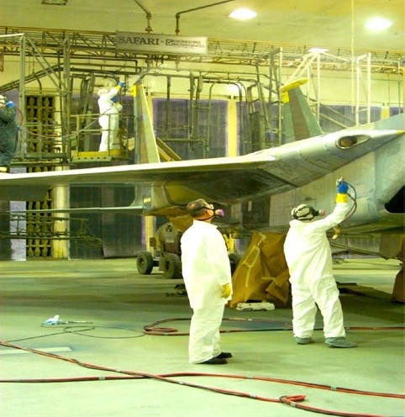
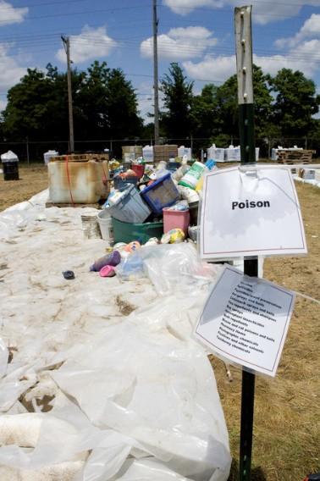
Exposure to Hazardous Materials
Spray finishing operations
Dipping and coating operations
Processing of highly hazardous chemicals
Clean-up and management of hazardous waste operations and emergency response
Source: OSHA; courtesy of U.S. Air Force
Source: FEMA; S. Shapira

Slide 8
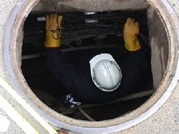
Exposure to Hazardous Materials
Additional precautions for hazard exposures:
Hazardous (classified) locations
Confined spaces
Source: OSHA

Slide 9
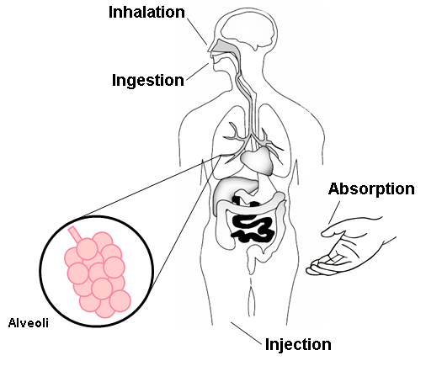
Exposure to Hazardous Materials
Routes of entry:
Inhalation*
Ingestion
Absorption
Injection
* Most Common
Source: Construction Safety Council, used with permission.

Slide 10





Hazards of Hazardous Materials
Types of physical hazards associated with hazardous materials:
Oxidizer
Flammable
Explosion
Corrosive to metal
High-pressure systems
Source of pictograms: OSHA

Slide 11




Hazards of Hazardous Materials
Types of health hazards associated with hazardous materials:
Acute/chronic toxicity
Skin corrosion or irritation
Aspiration hazard
Serious eye damage
Germ cell mutagenicity
Carcinogenicity
Reproductive toxicity
Specific target organ toxicity
or eye irritation
Respiratory or skin sensitization
Source of pictograms: OSHA

Slide 12

Hazards of Hazardous Materials
Compressed gases:
Oxygen displacement
Fires
Explosion
Toxic gas exposures
Physical hazards associated with high pressure systems
Source: OSHA

Slide 13
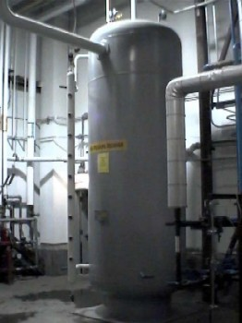
Hazards of Hazardous Materials
Cryogenic and refrigerated liquids:
Extreme cold
Extreme pressure
Asphyxiation
Fire or explosion
Source: OSHA

Slide 14
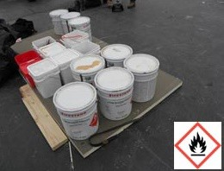
Hazards of Hazardous Materials
Flammable liquids:
Fire
Explosion
Source: OSHA
Criteria for Flammable Liquids
Category | Criteria
1 | Flashpoint < 73.4°F and initial boiling point ≤ 95°F
2 | Flashpoint < 73.4°F and initial boiling point > 95°F
3 | Flashpoint ≥ 73.4°F and ≤ 140°F
4 | Flashpoint > 140°F and ≤ 199.4°F
29 CFR 1910.1200
Appendix B, B.6.2

Slide 15


Hazards of Hazardous Materials
Spray finishing:
Flammable/combustible materials
Health hazards
Example: Isocyanates
  Powerful irritant to eyes and gastrointestinal and respiratory tracts
  Inflammation to skin
Source of photos: NIOSH

Slide 16



Hazards of Hazardous Materials
Liquefied petroleum gases (LPG):
Pictograms:
Signal word: Danger
Hazard statements:
  Extremely flammable gas.
  Contains gas under pressure; may explode if heated.
May cause frostbite.
May form explosive mixtures in air.
May displace oxygen and cause rapid suffocation.
Source: OSHA

Slide 17
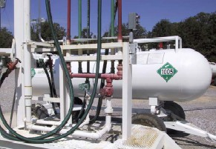




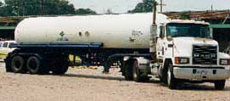
Hazards of Hazardous Materials
Anhydrous ammonia:
Pictograms:
Signal word: Danger
Hazard statements
  Flammable Gas
  Contains gas under pressure
  May explode if heated
  Toxic if inhaled
Causes severe skin burns and eye damage
Corrosive to respiratory tract
Source of photos: OSHA

Slide 18
Hazards of Hazardous Materials
Hazardous (classified) locations:
Class I – flammable gases or vapors
  Division 1
  Division 2
Class II – combustible dust
  Division 1
  Division 2
Class III – ignitable fibers or flyings

Slide 19
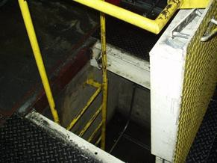
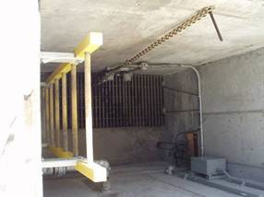
Hazards of Hazardous Materials
Confined spaces:
Limited or restricted means for entry/exit; not designed for continuous occupancy
PRCS contains or has potential to contain hazardous atmospheres
Source of photos: OSHA

Slide 20
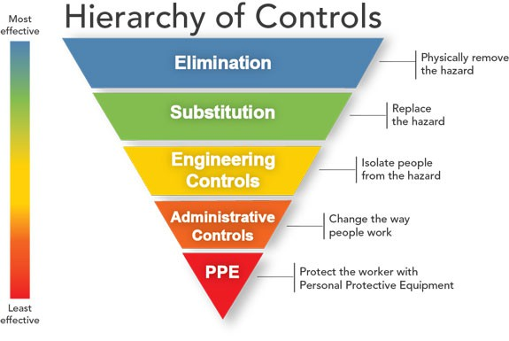
Controlling Physical Hazards
Source: NIOSH

Slide 21

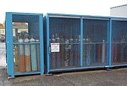
Controlling Physical Hazards
Compressed gases:
Compressed gas cylinders shall be in a safe condition to the extent that this can be determined by visual inspection.
Source of graphics: OSHA

Slide 22
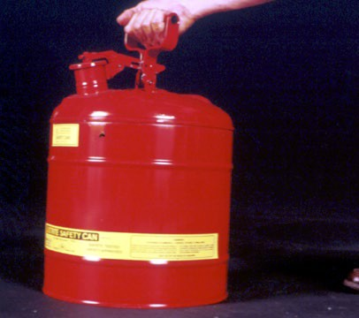
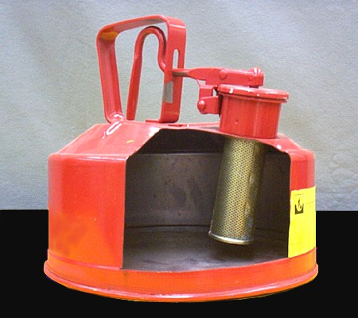
Controlling Physical Hazards
Safety can:
Not more than
5 gallons capacity
Spring-closing lid
Designed to relieve internal pressure when subjected to fire.
Source of photos: OSHA

Slide 23
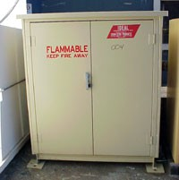

Controlling Physical Hazards
Cabinets:
Not more than 60 gallons of Category 1, 2, or 3 flammable liquids, nor more than 120 gallons of
Category 4 flammable liquids.
Suitable fire control devices shall be available at locations where flammable liquids are stored.
Source of photos: OSHA

Slide 24
Controlling Physical Hazards
Ventilation:
Category 1 or 2 flammable liquids, or Category 3 flammable liquids with a flashpoint below 100 °F (37.8 °C), shall be ventilated at a rate of not less than 1 cubic foot per minute per square foot of solid floor area.

Slide 25
Controlling Physical Hazards
Explosion-proof apparatus:
Apparatus enclosed in a case that is capable of withstanding an explosion of a specified gas or vapor that may occur within it and of preventing the ignition of a specified gas or vapor surrounding the enclosure by sparks, flashes or explosion of the gas or vapor within, and that operates at such an external temperature that it will not ignite a surrounding flammable atmosphere.

Slide 26
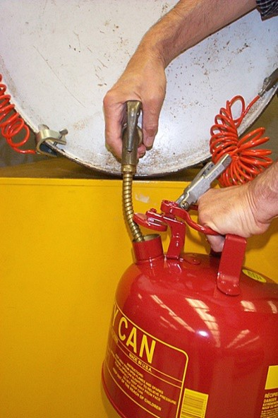


Controlling Physical Hazards
Grounding:
Category 1 or 2 flammable liquids, or Category 3 flammable liquids with a flashpoint below 100 °F (37.8 °C), shall not be dispensed into containers unless the nozzle and container are electrically interconnected.
Source of graphics: OSHA

Slide 27
Controlling Physical Hazards
Intrinsically safe:
An apparatus/equipment in which all the circuits in which any spark or thermal effect is incapable of causing ignition of a mixture of flammable or combustible material in air.

Slide 28
Controlling Health Hazards
Source: NIOSH

Slide 29

Controlling Health Hazards
Source: OSHA

Slide 30
Controlling Health Hazards
Source: NIOSH

Slide 31
Controlling Health Hazards
Source: NIOSH

Slide 32
Controlling Health Hazards
Source: NIOSH

Slide 33
Controlling Health Hazards
Process Safety Management (PSM) of highly hazardous chemicals:
Regulations designed to prevent the release of toxic, reactive, flammable and/or explosive chemicals.
Contains a list and threshold limits for when employers must comply.
  Anhydrous Ammonia - 10,000 lbs
  Chlorine - 1,500 lbs

Slide 34
Controlling Health Hazards
Hazardous Waste Operations and Emergency Response (HAZWOPER):
Applies to employers and their employees who are exposed to hazardous substances and who are engaged in several operations including clean-up, treatment, storage and disposal of hazardous waste.

Slide 35
Hazardous Materials Worksheet
Complete the Worksheet

Slide 36
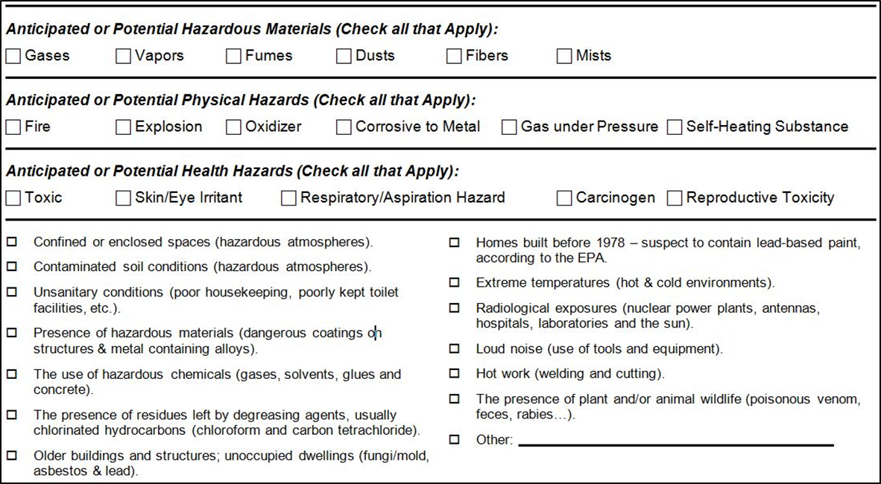
Hazardous Materials Worksheet
Hazard Anticipation
Source: Construction Safety Council, used with permission.

Slide 37
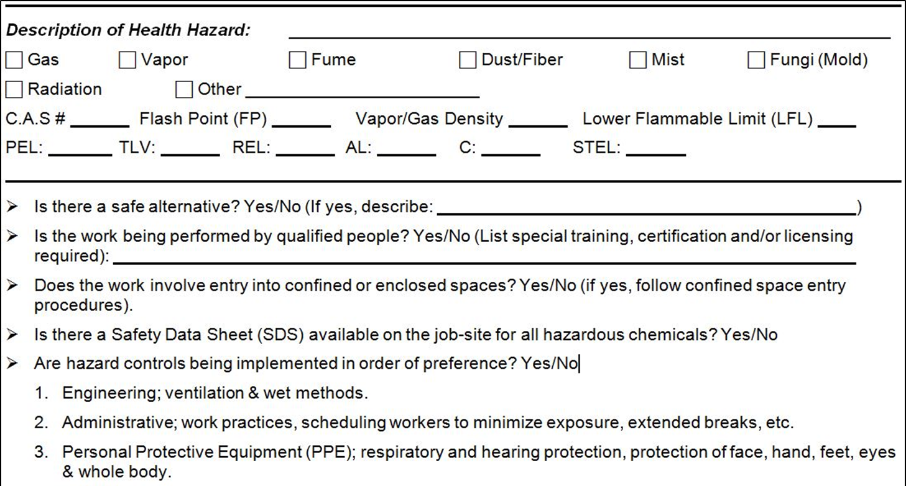
Hazardous Materials Worksheet
Hazards Identification
Source: Construction Safety Council, used with permission.

Slide 38
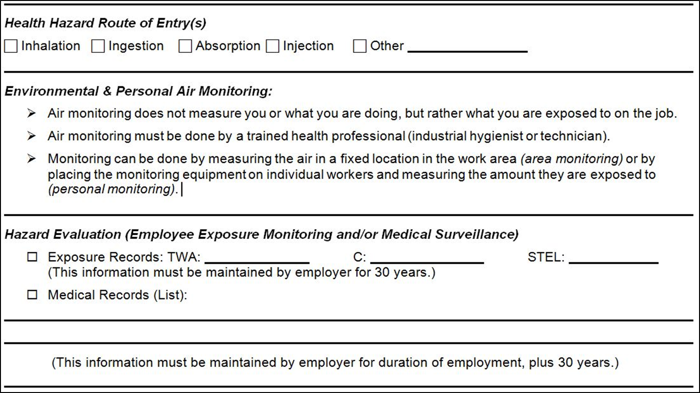
Hazardous Materials Worksheet
Hazards Evaluation
Source: Construction Safety Council, used with permission.

Slide 39
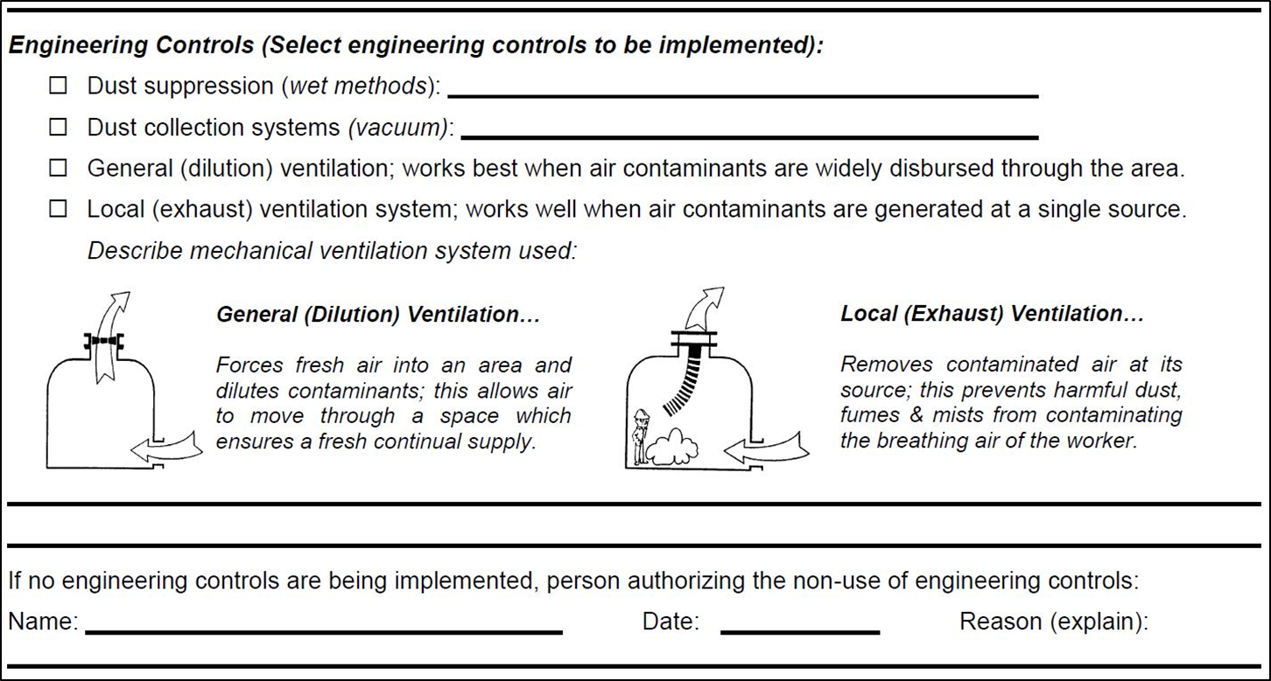
Hazardous Materials Worksheet
Hazards Controls - Engineering
Source: Construction Safety Council, used with permission.

Slide 40
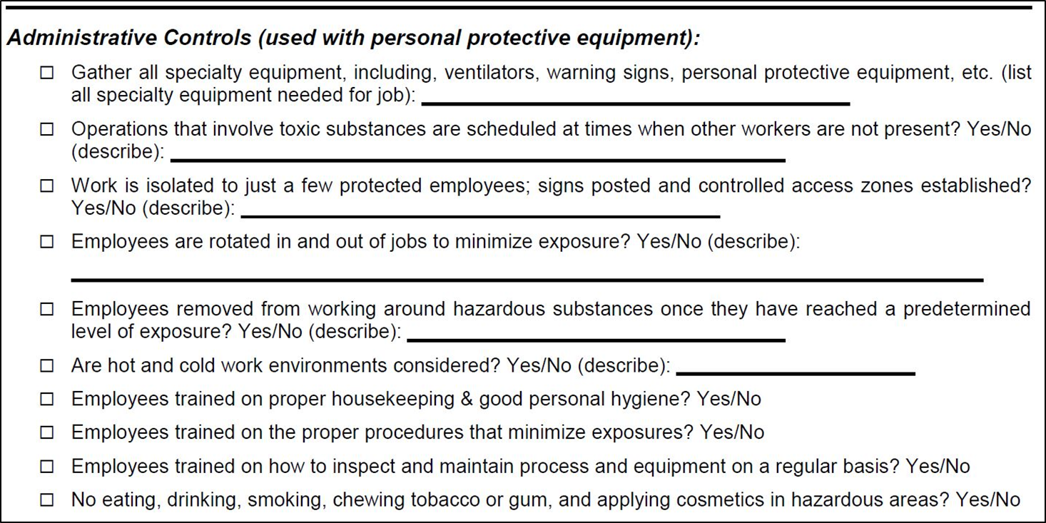
Hazardous Materials Worksheet
Hazards Controls - Administrative
Source: Construction Safety Council, used with permission.

Slide 41
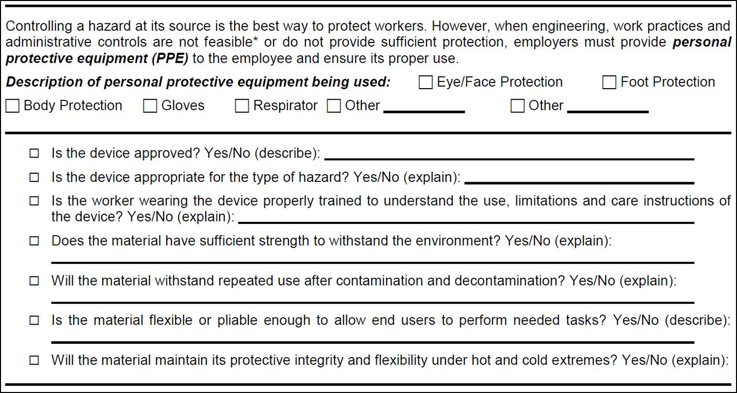
Hazardous Materials Worksheet
Hazards Controls - PPE
Source: Construction Safety Council, used with permission.

Slide 42

Summary
Stop health hazards before they stop you!
Source: Construction Safety Council, used with permission.

Slide 43
Knowledge Check
The most common route of entry by which hazardous materials are introduced into the body is .
  inhalation
  absorption
  ingestion
  injection
Answer: a. inhalation

Slide 44
Knowledge Check
Flammability is which type of hazard?
  Carcinogenic
  Health
  Physical
  Mutagenic
Answer: c. Physical

Slide 45
Knowledge Check
Which of the following hazards is an example of a physical hazard?
  Oxidizer
  Exposure to carcinogen
  Chronic toxicity
  Acute toxicity
Answer: a. Oxidizer

Slide 46
Knowledge Check
Which of the following hazards is an example of a health hazard?
  Fire hazard
  Acute toxicity
  Explosive
  High pressure
Answer: b. Acute toxicity

Slide 47
Knowledge Check
Which of the following is the preferred order of controlling hazards, or “hierarchy of controls,” for hazardous materials?
  PPE, Administrative Controls, Engineering Controls, Elimination
  Administrative Controls, Engineering Controls,
Elimination, PPE
  Engineering Controls, Elimination, PPE,
Administrative Controls
  Elimination, Engineering Controls, Administrative Controls, PPE
Answer: d. Elimination, Engineering Controls, Administrative Controls, PPE

Slide 48
Knowledge Check
When transferring a flammable liquid from one container to another, the containers should be to prevent static electricity from creating a fire hazard.
  ventilated or pressurized
  ventilated and pressurized
  bonded or grounded
  bonded and grounded
Answer: d. bonded and grounded

Slide 49
Knowledge Check
Which of the following hazard controls is an example of an engineering control?
  Enclosing an operation to prevent contact with the hazardous material
  Training employees on the proper handling and storage of a hazardous material
  Implementing a procedure for the proper use of a hazardous material
  Requiring personal protective equipment to be worn when working with a hazardous material
Answer: a. Enclosing an operation to prevent contact with the hazardous material

