Slide 1
Hazard Communications
OSHA 10-Hour General Industry Outreach Training

Slide 2
Introduction
Lesson objectives:
Identify the employer’s responsibilities under the HCS, including training requirements.
Identify components of a Hazard Communication program.
Describe requirements of the different types of Hazard Communication labels.
Locate pertinent information about chemicals on labels, including other forms of hazard communication, to ensure “right to understanding” provisions of GHS requirements.

Slide 3
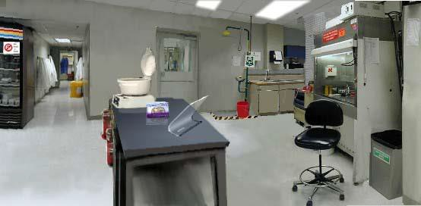
Introduction
Case study
Source: OSHA

Slide 4
Introduction
HCS/GHS
Save lives
  Approximately 43 per year (deaths)
  Approximately 585 per year injuries/illnesses
Save $
  $475.2M in increased productivity
  $32.2M in cost savings

Slide 5
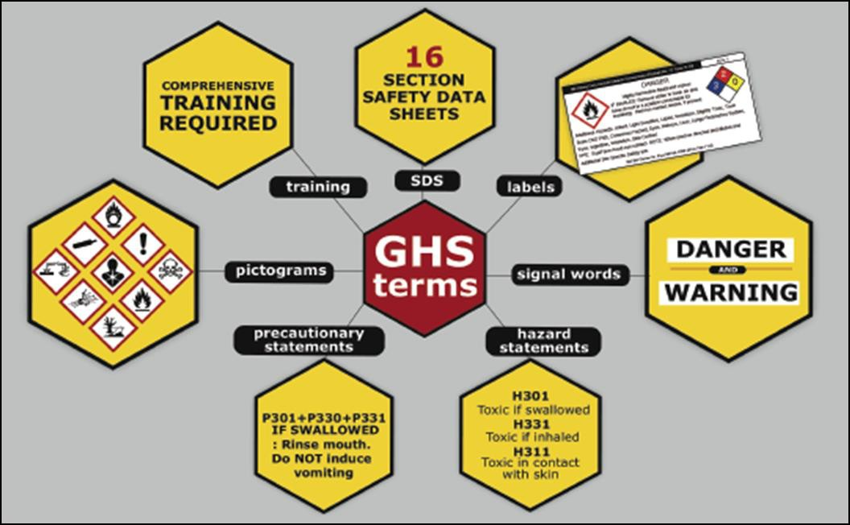
Introduction
Seven major elements in the GHS-aligned Hazard Communication Standard
Source: OSHA

Slide 6
Employer Responsibilities
Employer responsibilities under the HCS:
Ensure labels are on incoming labels and not defaced
Maintain SDSs from shipments
Obtain SDSs if not received
Ensure SDSs are readily accessible
Ensure chemicals in workplace are properly labeled, tagged, or marked
Provide information and training to employees
Provide information/access for employees in multi-employer workplaces
Develop, implement, and maintain a written hazard communication program

Slide 7
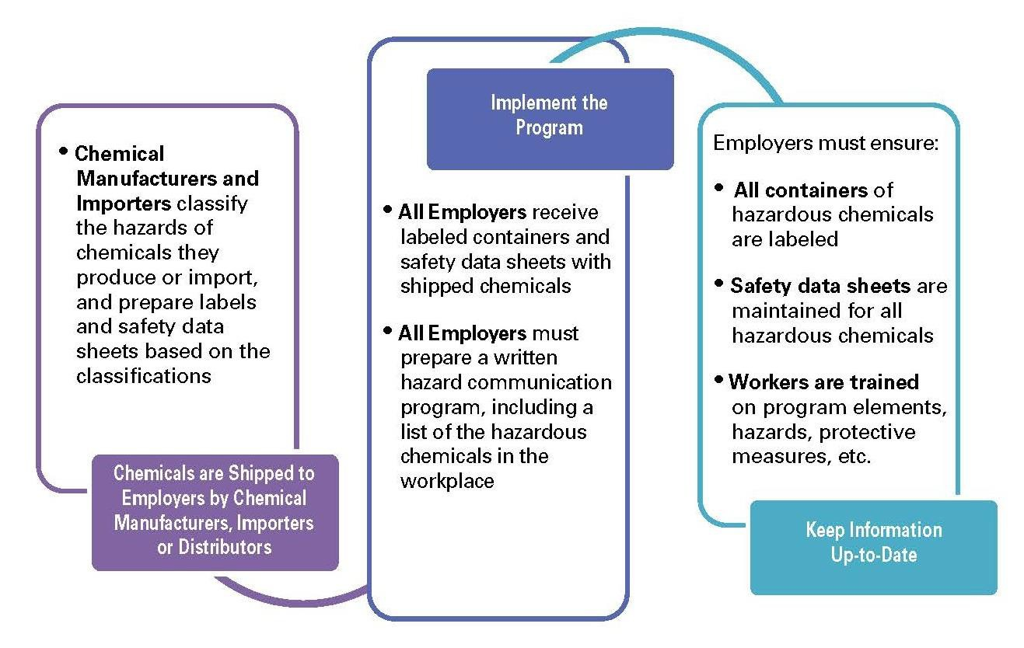
Employer Responsibilities
How hazard communication works:
Source: OSHA

Slide 8
Hazard Communication Program
Requirements for a written program:
Develop, implement, and maintain a written hazard communication program
Main intent is to ensure compliance with standard in a systematic way that coordinates all elements

Slide 9
Hazard Communication Program
Components of written program:
Lists of hazardous chemicals present at worksite
Availability of SDSs to employees and downstream employers
Labeling of chemical containers
Training programs regarding hazards of chemicals and protective measures

Slide 10
Hazard Communication Program
List of hazardous chemicals:
Use product identifier
  Product name, common name or chemical name
  Same as name used on SDS and label
Inventory of chemicals – employer must have available an SDS for each
Covers all chemicals in all forms, whether contained or not
Include chemicals in containers, pipes, and those generated by work operations

Slide 11
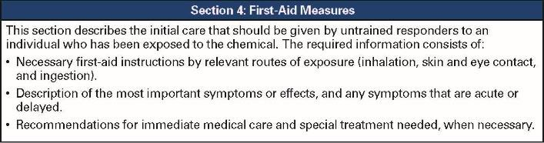
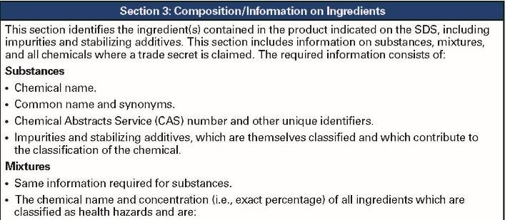
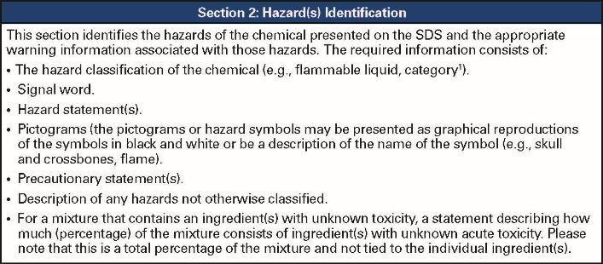
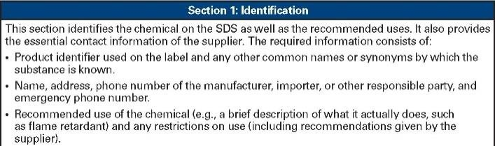
Hazard Communication Program
Safety data sheet (SDS):
Available and accessible to workers
Required for all hazardous chemical used
Do not use hazardous chemicals if there is no SDS available
16-section format
Source: OSHA

Slide 12

Hazard Communication Program
SDS documentation:
Designate person(s) responsible for obtaining and maintaining SDSs
Describe how SDSs are maintained and how employees can access them
Procedures if SDS is not received with first shipment
Must have SDS for each chemical; train workers on SDS format and use
Source: OSHA

Slide 13
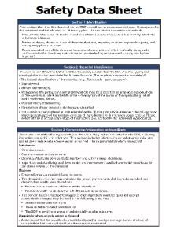
Hazard Communication Program
SDS 16-section format:
Section 1: Identification
Section 2: Hazard(s) identification
Source: OSHA
Section 3: Composition/information on ingredients
Section 4: First-aid measures
Section 5: Fire-fighting measures
Section 6: Accidental release measures
Section 7: Handling and storage
Section 8: Exposure control/personal protection

Slide 14
Hazard Communication Program
Section 9: Physical and chemical properties
Section 10: Stability and reactivity
Section 11: Toxicological information
Section 12: Ecological information
Section 13: Disposal considerations
Section 14: Transport information
Section 15: Regulatory information
Section 16: Other information
Not regulated
by OSHA

Slide 15
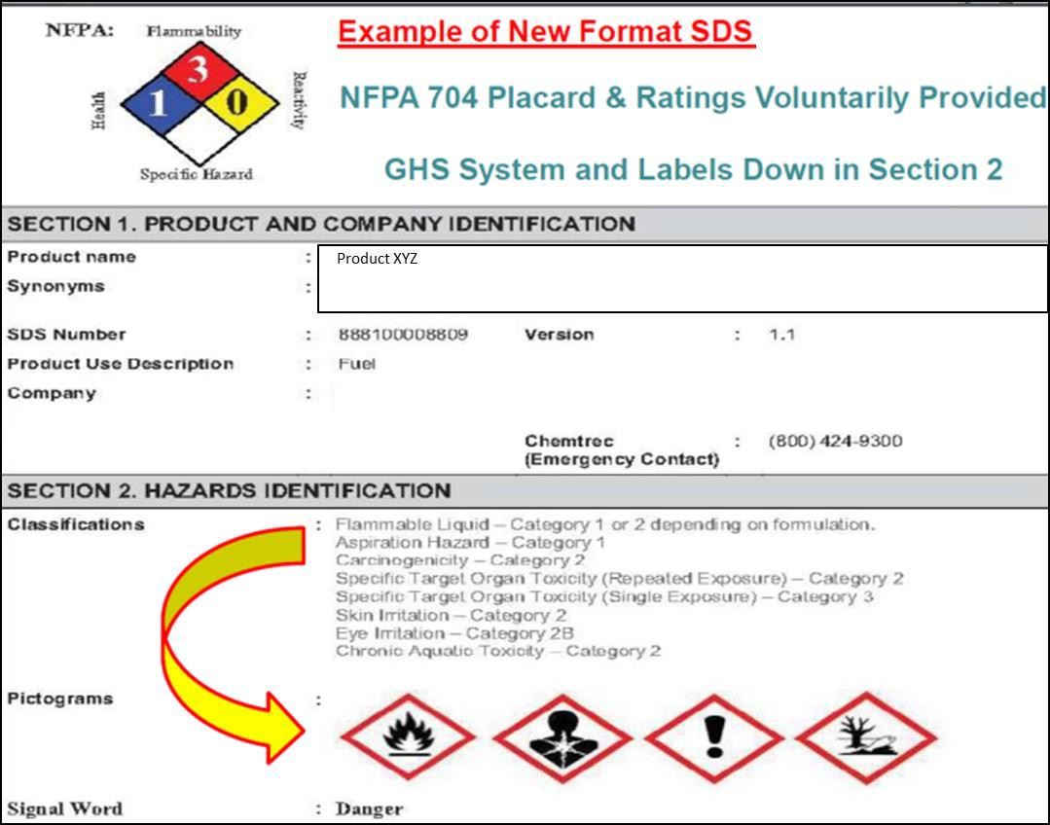
Hazard Communication Program
Source: OSHA

Slide 16
Hazard Communication Program
Labeling:
All containers of hazardous materials must be labeled
Immediate warning
Snapshot of hazards and protective information

Slide 17
Hazard Communication Program
Documentation for labeling:
Designate person(s) responsible for labeling compliance
Describe alternatives to labeling of stationary process containers
Ensure all workplace containers are labeled appropriately
Labels included in training (shipping and workplace containers)
Procedures for reviewing/updating workplace label information

Slide 18
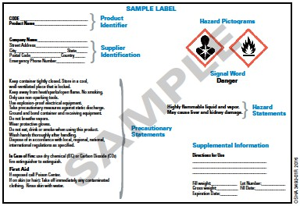
Hazard Communication Program
Required elements for shipping labels:
Name, address, telephone number
Product identifier
Signal word
Hazard statement(s)
Precautionary statement(s)
Pictogram
This sample illustrates the required elements for shipping labels. Source: OSHA

Slide 19

Hazard Communication Program
Requirements for workplace labels:
Employers can create own labeling system that works for their workplace/employees
Can choose same label required for shipped containers or alternative labels as long as they provide general information about hazards
Train employees to understand
Source: OSHA

Slide 20
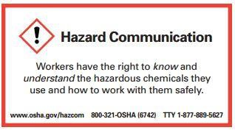
Hazard Communication Program
Training requirements:
Train employees on hazardous chemicals in their work area
– Before initial assignment
When new hazards are introduced
Nonroutine tasks
Include in training
  Methods/observations to determine presence/release of chemical in work area
  Hazards of chemicals
  Appropriate protective measures
  Where and how to obtain additional information
Source: OSHA

Slide 21

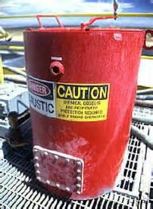


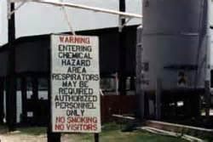
Hazard Communication Labels
Types of labels:
HCS shipping labels
HCS workplace labels
NFPA 704 labels
HMIS labels
DOT shipping labels, placarding, and markings
Source of graphics: OSHA

Slide 22
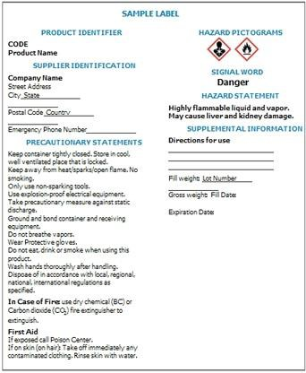
Hazard Communication Labels
Required elements for HCS shipping labels:
Product identifier
Signal word
Hazard statement(s)
Precautionary statement(s)
Pictogram
Name, address, telephone number
Source: OSHA

Slide 23
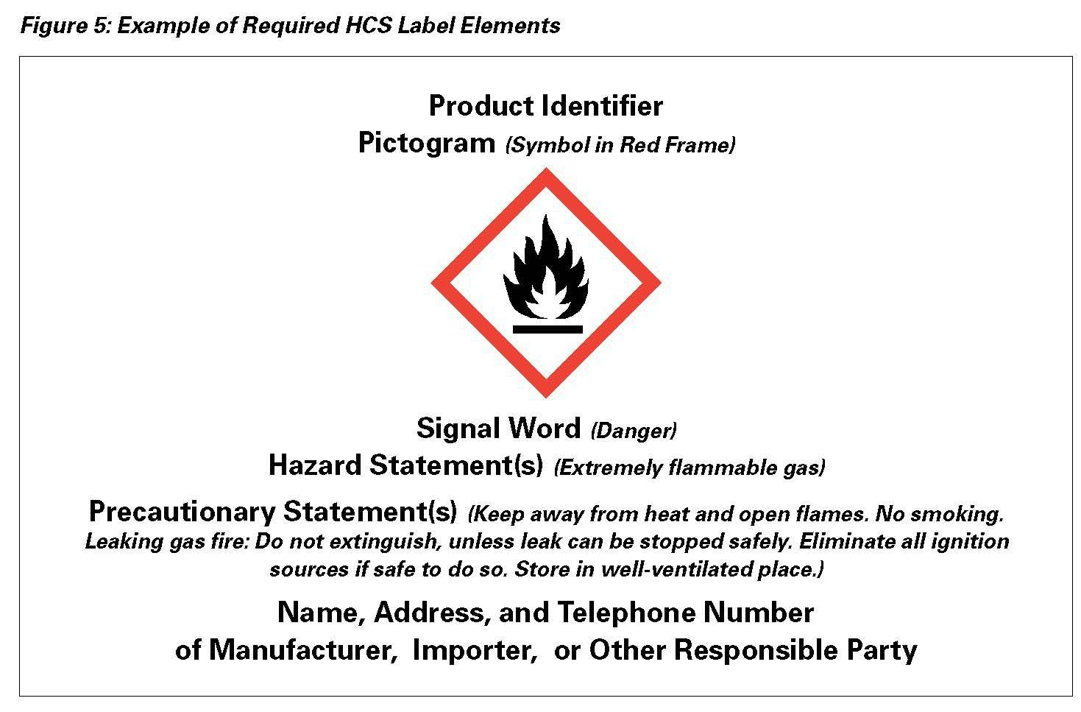

Hazard Communication Labels
How the hazardous chemical is identified
Contact information of Responsible Party
Source: OSHA

Slide 24

Hazard Communication Labels
Indicates the relative level of severity of hazard;
Pictograms convey specific information about the hazards of a chemical in symbols and other graphic elements
“Danger” is used for more severe hazards and “Warning” for less severe hazards
Source: OSHA

Slide 25
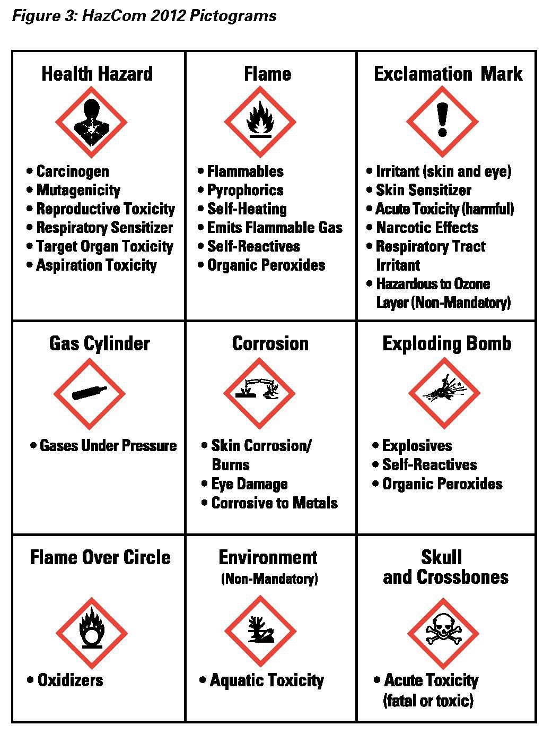

Hazard Communication Labels
Exclamation Mark
Source: OSHA

Slide 26

Hazard Communication Labels
Exploding Bomb
Source: OSHA

Slide 27

Hazard
Communication Labels
Skull and Crossbones
Not regulated by OSHA
Source: OSHA

Slide 28

Hazard Communication Labels
Describes recommended measures that should be taken to minimize or prevent adverse effects resulting from exposure to a hazardous chemical, or improper storage or handling.
Statement assigned to hazard class and category that describes the nature of the hazard(s), of a chemical, including, where appropriate, the degree of hazard.
Source: OSHA

Slide 29
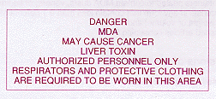

Hazard Communication Program
Requirements for workplace labels:
Same information as label from manufacturer or product identifier and words, pictures, symbols or combination thereof
May include signs, placards, process sheets, batch tickets, operation procedures, other written materials
Source of graphics: OSHA

Slide 30
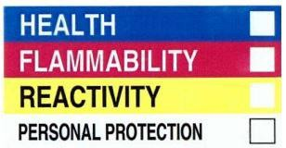
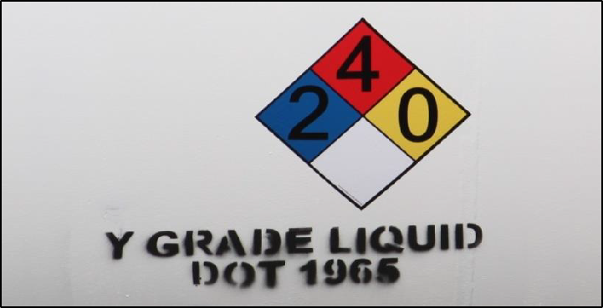
Hazard Communication Labels
Alternative workplace labels:
  Permitted for workplace labels
  Must provide at least general information regarding hazards of chemicals
  Hazard warnings or pictograms that conflict
with HCS label elements cannot be used
  Examples: NFPA 704 and HMIS
Source: OSHA
Source: TEEX

Slide 31
Hazard Communication Labels
Other labels:
NFPA 704
  Overall diamond shape made up of four smaller diamonds
  Each smaller diamond is a different color
  Numbers within smaller diamonds represent severity of hazard
Source: OTIEC

Slide 32
Hazard Communication Labels
– NFPA 704 – hazards and severity ratings
Flam
H
Yellow = Instability Hazards
0= normally stable
y
nstability
Hazard
White = Other Special Hazards ^{mabilit Blue = Health Hazards}
W= reactivity to water
OX = oxidizer
SA = simple asphyxiant
azard
0= normal material that
poses no health
Health
Hazard
Red = Flammability Hazards
0= will not burn
1 = flashpoint above 200°F
2 = flashpoint between 100 – 200°F
3 = flashpoint below 100°F
4 = flashpoint less than 73°F
I 1 = slight hazard
2 = moderate hazard
3 = extreme hazard
4 = deadly hazard
1 = slight hazard
2 = moderate hazard
3 = extreme hazard
4 = deadly hazard
Other
Special
Hazard
Source: OTIEC

Slide 33

Hazard Communication Labels
Source: OSHA

Slide 34
Hazard Communication Labels
HMIS label
  Intended for “In-plant” (workplace) labeling compliance
  Color-coded bars
  Numerical scale, 0-4, with 0 as lowest hazard and 4 as highest hazard
    0 = minimal hazard
    1 = slight hazard
    2 = moderate hazard
    3 = serious hazard
    4 = severe hazard
(Product identifier)
HEALTH
FLAMMABILITY
PHYSICAL HAZARD
PERSONAL PROTECTION
Source: OTIEC

Slide 35
Hazard Communication Labels
HMIS hazard indicators
PPE Index:
A = safety glasses
B = safety glasses + gloves
C = safety glasses + gloves + apron
D = face shield + gloves + apron
E = safety glasses + gloves + dust
respirator
F = safety glasses + gloves + apron
+ dust respirator
G = safety glasses + gloves + vapor
respirator
H = splash goggles + gloves + apron
+ vapor respirator
I = safety glasses + gloves + dust and vapor respirator
J = splash goggles + gloves + apron
+ dust and vapor respirator
K = air-line hood or mask + gloves +
full suit + boots
X = ask supervisor or safety specialist
Flammability ratings:
0 = will not burn
1 = flashpoint >200°F
2 = flashpoint ≥100°F,
Physical Hazard ratings:
0 = normally stable
1 = normally stable, but
can become unstable
2 = unstable
3 = explosive
4 = readily explosive
Health ratings:
The second space signifies chronic health hazard with an asterisk (*)
3 = major injury
4 = life-threatening
(Product identifier)
Health ratings:
0 = no significant risk
1 = irritation/minor injury
2 = temporary/minor injury
(Product identifier)
HEALTH
but <200°F
3 = flashpoint <73°F and boiling point >100°F, or flashpoint between 73°F and 100°F
4 = flashpoint <73°F and
boiling point <100°F
FLAMMABILITY
PHYSICAL HAZARD
PERSONAL PROTECTION
Source: OTIEC

Slide 36
Hazard Communication Labels
Ammonium Hydroxide
HEALTH | * | 2
FLAMMABILITY |  | 0
PHYSICAL HAZARD |  | 0
PERSONAL PROTECTION |  | J
Source: OTIEC

Slide 37
Hazard Communication Labels
DOT shipping containers – marking, labeling, and placarding
  Uses graphic elements on square-on-point placards or labels to identify shipments of hazardous materials
  Square-on-points have backgrounds of various colors
  Where shipping container is also container used in workplace, workers must be made aware of DOT pictograms
  DOT Classification – groups hazardous materials
based on dangers posed in transportation; 9 classes

Slide 38
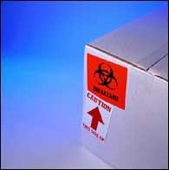


Hazard Communication Labels
Labels
Placards
Markings
Source: OSHA
Source: TEEX
Source: DOT - PHMSA

Slide 39
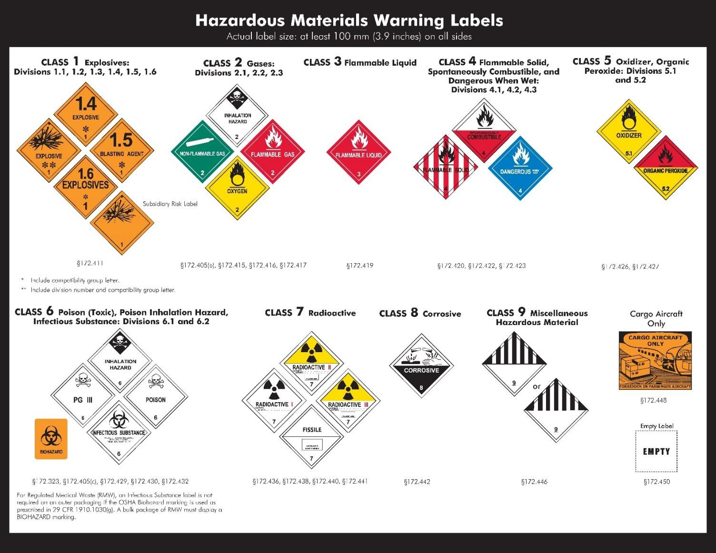
Hazard Communication Labels
DOT
Warning
Labels
Source: DOT - PHMSA

Slide 40
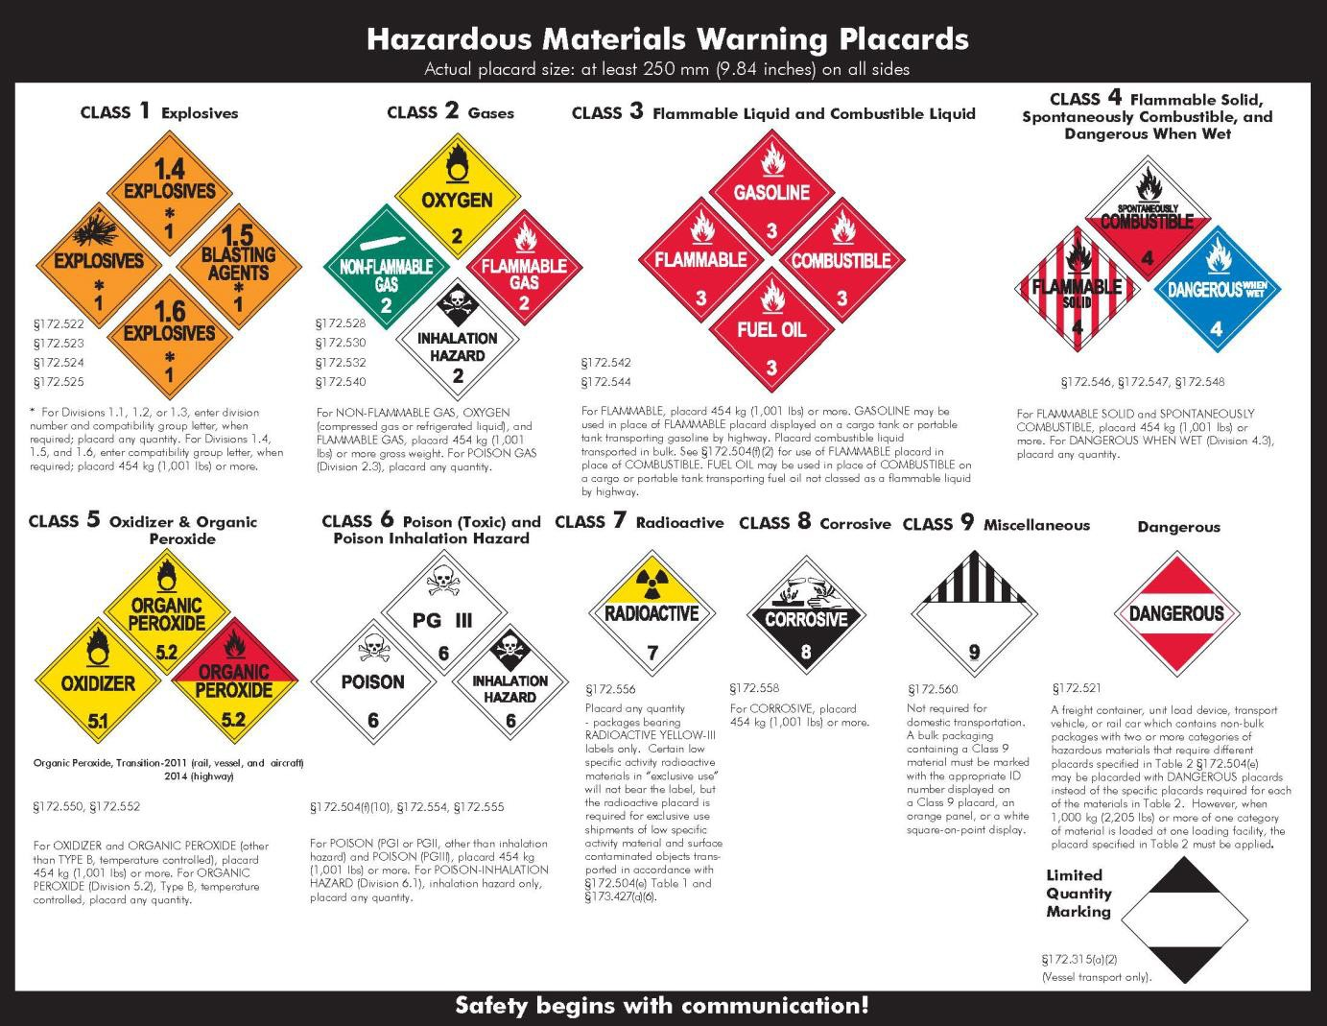
Hazard Communication Labels
DOT
Warning Placards
Source: DOT - PHMSA

Slide 41
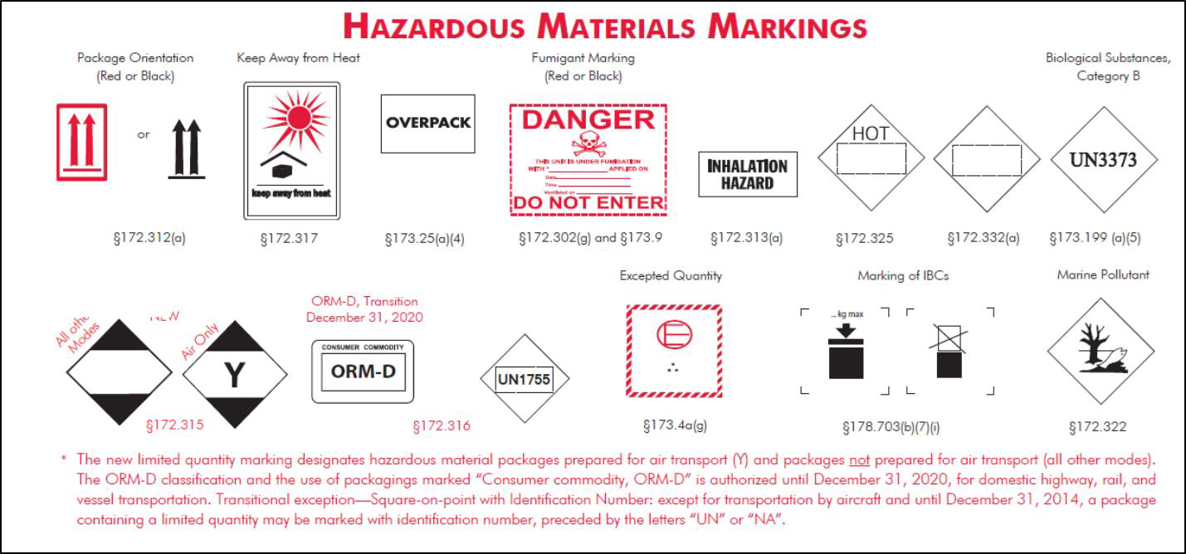
Hazard Communication Labels
DOT Markings
Source: DOT - PHMSA

Slide 42
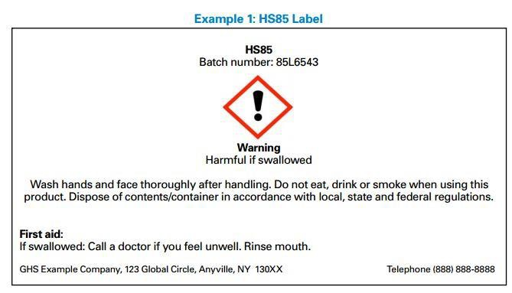
Locating Information
Source: OSHA

Slide 43
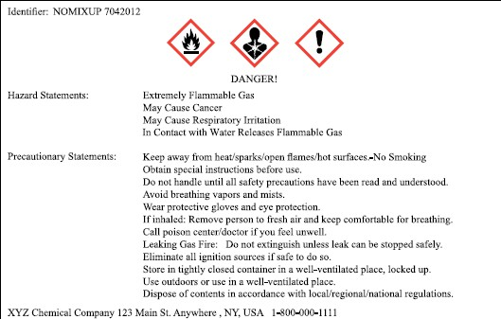
Locating Information
Source: OSHA

Slide 44
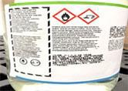
Locating Information
Source: OSHA

Slide 45
Locating Information
In which section of an SDS would you find the following information:
Hazard identification such as hazard classification, signal word, and precautionary statements Section 2: Hazard(s) Identification
Initial care instructions for untrained responders attending to an individual who has been exposed to the chemical
Section 4: First-Aid Measures
Recommendations for PPE
Section 8: Exposure Controls/Personal Protection

Slide 46
Summary
In this module we discussed:
Employer’s responsibilities under HCS
Components of a Hazard Communication Program
Requirements of different types of Hazard Communication labels
How to locate pertinent information

Slide 47
Knowledge Check
A hazard communication program requires which of the following components?
  Written program
  SDS/Labeling
  Training
  All of the Above
Answer: d. All of the above

Slide 48
Knowledge Check
How many sections are required on an SDS?
  11 sections
  16 sections
  4 sections
  As many as necessary to convey understanding
Answer: b. 16 sections

Slide 49
Knowledge Check
Which of the following statements is true of the pictograms on HCS labels?
  Pictograms on HCS labels are identical to those used on DOT transport labels and may have various background colors.
  Consist of four bars that are color-coded as blue,
red, yellow, and white to match hazard.
  HCS pictograms are required and standardized red square-on-points with black hazard symbols and white backgrounds.
  All of the Above
Answer: c. HCS pictograms are required and standardized red square-on-points with black hazard symbols and white backgrounds.

Slide 50
Knowledge Check
Your right to understand is .
  not simply shown or told
  not simply given an SDS
  required at initial assignment/when thing change
  all of the above
Answer: d. all of the above

