Slide 1
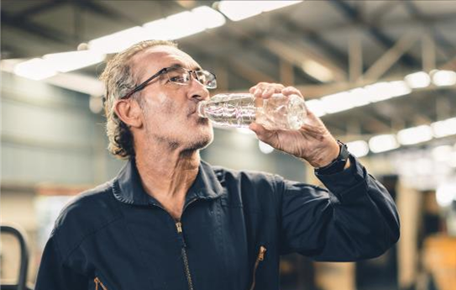
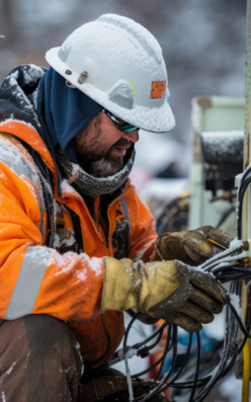
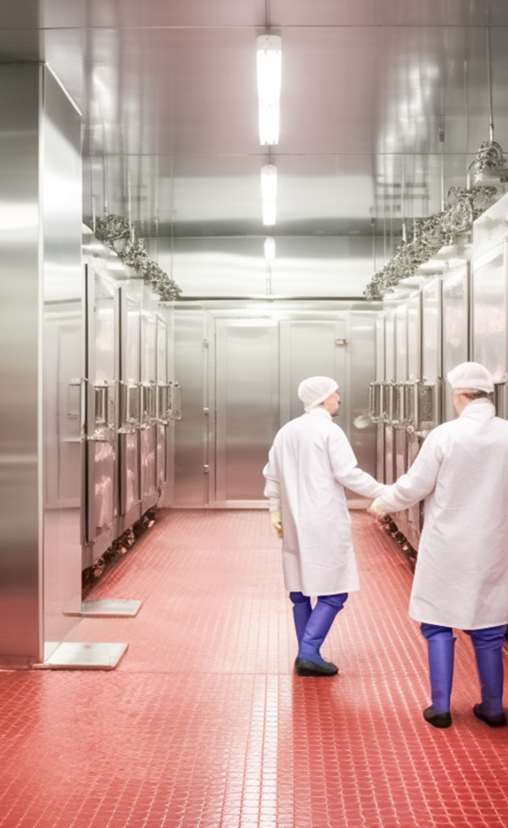
Temperature Extremes in the Workplace
This material was produced under grant number SH-000018-SH3 from the Occupational Safety and Health Administration, U.S. Department of Labor. It does not necessarily reflect the views or policies of the U.S. Department of Labor, nor does mention of trade names, commercial products, or organizations imply endorsement by the U.S. Government.
Notes:
This material was produced under grant number SH-000018-SH3 from the Occupational Safety and Health Administration, U.S. Department of Labor. It does not necessarily reflect the views or policies of the U.S. Department of Labor, nor does mention of trade names, commercial products, or organizations imply endorsement by the U.S. Government.
Image 1: Photo of an employee drinking water in a manufacturing plant
Image 2: Photo of two employees walking in an industrial refrigerator
Image 3: Photo of an electrician working outside in the cold

Slide 2
We Will Cover:
OSHA Information
Working in Extreme Heat
Heat Stress
Heat Stress Prevention
Working in Extreme Cold
Cold Stress
Cold Stress Prevention
Notes:
In this 4-hour course, we will begin by covering information about OSHA. We will then talk about the hazards of working in extreme heat, heat stress, including heat stress disorders and first aid, heat stress prevention, the hazards of working in extreme cold, cold stress, including cold stress disorders and first aid, and cold stress prevention.

Slide 3
Class Agenda and Objectives:
OSHA Background
Hazards of Working in Extreme Heat
How Heat Stress Develops and Types of Heat Stress Disorders
Symptoms of Heat Stress Disorders and First Aid Measures
Heat Stress Prevention
Hazards of Working in Extreme Cold
How Cold Stress Develops and Cold Stress Disorders
Symptoms of Cold Stress Disorders and First Aid Measures
Cold Stress Prevention
Summary, Discussion, Final Comments
Notes:
This is the agenda for our 4-hour course. We will also be doing a number of activities, both all together and in groups.

Slide 4
OSHA Background
Notes:
In this section we will briefly discuss OSHA. How did OSHA start and who is covered by OSHA.

Slide 5
OSHA “101”
In 1970, Congress created OSHA
  Assures safe and healthful conditions for working men and women
The OSH Act ensures OSHA’s mission by
  Setting and enforcing standards
  Providing training, outreach, education
  Compliance assistance
Notes:
In 1970, by an act of Congress, OSHA was created. Known as the OSH Act, it assured safe and healthful working conditions for men and women by setting and enforcing standards as well as providing training, outreach, education and compliance assistance.
When OSHA was created, an estimated 14,000 workers were killed on the job each year, or about 38 every day. Over the past 40-plus years of protecting workers, OSHA has made great strides in workplace safety and health. However, significant hazards and unsafe conditions still exist in U.S. workplaces. Each year more than 3.3 million working men and women suffer a serious job-related injury or illness. Millions more are exposed to toxic chemicals that may cause illnesses years from now.
Source: All About OSHA – OSHA Publication 3302-11R 2016

Slide 6
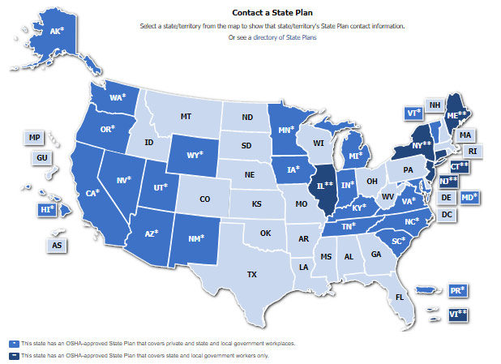
OSHA – Jurisdiction
OSHA coverage includes private sector employers and workers in all 50 states, the District of Columbia, and other U.S. jurisdictions either directly through Federal OSHA or through an OSHA-approved state plan.
Notes:
OSHA covers private sector employers and workers in all 50 states, the District of Columbia, and other U.S. jurisdictions either directly through federal OSHA or through an OSHA-approved state plan.
Graphic: A picture of the United States with the State Plans in marine blue and the Federal Plans in light blue. States that are in dark blue have plans that cover state and local workers only. All private employers in those states are covered by federal OSHA.
State plans are OSHA-approved job safety and health programs operated by individual states instead of federal OSHA. An example would be Cal-OSHA (in California) or North Carolina OSHA. OSHA approves and monitors all state plans and provides as much as 50 percent of the funding for each program. State-run safety and health programs must be at least as effective as the federal OSHA program. The following states have approved State Plans (in BLUE on graphic):
Alaska New Mexico
Arizona New York
California North Carolina
Connecticut Oregon
Hawaii Puerto Rico
Illinois South Carolina
Indiana Tennessee
Iowa Utah
Kentucky Vermont
Maryland Virgin Islands
Michigan Virginia
Minnesota Washington
Nevada Wyoming
New Jersey
NOTE: The Connecticut, Illinois, New Jersey, New York and Virgin Islands plans cover public sector (State & local government) employment only (in GREY on graphic).

Slide 7
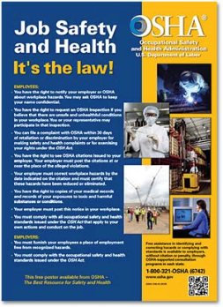
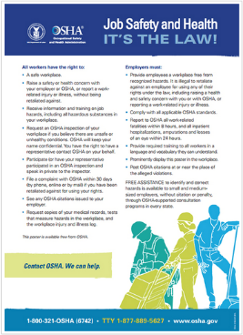
Employer Rights and Responsibilities
Employers have the responsibility to, at a minimum, comply with the OSH Act
Employers must perform their due diligence to find and correct safety and health hazards
Notes:
Employers must also:
Perform tests in the workplace, such as air sampling or noise monitoring, as required by some OSHA standards.
Provide hearing exams or other medical tests required by OSHA standards (if applicable).
Post injury/illness information so that employees can see them.
Prominently display the official OSHA "Job Safety and Health - It's the Law" poster that describes rights and responsibilities under the OSH Act; A new poster was issued in 2015, however, either poster is still acceptable.
AND employers MAY NOT retaliate or discriminate against workers for using their rights under the OSH Act to report hazards that could lead to or have caused a work-related injury or illness.
Graphic: This slide has a picture of the old OSHA poster and the 2015 version of the OSHA poster.

Slide 8
Workers’ Rights
Workplace free of recognized hazards
Report safety and health concerns and/or injuries and illnesses without retaliation
  File a discrimination complaint under Section 11 (c) of the OSH Act, which prohibits discharge or discrimination by “any person” against any employee for OSHA-related activity;
  File a complaint if punished or discriminated against for acting as a “whistleblower” under the additional federal laws for which OSHA has jurisdiction.
Receive appropriate training in a language and vocabulary that workers understand
Notes:
Employers have the responsibility to provide a safe workplace free from serious hazards and must follow all OSHA safety and health standards.
Employers must find and correct safety and health problems as their due diligence under the OSH Act. OSHA requires that employers first try to eliminate or reduce hazards by making feasible changes in working conditions rather than relying on personal protective equipment - a.k.a. PPE (e.g. masks, gloves, earplugs); and if an employer provides PPE, then the employer must train the employees on WHEN and HOW to use the PPE.
Any training given by the employer must be in a language that the employees can understand.
Temporary workers are also entitled to the same protection against retaliation as full-time workers. Employers may not take action against employees for participating in protected workplace activities (i.e., filing a complaint, voicing concerns about workplace hazards to supervisors, etc.). Workers also can inform OSHA of other whistleblower items that OSHA enforces, which currently is 22 different whistleblower statutes covering a variety of workplaces. For more information visit whistleblowers.gov.

Slide 9
Workers’ Rights (Continued)
Request an OSHA inspection at your facility (confidential)
Participate in an OSHA inspection
Speak to OSHA inspector in private
See OSHA citations
Request
  medical records,
  tests that measure hazards, and
  injury/illness log
Notes:
Workers can participate during an OSHA inspection. They may speak with an inspector in private without retaliation from an employer. Workers can see the OSHA citations and request medical records, tests that measure hazards, and the OSHA injury and illness logs.
Section 11(c) of the OSH Act prohibits discharge or discrimination by any person against any employee for OSHA-related activity AND authorizes the Secretary to investigate and seek all appropriate relief against any such person. Retaliatory lay-offs or failure to refer a worker who engages in protected activity under OSHA would be grounds for the Secretary to seek remedial - including injunctive - relief in district court.

Slide 10
Whistleblower Protection
Temp workers are entitled to the same protections as all other covered workers
Employers and Staffing Agencies are responsible and can be held accountable for
  Exposing workers to hazards
  Retaliating against workers for reporting hazardous conditions
Protected activities:
  report injuries,
  raise concerns to employer/OSHA/other government agencies about unsafe/unhealthful working conditions
Notes:
Employers should promptly report to each other any protected activity by workers, and appropriately investigate and respond to such activity. Both employers are responsible for safety and health and can be held accountable for exposing workers to hazards and retaliating against workers for reporting hazardous conditions.
For example, if after a worker engages in protected activity, the host employer asks the staffing agency to remove the worker from the host’s worksite, and the staffing agency complies, both employers may be investigated to determine if either one, or both, retaliated against the employee, even if the staffing agency places the worker at another worksite.
Retaliation can include:
• Blacklisting
• Demoting
• Denying overtime or promotion
• Disciplining
• Denying benefits
• Failing to hire or rehire
• Firing or laying off
• Intimidation
• Making threats
• Reassignment to a less desirable position, including one adversely affecting prospects for promotion
• Reducing pay
Workers can report injuries and raise safety and health concerns without retaliation.

Slide 11
Recordkeeping and Reporting
Employers of 11 or more employees must maintain records of occupational injuries and illnesses as they occur.
Employers with 10 or fewer employees are exempt from recordkeeping unless selected by BLS to participate in the Annual Survey.
Certain low-hazard employers (e.g., retail trade, finance, insurance, real estate) are not required to keep records.
Notes:
Employers that have more than 10 employees must keep the OSHA logs. Certain low-hazard employers such as retail trade, finance, insurance, and real estate are not required to keep the logs unless specifically asked to do so by OSHA, the Bureau of Labor Statistics, or other state agency under OSHA or BLS.

Slide 12
Recordkeeping and Reporting (Continued)
All employers must:
  Comply with OSHA standards
  Display the OSHA poster
  Report to OSHA:
    Within 8 hours: Any accident that results in a fatality
    Within 24 hours: Amputations, loss of an eye, or hospitalization of 1 or more employees
Notes:
All employers must comply with OSHA standards, display the OSHA poster in a conspicuous place where workers can see it and report to OSHA accidents that involve fatalities, amputations, loss of an eye, or hospitalization of 1 or more employees. Fatalities must be reported within 8 hours and amputations, loss of eye or hospitalizations must be reported within 24 hours.

Slide 13
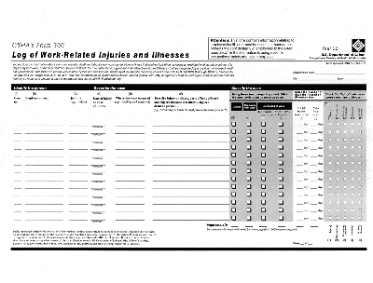
Recordkeeping Forms
Maintain on a calendar year basis
Maintain for 5 years at the establishment
Be available for inspection
Summary of records for the previous year must be posted from February through April
Must be certified by the highest-ranking official working at the establishment.
Notes:
The OSHA 300 log contains descriptions of recordable injuries and illnesses that occur in a calendar year.
The OSHA recordkeeping forms must be maintained for 5 years at the establishment and be available to OSHA, National Institute for Occupational Safety and Health (NIOSH), and BLS.
Logs must be updated to reflect any changes that occur.
Post the OSHA 300 A Log (summary log) in your workplace from February 1 to April 30th of the following year.
The highest ranking official working at the establishment has to certify the OSHA 300 A Log.
OSHA Recordkeeping Forms
OSHA 300 Log
OSHA 300A Summary
OSHA 301 Incident Report
Graphic: Picture of the OSHA 300 log.

Slide 14
Sources for Reference
OSHA Website
  E-tools, standards, presentations, etc.
  www.osha.gov
Enterprise Innovation Institute's Safety, Health, and Environmental Services Website
  Free, on-site safety and health consultation
  Completely confidential from OSHA
  oshainfo.gatech.edu
Notes:
OSHA’s website has a lot of information on employee rights, as well as employer rights and responsibilities. The website also has a lot of information and documents that can be helpful for employee training, including eTools, presentations, Fact Sheets, Quick Cards, etc.
We work with the Georgia Tech Safety and Health Consultation Program. We provide free on-site safety and health consultations for small and medium-sized businesses in the state of Georgia. The consultation program exists in every state. It is free and completely confidential. If you are in the state of Georgia, and you have 250 employees or less at one facility or 500 employees or less nationwide, then you can complete a consultation request form at our website: www.oshainfo.gatech.edu.

Slide 15
OSHA National Emphasis Program
Outdoor and Indoor Heat-Related Hazards
  Expands on agency’s ongoing heat-related illness prevention initiative
  Target enforcement component
  Compliance assistance and outreach
  Intended to encourage early interventions by employers to prevent heat-related illnesses and deaths
Notes:
OSHA’s National Emphasis Program on Outdoor and Indoor Heat-Related Hazards expands on the agency’s ongoing heat-related illness prevention initiative and campaign by setting forth a targeted enforcement component and reiterating its compliance assistance and outreach efforts. This approach is intended to encourage early interventions by employers to prevent illnesses and deaths among workers during high heat conditions, such as working outdoors in a local area experiencing a heat wave, as announced by the National Weather Service. Early interventions include, but are not limited to, implementing water, rest, shade, training, and acclimatization procedures for new or returning employees.
Source: https://www.osha.gov/sites/default/files/enforcement/directives/CPL_03-00-024.pdf

Slide 16
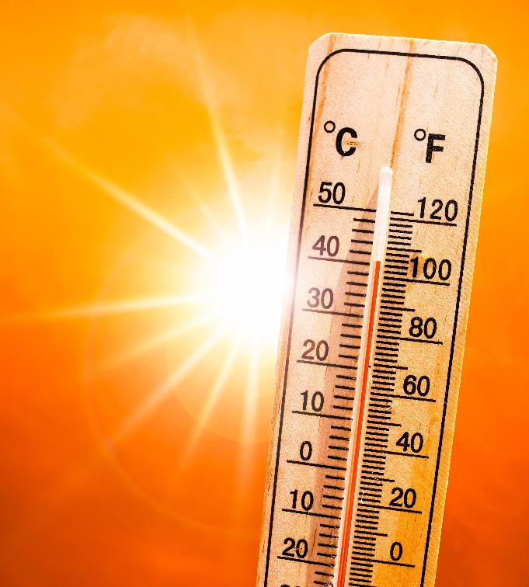
Working in Extreme Heat
Notes:
We will first begin by covering working in extreme heat – the hazards of working in extreme heat, heat stress disorders, and how to prevent heat stress in the workplace.
Image: Image of a thermostat with the sun in the background.

Slide 17
Do You Know The Facts?
Heat stress may result from the buildup of muscle-generated heat in the body.
  True or False?
The time to drink water is when you are thirsty.
  True or False?
What is the most important thing you should know about preventing heat stress?
  A. Water B. Shade C. Rest D. All three are Important
The evaporation of sweat is the most important way our bodies get rid of heat.
  True or False?
Over 70% of those who suffer a heat stroke die if not treated promptly.
  True or False?
Notes:
Questions to ponder as we begin to discuss heat stress. We will be covering each of these items throughout this section of today’s course.
Answers:
True
False
D – All three are important
True
True: Morbidity and mortality from heatstroke are related to the duration of the temperature elevation. When therapy is delayed, the mortality rate may be as high as 80%; however, with early diagnosis and immediate cooling, the mortality rate can be reduced to 10%.

Slide 18

Why Should We Be Concerned?
Gabriel Infante, 24 years old
  Installing fiber optic cables in San Antonio, TX – 5th day on the job
  Heat Index over 100 degrees
  Complained of feeling tired and was experiencing cramping
  Was moved from digging crew to dump a load, then returned to digging crew
  Lunged at a coworker in a fit of delirium – thought coworkers “were going to kill him”
  Fell and hit his head, became unconscious
  Body temperature nearly 110 degrees by the time he got to the ER
  Died in the hospital
  Source: OSHA News Clips Aug. 19-21, 2023
  CNN, August 19, 2023
Notes:
Anyone, under the right circumstances and environment, can be affected by heat stress. We oftentimes don’t realize how dangerous heat is until it is too late, and victims of heat stress may have a hard time helping themselves once they are seriously affected by the heat.
Gabriel Infante was installing fiber optic cables in San Antonio, when the heat index was over 100 degrees. It was his 5th day on the job. After working in the heat, he started to feel tired and experienced cramping. He was moved to perform a different job task, but after some time he returned to the digging crew. He then became delirious, combative, and aggressive towards his co-workers, alleging his co-workers were going to kill him.
The site supervisor on the job thought he was under the influence of drugs, but he was actually suffering from heat stroke. Soon after, he collapsed and became unconscious. By the time he got to the ER, his body temperature was nearly 110 degrees. Gabriel died in the hospital the following morning. The cause of his death was heat stroke.
Graphic: Photo of Gabriel Infante, victim of heat stroke
Source: https://edition.cnn.com/2023/08/19/business/extreme-heat-texas-worker-deaths-demand-change/index.html
https://www.osha.gov/ords/imis/establishment.inspection_detail?id=1604112.015

Slide 19
Why Should We Be Concerned? (Continued)
2011-2021: 436 work-related deaths caused by environmental heat exposure
35 employees died each year between 2015-2019 due to environmental heat cases
  An average of 2,700 environmental heat cases occurred each year resulting in days away from work
The total number of heat-related illnesses and fatalities is unknown
  Heat-related illnesses are oftentimes not recognized
  Cause of death is oftentimes listed as a heart attack
Notes:
According to the U.S. Department of Labor’s Bureau of Labor Statistics (BLS), between 2011 to 2021, there have been 436 work-related deaths caused by environmental heat exposure. 35 employees died each year between the years of 2015 and 2019 due to environmental heat cases. In addition, an average of 2,700 environmental heat cases occurred each year resulting in days away from work. According to both OSHA and NIOSH, the total number of heat-related illnesses and fatalities is unknown, as heat-related illnesses are oftentimes not recognized and the cause of death is oftentimes listed as a heart attack, rather than exposure to a heat-related hazard.
Source 1: “National Emphasis Program – Outdoor and Indoor Heat-Related Hazards.” OSHA.gov, US Department of Labor: Occupational Safety and Health Administration, April 2022, https://www.osha.gov/sites/default/files/enforcement/directives/CPL_03-00-024.pdf.
Source 2: https://www.bls.gov/opub/ted/2023/36-work-related-deaths-due-to-environmental-heat-exposure-in-2021.htm

Slide 20

Heat’s Effect in the Workplace
Exposure to heat in the workplace can result in reduced productivity, injuries, illness, and death
Individuals working in hot environments are at a higher risk of injury
  Sweaty palms, fogged up safety glasses
  Dizziness
  Reduced brain function
Notes:
Occupational exposure to hot environments and extreme heat can result in injuries, illness (including heat stroke, heat exhaustion, heat syncope, heat cramps, and heat rashes), death, and reduced productivity. Those working in hot environments are at a higher risk of injury, as heat may result in sweaty palms, fogged up safety glasses, dizziness, and reduced brain function, thus creating additional hazards.
Image: Photo of employee working in a manufacturing facility and showing signs of heat exhaustion.
Source: https://www.osha.gov/sites/default/files/enforcement/directives/CPL_03-00-024.pdf.

Slide 21
Heat Illness: A Matter of Life and Death
Heat illness can be a matter of life and death. Workers die from heat stroke every summer and every death is preventable.
When heat stroke doesn’t kill immediately, it can shut down major body organs causing acute heart, liver, kidney and muscle damage, nervous system problems, and blood disorders.
Having a serious injury or death occur at work affects everyone at a worksite.
Notes:
Heat illness can be a matter of life and death. Every summer, workers die from heat stroke. We need to remember that every single death related to heat illness is preventable. Immediate action is necessary for victims of heat exhaustion and heat stroke. 70-80% of heat stroke victims will pass away if they do not receive prompt treatment.
If heat stroke doesn’t kill, it can still shut down major body organs, causing acute heart, liver, kidney and muscle damage, nervous system problems, and blood disorders.
The long-term effects of heat stroke are very serious. For these reasons, employees need to know how to identify heat stress in themselves and in their co-workers, and how to respond immediately.

Slide 22
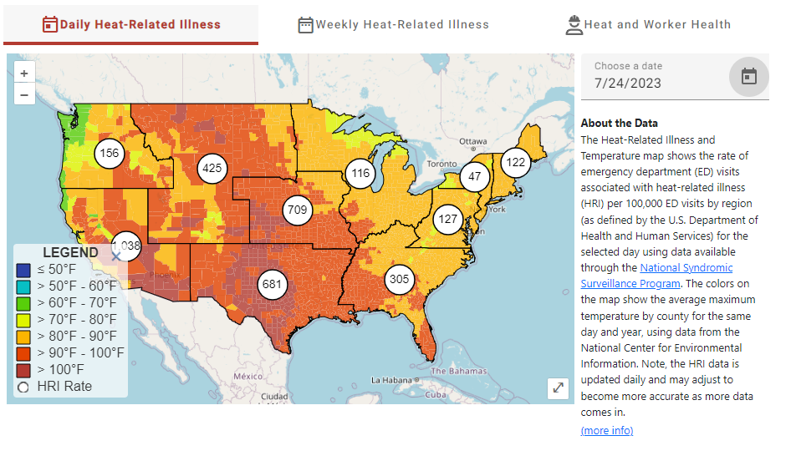
CDC Heat & Health Tracker
Notes:
The Centers for Disease Control and Prevention (CDC) Heat & Health Tracker provides local heat and health information. Their Heat-Related Illness and Temperature Map shows the rate of emergency department (ED) visits associated with heat-related illness per 100,000 ED visits by region. The colors on the map show the average maximum temperature by county for the same day and year. This map is from July 24, 2023. We can see the areas throughout the country that were most affected by heat-related illness that particular day. As the temperatures increase, we see more and more ED visits associated with heat-related illness.
Image: The CDC’s Heat-Related Illness and Temperature Map for July 24, 2023
Source: https://ephtracking.cdc.gov/Applications/heatTracker/

Slide 23
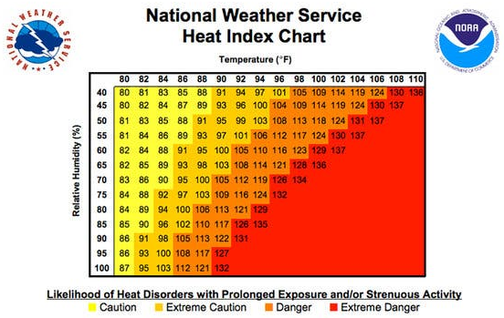
Heat Index
  Measures apparent temperature: what the temperature feels like to the human body
  Human body feels warmer in humid conditions
  As air temperature and humidity increase, heat index increases
Notes:
When the body gets too hot, it begins to perspire or sweat to cool itself off. If the perspiration is not able to evaporate, the body cannot regulate its temperature. Evaporation is a cooling process. When perspiration is evaporated off the body, it effectively reduces the body's temperature.
When the atmospheric moisture content (i.e. relative humidity) is high, the rate of evaporation from the body decreases. In other words, the human body feels warmer in humid conditions. The opposite is true when the relative humidity decreases because the rate of perspiration increases. The body actually feels cooler in arid conditions.
There is direct relationship between the air temperature and relative humidity and the heat index, meaning as the air temperature and relative humidity increase (decrease), the heat index increases (decreases).
Image 1: The National Weather Service’s Heat Index Chart
Image 1 Source: https://www.weather.gov/ama/heatindex

Slide 24
Who Is At Risk?
Construction
  Roofing, Roads, Outdoor Work
Manufacturing
  Hot local heat sources (e.g., paper products, asphalt, concrete)
Bakeries, Kitchens, Laundries
Agriculture
Landscaping
Maritime
Iron & Steel Mills
Foundries
Mail and Package Delivery
Warehousing
Electrical Utilities
Fire Service
Notes:
Individuals who work outdoors and in hot environments, such as construction workers, workers in agriculture and maritime, warehousing workers, bakery workers, and workers in various types of manufacturing are at a higher risk of heat stress and heat-related injuries and illnesses.
Occupational risk factors for heat illness include heavy physical activity, warm or hot environmental conditions, lack of acclimatization, and wearing clothing that holds in body heat.
Source: https://www.osha.gov/heat-exposure

Slide 25
Heat Stress
Notes:
Ask the class: What is heat stress? Can you name some different heat stress disorders? Have you or has anyone you know been affected by heat stress?

Slide 26
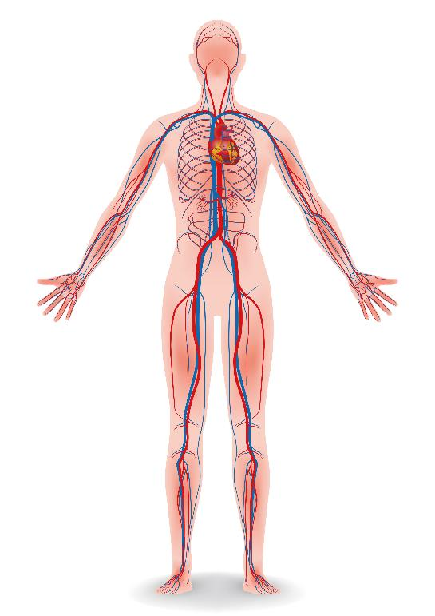
How the Body Cools Down
Blood is pumped from the core to blood vessels just under the skin
  lose heat by convection
Sweat more
  lose heat through evaporation
  BUT: the sweat mechanism can fail
Heart pumps faster in an attempt to cool the
body
Notes:
Before we discuss heat stress, we first need to talk about how our body cools down. Our body cools down by pumping blood from the core of our body to the blood vessels just under the skin (called convection) and by sweating (evaporation).
In warm environments, especially when physically active, the human body relies on these two mechanisms to get rid of excess heat to maintain a healthy internal body temperature. Workers cool down more rapidly if the external (environmental) heat and their physical activity (metabolic heat) are reduced. However, if heat dissipation through sweating and increased blood flow to the skin does not happen quickly enough, the internal body temperature will keep rising and workers will begin to experience heat stress.
Image: A graphic of the human body showing the circulatory system.
Source: http://www.osha.gov/SLTC/heatstress/index.html

Slide 27
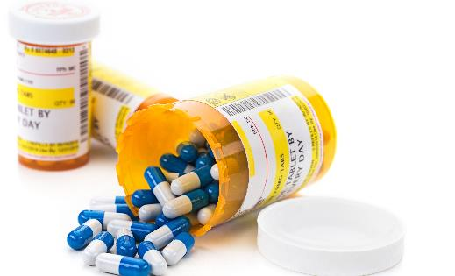
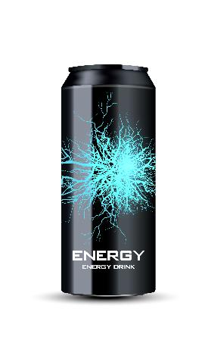
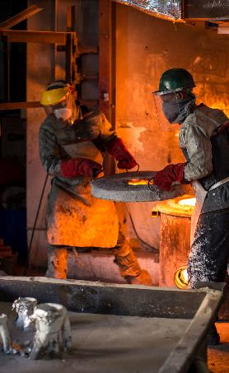
Factors that Affect the Body’s Ability to Cool
Age
Weight
Physical Fitness
Adjusting to the hot environment
Other Health Conditions
Use of Alcohol/Drugs/Caffeine
Clothing/PPE
Medications
Diuretics
Blood-pressure medications
Antihistamines
Anti-cholinergics (for COPD)
Psychiatric conditions
Notes:
There are a number of factors that affect the body’s ability to cool:
Age, weight, and physical fitness all influence how the body cools down.
Adjusting to the hot environment, which is called “acclimatization,” is a very important factor when it comes to cooling down. Our bodies need time to get used to working in hotter conditions.
Health conditions, such as high blood pressure, diabetes, and heart disease, can impact our body’s temperature regulation.
Certain medications can increase the risk for heat stress:
diuretics (water pills),
anti-hypertensives (blood pressure medication),
anti-cholinergics (for COPD pulmonary disorders),
antihistamines (allergy medications),
anti-depressants and
anti-psychotics
These medications affect how the body regulates internal temperature. Some medications can result in a worker's inability to feel heat conditions and/or the inability to sweat, so symptoms of heat stress may not be evident.
Both caffeine and alcohol are diuretics, which means they promote water loss through urine.
The clothing and PPE workers wear can have an impact on the body’s ability to cool.
Dark clothing is going to absorb heat, while lighter clothing is going to reflect it.
Impermeable clothing, such as chemical protective suits, prevents cooling by sweating and may contribute to heat illness at lower temperatures.
Image 1: Prescription medication
Image 2: Energy Drink
Image 3: Two workers in a foundry with PPE

Slide 28
Personal Risk Factors
Health conditions
  Diabetes
  High blood pressure
  Heart disease
  Kidney disease
  Respiratory illness
Medications
  Antihistamines
  Blood pressure medications
  Muscle relaxants
  Psychiatric medications
  Diuretics
Physical Characteristics
  Older age
  Lower level of fitness
  Pregnancy
  History of prior heat illness
  Acclimatization status
Behavioral Characteristics
  Alcohol use within 24 hours of shift
  Lower water intake
  Use of illicit drugs
Notes:
Discuss these personal risk factors with the class.
There are many different health conditions, medications, physical characteristics, and behavioral characteristics that may pre-dispose workers to heat-related illness.
Employers should recognize that not all workers tolerate heat the same way. Workplace controls should focus on making jobs safe for all the employees.
An occupational medical monitoring program can identify workers who are at increased risk of heat illness, while maintaining the confidentiality of workers’ health information.
When heat hazards are present, workers should receive training about personal factors that can make them more susceptible to heat-related illness.
When in doubt, workers should talk to their healthcare provider about whether they can work safely in the heat.
Source: https://www.osha.gov/heat-exposure/personal-risk-factors

Slide 29
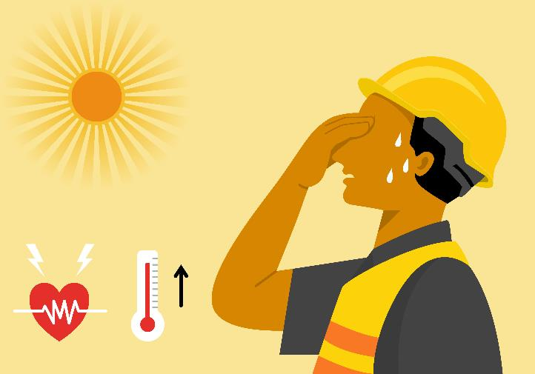
What is Heat Stress?
Build-up of heat in the body that cannot be removed by natural mechanisms.
The result of internal heat generated by the body (metabolic load) and the external heat load from the work environment.
Notes:
Heat stress is the build-up of heat in the body that cannot be removed by natural mechanisms (e.g., sweating and increased blood flow to skin). The build-up of heat is the result of internal heat generated by the body (what we call metabolic load) and the external heat load from the work environment.
Image: Graphic of an employee sweating and experiencing heat stress.

Slide 30
Behavioral Cues of Heat Stress Disorders
Hand/limb shaking
Decreased productivity through shift
Increased absenteeism
Awkward postures (to compensate for fatigue)
Notes:
These are behavioral cues to look out for (in yourself, in your employees, and in your co-workers). These may be an indication that you or someone else is experiencing heat stress.

Slide 31


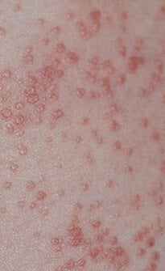
Types of Heat Stress Disorders
Heat Rash (Prickly Heat)
Heat Cramps
Heat Syncope
Heat Exhaustion
Heat Stroke
Notes:
There are several different types of heat stress disorders. Ask participants if they or anyone they know has developed one of these heat stress disorders. This list goes from least dangerous to most dangerous, with heat rash being the least dangerous of the heat stress disorders and heat stroke being the most dangerous.
Transient Heat Fatigue: temporary physical discomfort or mental/psychological strain (cranky, irritated); results in decline in work performance, coordination, alertness.
Image 1: Employee in manufacturing plant with her hand to her forehead. Showing signs of heat stress.
Image 2: Heat rash (prickly heat).
Image 3: An employee collapsed on the ground. Victim of heat stroke.

Slide 32
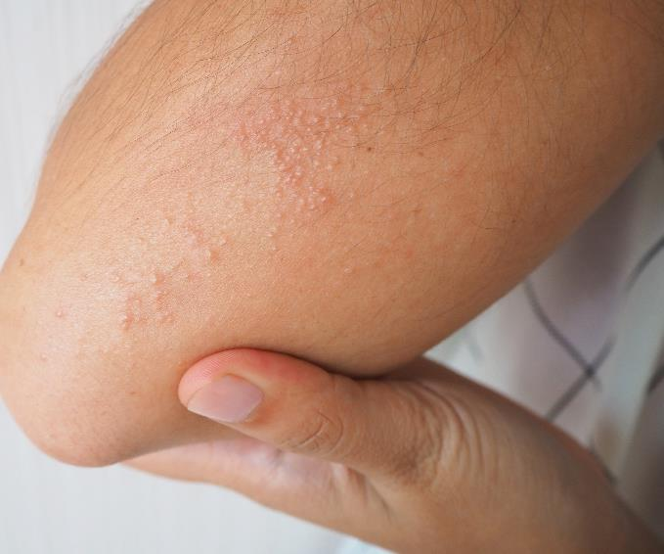
Heat Rash (Prickly Heat)
Caused by a blockage and inflammation of sweat ducts/glands in heat and high humidity
Causes red blotches and extreme itchiness and a prickling sensation on the skin when sweating occurs.
Best treatment is to provide a cooler, less humid work environment.
First Aid:
  Mild drying lotions
  Skin cleanliness
Notes:
Heat rash develops when there is unrelieved exposure to humid heat conditions and the skin is continuously wet with unevaporated sweat.
This may result in the plugging of sweat glands and a subsequent inflammatory reaction leading to small red bumps on the skin that looks like pimples or small blisters.
Heat rash, which is also called prickly heat, causes extreme itchiness and a prickly sensation on the skin when sweating occurs. Heat rash often appears on the neck, upper chest, and skin folds.
If a worker shows signs of possible heat rash, the best treatment is to provide a cooler, less humid work environment for the work area.
When treating heat rash, you do not want to use moisturizing lotions or creams. Anything that makes the skin warm or moist will only make the heat rash worse. Use mild drying lotions, like Calamine, or antihistamine or low-strength hydrocortisone cream (steroid cream to treat inflammation) and keep the skin clean and dry. Powder may also be applied to the area for comfort.
If you’re experiencing heat rash, here are some things that may help:
Cool down to avoid sweating. Try to avoid heat and humidity; stay in air conditioning or near a fan, and make sure there is good ventilation.
Keep the skin dry.
Try to wear loose cotton clothing which can help prevent you overheating and making the itch worse. Avoid fabrics which irritate your skin, like wool or scratchy fabrics.
Heat rash typically disappears on its own in a few days.
Image: Photo of a person with heat rash on their elbow.
Source: https://www.osha.gov/sites/default/files/publications/osha-niosh-heat-illness-infosheet.pdf

Slide 33
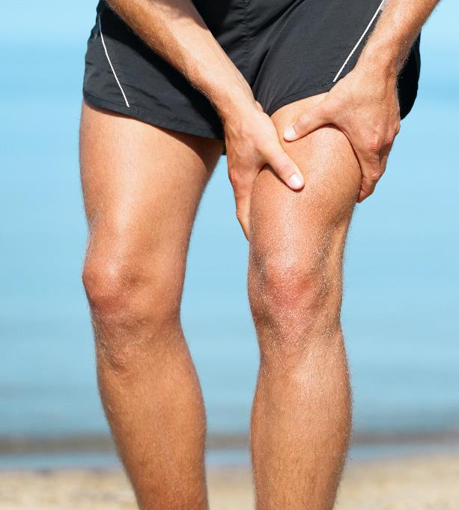
Heat Cramps
Usually affect workers performing strenuous activity
Sweating depletes the body's salt and moisture levels
Painful cramps take place when there are low salt levels in the muscles
  Usually in the abdomen, arms, and legs
May be a symptom of heat exhaustion
Notes:
Heat cramps are muscle pains usually caused by physical labor in a hot work environment. When workers are sweating, their bodies lose water and salt. If they are not rehydrating and replenishing their bodies, then low salt levels in the muscles will lead to painful cramps. Heat cramps usually take place in the abdomen, arms, and legs. It’s important to note that heat cramps may be a symptom of heat exhaustion and therefore require immediate action.
Image: An athlete clutching their leg in pain due to a heat cramp.

Slide 34
First Aid for Heat Cramps
Stop all activity and sit in a cool place
Drink water, have a snack, and/or sports drink
Do not return to strenuous work for a few hours after the cramps subside
  Further exertion may lead to heat exhaustion or heat stroke
Can do gentle stretches to help relieve pain
Avoid salt tablets
Seek medical attention if any of the following apply:
  The worker has heart problems
  The worker is on a low-sodium diet
  The cramps do not subside within one hour
Notes:
If a worker shows signs of heat cramps:
Have them stop all activity and sit in a cool place
Workers should replace fluid loss by drinking water and having a snack, and/or carbohydrate electrolyte replacement liquids (e.g., sports drinks) every 15 to 20 minutes.
Make sure the worker does not return to strenuous work for a few hours after the cramps subside. Further exertion may lead to heat exhaustion or heat stroke.
Gentle stretches may help relieve the pain.
Workers should avoid salt tablets.
Get medical help if the worker has heart problems, is on a low sodium diet, or if cramps do not subside within one hour.

Slide 35
Heat Syncope
Weakness, fatigue, or fainting, after exercising or performing work in the heat
Contributing factors include dehydration and lack of acclimatization
First Aid:
  Sit or lie down in a cool place when if feeling lightheaded, dizzy, or faint
  Slowly drink water, clear juice, or a sports beverage
Notes:
Heat syncope is a fainting (syncope) episode or dizziness that usually occurs when standing for too long or suddenly standing up after sitting or lying. Both dehydration and lack of acclimatization may contribute to heat syncope. If a worker is feeling lightheaded, dizzy, or faint, have them sit or lie down in a cool place. Do not have them return to perform strenuous work. Have them slowly drink water, clear juice, or a sports beverage to rehydrate.

Slide 36
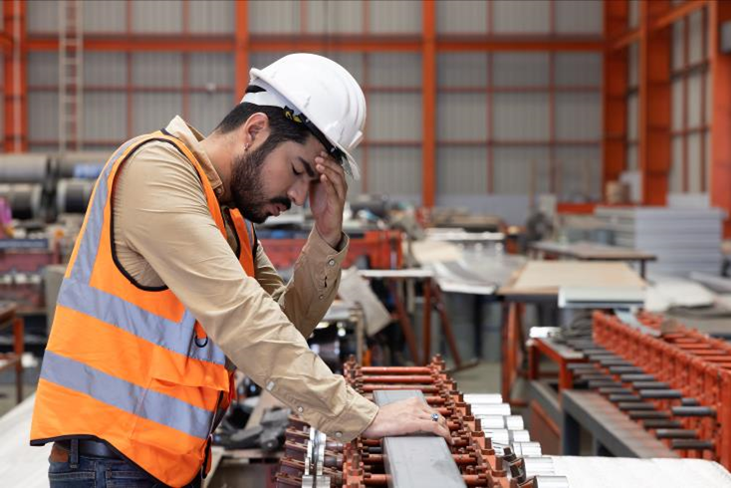
Heat Exhaustion
Heat exhaustion is the body's response to an excessive loss of water and salt, usually through excessive sweating. Workers most prone to heat exhaustion are those working in a hot environment.
Notes:
Heat exhaustion is the body’s response to an excessive loss of water and salt, usually through excessive sweating. Workers with high blood pressure are also more prone to heat exhaustion.
It takes 30 minutes to cool the body down once it has become overheated and suffers heat exhaustion.
Image: A person in a hard hat with his head in his hand. Showing signs of heat exhaustion.

Slide 37
Heat Exhaustion Symptoms
Symptoms:
  Profuse sweating
  Extreme weakness or fatigue
  Headache
  Dizziness, Confusion
  Loss of appetite
  Nausea
  Vomiting
  Fast and shallow breathing
  Vision problems
  Muscle aches and cramps
  Excessive thirst
  Chills
  Agitation or irritability
  Clammy, moist skin
  Sometimes unconsciousness
Notes:
If an employee shows these symptoms, immediate action must be taken to prevent heat stroke. Look out for these symptoms in yourself as well.

Slide 38
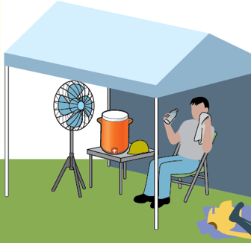
Heat Exhaustion Treatment
Seek medical care
Rest in a cool place
  Resting in an air-conditioned building is best
  At the very least, find a shady spot or sit in front of a fan
  Rest on back with legs elevated higher than heart level
Drink cool fluids
  Stick to water or sports drinks
  Do NOT drink alcoholic or caffeinated beverages
Notes:
If a worker shows signs of possible heat exhaustion:
Workers with signs or symptoms of heat exhaustion should be taken to a clinic or emergency room for medical evaluation and treatment.
If medical care is not available, call 911 immediately.
Make sure that someone stays with the worker until help arrives.
Workers should be removed from the hot area and given liquids to drink.
Image: Clip art of an employee sitting on a chair, in the shade under a pop-up tent, with a fan blowing air on them. The employee is wiping sweat off their face and drinking water.
Source of image: OSHA Heat Illness Symptoms and Signs Infographic (https://www.osha.gov/heat/employer-responsibility)

Slide 39
Heat Exhaustion Treatment (Continued)
Try cooling measures
  If possible, take a cool shower, soak in a cool bath, or put towels soaked in cool water on skin
Loosen clothing
  Remove any unnecessary clothing and make sure clothes are lightweight and nonbinding
Do not leave worker alone
Notes:
If a worker shows signs of possible heat exhaustion:
Remove any unnecessary layers or clothing. Makes sure clothes are lightweight and nonbinding.
Try cooling measures. If possible, take a cool shower or cool bath, or put towels soaked in cool water on the skin. If outdoors and not near shelter, soaking in a cool pond or stream can help bring their temperature down.
Never leave someone showing signs of possible heat exhaustion alone. Stay with them until they receive a medical evaluation and treatment.
Image: Clip art of an employee sitting on the ground at a construction site, wiping a towel on his neck.

Slide 40
Heat Stroke
Most serious heat-related disorder
Occurs when the body becomes unable to control its temperature:
  The body's temperature rises rapidly, the sweating mechanism fails, and the body is unable to cool down
When heat stroke occurs, the body temperature can rise to 106 °F or higher within 10 to 15 minutes
Heat stroke can cause death or permanent disability if emergency treatment is not given
Notes:
Heat stroke is the most serious heat-related disorder. It occurs when the body can no longer cool itself and body temperature rises to critical levels. When heat stroke occurs, the body temperature can rise to 106 °F or higher within 10 to 15 minutes. Heat stroke can cause death or permanent disability if emergency treatment in not given. Immediate response is necessary in order to save the life of someone experiencing a heat stroke.

Slide 41

Heat Stroke Symptoms
High body temperature (often 104 °F–105 °F or higher) and rising
Nausea and vomiting
Seizures
Disorientation or delirium
Hot, dry skin
Unconsciousness
Coma
Shortness of breath
Slurred speech
Decreased urination
Blood in urine or stool
Notes:
A high body temperature is an indication that someone is suffering from a heat stroke. However, it may not always be feasible to check someone’s temperature. We need to look out for other heat stroke symptoms. Nausea and vomiting, seizures, disorientation or delirium are all symptoms of heat stroke. With heat stroke, the sweating mechanism fails, so victims may have hot, dry skin. They may also become unconscious or suffer a coma. Shortness of breath, slurred speech, decreased urination, and blood in the urine or stool are also possible symptoms.
Image: Employee wearing a safety vest unconscious on the ground. Depicting victim of heat stroke.

Slide 42
Heat Stroke Treatment
Call 911
Immersion in cold water
  A bath of cold or ice water has been proven to be the most effective way of quickly lowering core body temperature. The quicker the employee can receive cold water immersion, the less risk of death and organ damage.
Use evaporation cooling techniques
  If cold water immersion is unavailable, health care workers may try to lower body temperature using an evaporation method.
  Cool water is misted on employee’s body while warm air is fanned over them, causing the water to evaporate and cool their skin.
Notes:
If you notice an employee or co-worker showing signs of heat stroke, call 911 immediately. You have less than 30 minutes to make an impact on decreasing their core body temperature. Cooling is the primary goal before transferring the victim to receive medical care.
While waiting for emergency personnel, there is treatment that can be employed on-site. The most effective way to quickly lower someone’s core body temperature is to immerse them in cold or ice water. The quicker the employee can receive cold water immersion, the less risk there is of death and organ damage.
If cold water immersion is not available, there are other cooling techniques that can be employed. Evaporation cooling is when cool water is misted on the employee’s body while warm air is fanned over them. The water evaporates and cools their skin.

Slide 43
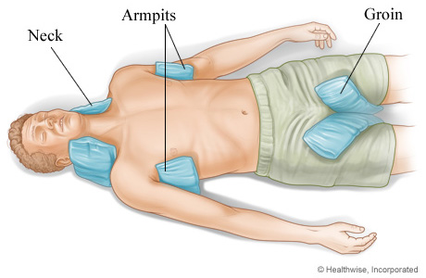
Heat Stroke Treatment (Continued)
Pack employee with ice and cooling blankets.
  Another method is to wrap employee in a special cooling blanket and apply ice packs to their groin, neck, back and armpits to lower body temperature.
  “TACO Method”
    Tarp-Assisted Cooling with Oscillation
REMEMBER: You have less than 30 minutes
to make an impact on decreasing an
employee’s core body temperature!
Notes:
Another cooling method is to pack the employee with ice and cooling blankets. Wrap the employee in a special cooling blanket and apply ice packs to their groin, neck, back, and armpits to lower their body temperature.
The “TACO method” is a cooling method that can be employed using a tarp and cold water and ice. Log roll the victim onto a tarp. Four individuals will then need to position themselves to grasp and elevate the tarp to maintain the victim’s head in an elevated position. Add sufficient ice and water to cover as much of the body as possible. Continuously circulate the water by agitating the tarp, adding more ice as needed to keep the water cool. Most heat dissipation occurs on the surface of the skin. By oscillating or moving the tarp back and forth and having cold water contact all parts of their body, the heat will come off their body more rapidly.
These cooling methods should all be thought of as temporary cooling methods. You still need to call 911 if someone is showing signs of heat stroke.
Image: Image of a heat stroke victim with ice packs in the neck, armpits, and groin area.
Image source: https://www.nyp.org/healthlibrary/multimedia/placement-of-ice-bags-for-heatstroke

Slide 44
Activity
Notes:
Go through each of the scenarios together with the class.
Ask them:
what heat stress disorder is the employee experiencing?
What first aid treatment should they receive?
What can the employee do to address the disorder?
What can their supervisor and/or co-workers do?

Slide 45
Reggie
Reggie, who works for a residential roofing company in Valdosta, Georgia, has been working in the sun for the past 6 hours. It’s now 2 p.m., and the sun is ruthless. His shirt is soaked with sweat, and he is beginning to feel nauseous and dizzy. He almost fell off the roof when he temporarily lost his balance. He sat down for a bit to re-gather himself and when he stood up, he felt a wave of extreme fatigue. His co-workers told him he should take a break, but he doesn’t want to delay the work any further. He already took a long break in the morning to go buy a case of water for himself and his co-workers. When he went to the store, he bought himself an energy drink since the heat was making him feel tired.
What is Reggie experiencing?
What actions should be taken by Reggie? By his co-workers/supervisor?
Notes:
Reggie is experiencing heat exhaustion. Reggie needs to be transferred to a cool place, drink fluids, remove any loose clothing, and take a cool shower or bath or put towels soaked in cool water on his skin. His co-workers and/or supervisor need to remain with him as he is cooling down. If he continues to show symptoms, his supervisor or co-workers should take him to a clinic or emergency room for medical evaluation and treatment.

Slide 46
Hallie
Hallie is an intern for a waste management company that has been tasked with the hazardous waste removal of an abandoned hospital in southern Mississippi that was severely damaged from a hurricane. It’s her first day working on this project. On the way to the hospital, her co-worker drives her to an industrial supply store to buy a half-mask respirator and Tyvek suit. Asbestos was detected in the hospital and half-mask respirators and Tyvek suits are now required within the hospital by the general contractor. It’s mid-July, and the heat index is 110 °F when they get to the hospital. This is Hallie’s first time wearing a half-mask respirator. Her team begins working on the 8th floor of the hospital, which is not equipped with electricity. The heat, coupled with the respirator and suit, is stifling.

Slide 47
Hallie (Continued)
As she moves from room to room, Hallie collects containers, aerosol cans, and buckets that may contain hazardous chemicals. She places the chemicals on a cart and continues throughout the hospital.
By the time she makes it to the 5th floor, she is starting to feel nauseous. She asks to take a break outside where there is a water station, but her supervisor tells her she must wait until lunch time since they are running behind. The cart is getting heavier and heavier, and Hallie begins to have a hard time breathing with the respirator on. She feels like she is breathing through a straw. She tries to tell her supervisor, but she can’t form any words. As she pushes the cart into the freight elevator to get to the 4th floor, Hallie collapses to the ground and becomes unconscious. She has stopped sweating and her skin is hot to the touch.
Notes:
Hallie is experiencing heat stroke. Her supervisor or co-workers must call 911 immediately. Hallie needs to be transferred to a cool area and cooling methods need to be employed. Different cooling methods include immersion in cold water, evaporation cooling, wrapping Hallie in a cooling blanket and applying ice packs to her neck, armpits, and groin area, or employing the TACO method.

Slide 48
Leonard
Leonard recently began working for an industrial bakery that manufactures waffles. It’s his third day on the job, and he has been assigned to work in the griddle room, which is equipped with industrial griddles that cook the waffles. When he first enters the griddle room, he is hit with a blast of hot air. He’s happy though, because the day before he had to stack boxes of waffles in the freezer. He would rather work in the heat than in the cold.

Slide 49
Leonard (Continued)
Leonard must wear beard and hair nets and gloves to prevent contamination of the waffles. Although he is sweating a lot, and at times feels fatigued by the heat radiating off the griddles, he makes it through his work shift just fine. However, the next morning when he wakes up, he discovers raised bumps on his hands, arms, neck, and face. The bumps are extremely itchy, but he figures he can still work with them.
He goes to work and is assigned to the griddle room again. After about 15 minutes, Leonard begins to sweat. This time, when he sweats, he feels a burning, prickly sensation throughout his body. It’s so uncomfortable that he asks his supervisor if he can go outside of the griddle room to cool off and dry his sweat.
Notes:
Leonard is experiencing heat rash (prickly heat). Leonard should notify his supervisor and not return to working in the gridler room until his heat rash disappears. Leonard will need to keep his hands dry and clean. He can also apply mild drying lotions, such as Calamine lotion, or antihistamine or low-strength steroid to help relieve the itching and reduce inflammation/swelling.

Slide 50
Heat Stress Prevention
Notes:
The next section of the course will focus on heat stress prevention. It will cover ways both workers and employers can help prevent heat stress in the workplace.

Slide 51
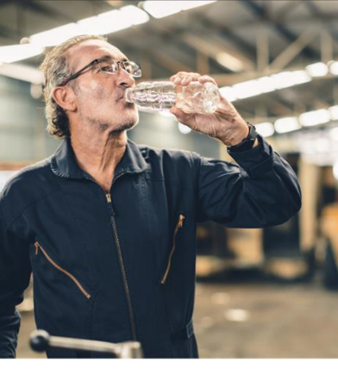
Heat Stress Hazard Controls
Engineering
Administrative
  Acclimatization
  Rest/Work Cycle
  Hydration
  Cool Area/Shade
  Pre-planning (heavy work during morning hours)
  Training
PPE
Notes:
Ask the participants if they can think of some examples of hazard controls for heat stress prevention.
What are some examples of engineering controls that can be used? What about administrative controls? What types of PPE have they seen or encountered that can be used for heat stress prevention?
Image: Employee in manufacturing facility drinking water from a water bottle.

Slide 52
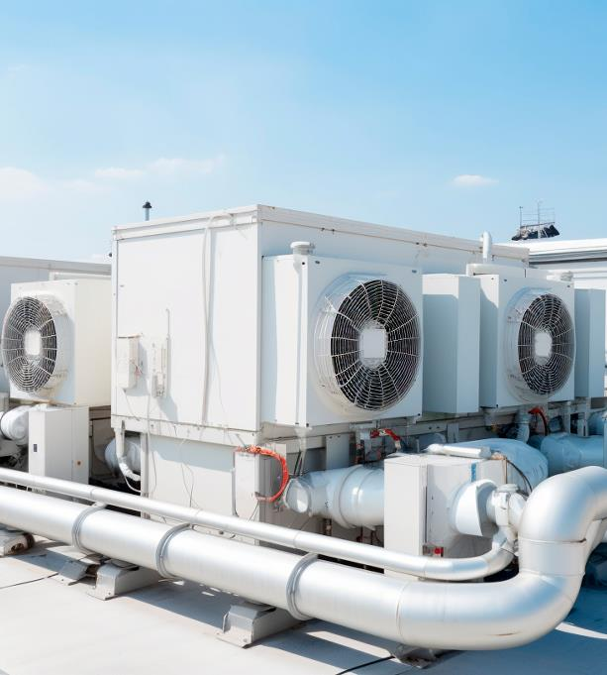
Engineering Controls
Air conditioning
Increased general ventilation
Cooling fans
Local exhaust ventilation at high heat/moisture production points
Reflective or heat-absorbing shielding/barriers
Insulation of hot surfaces
Misting fans
Use of mechanical equipment to reduce manual work (e.g., conveyors, forklifts)
Reduction of humidity, steam leaks, wet floors
Notes:
The best engineering controls to prevent heat-related illness make the work environment cooler and reduce manual workload with mechanization. A variety of engineering controls can reduce workers' exposure to heat:
Air conditioning (such as air-conditioned crane or construction equipment cabs, air conditioning in break rooms)
Increased general ventilation
Cooling fans
Local exhaust ventilation at points of high heat production or moisture (such as exhaust hoods in laundry rooms)
Reflective shields to redirect radiant heat
Insulation of hot surfaces (such as furnace walls)
Elimination of steam leaks
Cooled seats or benches for rest breaks
Use of mechanical equipment to reduce manual work (such as conveyors and forklifts).
Misting fans that produce a spray of fine water droplets
Source: https://www.osha.gov/heat-exposure/controls
Image: Industrial air conditioning systems

Slide 53
Administrative Controls/Work Practices
Acclimatization
Mandatory rest breaks
Scheduling work at cooler time of day
Pre-planning work to minimize physical demands
Job rotation
Hydration
Physiological and hydration monitoring of workers
Buddy system
Heat alert program
Emergency plan/Heat illness prevention plan
TRAINING
Notes:
Some worksites cannot be fully cooled by engineering controls. At those locations, employers should modify work practices when heat stress is too high to work safely. The following are administrative controls and work practices that can be implemented to prevent heat stress in the workplace:
Acclimatization - modify work schedules and activities for workers who are new to hot environments
Schedule shorter shifts for newly hired workers and unacclimatized existing workers. Gradually increase shift length over the first 1-2 weeks.
Require mandatory rest breaks in a cooler environment (such as a shady location or an air-conditioned building). The duration of the rest breaks should increase as heat stress rises. Limit time in the heat and/or increase recovery time spent in a cool area.
Consider scheduling work at a cooler time of day, such as early morning or late afternoon.
Reduce physical demands as much as possible by planning the work to minimize manual effort (such as delivering material to the point of use so that manual handling is minimized).
Rotate job functions among workers to help minimize exertion and heat exposure and increase the number of workers per task.
Ensure that workers drink an adequate amount of water or electrolyte-containing fluids. Provide adequate amounts of cool, potable water near the work area and encourage workers to drink often.
Employers should have an emergency plan that specifies what to do if a worker has signs of heat-related illness and ensures that medical services are available if needed.
Workers should watch out for each other for symptoms of heat-related illness and be prepared to administer appropriate first aid to anyone who is developing a heat-related illness.
Administer appropriate first aid to any worker who is developing a heat-related illness.
In some situations, employers may need to conduct physiological monitoring of workers.
Implement a buddy system for new workers and in heat stress environments. Make sure workers are observing each other for signs of heat-related illness.
Use a heat alert program whenever the weather service forecasts a heat wave.
Training of workers and supervisors about heat stress.
Source 1: https://www.cdc.gov/niosh/topics/heatstress/recommendations.html
Source 2: https://www.osha.gov/heat-exposure/controls

Slide 54
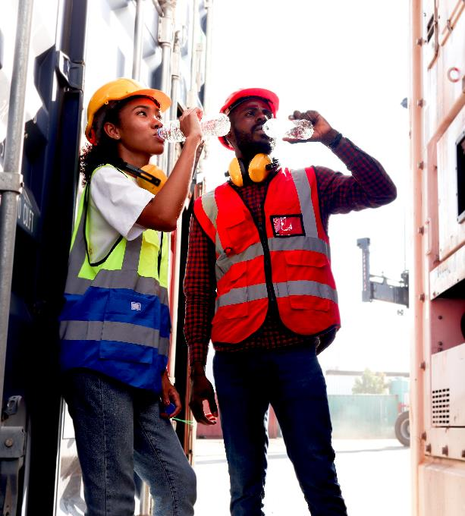
Heat Acclimatization – What is it?
The improvement in heat tolerance that comes from gradually increasing the intensity or duration of work performed in a hot setting
Gradually increasing workload performed over a period of 1-2 weeks is ideal
Employees begin to lose acclimatization after ~1 week away from working in heat
Notes:
Employers should have a formal acclimatization plan for employees working in the heat. Starting new employees at full intensity is not safe. Adjustments to the acclimatization schedule may be needed depending on the worksite’s situation and on individual factors. Most workers should be able to safely handle a full workload after 4 days of gradual increase, even though they will usually not be fully acclimatized yet. Most people will continue to see beneficial improvements in heat tolerance for up to 2 weeks after exposure starts.
Acclimatization will be maintained for a few days after heat exposure stops but will begin to be lost after about 1 week away from working in the heat. After 1 month away from working in the heat, most people’s heat tolerance will have returned to baseline. Working for 1–2 days in cooler conditions or taking breaks in air conditioning will not hurt acclimatization.
Image: Two employees taking a break and drinking water from water bottles.

Slide 55
Heat Acclimatization – Why is it important?
New employees are at the highest risk for heat illness
Heat casualties often occur with new or less experienced employees
Deaths from heat stress often occur during the first few days on the job
Notes:
OSHA has found that:
Almost half of heat-related deaths occur on a worker’s very first day on the job (Arbury 2014).
Over 70 percent of heat-related deaths occur during a worker’s first week (Tustin 2018).
New employees are at the highest risk for heat illness, since their bodies have not yet adapted to working in hot conditions.
Source: https://www.osha.gov/heat-exposure/protecting-new-workers

Slide 56
The Need for Acclimatization
With acclimatization, heat exposure causes less strain to the heart and other vital organs
Body produces more sweat → more evaporative cooling
Sweat contains less salt → less likely to develop electrolyte imbalances
Body is more efficient at getting rid of heat → slower body temperature increase
More blood flows to the skin → more efficient cooling through the skin
Acclimatized workers start sweating sooner and produce more sweat.
  Need more water
Increases worker ability to comfortably perform physical tasks in heat
Notes:
When workers are properly acclimatized, heat exposure causes less strain to the heart and other vital organs, and workers are able to perform physical tasks in the heat more comfortably.
The following takes place when the body has been acclimatized to a hot environment:
Body produces more sweat → more evaporative cooling
Sweat contains less salt loss → less likely to develop electrolyte imbalances and heat cramps
Body is more efficient at getting rid of heat → slower heart rate and slower body temperature increase
More blood flows to the skin → more efficient cooling through the skin
Acclimatized workers start sweating sooner and produce more sweat. This is why they need more water.
It’s important to note that sudden shifts in work intensity or sudden increases in environmental temperature can increase the risk for heat illness even for acclimatized workers.
Source: https://www.osha.gov/heat-exposure/protecting-new-workers

Slide 57
The Need for Acclimatization (Continued)
Laborer in Florida, 28 years old
  Moved to the United States on December 31, 2022
  January 1, 2023, was his 1st day working at a farm in Parkland, FL
  5 hours pulling weeds, placing wooden stakes in ground around vegetables
  Heat index near 90 degrees
  Struggling to keep pace
  Complained of fatigue and leg pain
  Found unresponsive in shallow drainage ditch
  Company cited by OSHA
  Source: OSHA News Release – Region IV, June 28, 2023
Notes:
This fatality could have been prevented if the employee was properly acclimatized to his working environment and given water, shade, and rest. He passed away on the first day of his job. His employer did not have an acclimatization program in place.
Source 1: https://www.osha.gov/news/newsreleases/region4/06282023
Source 2: https://www.osha.gov/ords/imis/establishment.inspection_detail?id=1325173.015

Slide 58
How to Acclimatize Workers
Gradually increase workers’ time in hot conditions over 1-2 weeks
For new workers, the schedule should be:
  No more than 20% of the usual duration of work in the heat on day 1
  No more than 20% increase on each additional day
For workers with previous experience, the schedule should be:
  No more than 50% of the usual duration of work in the heat on day 1
  No more than 60% on day 2
  No more than 80% on day 3
  No more than 100% on day 4
New employees must be closely supervised for the first 14 days or until they are fully acclimatized
More time is needed for workers who are not physically fit
Notes:
How to Acclimatize Workers:
Gradually increase workers’ time in hot conditions over 7 to 14 days.
For new workers, the schedule should be:
No more than 20% of the usual duration of work in the heat on day 1.
No more than 20% increase on each additional day.
For workers with previous experience, the schedule should be:
No more than 50% of the usual duration of work in the heat on day 1
No more than 60% of the usual duration of work in the heat on day 2
No more than 80% of the usual duration of work in the heat on day 3
No more than 100% of the usual duration of work in the heat on day 4.
Closely supervise new employees for the first 14 days or until they are fully acclimatized.
Workers who are not physically fit need more time to fully acclimatize.
Acclimatization can be maintained for a few days of non-heat exposure.
Taking breaks in air conditioning will not affect acclimatization.

Slide 59
Rest Breaks
Workers need to take breaks to allow their bodies to cool down
Rest and water breaks must be permitted if a worker feels heat discomfort
New and unacclimatized workers should be assigned lighter work and longer, more frequent rest periods
Work periods should be shortened, and rest periods increased:
  As temperature, humidity, and exposure to sunshine increase
  When there is no or little air movement
  If PPE is worn (clothing or equipment)
  When heavier work is being performed
Notes:
Rest breaks are very important when it comes to preventing heat-related illnesses, as they allow the body to cool down.
Employers should implement the following:
Modify work/rest periods to give the body a chance to get rid of excess heat.
Permit rest and water breaks when a worker feels heat discomfort.
Assign new and unacclimatized workers lighter work and longer, more frequent rest periods.
Shorten work periods and increase rest periods:
As temperature, humidity, and sunshine increase.
When there is no air movement.
If protective clothing or equipment is worn.
For heavier work.
Source: https://www.cdc.gov/niosh/topics/heatstress/recommendations.html

Slide 60
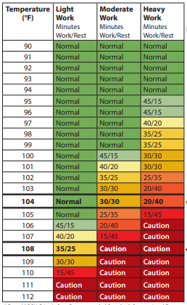
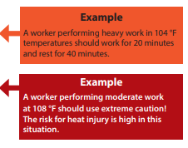

Rest Breaks (Continued)
A variety of work/rest schedules are available that can be adapted to different worksites
It is not sufficient to rely on self-pacing alone
Notes:
There are several work/rest schedules available that can be used by employers and adapted to different worksites. This particular schedule is from the CDC. This schedule is for workers who are physically fit, well-rested, fully hydrated, under age 40, and working in an environment that has 30% humidity and perceptible air movement. Therefore, this particular schedule may not be applicable to many worksites. It’s important to take into account personal risk factors as well as environmental and occupational factors when developing or adapting a work/rest schedule.
Go through this sample table with the participants. In the columns we have the work classification: Light Work, Moderate Work, and Heavy Work. The rows include the temperature in Fahrenheit.
It’s important to note that it is not sufficient to rely on worker self-pacing. It’s possible that workers may not realize when they need to take a break.
Source: https://www.cdc.gov/niosh/mining/UserFiles/works/pdfs/2017-127.pdf
Table: This table is a work/rest schedule from the CDC. It is based off NIOSH’s Criteria for a Recommended Standard, Occupational Exposure to Heat and Hot Environments.

Slide 61
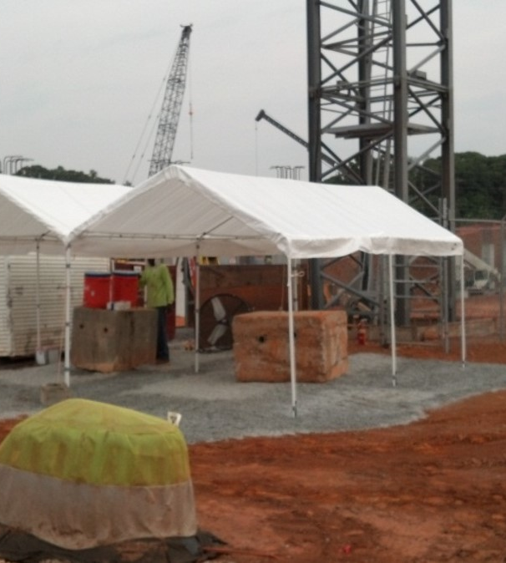
Shade
Can provide cooling from shade by using:
  Pop-Up Tents
  Canopies
  Umbrellas
  Structures that are mechanically ventilated or open to air movement
Set up in advance
As close to work area as possible
Large enough to accommodate employees and have space for responding to emergency situations
Notes:
If performing outdoor work, employees need to be provided with shade. Shade can be provided to workers in a variety of ways, including using pop-ups, canopies, umbrellas, and structures that are mechanically ventilated or open to air movement (e.g., unfinished structures or semi-finished garages). Other ways to provide shade are by using:
tarpaulins tied to 4 posts,
full and thick tree canopies that block direct sunlight,
buildings, and
enclosed areas only if they provide cooling comparable to shade in the open air (note: this is not a complete list).
Make sure the shade is set up prior to the start of work, and that is it located as close to the work area as possible.
Shaded areas need to be large enough to accommodate employees as well as have space for responding to emergency situations (e.g., if an employee has a heat stroke).
Have a designated person point out the daily location of the shade structures to the workers.
Image: Photo of a white pop-up tent used for shade at a construction site.
Source: https://www.dir.ca.gov/dosh/etools/08-006/EWP_shade.htm

Slide 62
Shade: Things to Consider
Only adequate when it completely blocks direct sunlight and allows the body to cool
Do not provide shade using: metal storage sheds (unless cool), the interior of vehicles unless AC system is continually running and working, areas underneath or near equipment
Do not sit directly on the ground (provide chairs and benches)
Notes:
Shade is adequate only when it completely blocks the direct sunlight and allows the body to cool.
Do not provide shade by using:
Metal storage sheds and other similar out-buildings unless they provide a cooling environment comparable to shade in the open air
The interior of vehicles. This is because they keep heating up in the sun and do not provide cooling unless the air-conditioning system is continually running and working effectively
Areas underneath or near equipment (e.g., tractors) or vehicles as they expose employees to other potential hazards
Access to shade is effective only when it does not deter or discourage access or use.
Do not have shade located:
Across a fence or obstacles
Too far from work area
Such that employees do not have to cross traffic or waterways to reach the shade
Near areas with dirty, dusty and unsanitary conditions
Next to portable toilet facilities or where employees would sit on wet or muddy ground or encounter branches, brush, and thorns.
Source: https://www.dir.ca.gov/dosh/etools/08-006/EWP_shade.htm

Slide 63

Hydration
Appropriate hydration must be provided to workers
Water should be potable, <59 °F, and accessible
Identify who will obtain and check on water supplies
Encourage workers to hydrate themselves
Provide individual drinking cups or bottles for each worker
Notes:
Hydration is extremely important when it comes to protecting employees from heat stress, as dehydration is a primary contributor to heat exhaustion. Employers should provide the means for appropriate hydration of workers. When providing water, ensure the following is met:
Water should be potable, <15°C (59°F), and made accessible near the work area.
Estimate how much water will be needed and decide who will get and check on water supplies.
Provide individual drinking cups for each worker.
Encourage workers to hydrate themselves.
Source: https://www.cdc.gov/niosh/topics/heatstress/recommendations.html
Image: An employee at a construction site drinking water from a disposable water bottle.

Slide 64
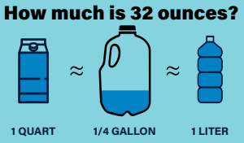
How to Stay Hydrated?
Hydrate before, during, and after work
For moderate activities in the heat that last less than 2 hours:
  Drink 8 oz. of water every 15-20 minutes
  (~32 oz. every hour)
Notes:
Workers should drink an appropriate amount to stay hydrated. This does not just refer to during their work shift. Being hydrated when you start work makes it easier to stay hydrated throughout the day. If you are dehydrated when you start work, you may not be able to drink enough to catch up with your body’s need for water. In addition, most people need several hours to drink enough fluids to replace what they have lost through sweat. The sooner you start rehydrating after your work shift, the less strain you place on your body from dehydration.
Hydrating after work is even more important if you work in the heat on a regular basis. Chronic dehydration increases the risk for several medical conditions, such as kidney stones.
Make sure workers are trained on the following hydration guidelines for during work, and that adequate water and sports drinks are provided:
For moderate activities in the heat that last less than 2 hours, drink 1 cup (8 oz.) of water every 15–20 minutes.
If sweating lasts for several hours, drink sports drinks containing balanced electrolytes.
It’s important to mention that by the time you feel thirsty, you are already behind in fluid replacement
Make sure you take your scheduled meal breaks. Eating meals and snacks will help ensure you are ingesting enough salt.
Do not drink more than 48 oz (6 cups) of water per hour. Drinking too much water or other fluids can cause a medical emergency because the concentration of salt in the blood becomes too low.
Source 1: https://www.cdc.gov/niosh/topics/heatstress/recommendations.html
Source 2: https://www.cdc.gov/niosh/mining/UserFiles/works/pdfs/2017-126.pdf
Graphic: This graphic shows what 32 ounces looks like in different ways. 32 ounces is equal to 1 quart, ¼ gallon, and 1 liter.

Slide 65
How to Stay Hydrated? (Continued)
If sweating lasts for several hours:
  Drink sports drinks containing balanced electrolytes
Take scheduled meal breaks
Do not drink more than 48 oz. per hour
**Remember: drinking at shorter intervals is more effective than drinking large amounts infrequently
Notes:
Workers should drink an appropriate amount to stay hydrated. This does not just refer to during their work shift. Being hydrated when you start work makes it easier to stay hydrated throughout the day. If you are dehydrated when you start work, you may not be able to drink enough to catch up with your body’s need for water. In addition, most people need several hours to drink enough fluids to replace what they have lost through sweat. The sooner you start rehydrating after your work shift, the less strain you place on your body from dehydration.
Hydrating after work is even more important if you work in the heat on a regular basis. Chronic dehydration increases the risk for several medical conditions, such as kidney stones.
Make sure workers are trained on the following hydration guidelines for during work, and that adequate water and sports drinks are provided:
For moderate activities in the heat that last less than 2 hours, drink 1 cup (8 oz.) of water every 15–20 minutes.
If sweating lasts for several hours, drink sports drinks containing balanced electrolytes.
It’s important to mention that by the time you feel thirsty, you are already behind in fluid replacement
Make sure you take your scheduled meal breaks. Eating meals and snacks will help ensure you are ingesting enough salt.
Do not drink more than 48 oz (6 cups) of water per hour. Drinking too much water or other fluids can cause a medical emergency because the concentration of salt in the blood becomes too low.

Slide 66
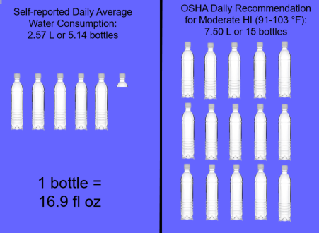
Hydration – Daily Recommendation
Notes:
Before showing this slide, consider doing this activity:
Ask the participants: how many bottles of water do you think is OSHA’s daily recommendation for working in a moderate heat index? Display 16.9 fluid oz bottles at the front of the class so they can see what they look like. Keep asking them what they think is OSHA’s daily recommendation until they get close to 15 bottles. Show them what 15 bottles looks like and remind them that this is for working in a moderate heat index (heat index of 91 to 103 degrees). If working in a higher heat index, they will need to consume more water.
Graphic: Graphic demonstrating self-reported daily average water consumption versus OSHA’s daily recommendation for water consumption wen working in a moderate heat index.
Source: American Builders 2017 “Are You Properly Hydrated?” Graphic

Slide 67
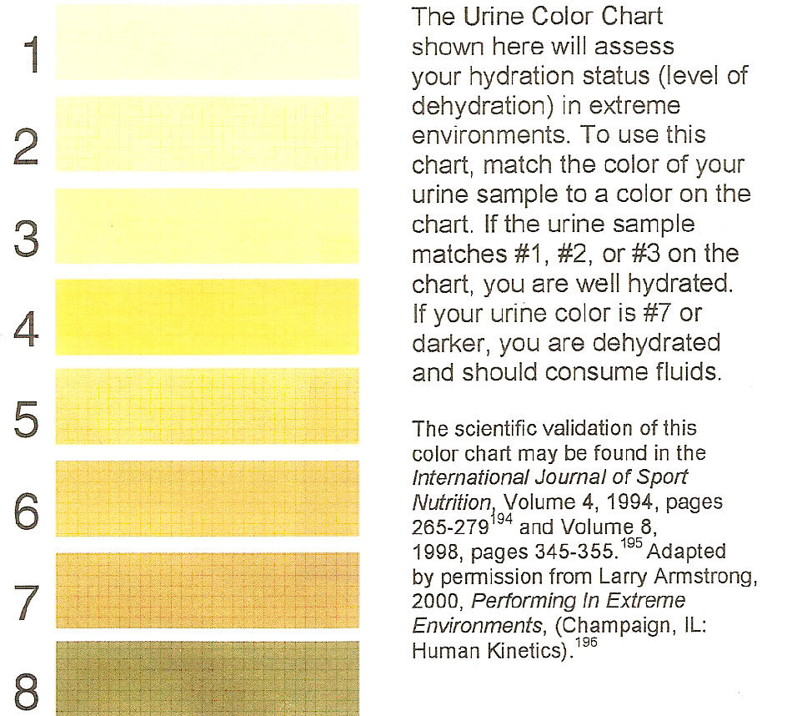
Hydration Chart
Notes:
Urine color charts can be used to gauge or assess your hydration status. In response to dehydration, the kidneys conserve water and excrete more concentrated urine; the more concentrated the urine the darker the color.
To use the chart, match the color of your urine sample to a color on the chart. Make sure you watch the urine stream not the toilet water, as the water in the toilet will dilute your urine color. If the urine sample matches #1, #2, or #3 on the chart, you are well hydrated. If you are a #4 or #5 you are at risk of becoming dehydrated and need to drink water to prevent becoming dehydrated. If your urine color is #6 or darker, you are severely dehydrated and need to consume more fluids immediately. This chart can be posted in restrooms for employees to use/reference.
Chart: This chart shows different shades of yellow/brown that demonstrate hydration status, starting with 1 (well hydrated) to 8 (severely dehydrated).

Slide 68
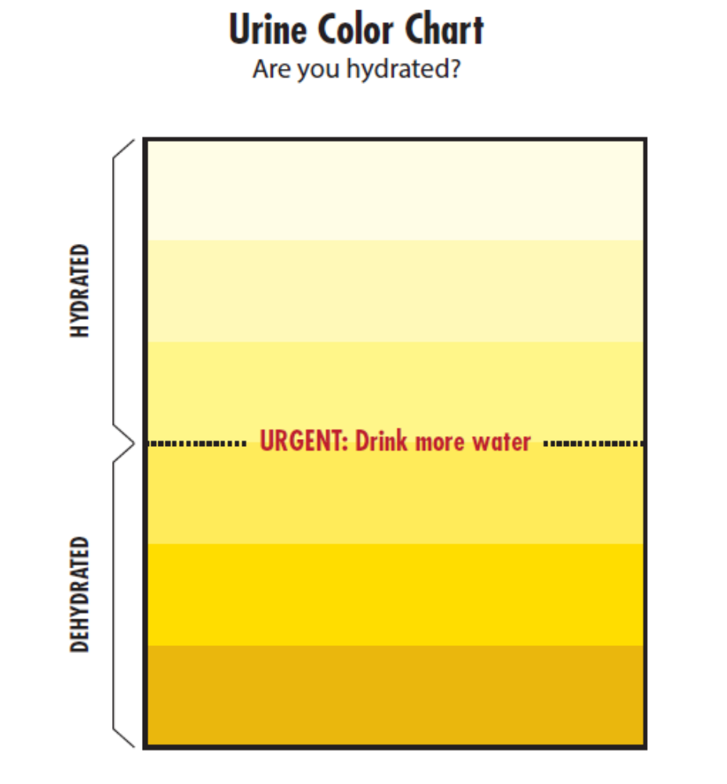
Urine Color Chart
Notes:
This is another urine color chart that can be posted in restrooms for employees to see.
Source: Georgia Tech Consultation Program Heat Stress Prevention Program
Chart: This chart demonstrates hydration status. Lighter shades of yellow suggest hydration, whereas darker shades of yellow/brown suggest dehydration and severe dehydration.

Slide 69
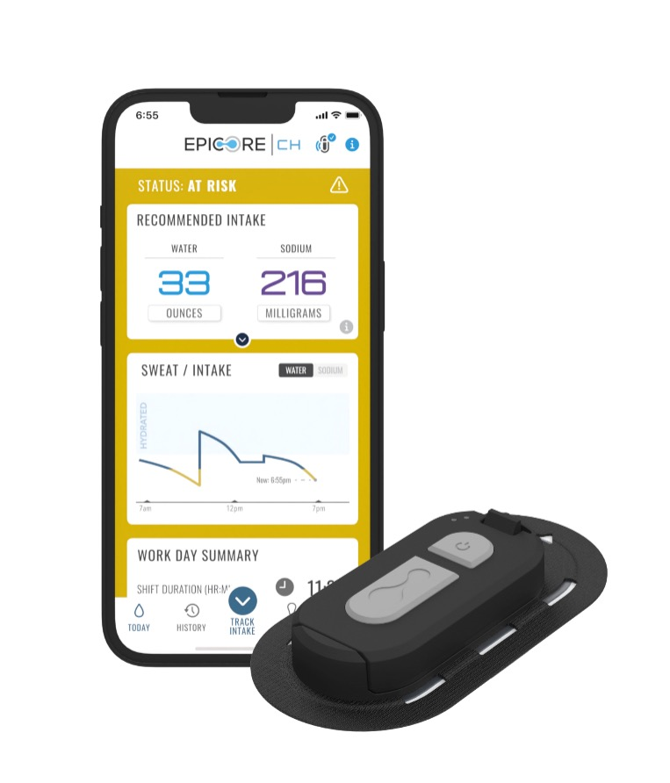
Hydration Monitoring
Wearable Hydration Trackers
  Measure fluid and sodium loss, skin temperature, and motion
  Direct and continuous sweat measurements
  Real-time alerts and hydration recommendations
Hydration Testing Systems
  Can track hydration levels of employees
  Saliva measurement (instant results, non-invasive)
Notes:
In recent years, technology has been developed to help workers and employers with monitoring hydration status. Wearable hydration trackers have been developed that measure fluid and sodium loss, skin temperature, and motion. They can be paired with an application that provides direct and continuous sweat measurements, as well as real-time alerts and hydration recommendations.
Hydration testing systems can also be used to monitor hydration status in the workplace. Hydration testing systems require a quick saliva or sweat sample and can provide employers and workers with immediate results. Worker hydration level is recorded within seconds of taking a saliva measurement, and the results can be immediately uploaded to a mobile application. The testing systems will tell you how much fluid to drink and what kind of fluid to drink to best replace electrolytes lost while working in the heat.
For companies that monitor employee hydration, these two means of monitoring are less invasive than taking urine samples. Companies also have access to the results through the applications and can use the results to help them make decisions related to employee hydration during the work shift.
Image: Photo of a wearable hydration tracker and a cellular app that is used to measure hydration status.

Slide 70
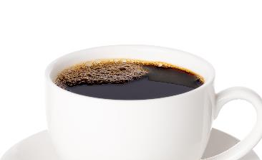

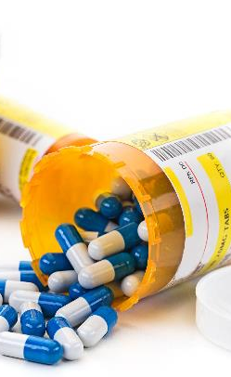
Come to Work Prepared!
Limit alcohol consumption
  Diuretic
  Consumption within 24 hours can contribute to heat illness
Limit caffeine consumption
  High levels can add additional strain on heart
  Avoid energy drinks
Notes:
Employers can only control so much. They cannot control the decisions workers make outside of the workplace. Workers are still responsible for the decisions they make that can either predispose them to heat-related illness or prepare them for working in the heat.
Alcohol can cause dehydration. Drinking alcohol within 24 hours of working in the heat can increase the risk of heat illness. Having a beer the night before a work shift can increase your risk of heat illness in the following day.
In addition, workers should limit their caffeine consumption. In general, a normal amount of caffeine will not influence your overall hydration. However, when your heart is strained from hot temperatures and workload, high caffeine levels can add additional strain on your heart. It’s important to note that some energy drinks contain more caffeine than coffee, and drinking several energy drinks per day can raise your caffeine levels enough to affect your heart.
Image 1: A white plate with two fried eggs and bacon. Included to demonstrate the need for workers to consume meals prior to and during their work shift.
Image 2: A bottle of prescription medication. Used to demonstrate the need for employees to consider any medication they may be on.
Image 3: A cup of black coffee. Included to demonstrate the need for employees to be aware of their caffeine consumption.

Slide 71
Come to Work Prepared! (Continued)
Do not skip meals
Bring your own water bottle
Hydrate the day before
Consider medications
  Some medications are diuretics or affect temperature regulation in the body
Dress appropriately for the heat, light-colored clothing
Notes:
Do not skip meals. Do not skip breakfast and do not work through your lunch break or any other break. Meals provide your body with salt, a critical electrolyte that delivers water to your body’s cells.
It may be helpful to bring your own water bottle, especially one that is insulated.
Make sure you are drinking enough water the day before your work shift. This is going to make it easier for you to remain hydrated during your work shift.
Certain medications may act as diuretics or affect temperature regulation in the body. Check to see if you are taking any medications that may do so. If you are, notify your supervisor. You will need to take additional precautions to ensure you do not experience heat stress.
Dress appropriately for the heat. Inappropriate clothing can increase the burden of the heat load on the body. In general appropriate work clothing should be:
Lightweight , loose fitting and made of breathable fabric that allow airflow and air movement aiding in cooling the body.
Light-colored that reflects the heat better than dark-colored clothes (which absorb heat).
Shirts with long sleeves that cover the body and avoid sunburn. Sunburn affects the body’s ability to cool itself and increases the loss of body fluid.

Slide 72
Knowledge Check: Hydration
How many ounces of water should be consumed every 15-20 minutes when performing moderate activities in the heat for less than 2 hours?
When should workers drink sports drinks with balanced electrolytes?
True or False: Alcohol consumption within 24 hours of work shift can increase risk of heat illness.
True or False: Employees should only worry about hydrating during and after their work shift.
True or False: Drinking water frequently and eating regular meals is usually sufficient for hydration.
List 4 ways employers can encourage proper hydration amongst workers.
Notes:
Go through these questions with the participants.
8 ounces
If sweating lasts for several hours
True
False – they also need to hydrate BEFORE
True
Equipping all work areas with accessible and cool water, educating workers on the importance of hydration and what should be avoided, designating a relief person so workers can take a water break, encouraging workers to drink at least 1 cup of water every 15-20 minutes, providing sports drinks with balanced electrolytes if strenuous, sweat-producing job tasks will be performed, maintain a cool or shaded rest location.

Slide 73
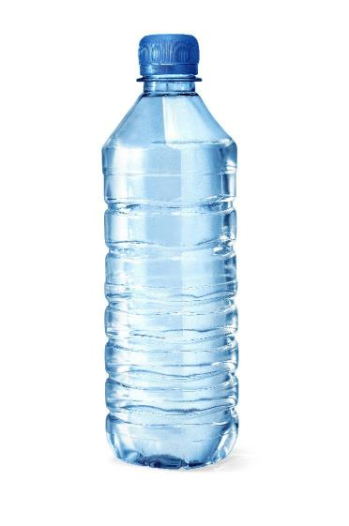
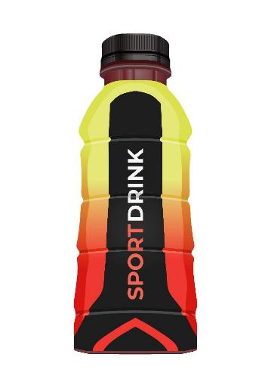
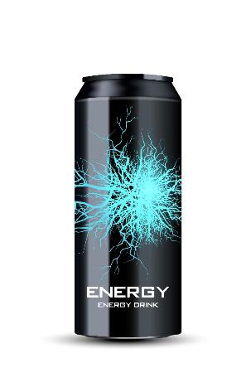
Hydration Activity
Sort the beverages in order of which would be the best to worst choice at:
  At the beginning of the shift
  At the end of the shift
Notes:
Activity: Conduct this activity with the class. Ask for two volunteers. Have at the front of the class an energy drink, a sports drink, an electrolyte supplement, and a bottle of water. Ask the first volunteer to sort the three beverages in order of which would be the best to worst choice at the beginning of the work shift. Ask the second volunteer to sort the three beverages in order of which would be the best to worst choice at the end of the work shift.
Answer: At both the beginning and end of the work shift the order should be: Water – Electrolyte Supplement – Sports Drink – Energy Drink
Do this activity to highlight the importance of drinking water, as well as the risks of drinking energy drinks while working in the heat.
Image 1: An energy drink
Image 2: A sports drink
Image 3: A bottle of water

Slide 74
Pre-Planning Exposure Assessments
Factors that need to be considered:
  Environmental conditions (e.g., air temperature, humidity, sunlight, air speed)
  Presence of heat sources (e.g., ovens or furnaces) in the work area
  Level of physical activity
  Use of clothing or protective gear
    Can reduce body’s ability to lose excess heat
  Individual and personal risk factors
Notes:
Employers are responsible for protecting their employees from heat-related hazards. To do so, pre-planning is very important. There are several factors employers need to consider when conducting pre-planning exposure assessments, including:
Environmental conditions (such as air temperature, humidity, sunlight, and air speed), especially on sequential days.
When the atmospheric moisture content (i.e., relative humidity) is high, the rate of evaporation from the body decreases. In other words, the human body feels warmer in humid conditions. The opposite is true when the relative humidity decreases because the rate of perspiration increases. The body feels cooler in arid conditions. There is direct relationship between the air temperature and relative humidity and the heat index, meaning as the air temperature and relative humidity increase (decrease), the heat index increases (decreases).
Presence of heat sources (e.g., hot tar ovens or furnaces) in the work area.
Level of physical activity )i.e., the workload leading to body heat production).
Use of clothing or protective gear that can reduce the body’s ability to lose excess heat.
Individual/personal risk factors.

Slide 75
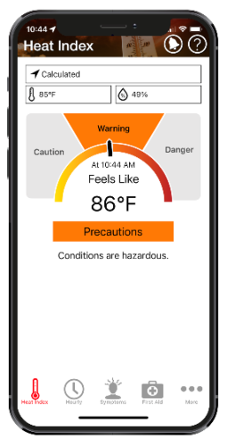
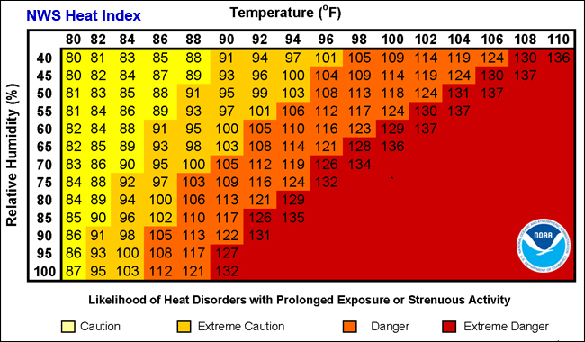
Pre-Planning Exposure Assessments
Notes:
Two resources that can help when determining the environmental conditions prior to a work shift are The National Weather Service (NWS) Heat Index Chart and the OSHA NIOSH Heat Safety Application.
The NWS Heat Index Chart measures the apparent temperature, which is what the temperature feels like to the human body. The human body feels warmer in humid conditions. The chart also shows the likelihood of heat stress disorders with prolonged exposure or strenuous activity depending upon the heat index.
The OSHA NIOSH Heat Safety Application provides a visual indicator of the current heat index and associated risk levels specific to your current geographical locations. In addition, it includes precautionary recommendations specific to heat index-associated risk levels, recommendations for planning outdoor work activities, and signs and symptoms and first aid for heat-related illnesses. In the application, the location, temperature, and humidity controls can all be edited to calculate the heat index for different conditions.
Image 1: The National Weather Service’s Heat Index Chart
Image 1 Source: https://www.weather.gov/ama/heatindex
Image 2: A screenshot of the home page on the OSHA NIOSH Heat Safety App

Slide 76
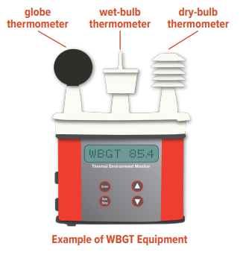
Heat Assessments – Wet Globe Bulb Thermometer (WBGT)
Estimates effect of temperature, relative humidity, wind speed, and solar radiation
Utilizes three different thermometers
Accounts for:
  Conditions inside a building
  Working in direct sunlight
  Heat generated by hot equipment, hot materials, and heat-absorbing surfaces
  Air movement
  Reflective materials in the work area
Notes:
Heat assessments can also be done on-site to determine the environmental conditions on the work-site as well as identify heat sources throughout the work site. Wet Globe Bulb Thermometers are used to estimate the effect of temperature, relative humidity, wind speed, and solar radiation by using three different thermometers:
The wet bulb measures the temperature read by a thermometer covered in a wet cloth. As water evaporates from the cloth, evaporation cools the thermometer. This mirrors how the human body cools itself with sweat.
The black globe is used to measure solar radiation. Solar radiation heats the globe and wind blowing across it cools the globe.
The dry bulb calculates the air temperature measured in the shade. It is the temperature you would see on your thermometer outside.
The Wet Globe Bulb Thermometers allow employers to estimate the effects of the following:
Indoor work — A weather report cannot gauge conditions inside a building.
Direct sunlight — Weather services measure temperature and Heat Index in the shade. Work in the sun may be considerably hotter. Direct sunlight can increase the Heat Index by up to 13.5°F (7.5°C).
Heat sources — Weather reports cannot account for the heat generated by fires, hot tar or other materials, ovens, or other hot equipment, or heat-absorbing surfaces such as roads and roof surfaces.
Wind blockage — Some worksites may be hotter than surrounding areas because of structures that block air movement. Examples include trenches and bowl-shaped athletic stadiums.
Reflective material — Water, metal, or other materials can reflect sunlight onto workers.
Image: An example of Wet Globe Bulb Thermometer, with the globe thermometer, wet-bulb thermometer, and the dry-bulb thermometer

Slide 77
Heat Assessments – Determining Workload
First step is to determine the workload
  Light: Sitting or standing with minimal arm and leg work.
  Moderate: Continuous moderate intensity, such as light pushing/pulling or normal walking.
  Heavy: Intense upper body work such as carrying loads or sawing.
  Very heavy: Intense activity at an almost maximum pace.
Notes:
Another factor that needs to be included when conducting a pre-planning exposure assessment is the workload. The workload is going to affect a worker’s heat stress.

Slide 78
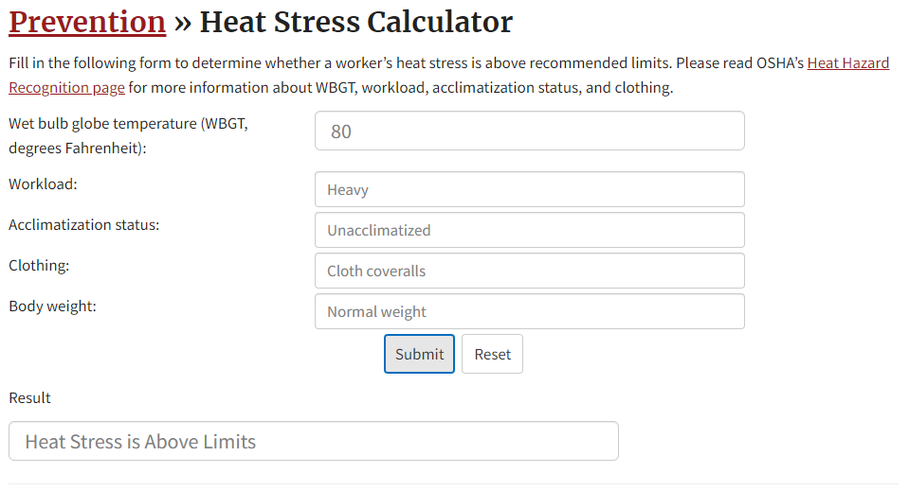
OSHA Heat Stress Calculator
Notes:
OSHA has a heat stress calculator on its website that employers can use when performing their pre-planning exposure assessments. The heat stress calculator considers
the wet bulb globe temperature,
the workload being performed,
the employee’s acclimatization status,
the clothing they are wearing, and
their body weight.
The calculator will then tell you whether the worker’s heat stress is above the recommended limits.
Image: Screenshot of OSHA’s Heat Stress Calculator
Source: https://www.osha.gov/heat-exposure/calculator

Slide 79
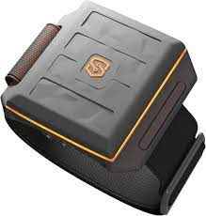
Heat Assessments – Physiological Monitoring
Heat Bands
  Measure core body temperature and heart rate
  Notify manager when dangerous levels are exceeded for employees
  Employees can alert manager on band if assistance is needed
  Data logging capabilities
Smart watches (i.e., Apple watch, Garmin, etc.)
  Can measure heart rate levels
  No core temperature readings
Notes:
Physiological monitoring can be conducted to monitor workers on-site. Heat bands are wearable technology that perform the following:
Measure core body temperature and heart rate
Notify manager when dangerous levels are exceeded for employees
Employees can alert manager on band if assistance is needed
Data logging
Smart watches can also be used, but only do measure heart rate levels when working. They are not capable of reading core body temperature.
Image: An image of a wearable heat band that can be used on-site to perform physiological monitoring of employees.

Slide 80
Employee Training – What Do Employees Need to Know?
How to recognize the signs and symptoms of heat-related illnesses
How to administer first aid
Causes of heat-related illnesses and steps to reduce risk (e.g., drinking enough water, monitoring urine output)
Proper care and use of heat-protective clothing and equipment and added heat load caused by exertion, clothing, and PPE
Effects of other factors (drugs, alcohol, obesity, etc.) on tolerance to heat stress
The importance of acclimatization
The importance of immediately reporting any symptoms or signs of heat-related illness in themselves or in coworkers
Procedures for responding to symptoms of possible heat-related illness
Notes:
Employers should provide a heat stress training program for all workers and supervisors the includes the following:
Recognition of the signs and symptoms of heat-related illnesses and administra­tion of first aid.
Causes of heat-related illnesses and steps to reduce the risk. These include drinking enough water and monitoring the color and amount of urine output.
Proper care and use of heat-protective clothing and equipment and the added heat load caused by exertion, clothing, and per­sonal protective equipment.
Effects of other factors (drugs, alcohol, obesity, etc.) on tolerance to occupational heat stress.
The importance of acclimatization.
The importance of immediately reporting any symptoms or signs of heat-related illness in themselves or in coworkers to the supervisor.
Procedures for responding to symptoms of possible heat-related illness and for contacting emergency medical ser­vices.

Slide 81
Worker Buddy System
Look out for your co-workers
  Weakness
  Nausea
  Dizziness
  Vomiting
  Confusion
  Fainting
  Irritability
Notes:
Worker buddy systems should be implemented to encourage employees to look out for one another, including when workers are being acclimatized to working in a hot environment. If you spot someone experiencing weakness, nausea, dizziness, vomiting, confusion, fainting, or irritability, it’s important to take action.

Slide 82
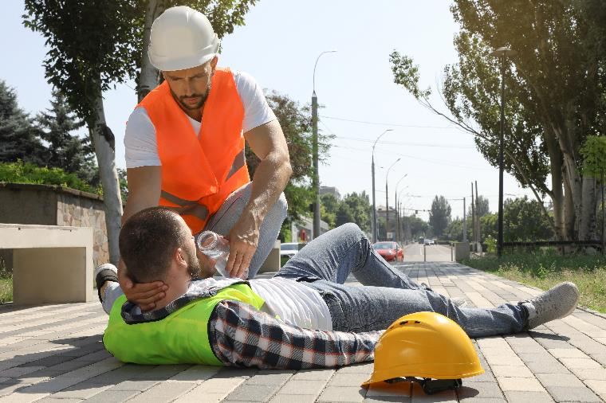
Worker Buddy System (Continued)
If you spot someone experiencing symptoms of heat stress, take action:
  Give them water to drink
  Move them to a cooler area
  Cool them with water, ice, or a fan
  Remove unnecessary clothing
  Do not leave them alone
  Notify supervisor
  If in doubt (or if supervisor is not available) call 911 or seek medical care
Notes:
If you spot someone experiencing weakness, nausea, dizziness, vomiting, confusion, fainting, or irritability, take action:
Give them water to drink
Move them to a cooler area
Cool them with water, ice or a fan
Remove unnecessary clothing
Do not them leave alone
If in doubt, call 911 or seek medical care
Image: An employee helping his co-worker who is lying on the ground. He is propping his head up and helping him drink water.

Slide 83
Heat Illness Prevention Plan
Outline company strategies for mitigation and employee protection including:
  Employee training
  Water locations (designated responsible person)
  Shade/cooling locations and sources
  Other measures (e.g., buddy system, rest break schedule, work shift adjustments, etc.)
Identify specific work activities that may expose employees/contractors to heat stress hazards
  Identify control measures company will implement for each activity
Notes:
Companies should develop a Heat Illness Prevention Plan that outlines how the company will perform/implement the following:
Employee training
Water locations
Shade/cooling locations and resources
Other measures, such as a buddy system, rest break schedule, and work shift adjustment
The plan should also identify specific work activities that may expose employees or contractors to heat stress hazards and identify control measures for each of those activities to protect workers.

Slide 84

Create a Heat Illness Prevention Plan
https://oshainfo.gatech.edu/written-program-templates/
Job Task/ Exposure to Heat | Company Implemented Control Measures
1.Example: Field work for botanical garden that is conducted outside in direct sunlight | Example: Use of moveable pop-up tent to provide shade Use of jugs of water and electrolytes stationed within 10 ft. of work area Use of cooling vests
Notes:
The Georgia Tech OSHA Consultation Program has a template for a written Heat Illness Prevention Plan. Scan the QR code to access the template. If using the template, make sure you make it specific to the facility/work-site.
Image 1: A table showing the job task and how employees will be exposed to heat, and the company implemented control measures to protect the workers from the heat.
Image 2: A QR code that can be scanned to access the Heat Illness Prevention Plan template

Slide 85
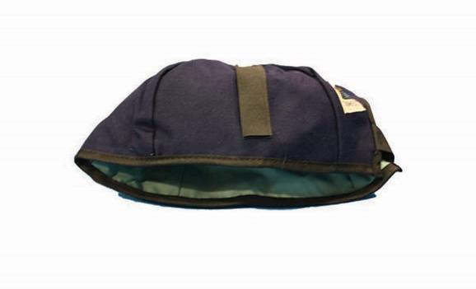
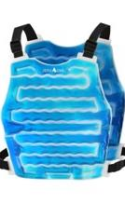
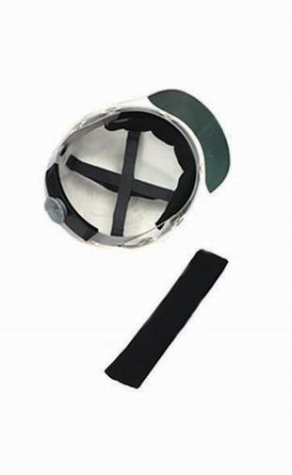
PPE/Clothing for Heat Stress Prevention
Cooling Garments
  Water Cooled Garments
    Battery-driven circulating pump, coolant, container
  Ice Packet Vest
  Air Cooled Garments
    Suits or hoods
  Wetted Over Garments
    Head and neck wraps
    Cooling caps, sweatbands
Lightweight, loose-fitting, breathable fabric
Light colored clothes
Shirts with long sleeves to avoid sunburn
Notes:
There is PPE that can be used to help prevent heat stress in the workplace. However, this PPE may come with limitations and employees must be trained in how to properly use the equipment.
Cooling garments include:
Water-cooled garments (e.g., hoods, vests and "long johns"). These require a battery-driven circulating pump, liquid-ice coolant, and a container. What are potential problems with cooling garments?
Limited operating time
Restriction of movement
Additional weight
Limited Dexterity
Reduction in effective work space
The interaction with PPE used at HAZWOPER sites
Ice packet vests
Air cooled garments (e.g., suits or hoods)
Wetted over garments (e.g., head and neck wraps, cooling caps, sweatbands).
Clothing selection can also have a significant effect on heat stress. Workers should wear clothing that is going to protect them against the sun and other environmental risk factors and allow the body to cool. In general, appropriate work clothing should be:
Lightweight , loose fitting and made of breathable fabric that allow airflow and air movement aiding in cooling the body.
Light-colored, which reflects the heat better than dark-colored clothes (which absorb heat).
Shirts with long sleeves that cover the body and avoid sunburn. Sunburn affects the body’s ability to cool itself and increases the loss of body fluid.
Image 1: A cooling cap that can be used to cool the head
Image 2: A sweatband that can be applied to the inside of a hard hat or cap to cool the head
Image 3: An ice packet vest

Slide 86
PPE/Clothing: Things to Consider
Inappropriate work clothing and PPE can increase the burden of heat load on the body
  Can trap heat and not allow the body to cool
Employees wearing PPE should not work alone in warm or hot conditions
Additional steps may need to be taken:
  Increased monitoring by supervisors and employees (buddy system)
  More frequent breaks to remove PPE and cool down
  Increased water consumption
  Shade and other cooling measures (e.g., misting machines, moving to AC, using cooling vests, etc.)
  Adjusting work schedules and activities
Notes:
Inappropriate work clothing and Personal Protective Equipment can increase the burden of heat load on the body caused by exertion and increase the risk of developing heat illness.
Employers need to train employees on how inappropriate clothing and Personal Protective Equipment can cause heat illness and on the appropriate clothing and Personal Protective Equipment for the particular job they will be performing.
PPE can increase the burden of heat load on the body by trapping the heat and not allowing the body to cool. It is important for employees wearing PPE, which may cover the upper or lower body or face, not to work alone in warm or hot conditions and during high heat or a heat wave. When employees wear this type of PPE in these conditions it may require you to take additional steps to prevent heat illness including (but not limited to):
Monitoring employees more frequently
Having employees watch one another more closely
Having employee take more frequent breaks to remove their PPE to cool down
Ensuring employees drink more water
Providing effective cooling measures
Adjusting work schedules and activities
Seeking additional help from qualified professionals

Slide 87

Preventing Heat Stress at Home
Remember: extreme heat kills more people than any other weather event
Older adults, infants, children, pregnant women, people with medical conditions, people with limited personal resources are all at high risk
Know the signs and symptoms of heat-related illness
Notes:
Individuals are not just at risk of experiencing heat-related illnesses and deaths on the job. It’s important we apply what we have just learned about heat stress prevention at home to ourselves and to our loved ones.
Image: Beach umbrella with sun shining through

Slide 88

Preventing Heat Stress at Home (Continued)
Take actions to protect yourself and your loved ones:
  Consider medications
  Stay hydrated throughout the day
  Stay in air-conditioning as much as possible
  Wear lightweight, loose clothing
  Take cool showers and baths
  Limit outdoor activity (e.g., gardening, exercising, renovating, etc.) to cooler parts of the day
Notes:
Heat-related illnesses have occurred amongst young, amateur, and professional athletes. It is important athletes are aware of the signs and symptoms of heat-related illness, as well as what to do to prevent heat stress when exercising. Athletes need to look out for themselves and their teammates, and coaches need to look out for their athletes. Emphasize the need to stay hydrated before, during, and after sports practices, as well as the importance of avoiding caffeinated beverages.
Image: Young person wearing football helmet and pads in the sun.

Slide 89
Heat Stress Resources for Companies
OSHA:
  National Emphasis Program: Outdoor and Indoor Heat-Related Hazards: https://www.osha.gov/sites/default/files/enforcement/directives/CPL_03-00-024.pdf
  Working in indoor and outdoor heat environments: https://www.osha.gov/heat-exposure
  Heat Stress Guide: https://www.osha.gov/emergency-preparedness/guides/heat-stress
  Heat Illness Prevention Campaign: https://www.osha.gov/heat
  Heat Stress Calculator: https://www.osha.gov/heat-exposure/calculator
NIOSH
  Heat stress page: https://www.cdc.gov/niosh/topics/heatstress/
  NIOSH-OSHA Heat Safety Tool Application: https://www.cdc.gov/niosh/topics/heatstress/heatapp.html
Georgia Tech
  Training guides, lesson plans, and PPTs: https://oshainfo.gatech.edu/resources/training-materials/additional-information/
Notes:
OSHA, NIOSH, and Georgia Tech all have a number of resources available to companies to help them in protecting their employees from heat-related hazards in the workplace.

Slide 90
Cold Stress
Notes:
The next session of the course will cover cold stress.

Slide 91
What is Cold Stress?
In cold environments, most of the body’s energy is used to keep the internal core temperature warm.
Over time, the body will begin to shift blood flow from the extremities and outer skin to the core (chest and abdomen).
The shift in blood flow allows the exposed skin and extremities to cool rapidly.
Cold stress occurs when the temperature of the skin is driven down, which eventually leads to the internal body temperature being reduced.
Notes:
In a cold environment, most of the body's energy is used to keep the internal core temperature warm.
Over time, the body will begin to shift blood flow from the extremities (hands, feet, arms, and legs) and outer skin to the core (chest and abdomen).
This shift allows the exposed skin and the extremities to cool rapidly and increases the risk of frostbite and hypothermia.
Cold stress occurs when the temperature of the skin is driven down which eventually leads to the internal body temperature being reduced. Serious health problems can occur when the body is unable to stay warm enough.

Slide 92
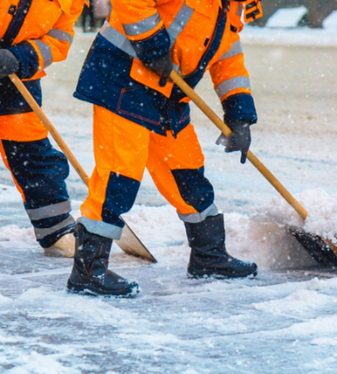
What is Cold Stress? (Continued)
The reduction of internal body temperature can cause tissue damage and even death.
Increased wind speeds and wetness/dampness will increase heat loss from the body.
Substantial outdoor temperature drop will increase heat loss from the body.
Deep core temperature should not fall below
96.8 °F.
Notes:
The reduction of internal body temperature can cause tissue damage and even death. Increased wind speeds, wetness/dampness, and a substantial drop in the outdoor temperature can all increase heat loss from the body. According to the American Conference of Governmental Industrial Hygienists (ACGIH®) Threshold Limit Values (TLV®), workers should be protected from exposure to cold so that the deep core temperature does not fall below 96.8°F (36°C) and to prevent frostbite to body extremities [ACGIH 2019].
Image: Two workers in cold-weather gear shoveling snow.

Slide 93
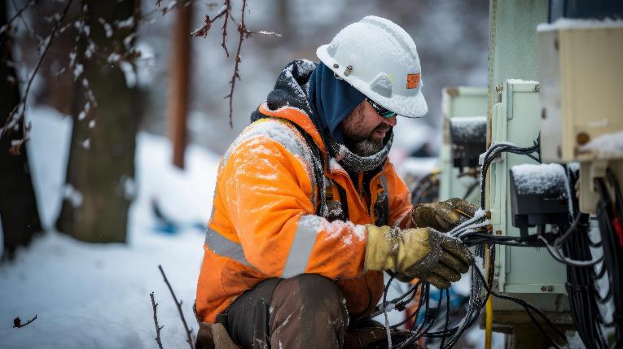
Who Is At Risk of Cold Stress?
Workers who are exposed to extreme cold or work in cold environments
  Outdoors
  Areas that are purposefully kept cold, poorly insulated, or without heat
  Cold, damp conditions
  Includes workers, both indoors and outdoors, in manufacturing, meat packing and cold storage, transportation, construction, agriculture, maritime, and other industries
Notes:
Workers, both indoors and outdoors, in manufacturing (e.g., in places kept purposefully cold, poorly insulated, or without heat), transportation, agriculture, construction, maritime and other industries may be exposed to environmental cold stress that can lead to thermal discomfort and in some cases even severe injuries, illnesses, or death.
For indoor workers, work in cold, damp conditions can be uncomfortable and may lead to declining work performance (i.e., a decline in cognitive function and dexterity) or result in cold-related illness or injury. Cold-related conditions can also worsen musculoskeletal injuries and vascular disorders.
For outdoor workers, what constitutes cold stress can vary across different areas of the country. In regions where workers are unaccustomed to winter weather, near freezing temperatures are considered factors for cold stress.
Image: Photo of an individual working on electrical equipment outdoors in the cold.

Slide 94

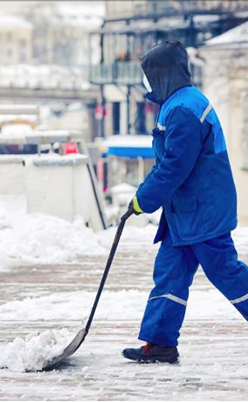
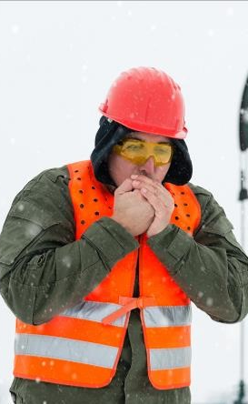
Risk Factors for Cold Stress
Wetness/dampness
Dressing improperly
Exhaustion
Predisposing health conditions
  Hypertension
  Hypothyroidism
  Diabetes
  Poor circulation
Previous experience of frostbite
Poor physical conditioning/sedentary workers
Not accustomed to cold weather
Notes:
Risk factors for cold stress include wetness/dampness, dressing improperly, exhaustion, predisposing health conditions (e.g., hypertension, hypothyroidism, diabetes, and poor circulation), previous experience of frostbite, poor physical conditioning, and not being accustomed to cold weather.
Image 1: Two workers in an industrial refrigerator
Image 2: An employee working outside in the cold without gloves and trying to warm his hands by blowing warm air on them.
Image 3: A person clearing snow from a sidewalk

Slide 95
Cold Stress Disorders
Hypothermia
Frostbite
Trench Foot (Immersion Foot Syndrome)
Chilblains
Notes:
We are going to cover four different cold stress disorders: hypothermia, frostbite, trench foot (also called immersion foot syndrome), and chilblains.

Slide 96

Hypothermia
A condition in which the body uses up its stored energy and can no longer produce heat
Often occurs after prolonged exposure to cold temperature
Clinically defined as core temperature below 95 °F
Notes:
Hypothermia is a condition that takes place when the body expends more heat than it creates. It often occurs after prolonged exposure to cold temperature. Hypothermia is clinically defined as a core temperature below 95 °F.
Image: Three human body diagrams, showing states of hyperthermia, normal state, and hypothermia.

Slide 97

Hypothermia – Symptoms
Early Symptoms:
  Shivering
  Fatigue
  Loss of coordination
  Confusion and disorientation
Late symptoms:
  No shivering
  Blue skin
  Dilated pupils
  Slowed pulse and breathing
  Loss of consciousness
Notes:
Early symptoms of hypothermia include shivering, fatigue, loss of coordination, and confusion and disorientation.
Late symptoms include no shivering, blue skin, dilated pupils, slowed pulse and breathing, and loss of consciousness.
Image: Photo of two workers wrapping their co-worker in a blanket to warm him.

Slide 98
Hypothermia – First Aid
Request immediate medical assistance
Move victim to warm room or shelter
Remove wet clothing
Warm the center of the body first – chest, neck, head, and groin – using an electric blanket; or use skin-to-skin contact under loose, dry layers of blankets, clothing, or towels
If conscious, warm beverages can help increase body temperature
Once temperature has increased keep them dry and wrapped in a warm blanket, including the head and neck
If no pulse, begin CPR
Notes:
What can be done for a person suffering from hypothermia?
Call 911 immediately in an emergency; otherwise seek medical assistance as soon as possible.
Move the person to a warm room or vehicle.
Remove wet clothes and replace with dry clothes, cover the body (including the head and neck) with layers of blankets; and with a vapor barrier (e.g. tarp, garbage bag). Do not cover the face.
If medical help is more than 30 minutes away:
Give warm sweetened drinks if alert (no alcohol), to help increase the body temperature. Never try to give a drink to an unconscious person.
Place warm bottles or hot packs in armpits, sides of chest, and groin. Call 911 for additional rewarming instructions.
If a person is not breathing or has no pulse:
Call 911 for emergency medical assistance immediately.
If the worker has no pulse, cardiopulmonary resuscitation (CPR) should be provided and continued during the warming attempts, until the person responds or medical aid becomes available. Chest compressions should not be performed for patients who manifest an organized rhythm on a cardiac monitor (e.g., automated external defibrillator [AED]), even if they have no palpable pulses and no other signs of life. The worker should be handled very gently and kept horizontal, because when cold, the heart is prone to ventricular fibrillation with any disturbance. Severely hypothermic patients have been known to survive neurologically intact after long periods (over an hour) in a state of “suspended animation” [State of Alaska DHSS 2014].
Source: NIOSH Fact Sheet on Cold Stress (https://www.cdc.gov/niosh/docs/2010-115/pdfs/2010-115.pdf?id=10.26616/NIOSHPUB2010115)

Slide 99

Frostbite
Injury caused by freezing of the skin and deeper tissues, resulting in the loss of feeling and color in the affected areas
Can permanently damage body tissues
Severe cases can lead to amputation
Risk factors:
  Contact with metal or water
  Dehydration
  Diabetes
  Smoking
  Alcohol abuse
  Sedating or judgment impairing medications
  Prior history to frostbite
Notes:
Frostbite is an injury caused by freezing of the skin and deeper tissues, resulting in the loss of feeling and color in the affected areas. Frostbite can permanently damage body tissues, and severe cases can lead to amputation. Examples of risk factors for frostbite include contact with metal or water, dehydration, diabetes, smoking, alcohol abuse, sedating or judgment impairing medications, and prior history of frostbite.
Image: A graphic of two hands showing frostbite in the fingers. Fingers are a dark blue color.

Slide 100

Frostbite – Symptoms
Symptoms:
  Reduced blood flow to hands and feet
  Numbness
  Aching
  Tingling or stinging
  Bluish or pale, waxy skin
Notes:
Symptoms of frostbite include numbness; tingling or stinging; aching; and bluish or pale, waxy skin.
Image: A photo of a foot with toes affected by frostbite.

Slide 101
Frostbite – First Aid
First Aid:
  Seek medical assistance as soon as possible
  Get into a warm room as soon as possible
  Replace wet clothes with dry clothes
  Avoid rubbing or putting pressure on affected areas
    Do not walk on frostbitten toes or feet
    Do not massage frostbitten area
  Loosely cover and protect area from contact
  Give warm, sweetened drinks if alert
  Do NOT use heating pad, fireplace, or radiator
  Do NOT apply snow or water
Notes:
What can be done for a person suffering from frostbite?
Follow the recommendations described in the previous slides for hypothermia.
Do not rub the affected area to warm it because this action can cause more damage.
Do not apply snow/water. Do not break blisters.
Loosely cover and protect the area from contact.
Do not try to rewarm the frostbitten area before getting medical help; for example, do not place in warm water. If a frostbitten area is rewarmed and gets frozen again, more tissue damage will occur. It is safer for the frostbitten area to be rewarmed by medical professionals.
Do not massage the frostbitten area; doing so may cause more damage.
Give warm sweetened drinks, if the person is alert. Avoid drinks with alcohol.
Source: NIOSH Cold Stress Fact Sheet (https://www.cdc.gov/niosh/docs/2010-115/pdfs/2010-115.pdf?id=10.26616/NIOSHPUB2010115).

Slide 102
Case Report: Frostbite
In the winter of 2009, a 56-year-old male truck driver went to the emergency room seeking care [Alaska Trauma Registry]. He had come to Alaska after a long-haul drive through Canada.
Along his route, he stopped to change a fuel filter. He accidentally splashed diesel fuel on his gloves, which froze to his hands as he worked outside along the highway. After arriving at his destination, he had to spend a night at the hospital receiving treatment for his frostbitten hands.
Notes:
Read through the case report with the participants.
Source: NIOSH Preventing Cold-Related Illness, (Injury, and Death Among Workers (https://www.cdc.gov/niosh/docs/wp-solutions/2019-113/pdfs/2019-113.pdf).

Slide 103

Trench Foot (Immersion Foot Syndrome)
An injury of the feet resulting from prolonged exposure to wet and cold-related conditions
Occurs because wet feet lose heat 25-times faster than dry feet
To prevent heat loss, the body constricts blood vessels in the feet, and the skin tissue begins to die
Causes damage to circulation and nerve function in feet
Can occur at temperatures as high as 60 °F if the feet are constantly wet
Notes:
Trench foot is an injury of the feet that occurs after prolonged exposure to wet and cold-related conditions.
Trench foot occurs because wet feet lose heat 25 times faster than dry feet.
To prevent heat loss, the body constricts blood vessels in the feet, and then the skin tissue begins to die.
Trench foot causes damage to the circulation and nerve function in the feet. It can occur at temperatures as high as 60 °F if the feet are constantly wet.
Trench foot got its name during World War I, when thousands of solders engaged in trench warfare were affected by trench foot.
Trench foot was greatly reduced later in the war through improvements to the trenches, modification of the soldiers’ footwear, and the provision of greases to prevent damage from excess moisture. Soldiers also participated in regular foot inspections. Soldiers were all paired, and each partner was made responsible for the feet of the other.
Image: A poster warning of trench foot. Poster reads: “Prevent it! Keep feet dry and clean.” Shows soldier drying feet. Public domain.

Slide 104

Trench Foot – Symptoms & First Aid
Symptoms:
  Reddening of skin
  Numbness
  Leg cramps
  Swelling
  Tingling pain
  Blisters or ulcers
  Bleeding under skin
  Gangrene (foot may turn dark purple, blue, or gray)
First Aid:
  Remove shoes/boots and wet socks
  Dry feet
  Avoid walking on feet (may cause tissue damage)
Notes:
Symptoms of trench foot include reddening of the skin, numbness, leg cramps, swelling, tingling pain, blisters or ulcers, bleeding under the skin, and gangrene (e.g., foot turns purple, blue, or gray).
Trench foot can be prevented by keeping the feet warm, clean, and dry. Keeping the feet dry is the first line of treatment. Treatment for trench foot includes removing shoes/boots and wet socks, drying the feet, and avoiding walking on the feet, as this may cause tissue damage. Talcum powder can also be applied to keep the feet dry. In severe cases, amputation may be necessary.
Image: Soldiers sitting on the ground having their feet inspected for trench foot during World War I.

Slide 105

Chilblains
Painful inflammation of small blood vessels in the skin
Occur in response to repeated exposure to cold but nonfreezing temperatures
Small blood vessels in the skin become permanently damaged by cold temperatures
Results in redness and itching during additional exposures
Notes:
Chilblains are the painful inflammation of small blood vessels in the skin that occur in response to repeated exposure to cold but nonfreezing temperatures. Small blood vessels in the skin may become permanently damaged by cold temperatures, resulting in redness and itching during additional exposures.
Image: A foot with a toe affected by chilblains.

Slide 106
Chilblains – Symptoms & First Aid
Symptoms:
  Redness
  Itching
  Possible blistering
  Inflammation
  Possible ulceration in severe cases
First Aid:
  Slowly warm skin
  Corticosteroid creams to relieve itching and swelling
  Keep blisters and ulcers clean and covered
  Avoid scratching
Notes:
Symptoms of chilblains include redness, itching, possible blistering, inflammation, and possible ulceration in severe cases. First aid includes slowly warming the skin, applying corticosteroid creams to relieve any itching and swelling, avoiding scratching the affected area, and keeping blisters and ulcers clean and covered.

Slide 107

How to Protect Yourself from Cold Stress
Wear appropriate clothing
  Several layers of loose clothing
    Remember: tight clothing reduces blood circulation to extremities
  Bring extra clothing
Protect ears, face, hands, and feet in extremely cold or wet weather
  Boots should be waterproof and insulated
  Wear hat to reduce loss of body heat from head
Notes:
To protect themselves from cold stress, workers should:
Wear appropriate clothing. This includes wearing several layers of loose clothing. Tight clothing reduces blood circulation to extremities and should not be used.
Make sure workers carry extra socks, gloves, hats, jacket, blankets, a change of clothes and a thermos of hot liquid.
The ears, face, hands, and feet are especially vulnerable in cold temperatures and should be protected in cold and wet weather. Boots should be waterproof and insulated, and hats should be used to reduce the loss of body heat from the head.
Image: A worker clearing snow on a street.

Slide 108

How to Protect Yourself from Cold Stress (Continued)
Take regular breaks in warm locations
Monitor your physical condition and that of your coworkers
Stay hydrated and well nourished
  Warm beverages (but be careful with caffeine)
  Snack on high carbohydrate foods
Avoid touching cold metal or wet surfaces with bare skin
Notes:
In order to protect themselves from cold stress, workers should:
Take regular breaks to warm up.
Monitor their physical condition and that of coworkers.
Stay hydrated by drinking lots of water; warm beverages may help increase body temperature. Workers can still become dehydrated in the cold. Make sure workers continue to hydrate themselves with water.
Stay well nourished by snacking on high carbohydrate foods.
Avoid touching cold metal or wet surfaces with bare skin.
Image: a graphic showing a thermos and cup emanating steam to illustrate that both contain a hot beverage.

Slide 109
Protecting Workers from Cold Stress
Implement a cold-related illness and injury prevention program that includes:
  Training workers about the hazards of working in cold environments
  Reducing workers’ time spent in cold environments
  Establishing work/rest schedules
  Using engineering controls (e.g., radiant heaters, shielding work areas from wind)
  Providing appropriate cold-weather gear
Notes:
The National Institute for Occupational Safety and Health (NIOSH) recommends that employers implement a cold-related illness and injury prevention program that includes preventive measures such as using engineering controls, establishing work/ rest schedules, reducing workers’ time spent in cold environments, training workers about the hazards of working in cold environments (in a language and vocabulary that the workers understand), and providing appropriate cold-weather gear such as hats, gloves, and boots for work in cold environments and wind protective clothing based on air velocities.
Source: https://www.osha.gov/winter-weather/cold-stress#affected

Slide 110

Protecting Workers from Cold Stress (Continued)
Implement a cold-related illness and injury prevention program that includes:
  Monitoring of workers in cold conditions
  Buddy system
  Ensuring access to warm areas and places to change out of wet clothes
  First aid kits including medical and environmental thermometers and chemical hot packs
  Providing prompt medical attention
Notes:
The National Institute for Occupational Safety and Health (NIOSH) recommends that employers implement a cold-related illness and injury prevention program that includes preventive measures such as:
reducing the physical demands of workers (e.g., using relief workers or rotating extra workers in and out of work for long, demanding jobs)
ensuring access to warm areas and a place to change out of wet clothes
encouraging employees to take breaks to warm up when needed, monitoring workers in cold conditions and initiating a buddy system
including a medical and environmental thermometer and chemical hot packs in first aid kits
participating in joint management/employee safety committees
providing prompt medical attention to workers who show signs of cold-related illness or injury.
Source: https://www.osha.gov/winter-weather/cold-stress#affected
Photo: An employee looking at a construction site in the background that is covered in snow.

Slide 111
Employee Training for Cold Stress Prevention
Employees should be trained in the following:
  How to recognize environmental and workplace conditions that can lead to cold stress
  The symptoms of cold stress
  How to prevent cold stress
  How to help those affected by cold stress
  How to select proper clothing for cold, wet, and windy conditions
Notes:
Although OSHA does not have a specific standard that covers working in cold environments, under the Occupational Safety and Health Act of 1970, employers have a duty to protect workers from recognized hazards, including cold stress hazards, that are causing or likely to cause death or serious physical harm in the workplace. Training is a very important when it comes to protecting workers from cold stress hazards. Employers should train workers in the following:
How to recognize the environmental and workplace conditions that can lead to cold stress.
The symptoms of cold stress, how to prevent cold stress, and what to do to help those who are affected.
How to select proper clothing for cold, wet, and windy conditions.
Source: https://www.osha.gov/winter-weather/cold-stress#affected

Slide 112

Safe Work Practices for Cold Stress Prevention
Provide warm and sweetened liquids to workers
Schedule heavy work during the warmer part of the day
Establish a buddy system so workers can monitor each other
Reduce physical demands of workers
  Relief workers
  Rotate workers
Give frequent breaks in warm areas
Acclimatize new workers and those returning after time away
Notes:
Employers should implement safe work practices for cold stress prevention, including the following:
Providing plenty of warm sweetened liquids to workers, as it is easy to become dehydrated in cold weather.
If possible, scheduling heavy work during the warmer part of the day.
Assigning workers to tasks in pairs (buddy system), so that they can monitor each other for signs of cold stress.
Reducing the physical demands of workers (for example, using relief workers or rotating extra workers in and out of work for long, demanding jobs).
Allowing workers to interrupt their work if they are extremely uncomfortable.
Giving workers frequent breaks in warm areas.
Acclimatizing new workers and those returning after time away from work, by gradually increasing their workload, and allowing more frequent breaks in warm areas, as they build up a tolerance for working in the cold environment.
Source: NIOSH Preventing Cold-Related Illness, Injury, and Death Among Workers (https://www.cdc.gov/niosh/docs/wp-solutions/2019-113/pdfs/2019-113.pdf).
Image: Photo of someone pouring a hot liquid from a thermos into a cup in the snow.

Slide 113
Knowledge Check: Cold Stress
Which cold stress disorder results in painful inflammation of the blood vessels under the skin?
Which part of the body should be warmed first if a worker is experiencing hypothermia? What can be used to warm the worker?
True or False: Applying a heating pad in the affected area is an effective way to treat someone with frostbite
True or False: Wet feet lose heat faster than dry feet
List 4 ways workers can prevent cold stress
List 4 safe work practices employers can implement for cold stress prevention
Notes:
Chilblains
The center of the body: chest, neck, head, and groin – using an electric blanket; or use skin-to-skin contact under loose, dry layers of blankets, clothing, or towels
FALSE
TRUE. Wet feet lose heat 25-times faster than dry feet.
Take regular breaks in warm locations, monitor your physical condition, wear appropriate clothing, protect ears, face, hands, and feet, stay hydrated and well nourished, avoid touching cold metal or wet surfaces with bare skin.
Train workers on cold stress prevention, provide warm and sweetened liquids to workers, schedule heavy work during the warmer part of the day, establish a buddy system so workers can monitor each other, reduce physical demands of workers, give frequent breaks in warm areas, acclimatize new workers and those returning after time away.

Slide 114
Cold Stress Resources for Workers and Employers
OSHA Winter Weather Page:
  https://www.osha.gov/winter-weather/cold-stress
OSHA Protecting Workers from Cold Stress Quick Card:
  https://www.osha.gov/sites/default/files/publications/OSHA3156.pdf
National Weather Service (NWS) Wind Chill Calculator
  https://www.weather.gov/safety/cold-wind-chill-chart
National Institute of Health and Safety (NIOSH) Cold Stress Page:
  https://www.cdc.gov/niosh/topics/coldstress/
Notes:
There are several cold stress prevention resources available for both workers and employers, including
OSHA’s Winter Weather Page,
OSHA’s Protecting Workers from Cold Stress Quick Card,
The National Weather Service (NWS) Wind Chill Calculator, and
NIOSH’s Cold Stress Page.
*Note about the NWS Wind Chill Calculator: Wind Chill is the term used to describe the rate of heat loss from the human body, resulting from the combined effect of low air temperature, and wind speed. This measurement is the actual effect of the environmental cold on the exposed skin. With the calculator, workers and employers can input the air temperature and wind speed, and it will calculate the wind chill temperature.

Slide 115
Group Activity:
Fatality Investigation Workshop
Notes:
The next slide includes instructions for the next activity. Groups will review individual NIOSH FACE reports.

Slide 116
Directions
Read the NIOSH FACE Report assigned to your group.
Discuss the report with your group:
  Determine what the causes of the accident were and what could have been done to prevent the accident from occurring.
  Use heat stress prevention concepts
  Feel free to add any safety and health management recommendations such as training, resources, management support, etc.
Take 30 minutes and then we will discuss the reports as a class.
Notes:
This slide includes directions on how to complete the activity. NIOSH FACE reports will be used for this activity.

Slide 117
Questions?

