Slide 1
Temperature Extremes in the Workplace
This material was produced under grant number SH-000018-SH3 from the Occupational Safety and Health Administration, U.S. Department of Labor. It does not necessarily reflect the views or policies of the U.S. Department of Labor, nor does mention of trade names, commercial products, or organizations imply endorsement by the U.S. Government.
Notes:
This material was produced under grant number SH-000018-SH3 from the Occupational Safety and Health Administration, U.S. Department of Labor. It does not necessarily reflect the views or policies of the U.S. Department of Labor, nor does mention of trade names, commercial products, or organizations imply endorsement by the U.S. Government.

Slide 2
We Will Cover:
OSHA Information
Working in Extreme Heat
Heat Stress
Heat Stress Prevention
Working in Extreme Cold
Cold Stress
Cold Stress Prevention
Notes:
In this 1-hour course, we will begin by covering information about OSHA. We will then talk about the hazards of working in extreme heat, heat stress, including heat stress disorders and first aid, heat stress prevention, the hazards of working in extreme cold, cold stress, including cold stress disorders, and cold stress prevention.

Slide 3
Class Agenda and Objectives:
OSHA Background
Hazards of Working in Extreme Heat
How Heat Stress Develops and Types of Heat Stress Disorders
Symptoms of Heat Stress Disorders and First Aid Measures
Heat Stress Prevention
Hazards of Working in Extreme Cold
How Cold Stress Develops and Cold Stress Disorders
Symptoms of Cold Stress Disorders and First Aid Measures
Cold Stress Prevention
Summary, Discussion, Final Comments
Notes:
This is the agenda for our 1-hour course.

Slide 4
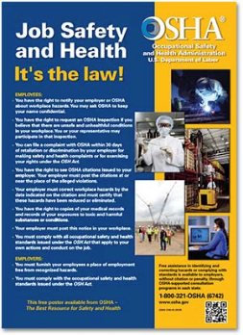
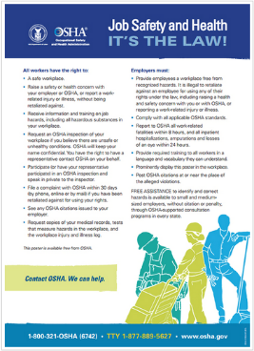
Employer Rights and Responsibilities
Employers have the responsibility to, at a minimum, comply with the OSH Act
Employers must perform their due diligence to find and correct safety
and health hazards
Notes:
Under the Occupational Safety and Health Act of, employers must:
Perform tests in the workplace, such as air sampling or noise monitoring, as required by some OSHA standards.
Provide hearing exams or other medical tests required by OSHA standards (if applicable).
Post injury/illness information so that employees can see them.
Prominently display the official OSHA "Job Safety and Health - It's the Law" poster that describes rights and responsibilities under the OSH Act; A new poster was issued in 2015, however, either poster is still acceptable.
AND employers MAY NOT retaliate or discriminate against workers for using their rights under the OSH Act to report hazards that could lead to or have caused a work-related injury or illness.
Graphic: This slide has a picture of the old OSHA poster and the 2015 version of the OSHA poster.

Slide 5
Workers’ Rights
Workplace free of recognized hazards
Report safety and health concerns and/or injuries and illnesses without retaliation
  File a discrimination complaint under Section 11(c) of the OSH Act, which prohibits discharge or discrimination by “any person” against any employee for OSHA-related activity;
  File a complaint if punished or discriminated against for acting as a “whistleblower” under the additional federal laws for which OSHA has jurisdiction.
Receive appropriate training in a language and vocabulary that workers understand
Notes:
Employers have the responsibility to provide a safe workplace free from serious hazards and must follow all OSHA safety and health standards.
Employers must find and correct safety and health problems as their due diligence under the OSH Act. OSHA requires that employers first try to eliminate or reduce hazards by making feasible changes in working conditions rather than relying on personal protective equipment - a.k.a. PPE (e.g., masks, gloves, earplugs); and if an employer provides PPE, then the employer must train the employees on WHEN and HOW to use the PPE.
Any training given by the employer must be in a language that the employees can understand.
Temporary workers are also entitled to the same protection against retaliation as full-time workers. Employers may not take action against employees for participating in protected workplace activities (i.e., filing a complaint, voicing concerns about workplace hazards to supervisors, etc.). Workers also can inform OSHA of other whistleblower items that OSHA enforces, which currently is 22 different whistleblower statutes covering a variety of workplaces. For more information visit whistleblowers.gov.

Slide 6
Workers’ Rights (Continued)
Request an OSHA inspection at your facility (confidential)
Participate in an OSHA inspection
Speak to OSHA inspector in private
See OSHA citations
Request medical records, tests that measure hazards and injury/illness log
Notes:
Workers can participate during an OSHA inspection. They may speak with an inspector in private without retaliation from an employer. Workers can see the OSHA citations and request medical records, tests that measure hazards, and the OSHA injury and illness logs.
Section 11(c) of the OSH Act prohibits discharge or discrimination by any person against any employee for OSHA-related activity AND authorizes the Secretary to investigate and seek all appropriate relief against any such person. Retaliatory lay-offs or failure to refer a worker who engages in protected activity under OSHA would be grounds for the Secretary to seek remedial - including injunctive - relief in district court.

Slide 7
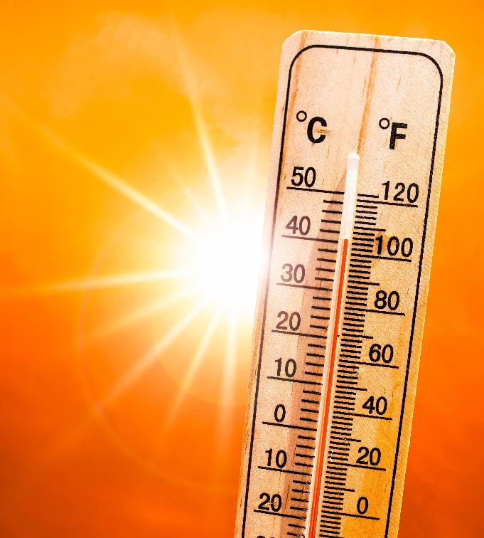
Working in Extreme Heat
Notes:
We will first begin by covering working in extreme heat – the hazards of working in extreme heat, heat stress disorders, and how to prevent heat stress in the workplace.
Image: Image of a thermostat with the sun in the background.

Slide 8
Do You Know The Facts?
Heat stress may result from the buildup of muscle-generated heat in the body.
  True or False?
The time to drink water is when you are thirsty.
  True or False?
What is the most important thing you should know about preventing heat stress?
  A. Water B. Shade C. Rest D. All three are Important
The evaporation of sweat is the most important way our bodies get rid of heat.
  True or False?
Over 70% of those who suffer a heat stroke die if not treated promptly.
  True or False?
Notes:
Questions to ponder as we begin to discuss heat stress. We will be covering each of these items throughout this section of today’s course.
Answers:
True
False
D – All three are important
True
True: Morbidity and mortality from heatstroke are related to the duration of the temperature elevation. When therapy is delayed, the mortality rate may be as high as 80%; however, with early diagnosis and immediate cooling, the mortality rate can be reduced to 10%.

Slide 9

Why Should We Be Concerned?
Gabriel Infante, 24 years old
  Installing fiber optic cables in San Antonio, TX – 5th day on the job
  Heat Index over 100 degrees
  Complained of feeling tired and was experiencing cramping
  Was moved from digging crew to dump a load, then returned to digging crew
  Lunged at a coworker in a fit of delirium – thought coworkers “were going to kill him”
  Fell and hit his head, became unconscious
  Body temperature nearly 110 degrees by the time he got to the ER
  Died in the hospital
  Source: OSHA News Clips Aug. 19-21, 2023
  CNN, August 19, 2023
Notes:
Anyone, under the right circumstances and environment, can be affected by heat stress. We oftentimes don’t realize how dangerous heat is until it is too late, and victims of heat stress may have a hard time helping themselves once they are seriously affected by the heat.
Gabriel Infante was installing fiber optic cables in San Antonio, when the heat index was over 100 degrees. It was his 5th day on the job. After working in the heat, he started to feel tired and experienced cramping. He was moved to perform a different job task, but after some time he returned to the digging crew. He then became delirious, combative, and aggressive towards his co-workers, alleging his co-workers were going to kill him.
The site supervisor on the job thought he was under the influence of drugs, but he was actually suffering from heat stroke. Soon after, he collapsed and became unconscious. By the time he got to the ER, his body temperature was nearly 110 degrees. Gabriel died in the hospital the following morning. The cause of his death was heat stroke.
Graphic: Photo of Gabriel Infante, victim of heat stroke
Source: https://edition.cnn.com/2023/08/19/business/extreme-heat-texas-worker-deaths-demand-change/index.html
https://www.osha.gov/ords/imis/establishment.inspection_detail?id=1604112.015

Slide 10
Why Should We Be Concerned? (Continued)
2011-2021: 436 work-related deaths caused by environmental heat exposure
35 employees died each year between 2015-2019 due to environmental heat cases
  An average of 2,700 environmental heat cases occurred each year resulting in days away from work
The total number of heat-related illnesses and fatalities is unknown
  Heat-related illnesses are oftentimes not recognized
  Cause of death is oftentimes listed as a heart attack
Individuals working in hot environments are at a higher risk of injury
Notes:
According to the U.S. Department of Labor’s Bureau of Labor Statistics (BLS), between 2011 to 2021, there have been 436 work-related deaths caused by environmental heat exposure. 35 employees died each year between the years of 2015 and 2019 due to environmental heat cases. In addition, an average of 2,700 environmental heat cases occurred each year resulting in days away from work. According to both OSHA and NIOSH, the total number of heat-related illnesses and fatalities is unknown, as heat-related illnesses are oftentimes not recognized and the cause of death is oftentimes listed as a heart attack, rather than exposure to a heat-related hazard.
Source 1: “National Emphasis Program – Outdoor and Indoor Heat-Related Hazards.” OSHA.gov, US Department of Labor: Occupational Safety and Health Administration, April 2022, https://www.osha.gov/sites/default/files/enforcement/directives/CPL_03-00-024.pdf.
Source 2: https://www.bls.gov/opub/ted/2023/36-work-related-deaths-due-to-environmental-heat-exposure-in-2021.htm

Slide 11
Heat Stress
Notes:
Ask the class: What is heat stress? Can you name some different heat stress disorders? Have you or has anyone you know been affected by heat stress?

Slide 12
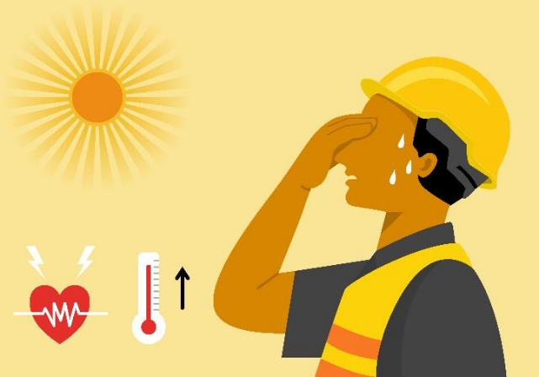
What is Heat Stress?
Build-up of heat in the body that cannot be removed by natural mechanisms.
A result of internal heat generated by the body (metabolic load) and the external heat load from the work environment.
Notes:
Heat stress is the build-up of heat in the body that cannot be removed by natural mechanisms (e.g., sweating and increased blood flow to skin). The build-up of heat is the result of internal heat generated by the body (what we call metabolic load) and the external heat load from the work environment.
Image: Graphic of an employee sweating and experiencing heat stress.

Slide 13
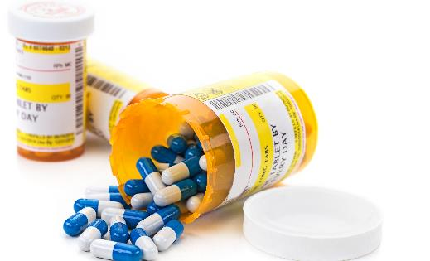
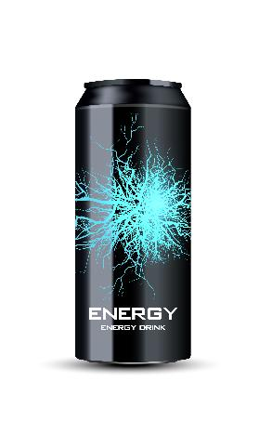
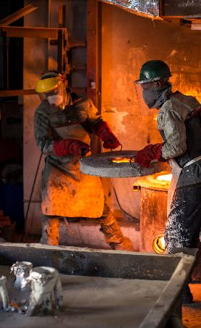
Factors that Affect the Body’s Ability to Cool
Age
Weight
Physical Fitness
Adjusting to the hot environment
Other Health Conditions
Use of Alcohol/Drugs/Caffeine
Clothing/PPE
Medications
Diuretics
Blood-pressure medications
Antihistamines
Anti-cholinergics (for COPD)
Psychiatric conditions
Notes:
There are a number of factors that affect the body’s ability to cool:
Age, weight, and physical fitness all influence how the body cools down.
Outdoor acclimatization
People who spend a great deal of time outdoors become "outdoor acclimatized." These persons are affected less by heat or cold extremes because their bodies have adjusted to the outdoor environments.
Acclimatization usually occurs over a period of about two weeks in healthy, normal persons. This process is faster in response to heat, but slower in the cold.
Factors affecting climate acclimatization
Your physical condition, age, and other factors also affect how your body copes with heat and cold.
Body fat
Lean people tolerate heat better than obese people. The more obese a person is, the less skin surface area the person has in relation to his or her weight. Greater surface area provides more exposed skin to perspire and cool the body through evaporation.
But this same fat can be beneficial to a person who lives in cold climates because the fat insulates skin tissue. The Inuit, who live in cold regions, tend to have more body fat than people who live in warmer climates.
Age
Elderly persons usually don't tolerate temperature extremes as well as do younger people. As a person ages, the body's response to temperature change–shivering in low temperatures and sweating in high temperatures–is delayed and reduced.
Metabolic rate
A person's metabolic rate–the speed at which the body's cells turn food into energy–affects the person's ability to cope with heat and cold. A relatively high metabolic rate produces more heat than a relatively low metabolic rate. As a result someone with a high metabolic rate may feel warm in a room of 72 degrees where a person with a low rate may feel cool.
Adjusting to the hot environment, which is called “acclimatization,” is a very important factor when it comes to cooling down. Our bodies need time to get used to working in hotter conditions.
Health conditions, such as high blood pressure, diabetes, and heart disease, can impact our body’s temperature regulation.
Certain medications can increase the risk for heat stress:
diuretics (water pills),
anti-hypertensives (blood pressure medication),
anti-cholinergics (for COPD pulmonary disorders),
antihistamines (allergy medications),
anti-depressants and
anti-psychotics
These medications affect how the body regulates internal temperature. Some medications can result in a worker's inability to feel heat conditions and/or the inability to sweat, so symptoms of heat stress may not be evident.
Both caffeine and alcohol are diuretics, which means they promote water loss through urine.
The clothing and PPE workers wear can have an impact on the body’s ability to cool.
Dark clothing is going to absorb heat, while lighter clothing is going to reflect it.
Impermeable clothing, such as chemical protective suits, prevents cooling by sweating and may contribute to heat illness at lower temperatures.
Image 1: Prescription medication
Image 2: Energy Drink
Image 3: Two workers in a foundry with PPE

Slide 14


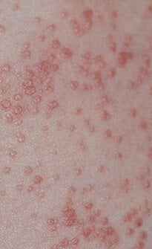
Types of Heat Stress Disorders
Heat Rash (Prickly Heat) – blockage and inflammation of sweat glands in heat and high humidity
Heat Cramps – Low salt and moisture levels in body
Heat Syncope – Weakness, fatigue, or fainting after exercising in the heat
Heat Exhaustion
Heat Stroke
Notes:
There are several different types of heat stress disorders. Ask participants if they or anyone they know has developed one of these heat stress disorders. This list goes from least dangerous to most dangerous, with heat rash being the least dangerous of the heat stress disorders and heat stroke being the most dangerous.
Heat Rash:
Heat rash develops when there is unrelieved exposure to humid heat conditions and the skin is continuously wet with unevaporated sweat.
This may result in the plugging of sweat glands and a subsequent inflammatory reaction leading to small red bumps on the skin that looks like pimples or small blisters.
Heat rash, which is also called prickly heat, causes extreme itchiness and a prickly sensation on the skin when sweating occurs. Heat rash often appears on the neck, upper chest, and skin folds.
If a worker shows signs of possible heat rash, the best treatment is to provide a cooler, less humid work environment for the work area. A mild drying lotion, like Calamine, or antihistamine or low-strength hydrocortisone cream (steroid cream to treat inflammation) can also be applied to the skin. Keep the skin clean and dry. Powder may also be applied to the area for comfort.
Heat Cramps:
Muscle pains usually caused by physical labor in a hot work environment.
When workers are sweating, their bodies lose water and salt. If they are not rehydrating and replenishing their bodies, then low salt levels in the muscles will lead to painful cramps.
It’s important to note that heat cramps may be a symptom of heat exhaustion and therefore require immediate action.
If a worker shows signs of heat cramps:
Have them stop all activity and sit in a cool place
Workers should replace fluid loss by drinking water and having a snack, and/or carbohydrate electrolyte replacement liquids (e.g., sports drinks) every 15 to 20 minutes.
Make sure the worker does not return to strenuous work for a few hours after the cramps subside. Further exertion may lead to heat exhaustion or heat stroke.
Heat Syncope:
A fainting (syncope) episode or dizziness that usually occurs when standing for too long or suddenly standing up after sitting or lying.
Both dehydration and lack of acclimatization may contribute to heat syncope.
If a worker is feeling lightheaded, dizzy, or faint, have them sit or lie down in a cool place. Do not have them return to perform strenuous work. Have them slowly drink water, clear juice, or a sports beverage to rehydrate.
Transient Heat Fatigue: temporary physical discomfort or mental/psychological strain (cranky, irritated); results in decline in work performance, coordination, alertness.
Image 1: Employee in manufacturing plant with her hand to her forehead. Showing signs of heat stress.
Image 2: Heat rash (prickly heat).
Image 3: An employee collapsed on the ground. Victim of heat stroke.

Slide 15
Behavioral Cues of Heat Stress Disorders
Hand/limb shaking
Decreased productivity through shift
Increased absenteeism
Awkward postures (to compensate for fatigue)
Workers need to be trained on these behavioral cues – this can save a co-worker, friend, or family member’s life
Notes:
These are behavioral cues to look out for (in yourself, in your employees, and in your co-workers). These may be an indication that you or someone else is experiencing heat stress.

Slide 16
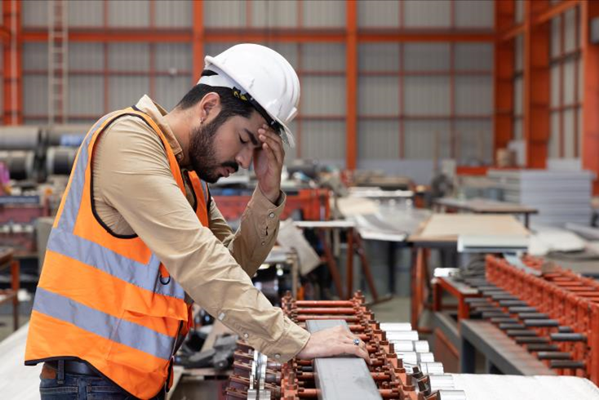
Heat Exhaustion
Heat exhaustion is the body's response to an excessive loss of water and salt, usually through excessive sweating.
Notes:
Heat exhaustion is the body’s response to an excessive loss of water and salt, usually through excessive sweating. Workers with high blood pressure are also more prone to heat exhaustion.
It takes 30 minutes to cool the body down once it has become overheated and suffers heat exhaustion.
Image: A person in a hard hat with his head in his hand. Showing signs of heat exhaustion.

Slide 17
Heat Exhaustion Symptoms
Symptoms:
  Profuse sweating
  Extreme weakness or fatigue
  Headache
  Dizziness, Confusion
  Loss of appetite
  Nausea
  Vomiting
  Fast and shallow breathing
  Vision problems
  Muscle aches and cramps
  Excessive thirst
  Chills
  Agitation or irritability
  Clammy, moist skin
  Sometimes unconsciousness
Notes:
If an employee shows these symptoms, immediate action must be taken to prevent heat stroke. Look out for these symptoms in yourself as well.
Important for people to know. This is why training is so important – we want them to think about these things and recognize the symptoms.
Behavioral cues: we want to pay attention to this before they get to heat exhaustion.

Slide 18
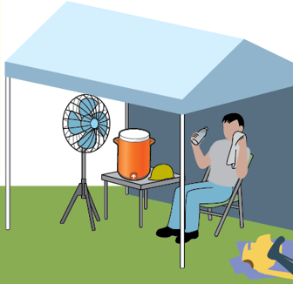
Heat Exhaustion Treatment
Rest in a cool place
Drink cool fluids
Try cooling measures
  If possible, take a cool shower, soak in a cool bath, or put towels soaked in cool water on skin
Loosen clothing
If measures above fail to provide relief in 15 minutes, seek emergency medical help
Never leave someone showing signs of possible heat exhaustion alone
Notes:
If a worker shows signs of possible heat exhaustion:
• Workers with signs or symptoms of heat exhaustion should be taken to a clinic or emergency room for medical evaluation and treatment.
• If medical care is not available, call 911 immediately.
• Make sure that someone stays with the worker until help arrives.
• Workers should be removed from the hot area and given liquids to drink.
Remove any unnecessary layers or clothing. Makes sure clothes are lightweight and nonbinding.
Try cooling measures. If possible, take a cool shower or cool bath, or put towels soaked in cool water on the skin. If outdoors and not near shelter, soaking in a cool pond or stream can help bring their temperature down.
Never leave someone showing signs of possible heat exhaustion alone. Stay with them until they receive a medical evaluation and treatment.
Image: Clip Art of an employee sitting on a chair, in the shade under a pop-up tent, with a fan blowing air on them. The employee is wiping sweat off their face and drinking water.
Source of image: OSHA Heat Illness Symptoms and Signs Infographic (https://www.osha.gov/heat/employer-responsibility)

Slide 19
Heat Stroke
Most serious heat-related disorder
Occurs when the body becomes unable to control its temperature: the body's temperature rises rapidly, the sweating mechanism fails, and the body is unable to cool down
When heat stroke occurs, the body temperature can rise to 106 degrees Fahrenheit or higher within 10 to 15 minutes
Heat stroke can cause death or permanent disability if emergency treatment is not given
Notes:
Heat stroke is the most serious heat-related disorder. It occurs when the body can no longer cool itself and body temperature rises to critical levels. When heat stroke occurs, the body temperature can rise to 106 °F or higher within 10 to 15 minutes. Heat stroke can cause death or permanent disability if emergency treatment in not given. Immediate response is necessary in order to save the life of someone experiencing a heat stroke.

Slide 20

Heat Stroke Symptoms
High body temperature (often 104°F-105°F or higher) and rising
Nausea and vomiting
Seizures
Disorientation or delirium
Hot, dry skin
Unconsciousness
Coma
Shortness of breath
Slurred speech
Decreased urination
Blood in urine or stool
Notes:
A high body temperature is an indication that someone is suffering from a heat stroke. However, it may not always be feasible to check someone’s temperature. We need to look out for other heat stroke symptoms. Nausea and vomiting, seizures, disorientation or delirium are all symptoms of heat stroke. With heat stroke, the sweating mechanism fails, so victims may have hot, dry skin. They may also become unconscious or suffer a coma. Shortness of breath, slurred speech, decreased urination, and blood in the urine or stool are also possible symptoms.
Emphasize that these are the symptoms workers should be looking out for in their co-workers. The victims aren’t going to catch these symptoms themselves.
Image: Employee wearing a safety vest unconscious on the ground. Depicting victim of heat stroke.

Slide 21
Heat Stroke Treatment
Call 911
Immersion in cold water
  A bath of cold or ice water has been proven to be the most effective way of quickly lowering core body temperature. The quicker the employee can receive cold water immersion, the less risk of death and organ damage.
Use evaporation cooling techniques
  If cold water immersion is unavailable, health care workers may try to lower body temperature using an evaporation method.
  Cool water is misted on employee’s body while warm air is fanned over them, causing the water to evaporate and cool their skin.
Notes:
If you notice an employee or co-worker showing signs of heat stroke, call 911 immediately. You have less than 30 minutes to make an impact on decreasing their core body temperature. Cooling is the primary goal before transferring the victim to receive medical care. While waiting for emergency personnel, there is treatment that can be employed on-site. The most effective way to quickly lower someone’s core body temperature is to immerse them in cold or ice water. The quicker the employee can receive cold water immersion, the less risk there is of death and organ damage.
If cold water immersion is not available, there are other cooling techniques that can be employed. Evaporation cooling is when cool water is misted on the employee’s body while warm air is fanned over them. The water evaporates and cools their skin.

Slide 22
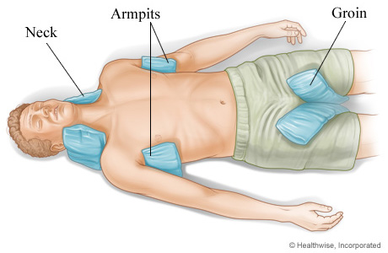
Heat Stroke Treatment (Continued)
Pack employee with ice and cooling blankets.
  Another method is to wrap employee in a special cooling blanket and apply ice packs to their groin, neck, back and armpits to lower body temperature.
  “Taco Method”
REMEMBER: You have less than 30 minutes to make an impact on decreasing employee’s core body temperature
Notes:
Another cooling method is to pack the employee with ice and cooling blankets. Wrap the employee in a special cooling blanket and apply ice packs to their groin, neck, back, and armpits to lower their body temperature.
The “TACO method” is a cooling method that can be employed using a tarp and cold water and ice. Log roll the victim onto a tarp. Four individuals will then need to position themselves to grasp and elevate the tarp to maintain the victim’s head in an elevated position. Add sufficient ice and water to cover as much of the body as possible. Continuously circulate the water by agitating the tarp, adding more ice as needed to keep the water cool. Most heat dissipation occurs on the surface of the skin. By oscillating or moving the tarp back and forth and having cold water contact all parts of their body, the heat will come off of their body more rapidly.
These cooling methods should all be thought of as temporary cooling methods. You still need to call 911 if someone is showing signs of heat stroke.
Emphasize the need to plan ahead. Make sure you have ice packs/equipment for cooling on-site.
Image: Image of a heat stroke victim with ice packs in the neck, armpits, and groin area.
Image source: https://www.nyp.org/healthlibrary/multimedia/placement-of-ice-bags-for-heatstroke

Slide 23
Worker Buddy System
Look out for your co-workers
  Weakness
  Nausea
  Dizziness
  Vomiting
  Confusion
  Fainting
  Irritability
If you spot someone experiencing symptoms of heat stress, take action:
  Give them water to drink
  Move them to a cooler area
  Cool them with water, ice, or a fan
  Remove unnecessary clothing
  Do not leave them alone
  Notify supervisor
  If in doubt (or if supervisors is not available) call 911 or seek medical care
Notes:
Worker buddy systems should be implemented to encourage employees to look out for one another, including when workers are being acclimatized to working in a hot environment. If you spot someone experiencing weakness, nausea, dizziness, vomiting, confusion, fainting, or irritability, it’s important to take action.
If you spot someone experiencing weakness, nausea, dizziness, vomiting, confusion, fainting, or irritability, take action:
Give them water to drink
Move them to a cooler area
Cool them with water, ice or a fan
Remove unnecessary clothing
Do not them leave alone
If in doubt, call 911 or seek medical care

Slide 24
Activity
Notes:
Go through each of the scenarios together with the class. Ask them: what heat stress disorder is the employee experiencing? What first aid treatment should they receive? What can the employee do to address the disorder? What can their supervisor and/or co-workers do?

Slide 25
Reggie
Reggie, who works for a residential roofing company in Valdosta, Georgia, has been working in the sun for the past 6 hours. It’s now 2 p.m., and the sun is ruthless. His shirt is soaked with sweat, and he is beginning to feel nauseous and dizzy. He even almost fell off the roof when he temporarily lost his balance. He sat down for a bit to re-gather himself and when he stood up he felt a wave of extreme fatigue. His co-workers told him he should take a break, but he doesn’t want to delay the work any further. He already took a long break in the morning to go buy a case of water for himself and his co-workers. When he went to the store, he also grabbed an energy drink since the heat was making him feel tired.
What is Reggie experiencing?
What actions should be taken by Reggie? By his co-workers/supervisor?
Notes:
Reggie is experiencing heat exhaustion. Reggie needs to be transferred to a cool place, drink fluids, remove any loose clothing, and take a cool shower or bath or put towels soaked in cool water on his skin. His co-workers and/or supervisor need to remain with him as he is cooling down. If he continues to show symptoms, his supervisor or co-workers should take him to a clinic or emergency room for medical evaluation and treatment.

Slide 26
Hallie
Hallie is an intern for a waste management company that has been tasked with the hazardous waste removal of an abandoned hospital in southern Mississippi that was severely damaged from a hurricane. It’s her first day working on this project. On the way to the hospital, her co-worker drives her to an industrial supply store to buy a half-mask respirator and Tyvek suit. Asbestos was detected in the hospital and half-mask respirators and Tyvek suits are now required within the hospital by the general contractor. It’s mid-July, and the heat index is 110 °F when they get to the hospital. This is Hallie’s first time wearing a half-mask respirator. Her team begins working on the 8th floor of the hospital, which is not equipped with electricity. The heat, coupled with the respirator and suit, is stifling.

Slide 27
Hallie (Continued)
As she moves from room to room, Hallie collects containers, aerosol cans, and buckets that may contain hazardous chemicals. She places the chemicals on a cart and continues throughout the hospital.
By the time she makes it to the 5th floor, she is starting to feel nauseous. She asks to take a break outside where there is a water station, but her supervisor tells her she must wait until lunch time since they are running behind. The cart is getting heavier and heavier, and Hallie begins to have a hard time breathing with the respirator on. She feels like she is breathing through a straw. She tries to tell her supervisor, but she can’t form any words. As she pushes the cart into the freight elevator to get to the 4th floor, Hallie collapses to the ground and becomes unconscious. She has stopped sweating and her skin is hot to the touch.
Notes:
Hallie is experiencing heat stroke. Her supervisor or co-workers must call 911 immediately. Hallie needs to be transferred to a cool area and cooling methods need to be employed. Different cooling methods include immersion in cold water, evaporation cooling, wrapping Hallie in a cooling blanket and applying heat packs to her neck, armpits, and groin area, or employing the TACO method.

Slide 28
Heat Stress Prevention
Notes:
The next section of the course will focus on heat stress prevention. It will cover ways both workers and employers can help prevent heat stress in the workplace.

Slide 29
Heat Acclimatization – What Is It?
The improvement in heat tolerance that comes from gradually increasing the intensity or duration of work performed in a hot setting
Gradually increasing workload over 1-2 weeks is ideal
Employees begin to lose acclimatization after ~1 week away from working in heat
Notes:
Employers should have a formal acclimatization plan for employees working in the heat. Starting new employees at full intensity is not safe. Adjustments to the acclimatization schedule may be needed depending on the worksite’s situation and on individual factors. Most workers should be able to safely handle a full workload after 4 days of gradual increase, even though they will usually not be fully acclimatized yet. Most people will continue to see beneficial improvements in heat tolerance for up to 2 weeks after exposure starts.
Acclimatization will be maintained for a few days after heat exposure stops, but will begin to be lost after about 1 week away from working in the heat. After 1 month away from working in the heat, most people’s heat tolerance will have returned to baseline. Working for 1–2 days in cooler conditions or taking breaks in air conditioning will not hurt acclimatization.
OSHA has found that:
Almost half of heat-related deaths occur on a worker’s very first day on the job (Arbury 2014).
Over 70 percent of heat-related deaths occur during a worker’s first week (Tustin 2018).
New employees are at the highest risk for heat illness, since their bodies have not yet adapted to working in hot conditions. When workers are properly acclimatized, heat exposure causes less strain to the heart and other vital organs, and workers are able to perform physical tasks in the heat more comfortably.
The following takes place when the body has been acclimatized to a hot environment:
Body produces more sweat → more evaporative cooling
Sweat contains less salt loss → less likely to develop electrolyte imbalances and heat cramps
Body is more efficient at getting rid of heat → slower heart rate and slower body temperature increase
More blood flows to the skin → more efficient cooling through the skin
Acclimatized workers start sweating sooner and produce more sweat. This is why they need more water.
It’s important to note that sudden shifts in work intensity or sudden increases in environmental temperature can increase the risk for heat illness even for acclimatized workers.

Slide 30
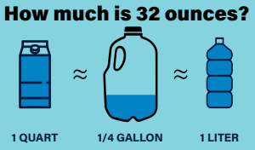
Heat Stress Controls – Plan Ahead
Rest Breaks
  Workers need to take breaks to allow their bodies to cool down
Shade
  Set up in advance
  As close to work area as possible
  Large enough to accommodate employees and have space for responding to emergency situations
Hydration – Hydrate before, during, and after work
  For moderate activities in the heat that last less than 2 hours: Drink 8 oz of water every 15-20 minutes (~32 oz every hour)
Notes:
Rest breaks:
Rest breaks are very important when it comes to preventing heat-related illnesses, as they allow the body to cool down.
Shade:
Make sure the shade is set up prior to the start of work, and that is it located as close to the work area as possible.
Shaded areas need to be large enough to accommodate employees as well as have space for responding to emergency situations (e.g., if an employee has a heat stroke).
Have a designated person point out the daily location of the shade structures to the workers.
Hydration:
Workers should drink an appropriate amount to stay hydrated. This does not just refer to during their work shift. Being hydrated when you start work makes it easier to stay hydrated throughout the day. If you are dehydrated when you start work, you may not be able to drink enough to catch up with your body’s need for water. In addition, most people need several hours to drink enough fluids to replace what they have lost through sweat. The sooner you start rehydrating after your work shift, the less strain you place on your body from dehydration.
Make sure workers are trained on the following hydration guidelines for during work, and that adequate water and sports drinks are provided:
For moderate activities in the heat that last less than 2 hours, drink 1 cup (8 oz.) of water every 15–20 minutes.
If sweating lasts for several hours, drink sports drinks containing balanced electrolytes.
It’s important to mention that by the time you feel thirsty, you are already behind in fluid replacement
Make sure you take your scheduled meal breaks. Eating meals and snacks will help ensure you are ingesting enough salt.
Do not drink more than 48 oz (6 cups) of water per hour. Drinking too much water or other fluids can cause a medical emergency because the concentration of salt in the blood becomes too low.
Source: 1https://www.cdc.gov/niosh/topics/heatstress/recommendations.html
Source 2: https://www.cdc.gov/niosh/topics/heatstress/recommendations.html
Source 3: https://www.cdc.gov/niosh/mining/UserFiles/works/pdfs/2017-126.pdf
Graphic: This graphic shows what 32 ounces looks like in different ways. 32 ounces is equal to 1 quart, ¼ gallon, and 1 liter.

Slide 31
Heat Stress Controls – Plan Ahead
Work periods should be shortened, and rest periods increased:
  As temperature, humidity, and sunshine increase
  When there is no or little air movement
  If PPE is worn (clothing or equipment)
  When heavier work is being performed
Schedule hot jobs for cooler parts of the day
Provide relief workers/job rotation
Increased ventilation, air flow
Notes:
Employers should implement the following:
Modify work/rest periods to give the body a chance to get rid of excess heat.
Permit rest and water breaks when a worker feels heat discomfort.
Assign new and unacclimatized workers lighter work and longer, more frequent rest periods.
Shorten work periods and increase rest periods:
As temperature, humidity, and sunshine increase.
When there is no air movement.
If protective clothing or equipment is worn.
For heavier work.
Source: https://www.cdc.gov/niosh/topics/heatstress/recommendations.html

Slide 32
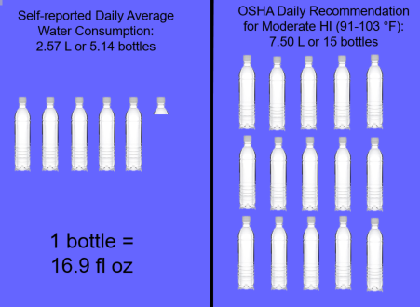
Hydration – OSHA Recommendation
Notes:
Consider this activity: Ask the participants: how many bottles of water do you think is OSHA’s daily recommendation for working in a moderate heat index? Display 16.9 fluid oz bottles at the front of the class so they can see what they look like. Keep asking them what they think is OSHA’s daily recommendation until they get close to 15 bottles. Show them what 15 bottles looks like and remind them that this is for working in a moderate heat index (heat index of 91 to 103 degrees). If working in a higher heat index, they will need to consume more water.
Graphic: Graphic demonstrating self-reported daily average water consumption versus OSHA’s daily recommendation for water consumption when working in a moderate heat index.
Source: American Builders 2017 “Are You Properly Hydrated?” Graphic

Slide 33
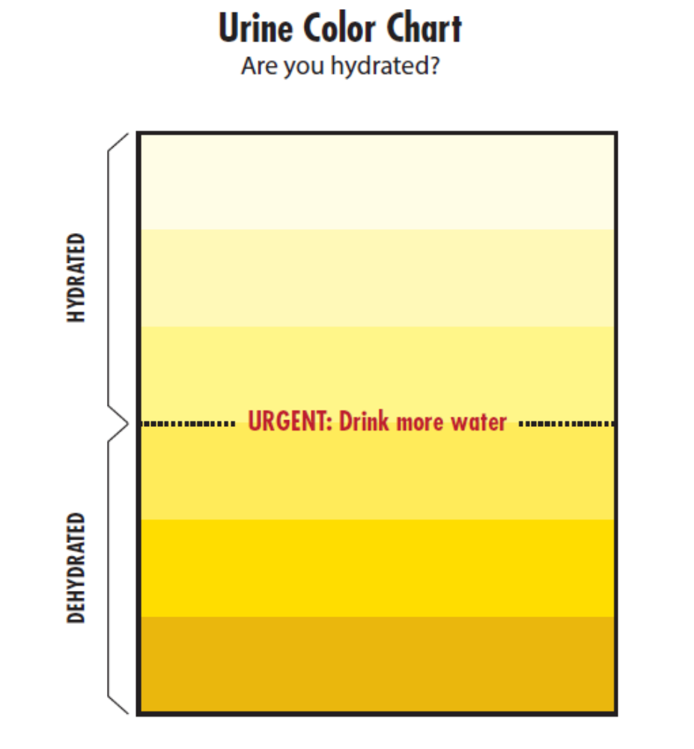
Urine Color Chart
Notes:
Urine color charts can be used to gauge or assess your hydration status.
In response to dehydration, the kidneys conserve water and excrete more concentrated urine; the more concentrated the urine the darker the color.
To use the chart, match the color of your urine sample to a color on the chart. Make sure you watch the urine stream not the toilet water, as the water in the toilet will dilute your urine color.
This is a urine color chart that can be posted in restrooms for employees to see.
In recent years technology has been developed to help workers and employers with monitoring hydration status. Wearable trackers have been developed that measure fluid and sodium loss, skin temperature, and motion. They can be paired with an application that provides direct and continuous sweat measurements, as well as real-time alerts and hydration recommendations. Hydration testing systems can also be used to monitor hydration status in the workplace. Hydration testing systems require a quick saliva or sweat sample and can provide employers and workers with immediate results. Worker hydration level is recorded within seconds of taking a saliva measurement, and the results can be immediately uploaded to a mobile application. The testing systems will tell you how much fluid to drink and what kind of fluid to drink to best replace electrolytes lost while working in the heat.
For companies that monitor employee hydration, these two means of monitoring are less invasive than taking urine samples. Companies also have access to the results through the applications and can use the results to help them make decisions related to employee hydration during the work shift.
Source: Georgia Tech Consultation Program Heat Stress Prevention Program
Chart: This chart demonstrates hydration status. Lighter shades of yellow suggest hydration, whereas darker shades of yellow/brown suggest dehydration and severe dehydration.

Slide 34
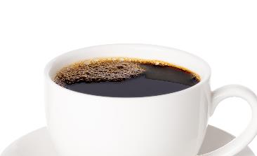

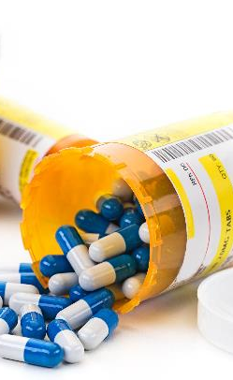
Come to Work Prepared!
Limit alcohol consumption
  Consumption within 24 hours can contribute to heat illness
Limit caffeine consumption
  High levels can add additional strain on heart
  Avoid energy drinks
Notes:
Employers can only control so much. They cannot control the decisions workers make outside of the workplace. Workers are still responsible for the decisions they make that can either predispose them to heat-related illness or prepare them for working in the heat.
Alcohol can cause dehydration. Drinking alcohol within 24 hours of working in the heat can increase the risk of heat illness. Having a beer the night before a work shift can increase your risk of heat illness in the following day.
In addition, workers should limit their caffeine consumption. In general, a normal amount of caffeine will not influence your overall hydration. However, when your heart is strained from hot temperatures and workload, high caffeine levels can add additional strain on your heart. It’s important to note that some energy drinks contain more caffeine than coffee, and drinking several energy drinks per day can raise your caffeine levels enough to affect your heart.
Image 1: A white plate with two fried eggs and bacon. Included to demonstrate the need for workers to consume meals prior to and during their work shift.
Image 2: A bottle of prescription medication. Used to demonstrate the need for employees to consider any medication they may be on.
Image 3: A cup of black coffee. Included to demonstrate the need for employees to be aware of their caffeine consumption.

Slide 35
Come to Work Prepared! (Continued)
Do not skip meals
Bring your own water bottle
Hydrate the day before
Consider medications
  Some medications are diuretics or affect temperature regulation in the body
Dress appropriately for the heat, light-colored clothing
Notes:
Do not skip meals. Do not skip breakfast and do not work through your lunch break or any other break. Meals provide your body with salt, a critical electrolyte that delivers water to your body’s cells.
It may be helpful to bring your own water bottle, especially one that is insulated.
Make sure you are drinking enough water the day before your work shift. This is going to make it easier for you to remain hydrated during your work shift.
Certain medications may act as diuretics or affect temperature regulation in the body. Check to see if you are taking any medications that may do so. If you are, notify your supervisor. You will need to take additional precautions to ensure you do not experience heat stress.
Dress appropriately for the heat. Inappropriate clothing can increase the burden of the heat load on the body. In general appropriate work clothing should be:
Lightweight , loose fitting and made of breathable fabric that allow airflow and air movement aiding in cooling the body.
Light-colored that reflects the heat better than dark-colored clothes (which absorb heat).
Shirts with long sleeves that cover the body and avoid sunburn. Sunburn affects the body’s ability to cool itself and increases the loss of body fluid.

Slide 36
Pre-Planning Exposure Assessments
Factors that need to be considered:
  Environmental conditions (e.g., air temperature, humidity, sunlight, air speed)
  Presence of heat sources (e.g., ovens or furnaces) in the work area
  Level of physical activity
  Use of clothing or protective gear
    Can reduce body’s ability to lose excess heat
  Individual and personal risk factors
Notes:
Employers are responsible for protecting their employees from heat-related hazards. In order to do so, pre-planning is very important. There are several factors employers need to consider when conducting pre-planning exposure assessments, including:
Environmental conditions (such as air temperature, humidity, sunlight, and air speed), especially on sequential days.
When the atmospheric moisture content (i.e. relative humidity) is high, the rate of evaporation from the body decreases. In other words, the human body feels warmer in humid conditions. The opposite is true when the relative humidity decreases because the rate of perspiration increases. The body feels cooler in arid conditions. There is direct relationship between the air temperature and relative humidity and the heat index, meaning as the air temperature and relative humidity increase (decrease), the heat index increases (decreases).
Presence of heat sources (e.g., hot tar ovens or furnaces) in the work area.
Level of physical activity, i.e., the workload leading to body heat production.
Use of clothing or protective gear that can reduce the body’s ability to lose excess heat.
Individual/personal risk factors.
When the body gets too hot, it begins to perspire or sweat to cool itself off. If the perspiration is not able to evaporate, the body cannot regulate its temperature. Evaporation is a cooling process. When perspiration is evaporated off the body, it effectively reduces the body's temperature.
When the atmospheric moisture content (i.e. relative humidity) is high, the rate of evaporation from the body decreases. In other words, the human body feels warmer in humid conditions. The opposite is true when the relative humidity decreases because the rate of perspiration increases. The body actually feels cooler in arid conditions. There is direct relationship between the air temperature and relative humidity and the heat index, meaning as the air temperature and relative humidity increase (decrease), the heat index increases (decreases).

Slide 37
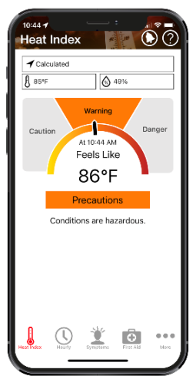
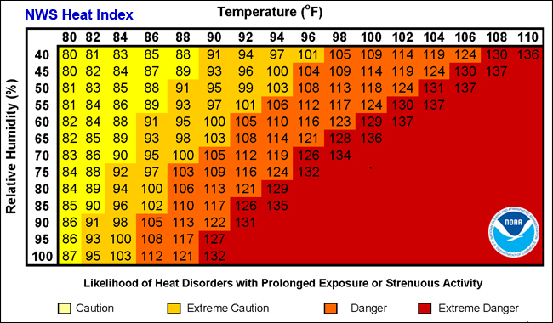
Pre-Planning Exposure Assessments
Notes:
Two resources that can help when determining the environmental conditions prior to a work shift are The National Weather Service (NWS) Heat Index Chart and the OSHA NIOSH Heat Safety Application. The NWS Heat Index Chart measures the apparent temperature, which is what the temperature feels like to the human body. The human body feels warmer in humid conditions. The chart also shows the likelihood of heat stress disorders with prolonged exposure or strenuous activity depending upon the heat index.
The OSHA NIOSH Heat Safety Application provides a visual indicator of the current heat index and associated risk levels specific to your current geographical locations. In addition, it includes precautionary recommendations specific to heat index-associated risk levels, recommendations for planning outdoor work activities, and signs and symptoms and first aid for heat-related illnesses. In the application, the location, temperature, and humidity controls can all be edited to calculate the heat index for different conditions.
Image 1: The National Weather Service’s Heat Index Chart
Image 1 Source: https://www.weather.gov/ama/heatindex
Image 2: A screenshot of the home page on the OSHA NIOSH Heat Safety App

Slide 38
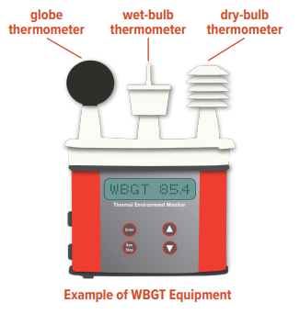
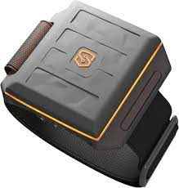
Heat Assessments
Wet Globe Bulb Thermometer
  Estimates effect of temperature, relative humidity, wind speed, and solar radiation
Heat Bands
  Measure core body temperature and heart rate
  Notify manager when dangerous levels are exceeded for employees
  Employees can alert manager on band if assistance is needed
  Data logging capabilities
Notes:
Heat assessments can also be done on-site to determine the environmental conditions on the work-site as well as identify heat sources throughout the work site. Wet Globe Bulb Thermometers are used to estimate the effect of temperature, relative humidity, wind speed, and solar radiation by using three different thermometers:
The wet bulb measures the temperature read by a thermometer covered in a wet cloth. As water evaporates from the cloth, evaporation cools the thermometer. This mirrors how the human body cools itself with sweat.
The black globe is used to measure solar radiation. Solar radiation heats the globe and wind blowing across it cools the globe.
The dry bulb calculates the air temperature measured in the shade. It is the temperature you would see on your thermometer outside.
The Wet Globe Bulb Thermometers allow employers to estimate the effects of the following:
Indoor work — A weather report cannot gauge conditions inside a building.
Direct sunlight — Weather services measure temperature and Heat Index in the shade. Work in the sun may be considerably hotter. Direct sunlight can increase the Heat Index by up to 13.5°F (7.5°C).
Heat sources — Weather reports cannot account for the heat generated by fires, hot tar or other materials, ovens, or other hot equipment, or heat-absorbing surfaces such as roads and roof surfaces.
Wind blockage — Some worksites may be hotter than surrounding areas because of structures that block air movement. Examples include trenches and bowl-shaped athletic stadiums.
Reflective material — Water, metal, or other materials can reflect sunlight onto workers.
Physiological monitoring can be conducted to monitor workers on-site. Heat bands are wearable technology that perform the following:
Measure core body temperature and heart rate
Notify manager when dangerous levels are exceeded for employees
Employees can alert manager on band if assistance is needed
Data logging
Smart watches can also be used, but only do measure heart rate levels when working. They are not capable of reading core body temperature.
Image: An image of a wearable heat band that can be used on-site to perform physiological monitoring of employees.
Image: An example of Wet Globe Bulb Thermometer, with the globe thermometer, wet-bulb thermometer, and the dry-bulb thermometer

Slide 39
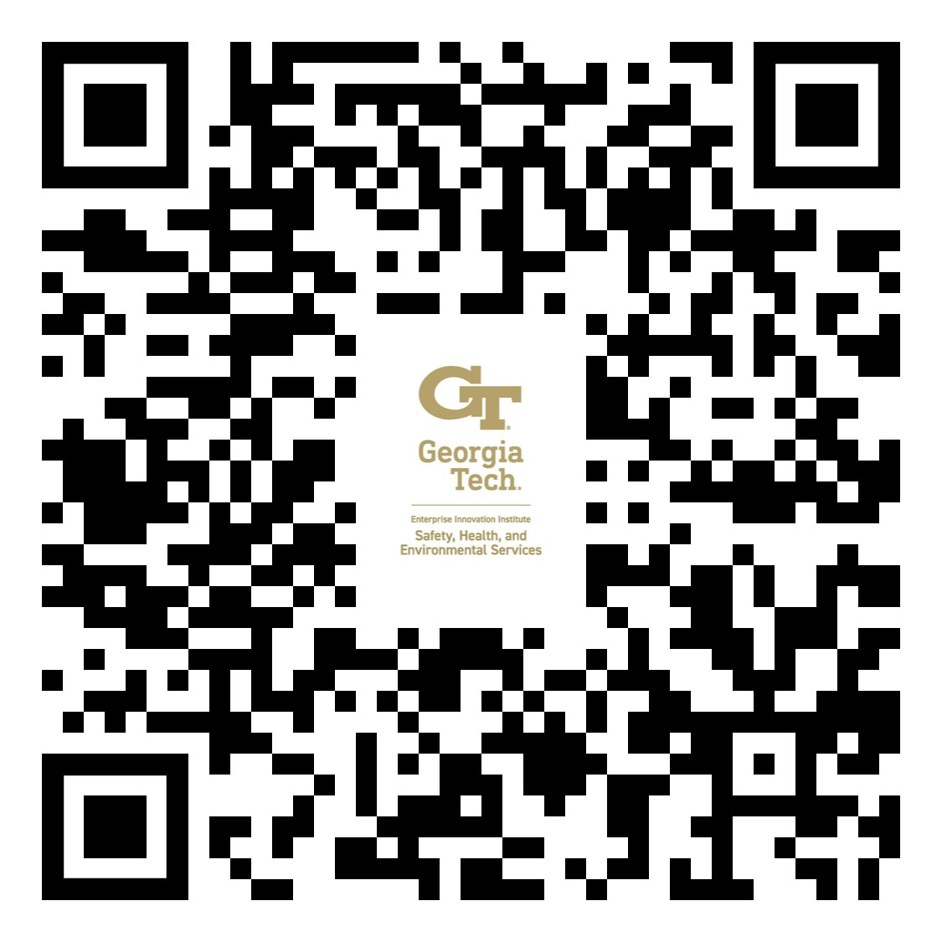
Create a Heat Illness Prevention Plan
https://oshainfo.gatech.edu/written-program-templates/
Job Task/ Exposure to Heat | Company Implemented Control Measures
1.Example: Field work for botanical garden that is conducted outside in direct sunlight | Example: Use of moveable pop-up tent to provide shade Use of jugs of water and electrolytes stationed within 10 ft. of work area Use of cooling vests
Notes:
Companies should develop a Heat Illness Prevention Plan that outlines how the company will perform/implement the following:
Employee training
Water locations
Shade/cooling locations and resources
Other measures, such as a buddy system, rest break schedule, and work shift adjustment
The plan should also identify specific work activities that may expose employees or contractors to heat stress hazards and identify control measures for each of those activities to protect workers.
The Georgia Tech OSHA Consultation Program has a template for a written Heat Illness Prevention Plan. Scan the QR code to access the template. If using the template, make sure you make it specific to the facility/work-site.
Image 1: A table showing the job task and how employees will be exposed to heat, and the company implemented control measures to protect the workers from the heat.
Image 2: A QR code that can be scanned to access the Heat Illness Prevention Plan template

Slide 40
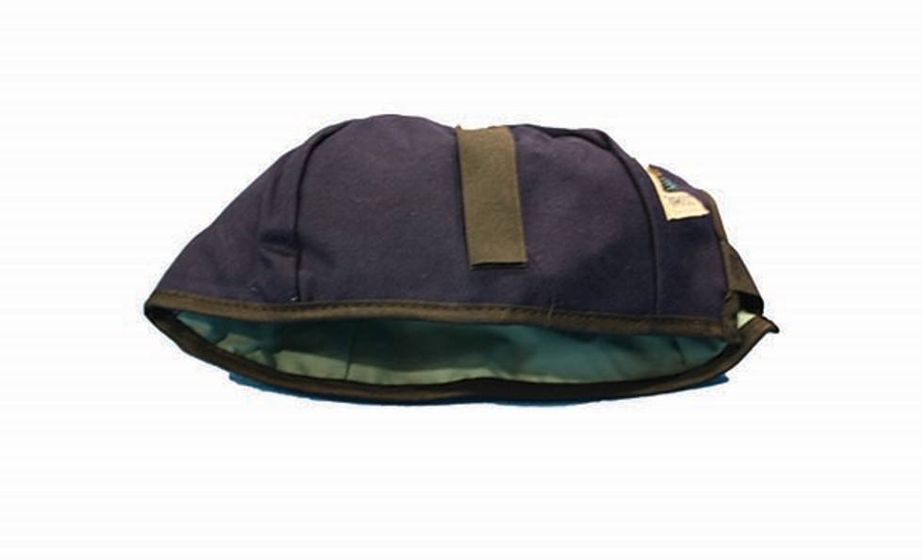
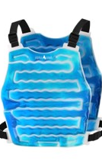
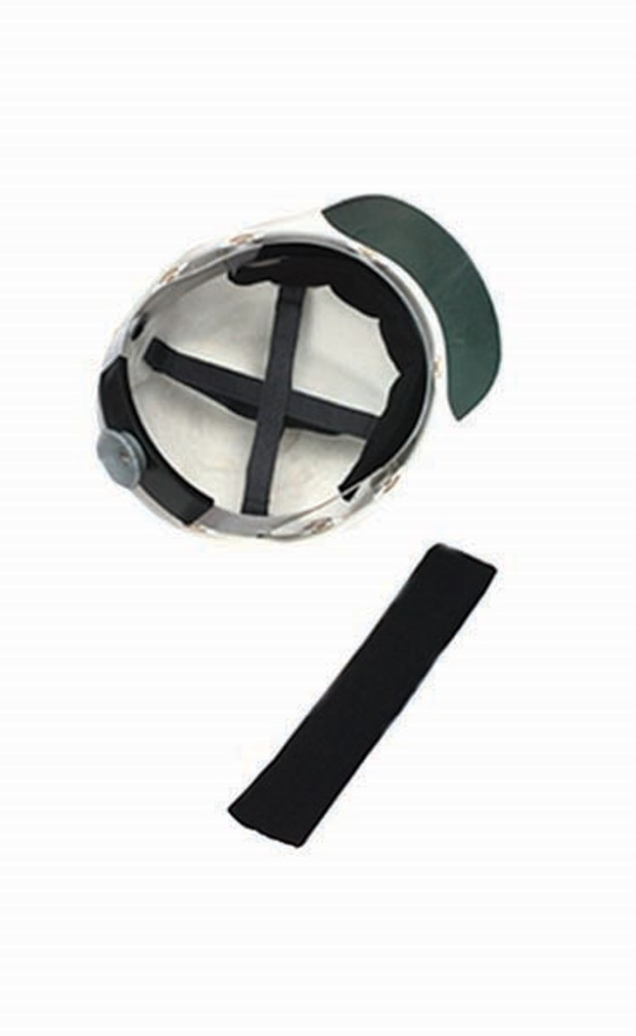
PPE/Clothing for Heat Stress Prevention
Cooling Garments
Lightweight, loose fitting, breathable fabric
Light colored clothes
Shirts with long sleeves to avoid sunburn
Notes:
There is PPE that can be used to help prevent heat stress in the workplace. However, this PPE may come with limitations and employees must be trained in how to properly use the equipment.
Cooling garments include:
Water-cooled garments (e.g., hoods, vests and "long johns"). These require a battery-driven circulating pump, liquid-ice coolant, and a container. What are potential problems with cooling garments?
Limited operating time
Restriction of movement
Additional weight
Limited Dexterity
Reduction in effective work space
The interaction with PPE used at HAZWOPER sites
Ice packet vests
Air cooled garments (e.g., suits or hoods)
Wetted over garments (e.g., head and neck wraps, cooling caps, sweatbands).
Clothing selection can also have a significant effect on heat stress. Workers should wear clothing that is going to protect them against the sun and other environmental risk factors and allow the body to cool. In general, appropriate work clothing should be:
Lightweight , loose fitting and made of breathable fabric that allow airflow and air movement aiding in cooling the body.
Light-colored, which reflects the heat better than dark-colored clothes (which absorb heat).
Shirts with long sleeves that cover the body and avoid sunburn. Sunburn affects the body’s ability to cool itself and increases the loss of body fluid.
Image 1: A cooling cap that can be used to cool the head
Image 2: A sweatband that can be applied to the inside of a hard hat or cap to cool the head
Image 3: An ice packet vest

Slide 41
Actions to Take to Prevent Heat Stress
Train employees, contractors, volunteers, etc.
Assign responsibilities
Identify water sources, shade/cooling locations and sources
Perform pre-planning exposure assessments
Have a plan for emergencies
Have necessary equipment
  Shade
  Cooling areas
  Cooling equipment/PPE
  Emergency equipment
  Check out our shopping list!
Notes:
To prevent heat stress, several actions must be taken by employers:
Training employees, contractors, and volunteers;
Assign responsibilities (e.g., who will identify shade or cooling locations and sources, who will ensure sufficient water is provided to employees, etc.)
Identify water sources (location, how water will be provided, persons responsible for checking on quantity)
Perform pre-planning exposure assessments
Have a plan in place for emergencies
Have the necessary equipment (e.g., equipment for shade, cooling areas, cooling equipment/PPE, emergency equipment)
We have provided a shopping list for you all that includes equipment that should be on-site to prevent heat stress and respond to heat stress disorders

Slide 42

Preventing Heat Stress at Home
Take actions to protect yourself and your loved ones:
  Stay hydrated throughout the day
  Consider medications
  Stay in air-conditioning as much as possible
  Wear lightweight, loose clothing
  Take cool showers and baths
  Limit outdoor activity (e.g., gardening, exercising, renovating, etc.) to cooler parts of the day
Notes:
Individuals are not just at risk of experiencing heat-related illnesses and deaths on the job. It’s important we apply what we have just learned about heat stress prevention at home to ourselves and to our loved ones.
Heat-related illnesses have occurred among young, amateur, and professional athletes. It is important athletes are aware of the signs and symptoms of heat-related illness, as well as what to do to prevent heat stress when exercising. Athletes need to look out for themselves and their teammates, and coaches need to look out for their athletes. Emphasize the need to stay hydrated before, during, and after sports practices, as well as the importance of avoiding caffeinated beverages.
Image: Young person wearing football helmet and pads in the sun.

Slide 43
Heat Stress Resources for Companies
OSHA:
  National Emphasis Program: Outdoor and Indoor Heat-Related Hazards: https://www.osha.gov/sites/default/files/enforcement/directives/CPL_03-00-024.pdf
  Working in indoor and outdoor heat environments: https://www.osha.gov/heat-exposure
  Heat Stress Guide: https://www.osha.gov/emergency-preparedness/guides/heat-stress
  Heat Illness Prevention Campaign: https://www.osha.gov/heat
  Heat Stress Calculator: https://www.osha.gov/heat-exposure/calculator
NIOSH
  Heat stress page: https://www.cdc.gov/niosh/topics/heatstress/
  NIOSH-OSHA Heat Safety Tool Application: https://www.cdc.gov/niosh/topics/heatstress/heatapp.html
Georgia Tech
  Training guides, lesson plans, and PPTs: https://oshainfo.gatech.edu/resources/training-materials/additional-information/
Notes:
OSHA, NIOSH, and Georgia Tech all have a number of resources available to companies to help them in protecting their employees from heat-related hazards in the workplace.

Slide 44
Cold Stress
Notes:
The next session of the course will cover cold stress.

Slide 45
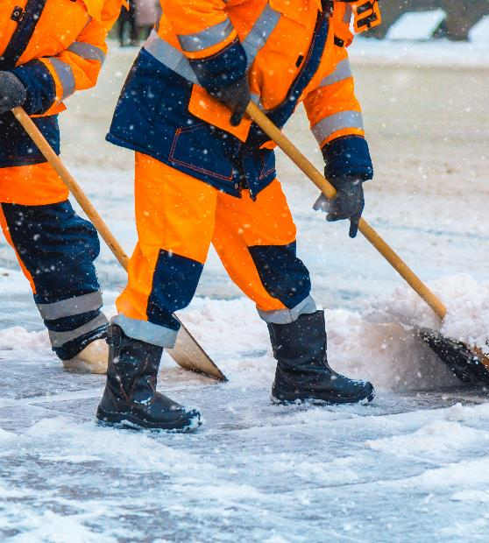
What is Cold Stress?
Occurs when the temperature of the skin is driven down which eventually leads to the internal body temperature being reduced.
The reduction of internal body temperature can cause tissue damage and even death.
Increased wind speeds and wetness/dampness will increase heat loss from the body.
Substantial outdoor temperature drop will increase heat loss from the body.
Deep core temperature should not fall below 96.8°F.
Notes:
In a cold environment, most of the body's energy is used to keep the internal core temperature warm.
Over time, the body will begin to shift blood flow from the extremities (hands, feet, arms, and legs) and outer skin to the core (chest and abdomen).
This shift allows the exposed skin and the extremities to cool rapidly and increases the risk of frostbite and hypothermia.
Cold stress occurs when the temperature of the skin is driven down which eventually leads to the internal body temperature being reduced. Serious health problems can occur when the body is unable to stay warm enough.
The reduction of internal body temperature can cause tissue damage and even death. Increased wind speeds, wetness/dampness, and a substantial drop in the outdoor temperature can all increase heat loss from the body. According to the American Conference of Governmental Industrial Hygienists (ACGIH®) Threshold Limit Values (TLV®), workers should be protected from exposure to cold so that the deep core temperature does not fall below 96.8°F (36°C) and to prevent frostbite to body extremities [ACGIH 2019].
Image: Two workers in cold-weather gear shoveling snow.

Slide 46
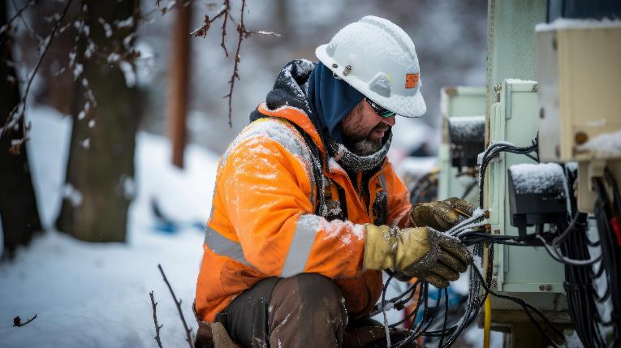
Who Is At Risk?
Workers who are exposed to extreme cold or work in cold environments
  Outdoors
  Areas that are purposefully kept cold, poorly insulated, or without heat
  Cold, damp conditions
  Includes workers, both indoors and outdoors, in manufacturing, transportation, construction, agriculture, maritime, and other industries
Notes:
Workers, both indoors and outdoors, in manufacturing (e.g., in places kept purposefully cold, poorly insulated, or without heat), transportation, agriculture, construction, maritime and other industries may be exposed to environmental cold stress that can lead to thermal discomfort and in some cases even severe injuries, illnesses, or death.
For indoor workers, work in cold, damp conditions can be uncomfortable and may lead to declining work performance (i.e., a decline in cognitive function and dexterity) or result in cold-related illness or injury. Cold-related conditions can also worsen musculoskeletal injuries and vascular disorders.
For outdoor workers, what constitutes cold stress can vary across different areas of the country. In regions where workers are unaccustomed to winter weather, near freezing temperatures are considered factors for cold stress.
Image: Photo of an individual working on electrical equipment outdoors in the cold.

Slide 47
Case Report: Frostbite
In the winter of 2009, a 56-year-old male truck driver went to the emergency room seeking care [Alaska Trauma Registry]. He had come to Alaska after a long-haul drive through Canada. Along his route, he stopped to change a fuel filter. He accidentally splashed diesel fuel on his gloves, which froze to his hands as he worked outside along the highway. After arriving at his destination, he had to spend a night at the hospital receiving treatment for his frostbitten hands.
Notes:
Read through the case report with the participants.
Source: NIOSH Preventing Cold-Related Illness, (Injury, and Death Among Workers (https://www.cdc.gov/niosh/docs/wp-solutions/2019-113/pdfs/2019-113.pdf).

Slide 48
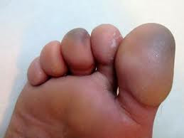
Cold Stress Disorders
Hypothermia – core temperature below 95°F. Early signs are shivering, fatigue, loss of coordination, confusion
Frostbite – freezing of the skin and deeper tissues causing loss of feeling and color in affected areas. Can permanently damage body tissues and lead to amputation.
Notes:
Hypothermia, frostbite, trench foot, and chilblains are all cold stress disorders.
Hypothermia
A condition that takes place when the body expends more heat than it creates. It often occurs after prolonged exposure to cold temperature. Hypothermia is clinically defined as a core temperature below 95°F. Early symptoms of hypothermia include shivering, fatigue, loss of coordination, and confusion and disorientation. Late symptoms include no shivering, blue skin, dilated pupils, slowed pulse and breathing, and loss of consciousness.
Frostbite
Frostbite is an injury caused by freezing of the skin and deeper tissues, resulting in the loss of feeling and color in the affected areas. Frostbite can permanently damage body tissues, and severe cases can lead to amputation. Examples of risk factors for frostbite include contact with metal or water, dehydration, diabetes, smoking, alcohol abuse, sedating or judgment impairing medication. Symptoms of frostbite include numbness; tingling or stinging; aching; and bluish or pale, waxy skin.
Image: A photo of a foot with toes affected by frostbite.

Slide 49
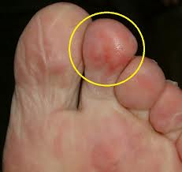
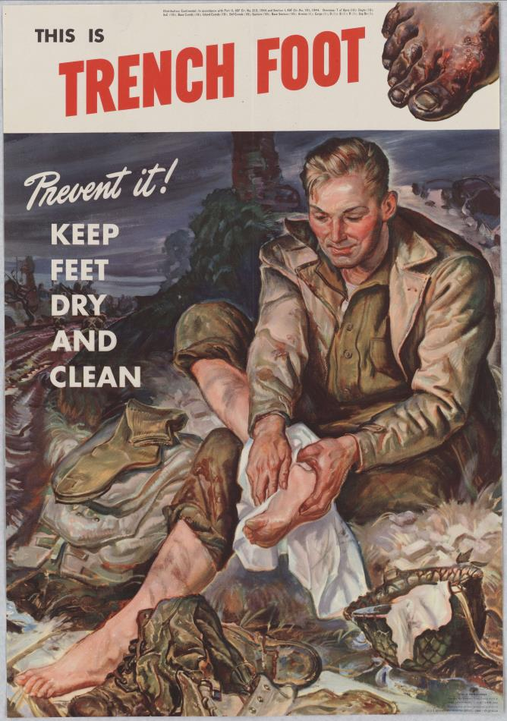
Cold Stress Disorders (Continued)
Chilblains – painful inflammation of small blood vessels in the skin resulting in redness, itching, inflammation
Trench Foot (Immersion Foot Syndrome) – occurs after prolonged exposure to wet and cold conditions. Causes damage to the circulation and nerve function in the feet
Notes:
Chilblains
Chilblains are the painful inflammation of small blood vessels in the skin that occur in response to repeated exposure to cold but nonfreezing temperatures. Small blood vessels in the skin may become permanently damaged by cold temperatures, resulting in redness and itching during additional exposures. Symptoms of chilblains include redness, itching, possible blistering, inflammation, and possible ulceration in severe cases. First aid includes slowly warming the skin, applying corticosteroid creams to relieve any itching and swelling, avoiding scratching the affected area, and keeping blisters and ulcers clean and covered.
Trench Foot
Trench foot is an injury of the feet that occurs after prolonged exposure to wet and cold-related conditions. Trench foot occurs because wet feet lose heat 25 times faster than dry feet. To prevent heat loss, the body constricts blood vessels in the feet, and then the skin tissue begins to die. Trench foot causes damage to the circulation and nerve function in the feet. It can occur at temperatures as high as 60°F if the feet are constantly wet. Symptoms of trench foot include reddening of the skin, numbness, leg cramps, swelling, tingling pain, blisters or ulcers, bleeding under the skin, and gangrene (e.g., foot turns purple, blue, or gray). Trench foot can be prevented by keeping the feet warm, clean, and dry.
Image 1: A foot with a toe affected by chilblains.
Image 2: A poster warning of trench foot. Poster reads: “Prevent it! Keep feet dry and clean.” Shows soldier drying feet. Public domain.

Slide 50
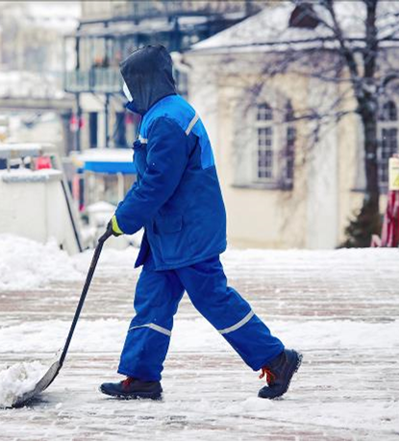
How to Protect Yourself from Cold Stress
Wear appropriate clothing
  Several layers of loose clothing
  Remember: tight clothing reduces blood circulation to extremities
  Bring extra clothing
Protect ears, face, hands, and feet in extremely cold or wet weather
  Boots should be waterproof and insulated
  Wear hat to reduce loss of body heat from head
Notes:
In order to protect themselves from cold stress, workers should:
Wear appropriate clothing. This includes wearing several layers of loose clothing. Tight clothing reduces blood circulation to extremities and should not be used.
Make sure workers carry extra socks, gloves, hats, jacket, blankets, a change of clothes and a thermos of hot liquid.
The ears, face, hands, and feet are especially vulnerable in cold temperatures and should be protected in cold and wet weather. Boots should be waterproof and insulated, and hats should be used to reduce the loss of body heat from the head.
Image: A worker clearing snow on a street.

Slide 51
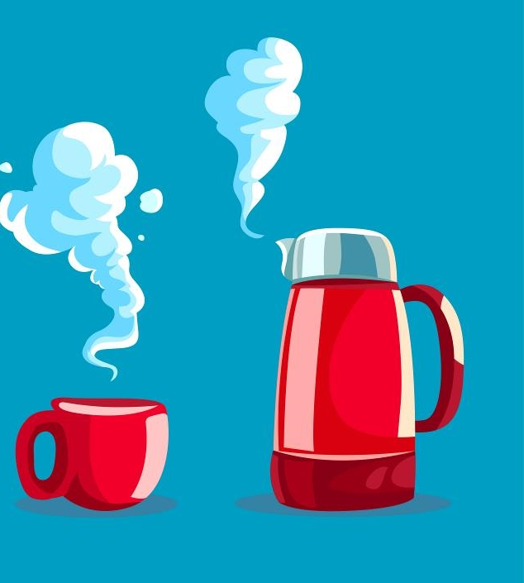
How to Protect Yourself from Cold Stress (Cont.)
Take regular breaks in warm locations
Monitor your physical condition and that of your coworkers
Stay hydrated and well nourished
  Warm beverages (but be careful with caffeine)
  Continue to drink water
Avoid touching cold metal or wet surfaces with bare skin
Notes:
In order to protect themselves from cold stress, workers should:
Take regular breaks to warm up.
Monitor their physical condition and that of coworkers.
Stay hydrated by drinking lots of water; warm beverages may help increase body temperature. Workers can still become dehydrated in the cold. Make sure workers continue to hydrate themselves with water.
Avoid touching cold metal or wet surfaces with bare skin.
Image: a graphic showing a thermos and cup both containing a hot beverage.

Slide 52
How Employers Can Protect Workers from Cold Stress
Implement a cold-related illness and injury prevention program that includes:
  Training workers about the hazards of working in cold environments and how to respond to and prevent cold stress
  Reducing workers’ time spent in cold environments
  Establishing work/rest schedules
  Using engineering controls (e.g., radiant heaters, shielding work areas from wind)
  Providing appropriate cold-weather gear
Notes:
The National Institute for Occupational Safety and Health (NIOSH) recommends that employers implement a cold-related illness and injury prevention program that includes preventive measures such as using engineering controls, establishing work/ rest schedules, reducing workers’ time spent in cold environments, training workers about the hazards of working in cold environments (in a language and vocabulary that the workers understand), and providing appropriate cold-weather gear such as hats, gloves, and boots for work in cold environments and wind protective clothing based on air velocities.
Source: https://www.osha.gov/winter-weather/cold-stress#affected

Slide 53

Protecting Workers from Cold Stress
Implement a cold-related illness and injury prevention program that includes:
  Monitoring of workers in cold conditions
  Buddy system
  Ensuring access to warm areas and places to change out of wet clothes
  First aid kits including medical and environmental thermometers and chemical hot packs
  Providing prompt medical attention
Notes:
The National Institute for Occupational Safety and Health (NIOSH) recommends that employers implement a cold-related illness and injury prevention program that includes preventive measures such as reducing the physical demands of workers (e.g., using relief workers or rotating extra workers in and out of work for long, demanding jobs), ensuring access to warm areas and a place to change out of wet clothes, encouraging employees to take breaks to warm up when needed, monitoring workers in cold conditions and initiating a buddy system, including a medical and environmental thermometer and chemical hot packs in first aid kits, participating in joint management/employee safety committees, and providing prompt medical attention to workers who show signs of cold-related illness or injury.
Source: https://www.osha.gov/winter-weather/cold-stress#affected
Photo: An employee looking at a construction site in the background that is covered in snow.

Slide 54
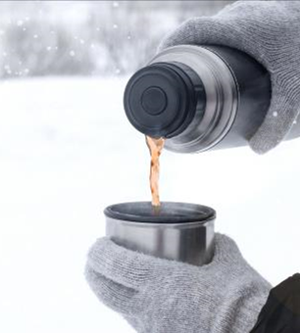
Safe Work Practices for Cold Stress Prevention
Provide warm and sweetened liquids to workers
Schedule heavy work during the warmer part of the day
Establish a buddy system so workers can monitor each other
Reduce physical demands of workers
  Relief workers
  Rotate workers
Give frequent breaks in warm areas
Acclimatize new workers and those returning after time away
Notes:
Employers should implement safe work practices for cold stress prevention, including the following:
Providing plenty of warm sweetened liquids to workers, as it is easy to become dehydrated in cold weather.
If possible, scheduling heavy work during the warmer part of the day.
Assigning workers to tasks in pairs (buddy system), so that they can monitor each other for signs of cold stress.
Reducing the physical demands of workers (for example, using relief workers or rotating extra workers in and out of work for long, demanding jobs).
Allowing workers to interrupt their work if they are extremely uncomfortable.
Giving workers frequent breaks in warm areas.
Acclimatizing new workers and those returning after time away from work, by gradually increasing their workload, and allowing more frequent breaks in warm areas, as they build up a tolerance for working in the cold environment.
Source: NIOSH Preventing Cold-Related Illness, Injury, and Death Among Workers (https://www.cdc.gov/niosh/docs/wp-solutions/2019-113/pdfs/2019-113.pdf).
Image: Photo of someone pouring a hot liquid from a thermos into a cup in the snow.

Slide 55
Knowledge Check: Cold Stress
List 4 ways workers can prevent themselves from cold stress
List 4 safe work practices employers can implement for cold stress prevention
Notes:
Take regular breaks in warm locations, monitor your physical condition, wear appropriate clothing, protect ears, face, hands, and feet, stay hydrated and well nourished, avoid touching cold metal or wet surfaces with bare skin.
Train workers on cold stress prevention, Provide warm and sweetened liquids to workers, Schedule heavy work during the warmer part of the day, Establish a buddy system so workers can monitor each other, Reduce physical demands of workers, Give frequent breaks in warm areas, Acclimatize new workers and those returning after time away

Slide 56
Cold Stress Resources for Workers and Employers
OSHA Winter Weather Page: https://www.osha.gov/winter-weather/cold-stress
OSHA Protecting Workers from Cold Stress Quick Card: https://www.osha.gov/sites/default/files/publications/OSHA3156.pdf
National Weather Service (NWS) Wind Chill Calculator: https://www.weather.gov/safety/cold-wind-chill-chart
National Institute of Health and Safety (NIOSH) Cold Stress Page: Cold Stress | NIOSH | CDC
Notes:
There are a number of cold stress prevention resources available for both workers and employers, including OSHA’s Winter Weather Page, OSHA’s Protecting Workers from Cold Stress Quick Card, The National Weather Service (NWS) Wind Chill Calculator, and NIOSH’s Cold Stress Page.
*Note about the NWS Wind Chill Calculator: Wind Chill is the term used to describe the rate of heat loss from the human body, resulting from the combined effect of low air temperature, and wind speed. This measurement is the actual effect of the environmental cold on the exposed skin. With the calculator, workers and employers can input the air temperature and wind speed, and it will calculate the wind chill temperature.

Slide 57
Questions?

