Slide 1
Walking and Working Surfaces, including Fall Protection
OSHA 10-hour Outreach Training General Industry

Slide 2
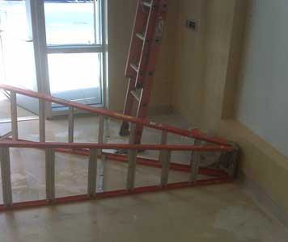
Fatal Ladder Incident
A worker was cleaning windows when he fell onto a tiled floor and hit his head.
It is believed that the worker had positioned the step ladder with the rungs facing towards the windows, and that he stood backwards on the step ladder.
NIOSH In-house FACE Report 2009-01

Slide 3
Introduction
Slips, trips, and falls:
make up the majority of general industry accidents; and
cause 15% of all accidental deaths, second only to motor vehicle crashes.

Slide 4
Introduction
Lesson objectives:
Identify hazards in the workplace associated with walking and working surfaces.
Identify best practices for eliminating or controlling hazards associated with walking and working surfaces in the workplace.
Recognize employer requirements to protect workers from walking and working surface hazards.

Slide 5
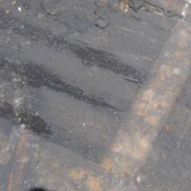

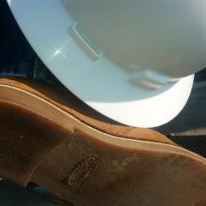

Hazards and Controls
Slip hazards:
Grease, oil, water, ice, snow, liquid spills, or polished floors
Improper footwear
Source: Photos WVU Susan Harwood

Slide 6
Hazards and Controls
Controlling slip hazards:
Keep walking/working surfaces as clean and dry as possible.
Make sure your footwear is as slip resistant as possible.
Require drainage for wet operations.
Clean up or mark and report spills.
Remove ice and snow frequently and regularly.

Slide 7
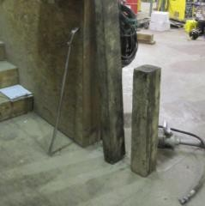
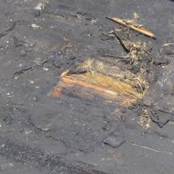
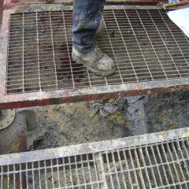
Hazards and Controls
Trip hazards:
Poor housekeeping
Loose flooring, carpeting, or uneven surfaces
Source: Photos WVU Susan Harwood

Slide 8
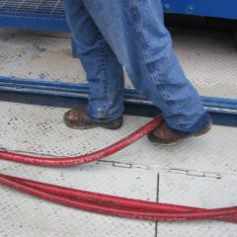
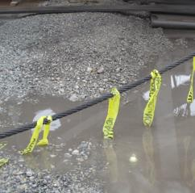
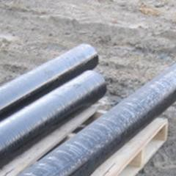
Hazards and Controls
Cords, hoses, open draws or other protruding items
Source: Photos WVU Susan Harwood

Slide 9
Hazards and Controls
Controlling trip hazards:
Aisles and passageways should be well-lit, clean, and marked.
Material storage and work-related scraps
shouldn’t create trip hazards.
Trip hazards, such as loose flooring, carpeting, uneven surfaces, and protrusion hazards, should be repaired or reported.
Hoses and cables should be routed away from active work zones and walkways.

Slide 10
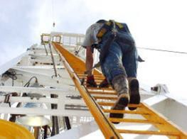
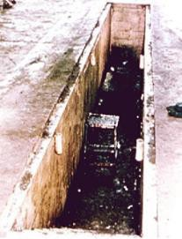
Hazards and Controls
Fall hazards:
Elevated surfaces – top of tanks, towers, machines, platforms, runways, or other elevated surfaces
Lower-level surfaces – open pits, tanks, vats, or ditches
Source of photos: OSHA

Slide 11
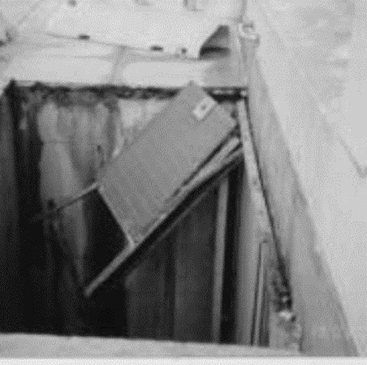
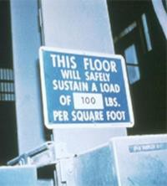
Hazards and Controls
Structural collapse
  structurally unsound
surfaces, and/or
  exceeding load limits.
Photo: example of a sidewalk grate system failure
Source of photos: OSHA

Slide 12

Hazards and Controls
Controlling fall hazards
Tanks, towers, machines, and other elevated
surfaces:
It is best to engineer out the need to go up in the first place.
Guardrails are often used, whether temporary
or permanent.
As a last resort, use a
Source: OSHA
Personal Fall Arrest System (PFAS).

Slide 13
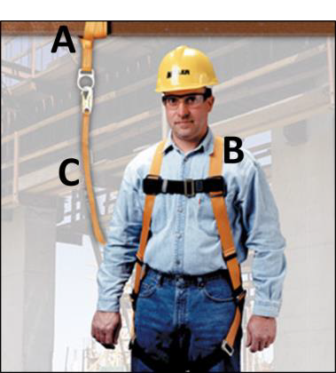
Hazards and Controls
Know the ABCs of Personal Fall Arrest Systems
Anchorages
Body harness
Components (connectors like snaphooks or Dee-rings, connection points, lanyards, deceleration devices,
Source: Honeywell/Miller, used with permission.
lifelines, etc.)
Installed, used, and maintained according to the manufacturer.

Slide 14
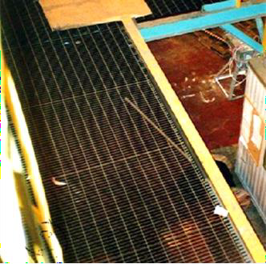
Hazards and Controls
Open-sided platforms and runways:
  Use proper guardrail system at all times.
  Platforms and runways next to dangerous operations require standard railings, regardless of height.
Source: OSHA

Slide 15
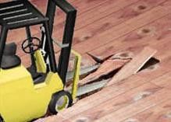
Hazards and Controls
Structural collapse:
  Ensure walking/working surfaces are structurally sound.
  Surfaces must be able to support intended/potential load, including people, equipment, and stored materials
  Load limits must be posted
Source: OSHA

Slide 16
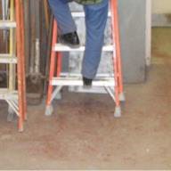
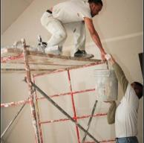
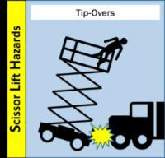
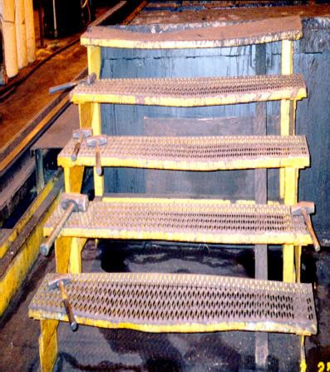
Hazards and Controls
Conditions leading to falls:
Ladders
Scaffolds and scissor lifts
Stairways
Floor and wall openings
Other elevated surfaces
Source: WVU Susan Harwood
Source: www.elcosh/org
Source: OSHA
Source: OSHA

Slide 17
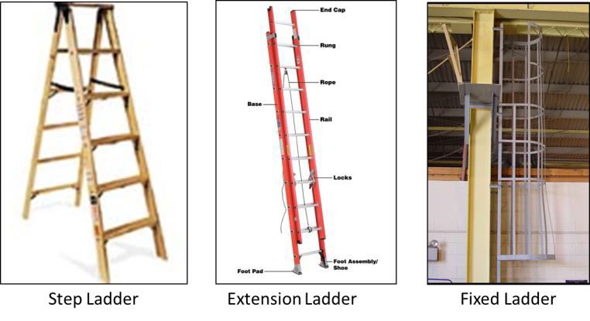
Hazards and Controls
Basic types of ladders:
Source of photos: OSHA

Slide 18
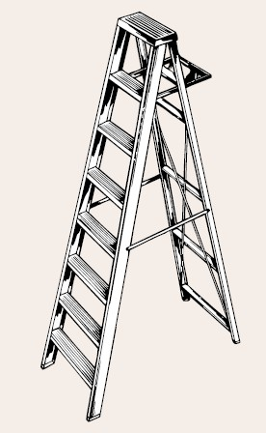
Hazards and Controls
Controlling fall hazards –
ladders:
One of the leading causes of fatalities and injuries.
Ladder safety
  Use the right ladder.
  Use ladder that is free from defects.
  Use the ladder properly.
Source: OSHA

Slide 19
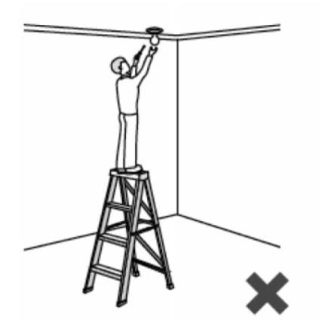

Hazards and Controls
Wrong Ladder-too short!
The right ladder:
  Use the right type, length, and rating for the job.
  Never use the top two steps of a step ladder.
  Tell your supervisor if you need a longer ladder.
Source: OSHA

Slide 20
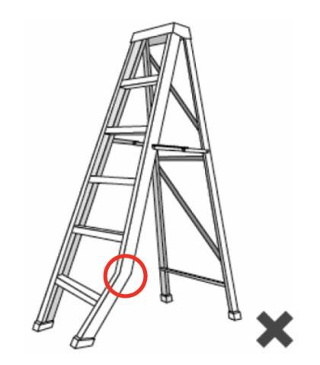

Hazards and Controls
Free from defects
  Regardless of ladder type, inspect the ladder before use.
  Do not use the ladder if it is bent or there are missing parts.
  Tell your supervisor about the defective ladder.
Source: OSHA

Slide 21
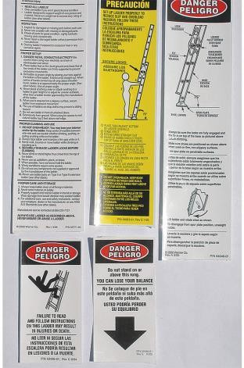
Hazards and Controls
Proper use
  Ladders must be used according to the manufacturer.
  Take the time to read the information.
  Read and follow all informational stickers and warning labels.
Source: Wernerco shares page

Slide 22
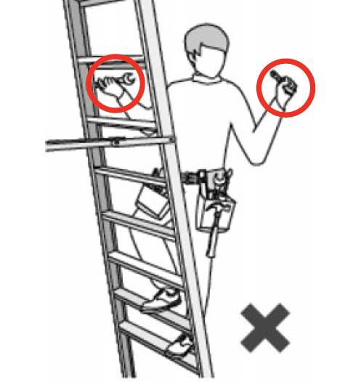
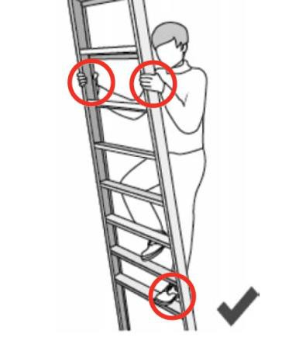

Hazards and Controls
Maintain 3 points of contact
Source: OSHA

Slide 23
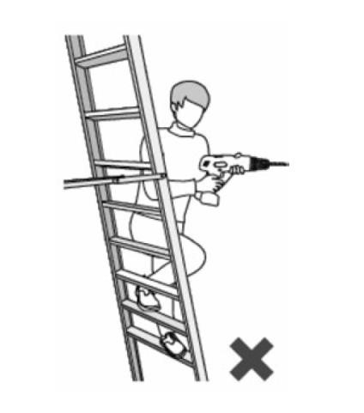

Hazards and Controls
Maintain proper positioning.
Do not lean away from the ladder to carry out your task.
Always keep your weight centered between the side rails.
Move the ladder as necessary.
Source: OSHA

Slide 24
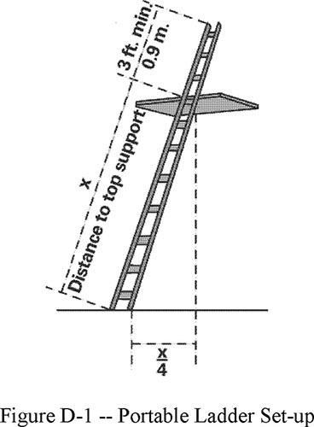
Hazards and Controls
3 feet
When using ladders to access another level, secure and extend the ladder at least 3 feet above the landing point.
Angle ladder so the horizontal distance of bottom is ¼ the working length of the ladder.
Source: OSHA

Slide 25
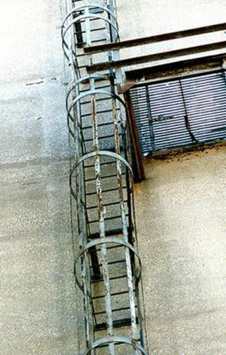
Hazards and Controls
Fixed industrial ladders
  Must be equipped with a
    Personal fall arrest system, ladder safety system (if installed on/after 12/19/18)
    Personal fall arrest system, ladder safety system, cage, or well (if installed before 12/19/18)
  PFAS or ladder safety system must provide protection throughout entire vertical distance of ladder
Source: OSHA

Slide 26
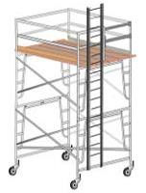
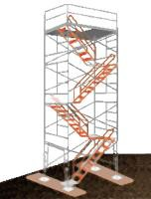
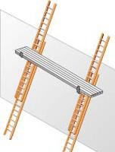
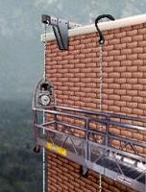
Hazards and Controls
Controlling fall hazards –
scaffolds:
Scaffold-related incidents can also lead to injury and death.
Scaffold safety
  free from defects
  proper set-up
  proper use
Source: OSHA

Slide 27
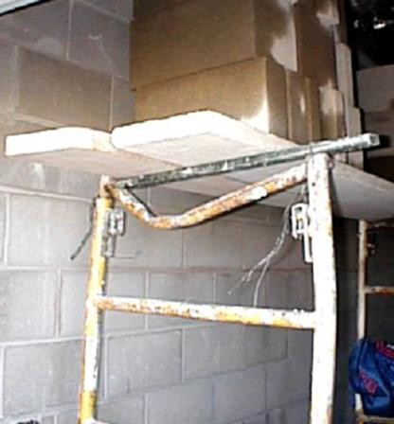
Hazards and Controls
Free from defects
  Take the time to look the scaffold over before you use it.
  Report damage if you identify defective components.
  Damaged components must be replaced before use.
Source: OSHA

Slide 28
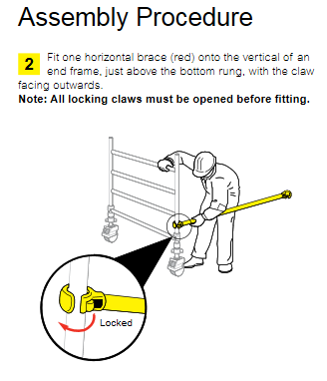
Hazards and Controls
Proper set-up
  Scaffolds must be assembled and used according to the manufacturer.
  All components such as braces and pins must be present.
  If you don’t have a copy of instructions, most can be downloaded.
Source: Wernerco shares page

Slide 29
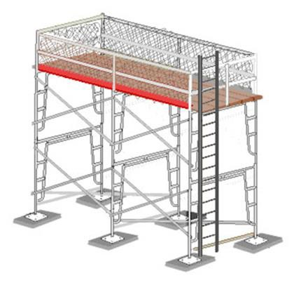
Hazards and Controls
Each platform must be fully planked or decked between the front uprights and the guardrail supports.
You should not be exposed to a fall hazard due to partial decking.
Source: OSHA

Slide 30
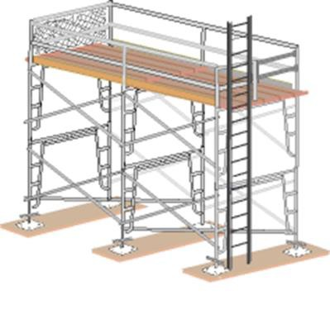
Hazards and Controls
Fall protection consists of either a guardrail system or a personal fall-arrest systems (PFAS).
It must be provided on any scaffold 10 feet or more above a lower level.
Source: OSHA

Slide 31
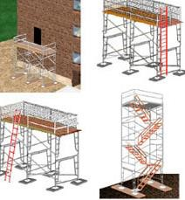
Hazards and Controls
Safe access
  Preventing falls begins
with safe access.
  You are most vulnerable to fall hazards when climbing on or off a scaffold.
  Your employer is required to provide safe scaffold access.
Source: OSHA

Slide 32
Hazards and Controls
Proper use
  Make sure you are a properly trained scaffold
user.
  Use scaffolds according to the manufacturer.
  Follow your company’s scaffold safety policy.
  Report scaffold-related safety issues to your employer.

Slide 33
Hazards and Controls
Never climb the bracing.
Never climb the frame unless designed to be a
ladder.
Don’t carry tools or materials while climbing.
Never use a ladder or other device to increase your reach from platform.

Slide 34
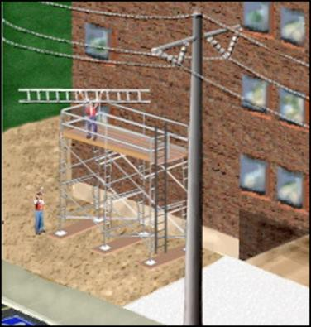
Hazards and Controls
Make sure the scaffold system, your tools, and the materials your are working with stay at least 10 feet away from powerlines.
3 feet from insulated lines.
Source: OSHA

Slide 35
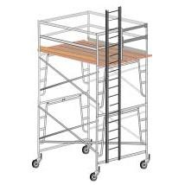
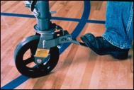
Hazards and Controls
Mobile scaffolds - additional concerns:
  All casters must be locked when occupied.
  They can not be moved while occupied.
  All casters must have retainer pins.
Source: OSHA

Slide 36
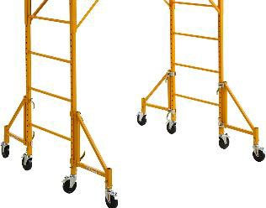
Hazards and Controls
The height of the platform must never exceed 4 times the minimum base dimension.
Outriggers may be necessary to increase the minimum base dimension.
Source: Wernerco shares page

Slide 37
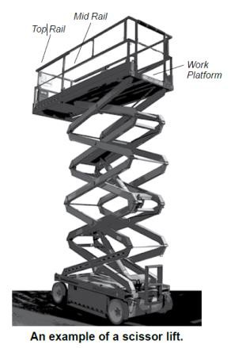
Hazards and Controls
Controlling fall hazards –
scissor lifts:
OSHA’s investigations found that most injuries and fatalities involving scissor lifts were the result of employers not addressing:
  Fall Protection
  Stabilization
  Positioning
Source: OSHA

Slide 38
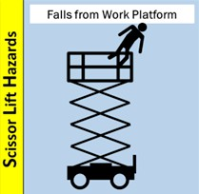
Hazards and Controls
Fall protection
  Check to see that a guardrail system is in place before working on the scissor lift.
  Only stand on the work platform; never stand on the guardrails.
  Keep work within easy reach to avoid leaning away from the scissor lift.
Source: OSHA
Note: Some manufacturers require a PFAS in addition to the unit’s guardrails.

Slide 39
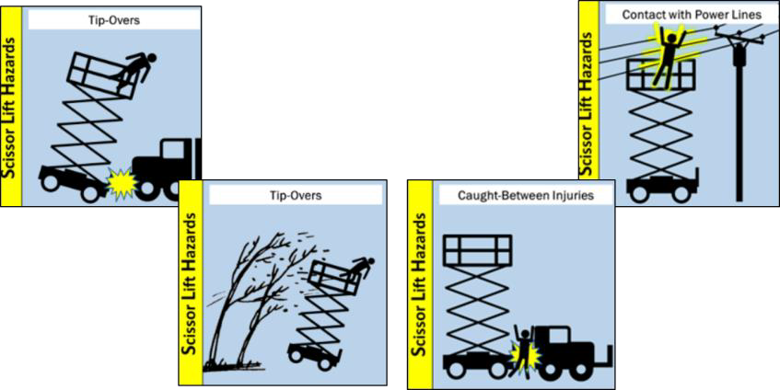
Hazards and Controls
Stabilization and positioning
Source: OSHA

Slide 40
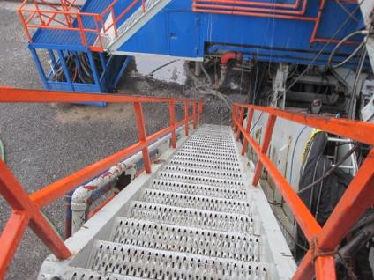
Hazards and Controls
Controlling fall hazards
– stairs:
Often stair-related hazards can be overlooked.
Stair safety comes down to proper
  Design & Construction
  Condition
  Use
Source: WVU Susan Harwood

Slide 41
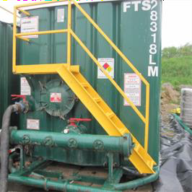
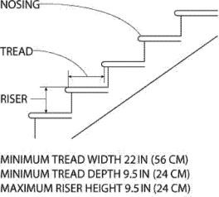
Hazards and Controls
Proper design/construction
  Fixed industrial stairs must be:
    strong enough to handle a minimum 1,000 lb. live load;
    at least 22 inches wide;
    installed at angles between 30-50 degrees; and
    no more than ¼ inch variation.
Source: OSHA
Source: WVU Susan Harwood

Slide 42
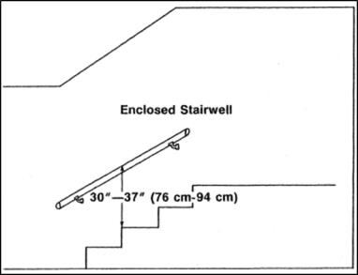

Hazards and Controls
Handrails are required when there is 4 or more risers.
Mainly to be used on the right side as you descend.
Allows you to maintain three points of contact.

Slide 43

Hazards and Controls
Stair rails prevent falls
from open sides.
Stair rail system must be present on the unprotected sides and edges (open stairs).
Stair rails are required when there is 4 or more risers.

Slide 44


Hazards and Controls
Condition
  Fixed industrial stairs must be maintained in good shape
  These stairs are uneven and unpredictable.
  Report stair-related defects
  What else is wrong?

Slide 45

Hazards and Controls
Proper use
  Maintain at least three
(3) points of contact.
  Do not run up or down stairs.
  Do not carry heavy objects, only light loads.
  Do not jump the last few steps.
Source: WVU Susan Harwood

Slide 46

Hazards and Controls
Items should never be placed or stored on stairs.
Stairs should be inspected on a regular basis.
Remove items to ensure no one gets hurt.
Source: OSHA

Slide 47

Hazards and Controls
Common fall hazards:
Floor and wall openings
Open-sided platforms and runways

Slide 48


Hazards and Controls
Controlling fall hazards –
floor openings:
Unguarded openings like this must never exist.
They require a proper cover or guardrail system at all times.
Posting a “guard” to monitor an opening like this for temporary access is permitted.
Source: OSHA

Slide 49

Hazards and Controls
Controlling fall hazards –
wall openings
Wall openings from which there is a drop of more than 4 feet must be guarded.
They require a proper guardrail system, like this one, at all times.
Source: OSHA

Slide 50

Hazards and Controls
Guardrail systems:
Standard railing: consists of top rail, mid-rail, and posts. Height from the upper surface of top rail to floor level is 42” (+/− 3”). Mid-rail height is 21 inches.
Standard toeboard:
3.5” high, with not more than ¼” clearance above the floor.
Source: OSHA

Slide 51
Employer Requirements
To prevent employees from being injured from falls, employers must:
Guard every floor hole into which a worker can accidentally walk.
Provide a guardrail and toeboard around every open-sided platform, floor or runway that is 4 feet or higher off the ground or next level.

Slide 52
Employer Requirements
Regardless of height, if a worker can fall into or onto dangerous machines or equipment, employers must provide guardrails and toeboards.
Other means of fall protection that may be required on certain jobs include safety harness and line, safety nets, stair railings and handrails.

Slide 53
Employer Requirements
Provide working conditions that are free of known dangers.
Keep floors in work areas in a clean and sanitary condition.
Select and provide required personal protective equipment at no cost to workers.
Train workers about job hazards in a language that they can understand.

Slide 54



Hazard Recognition
Identify hazards and what should be done to control them.
Source of photos: WVU

Slide 55



Hazard Recognition
Identify hazards and what should be done to control them.
Source : WVU
Source: OSHA
Source: WVU

Slide 56



Hazard Recognition
Identify hazards and what should be done to control them.
Source of photos: OSHA

Slide 57



Hazard Recognition
Identify hazards and what should be done to control them.
Source of photos: OSHA

Slide 58



Hazard Recognition
Identify hazards and what should be done to control them.
Source: OSHA
Source: WVU
Source: OSHA

Slide 59



Hazard Recognition
Identify hazards and what should be done to control them.
Source of photos: OSHA

Slide 60
Knowledge Check
Slips, trips, and falls make up what percent of all accidental deaths?
  2%
  15%
  36%
  50%
Answer: b. 15%

Slide 61
Knowledge Check
What is the easiest and most accurate way to use a portable ladder according to the manufacturer?
  Contact the manufacturer via cell phone
  Download the material from the internet.
  Read and follow all warning labels and stickers.
  Ask a fellow worker.
Answer: c. Read and follow all warning labels and stickers.

Slide 62
Knowledge Check
When using a portable ladder to access another level, which statement is true?
  A step ladder may be used if long enough.
  Portable ladders may never be used.
  The ladder should be secured and extend 3 feet above the level you are accessing.
  Carrying tools and materials is permitted.
Answer: c. The ladder should be secured and extend 3 feet above the level you are accessing.

Slide 63
Knowledge Check
4. The maximum work level height of a free- standing scaffold’s platform should never exceed times the minimum base dimension.
a. 2
b. 3
c. 4
d. 5
Answer: c. 4

Slide 64
Knowledge Check
Which best describes a safe scaffold?
  Placed on a firm foundation and is plumb and level
  Has proper access and is fully decked
  Has proper guardrail system
  All of the above
Answer: d. All of the above

Slide 65
Knowledge Check
Scissor lifts rated for outdoor use are generally limited to wind speeds below .
  28 MPH
  50 MPH
  60 MPH
  75 MPH
Answer: a. 28 MPH

Slide 66
Knowledge Check
The height of a proper guardrail system is (+/− 3”) from the walking/working surface.
  30 inches
  42 inches
  60 inches
  None of the above
Answer: b. 42 inches

