Slide 1
Personal Protective Equipment
10-hour General Industry Outreach Training

Slide 2

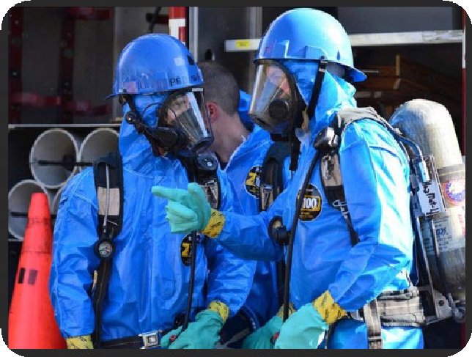
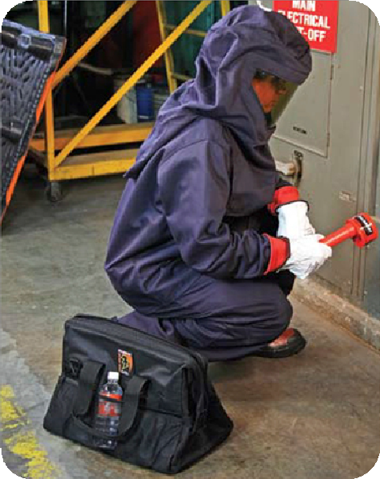
Introduction
Source of photos: OSHA

Slide 3
Introduction
Lesson objectives:
Describe the hierarchy of controls as it relates to personal protective equipment.
Identify types of personal protective equipment utilized in general industry.
Explain personal protective equipment training requirements.
Explain the employer responsibilities regarding personal protective equipment.
Explain the employee responsibilities regarding personal protective equipment.

Slide 4
Introduction
Employers must protect employees:
Assess the workplace
Eliminate and reduce the hazards found using engineering and administrative controls
Then use appropriate personal protective equipment
Remember, Personal Protective Equipment is the last level of control.

Slide 5
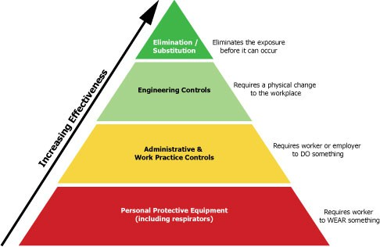
Hierarchy of Controls
Source: OSHA

Slide 6
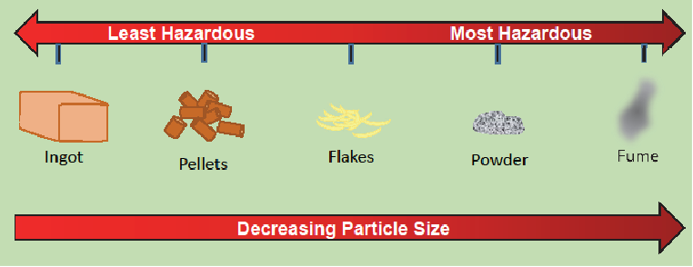
Hierarchy of Controls
Elimination/substitution:
Highest level of protection
Eliminate hazard from the workplace
Substitute
  Use safer item/substance
  Use same chemical but in a different form; as particle size of a substance decreases, hazard level increases
Source: OTIEC Workgroup

Slide 7
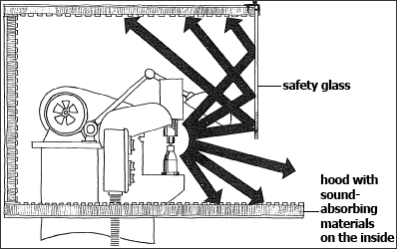
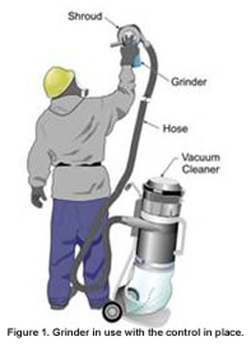
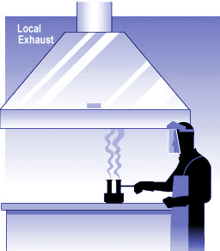
Hierarchy of Controls
Engineering controls:
Physical changes to workplace
Examples
  Isolation
  Ventilation
  Equipment modification
  Others

Slide 8
Hierarchy of Controls
Administrative controls/work practice control:
Requires worker or employer to do something
Examples
  Written proper operating procedures, work permits and safe work practices
  Inspection and maintenance
  Housekeeping
  Monitoring the use of highly hazardous materials
  Supervision
  Training
  Alarms, signs and warnings
  Regulated areas
  Limit exposure by time or distance

Slide 9
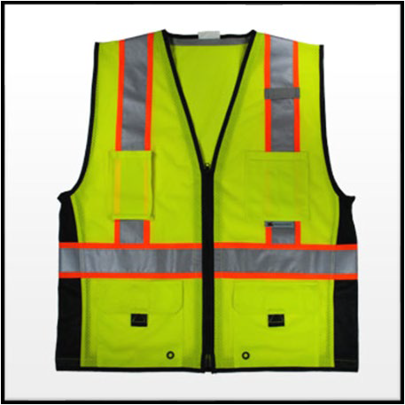
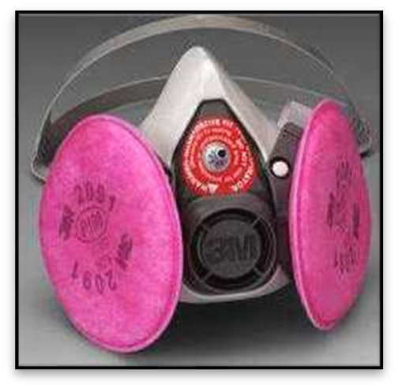
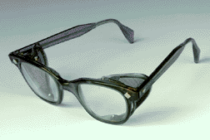
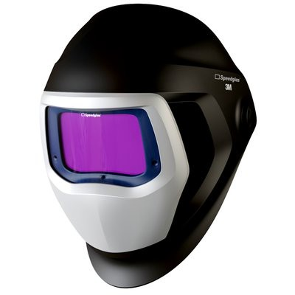
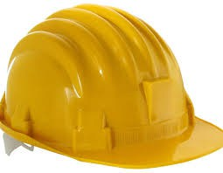
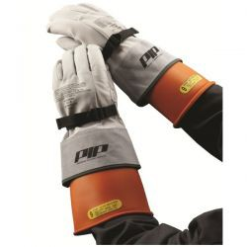

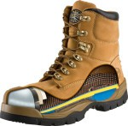
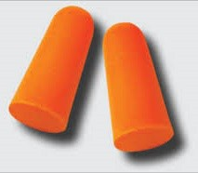
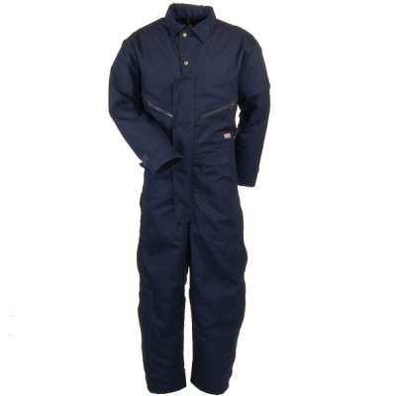
Hierarchy of Controls
PPE controls:
Requires worker to wear something
Examples
Source of Photos: OSHA

Slide 10

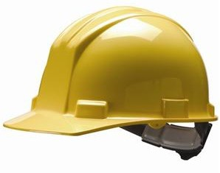
Types of PPE
Head protection:
Frequent causes of head injuries
  Falling objects from above striking on the head;
  Bump head against fixed objects, such as exposed pipes or beams; or
  Accidental head contact with electrical hazards.
Source: OSHA

Slide 11
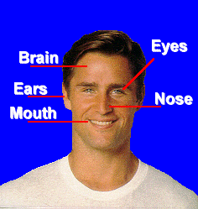
Types of PPE
Why head protection is important…
Source: OSHA

Slide 12
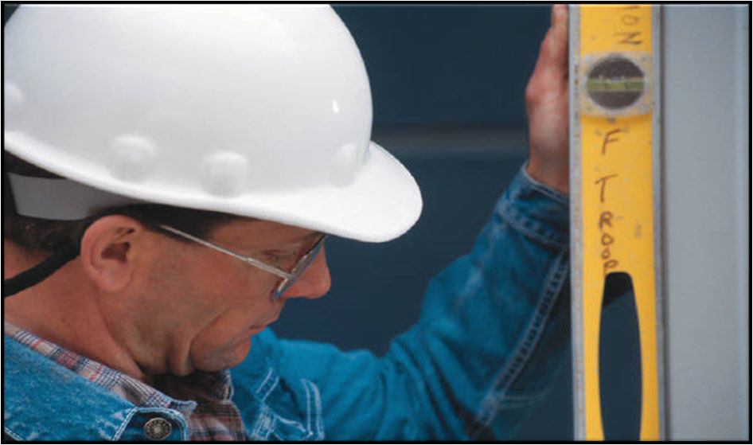
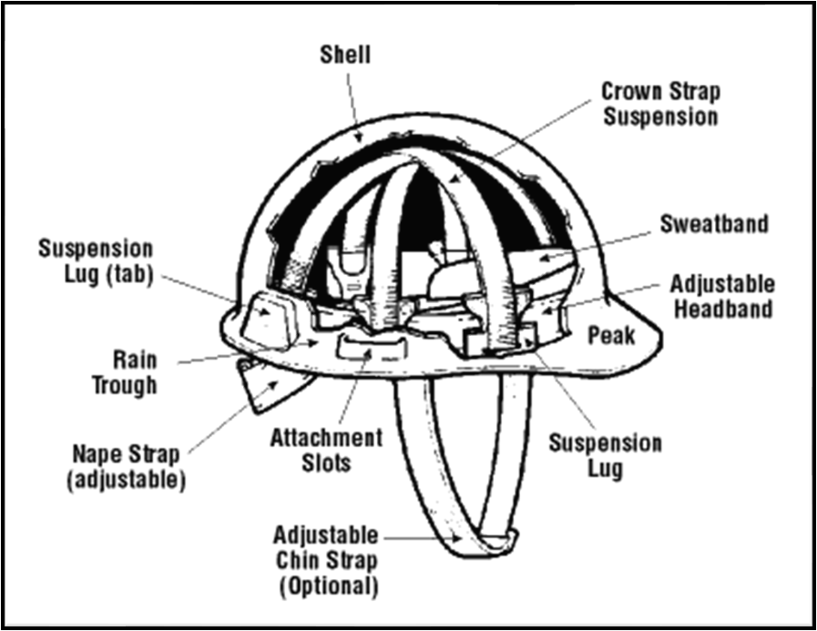
Types of PPE
Classes of hard hats:
  CLASS G (General)
    Protect against impact, penetration
    Low-voltage electrical protection (proof-tested to 2,200 volts)
Source of graphics: OSHA

Slide 13
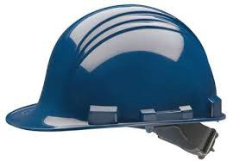
Types of PPE
CLASS E (Electrical)
  Designed for electrical/utility work
  Protect against falling objects, impact
  Electrical protection against high-voltage (proof-tested to 20,000 volts)
Source: OSHA

Slide 14
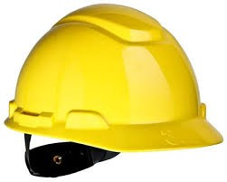
Types of PPE
CLASS C (Conductive)
  Designed for comfort; offers limited protection
  Protects heads that may bump against fixed objects
  Does not protect against falling objects or electrical hazards
Source: OSHA

Slide 15

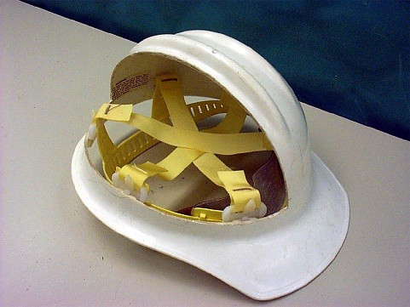
Types of PPE
ANSI Z89.1, 1997
  Type I: provides protection from objects fall directly on top of the helmet, but not from objects that strike the side, front, or back of the head.
  Type II: provides protection from strikes to the top of the head and also provides protection from blows to the sides, front, and back of the head.
More suitable for workers who are not always in a standing position
Source of photos: OSHA

Slide 16

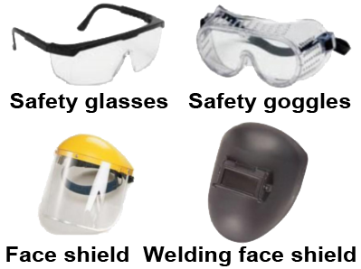
Types of PPE
Eye and face protection:
Source of images: OSHA

Slide 17

Types of PPE
Common causes of eye injuries
  Chemical splashes
  Blood or OPIM splashes or sprays
  Intense light
  Dust and other flying particles
  Molten metal splashes
Source: OSHA

Slide 18
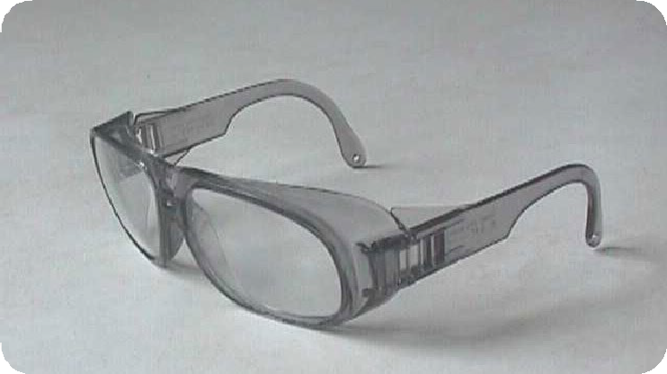
Types of PPE
Eye and face protection – must comply with
– ANSI Z87.1-2003, or
– ANSI Z87.1-1989 (R-1998)
Source: OSHA

Slide 19
Types of PPE
Selecting eye and face protection – elements to consider:
  Ability to protect against workplace hazards
  Should fit properly
  Should provide unrestricted vision and movement
  Durable and cleanable
  Allow unrestricted functioning of other PPE

Slide 20
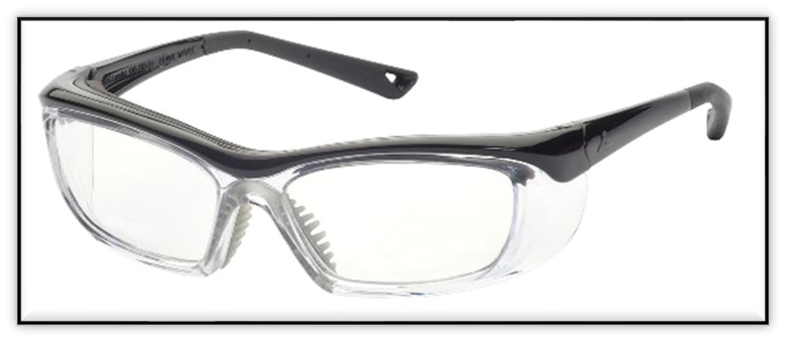
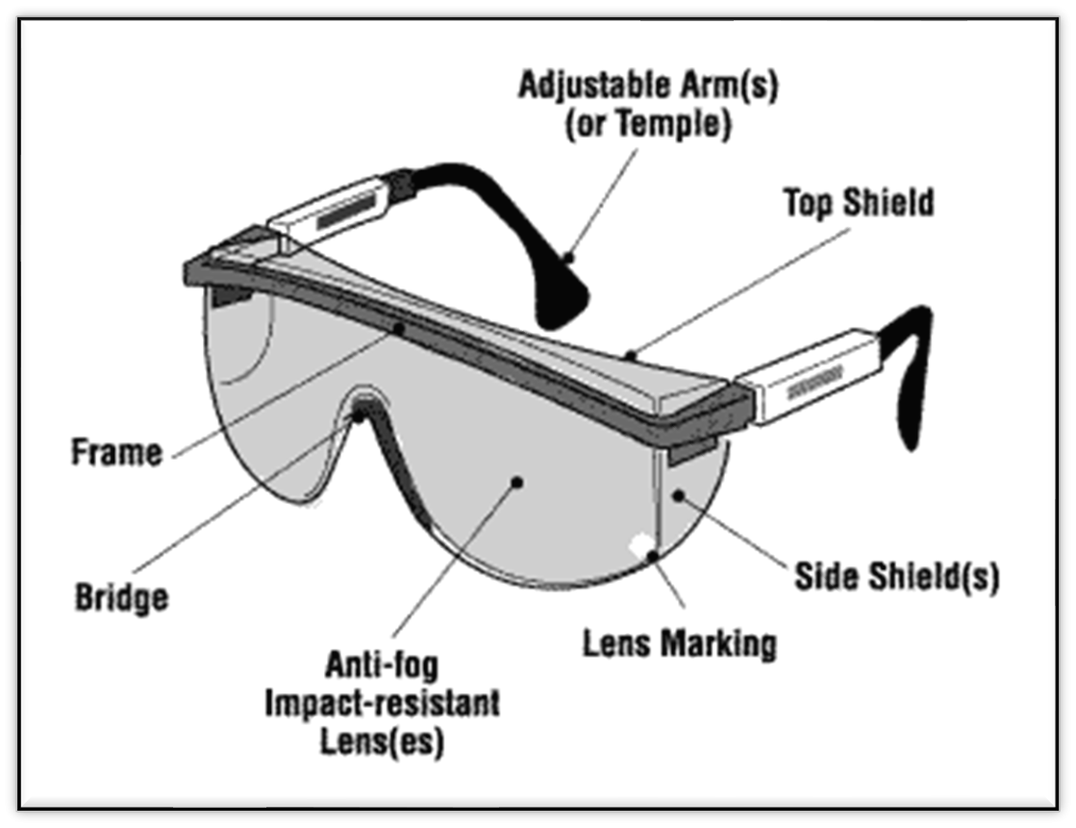
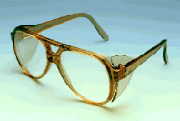
Types of PPE
Safety glasses
– Used to protect against moderate impacts from particles
Source of graphics: OSHA

Slide 21
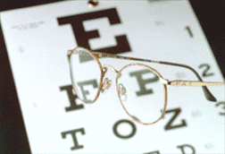
Types of PPE
Prescription glasses
– Employees who use prescription glasses while performing operations with potential eye hazards must use eye protection that:
Source: OSHA
Incorporates the prescription in its design, or
Can be used over your prescription glasses without interfering with the proper positioning of the prescription glasses or goggles

Slide 22
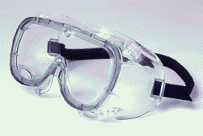
Types of PPE
Goggles
– Protect eyes, and the facial area immediately surrounding the eyes from impact, dust, splashes.
Source: OSHA
– Some can be used over corrective lenses, if they fit them.

Slide 23
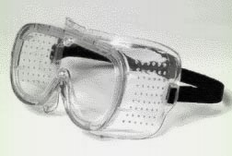
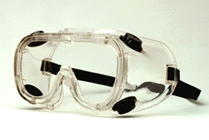
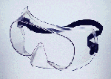
Types of PPE
– Goggle types
Direct-ventilated
Resist direct passage of large particles into the goggle
Prevents fogging by allowing air circulation
Indirect-ventilated
Non-ventilated
Does not allow the passage of air into the goggle
Prevents splash entry
May fog and require frequent lens cleaning
Prevents fogging by allowing air circulation
Protects against liquid or chemical splash entry
Source: OSHA.gov

Slide 24
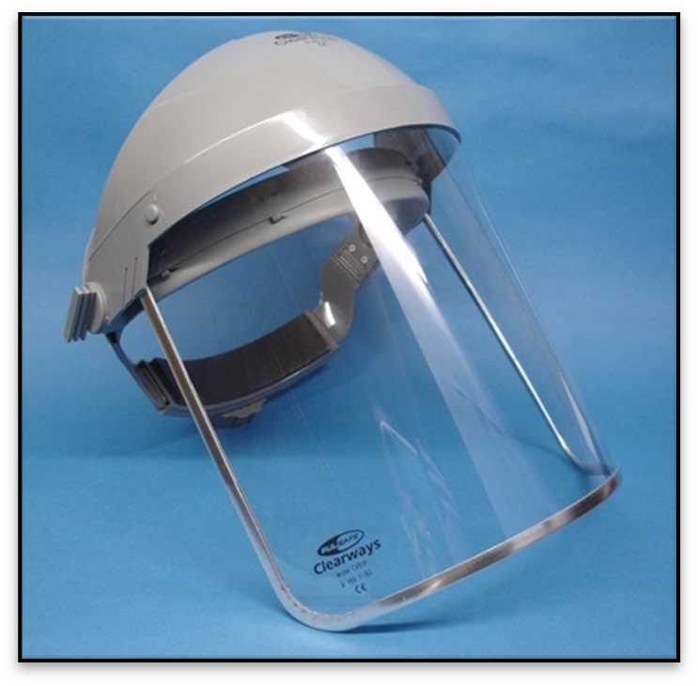
Types of PPE
Face shields
  Protect face from nuisance dusts and potential splashes or sprays of hazardous liquids
  Shields do not protect from impact hazards unless so rated
  Shields are for face protection, not eye protection. To protect the eyes, wear safety glasses with side shields, or goggles under the face shield.
Source: OSHA

Slide 25
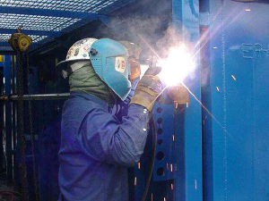
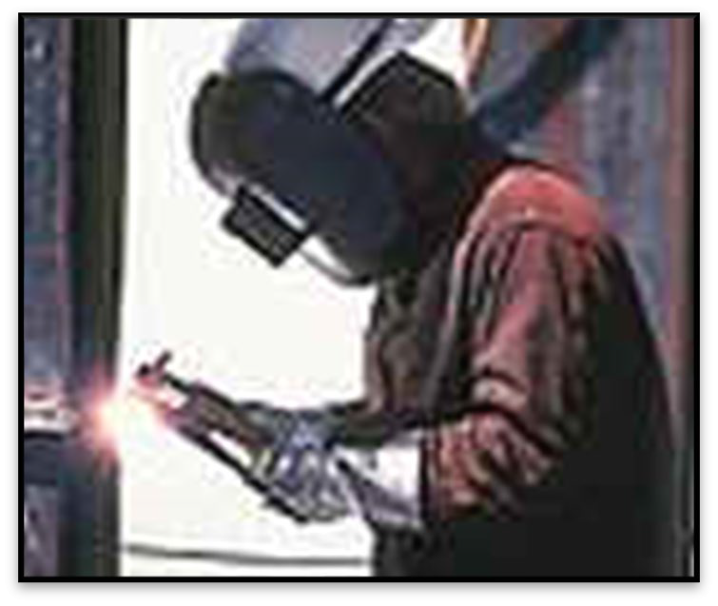
Types of PPE
Welding shields
  Protect eyes from burns caused by:
    Infared light
    Intense radiant light
  Protect eyes and face from flying sparks, metal spatter, and slag chips
Source of photos: OSHA

Slide 26
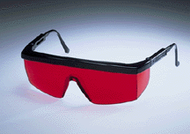
Types of PPE
Laser safety goggles
  Provide protection from hazards:
    physical contact such as flying particles
    ultraviolet light, laser, and welding
Source: OSHA

Slide 27
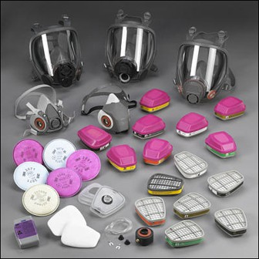
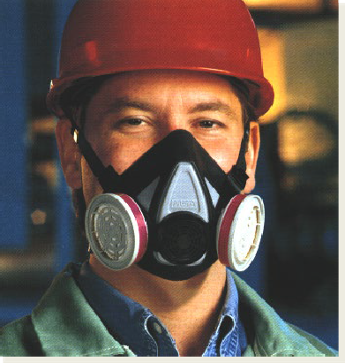
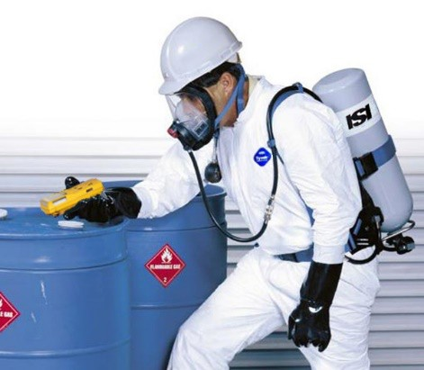
Types of PPE
Respiratory protection:
Source of photos: OSHA

Slide 28
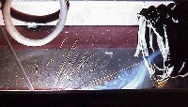
Types of PPE
Elimination/substitution or Engineering controls
  Eliminate toxic material or substitute a less toxic material
  Enclose or confine operation
  General or local exhaust ventilation
Only when engineering controls are not feasible, will respirators be used
Source: OSHA

Slide 29
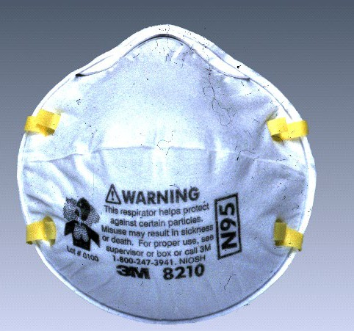
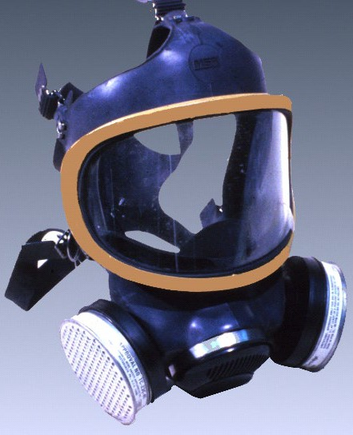
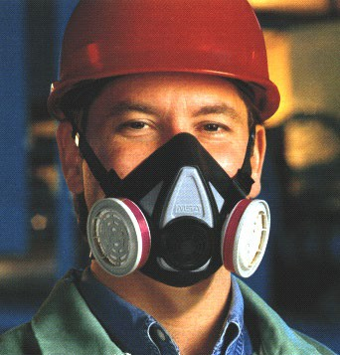
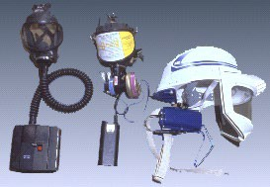
Types of PPE
Types of respirators
  Air-Purifying (APR) – remove contaminants from air
    Particulate respirators
    Chemical cartridge/ gas mask respirator
    Powered Air-Purifying Respirator (PAPR)
Source of photos: OSHA

Slide 30
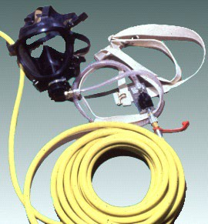
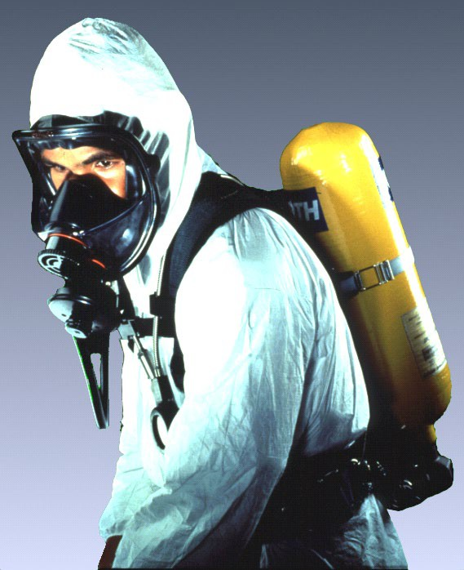
Types of PPE
Atmosphere-Supplying – provide clean, breathable air
  Self-Contained Breathing Apparatus (SCBA)
  Supplied-Air Respirator (SAR)
Source of photos: OSHA

Slide 31
Types of PPE
Medical evaluation
  Before fit tests are conducted and employee is authorized the use of a respirator, a medical evaluation must be provide to determine the ability of the employee to use a respirator.
  Identify a physician or other license health care professional (PLHCP) to perform medical evaluations using a medical questionnaire or an initial medical evaluation with which the same information is obtained.

Slide 32
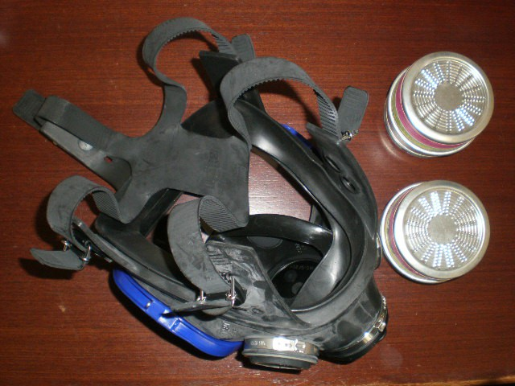
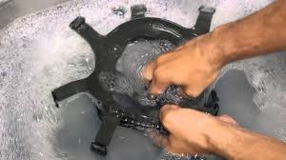
Types of PPE
Inspecting and cleaning respirators
  Inspect all respirators for wear and tear before and after each use
  Wash in a detergent solution; then, disinfect by immersing in a sanitizing solution
Source of photos: Carmen Vazquez

Slide 33
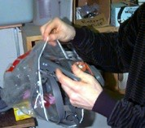


Types of PPE
Storing respirators
  Protect against dust, sunlight, heat, extreme cold, excessive moisture, and damaging chemicals
  Store in position to retain natural configuration
Source of photos: Carmen Vazquez

Slide 34


Types of PPE
Hearing protection:
Source of photos: OSHA

Slide 35

Types of PPE
Exposure to noise levels over 85 dB can cause hearing loss
Hearing protection required at 90 dB
Implement effective Hearing Conservation Program
Source: OSHA

Slide 36

Types of PPE
The employer must provide ear protection when the noise level in the work area is greater than indicated in this table.
Permissible Noise Exposure 29 CFR 1910.95(b)(1)
Duration per Day (hours) | Sound Level (dBA)
8 | 90
6 | 92
4 | 95
3 | 97
2 | 100
1 | 105
1/2 | 110
1/4 | 115
Source: NIOSH
Impact noise should not exceed 140 dB

Slide 37



Types of PPE
Examples of hearing protection:
– Disposable foam plugs
Molded ear plugs
Noise-cancelling ear plugs
Ear muffs
Consider Noise Reduction Rating (NRR) of devices
Source of photos: OSHA
NIOSH/John Rekus/elcosh.org

Slide 38

Types of PPE
How to insert ear plugs properly
Source: NIOSH

Slide 39



Types of PPE
Hand protection:
Potential hazards for hands
  Skin absorption of hazardous substances
  Lacerations or severe cuts
  Punctures
  Chemical burns
  Thermal burns
  Extreme temperatures
Source of photos: OSHA

Slide 40






Types of PPE
Types of gloves
Anti-vibration
Chemical-resistant
Leather Palm
Heat-resistant
Cut-resistant
Permeation-resistant
Source of photos: OSHA

Slide 41

Types of PPE
Foot and leg protection:
Causes of foot injuries:
  Falling or rolling of heavy objects
  Crushing or penetrating materials
  Sharp objects that can penetrate the sole
  Exposure to molten metal
  Working on, or around, hot, wet, or slippery surfaces
  Working when electrical hazards are present.
Source: OSHA

Slide 42

Types of PPE
Conditions requiring foot protection
  Impacts
  Compressions
  Cuts/punctures
  Chemicals
  Temperatures
Source: OSHA

Slide 43


Types of PPE
Examples of foot and leg protection
  Impact-resistant toe and/or instep
    Steel
    Composite
  Heat-resistant soles
  Metal shanks
  Specialty footwear may be needed
    Metatarsal guards
    Liquid- or chemical-resistant
    Conductive or nonconductive
Source of photos: OSHA

Slide 44

Types of PPE
Protective footwear must comply with any of the following consensus standards:
  ANSI Z41.1 – 1991 - "American
National Standard for Personal Protection -- Protective Footwear,"
  ASTM F-2412 – 2005 – “ Standard
Test Methods for Foot Protection”
– ASTM F-2413 – 2005 –
“Standard Specification for Performance Requirements for Protective Footwear”
Source: OSHA

Slide 45



Types of PPE
Protection from hazards
  Shoes with metal toe-cap protects against knocks, falling objects
  Rubber shoes protect against chemical materials, as directed by the SDS
Source of photos: OSHA

Slide 46



Types of PPE
Body protection – protective clothing:
Source of photos: OSHA

Slide 47


Types of PPE
Provide protective clothing for those parts of the body exposed to possible injuries
Types of body protection
  Laboratory coats
  Coveralls
  Vests
  Jackets
  Aprons
  Surgical gowns
  Full-body suits
Source of photos: OSHA

Slide 48


Types of PPE
Selection of body protection – variety of materials effective against particular hazard
Paper-like fiber – dust and splashes
Treated wool and cotton – fire- resistant; dust, abrasions, rough/irritating surfaces
Duck – cuts, bruises
Leather – dry heat, flames
Rubber, rubberized fabrics, neoprene, and plastics – certain chemicals and physical hazards
Source of photos: OSHA

Slide 49
Types of PPE
Protective clothing is required for HAZWOPER activities
EPA’s levels of PPE
  Level A
    Provides highest level of protection
    Required when greatest potential for exposure exists and greatest level of skin, respiratory, and eye protection is required
    Examples
      Positive pressure, full facepiece SCBA, or positive pressure supplied air respirator with escape SCBA
      Totally encapsulated chemical- and vapor-protective suit
      Inner and outer chemical-resistant gloves
      Disposable protective suit, gloves, and boots

Slide 50
Types of PPE
Level B
  Required for highest level of respiratory protection and lesser level of skin protection
  Examples
    Positive pressure, full facepiece SCBA, or positive pressure supplied air respirator with escape SCBA
    Inner and outer chemical-resistant gloves
    Face shield
    Hooded chemical-resistant clothing
    Coveralls
    Outer chemical-resistant boots

Slide 51
Types of PPE
Level C
  Required when concentration and type of airborne substances are known and criteria for using APR is met
  Examples
    Full-face air-purifying respirators
    Inner and outer chemical-resistant gloves
    Hard hat
    Escape mask
    Disposable chemical-resistant outer boots

Slide 52
Types of PPE
Level D
  Required when minimum protection is needed
  Sufficient when no contaminants are present or work operations preclude splashes, immersion, or potential for unexpected inhalation or contact
  Examples
    Gloves
    Coveralls
    Safety glasses
    Face shield
    Chemical-resistant, steel-toe boots or shoes

Slide 53
Training
Training requirements:
Each employee who is required to use PPE must be trained to know:
  When PPE is necessary
  What PPE is necessary
  How to properly put on, take off, adjust, and wear the PPE
  The limitation of the PPE
  Proper care, maintenance, useful life, and disposal of PPE

Slide 54
Responsibilities
The employer is required to:
  Perform hazard assessment
  Provide appropriate PPE
  Train employees
  Maintain/replace PPE
  Review/update/evaluate PPE Program

Slide 55
Responsibilities
$
The employer is required to pay for PPE
used to comply with OSHA standards
  Examples
    Metatarsal foot protection
    Rubber boots with steel toes
    Non-prescription eye protection
    Prescription eyewear inserts/lenses for full face respirators
    Goggles and face shields
    Fire fighting PPE
    Hard hats
    Hearing protection
    Welding PPE

Slide 56
Responsibilities
$
Employer payment exemptions
  Non-specialty safety-toe protective footwear and non-specialty prescription safety eyewear
  Everyday clothing
  Ordinary clothing, skin creams, or other items, used solely for protection from weather
  Consumer safety items worn by food workers
  Lifting belts
  When employee lost or intentionally damaged PPE

Slide 57

Responsibilities
The employee is required to:
  Properly wear PPE
  Attend PPE training
  Care for, clean, and maintain PPE
  Inform supervisor of needs for repair/replacement
Source: OSHA

Slide 58
Knowledge Check
Common causes of foot injuries include: crushing, penetration, molten metal, chemicals, slippery surfaces, and sharp objects.
  True
  False
Answer: a. True

Slide 59
Knowledge Check
Who is responsible for providing PPE needed to comply with OSHA standards?
  The employee
  OSHA
  The Employer
  Workers’ Compensation
Answer: c. The Employer

Slide 60
Knowledge Check
Hazard controls must be addressed in which order of priority?
  Substitution, PPE, workaround, and administrative
  Workaround, stop work, PPE, and engineering
  Stop work, PPE, engineering, and substitution
  Substitution, engineering, administrative, and PPE
Answer: d. Substitution, engineering, administrative, and PPE

Slide 61
Knowledge Check
Which type of hard hat would provide the most protection from electrical hazards?
  Class A
  Class C
  Class E
  Class G
Answer: c. Class E

Slide 62
Knowledge Check
Hearing protection is required when noise levels exceed OSHA’s PEL of dBA as a TWA.
  80
  90
  100
  110
Answer: b. 90 dBAs

Slide 63
Knowledge Check
Who is responsible for providing specialized work footwear?
  Insurance companies
  The employee
  OSHA
  The employer
Answer: d. The employer

Slide 64
Knowledge Check
Which of the following is considered approved eye protection?
  Sun glasses
  Prescription glasses
  Reading glasses
  Glasses meeting ANSI standard Z87
Answer: d. Glasses meeting ANSI standard Z87

Slide 65
Knowledge Check
Which of the following is NOT
considered PPE?
  Rubber gloves
  Glasses meeting ANSI standard Z87
  Sports shoes
  Hearing muffs
Answer: c. Sports shoes

