Slide 1
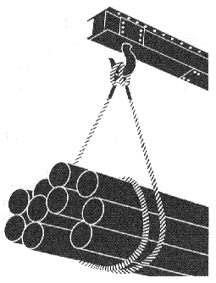
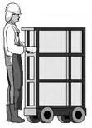
Materials Handling, Storage, Use, and Disposal
OSHA 10-hour Outreach Training General Industry

Slide 2
Introduction
Lesson objectives:
Identify types of material handling equipment.
Describe hazards associated with material handling activities.
Identify methods to prevent hazards associated with material handling equipment.
Recognize employer requirements to protect workers from material handling hazards.

Slide 3
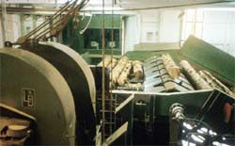
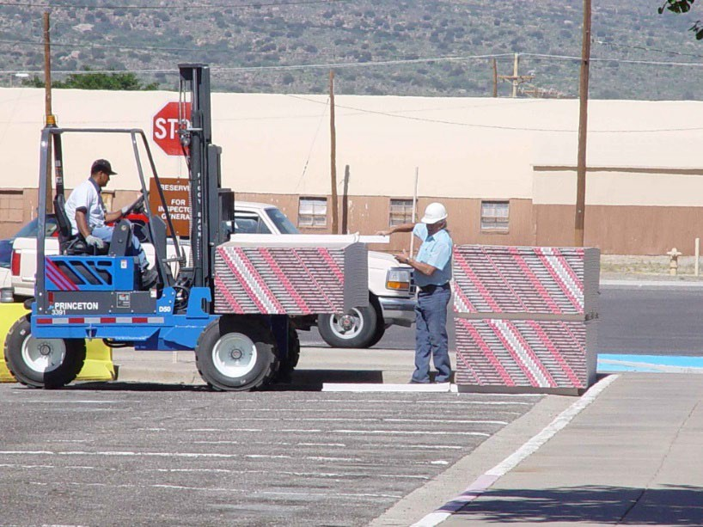
Types of Equipment
Powered Industrial Trucks
Conveyors
Source: OSHA
Source: TEEX-Harwood

Slide 4
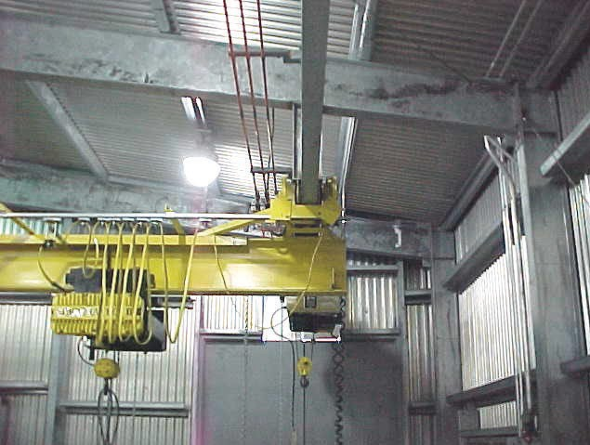
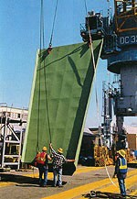
Types of Equipment
Cranes
Slings
Source: TEEX
Source: OSHA

Slide 5
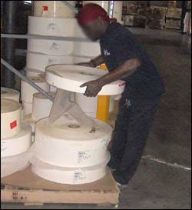
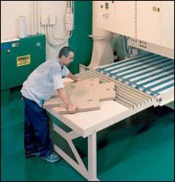
Hazards Associated with Materials Handling
Factors contributing to injuries:
Weight and bulkiness of objects
Bending, twisting, turning movements
Source of photos: OSHA

Slide 6
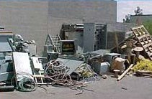
Hazards Associated with Materials Handling
Hazards:
Improper operation of equipment
Accumulated materials or clutter
Source: OSHA

Slide 7
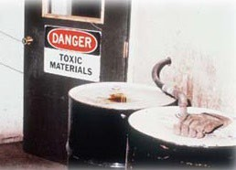
Hazards Associated with Materials Handling
Unsafe conditions of materials or containers
Flammability or toxicity of some materials
Source: OSHA

Slide 8
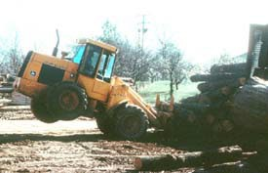
Hazards Associated with Materials Handling
Weight of materials
Binding ties or other devices that secure bundles or
bound materials
Source: OSHA

Slide 9
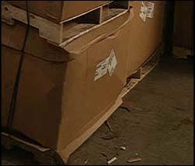
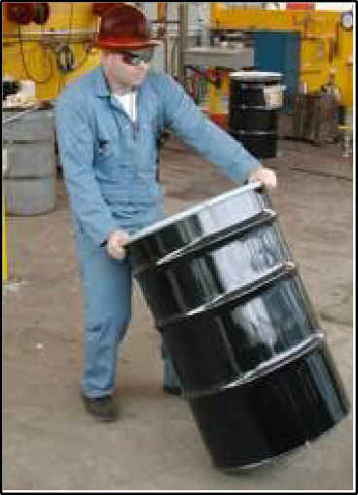
Hazards Associated with Materials Handling
Falling objects
Lifting, pushing, pulling, or otherwise manually moving large, heavy items
Source: OSHA
Source: OSHA

Slide 10
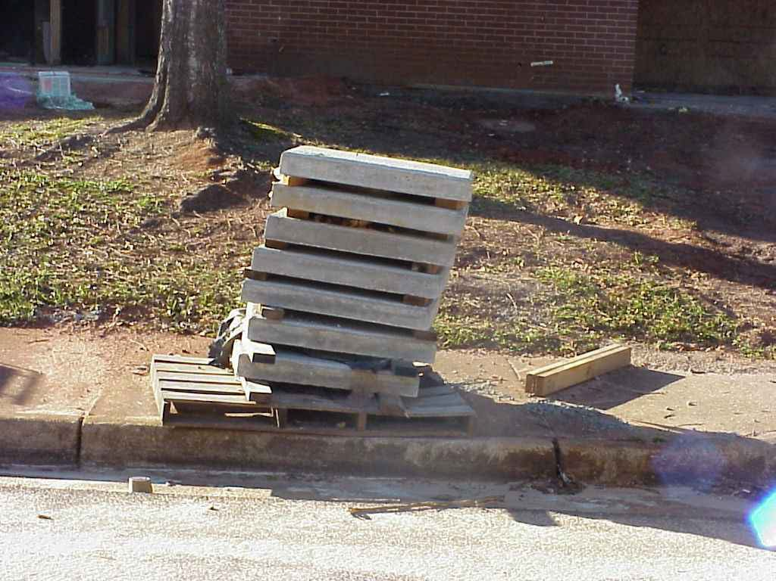
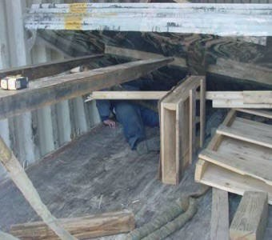
Hazards Associated with Materials Handling
Improperly stacked materials
Struck-by or caught-in/-between hazards
Source TEEX - Harwood
Source: OSHA

Slide 11

Hazards Associated with Materials Handling
Types of injuries commonly reported:
Sprains, strains, tears
Soreness and pain
Bruises and contusions
Cuts, lacerations, punctures, crushing, and amputations
Source: OSHA

Slide 12
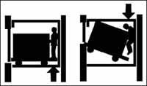
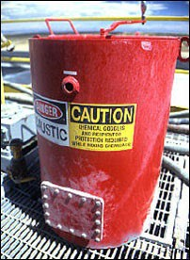
Hazards Associated with Materials Handling
Examples of events or exposures leading to injuries:
Contact with objects and equipment
Transportation incidents
Exposure to harmful substances or environments
Source: OSHA
Source: OSHA

Slide 13
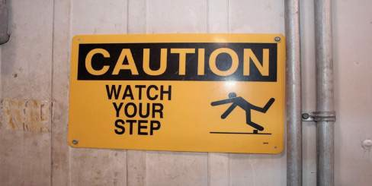
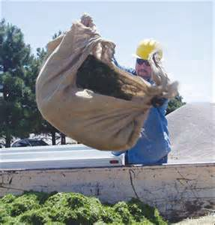
Hazards Associated with Materials Handling
Falls, slips, trips, or loss of balance
Repetitive motion
Overexertion
Source: OSHA
Source: OSHA

Slide 14
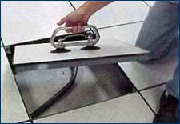
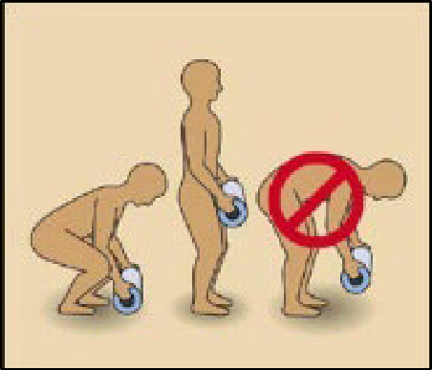
Preventing Hazards
Moving materials manually:
Use devices to assist with holding loads
Wear PPE
Use proper lifting technique
Seek help for oversized loads
Use blocking materials
Source of photos: OSHA

Slide 15
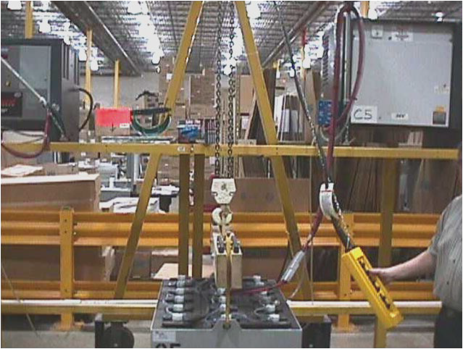
Preventing Hazards
Overhead and gantry cranes:
Never move a load over co-workers or allow co-workers to walk underneath
Return the load block to its designated
location after use
Do not leave the load
block low enough for someone to run into
Never leave a suspended load unattended
Source: OSHA

Slide 16
Preventing Hazards
Do not leave unused slings suspended on a crane hook
Store wall-mounted cranes against the wall
Continuously observe equipment for any sign of problems during operation.
Don’t allow yourself to become distracted.

Slide 17

Preventing Hazards
Operated only by thoroughly trained and qualified workers
Source: UA

Slide 18
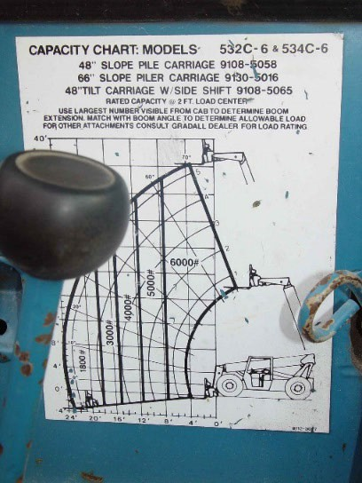
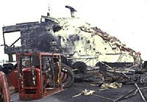
Preventing Hazards
Eliminate/reduce crane hazards by:
Knowing
  Load
  Capacity of the crane
  When the load is safe to lift
Always checking crane load chart and never exceed load limits
Source: TEEX - Harwood
Source: TEEX - Harwood

Slide 19
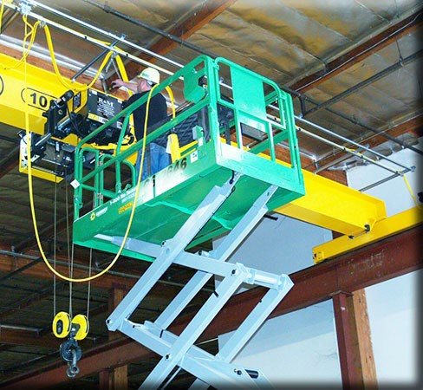
Preventing Hazards
Inspection of crane by a qualified person
  Modified, repaired, or adjusted
  Post-assembly
  At least every 12 months
  Equipment not in regular use
Visual inspection by a competent person
  Prior to each shift
  Monthly
Source: OSHA

Slide 20


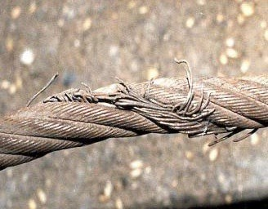
Preventing Hazards
Slings
  Connects a crane hook to a load
  Proper selection
  Inspection
Source of photos: OSHA

Slide 21
Preventing Hazards
Reduce sling hazards by:
  Lubricating
  Not shortening with knots, bolts, or other devices, or kink legs
  Keeping clear of loads
  Avoiding sudden movement

Slide 22
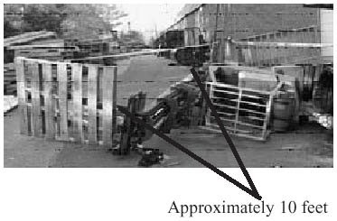
Preventing Hazards
Forklifts
Main causes of injuries
  Forklift overturns
  Forklift striking workers on foot
Persons crushed by forklifts
Persons falling from forklifts
Forklift toppled sideways possibly due to shift in center of gravity.
Source: OSHA

Slide 23

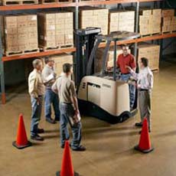
Preventing Hazards
Illegal forklift operators
  Anyone under 18
  Anyone not properly trained
Source of photos: OSHA

Slide 24
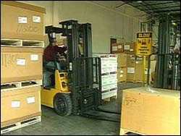
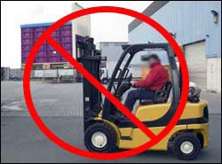
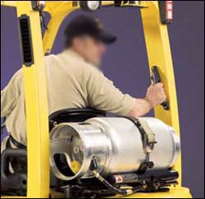
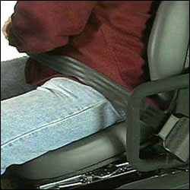
Preventing Hazards
Driving the forklift
  Obstructed vision
  Travel path
  Approaching people
  Elevated platform
  Seat belts and ROPS
  Raising/lowering forks
  Safe distance
Source of photos: OSHA

Slide 25
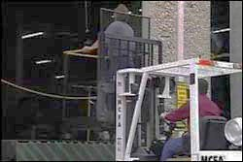
Preventing Hazards
Elevating workers with forklift
  Standing on forks
  Lifting personnel
  Approved lift platform
  Restraining means
Source: OSHA

Slide 26
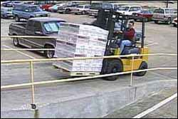
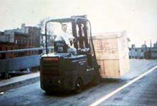
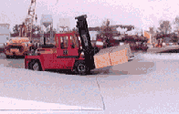
Preventing Hazards
Driving forklift on grades/ramps
  Use extreme caution
  No turns
  Tilting and raising load
  Point load up the incline
Source of photos: OSHA

Slide 27
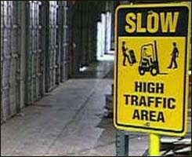
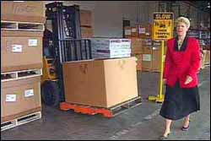
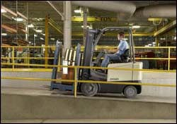
Preventing Hazards
Forklift operating speed
  Tip-overs
  Turning
  Avoiding collisions
  Wet and slippery floors
  Ascending/descending
  Obstructed vision
Source of photos: OSHA

Slide 28
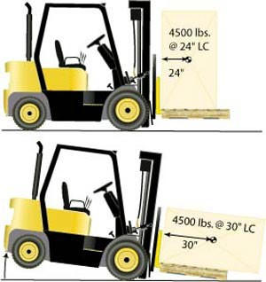
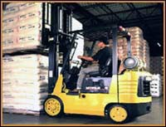
Preventing Hazards
Avoiding excess weight
  Do not exceed weight capacity of forklift.
  Center loads and secure to keep from shifting to maintain balance of weight
Source of graphics: OSHA

Slide 29
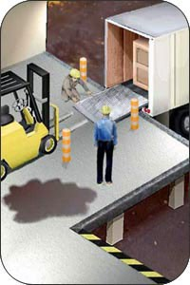
Preventing Hazards
Use of dock boards for loading/uploading
  Bridging space
  Securing portable dock boards
  Handholds for dock boards
Source: OSHA

Slide 30
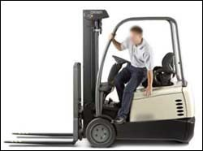
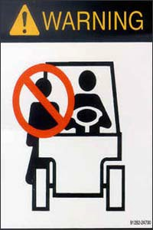
Preventing Hazards
Exiting the forklift
  Set brake, lower forks/lifting carriage, neutralize controls
  Stand-up type forklift
Riding the forklift
  No passengers allowed
  Exception – seat is provided
Source of photos: OSHA

Slide 31
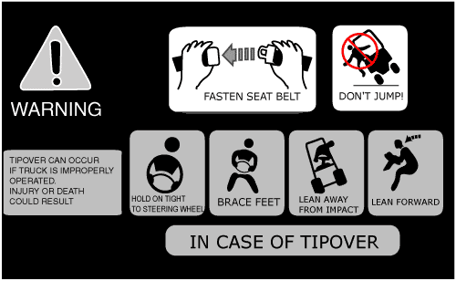
Preventing Hazards
Avoiding struck-by/crushed-by
  Don’t jump from an overturning, sit-down type forklift.
  Stay with the truck, hold on firmly, and
lean in the opposite direction of the overturn.
Source: OSHA

Slide 32
Preventing Hazards
Forklift training – do not operate a forklift without proper training
Reporting damage – any damage or problems that occur to a forklift during a shift should be reported to the supervisor.
Source: OSHA

Slide 33
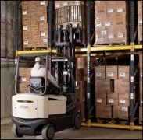
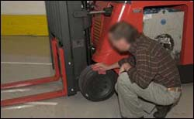
Employer Requirements
Comply with OSHA standards related to materials handling, including:
Training requirements
Inspection requirements
Source of photos: OSHA

Slide 34
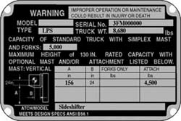
Employer Requirements
Comply with manufacturers’ requirements and recommendations for materials handling equipment.
Source : OSHA

Slide 35
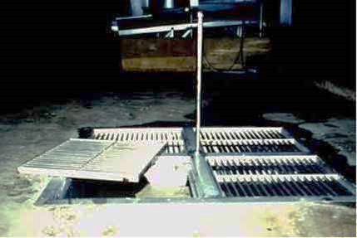
Recognizing Hazards
Identify potential hazards and possible solutions:
Source: OSHA

Slide 36
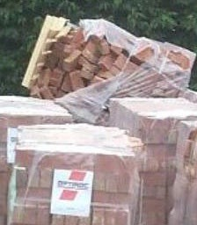

Recognizing Hazards
Identify potential hazards and possible solutions:
Source: OSHA
Source: TEEX - Harwood

Slide 37


Recognizing Hazards
Identify potential hazards and possible solutions:
Source of photos : TEEX Harwood
Source of photos : OSHA -UFCW

Slide 38
Knowledge Check
What is the minimum age requirement for the operation of a forklift, regardless of training?
  16
  18
  21
  25
Answer: b. You must be at least 18 years old to operate a forklift.

Slide 39
Knowledge Check
A way to prevent materials handling hazards is to .
  refuse to allow personnel to ride equipment without a seat and seatbelt
  report all damaged equipment immediately
  operate within manufacturer’s specifications
  All of these
Answer: d. All of these are good ways to prevent materials handling hazards.

Slide 40
Knowledge Check
Which of the following is a method for eliminating or reducing crane operation hazards?
  A competent person should visually inspect the crane once a year
  Never exceed the load limit by more than 10%
  Never move a load over co-workers
  All of these
Answer: c. Never move a load over co-workers or allow co-workers to walk underneath.

Slide 41
Knowledge Check
Employers must comply with OSHA standards related to materials handling, including training and .
  equipment
  operations
  inspection
  all of these
Answer: c. Employers must comply with OSHA standards for training and inspection.

