Slide 1
Hazardous Energy Control
(lockout/tagout)
29 CFR 1910.147
The material was produced under grant number Grant SH-99019-SH0 (from the Occupational Safety and Health Administration, U.S. Department of Labor). It does not necessarily reflect the views or policies of the U.S. Department of Labor, nor does the mention of trade names, commercial products, or organizations imply endorsement by the U.S. Government.
Notes:
The material was produced under grant number Grant SH-99019-SH0 (from the Occupational Safety and Health Administration, U.S. Department of Labor). It does not necessarily reflect the views or policies of the U.S. Department of Labor, nor does the mention of trade names, commercial products, or organizations imply endorsement by the U.S. Government.

Slide 2
WE WILL COVER:
OSHA Information
OSHA’s Lockout/Tagout (LOTO) Standard
Elements of an Energy Control Program
Effective Hazardous Energy Control Methods
Notes:
During this module, we will cover general information on OSHA, the requirements in OSHA’s lockout/tagout standard, the required elements of an energy control program, and how to effectively control hazardous energy. Ask the class what their experience with LOTO looks like. Based upon their own history and experience, why do they think lockout/tagout is important? Have they ever witnessed an incident involving lack or improper execution of LOTO? Are they maintenance personnel? Are they authorized to do LOTO? Are they training other employees in how to do LOTO?

Slide 3
CLASS AGENDA AND OBJECTIVES
Introduction to Lockout/Tagout
Identification of Hazardous Energy Sources
Identification of Hazards Associated with Poor Execution of Lockout/Tagout
Methods of Energy Control
Requirements of Energy Control Program
Specific Topics addressed in training:
    NIOSH FACE Case Study, LOTO Case Study
    Hazardous Energy Control for Robots
Summary, Discussion, Final Comments
Notes:
We will begin with an introduction on lockout/tagout, including what lockout/tagout it, why it is important, and what is the purpose of the standard. We will review and identify various hazardous energy sources that may be used to power equipment or machinery. We will identify hazards associated with poor execution of LOTO, and we will discuss how energy is properly controlled. We will review OSHA’s requirements for energy control programs, including equipment-specific procedures, periodic inspections, and employee training.
We will also have two workshops, where we will review NIOSH fatality reports related to lockout/tagout failures, and case studies from OSHA’s LOTO eTool.
LOTO for robots will be covered as a special topic.

Slide 4
OSHA BACKGROUND
Notes:
In this section we will briefly discuss OSHA. How did OSHA start and who is covered by OSHA.

Slide 5
OSHA “101”
In 1970, Congress created OSHA
  Assure safe and healthful conditions for working men and women
The OSH Act ensures OSHA’s mission by
  Setting and enforcing standards
  Providing training, outreach, education
  Compliance assistance
Notes:
In 1970, with an act of Congress, OSHA was created. Known as the OSH Act, it assured safe and healthful working conditions for men and women by setting and enforcing standards as well as providing training, outreach, education and compliance assistance.
When OSHA was created, an estimated 14,000 workers were killed on the job each year, or about 38 every day. Over the past 50-plus years of protecting workers, OSHA has made great strides in workplace safety and health. However, significant hazards and unsafe conditions still exist in U.S. workplaces. Each year more than 3.3 million working men and women suffer a serious job-related injury or illness. Millions more are exposed to toxic chemicals that may cause illnesses years from now.
Source: All About OSHA – OSHA Publication 3302-11R 2016

Slide 6
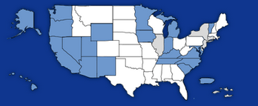
OSHA—JURISDICTION
OSHA coverage includes private sector employers and workers in all 50 states, the District of Columbia, and other U.S. jurisdictions either directly through Federal OSHA or through an OSHA-approved state plan.
Notes:
OSHA covers private sector employers and workers in all 50 states, the District of Columbia, and other U.S. jurisdictions either directly through federal OSHA or through an OSHA-approved state plan.
Graphic: A picture of the United States with the State Plans in blue and the Federal Plans in white.
State plans are OSHA-approved job safety and health programs operated by individual states instead of federal OSHA. An example would be Cal-OSHA (in California) or North Carolina OSHA. OSHA approves and monitors all state plans and provides as much as 50 percent of the funding for each program. State-run safety and health programs must be at least as effective as the federal OSHA program. The following states have approved State Plans (in BLUE on graphic):
Alaska New Mexico
Arizona New York
California North Carolina
Connecticut Oregon
Hawaii Puerto Rico
Illinois South Carolina
Indiana Tennessee
Iowa Utah
Kentucky Vermont
Maryland Virgin Islands
Michigan Virginia
Minnesota Washington
Nevada Wyoming
New Jersey
NOTE: The Connecticut, Illinois, New Jersey, New York and Virgin Islands plans cover public sector (State & local government) employment only (in GREY on graphic).

Slide 7


EMPLOYER RIGHTS AND RESPONSIBILITIES
Employers have the responsibility to, at a minimum, comply with the OSH Act
Employers must perform their due diligence to find and correct safety and health hazards
Notes:
Employers must also:
Perform tests in the workplace, such as air sampling or noise monitoring, as required by some OSHA standards.
Provide hearing exams or other medical tests required by OSHA standards (if applicable).
Post injury/illness information so that employees can see them.
Prominently display the official OSHA "Job Safety and Health - It's the Law" poster that describes rights and responsibilities under the OSH Act; new poster issued in 2015, however, either poster is still acceptable.
AND employers MAY NOT retaliate or discriminate against workers for using their rights under the OSH Act to report hazards that could lead to or have caused a work-related injury or illness.
Graphic: This slide has a picture of the old OSHA poster and the 2015 version of the OSHA poster.

Slide 8
WORKERS’ RIGHTS
Workplace free of recognized hazards
Report safety and health concerns and/or injuries and illnesses without retaliation
  File a discrimination complaint under Section 11 (c) of the OSH Act, which prohibits discharge or discrimination by “any person” against any employee for OSHA-related activity;
  File a complaint if punished or discriminated against for acting as a “whistleblower” under the additional federal laws for which OSHA has jurisdiction.
Receive appropriate training in a language and vocabulary that workers understand
Notes:
Employers have the responsibility to provide a safe workplace free from serious hazards and must follow all OSHA safety and health standards.
Employers must find and correct safety and health problems as their due diligence under the OSH Act. OSHA requires that employers first try to eliminate or reduce hazards by making feasible changes in working conditions rather than relying on personal protective equipment - a.k.a. PPE (e.g. masks, gloves, earplugs); and if an employer provides PPE, then the employer must train the employees on WHEN and HOW to use the PPE.
Any training given by the employer must be in a language that the employees can understand. An example is when an employer is giving training on procedures for how to de-energize or re-energize a piece of equipment by locking out or tagging out (LOTO) the various energy sources to prevent employee entrapment or other hazards from released energy.
Temporary workers are also entitled to the same protection against retaliation as full-time workers. Employers may not take action against employees for participating in protected workplace activities (i.e., filing a complaint, voicing concerns about workplace hazards to supervisors, etc.). Workers also can inform OSHA of other whistleblower items that OSHA enforces, which currently (2014) is 22 different whistleblower statutes covering a variety of workplaces. For more information visit whistleblowers.gov.
The whistleblower document is included in Resource Section.

Slide 9
WORKERS’ RIGHTS (CONT.)
Request an OSHA inspection at your facility (confidential)
Participate in an OSHA inspection
Speak to OSHA inspector in private
See OSHA citations
Request medical records, tests that measure hazards and injury/illness log
Notes:
Workers can participate during an OSHA inspection. They may speak with an inspector in private without retaliation from an employer. Workers can see the OSHA citations and request medical records, tests that measure hazards and the OSHA log.
Section 11(c) of the OSH Act prohibits discharge or discrimination by any person against any employee for OSHA-related activity AND authorizes the Secretary to investigate and seek all appropriate relief against any such person. Retaliatory lay-offs or failure to refer a worker who engages in protected activity under OSHA would be grounds for the Secretary to seek remedial - including injunctive - relief in district court.
Employers may not take action against employees for participating in protected workplace activities (i.e. filing a complaint, voicing concerns about workplace hazards to supervisors, etc.). Workers also can inform OSHA of other whistleblower items that OSHA enforces, which currently (2019) is 23 different whistleblower statutes covering a variety of workplaces. For more information visit whistleblowers.gov.

Slide 10
WHISTLEBLOWER PROTECTION
Temp workers are entitled to the same protections as all other covered workers
Employers and Staffing Agency are responsible & can be held accountable for
    Exposing workers to hazards
    Retaliating against workers for reporting hazardous conditions
Protected activities: report injuries, raise concerns to employer/OSHA/other government agencies about unsafe/unhealthful working conditions
Notes:
Employers should promptly report to each other any protected activity by workers, and appropriately investigate and respond to such activity. Both employers are responsible for safety and health and can be held accountable for exposing workers to hazards and retaliating against workers for reporting hazardous conditions.
For example, if after a worker engages in protected activity, the host employer asks the staffing agency to remove the worker from the host’s worksite, and the staffing agency complies, both employers may be investigated to determine if either one, or both, retaliated against the employee, even if the staffing agency places the worker at another worksite.
Retaliation can include:
• Blacklisting
• Demoting
• Denying overtime or promotion
• Disciplining
• Denying benefits
• Failing to hire or rehire
• Firing or laying off
• Intimidation
• Making threats
• Reassignment to a less desirable position, including one adversely affecting prospects for promotion
• Reducing pay
Workers can report injuries and raise safety and health concerns without retaliation.

Slide 11

RECORDKEEPING AND REPORTING
Employers of 11 or more employees must maintain records of occupational injuries and illnesses as they occur.
Employers with 10 or fewer employees are exempt from recordkeeping unless selected by BLS to participate in the Annual Survey.
Certain low-hazard employers (e.g., retail trade, finance, insurance, real estate) are not required to keep records.
Notes:
Graphic: clip art of a file cabinet for recordkeeping.
Adequate records of injuries and illnesses must be maintained and kept on file for at least 5 years. Employers that have more than 10 employees must keep the OSHA logs. Certain low-hazard employers such as retail trade, finance, insurance and real estate are not required to keep the logs unless specifically asked to do so by OSHA, Bureau of Labor Statistics or other state agency under OSHA or BLS.

Slide 12
RECORDKEEPING AND REPORTING REQUIREMENTS
All employers must:
  Comply with OSHA standards
  Display the OSHA poster
  Report to OSHA:
    Within 8 hours: Any accident that results in a fatality
    Within 24 hours: Amputations, loss of an eye, or hospitalization of 1 or more employees
Notes:
All employers must comply with OSHA standards, display the OSHA poster in a conspicuous place where workers can see it and report to OSHA accidents that involve fatalities, amputations, loss of an eye, or hospitalization of 1 or more employees. Fatalities must be reported within 8 hours and amputations, loss of eye or hospitalizations must be reported within 24 hours.

Slide 13
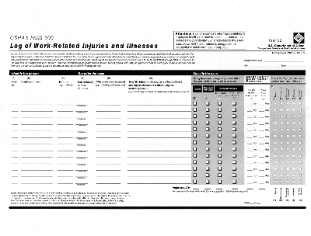
RECORDKEEPING FORMS
Maintain on a calendar year basis
Maintain for 5 years at the establishment
Be available for inspection
Summary of records for the previous year must be posted from February through April
Must be certified by the highest ranking official working at the establishment.
Notes:
Graphic: Picture of the OSHA 300 log.
The OSHA 300 log contains descriptions of recordable injuries and illnesses that occur in a calendar year.
The OSHA recordkeeping forms must be maintained for 5 years at the establishment and be available to OSHA, National Institute for Occupational Safety and Health (NIOSH), and BLS.
Logs must be updated to reflect any changes that occur.
Post the OSHA 300 A Log (summary log) in your workplace from February 1 to April 30th of the following year.
The highest ranking official working at the establishment has to certify the OSHA 300 A Log.
Do not send any recordkeeping forms to OSHA or any other agency unless you are asked to do so. When conducting its annual survey, the BLS may send you a form in the mail, which must be completed and returned to them.
OSHA Recordkeeping Forms
OSHA 300 Log
OSHA 300A Summary
OSHA 301 Incident Report

Slide 14
SOURCES FOR REFERENCE
www.osha.gov
  E-tools, standards, presentations, etc.
www.oshainfo.gatech.edu
  Free, on-site safety and health consultation
  Completely confidential from OSHA
Notes:
OSHA’s website has a lot of information on employee rights, as well as employer rights and responsibilities. The website also has a lot of information and documents that can be helpful for employee training, including eTools, presentations, Fact Sheets, Quick Cards, etc.
We work with the Georgia Tech Safety and Health Consultation Program. We provide free on-site safety and health consultations for small businesses in the state of Georgia. The consultation program exists in every state. It is free and completely confidential. If you are in the state of Georgia, and you have 250 employees or less at one facility or 500 employees or less nationwide, then you can complete a consultation request form at our website: www.oshainfo.gatech.edu

Slide 15
1910.147:
Purpose and SCOPE
Notes:
We will first begin by discussing the purpose and scope of OSHA’s Hazardous Energy Control Standard, 1910.147.

Slide 16
INTRODUCTORY LOTO QUIZ
What is the purpose of LOTO?
When does LOTO apply?
What are the primary sources of energy in the work environment?
What are the components of a LOTO program?
How often do you have to audit LOTO procedures?
Notes:
Questions to ponder as we start to discuss LOTO in detail. We need to understand these basic questions to know the importance of LOTO. Lockout/tagout” refers to specific practices and procedures to safeguard employees from the unexpected energization or startup of machinery and equipment, or the release of hazardous energy during service or maintenance activities.

Slide 17
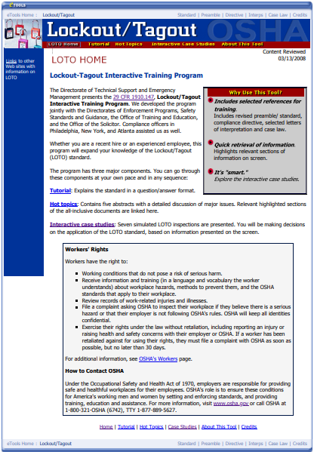
LOCKOUT TAGOUT STANDARD
1910.147(a) Scope, Application and Purpose
1910.147(b) Definitions
1910.147(c) General
1910.147(d) Application of Control
1910.147(e) Release from LOTO
1910.147(f) Additional Requirements
Notes:
1910.147 is OSHA’s standard for LOTO. The standard is broken up in the following way: scope, application and purpose, definitions, general requirements, application of energy control, release from LOTO, and additional requirements. We have included a screenshot here of OSHA’s LOTO eTool. You can easily access this etool on OSHA’s website. The eTool does a great job at explaining the concept of hazardous energy control, and the procedures that must be taken in order to properly control any hazardous energy prior to doing any servicing or maintenance work on equipment.
Graphic: Screenshot of OSHA’s LOTO eTool home page.
OSHA’s Lockout/Tagout eTool: https://www.osha.gov/dts/osta/lototraining/index.html

Slide 18
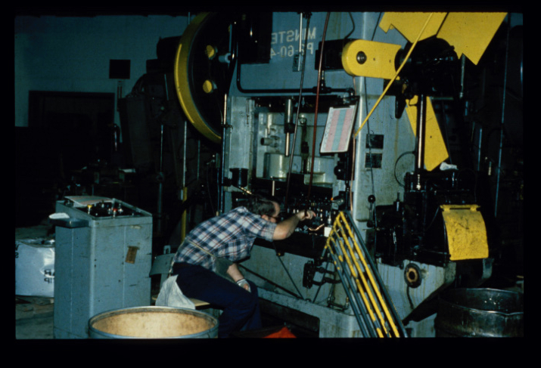
LOCKOUT/TAGOUT: What is it?
Lockout Tagout = Verified Energy Control with Communication
Notes:
What is LOTO? Essentially, LOTO is verified energy control with communication. Breaking the term “lockout/tagout” down: lockout is the verified energy control, and tagout is the communication portion.
When does LOTO apply? LOTO applies any time an employee performs maintenance or servicing on equipment or machinery, and any time an employee bypasses a guard or works in a hazardous area-or what we call a danger zone. Again-LOTO applies whenever servicing or maintenance is performed, and whenever a guard must be removed and an employee is working in a hazardous area.
OSHA’s LOTO standard covers servicing and maintenance of machinery and equipment that could become unexpectedly energized. Not referring to locking/tagging something out of service, but rather it comes into play when servicing or maintenance needs to be performed on machinery.
Photo: Employee performing maintenance on a mechanical power press.

Slide 19
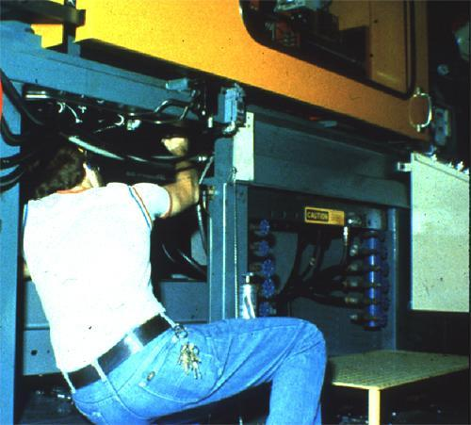
LOCKOUT/TAGOUT: What is it?
Practices and procedures necessary to disable machinery and equipment
Protects workers performing service or maintenance activities
Notes:
Lockout/Tagout is performed in order to disable machinery and equipment when employees perform servicing or maintenance. It prevents the possibility of a machine turning on or operating when an employee is in the danger zone and exposed to hazardous parts. Furthermore, it is performed when employees must bypass a guard during normal production operations, so that employees are not killed or injured due to the accidental start up of the machine while they are exposed to machine hazards.
Photo: employee in the danger zone of a machine, performing servicing or maintenance.

Slide 20
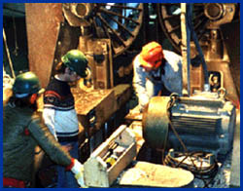
WHY USE LOCKOUT/TAGOUT?
To Prevent “Unexpected”:
  Energizing
  Start-up
  Movement
  Release of Stored Energy
“Unexpected” Movement
Leads to Serious Injury
Notes:
LOTO is used to prevent the unexpected energization, start-up, moving, or release of stored energy while employees are performing servicing or maintenance on equipment, or when they bypass a guard. Exposure to such unexpected movements may lead to serious injury or death.
Photo: three employees doing maintenance work on a piece of machinery.

Slide 21
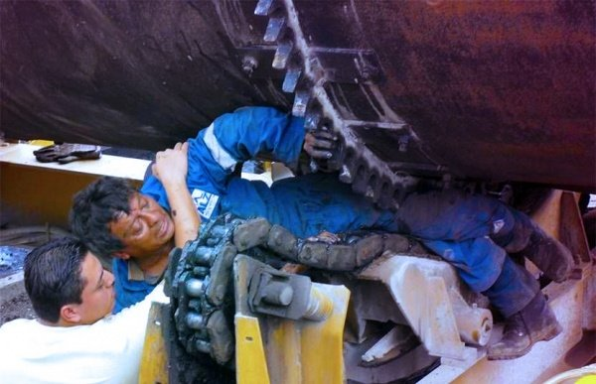
LOCKOUT/TAGOUT
Every Year Lockout/Tagout is one of the top ten most violated standards in industry.
Compliance with the Lockout/Tagout standard prevents 120 fatalities and 50,000 injuries each year.
Notes:
Not only is LOTO one of the top ten most violated standards in general industry, but the failure to control the release of hazardous energy is responsible for the deaths of 150-200 people per year, as well as 50,000 or more injuries per year. This slide cause us to realize that we aren’t just talking about statistics here. We are talking about real people, who are husbands, wives, daughters, sons, mothers, and fathers. If lockout/tagout was properly applied, these employees would not have lost their lives on the job. The injuries and fatalities that result from either a lack of performing LOTO or from inadequately performing LOTO are 100% preventable when the proper procedures are put into place. Oftentimes the maintenance employees themselves are not deliberately choosing to not follow LOTO. Rather, their companies do not have a formal LOTO program in place, employees have not received the adequate training they need in order to effectively perform LOTO, or they may feel rushed by their employer to get the job done quickly so that production can resume. It is the employer’s responsibility to develop an effective LOTO program and to prioritize employee safety when servicing or maintenance needs to be performed on equipment.
Photos: This employee was caught between a large chain and sprocket system due to lockout/tagout failure.
Source: https://www.osha.gov/OshDoc/data_General_Facts/factsheet-lockout-tagout.pdf

Slide 22
PURPOSE
Employers are required to establish a program to:
  Affix lockout or tagout devices to energy isolating devices
  Disable machines or equipment to prevent unexpected energization, start up, or release of stored energy
Notes:
Employers are required to establish a program and use procedures for affixing appropriate lockout or tagout devices to energy-isolating devices, and to otherwise disable machines or equipment to prevent unexpected energization, start up, or release of stored energy to prevent injury to workers.

Slide 23
SCOPE
LOTO covers the servicing and maintenance of equipment or machinery to prevent injury to workers from:
  Unexpected energization or start up of the machines or equipment
  Release of stored energy
Notes:
LOTO covers the servicing and maintenance of machines and equipment in which the unexpected energization or start up of the machines or equipment, or release of stored energy could cause injury to workers. This standard establishes the minimum performance requirements for the control of such hazardous energy.

Slide 24
SCOPE (CONT.)
LOTO covers servicing or maintenance during normal production operations where:
  Employees by-pass guard(s)
  Employees place any part of their body in a hazardous area
Notes:
LOTO also applies to servicing or maintenance during normal production operations when employees bypass a machine guard or place any part of their body in a hazardous area. Employees should never be exposed to machine hazards, whether while doing servicing or maintenance or during normal production operations.

Slide 25
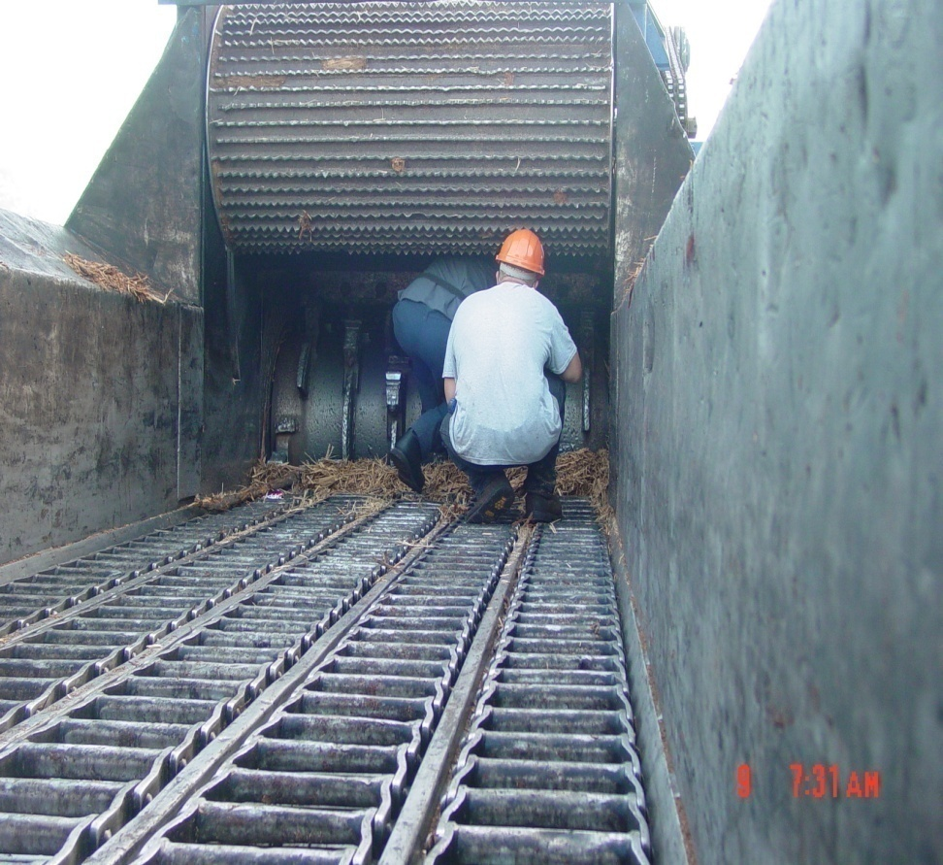
LOTO APPLIES WHEN:
Workers are performing servicing and/or maintenance
There is potential for injury from unexpected start-up or release of stored energy
*Normal production operations are not taking place
Notes:
LOTO applies when workers are performing servicing and/or maintenance on equipment, and there is the potential for injury from unexpected start-up or release of stored energy. Here is an example: employees are working in a log shredder. This is not during normal production operations. However, the log shredder is not locked and tagged out. If the shredder was to start up, these employees may be seriously injured or killed.
Photo: Two employees working on a log shredder that has not been locked or tagged out.

Slide 26
LOTO ALSO APPLIES WHEN:
Service and maintenance takes place during normal production, if employee:
      Must remove or bypass a guard or safety device; or
      Must place any part of their bodies into the danger zone
Notes:
LOTO also applies when servicing or maintenance must take place during normal production, and an employee removes or bypasses a guard or safety device, or places any part of their body into the danger zone.

Slide 27
1910.147 DOES NOT APPLY TO:
Construction, agriculture, and maritime
Normal production operations
  Subpart O
Cord-and-plug under the control of employee
  Written procedure still required
Exposure to electrical conductors
  Subpart S and electrical safety-related work practices
Notes:
The general industry standard does not apply to maritime, but maritime most certainly has a standard. The construction standard does not mention a LOTO standard, but workers certainly must have equipment rendered inoperable before working on the equipment.
Bullet #2 suggests an alternative for LOTO is when the machine is protected by some other means, such as machine guarding.
Bullet #3-Cord and plug connected equipment is exempt when the worker has direct control over the cord of the equipment.
Bullet #4 There are electrical safe work practices to protect workers, but sometimes you have to lockout machine electrical conductors as well. The standards 1910-330 through 360 would apply and the consensus standard (2018 NFPA 70E) discusses the best work practices.
Cord and plug connected equipment is conditionally exempt provided the worker has control over the end of the cord. It would be best practice to go ahead and install an attachment plug as a precaution.

Slide 28
EXCEPTION TO LOTO
Exception to paragraph (a)(2)(ii):
Minor tool changes and adjustments, and other minor servicing activities, which take place during normal production operations, are not covered by this standard if they are routine, repetitive, and integral to the use of the equipment for production (provided that the work is performed using alternative measures which provide effective protection).
Notes:
The LOTO standard includes something called the minor servicing exception. This exception states that minor tool changes and adjustments, and other minor servicing activities, which take place during normal production operations, are not covered if they are routine, repetitive, and integral to the use of the equipment for production (provided that the work is performed using alternative measures which provide effective protection). Alternative measures of protection must be provided. Employees must be protected by LOTO or safeguarding.

Slide 29
MINOR SERVICING DURING NORMAL PRODUCTION OPERATIONS
The activity must be:
  Routine: a regular course of procedure in accordance with established practices.
  Repetitive: repeated as part of the production process or cycle.
  Integral: inherent to the production process.
  Must use alternative measures that provide effective protection.
Notes:
In order for an activity to fall under the minor servicing exception, the activity must be routine, repetitive, and integral to production. Furthermore, alternative measures of protection must be used.

Slide 30
EXCEPTION TO LOTO
Has to take place during normal production operations.
Definition of “Set-Up”: Any work to prepare a machine to perform its normal production operation.
  By definition, set-up activities can’t take place during normal production, so LOTO applies.
Notes:
Another requirement is that the activity must take place during normal production operations.
Set up activities are an on-going issue. In most setup activities power to the machine is needed and allowed by the standard. However, this only applies to the tasks where power is needed, which does not include all setup tasks.

Slide 31
ALTERNATIVE EFFECTIVE PROTECTION SUCH AS:
Interlocked gates, barriers and other effective safeguarding.
Mechanical blocks, pins, bars, or locking devices.
Remote lubricators or other remote devices that remove worker from danger zone.
Notes:
Examples of alternative measures of protection include interlocked gates, barriers, and other effective safeguarding devices, mechanical blocks, pins, bars, or locking devices, as well as remote lubricators or other remove devices that remove workers from the danger zone. If the minor servicing exception is used, it is important that companies defend why the exception is being used for a particular activity, and how the alternative method of protection is effective in protecting employees. Furthermore, if effective alternative measures of protection are not provided, LOTO must be performed, even if the activity takes place during normal production operations.

Slide 32
EXAMPLE – MEETING EXCEPTION
Automatic IMM machine. About once an hour, a plastic part sticks on the mold, the operator opens the interlocked gate, pulls the part off by hand, and drops it into a box.
This takes place during production, and appears to be routine, repetitive, and integral to the use of the equipment.
The alternative protection is the interlock gate.
Notes:
This scenario meets the minor servicing exception because it takes place during production, is routine, repetitive, and integral to production, and an alternative method of protection is provided (the interlocked gate).

Slide 33
EXAMPLE – NOT MEETING EXCEPTION
Same machine: the mold opens too soon, the plastic part melts in the mold, and doesn’t fall.
Now someone must go between the mold with hand tools to pry and scrape off the material.
This is not routine or repetitive; it is done only as needed, so LOTO would apply.
Notes:
This scenario does not meet the minor servicing exception. This situation is not routine or repetitive. Therefore, the exception would not apply, and LOTO would need to be performed prior to employees going between the mold to scrape the material off.

Slide 34
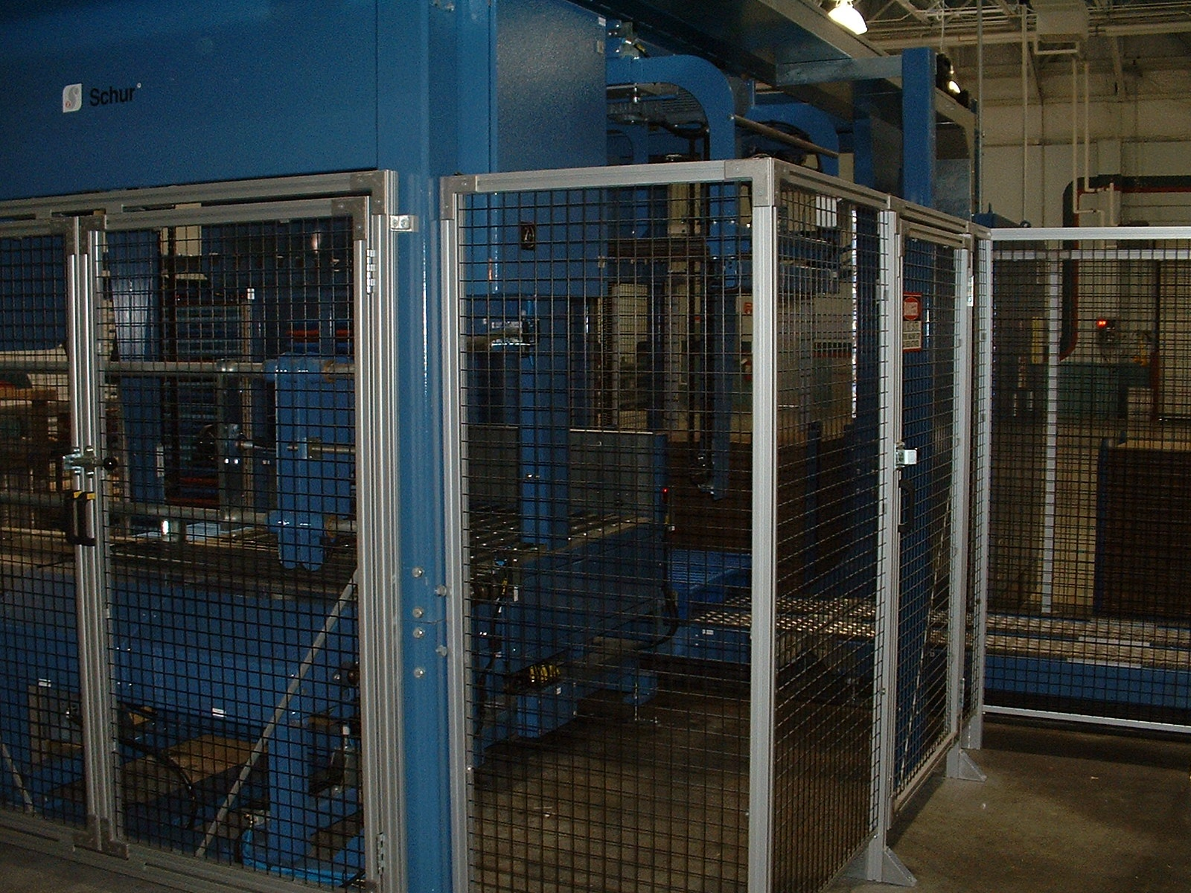
AUTOMATED PALLETIZER
Operator goes inside this interlocked gate to perform minor servicing, but goes on the back side out of sight.
  Is this effective protection?
Notes:
This would not be an effective means of alternative protection. If they are out of sight, nobody may know that they are within the danger zone. Someone can still come and startup the machine.

Slide 35
ALTERNATIVE EFFECTIVE PROTECTION?
Employee reaches into the die area of a hydraulic press to clean die surface, which is done about once an hour.
The press has a light curtain for protection.
Assume this is minor servicing work.
  Is this effective protection?
Notes:
This is not effective protection because it does not account for gravity. The die could still drop due to a hydraulic hose failure. Die blocks will need to be used in the press.

Slide 36
INCIDENT REPORTS
An employee was beginning to repair a leaking pneumatic fitting of an abrasive blasting machine. He shut off the blasting machine and disconnected the media hose before walking to another building to get a wrench to remove the worn fitting. While the employee was away from the machine, a coworker turned the machine back on and walked back to his work area. When the employee returned and was lying in front of the fitting, the coworker triggered the valve to open. The employee was injured when the machine was not locked out and it re-energized.
An employee was performing maintenance on a Foltex feeder. The employee forgot to lock out the machine before starting with preventive maintenance. The employee's glove got caught and was pulled into a sprocket. The employee's right index finger was amputated.
What are your thoughts about what happened here? What went wrong?
Notes:
Both incidents could have been prevented if lockout/tagout was performed. Unfortunately, this type of incident is quite common. This is where communication is also very essential. If proper LOTO was performed, employees would be unable to flip the switch because there would be a lock on it, and they would know from the tag who is working on the equipment.
2nd incident: it sounds like the machine was still on while the maintenance employee was working on it. The machine should not be powered while performing servicing or maintenance. LOTO not only ensures that equipment is powered down prior to servicing or maintenance, but it also ensures that it can’t be powered back up while employees are working on it.
Source: OSHA Accident Report Detail (https://www.osha.gov/pls/imis/accidentsearch.accident_detail?id=93469.015 and https://www.osha.gov/pls/imis/accidentsearch.accident_detail?id=97001.015).

Slide 37
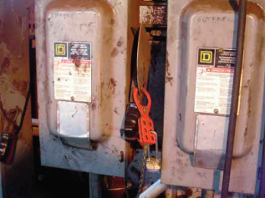
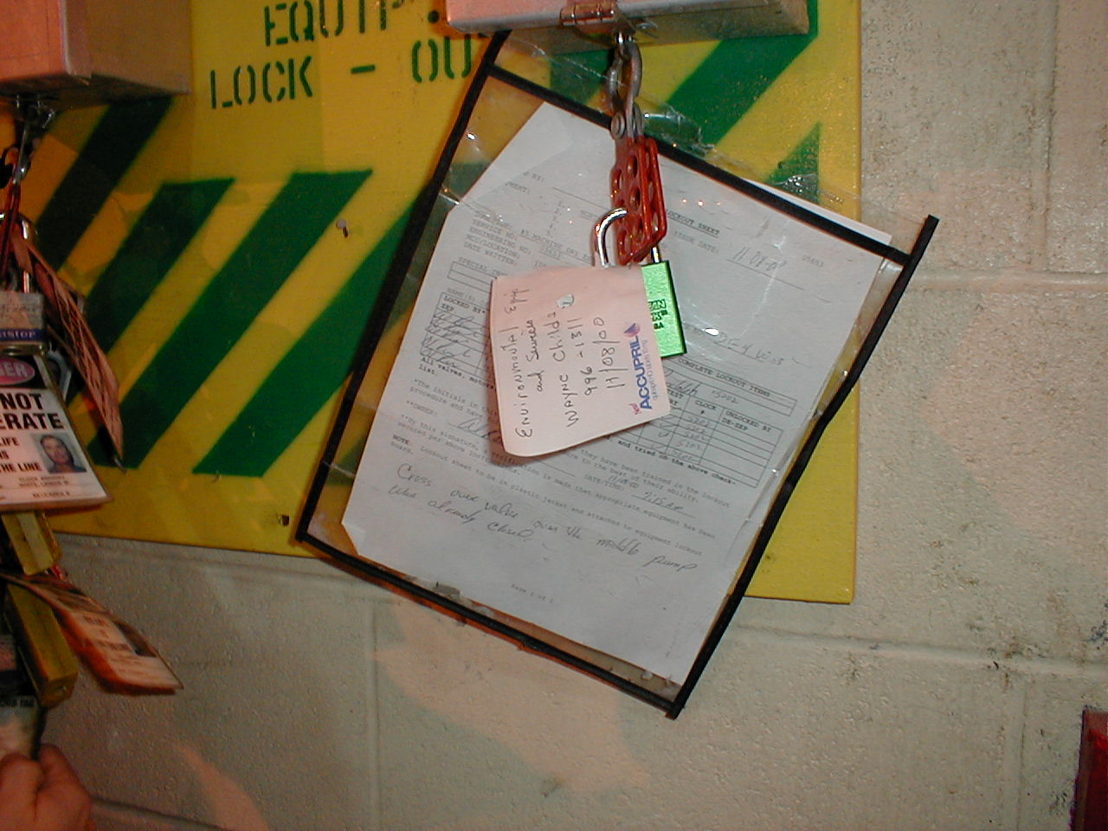
WHY DOES A LOCKOUT/TAGOUT PROGRAM FAIL?
I can get this done much faster
It’s too much trouble
Loss of respect for equipment
I didn’t know we had a Lockout/Tagout Program
LOTO …. Huh?
Notes:
There are many different reasons why a LOTO program may fail. Have any of you come across these statements when addressing LOTO?
I can get this done much faster-For example, employees may think it’s not worth it to go through all the steps just to clear a jam. It would be a lot faster if they just turn the machine off and stick their hand in a machine to clear a jam.
It’s too much trouble-it’s too much trouble to go over to the breaker, and apply a lock and tag, or if you have many different energy sources, to isolate each of the energy sources.
I didn’t know we had a LOTO program-this is quite common. It is up to the employer to ensure that employees receive the proper training they need to perform LOTO, and it’s also important that employers are on board with keeping their employees safe and that they have a disciplinary system in place to address when employees don’t perform LOTO, or don’t perform it adequately. Having a disciplinary system in place is essential when it comes to having an effective LOTO program. You can have everything in writing, you can have a written program and procedures, but if there is no enforcement regarding following the procedures, then employees may be more likely to cut corners, especially when they are pressed for time.
LOTO…huh? Some employees don’t know what LOTO even is. This is a problem, especially if they are servicing or maintenance employees.
Top photo: Two disconnects. The disconnect on the left has a hasp with a lock affixed to it. There is not tag. Make sure you use both locks and tags.
Bottom photo: This is an example of an insufficient tag. A post-it note cannot be used as a tag. Tags need to be durable and standardized.

Slide 38
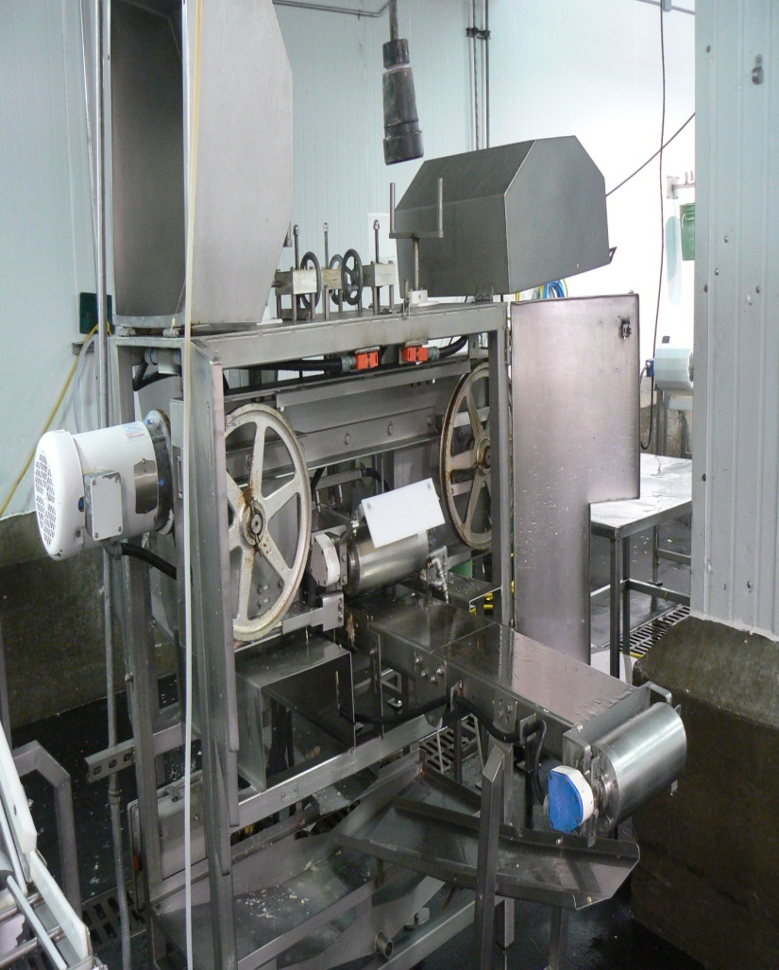
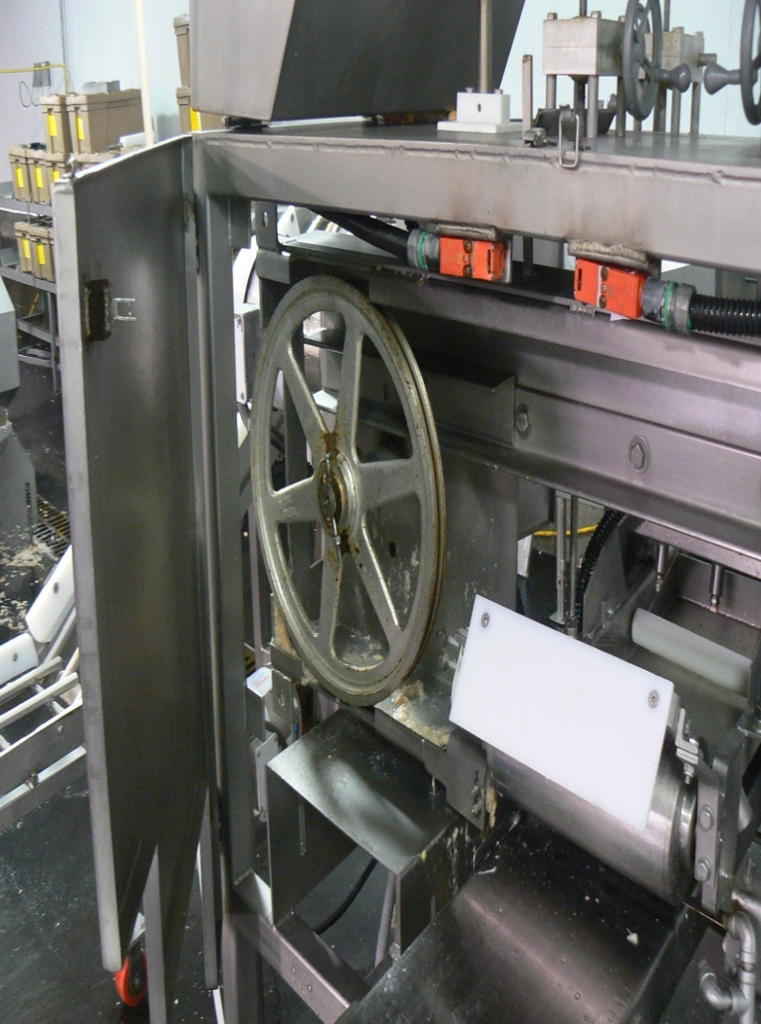
LOCKED OUT?
39
Notes:
Photos: Left photo—food processing equipment that has moving parts; Right photo—close-up of food processing equipment showing the guard opened and moving parts accessible. If we open the guard to do servicing or maintenance, we would have to LOTO the machinery.

Slide 39
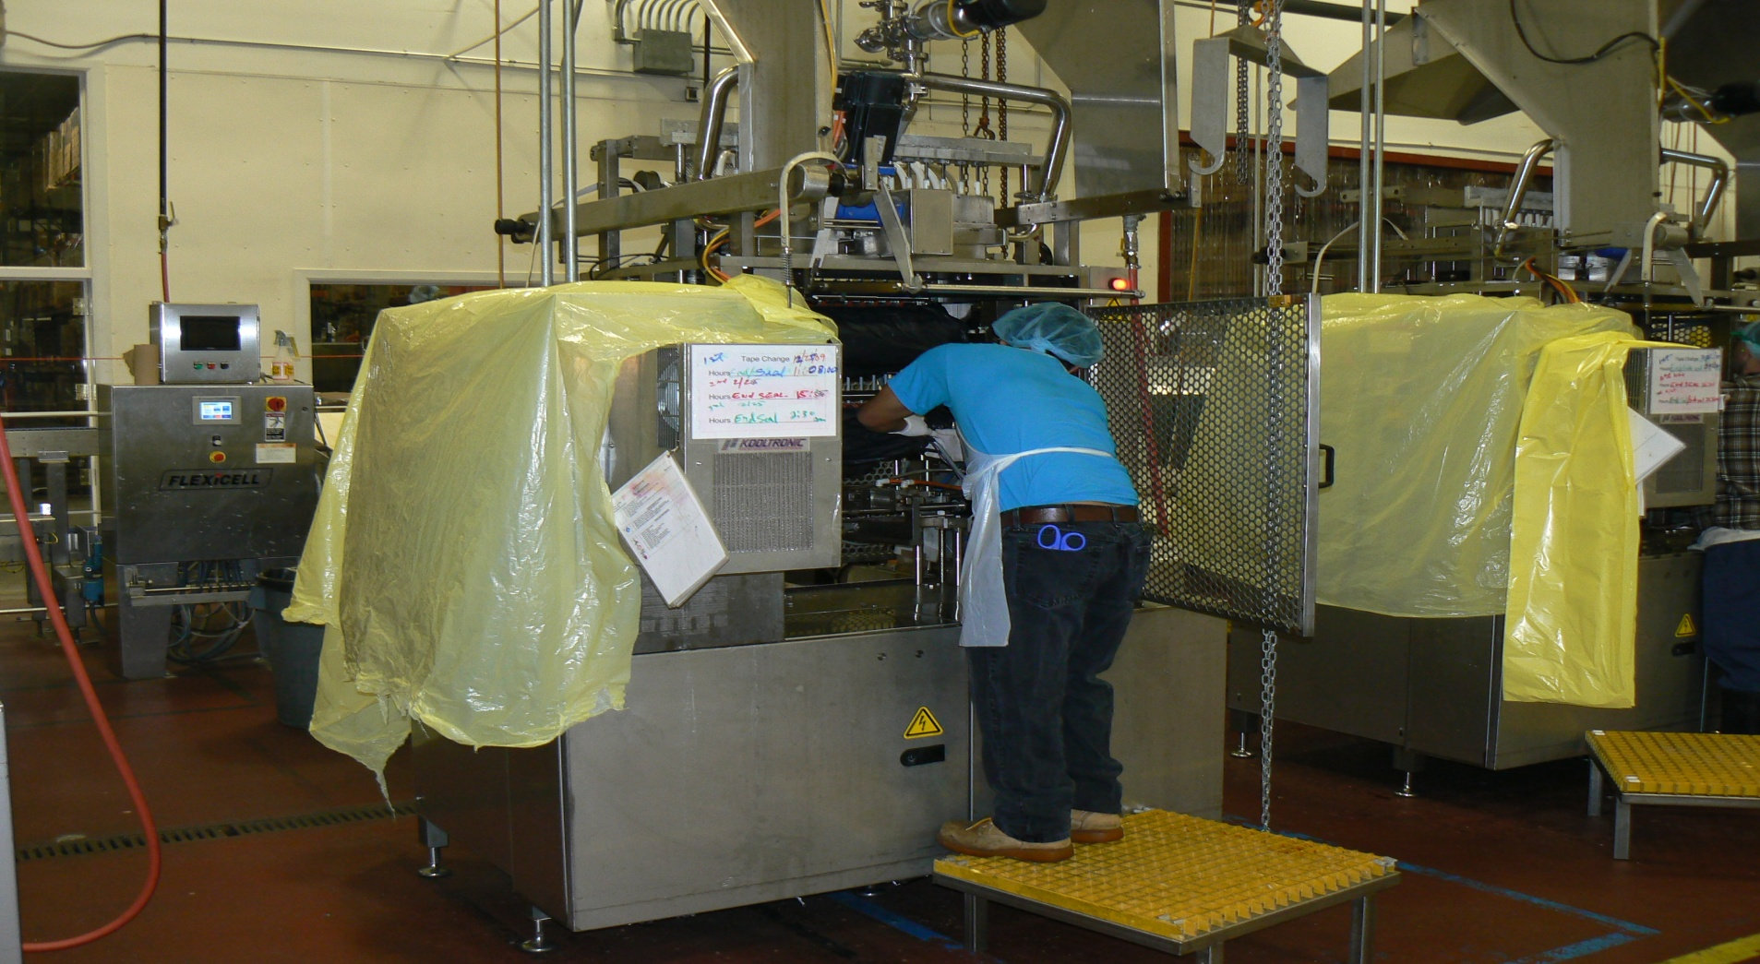
EQUIPMENT LOCKED OUT?
40
Notes:
No! The employee in the picture is preparing the plant for the sanitation crew. He is covering the sensitive parts of the machinery, but he opened the machine and inserted part of his body without locking and tagging out the equipment.
Photo: food processing equipment with most of it covered in yellow plastic to protect the sensitive parts of the machines. In center is employee leaning into machine that has NOT been locked or tagged out.

Slide 40
Energy control program review
Notes:
Now we will review what must be included in a company’s energy control program.

Slide 41
CORE COMPONENTS OF AN ENERGY CONTROL PROGRAM
Written program which includes energy control procedures for each type of machine
Training and retraining to ensure employees understand the program (not just maintenance employees!)
Periodic inspections to ensure procedures are followed and accurate
Application of energy controls
Notes:
The following are the core components of an energy control program:
A written program
Written equipment-specific LOTO procedures
Employee training
Periodic inspections of the equipment-specific procedures
Proper application of energy controls

Slide 42
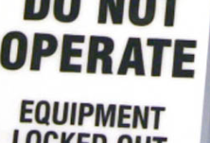
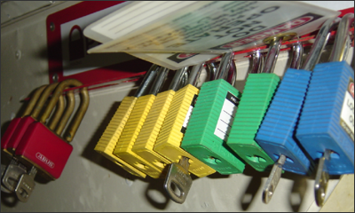
LOCKOUT TAGOUT PROGRAM
Your hazardous energy control plan must specifically outline the scope, purpose, authorization, rules, and techniques to be utilized for the control of hazardous energy.
The plan must also include your methods to enforce compliance.
Notes:
The written LOTO program must specifically outline the scope, purpose, authorization, rules, and techniques that must be utilized for the control of hazardous energy. The written program describes how the different requirements in the OSHA LOTO standard will be met, and thereby how employees will effectively control hazardous energy. For example, the written program will include sections on employee training, the periodic review of the equipment-specific procedures, group LOTO procedures, what to do if you have contractors who will be performing LOTO on-site, the specific steps that must be followed when performing LOTO, etc. The plan must include your methods to enforce compliance. It is very important that these methods are followed. Not only is it important that everything in the written program is being done, but it’s just as important that you have some sort of disciplinary system in place to ensure employees continue to follow what is covered in the written program.
Photo 1: Snapshot of a tag used for lockout/tagout.
Photo 2: Various locks that are used for lockout/tagout.

Slide 43

LOCKOUT TAGOUT REQUIREMENTS
Written program which includes specific written procedures
Training of employees (not just maintenance!)
Periodic review of procedures
Notes:
There are three vital components of a lock out tag out program (Hazardous Energy Control Program).
A written program outlines the scope, activities, and accountability for controlling the energy.
Training includes many more people than maintenance. Others in the plant need at least awareness training.
Periodic reviews are necessary to determine if there is a problem with the procedure and execution of the procedure.
Clip Art: Indicates a pen in the hand to write procedures for LOTO.

Slide 44
LOTO PROGRAM CONSISTS OF:
  a) Survey of all hazardous energy
  b) Identifying energy-isolating devices
  c) Selecting and procuring protective materials and hardware
  d) Assigning duties and responsibilities
  e) Determining shut-down, de-energization, energization and start-up sequences
  f) Written procedures for machines, equipment, and processes
  g) Training of personnel
  h) Auditing program elements
Notes:
Lockout/tagout is a systematic program that consist of the following elements to provide effective protection of personnel:
a) Survey of all hazardous energy
b) Identifying energy-isolating devices
c) Selecting and procuring protective materials and hardware
d) Assigning duties and responsibilities
e) Determining shut-down, de-energization, energization and start-up sequences
f) Written procedures for machines, equipment, and processes
g) Training of personnel
h) Auditing program elements

Slide 45
WHO’S COVERED?
Authorized Employee:
  The person who services or performs maintenance on machines and equipment.
Affected Employee:
  The person who operates or uses a machine or piece of equipment which is being serviced.
Other Employee:
  The person who works in an area where lockout/tagout procedures are being used.
Notes:
The OSHA standard distinguishes between three different groups of employees, all of whom are covered under the LOTO standard. First are the authorized employees. These are the employees who are performing servicing or maintenance on machines and equipment. Authorized employees are those who will be performing LOTO. It is important that companies identify in their written program who the authorized employees are.
Second are the affected employees. These are the employees who are operating or using the machines or equipment that may need to be serviced or maintained. However, affected employees do NOT perform LOTO. For example, you have a press operator. The press operator is going to be the affected employee. If you have a maintenance employee who performs some work on the press, they will be considered an authorized employee.
Lastly, other employees are those who are working in the area where LOTO procedures may be used.

Slide 46
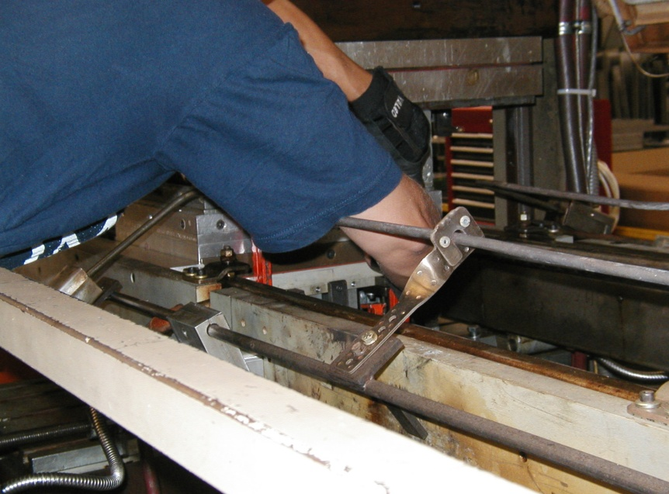
SERVICING AND MAINTENANCE INCLUDES:
Setting up
Adjusting
Inspecting
Modifying
Installing
Constructing
Tool changes
Lubricating
Notes:
The standard applies to the control of hazardous energy when employees are involved in service or maintenance activities such as constructing, installing, setting up, adjusting, inspecting, modifying, and maintaining or servicing machines or equipment. These activities include lubricating, cleaning or unjamming machines, and making adjustments or tool changes, where the employees may be exposed to hazardous energy. Set up usually occurs before manufacturing on a machine.
Photo: An employee inserting their arm into a machine to perform servicing or maintenance.

Slide 47
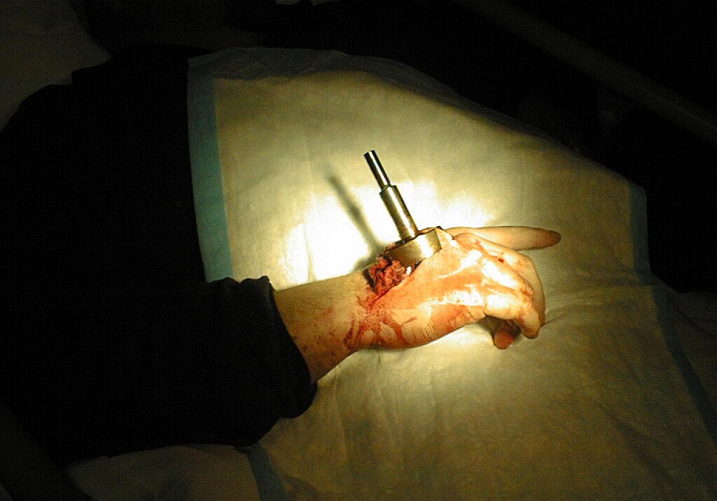
SERVICING – POLISHING MACHINE
18-year-old employee had worked for 2 months
Polishing machine stopped
He went behind the machine
He opened the guard to see if one of the empty polishing holders would spin freely.
He had his hand in there and hit the start switch.
The polishers began to spin at a little over 1,000 rpm.
What about the guard?
Notes:
When the polishing machine stopped for an unknown reason the employee decided to go around behind the machine, open the guard and see if one of the empty polishing holders would spin freely. As the employee had his hand in the machine, he hit the start switch, the polishers began to spin at a little 1,000 rpm.
What about the guard? He bypassed the guard. If LOTO was properly performed, this accident would have been prevented.
Photo: Picture of injured hand. Polishing arm was lodged into employee’s hand. Blue box is covering the injured area.
Source: OSHA 7115 Course

Slide 48
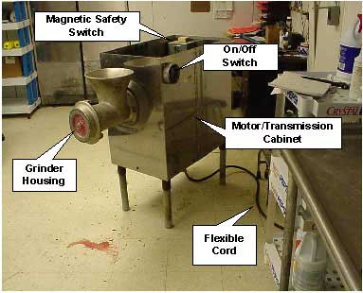
CLEANING – MEAT GRINDER
A 15-year-old worker at a retail grocery store suffered amputation of the right arm.
He was caught by the auger of a meat grinder.
The victim was reassembling parts of a grinder he had cleaned without de-energizing and locking out the machine's power supply.
Notes:
Accident involving cleaning: A 15-year-old part-time worker at a retail grocery store suffered amputation of the right arm as a result of being caught by the auger of a meat grinder while he was reassembling it.
The victim, working after school, had completed washing and cleaning the disassembled parts of the grinder and was reassembling it without de-energizing and locking out the machine's power supply.
Photo: The accident took place on the meat grinder in the photo. Photo shows the different parts of the grinder that were involved with the amputation.
Source: OSHA 7115 Course

Slide 49
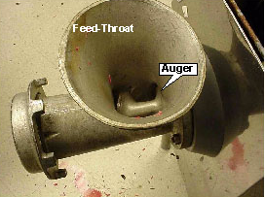
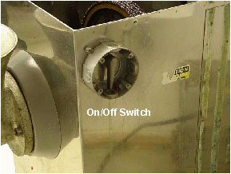
CLEANING – MEAT GRINDER (CONT.)
He inserted the auger into the grinder's housing and reached through the feed-throat with his right hand to guide it into engagement.
He bumped against the on/off switch.
The grinder started, and the auger pulled his hand and arm into the housing.
Notes:
LOTO Issues and protecting on/off switches:
He inserted the auger into the grinder's housing and reached through the feed-throat with his right hand to guide it into engagement. As he did so, he bumped against the on/off switch mounted about waist high on the machine's side. The grinder started and the auger pulled his hand and arm into the housing.
If LOTO was performed, this accident would have been prevented. Even if he hit the on/off switch, the machine would not have started up.
Photo 1: Photo shows feed throat and auger.
Photo 2: Photo shows on/off switch that was bumped during cleaning.
Source: OSHA 7115 Course

Slide 50
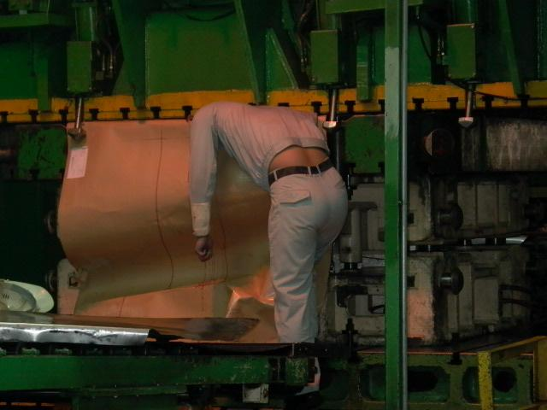
INSPECTING - PRESS
An engineer was looking at why paper backing was not feeding into a press.
His head was caught between press and paper roll.
Notes:
This was an engineer and not an operator looking at why paper backing was not feeding into a press for headliner material. Head was caught between press and paper roll.
This resulted in a fatality.
Photo: Photo of employee with head caught in between press and paper roll. Blue box is covering where his head got caught.
Source: OSHA 7115 Course

Slide 51
TERMS USED IN LOTO PROCESS:
Isolate all energy sources
Apply locks and tags
Release stored energy
Verify equipment isolation
Notes:
There are several terms used in the LOTO process:
Isolate all energy sources. This is done by locking out the energy isolating devices.
Apply locks and tags.
Release stored energy. This oftentimes involves pneumatic or hydraulic energy.
Verify equipment isolation. This is to turn on the equipment after it has been locked out to ensure the energy was properly isolated.

Slide 52


FORMS OF HAZARDOUS ENERGY
Any source of electrical, mechanical, hydraulic, pneumatic, chemical, thermal, or other energy.
Kinetic (mechanical) energy in the moving parts of mechanical systems
Potential energy stored in pressure vessels, gas tanks, hydraulic or pneumatic systems, and springs (potential energy can be released as hazardous kinetic energy)
Thermal energy (high or low temperature) resulting from mechanical work, radiation, chemical reaction, or electrical resistance
Any other active or stored energy sources that could harm a worker.
Notes:
There are several different types of energy. These include electrical, mechanical, hydraulic, pneumatic, chemical, thermal energy, springs, gravity…Because there are multiple types of energy, it’s important to evaluate your machinery to determine whether there is more than one energy source. Sometimes machines will be powered by both electrical and pneumatic energy, and if this is the case, then both those energy sources need to be controlled.
Photo 1: an electrical outlet, demonstrating electrical energy.
Photo 2: meshing gears, demonstrating mechanical energy.

Slide 53
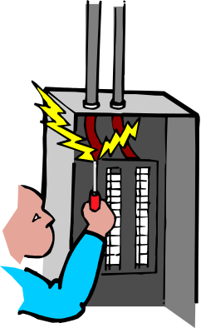
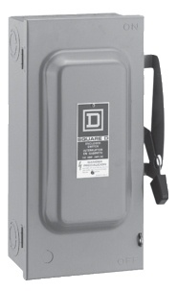
ENERGIZED VS. DE-ENERGIZED
Energized: Connected to an energy supply or containing residual or stored energy.
De-energized: Disconnected from all energy sources and not containing residual or stored energy (isolation).
Notes:
A machine is energized when it is connected to an energy supply or containing residual or stored energy.
A machine is de-energized when it is disconnected from all energy sources and is not containing residual or stored energy. This is when the energy is isolated.
Graphic: Clip Art showing someone working in a breaker box.
Photo: Picture of a safety switch/cut-off device.

Slide 54
ENERGY-ISOLATING DEVICE:
A mechanical device that physically prevents the transmission or release of energy, including the following:
  A manually operated electrical circuit breaker, a disconnect switch, a manually operated switch by which the conductors of a circuit can be disconnected from all ungrounded supply conductors.
  A line valve; a block; and any similar device used to block or isolate energy.
Push buttons, selector switches, and other control circuit type devices are not energy-isolating devices.
Notes:
An energy-isolating device is a mechanical device that physically prevents the transmission or release of energy. Examples include manually-operated circuit breakers, disconnect switches, manually operated safety switch, a line valve, a line block, etc.
Push buttons, e-stops, on/off switches are not energy isolating devices.

Slide 55
STORED ENERGY
Release, Block, or Otherwise Rendered Safe
Discharge capacitors
Block or release springs
Relieve system pressure
Drain fluids
Vent gases
Allow system to cool (or use PPE)
Allow momentum of mechanical motion to stop
Notes:
This slide shows some ways to release or block stored energy.
Some energy sources have to be addressed by other means, including allowing the system to cool, and allowing momentum of a mechanical motion to stop.

Slide 56
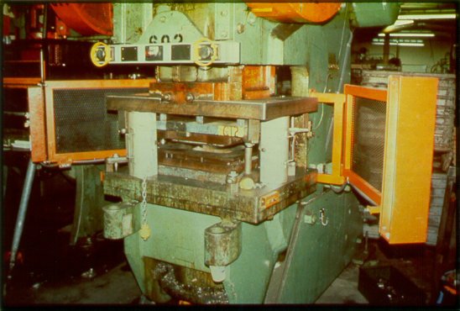
BLOCKING
Notes:
Photo: Mechanical Power Press with die blocks

Slide 57
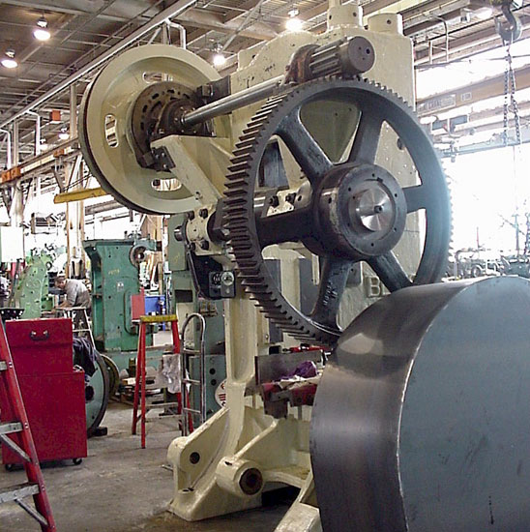

MOMENTUM - ENERGY
Notes:
Point out that this type of energy source may require a waiting period before momentum winds down. Most will continue to rotate until they wind down to a stop.
Left Photo: Bull Gears
Right Photo: Flywheels
Procedures may require waiting for motion to stop on some machines.

Slide 58
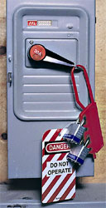
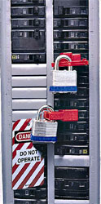
ELECTRICAL ISOLATION
DEVICES
Electrical disconnects and circuit breakers
Notes:
These are some examples of electrical isolation devices.
Left photo: Hasp with locks and tags affixed to a switch.
Middle Photo: Electrical disconnect/safety switch
Right Photo: Circuit breaker with two switches locked out.

Slide 59
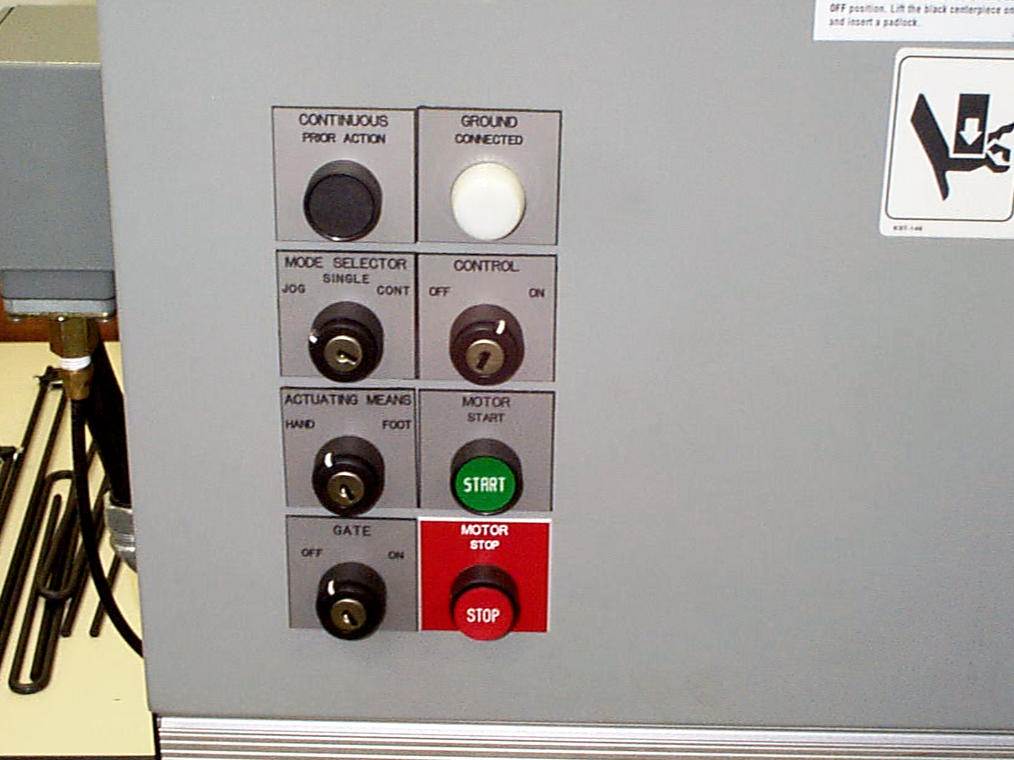
CIRCUIT TYPE DEVICES
Push buttons, selector switches, and other control circuit type devices are not energy isolating devices.
Such controls interrupt power, but do not isolate power.
Notes:
Push buttons, selector switches, and other control circuit type devices are NOT energy isolating devices. These controls interrupt the power to the machine, but they do not ISOLATE the power.
Photo: Example of push buttons on a machine.

Slide 60
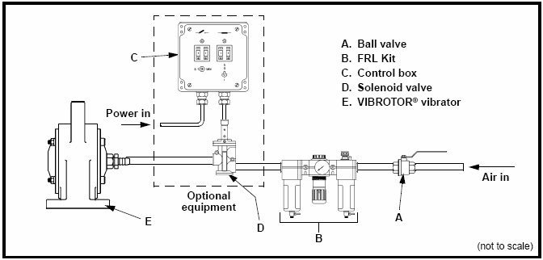
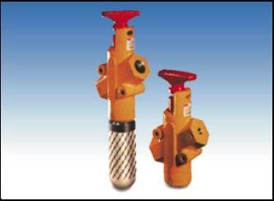

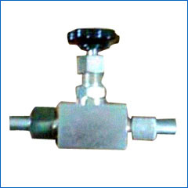
PNEUMATIC VALVE ISOLATION DEVICES
Piston
Handle /lever
Notes:
These are examples of pneumatic valve isolation devices.
Top left photo: piston
Lower left photo: handle/lever
Top right photo: diagram demonstrating pneumatic valve isolation
Lower right photo: shut-off valve
Note: Some pneumatic valves are self-exhausting, but not all.

Slide 61
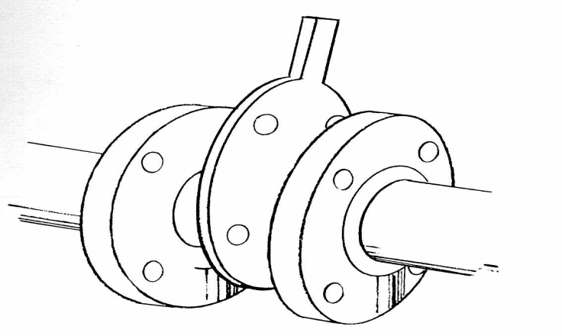
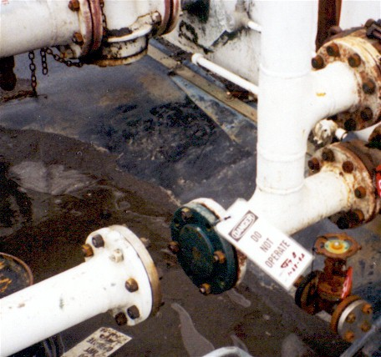
PIPE ISOLATION EXAMPLES
Notes:
Left photo: example of a line blank
Right photo: example of a line break

Slide 62
LINE BREAKING
Means the intentional opening of a pipe, line, or duct that is or has been carrying flammable, corrosive, or toxic material, an inert gas, or any fluid at a volume, pressure, or temperature capable of causing injury.
Notes:
This slide explains what a line break is.
Photo: Illustrates a pipe was that opened. The pipe may have been used to carry flammable, corrosive, or toxic materials.

Slide 63
LINE BLANKING OR BLINDING
Means the absolute closure of a pipe, line, or duct by fastening of a solid plate that completely covers the bore and that is capable of withstanding the maximum pressure of the pipe, line, or duct with no leakage beyond the plate.
Notes:
In order to implement line blanking or blinding the pipe must be closed off with a solid plate that covers the bore. The plate must be capable of withstanding the maximum pressure with no leaks.
Graphic: Graphic demonstrating a link blank.

Slide 64
DOUBLE BLOCK AND BLEED
Means the closure of a line, duct, or pipe by closing and locking or tagging two in-line valves and by opening and locking or tagging a drain or vent valve in the line between the two closed valves.
Notes:
Double block and bleed is a technique used to control materials that flow through pipes.

Slide 65
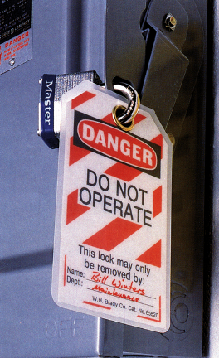
DEFINITION: LOCKOUT DEVICE
A device that uses a positive means such as a lock, either key or combination type, to hold an energy-isolating device in the safe position and prevent the energizing of a machine or equipment.
Notes:
This slide describes was a lockout device is. An example would be a lock with a key.
Photo: A lock and tag are affixed to a disconnect switch.

Slide 66
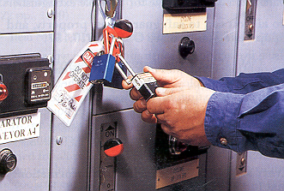
DEFINITION: LOCKOUT
Placing a lockout device on an energy-isolating device (in accordance with an established procedure) ensuring that the energy isolating device and the equipment being controlled cannot be operated until the lockout device is removed.
Notes:
This slide describes what lockout means.
Photo: An employee is placing their lock on a hasp that is affixed to an electrical isolation device.

Slide 67
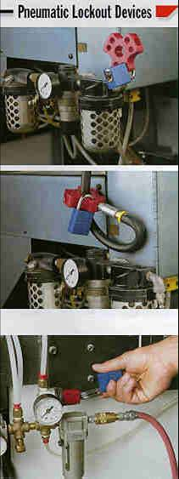
PROTECTIVE MATERIALS AND HARDWARE
Locks, tags, chains, wedges, key blocks, adapter pins, self-locking fasteners, or other hardware used for the isolating, securing, or blocking of machines or equipment from energy sources.
More than just locks may be required
Notes:
This slide describes various type of LOTO protective materials. Protective materials and hardware shall be provided by the employer.
Photo: This photo demonstrates the isolation of pneumatic energy.

Slide 68
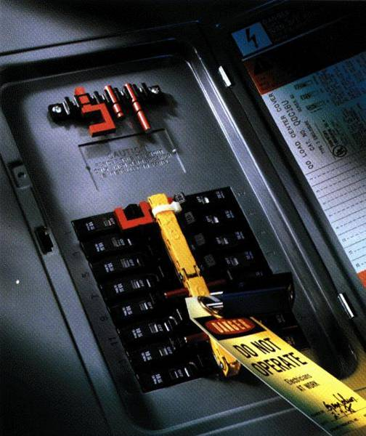
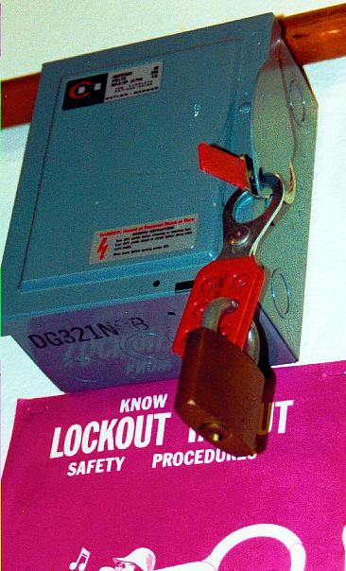
ELECTRICAL LOCKOUT DEVICES
Hasp for multiple locks
Locked out circuit breaker
Locked out electrical panel
Notes:
This slide shows electrical lockout devices that may be used to isolate electrical energy.
Left photo: An electrical panel locked out with a hasp and lock.
Right photo: A circuit breaker locked out with a lock and tag.

Slide 69

GROUP LOCK BOX
Simplifies lockout of large equipment.
After machine or process is locked out, keys are placed in a lock box.
Each authorized work team member places a personal lock or tagout device to the group lock box.
Notes:
A group lock box ensures that not one employee has access to the box unless all employees have removed their locks or tags.
Photo: An example of a lock box used for group lockout.

Slide 70
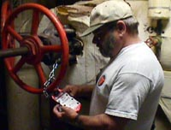
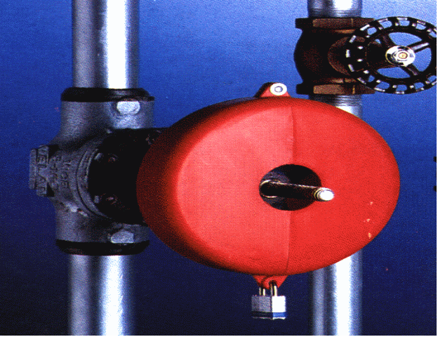
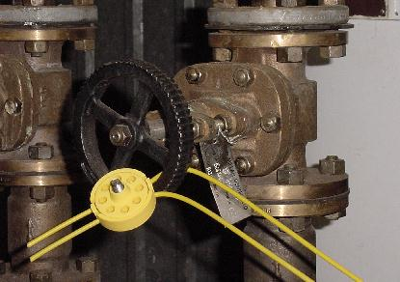
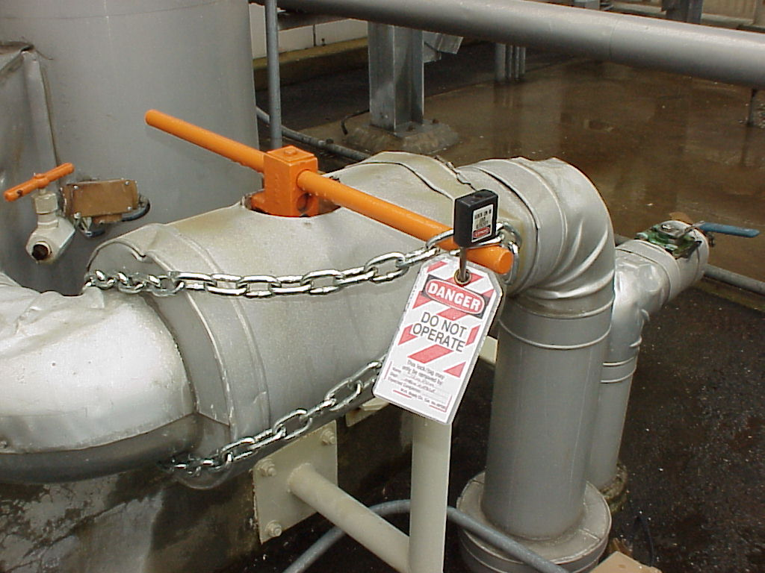
FLUID AND GAS LOCKOUT
DEVICES
Notes:
These lockout devices prevent the valves in air, water, gas or steam lines from being opened.
Photos: These photos demonstrate ways in which fluid and gas valves may be locked out.

Slide 71
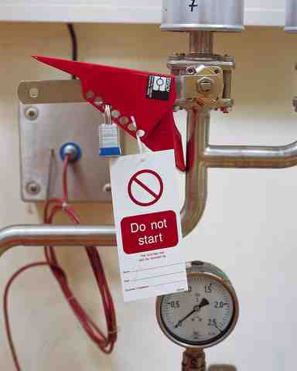
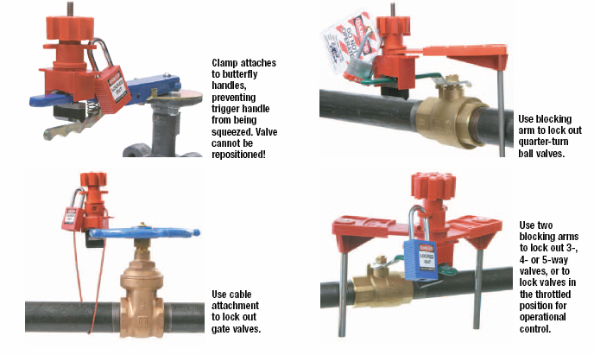
VALVE LOCKOUT
Notes:
This slide shows multiple ways in which valves may be locked out.
Left photo: Shows a valve lockout device.
Right diagram: Shows various ways valves may be locked out using different lockout devices.

Slide 72

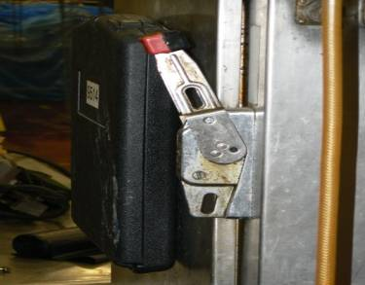
LOCKOUT VS. TAGOUT
If capable of being locked out:
  Prefer lockout
  Tags allowed, if employer can demonstrate FULL EMPLOYEE PROTECTION
Machine Modifications
  If you alter a machine you must make the machine capable of accepting a lock.
Notes:
In all cases, if a machine can be locked out, the worker must lock out the machine. If the only means to safeguard the machine is tag out, the worker must take additional steps to ensure workers are protected to the equivalency of LOTO. Additional steps are needed to provide full employee protection. If alterations or modification are made the machine, the employer must upgrade the system to ensure the equipment can be locked out.
Pictures: Top: Show means that can be used to LOTO equipment, such as a valve with a tag stating “Danger; Hands Off; Do not Operate” and Bottom: an electrical disconnect with a place to add a lock.

Slide 73
FULL EMPLOYEE PROTECTION?
Tags attached at the same location as locks
Full compliance with all tagout provisions in 29 CFR 1910.147
Tagout program must provide same level of safety as the lockout program
Additional means when necessary
  e.g., removal of a valve handle
Notes:
The slide explains exactly what is meant by full employee protection. A worker can’t rely solely on the tag alone; other steps must be taken to protect personnel.
Picture: Illustrates a tag on a valve stating “Danger; Hands Off; Do not Operate”

Slide 74
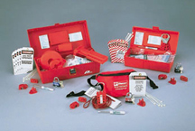


LOCKOUT TAGOUT DEVICES
Hardware Requirements (1)
Durable
Standardized
Substantial
Identifiable
Notes:
LOTO equipment has to be procured to adequately control the energy sources. We have to ensure the equipment is: durable, standardized, substantial, and identifiable. The equipment has to be standardized to ensure that it is recognized as a LOTO lock. We can’t use the lock for other purpose, but LOTO. Tags have to be identifiable to ensure we know who placed LOTO tag on the equipment.
Pictures (Clockwise): Photo of several different LOTO kits. The kits contain equipment that is necessary to LOTO equipment. The top picture shows an assortment of locks that are to control hazardous energy. The lower righthand picture shows tags with standardized verbiage and a picture of the worker.
LOTO hardware must be used only for the purpose in which it is intended. The equipment may not be used for anything else.

Slide 75
LOCKOUT TAGOUT DEVICES
Hardware Requirements (2)
Provided by the employer
Singularly identified
Only devices used for control
Not used for other purposes
Notes:
LOTO equipment must be provided by the employer. LOTO equipment needs to be singularly identified, and it should not be used for any other purposes except to control hazardous energy during servicing or maintenance activities.

Slide 76
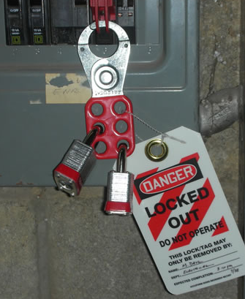
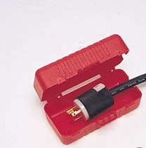
LOCKOUT TAGOUT DEVICES
Hasps and Plug Covers
Hasp
Plug Cover
Notes:
Left photo: A hasp connected to a circuit breaker. The circuit breaker is effectively locked out. It looks like more than one authorized employee is working on the equipment that is connected to this breaker because there are two locks here. Since there are two authorized employees working on the equipment, there should be two tags as well. Hasps are good to use when more than one person is working on equipment, because they allow for multiple employees to apply locks and tags.
Right photo: A plug cover. This cover can be locked out. These covers need to be used when an authorized employee doesn’t have autonomous control over the plug while performing any servicing or maintenance, or when the plug is not the only source of energy to the machine.

Slide 77
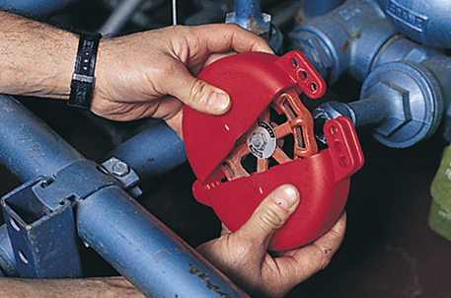


LOCKOUT TAGOUT DEVICES
Valve Covers and Single Pole Device
Valve Cover
Single Pole
Ball Valve Cover
Notes:
Left photo: A single pole device, which keeps the circuit switch in the off position. This can only be used when one authorized employee is working on a piece of equipment or machinery, because it only allows for one lock to be applied. It also looks like a standard master lock is used here, which may be an issue if this type of lock is used for other purposes in the work environment. It’s hard to tell in the photo, but it may be that a tag was not affixed here.
Lower right photo: A ball valve cover, which is securing the valve in a position that will prevent the release of any energy. It looks like they are just using a generic master lock.
Upper right photo: A valve cover. This cover prevents employees from coming and twisting the valve when it is locked out.

Slide 78

LOCKOUT TAGOUT DEVICES
Hardware Requirements (3)
Durable – be able to withstand environment
Standardized – color, size, etc.
  Tags : print and format
Substantial – no accidental removal
  Tag attachment means:
    Withstand at least 50 pounds of force
    Not re-usable
    Self locking
    Attachable by hand
Notes:
LOTO devices need to be durable, they need to be standardized. One way to standardize them is by color, having locks that are a particular color, and designating those locks as LOTO locks. The format of the tags must also be standardized.
LOTO devices need to be substantial to prevent their accidental removal. Tag attachment means must be able to withstand at least 50 pounds of force, they must not be re-usable, they must be self-locking, and they must be attachable by hand.
Photo: This is an example of insufficient lockout/tagout. The company used zip-ties to “lock out” the disconnect. Zip-ties are a good way to attach tags, but not to lockout energy isolating equipment.

Slide 79


DURABLE?
Notes:
Tags must be durable and able to withstand the work environment.
Left: A tag in good condition
Right: A tag that has been damaged. This tag did not withstand the work environment.

Slide 80
LOCKOUT TAGOUT DEVICES
Hardware Requirements (4)
Identifiable – identify the employee who applied
  Tags must include legend such as DO NOT START
Notes:
Tags must identify the employee who applied the tag itself, and they must include a legend such as “Do not start” or “do not operate.”
Photo: This photo demonstrates a sufficient tag that can be used when performing lockout/tagout. The tag has the name of the employee and their department.

Slide 81

SUFFICIENT LOCKOUT/TAGOUT?
Notes:
LOTO has to be done to ensure that no materials may flow through pipes.
Photo: The picture illustrates valve handles that have been locked. However, it is still possible to move or rotate the valve handles.

Slide 82

ANY BETTER?
Notes:
Photo: This picture illustrates another position of the valve handles and locks. However, it still does not prevent the handles from being turned.

Slide 83

EFFECTIVE LOCKOUT/TAGOUT?
Notes:
Is attaching a tag to a key sufficient? No! It looks like this is the key that powers the machine, and therefore the machine has not yet been isolated from the energy source. And there is nothing in place here that would prevent someone from turning that key.
Photo: This photo demonstrates inadequate LOTO. The tag was affixed to a key that is still inserted into machine.

Slide 84

TAG SUFFICIENT?
Notes:
Photo: The picture shows two locks and two tags that have been placed on a switchgear. The locks are common Master locks, which may not be adequate. Locks for lockout must be used only for that purpose. The locks and the tags need to standardized and identifiable for that purpose.

Slide 85
WHAT ABOUT THIS TAG?
Notes:
The employer needs to ensure the appropriate hardware has been procured to do the work.
Photo: This picture illustrates a lock (not sure if it is standardized or not; does not appear to be a LOTO lock) and a post-it note has been used as a tag. The post-it note is not adequate because it would not be durable, identifiable, standardized, and self locking.

Slide 86

CLOSE CALL
The millwright locked out the breaker of a refiner. He had a hasp with his padlock. He intended to only lock out the drive for himself. He had stored the hasp on his padlock by inserting it through one of the holes.
When he went to lock out the breaker, he opened the shank of the padlock but did not remove the hasp that was attached.
Upon locking out the breaker, the hasp appeared to be used as part of the lock out system but was not.
Notes:
This slide describes an event when a millwright incorrectly installed a hasp and lock on a breaker. Because of the way the hasp was installed, the lockout device did not provide full employee protection for all the other employees who had to work on the refiner, because the hasp could be removed when the first lock was removed.
Photo: shows the lock from the west view.

Slide 87

CLOSE CALL (CONT.)
Other people became involved with the refiner and needed to lock out the same breaker.
They saw the hasp (multiple lock out device) and placed their locks on the hasp.
The millwright was able to take his lock off the breaker and remove all other locks.
Notes:
This slide describes an event when a millwright incorrectly installed a hasp and lock on a breaker. Because of the way the hasp was installed, the lockout device did not provide full employee protection for all the other employees who had to work on the refiner, because the hasp could be removed when the first lock was removed.
Photo 2: shows the same lock but from the east side of the breaker showing that the hasp was not installed properly.

Slide 88
VERIFY EQUIPMENT ISOLATION
Verification of isolation and de-energization must be performed by authorized employee before working on machines or equipment that have been locked out or tagged out.
Notes:
Prior to starting work on machines or equipment that have been locked out or tagged out, the authorized employee shall verify that isolation and de-energization of the machine or equipment have been accomplished.

Slide 89
VERIFY EQUIPMENT ISOLATION (CONT.)
Check that other workers are clear of hazards
Check that locking devices are secure
Attempt normal startup
Return control to OFF/Neutral
Controls to verify
energy isolation
Notes:
This slide explains what must be done to verify that equipment has been isolated. The verification of equipment isolation is a very important part of the process.
Photo: An employee is placing their lock on a hasp that is affixed to an electrical isolation device.

Slide 90
VERIFICATION
Testing circuitry, cycling, visually inspecting position, manually trying; monitoring movement or discharge; observing bleeds, gauges, indicators, etc; or other available means.
Use technique(s) with the best degree of isolation assurance.
Do not rely on pressure gages alone to indicate pressure. They are often inoperable.
Notes:
This slide explains some of the ways authorized employees may need to verify equipment isolation.

Slide 91
INJURIES
Employees opened disconnect on a back wall and applied locks.
Another employee (not seeing the other 2) activated start button, causing serious injury to both.
Employees had locked the wrong disconnect box.
Disconnects were not labeled and employees did not verify isolation.
Notes:
This slide describes an accident that may have been prevented if employees performed verification of isolation.

Slide 92
REVIEW
True or False: E-stops and push buttons are considered energy isolating devices.
List examples of hazardous energy.
List examples of stored energy.
Name examples of energy isolating devices.
Notes:
This slide provides some questions that review the previous section of the module.
Answers:
Question 1: False. Circuit type devices are NOT energy isolating devices.
Question 2: There are many types of hazardous energy, including electrical, mechanical, hydraulic, pneumatic, chemical, thermal, potential, and kinetic energy.
Question 3: Examples of stored energy include capacitors, springs, pressure, fluids, and gases.
Question 4: Some examples of energy isolating devices include disconnects or circuit breakers (electrical), shut-off valves, pistons, and levers.

Slide 93
Class ACTIVITY:
CASE STUDIES
Notes:
This section describes the next class activity.

Slide 94
DIRECTIONS
Review the lockout/tagout case studies.
Answer the questions listed under each description.
Review answers with the class.
Notes:
Students will review the LOTO case studies from OSHA’s LOTO eTool. As they read through the case studies, they will answer the questions that go along with each case study.

Slide 95
ENERGY CONTROL PROCEDURE
Notes:
The next portion of the course will cover energy control procedures.

Slide 96

ENERGY CONTROL PROCEDURES
Employers must develop and document machine-specific procedures to control potentially hazardous energy.
Notes:
96
Procedures shall be developed, documented, and used for the control of potentially hazardous energy when employees are engaged in the activities covered by this section.
Photo: of binder containing machine-specific procedure steps and photos.

Slide 97
ENERGY CONTROL PROCEDURE REQUIREMENTS
Must clearly and specifically outline:
  Intended use of procedure
  Specific procedural steps
  Specific testing requirements
  Means to enforce compliance
Notes:
Enforcement is very vital to a LOTO program. Train the personnel and hold them accountable for following the procedures. The procedural steps will direct and guide personnel in taking steps to implement LOTO.

Slide 98
DEVELOPMENT OF ENERGY CONTROL PROCEDURE
Includes:
A survey of all hazardous energy;
Identification of energy isolating devices;
Determining shut-down, de-energization, energization and start-up sequences; and
Selecting and procuring protective materials and hardware
Notes:
There are several steps involved in the development of an energy control procedure: employees must survey all hazardous energy, identify energy isolating devices, determine shut-down, de-energization, energization and start-up sequences, and select and procure protective materials and hardware.

Slide 99
EXCEPTION
The employer need not document the required procedure when the machine or equipment:
1) Has no potential for stored or residual energy or re-accumulation of stored energy.
2) Has a single energy source which can be readily identified and isolated.
3) Would be de-energized and de-activated by isolating and locking out that energy source.
4) is isolated from that energy source and locked out during servicing or maintenance.
Notes:
There are eight provisions that exempt machine specific procedures. All eight conditions must be met in order to get the exemption. If there has ever been an accident, a machine-specific procedure has to be developed.

Slide 100
EXCEPTION (CONT.)
5) A single lockout device achieves a locked-out condition.
6) The lockout device is under control of the authorized employee performing the servicing or maintenance.
7) Servicing or maintenance does not create hazards for other employees.
8)The employer has had no accidents involving activation or re-energization of the machine or equipment during servicing or maintenance.
Note: must meet all 8 items before exception applies.
Notes:
There are eight provisions that exempt machine specific procedures. All eight conditions must be met in order to get the exemption. If there has ever been an accident, a machine-specific procedure has to be developed.

Slide 101
ENERGY CONTROL PROCEDURE
Requirements
Must be specific to each type of machine or equipment.
Must outline the scope, purpose, authorization, rules, and techniques for the control of hazardous energy, and the means to enforce compliance.
Notes:
The energy control procedure must be specific for each type of machine or equipment. If the control procedures are the same for various pieces of equipment, then a single energy control procedure may be sufficient. Machines that are similar, using the same type and magnitude of energy and the same types of controls, can be covered with a single procedure.
The procedure must identify the type and magnitude of the hazardous energy they expect to encounter and the approved methods to control it.

Slide 102
ENERGY CONTROL PROCEDURE
Requirements (Cont.)
Procedure must include:
  Statement of intended use of the procedure
  Steps for shutting down and securing machines and equipment
  Steps for placing, removing, and transferring of lockout devices
  Requirements for testing and verifying effectiveness of lockout devices
Notes:
Energy control procedures provide authorized employees with written instructions specifying how to safely control hazardous energy while performing servicing and maintenance on specific machines. The procedures must include the steps outlined in this slide in order to ensure effective energy isolation.

Slide 103



ENERGY CONTROL PROCEDURE
Steps Included
Notification of employees
Preparation for shutdown
Machine or equipment shutdown
Machine or equipment isolation
Lockout/tagout device application
Stored energy
Verification of isolation
Perform maintenance/servicing
Release from lockout/tagout
Notes:
The elements listed in the slide are all components of an energy control procedure. We will discuss each of these items.
Top graphic: clip art of a pencil and journal.
Lower left photo: photo of a lockout/tagout station.
Lower right graphic: clip art of an employee working at a circuit breaker.

Slide 104
ENERGY CONTROL PROCEDURE
Step 1 - Notification of Employees
Notify all affected employees working on or around the equipment or machinery, that servicing and maintenance is about to occur.
  Before controls are applied, and again before they are removed
Notes:
It is very important to coordinate LOTO activities. One of the most important activities is to notify personnel of impending lock out of machines to ensure that personnel activities do create additional hazards. Personnel need to be clear of the machinery.

Slide 105

ENERGY CONTROL PROCEDURE
Step 2 - Preparing for Shutdown
Procedure – do you know it?
Equipment – do you have it?
Know types and magnitude of energy sources
Know hazards posed by energy sources
Know how to control the hazards
Who’s involved
Caution: Employees who operate circuit breakers, disconnects, or other electrical devices must be trained and qualified.
Notes:
Authorized personnel must take the necessary steps prior to shutdown. They need the knowledge and skills necessary for the safe application, use, and removal of energy-isolating devices. They also need training in the following: Hazardous energy source recognition; The type and magnitude of the hazardous energy sources in the workplace; and Energy-control procedures, including the methods and means to isolate and control those energy sources.
Picture: a sample energy control procedure.

Slide 106
PRECAUTIONS WHEN OPERATING ELECTRICAL DISCONNECTS/BREAKERS
Employees should be very careful when initially operating circuit breakers and disconnects.
The equipment may be allowed to be used in the normal operation mode, if all conditions are met:
  Covers/doors are in place
  The equipment is maintained
  The equipment is properly installed
  The equipment is inspected to ensure it meets the installation codes
  There is no impending sign of failure
Notes:
This slide discusses the requirements to operate disconnects and circuit breakers in normal operating mode. If the equipment is damaged or does not meet the criterion for operation in normal mode, adequate precautions must be put in place.

Slide 107
PRECAUTIONS WHEN OPERATING ELECTRICAL DISCONNECTS/BREAKERS (CONT.)
If the equipment does not meet all six of the criterions, as mentioned in the previous slide additional precautions must be taken (outlined in 2018 NFPA 70E):
  Hazard Risk Assessment must be performed to determine if an arc flash hazard exists
  The results of the Hazard Risk Assessment will determine what controls to put in place using the hierarchy of controls
    PPE is the last resort
  If PPE must be used, determine the PPE Category (1-4) and arc flash/shock boundaries
  Refer to PPE matrix to determine what kind of PPE must be used for the task
Note: OSHA does not mention any of this in the LOTO standard, but these actions are vital to protect the workers.
Notes:
If the equipment does not meet the criterion for normal operation (as discussed in the previous slide), adequate precautions must be put in place, such as PPE and safe work practices.

Slide 108


ENERGY CONTROL PROCEDURE
Step 3 - Machine or Equipment Shutdown
Turn off or shut down equipment using the procedures for that machine.
Orderly shutdown to avoid increased hazard.
  Note: There is still power to the machine!
Notes:
Specific steps or actions may be necessary to shut down the equipment. If the manufacturer has specific instructions, we need to follow the information to safely shut down the equipment. The machine(s) or equipment must be turned off or shut down using normal stopping means, such as using the stop button(s) at the production control center. An orderly shutdown must be conducted to avoid any additional or increased hazards to employees as a result of equipment de-energization.
Top photo: A control panel on a machine. This is where the machine is shut down. However, it is not where the energy is isolated.
Bottom photo: The on/off switch for a machine. This is where the machine is shut down. However, it is not where the energy is isolated.

Slide 109

ENERGY CONTROL PROCEDURE
Step 4 - Machine or Equipment Isolation
Isolate each energy source
  What does “isolate” mean?
  What is an energy isolation device?
Disconnects vs. on/off buttons
Circuit breakers vs. e-stops
Notes:
The primary way to prevent the release of hazardous energy during service and maintenance activities is by using energy-isolating devices such as manually operated circuit breakers, disconnect switches, and line valves and safety blocks. Lockout requires use of a lock or other lockout device to hold the energy-isolating device in a safe position to prevent machinery from becoming reenergized. All energy isolating devices used to control the energy to the machine or equipment must be physically located and placed in the "off" position to disconnect the machine or equipment from its energy source and de-energize it. Control circuitry does not provide a physical barrier that controls hazardous energy and, therefore, is not an energy isolation device. For example, push buttons, selector switches, and interlocking gates are not energy isolation devices and are not permissible substitutes for energy isolation devices under the standard.
Photo: A circuit breaker schedule on the door of a panel board. The information from the schedule may be used to find the breaker, but the employee would still have to perform verification. There have been numerous injuries where workers have put total confidence in the schedule and were surprised to still find the equipment was still energized.

Slide 110



ENERGY ISOLATING DEVICES
Electrical Energy
Electrical
Energy
Fuses
Breakers
Predetermined
lockout
points
Disconnects
Plug
Notes:
There are many different types of energy isolating devices. For electrical energy there are fuse breakers, disconnects, plugs. With plugs, there is a section in the standard that exempts cord and plug equipment, as long as the person who is doing work on the equipment has absolute control over the plug while doing servicing or maintenance, and the plug is the only energy source for the equipment. If necessary, there are clamps that can be used to go over the plug. They can be secured with a lock and tag, which prevent someone from powering the equipment while it is being worked on.
Left photo: An example of a plug.
Top right photo: An example of a switch on a circuit beaker.
Bottom right photo: an electrical disconnect (gray metal box with handle) is shown in the picture to serve as a precaution to workers. The disconnect and circuit breakers should only be operated by someone that is qualified.

Slide 111

ENERGY ISOLATING DEVICES
Other Energy
Ball Valves
and
Gate Valves
Pneumatic
Hydraulic
Natural gas
Chemical
Notes:
Other types of energy include pneumatic energy, hydraulic energy, chemical energy, and natural gas. The energy isolating devices for these types of energy sources are typically going to be ball valves, gate valves, or line valves. Make sure these valves are turned into the position that prevents the machines from being reenergized. There are plenty of different lockout devices that allow you to isolate these energy sources.
Photo: An example of a lockout device on a line valve. Both the lock and tag are affixed to the energy isolating device.

Slide 112
TEST YOUR KNOWLEDGE
True or False
Pushbuttons, selector switches and other control circuit type devices are energy isolating devices.
False
Notes:
The answer is false. Make sure to shut the power off at the pushbuttons, but this is not where the energy is going to be isolated.
Photo: A control panel on a machine. This is where the machine will be shut off, but not where the energy will be isolated.

Slide 113




ENERGY ISOLATION
Notes:
Photos: The two pictures illustrate the proper way to LOTO equipment. The first picture (left) illustrates not to use a control circuit, such as an emergency stop, to control hazardous energy. A control circuit is subject to failure and does not have control reliability. The photo on the right shows locks applied to the electrical disconnects which is an approved method as indicated with “thumbs up” clipart below the photo.

Slide 114

ENERGY CONTROL PROCEDURE
Step 5 – Lockout or Tagout Device Application
Apply lockout device and tag to each energy-isolating device
Affixed by Authorized Employee
One lock per person
One key per lock
This includes:
  Supervisors
  Contractors
Supervisors cannot lockout on behalf of their crew.
Standard Lock
Notes:
After the machine is isolated from the energy source, the next step is to apply the lockout and tagout devices. A few important things to note here:
-a lockout device and tag need to be applied to each energy source. Therefore, if you have multiple sources of energy powering one machine, you will need to apply a lock and tag at the energy-isolating devices for each energy source. The locks and tags must be affixed by an authorized employee. An authorized employee cannot ask another employee to affix their locks and tags for them. Also, you must follow the one lock one person principle. Each authorized employee must have their own lock, and they must be the only ones who have the key to that lock. Nobody else should have a key to their lock. These requirements also include supervisors and contractors. Supervisors cannot lockout on behalf of their crew. If their crew members are the ones who are going to be performing maintenance or servicing, the crew members themselves must apply their own locks and tags to the applicable energy isolating devices.
Photo: An example of a standard lock and tag affixed to an electrical disconnect. Here we can see that only one employee is working on the deenergized equipment, since there is only one lock and one tag.

Slide 115


ENERGY CONTROL PROCEDURE
Step 6 – Stored Energy
Does this machine have “stored” energy?
Examples:
  Pressure Differential – air, hydraulic, vacuum
  Moving parts such as a ram
  Springs
  Gravity
Be sure to release, disconnect or block ALL stored energy
Continue to verify if there is a chance of re-accumulation
Notes:
Stored energy takes the form of many different devices, such as springs, gravity, and capacitors. We must secure all sources of energy to protect personnel. Do not overlook the stored energy sources.
You must consider whether a machine has any stored energy. The problem with stored energy is that it can still be released after performing lockout/tagout. Examples of stored energy can be a pressure differential, moving parts such as a ram, springs, or gravity. It may be that you will need to chock part of your equipment to prevent it from coming down due to gravity. If it is determined that the machine has stored energy, make sure to release, disconnect, or block all stored energy prior to performing any work on the machine. If the possibility exists for the re-accumulation of stored energy to hazardous levels, the authorized employee must regularly perform verification steps to detect any re-accumulation before it has the potential to cause an injury.
Top photo: An example of a spring. Evaluate machinery to see whether there are any springs. Springs are an example of stored energy, and will need to be released prior to any work being done.
Bottom photo: An example of a line that may be carrying stored energy, such as hydraulic energy. This energy would need to be opened (line breaking), closed via a solid plate (line blanking or blinding), or the two in-line valves would need to be closed by locking and tagging out, and the line between the two valves would need to be drained or vented and locked and tagged out (double block and bleed).

Slide 116

ENERGY CONTROL PROCEDURE
Step 7 – VERIFICATION OF ISOLATION
Prior to servicing or maintenance, authorized employee must verify machine has been de-energized
Is it done correctly?
ALWAYS verify!
Review your checklist:
  Proper communication
  Everyone involved is on the same page
  Machine will not run
  All controls back to proper position before beginning work
Notes:
Prior to starting work on machines or equipment that have been locked out or tagged out, the authorized employee shall verify that isolation and de-energization of the machine or equipment have been accomplished.
Before an authorized proceeds, it is very to important verification has been done to ensure the energy has been isolated. Lack of verification of the isolation of energy sources has resulted in many fatalities and injuries. Verification can also be accomplished using monitoring instruments such as a voltmeter to test electrical circuits to determine that there is no electrical energy available to the machine or equipment. Similar test equipment could be used to check for the presence of other energy types and sources. In order to verify that all potentially hazardous energy has been isolated, the authorized employee may need to use a combination of verification methods. The appropriate combination will depend upon the type of machinery or equipment involved, the complexity of the system, or other factors.
Photo: This photo demonstrates improper lockout/tagout. Simply wrapping a chain around the on/off lever is not going to effectively isolate the energy. If verification of isolation was performed here, the employee may have found that the energy was not properly locked and tagged out.

Slide 117


FATALITY REPORT
A millwright was fatally injured when he was pinned between the feed rolls of a de-barker as he was welding additional metal to the teeth on the feed rolls. The victim had locked out two electrical disconnects before beginning his work, but he had not locked out all electrical disconnects and had not shut off and locked out the air line to the machine. As the victim welded, he leaned forward and placed his head between the upper and lower feed rolls to reach areas that required more metal. The air pressure on the rolls automatically cycled and the feed rolls closed over the victim’s head.
Notes:
This photo describes a fatality that may have been prevented if verification of isolation was performed. If the employee had turned the de-barker on to verify that the energy was isolated, he would have likely realized that the energy was not properly isolated, because the de-barker would have likely turned on. Employees typically do not deliberately skip this step. Oftentimes they do not know this step is part of the LOTO procedure, because it isn’t included on the written LOTO procedure. Review your written LOTO procedures to ensure that verification of isolation is included, and train employees on the importance of this step.
Top photo: This photo illustrates the feed rolls of the south debarker where the victim had been welding metal onto the debarker teeth.
Bottom photo: This photo illustrates the air line that supplied the debarker and is not properly locked out [courtesy of SCOSHA]. The insert illustrates an example of a ball valve lockout device that can be used to lock out the pneumatic airline. The manufacturers’ directions for installing any lockout device must be followed.
Source: NIOSH FACE Study (https://www.cdc.gov/niosh/face/in-house/full200602.html#:~:text=On%20January%2017%2C%202006%2C%20a,teeth%20on%20the%20feed%20rolls)

Slide 118

ENERGY CONTROL PROCEDURE
Step 8 – Perform the Task
Perform servicing or maintenance on equipment.
Notes:
After verification of isolation has been performed, go forward with performing the necessary servicing or maintenance on the equipment.
Photo: A calender machine.

Slide 119

ENERGY CONTROL PROCEDURE
Step 9 – Release From Lockout or Tagout (1)
  Inspect work area to ensure removal of non-essentials
  Employees safely positioned and notified
  Lockout/tagout removal (by employee who applied)
  Restart
Notes:
Employees who work on deenergized machinery may be seriously injured or killed if someone removes lockout/tagout devices and reenergizes machinery without their knowledge. Thus, it is extremely important that all employees respect lockout and tagout devices and that only the person(s) who applied these devices remove them.
Before removing lockout or tagout devices, the employees must take the following steps in accordance with the specific provisions of the energy-control procedure: Inspect machines or their components to assure that they are operationally intact and that nonessential items are removed from the area; and Check to assure that everyone is positioned safely and away from machines.
Photo: Employee using a key to remove his lock from a hasp. Removal of locks and tags must be performed by the individual who initially applied the lock

Slide 120

ENERGY CONTROL PROCEDURE
Step 9 – Release From Lockout or Tagout (2)
  Lock/Tag removal if authorized employee is not available:
  Verify that authorized employee is not at facility
  Make reasonable efforts to inform him or her
  Ensure that he/she knows of removal upon re-entering
  This procedure must be included in the written program.
Notes:
If an authorized employee leaves their locks and tags on a piece of equipment and they are not available for lock/tag removal, the locks and tags can only be removed if the company verifies that the authorized employee is not at the facility, the company makes a reasonable effort to inform them that their locks and tags were left on the equipment and they need to be removed, and the company notifies the employee of the lock and tag removal once they return to the facility. These steps do need to be included in your company’s written lockout/tagout program.
Photo: Pliers that may be used to remove a lock from an energy isolating device if necessary. Before the lock is removed, the steps listed in this slide must be met.

Slide 121
LOTO PROCEDURE WORKSHOP
Introduction
Using the information provided, students will develop a LOTO equipment-specific procedure for a 16/03 IVA Oven used for heat treating.
The oven is powered by multiple energy sources.
The next slide shows the oven and the location of the energy isolating devices for the energy sources powering the machine.
Include the 9 steps for performing lockout/tagout when developing the procedure.
Notes:
The following workshop will consist of developing an equipment-specific lockout/tagout procedure for an industrial oven used for heat treating. Students will break into groups and develop the procedure together with their group. Additional information on this workshop is found in the student handbook, including a worksheet with questions. An answer sheet is provided in the appendix.
The oven is powered by multiple energy sources, including electrical, hydro (water), and chemical (gas, anhydrous ammonia, carbon dioxide, and nitrogen) energy. Slide 122 includes a photo of the front of the oven, as well as a map that shows where the different energy isolating devices are. Each of these energy isolating devices will need to be locked and tagged out.
Students are expected to develop a lockout/tagout procedure for the oven based upon the information provided. There is some information that is not provided, such as how the stored energy must be handled, and how to verify the isolation of each specific energy source. It is ok if the students do not go into detail about these items. However, they should still include these steps in their procedures (e.g., relieve, disconnect, or restrain all stored energy, and verify the isolation of the energy sources).

Slide 122

LOTO PROCEDURE WORKSHOP
Oven
Energy Sources:
Main power control disconnect – Electrical, 480 volts
Chill Water Valves – Hydro, 30 SI pressure
Main gas valve - Chemical
Anhydrous Ammonia, Carbon Dioxide, and Nitrogen – Chemical
Notes:
This slide includes a photo of the front of the oven, as well as a map that shows where the energy isolating devices are located in relation to the oven. Each energy-isolating device will need to be locked and tagged out. These devices include the electrical disconnect, the main chill water valves, the main gas valve, and the valves for anhydrous ammonia, carbon dioxide, and nitrogen.
This slide also lists the energy sources that power this oven, along with the magnitude of the energy sources. The students should include the magnitude of the electrical and hydro energy in their procedures. The magnitude of the gas, anhydrous ammonia, carbon dioxide, and nitrogen energy are unknown. Therefore, the students are not expected to include the magnitude of this energy in their procedures.
Photo: The oven that is being locked and tagged out.
Map: Area map showing the location of the energy isolating devices that power the oven.
Note: The primary purpose of this workshop is to give the students practice in the development of a LOTO procedure. It is okay if they do not get it completely right.

Slide 123




LOTO PROCEDURE WORKSHOP
Oven
Notes:
This slide shows the devices that are used to isolate the energy powering the oven. A map of the different energy isolating devices is also provided.
The electrical disconnect, which is labeled as E1, is used to power the oven with electrical energy. This disconnect will need to be switched to the “off” position and locked and tagged out.
The chill water valves, which are labeled as W1 and W2, will need to be closed, and locked and tagged out.
The gas valve, which is labeled as G1, will need to be closed and locked and tagged out.
The anhydrous ammonia, carbon dioxide, and nitrogen valves, which are labeled as C1, C2, and C3, respectively, will need to be closed and locked and tagged out.
After the locks and tags have been applied to the energy isolating devices, any stored energy (including the water line, gas line, and chemical lines) will need to be relieved, disconnected, restrained, and otherwise rendered safe. We do not have specific steps on how to do this. Acceptable answers may be to perform a line break, line blank, or double block and bleed on the water, gas, and chemical lines.
After the release of any stored energy, verification of isolation will need to take place. This will include using a voltmeter to test the conductors at the disconnect to ensure there is no voltage, as well as reading the pressure gauge on the chill water valves to confirm the pressure is at 0.
After it has been verified that the equipment was isolated, employees can go forward in beginning their work. However, it is important to mention that this oven is a permit-required confined space. Therefore, prior to entering into the oven, employees must follow the specific permit-required confined space entry procedures for the oven. The students in the module are not expected to go into detail about this, but it is important to mention. LOTO must be performed prior to entry into a permit-required confined space if there is the potential for exposure to hazardous energy.
Photos (clockwise from top): Area map showing the location of the different energy isolating devices and the oven, photo of the chemical valves, photo of the chill water valves, photo of the disconnect that is powering the oven.

Slide 124

LOTO PROCEDURE REVIEW
Oven
Review the procedure as a class.
Notes:
Instructor should review the procedure and ask students about what they have written for the workshop.
Photo: The oven that is being locked and tagged out.
Answer sheet is in the appendix of the student handbook.

Slide 125
Required training
Notes:
The next session of the course covers employee training requirements for lockout/tagout.

Slide 126
DEFINITIONS
"Authorized employee" A person who locks out or tags out machines or equipment in order to perform servicing or maintenance on that machine or equipment.
  *An affected employee becomes an authorized employee when that employee's duties include performing servicing or maintenance covered under this section.
Notes:
Authorized employees perform servicing or maintenance on equipment, and thereby perform lockout/tagout.

Slide 127
DEFINITIONS (CONT.)
"Affected employee" An employee whose job requires him/her to operate or use a machine or equipment on which servicing or maintenance is being performed under lockout or tagout; or
An employee whose job requires him/her to work in an area in which such servicing or maintenance is being performed.
Notes:
An affected employee operates or uses a machine or equipment on which servicing or maintenance is being performed under lockout/tagout.

Slide 128

TRAINING & RETRAINING
Authorized employees
  Recognition of hazardous energy
  Type and magnitude of hazardous energy
  Methods of isolating energy
  How to verify isolation
Affected – Purpose and use of procedure
Other – Procedure and Prohibition from tampering
Tagout provisions
Notes:
Employees need to be trained to ensure that they know, understand, and follow the applicable provisions of the hazardous energy control procedures. The training must cover at least three areas: aspects of the energy control program; elements of the energy control procedure relevant to the employee’s duties or assignment; and the various requirements of the OSHA standards related to lockout/tagout.
Affected employees must receive training in the purpose and use of energy-control procedures. They also need to be able to do the following: Recognize when the energy-control procedure is being used Understand the purpose of the procedure, and Understand the importance of not tampering with lockout or tagout devices and not starting or using equipment that has been locked or tagged out.
All other employees whose work operations are or may be in an area where energy-control procedures are used must receive instruction regarding the energy-control procedure and the prohibition against removing a lockout or tagout device and attempting to restart, reenergize, or operate the machinery.
Graphic: Clip art shows the information as thoughts from an employee.

Slide 129
REQUIRED TRAINING
Tagout
Employees must be trained in the following limitations of tagout systems:
  Tags are warning devices and do not provide the physical restraint that is provided by a lock.
  When a tag is attached to an energy isolating means, it is never to be removed without authorization or ignored.
Notes:
If employees perform tagout, they need to receive training on the limitations of tagout systems. Employees must understand tags are warning devices and do not provide the same physical restraint that is provided by a lock, as well as the requirement that when a tag is attached to an energy isolating means, it is never to be removed without authorization or ignored.

Slide 130
REQUIRED TRAINING
Tagout (Cont.)
Tags must be understandable by all authorized employees, affected employees, and all other employees whose work operations are in the area.
Tags and their means of attachment must be made of materials that will withstand the environmental conditions in the workplace.
Tags may evoke a false sense of security.
Tags must be securely attached to energy-isolating devices so that they cannot be detached during use.
Notes:
Employees must be trained on the requirement for tags to be understandable by all authorized, affected, and other employees, and that tags and their attachment means must be durable and able to withstand the environmental conditions of the workplace. Employees must understand that tags may evoke a false sense of security. Tags must also be securely attached to energy-isolating devices so that they cannot be detached during use.

Slide 131
TRAINING & RE-TRAINING
Re-training is required when:
Change in job assignment
Change in machine or process
Change in lockout/tagout procedure
Equipment or processes present new hazards
Inadequacies revealed in periodic review
Notes:
Retraining is vital to a LOTO program, especially if there are changes in the procedures or equipment. Retraining is also needed when the results of the audit indicate a worker has problems with the execution of the procedure.

Slide 132

TRAINING & RE-TRAINING
Certification
Certify that the training has been conducted and kept up to date:
  Employee names
  Date(s) of training
Notes:
Evidence of training is necessary. The information on the certificate needs to include: name of trainee, name of trainer, topics of training, and date of the training.
Photo: This photo shows one employee observing another employee performing lockout/tagout.

Slide 133
PERIODIC INSPECTIONS
Notes:
The next section of the course covers the requirement for periodic inspections.

Slide 134

PERIODIC INSPECTIONS
Performed at least annually
Conducted by authorized employees
Intended to correct inadequacies identified in program
Certified
Notes:
134
LOTO procedures must be inspected periodically (at least annually) to ensure that they are being followed and that they remain effective in preventing employee exposure to hazardous energy. A review in the office or a meeting does not meet that requirement. A qualified person (an authorized employee not involved with the process) must evaluate another qualified person that is executing the procedure.
Photo: Employees inspecting a control panel on a machine, perhaps as part of a periodic inspection.

Slide 135
PERIODIC INSPECTIONS (CONT.)
The employer shall conduct a periodic inspection of the energy control procedure to ensure that the procedure and the requirements of this standard are being followed.
The periodic inspection shall be performed by an authorized employee (other than the one(s) utilizing the energy control procedure being inspected).
Notes:
A qualified person (an authorized employee not involved with the process) must evaluate another qualified person that is executing the procedure.

Slide 136
WHY PERFORM PERIODIC INSPECTIONS?
  Review Modifications
  Verification of accuracy
  Confirm successful execution by all authorized employees
  Opportunity for Q&A
Notes:
Periodic inspections must be conducted at least annually for multiple reasons. Firstly, things change in the workplace. Equipment may get moved around and the energy isolating device for a piece of equipment is changed. Periodic inspections ensure the written procedure is accurate, and that authorized employees are following the proper steps to lock and tag out equipment. Once the inspections have been completed, it’s important for all the authorized employees to meet together to discuss how the inspections went and whether any changes need to be made to the LOTO procedures.

Slide 137

PERIODIC INSPECTIONS (CONT.)
Where lockout is used, the inspection shall include a review, between the inspector and each authorized employee, of that employee's responsibilities.
Where tagout is used, review must include both affected and authorized employees.
Notes:
After periodic inspections are performed, a review of the inspections must take place with employees. When lockout is performed, this review must involve the inspector and each authorized employee. When tagout is performed, this review must involve both the authorized employees and the affected employees.
Photo: This photo demonstrates two employees reviewing a lockout/tagout equipment-specific procedure.

Slide 138

CERTIFICATION REQUIREMENTS
Identification of equipment or machinery
Date of inspection
Names of employees involved in the inspection
Name of person(s) performing inspection
Notes:
138
Periodic inspections must be certified. The certification must include the equipment or machinery, the date of the inspection, the names of the employees involved in the inspection, and the name of the person performing the inspection.
Photo: This photo demonstrates two employees inspecting an energy isolating device (an electrical disconnect).

Slide 139
EXERCISE: PERIODIC INSPECTIONS
You have been hired as a consultant to assist XYZ company to implement procedures for periodic inspections. You notice the following issues:
  There are no procedures for periodic inspections.
  The safety manager, who is not an authorized employee, occasionally has interaction with workers while they implement lockout/tagout.
  Meetings are held to discuss the machine specific procedures.
  Some of the employees frequently have to consult with other workers on the execution of the procedures.
65
Notes:
The slide discusses the exercise on periodic inspections of LOTO procedures. A consultant has been hired to improve existing procedures, but there are many things missing. What needs to be improved?
Answer: Procedures for periodic inspections should be documented in the lockout/tagout program. The safety manager is not an authorized employee and should not be part of the periodic inspections. Only authorized employees should be doing the periodic inspections. Training may be inadequate if employees are not sure how to do the procedures.

Slide 140
EXERCISE: PERIODIC INSPECTIONS (CONT.)
Based on the facts on the previous slide, what would you do to assist the company in developing and implementing a periodic inspection system. Address the following:
  What elements need to be included in the system?
  How would you conduct a periodic inspection?
  Who needs to be involved in the periodic inspections?
  What are the best practices to ensure that all machine specific procedures get evaluated?
66
Notes:
Discussion points about developing a system for periodic inspections.
Answer: Procedures for periodic inspections should be documented in the lockout/tagout program. The safety manager is not an authorized employee and should not be part of the periodic inspections. Only authorized employees should be doing the periodic inspections. Training may be inadequate if employees are not sure how to do the procedures.

Slide 141
ADDITIONAL REQUIREMENTS
Notes:
The final section of the presentation covers additional requirements included in OSHA’s hazardous energy control standard.

Slide 142

OUTSIDE CONTRACTORS
Whenever outside servicing personnel are to be engaged in activities covered by the scope and application of this standard:
  The on-site employer and the outside employer shall inform each other of their respective lockout or tagout procedures.
Notes:
When outside servicing personnel are engaged in activities covered by this standard, the on-site employer and the outside employer shall inform each other of their respective lockout or tagout procedure.
Photo: Two employees reviewing a document. It is important to ensure that on-site employers and outside employers are aware of each other’s lockout/tagout procedures. If you are an on-site employer, ensure temporary workers or outside contactors are aware of your company’s lockout/tagout program, and the requirements covered in the program.

Slide 143

TESTING OR POSITIONING MACHINES
Clear the machine of tools and materials
Remove employees from the area
Remove lockout/tagout devices
Energize and proceed with testing/positioning
De-energize and re-apply energy control measures
Notes:
OSHA allows the temporary removal of lockout or tagout devices and the reenergization of the machine only in limited situations for particular tasks that require energization — for example, when power is needed to test or position machines, equipment, or components. However, this temporary exception applies only for the limited time required to perform the particular task requiring energization.
The procedures must provide maximum safety coverage for employees when the equipment or machinery must be energized during the course of servicing. Employee exposure to hazards is high during these transition periods. To ensure workplace safety, the following sequence must be followed when testing or repositioning a machine or piece of equipment: Clear the machines or equipment of tools and materials. Remove employees from the machine or equipment area. Remove the lockout or tagout devices as specified. Energize and proceed with testing or positioning. Deenergize all systems, isolate the machine or equipment from the energy source, and reapply lockout or tagout devices as specified. OSHA permits the removal of lockout/tagout devices and the reenergization of equipment only during the time necessary for the testing or positioning of the machine, equipment, or component, and only when reenergization is essential to accomplishing the servicing task.
Photo: An employee testing a machine.

Slide 144


GROUP LOCKOUT TAGOUT
Personal lock or tag (usually)
Lockbox or master tag system with principal authorized employee
“Shall utilize a procedure which affords a level of protection equivalent to that provided by the implementation of a personal lockout or tagout device”
Notes:
Each employee must affix their own lock to the hasp on the energy isolation device. Procedures for group lockout tagout must be discussed in the hazardous energy control plan. An authorized employee may represent a group and have primary responsibility for the group.
Top photo: Hasps that may be used for group lockout/tagout
Bottom photo: A lock and two hasps to demonstrate a group lockout tagout in progress.

Slide 145


GROUP LOCKOUT
Each exposed employee must be provided the same level of protection…Each person must be protected by their own lock!
Notes:
Each authorized person performing work must still apply their individual lock to the machine, equipment or device.
Photos: These photos illustrate personnel are conducting a group lockout. Note at least two or more locks and tags on the equipment (electrical disconnect).

Slide 146

LOCKOUT TAGOUT RESOURCES
Lockout-Tagout eTool @
www.osha.gov
Tutorial
Hot Topics
Interactive Case Studies
Standards
Letters of Interpretation
Compliance Directive
Notes:
This slide directs you to the LOTO eTool that is available at www.osha.gov. The eTool provides information on the standard and tutorials.
Graphic: A screenshot of OSHA’s LOTO eTool homepage.
OSHA’s Lockout/Tagout eTool: https://www.osha.gov/dts/osta/lototraining/index.html

Slide 147
SUMMARY
Written program including written procedures for each machine
Training of employees
Periodic review of program
ENFORCEMENT
Notes:
This slide summarizes the basics of a hazardous energy control plan. Written procedures are important to direct the activities of the hazardous energy control at the facility. The basic must outline the scope, authority, and responsibility of implementing LOTO. Items that must be included are: steps to isolate the equipment, verification of isolation, steps to release the equipment, interaction with contractors, group LOTO, shift changes, lock removal, training, machine specific procedures, and periodic inspections. The policy must be enforced to be effective!

Slide 148
GROUP ACTIVITY: fatality investigation workshop
Notes:
The last portion of the course is a group activity. Groups will review individual NIOSH FACE reports.

Slide 149
WORKSHOP DIRECTIONS
Read the NIOSH FACE Report assigned to your group.
Discuss the report with your group:
  Determine what the causes of the accident were and what could have been done to prevent the accident from occurring.
  Use LOTO concepts.
  Feel free to add any safety and health management recommendations such as training, inspections, management support, etc.
Take ½ hour and then we will discuss the reports as a class.
Notes:
This slide includes directions on how to complete the activity. NIOSH FACE reports will be used for this activity.

