Slide 1
Fall Protection
OSHA 10-hour Outreach Training General Industry

Slide 2
Introduction
Fatal Fall
Eighteen-Year-Old Sporting Goods Retail Store Worker Dies in a Fall From a Shelving Unit - Pennsylvania
NIOSH In-house FACE Report 2001-06

Slide 3
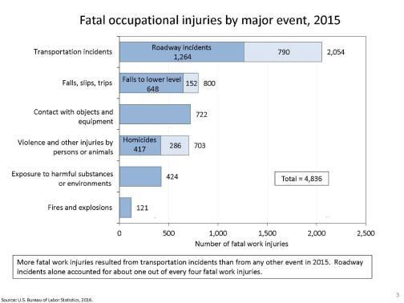
Introduction
Slips, trips, and falls make up the majority of general industry accidents
Are second only to motor vehicle crashes

Slide 4
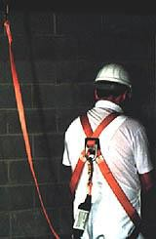
Introduction
Unless working on a ladder, scaffold or scissor lift, OSHA requires fall protection when exposed to a
4-foot fall or greater.
Source: OSHA

Slide 5
Introduction
Lesson Objectives
Identify types of fall hazards associated with workplace environments.
Identify methods to eliminate or protect against fall hazards.

Slide 6
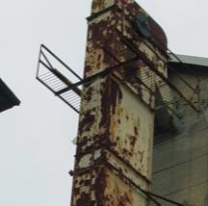
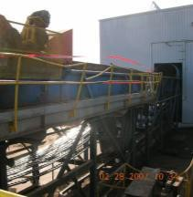
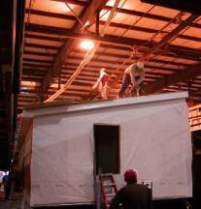


Common Fall Hazards
Overhead Platforms
Overhead Runways
Elevated Work Stations
Source of photos: OSHA

Slide 7
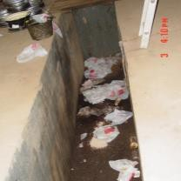
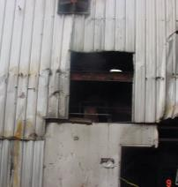
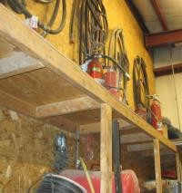
Common Fall Hazards
Floor Openings/Pits
Wall Openings
Shelving Units
Source of photos: OSHA

Slide 8
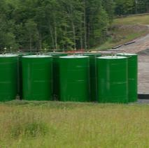
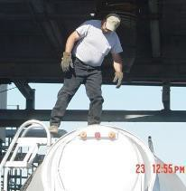
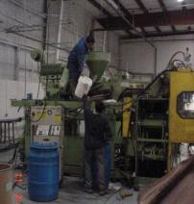
Common Fall Hazards
Stationary Storage Tanks
Tanker Trucks
Industrial Production Units
Source: WVU
Source: OSHA
Source: OSHA

Slide 9
Fall Hazard Controls
Hierarchy of Fall Hazard Control:
First line of defense
  Eliminate the fall hazard
Second line of defense
  Prevent the fall
Third and last resort
  Control the fall

Slide 10
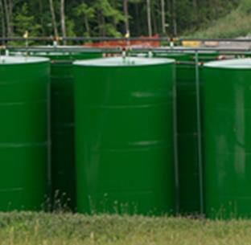
Fall Hazard Controls
Eliminate fall hazards
– work from the ground
Gauge at top of tank moved to ground level
Use drone, equipped with camera, for inspections at heights
Source: WVU

Slide 11
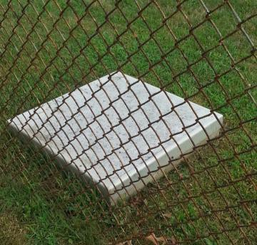
Fall Hazard Controls
Eliminate fall hazards – hole covers/grates
Very effective way to eliminate a fall hazard.
Designed to withstand intended load.
Secured-bolted, hinged, latched, locked
Source: WVU

Slide 12
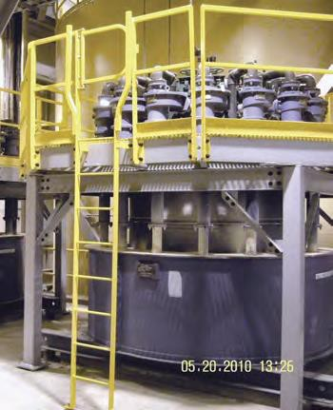
Fall Hazard Controls
Prevent the fall – guardrails
Standard railing
  Top rail, mid rail, and posts
  Height from upper surface of top rail to floor level is 42” (+/− 3”)
  Mid-rail height is 21”
Standard toeboard
  3.5” high
  Not more than ¼” clearance above the floor
Source: OSHA

Slide 13
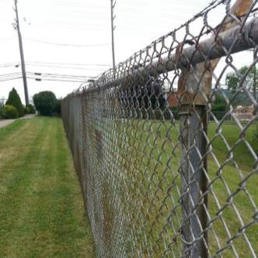
Fall Hazard Controls
Prevent the fall – fences and barricades
Prevents unauthorized employee exposure to fall hazard
Employer authorizes access
Authorized personnel must then be protected from the fall hazards within
Source: WVU

Slide 14
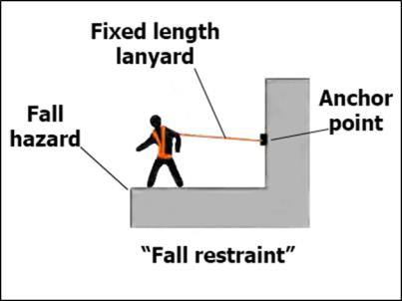
Fall Hazard Controls
Prevent the fall –
personal all restraint
Prevent falls by keeping worker from reaching fall hazard
Comprised of a body belt or body harness, an anchorage, connectors
Often used when section of guardrail or hole cover is temporarily removed
Source: OSHA

Slide 15
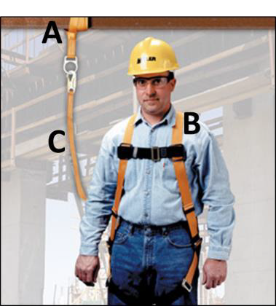
Fall Hazard Controls
Know the A, B, Cs of Personal Fall Arrest Systems
Anchorages
Body harness
Components
(connectors like snaphooks or Dee-rings, connection points, lanyards, deceleration devices,
Source: Honeywell/Miller; used with permission.
lifelines, etc.)
Installed, used, and maintained according to the manufacturer

Slide 16
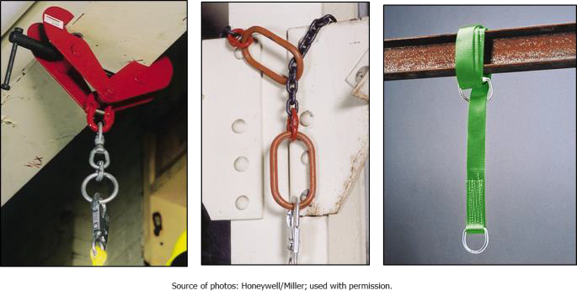
Fall Hazard Controls
PFAS – temporary anchorage

Slide 17
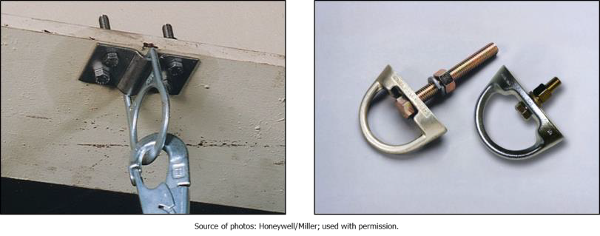
Fall Hazard Controls
PFAS – permanent anchorage

Slide 18
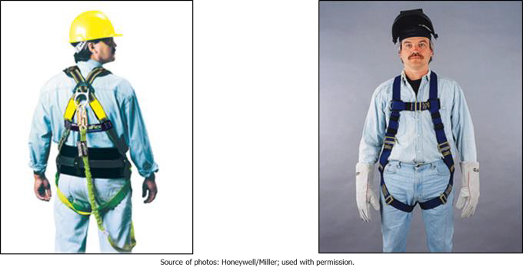
Fall Hazard Controls
PFAS – full-body harness

Slide 19
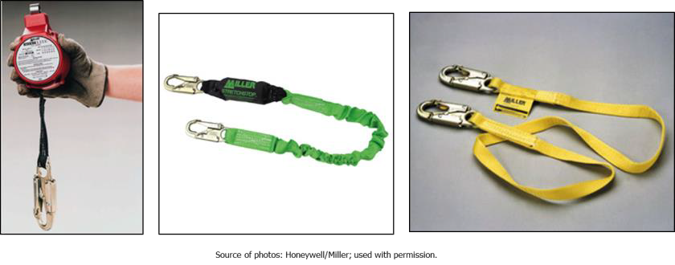
Fall Hazard Controls
PFAS – connecting components

Slide 20
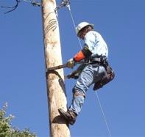
Fall Hazard Controls
Control the fall –
positioning devices
Consists of a body belt and connecting device
Keeps workers from falling, while allowing their hands to be free to perform work
Source: OSHA

Slide 21
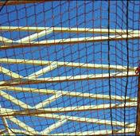
Fall Hazard Controls
Control the fall –
safety net systems
Consists of specially designed mesh nets, panels, and connecting components
Must be designed, installed and maintained properly
Source: OSHA

Slide 22
Employer Requirements
Training – your employer must train you on the following:
Fall hazards associated with your facility and your work
Methods used to protect you from those hazards
Proper and safe use of any personal fall arrest, positioning, or fall restraint systems
Applicable OSHA standards

Slide 23
Employer Requirements
Inspection
Your employer must inspect the:
  workplace for existing and potential fall hazards
  fall hazard controls used; such as guardrails, covers, grates, and anchorage points
You must inspect your PFAS, Positioning and Fall Restraint hardware before each use.

Slide 24
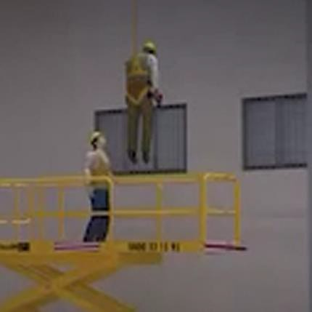
Employer Requirements
Rescue
Personal Fall Arrest Systems require a rescue plan
Employer must develop and communicate the rescue plan to all involved
Source: OSHA

Slide 25
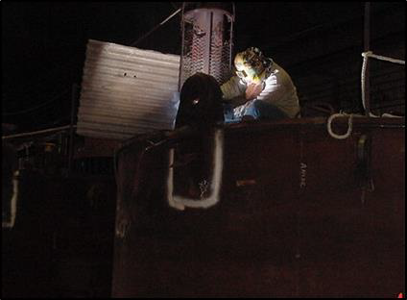
Hazard Recognition
Source of photo: OSHA

Slide 26
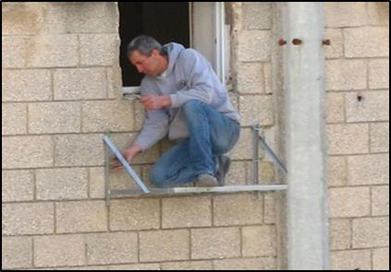
Hazard Recognition
Source of photo: OSHA

Slide 27
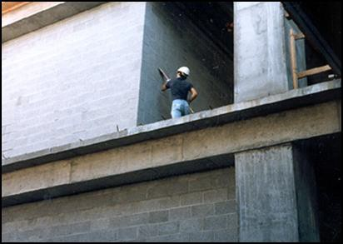
Hazard Recognition
Source of photo: OSHA

Slide 28
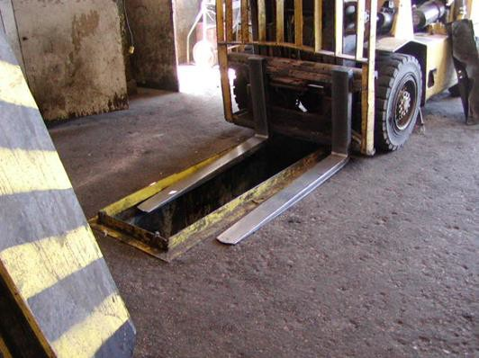
Hazard Recognition
Source of photo: OSHA

Slide 29
Knowledge Check
What is the first line of defense when it comes to falls in the workplace?
  Control the fall itself once it occurs
  Eliminate the fall hazard completely
  With the fall hazard present, prevent the fall.
  Use personal protective equipment
Answer: b. Eliminate the fall hazard completely

Slide 30
Knowledge Check
A worker is required to remove a section of guardrail in order to receive materials from a fork truck; which of the following provides the best protections to prevent a fall?
  Avoid the edge
  Use a personal fall arrest system
  Use a fall restraint system
  Use grab handles
Answer: c. Use a fall restraint system

Slide 31
Knowledge Check
A personal fall arrest system (PFAS) anchorage point must be capable of handling pounds.
  2,000
  3,000
  4,000
  5,000
Answer: d. 5,000

