Slide 1
Introduction to Ergonomics
10-hour General Industry Outreach Training

Slide 2
Introduction
Lesson objectives:
Identify common work-related musculoskeletal disorders (MSDs).
Recognize risk factors associated with work-related MSDs.
Identify ergonomic control methods for eliminating/reducing work-related MSDs.

Slide 3
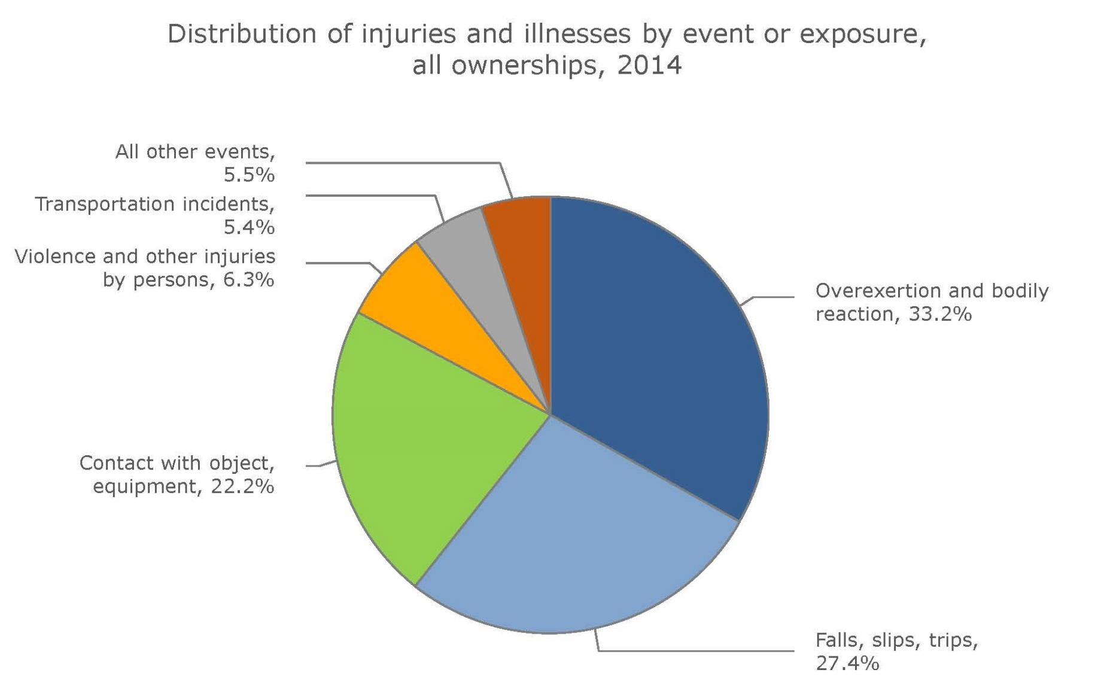
Introduction
This chart shows how MSDs compare to other hazards based on percentage of injuries and illnesses using statistics from the Bureau of Labor Statistics, FY2014.

Slide 4
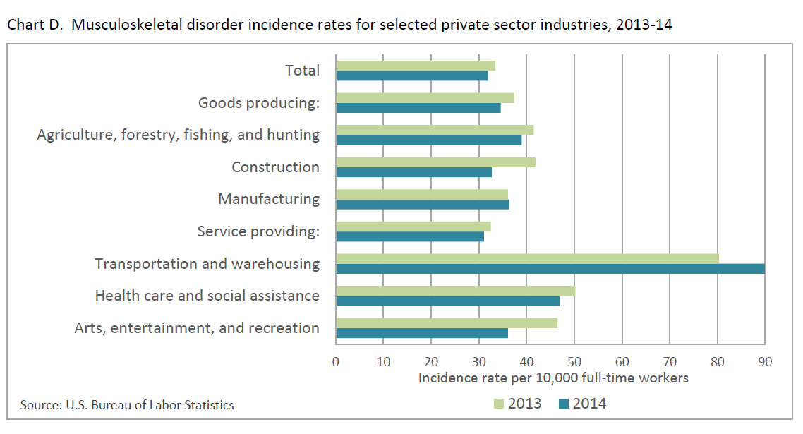
Introduction
This chart shows the incident rates of musculoskeletal disorders for selected private sector industries. Source: Bureau of Labor Statistics

Slide 5
Introduction
Ergonomics
“The scientific discipline concerned with understanding of interactions among humans and other elements of a system, and the profession that applies theory, principles, methods and data to design in order to optimize human well-being and overall system performance”

Slide 6
Introduction
Ergonomics means
“fitting the job to the worker,”
including:
Work stations
Tools
Equipment
Ergo = Work Nomos = Law

Slide 7
Introduction
Why is ergonomics important?
Overexertion leading cause of injuries
  Most costly
  Recurring/Persistent pain may develop in future
Bodily reaction is another leading cause of injuries in workplace
Repetitive motion also within top 10 most common workplace injuries

Slide 8
Common Work-Related MSDs
Musculoskeletal Disorders (MSDs)
Affect the muscles, nerves, blood vessels, ligaments, and tendons
Symptoms
− Discomfort
− Pain
− Numbness
− Loss of motion/flexibility
− Spasticity
− Stiff joints
− Burning
− Swelling
− Tingling
− Inflammation
− Throbbing
− Paralysis

Slide 9
Common Work-Related MSDs
Common MSD disorders:
  Carpal Tunnel Syndrome
  Tennis Elbow
  Bursitis
  Ischemia
  De Quervain’s
  Sciatica
  Herniated Discs
  Neck strain/disability
  Tendinitis
Rotator Cuff
Neuritis
Reynaud’s Syndrome
Trigger Finger
Thoracic Outlet Syndrome
Epicondylitis
Back strain/disability

Slide 10
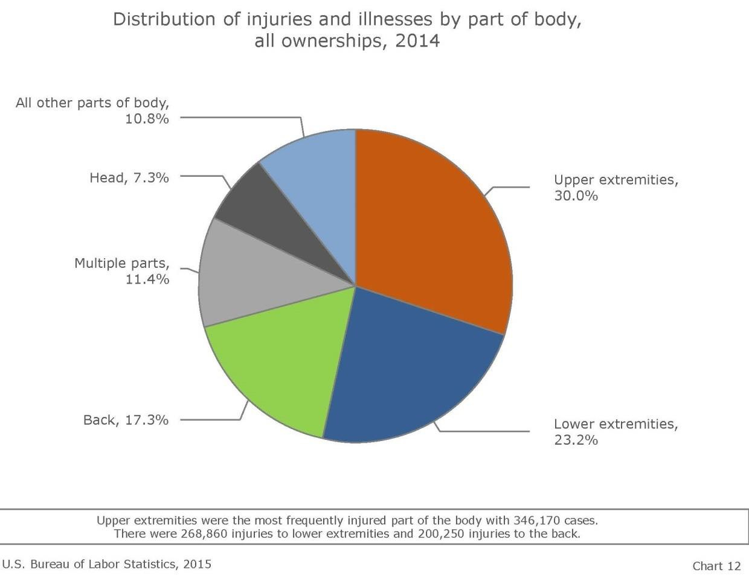
Common Work-Related MSDs
Most commonly affected areas:
Back
Arms, Elbows, and Shoulders
Neck
Hands, Wrists, and Fingers
Knees, Ankles, and Feet
This chart shows a distribution of injuries and illnesses to body parts due to MSDs using statistics from the Bureau of Labor Statistics, FY2014.

Slide 11
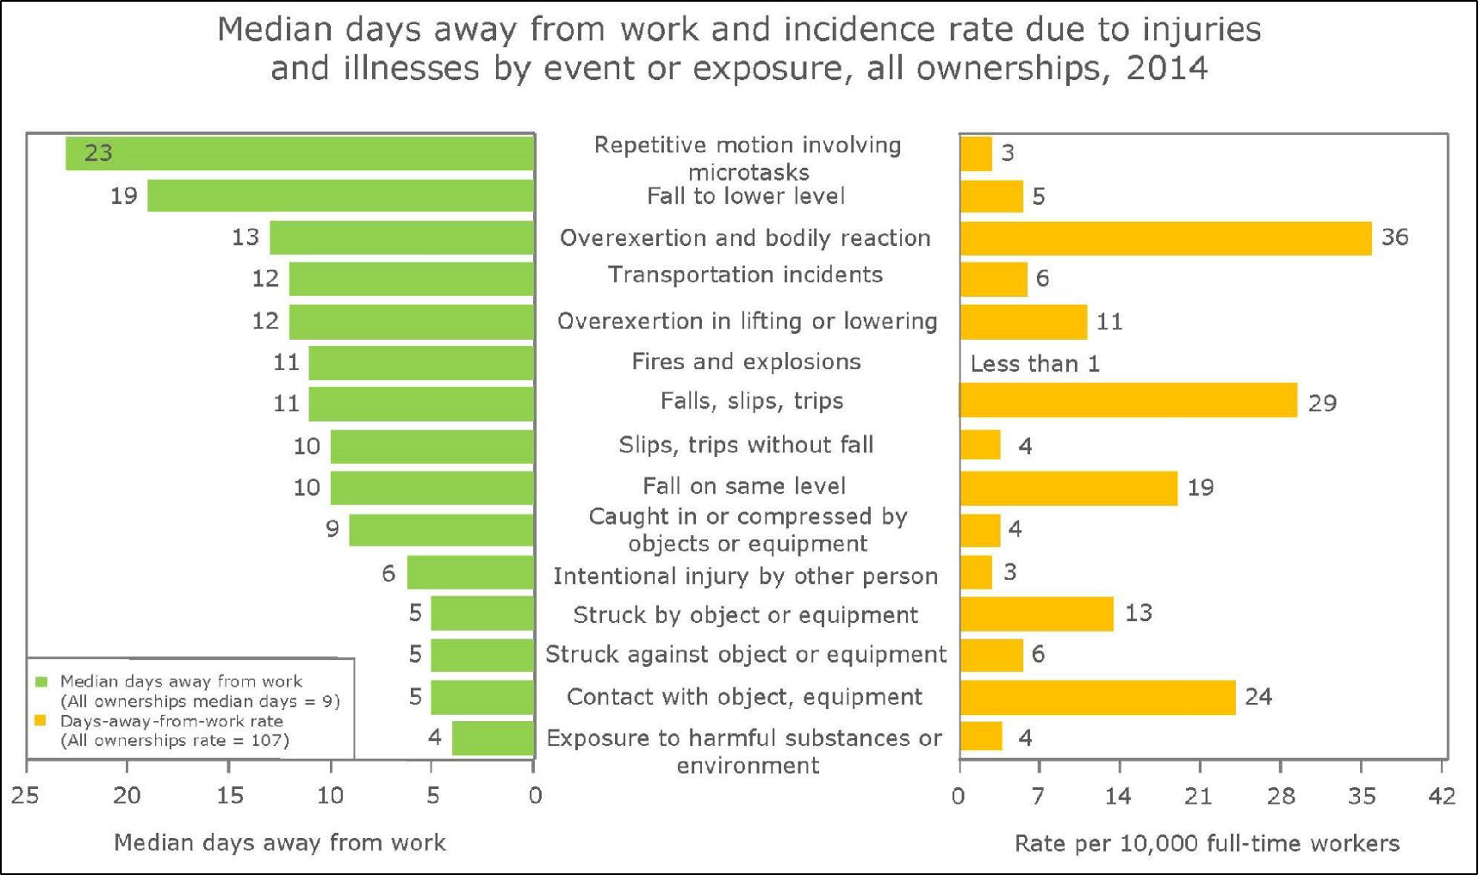
Common Work-Related MSDs
Highest rate of missed days
Highest incident rate
Source: Bureau of Labor Statistics

Slide 12
Risk Factors Associated with MSDs
Risk factors of MSD injuries:
Dependent upon:
  Work positions and postures
  How often task is performed
  Level of required effort and duration of task

Slide 13
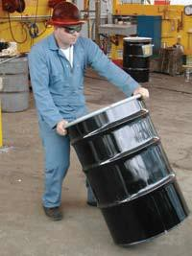
Risk Factors Associated with MSDs
Examples of risk factors include:
  Exerting excessive force
    Lifting heavy objects/people
    Pushing or pulling heavy loads
    Manual pouring materials
    Maintaining control of equipment
or tools
  Performing same/similar tasks
repetitively
Source: OSHA

Slide 14
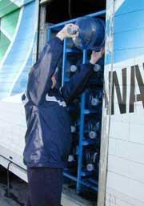
Risk Factors Associated with MSDs
Working in awkward postures or
same postures for long periods
  Prolonged/repetitive reaching above
shoulder height
  Kneeling
  Squatting
  Leaning over a counter/bending
  Using a knife with wrists bent
  Twisting the torso while lifting
Localized pressure into the body part
  Pressing the body/part of the body against
hard or sharp edges
  Using the hand as a hammer
Source: OSHA

Slide 15
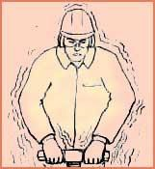
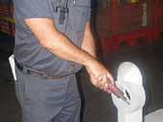
Risk Factors Associated with MSDs
Cold temperatures
(in combination with other risk factors)
Vibration
  Whole body
  Hand-arm
Combined exposure to
several risk factors
Source of graphics: OSHA

Slide 16
Ergonomic Control Methods
Methods of protecting against MSDs:
Establish ergonomics program
  Training
  Feedback from all levels
Conduct job hazard analysis (JHAs)
Early recognition and reporting of potential MSDs

Slide 17


Ergonomic Control Methods
Job Hazard Analysis
Tasks | Hazards | Controls
This table provides an example of a tool that can be used when conducting a job hazard analysis. The first column provides a list of tasks performed by a job; the middle column is
provided for listing identified hazards; and, the third column provides a list of controls that can be used to mitigate the hazards.

Slide 18
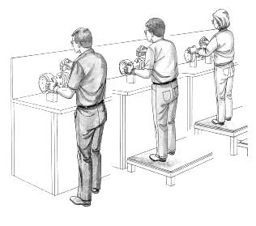
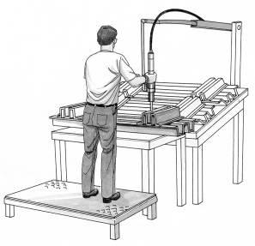
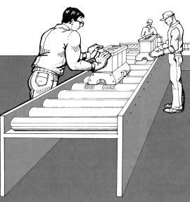
Ergonomic Control Methods
Examples of engineering controls
  Work station design and setup
  Ergonomically designed tools
  Ergonomically designed equipment
  Load weight reduction
Source: OSHA (International Labor Organization)

Slide 19
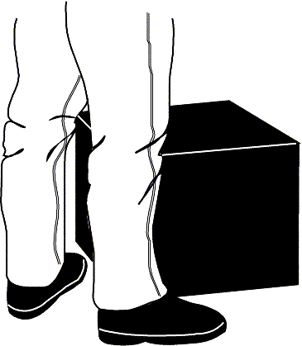
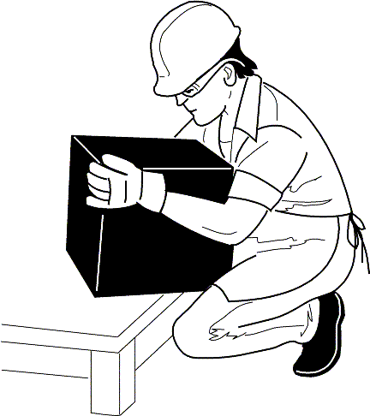
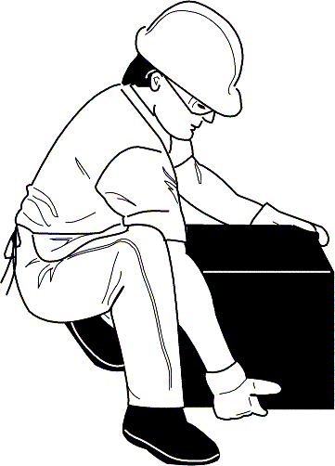
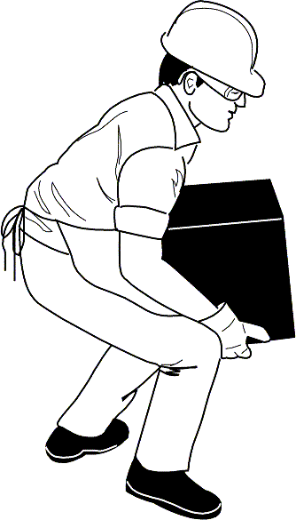
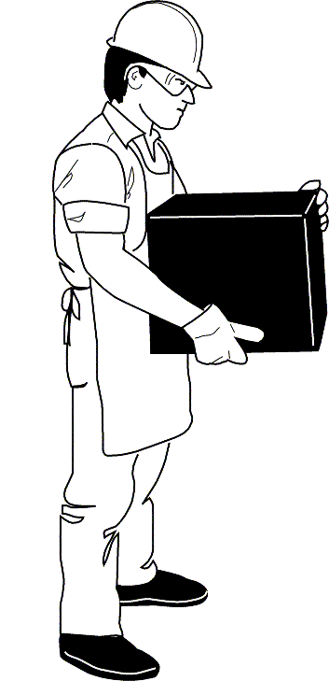
Ergonomic Control Methods
Examples of proper work practices:
  Proper lifting techniques (NIOSH)
  Team lift heavy/bulky/awkward loads
  Stretch
  Work rotation
  Task variety
  Increase rest breaks
Source of graphics: OSHA

Slide 20
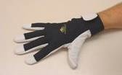
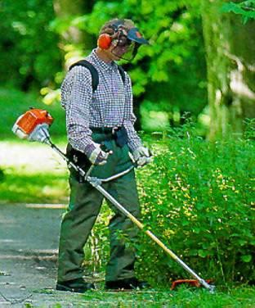
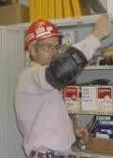
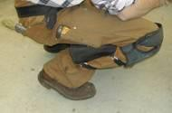
Ergonomic Control Methods
Examples of PPE:
  Gripping gloves
  Knee pads
  Vibration gloves
  Thermal gloves
  Lifting straps
  Shoulder harness
  Lifting braces
Source of graphics: OSHA

Slide 21
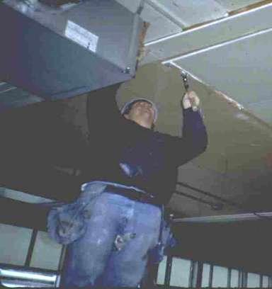
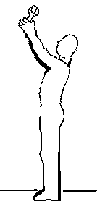
Ergonomic Control Methods
Physical ergonomic hazards and solutions:
Reaching above the head/shoulders - hazards
– Working with the hands above head for more than
2 hours per day
Source of graphics: OSHA

Slide 22
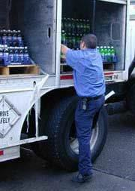
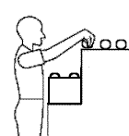
Ergonomic Control Methods
– Working with the elbows above shoulders for more than 2 hours per day
Source of graphics: OSHA

Slide 23
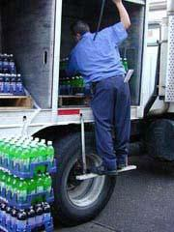
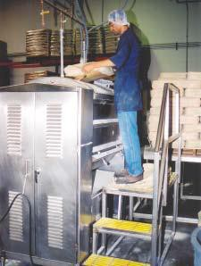
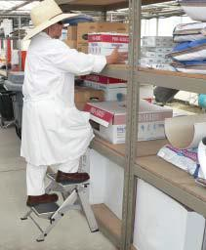
Ergonomic Control Methods
Reaching above the head/shoulders - solutions
  Keep items within close reach
  Elevate work areas
Source: NIOSH
Source: NIOSH
Source: OSHA

Slide 24
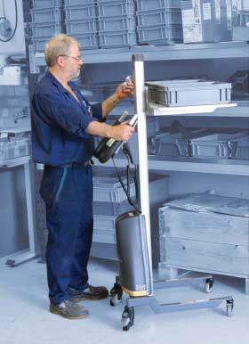
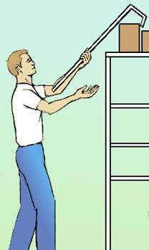

Ergonomic Control Methods
Reaching above the head/shoulders - solutions
  Remove obstacles
  Utilize equipment to raise and lower items or move items closer to worker
Source: OSHA
Source: OSHA
Source: NIOSH

Slide 25
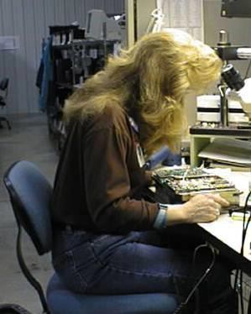
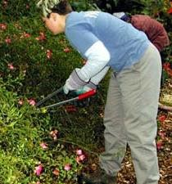
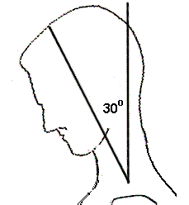
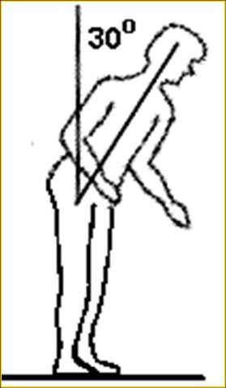
Ergonomic Control Methods
Awkward body postures - hazards
– Working with the neck or back bent forward more than 30° for more than 2 hours per day
Source of graphics: OSHA

Slide 26
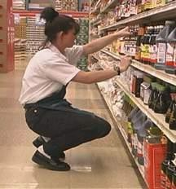
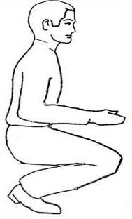
Ergonomic Control Methods
– Squatting for more than 2 hours per day
Source of graphics: OSHA

Slide 27
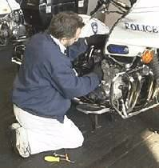
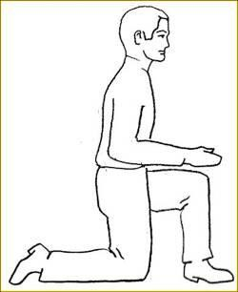
Ergonomic Control Methods
– Kneeling for more than 2 hours per day
Source: OSHA

Slide 28

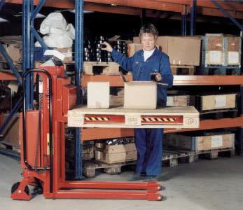
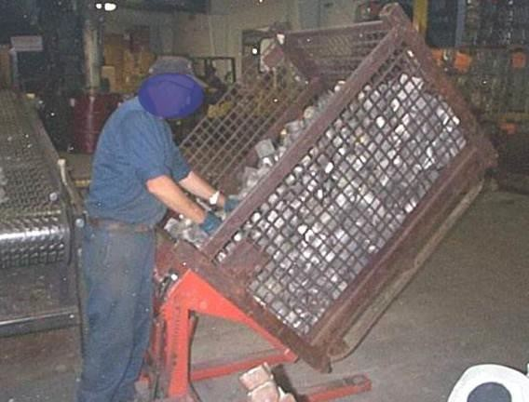
Ergonomic Control Methods
Awkward body postures - solutions
  Raise and/or tilt the work for better access
  Use a stool for ground-level work
Source: OSHA
Source: NIOSH
Source: OSHA

Slide 29
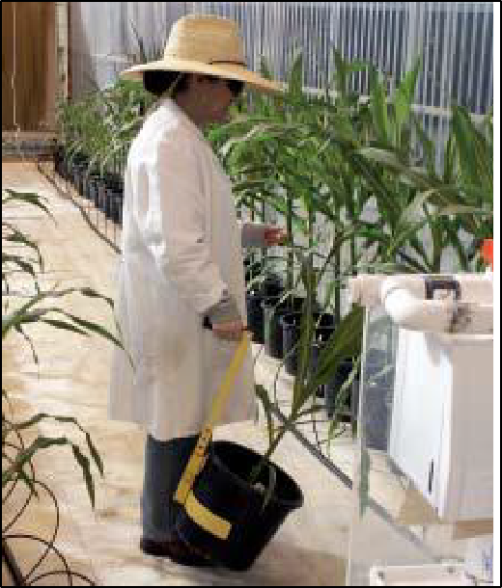
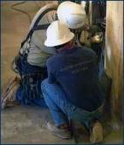
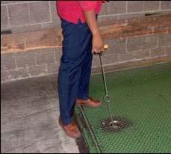
Ergonomic Control Methods
Awkward body postures - solutions
  Use tools with longer handles
  Alternate between bending, kneeling, sitting, and squatting
Source: OSHA
Source: NIOSH
Source: OSHA

Slide 30
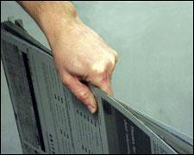
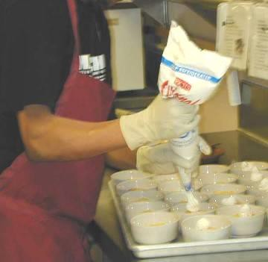
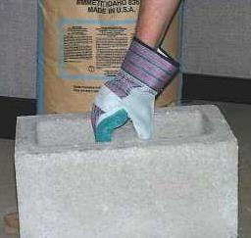
Ergonomic Control Methods
Awkward grips - hazards
– Gripping 10 or more pounds or force for 2 or more hours per day
Source of graphics: OSHA

Slide 31
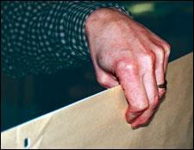
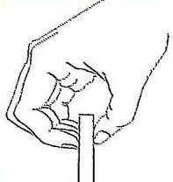
Ergonomic Control Methods
Awkward grips - hazards
– Pinching 2 or more pounds of weight or 4 or more
pounds of force for 2 or more hours per day
Source of graphics: OSHA

Slide 32
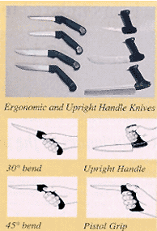
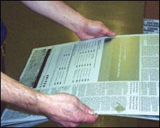
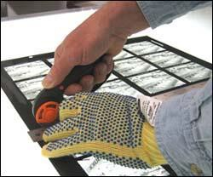

Ergonomic Control Methods
Awkward grips - solutions
  Design work layout to reduce hand-carrying
  Reduce amount of items carried at one time
  Use non-pinch grip postures
  Use ergonomically designed tools/aids
  Use job/task rotation
“C” shaped posture
Source of graphics: OSHA

Slide 33


Ergonomic Control Methods
Repetitive motions - hazards
– Repeating same motion for more than two hours per day with hands, wrists, elbows, shoulders, or neck
Source: OSHA

Slide 34

Ergonomic Control Methods
Repetitive motions - hazards
– Intense keying for more than 4 hours per day
Source: OSHA

Slide 35


Ergonomic Control Methods
Repetitive motions - solutions
  Arrange work to avoid unnecessary motions
  Let power tools and machinery do the work
  Spread repetitive work out during the day
  Take stretch pauses
  Rotate task with co-workers if possible
  Change hands or motions frequently
Source of graphics: OSHA

Slide 36


Ergonomic Control Methods
Localized pressure on body part - hazards
  Pressing the body/part of the body against hard or sharp edges
  Standing/kneeling for prolonged periods on hard surfaces
  Using tools with hard handle surfaces or short handles
Source of graphics: OSHA

Slide 37




Ergonomic Control Methods
Localized pressure on body part - hazards
– Using hands/knees as a hammer more than 10 times
in 1 hour or more than 2 times per day (long-term)
Source of graphics: OSHA

Slide 38





Ergonomic Control Methods
Localized pressure on body part - solutions
  Use tools with longer handles
  Use tools with padded grips
  Alternate between bending, kneeling, sitting, and squatting; use sit/stand stools or tables
Source of graphics: OSHA

Slide 39




Ergonomic Control Methods
Localized pressure on body part - solutions
  Pad table edges or use tables/desktops with
rounded edges
  Use wrist rests, anti-fatigue mats,
knee pads, shoe inserts or other
items that reduce stress on body parts
Source of graphics: OSHA

Slide 40



Ergonomic Control Methods
Lifting objects - hazards
  Lifting more than
    75 lbs. once/day
    55 lbs. ten times/day
    10 lbs. more than twice/minute or
for more than 2 hours/day
    25 lbs. above shoulders, below knees,
or at arms length more than
25 times/day
Source of graphics: OSHA

Slide 41



Ergonomic Control Methods
Lifting objects - hazards
– Heavy, frequent, and awkward lifting
Source of graphics: OSHA

Slide 42




Ergonomic Control Methods
Lifting - solutions
  Managing for safer lifting
    Plan lifts
    Minimize lifting distances
    Position materials to power zone levels
    Avoid manually lifting/lowering loads
to/from floor
    Identify/reduce unstable or heavy
loads
    Reduce frequency of lifting and
duration of lifting tasks
    Provide clear access
Source of graphics: NIOSH

Slide 43




Ergonomic Control Methods
Lifting - solutions
  Employee guidelines for safer lifting
    Stretch before lifting
    Check for tags on loads
    Test load for stability and weight
    Plan the lift
    Use proper lifting techniques –
grip; two hands; smooth, even motions; load close to body; legs to push up and lift load; avoid twisting; alternate with less physically demanding tasks;
rest breaks
    Get assistance when necessary
Source of graphics: OSHA

Slide 44




Ergonomic Control Methods
Lifting - solutions
– Use proper lifting techniques
Caution: This technique may be effective only if loads are small, light- weight, and can easily fit between the knees.
Keep the load close to your body and lift by pushing up with your legs.
Source: NIOSH

Slide 45





Ergonomic Control Methods
Lifting - solutions
– Use proper lifting techniques
Lean the sack onto
your kneeling leg.
Slide the sack up onto your kneeling leg.
Slide the sack onto the other leg while keeping the sack close to your body.
As you stand up, keep the sack close to your body.
Source: NIOSH

Slide 46



Ergonomic Control Methods
Vibration – hazards
Moderate – more than 2 hours per day
High – more than 30 minutes per day
Prolonged
Source of graphics: OSHA

Slide 47



Ergonomic Control Methods
Vibration – solutions
Use low-vibration tools and devices that may reduce vibration (tool balancers, extension handles, vibration isolators, damping techniques)
Adequate rest periods
Rotate jobs
Maintenance
PPE
Source of graphics: OSHA

Slide 48
Ergonomic Control Methods
Environmental ergonomic hazards:
Amplify/increase risk of MSDs
Examples
  Hot weather
  Cold weather – affects worker coordination and
dexterity
  High-temperature indoor (steam rooms, attics)
  Cold-temperature indoor (walk-in freezers, cold
process rooms)
  Low visibility

Slide 49
Employer/Employee Requirements
General Duty Clause
Each Employer:
  Shall furnish to each of his employees employment and a place of employment which are free from recognized hazards that are causing or are likely to cause death or serious physical harm to his employees;
  Shall comply with occupational safety and health standards
promulgated under this Act.
Each Employee:
  Shall comply with occupational safety and health standards and all rules, regulations, and orders issued pursuant to this Act which are applicable to his own actions and conduct.

Slide 50
Employee/Employer Requirements
Report signs or symptoms if:
Pain is persistent, severe or worsening
Pain radiates
Symptoms include numbness or tingling
Symptoms keep you from sleeping at night
Fingers blanch or turning white

Slide 51
Employee/Employer Requirements
Getting involved:
Look at jobs
Come up with solutions
Work with solutions
Take part in training
Take responsibility for changing the way you do your job
Help to make sure efforts are successful

Slide 52
Five Key Points to Remember
Ergonomics can help you on your job
WMSDs can happen in jobs with risk factors
Risk factors can be reduced and WMSDs prevented
Reporting signs and symptoms early is important
You can help your company put ergonomics changes into place

Slide 53
Knowledge Check
Ergonomics is the science of .
  designing the job to fit the worker
  fitting the worker to the job
  lifting injuries
  safety and health
Answer: a. designing the job to fit the worker

Slide 54
Knowledge Check
MSDs account for approximately of all injuries and illnesses.
  1%
  10%
  33%
  54%
Answer: c. 33%

Slide 55
Knowledge Check
Which of the following is an example of an ergonomic risk factor?
  Neutral postures
  Rest
  Repetition
  Personal protective equipment
Answer: c. Repetition

Slide 56
Knowledge Check
Ergonomic hazards can be prevented or reduced by which of the following control methods?
  Engineering controls
  Proper work practices/administrative controls
  Personal protective equipment
  All of the above
Answer: d. All of the above

Slide 57
What questions do you have?
Thank You

