Slide 1
Electrical
OSHA 10-hour Outreach Training General Industry

Slide 2
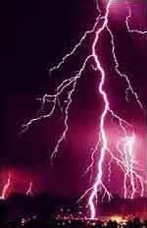
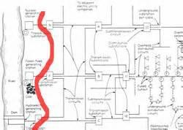
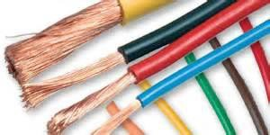
Electrical
Source of photos: OSHA

Slide 3
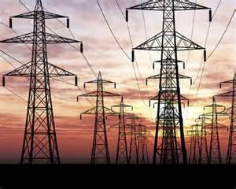
Introduction
Lesson objectives:
Identify major electrical hazards
Describe types of electrical hazards
Describe electrical protection methods
Recognize employer requirements to protect workers from electrical hazards
Source: OSHA

Slide 4
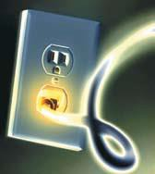
Introduction
Definitions:
Electricity – movement
of the free electrons between atoms;
  Related terms:
    Current – the movement of
electrical charge
    Resistance – opposition to current flow
Source: NIOSH
Voltage – a measurement of electrical force

Slide 5
Introduction
Conductors – substances, such as metals, that have
little resistance to electricity
Insulators – substances, such as dry wood, rubber, glass and Bakelite, that have high resistance to electricity
Grounding – a conductive connection to the earth
which acts as a protective measure

Slide 6
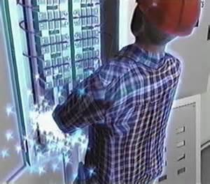
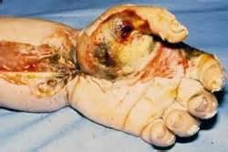
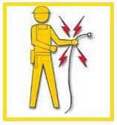
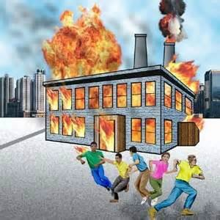
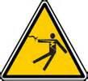
Electrical Hazards
Serious injuries and death can be caused by electrical hazards such as arc flash, shocks, burns, falls, and fires. Source of graphics: OSHA

Slide 7
Electrical Hazards
Examples of electrical hazards that could cause workers to be electrocuted.
Repair Welder Electrocuted
Lockout/Tagout Failure

Slide 8
Electrical Hazards
BE SAFE:
Burns
Electrocution
Shock
Arc flash/arc blast
Fire
Explosions

Slide 9
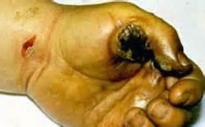
Electrical Hazards
Burns:
Most common shock-related injury
Three types of electrical burns:
  Electrical
  Arc flash
  Thermal contact
Source: OSHA

Slide 10
Electrical Hazards
Electrocution:
Is fatal
Meaning: to kill with electrical shock
Results when a human is exposed to a lethal amount of electrical energy

Slide 11

Electrical Hazards
Shock:
Body becomes part of electrical circuit
Reflex response to passage of electric current through the body
Source: OSHA

Slide 12
Electrical Hazards
Arc Flash/Arc Blast
Arc flash
  Sudden release of electrical energy through air when a high-voltage gap exists and there is a breakdown between conductors
  Gives off thermal radiation (heat) and bright, intense light that can cause burns
  Temperatures as high as 35,000°F

Slide 13
Electrical Hazards
Arc blast – high-voltage arcs can also produce considerable pressure waves by rapidly heating the air and creating a blast

Slide 14
Electrical Hazards
Fire:
Most result from problems with "fixed
wiring”
Problems with cords, plugs, receptacles, and switches also cause electrical fires

Slide 15
Electrical Hazards
Explosions:
Occur when electricity ignites explosive mixture of material in the air
Note:
  Electricity is source of these hazards
  All hazards are of equal importance
  Lesson focuses on eliminating electrical hazards

Slide 16
Electrical Hazards
Examples of fatal accidents:
Case #1: Worker electrocuted when the ladder came in contact with overhead power lines
Case #2: Worker electrocuted when mast came in contact with high voltage overhead lines

Slide 17
Electrical Hazards
Case #3: Worker changing energized ballast on light fixture was electrocuted and fell to the concrete floor while working from an 8' fiberglass stepladder.

Slide 18
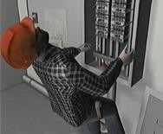
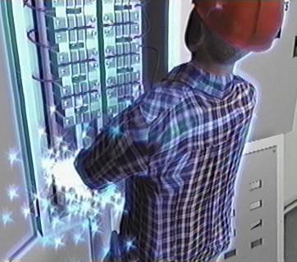
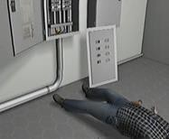
Electrical Hazards
U.S. Bureau of Labor Statistics:
156 electrocutions for 2014
Up from 141 in 2013
Source of graphics: OSHA

Slide 19
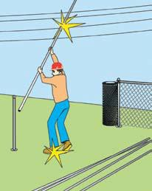
Types of Electrical Hazards
Contact with overhead power lines:
Overhead and buried power lines carry extremely high voltage
Risks
  Electrocution (main risk)
  Burns and falls
Source: NIOSH

Slide 20
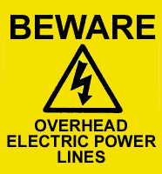
Types of Electrical Hazards
Cranes are not the only equipment that can reach overhead power lines.
Use of ladders or suspension in a man-basket under or near power lines are risks.
Source: OSHA

Slide 21
Types of Electrical Hazards
Important: the covering on an overhead power line is primarily for weather protection; therefore, workers need to know that if they touch a power line, covered or bare, death is probable.
Ladders near powerlines

Slide 22
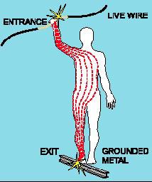
Types of Electrical Hazards
Contact with energized sources:
Live parts
  The major hazards
    Electrical shock and burns
    Electrical shock occurs when the body becomes part of the electric circuit
Source: OSHA

Slide 23
Types of Electrical Hazards
Severity and effects of an electrical shock depend on a number of factors
  Pathway through the body
  Amount of current
  Length of time of the exposure
  Whether skin is wet or dry
Water
  Great conductor
  Allows current to flow more easily in wet conditions
and through wet skin

Slide 24
(1,000 milliamperes = 1 amp; therefore, 15,000 milliamperes = 15 amp circuit)
Current | Reaction
Below 1 milliampere | Generally not perceptible
1 milliampere | Faint tingle
5 milliampere | Slight shock felt; not painful but disturbing. Average individual can let go. Strong involuntary reactions can lead to other injuries
6-25 milliamperes (women) | Painful shock, loss of muscular control
9-30 milliamperes (men) | The freezing current or “let-go” range. Individual cannot let go, but can be thrown away from the circuit if extensor muscles are stimulated.
50-150 milliampres | Extreme pain, respiratory arrest, severe muscular contractions. Death is possible.
1,000-4,300 milliamperes | Rhythmic pumping action of the heart ceases. Muscular contraction and nerve damage occur; death likely
10,000 milliamperes | Cardiac arrest, severe burns; death probable
This table shows the body’s reaction when exposed to various levels of current. Source: OSHA

Slide 25
Types of Electrical Hazards
Damaged or bare wires
  Fault current may travel through a body,
causing electrical burns or death, if
    Power supply is not grounded
    Path has been broken
    There are live parts or bare wires
  Extreme conditions and rough treatment can change electrical equipment from safe to hazardous

Slide 26
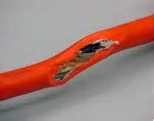
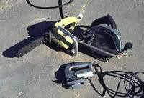
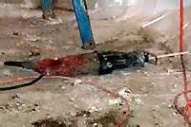
Types of Electrical Hazards
Defective equipment or tools
These photos show examples of defective equipment/tools. Source of photos: OSHA

Slide 27
Types of Electrical Hazards
Improper repairs
  Examples of incidents
    Ballast strap not replaced after repair = Electrocution of 11 year old boy
    Cutting off bleed resistor on capacitor= causes 370-volt shock
    Removing and leaving off terminal insulator on capacitor
= causes 440-volt shock

Slide 28
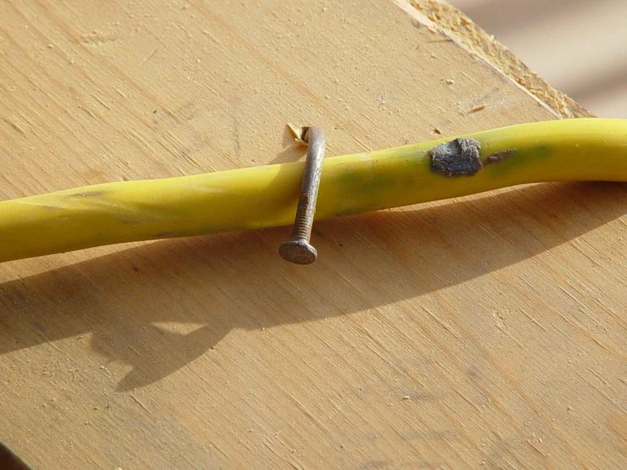
Types of Electrical Hazards
Improper use:
Extension and flexible cords
  Care
  Connection
  Capacity
Source: TEEX SH 46F1-HT06

Slide 29
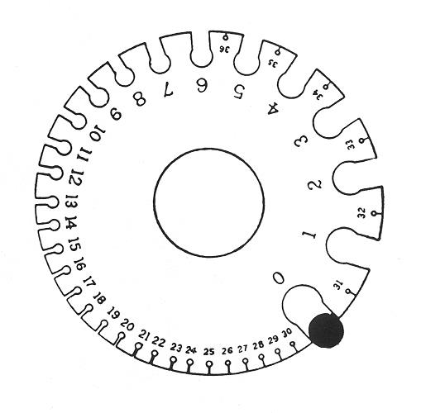
Types of Electrical Hazards
Capacity affected by
  Size of wire
    14 gauge = 15 amps
    12 gauge = 20 amps
  Length of the cord
    UL tag capacity
    In general any cord over 100 ft. requires one size larger cord
(14 gauge to 12 gauge)
Source: OSHA

Slide 30
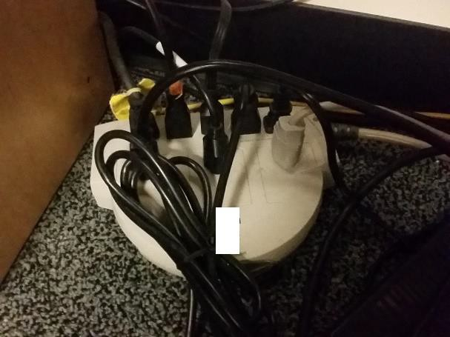
Types of Electrical Hazards
Power strips:
– Can be over loaded because of multiple plug arrangement
– Most have overload protection
but often malfunction causing fire
– Use fixed wiring when possible
Source: UBATC

Slide 31
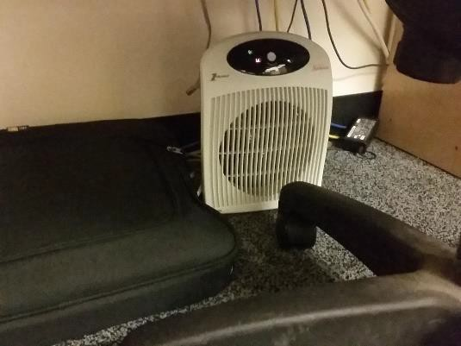
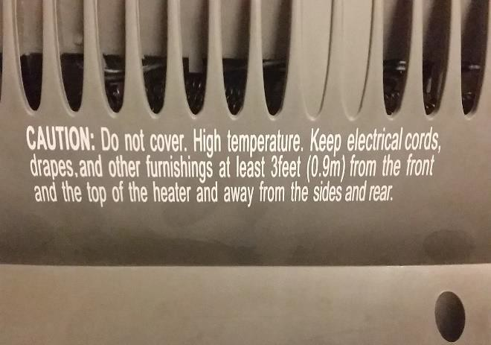
Types of Electrical Hazards
Portable heaters and appliances:
  Manufacturer recommendations not followed
  Do not plug into a power strip!
This causes overloads and fires.
Source of photos: UBATC

Slide 32
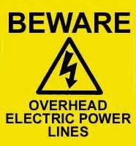
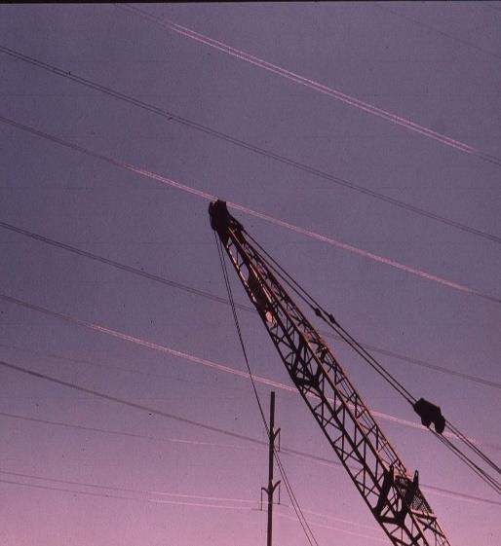
Electrical Protection Methods
Maintain safe distance from overhead power lines:
Staying away
Following table shows the safe power line clearance distance for various line voltages.
Safe Distance Video
Source of graphics: OSHA

Slide 33
Electrical Protection Methods
Voltage (nominal, kV, alternating current) | Minimum Clearance Distance (feet)
Up to 50 | 10
Over 50 to 200 | 15
Over 200 to 350 | 20
Over 350 to 500 | 25
Over 500 to 750 | 35
Over 750 to 1000 | 45
Over 1000 | (As established by the power line owner/operator or registered professional engineer who is a qualified person with respect to electrical transmission and distribution)
This table shows the minimum clearance distances, in feet, for different power line voltages. Source: OSHA

Slide 34
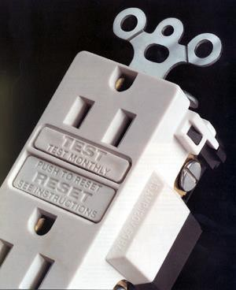
Electrical Protection Methods
Use ground-fault circuit interrupters (GFCI):
Designed to protect people from electrical shock
Detects ground faults and interrupts electric current
Limits duration of electrical shock
Source: OSHA

Slide 35



Electrical Protection Methods
Three types of GFCI:
Receptacle GFCI
Temporary/portable GFCI
Circuit Breaker GFCI
These photos show examples of the three types of GFCI. Source of photos: OSHA

Slide 36
Electrical Protection Methods
Inspect portable tools and extension cords:
Workers need to inspect extension cords prior to their use for any cuts or abrasion.
Electric hand tools that are old, damaged, or misused may have damaged insulation inside.

Slide 37
Electrical Protection Methods
Use power tools and equipment as designed:
Follow tool safety tips to avoid misusing equipment
Follow manufacturer’s instructions

Slide 38
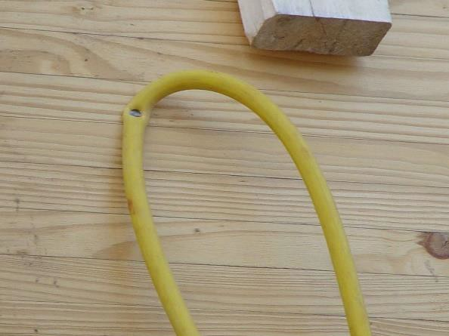
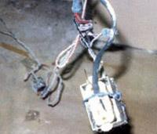
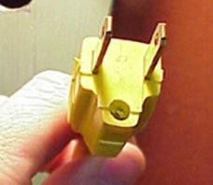
Electrical Protection Methods
Common examples of misused equipment
Source: TEEX SH 46F1-HT06
Source of photos: OSHA
Source of photos: OSHA
These photos show examples of equipment misuse.

Slide 39
Electrical Protection Methods
Tool safety tips
Never carry a tool by the cord.
Never yank the cord to disconnect it.
Keep cords away from heat, oil, and sharp edges.
Disconnect when not in use and when changing accessories such as blades and bits.

Slide 40
Electrical Protection Methods
Avoid accidental starting. Do not hold fingers on the switch button while carrying a plugged-in tool.
Use gloves and appropriate footwear.
Store in dry a place when not using.

Slide 41
Electrical Protection Methods
Don’t use in wet/damp environments.
Keep working areas well lit.
Ensure that cords do not cause a tripping hazard.
Remove damaged tools from use.
Use double-insulated tools.

Slide 42
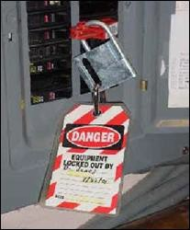
Electrical Protection Methods
Follow lockout/tagout (LOTO) procedures:
Lockout/tagout
  Essential safety procedure
  Protects workers from injury while
working on or near electrical
circuits and equipment
– Prevents contact with operating equipment parts such as, blades, gears, shafts, etc.
Source: OSHA

Slide 43
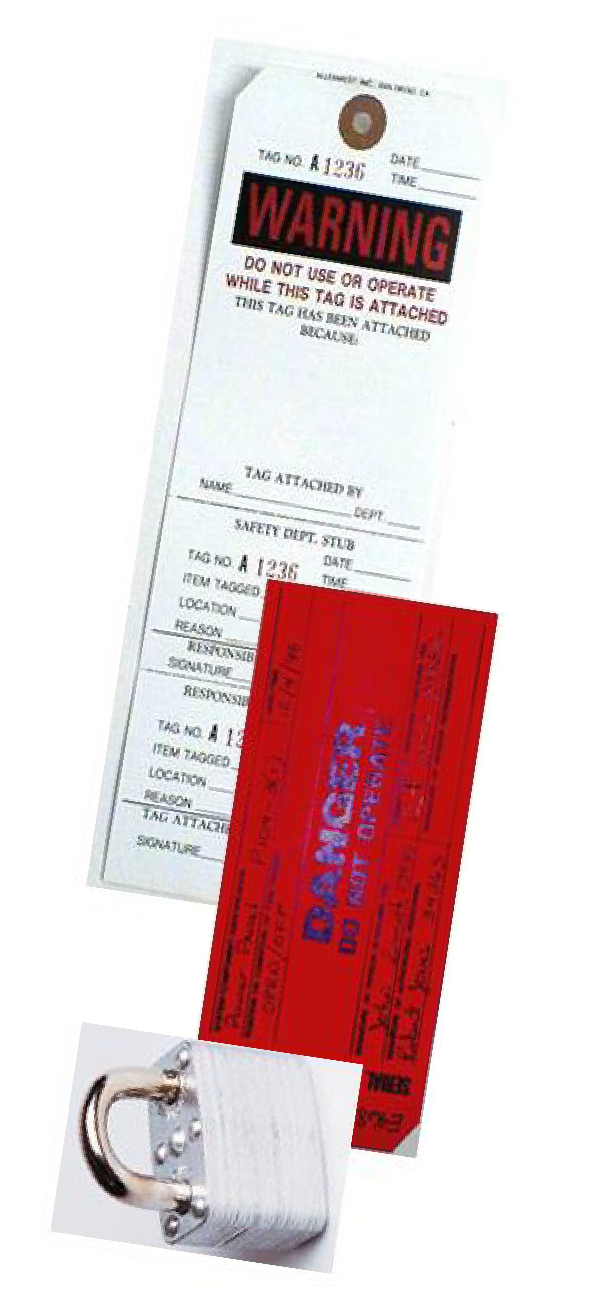
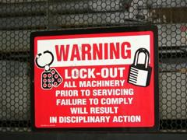
Electrical Protection Methods
– LOTO prevents the unexpected release of hazardous gases, fluids, or solid matter in areas where workers are present.
Source of photos: OSHA

Slide 44
Electrical Protection Methods
Power source identification:
Mark all breakers accordingly for the circuits they protect
Mark all disconnect means accordingly for the equipment they service
Identify all voltages with proper labeling

Slide 45
Employer Requirements
Employer requirements to protect workers:
Ensure overhead power line safety
Isolate electrical parts
Supply ground-fault circuit interrupters (GFCI) protection
Establish and implement an AEGCP
Ensure power tools are maintained in a safe condition

Slide 46
Employer Requirements
Ensure proper guarding
Provide training
Enforce LOTO safety related work practices
Ensure proper use of flexible cords and power strips
Ensure proper identification of power sources

Slide 47
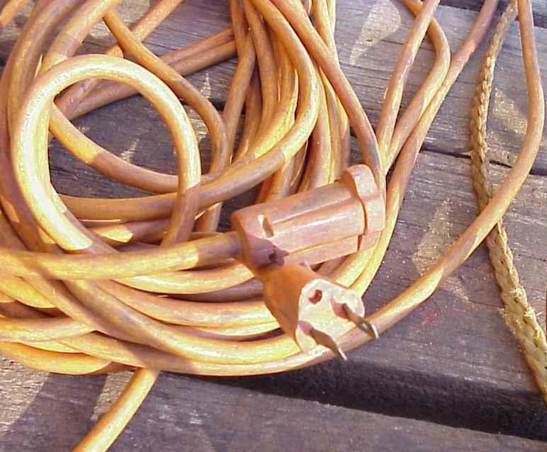
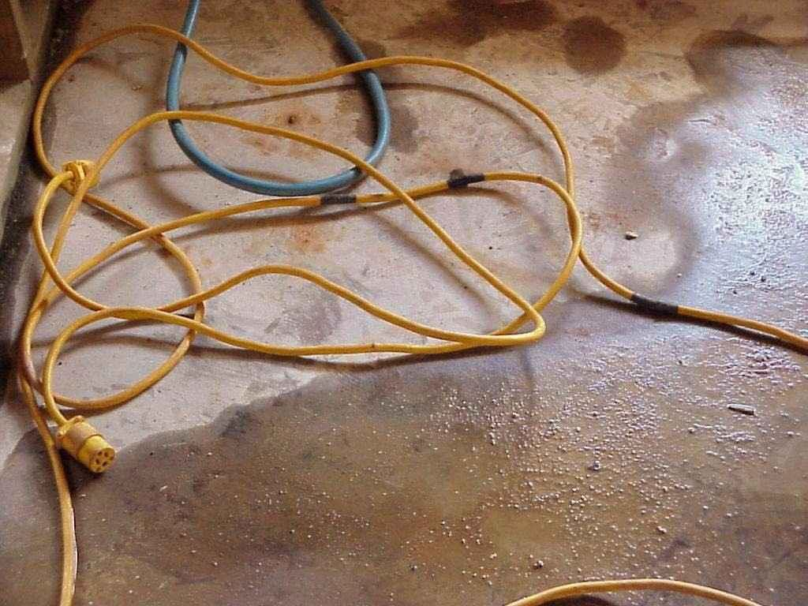
What’s Wrong?
Identify the hazards in these photos. Source of photos: TEEX SH 46F1-HT06

Slide 48
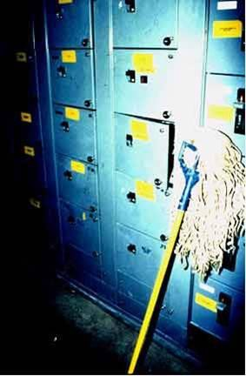
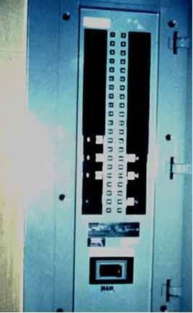
What’s Wrong?
Identify the hazards in these photos. Source of photos: OSHA

Slide 49
Knowledge Check
What is electricity?
  The movement of atoms within an object
  The movement of free electrons between atoms
  Solid mass
  Movement within the nucleus of an atom
Answer: b. The movement of free electrons between atoms

Slide 50
Knowledge Check
“Electrocution” means .
  received a mild electrical shock
  killed by electrical shock
  exposed to electrical current
  any accident involving electricity
Answer: b. killed by electrical shock
R.I.P.

Slide 51
Knowledge Check
Arc flash/arc blast can reach maximum temperatures up to 350˚F?
  True
  False
Answer: b. False - temperatures can reach up to 3,500˚F

Slide 52
Knowledge Check
Which gauge of wire will carry the most current?
  14 gauge
  12 gauge
  10 gauge
  00 gauge
Answer: d. 00 gauge – the lower the wire gauge number, the more current it can carry

Slide 53
Knowledge Check
What does GFCI stand for?
  Ground Flexible Conduit Insulator
  Ground Flow Current Interceptor
  Ground Fault Circuit Interrupter
  Ground Floor Connection Intersector
Answer: c. Ground Fault Circuit Interrupter

Slide 54
Knowledge Check
Which of the following is a safe practice?
  Carrying power tool by the cord
  Holding fingers on switch button while carrying a plugged-in tool
  Keeping cords away from heat, oil, and sharp edges
  Yanking cord to disconnect plug from outlet
Answer: c. Keeping cords away from heat, oil, and sharp edges

Slide 55
Knowledge Check
Who is responsible for ensuring that overhead power lines are de-energized?
  Power company
  Employer
  Employee
  Municipality
Answer: b. Employer

