Slide 1
Exit Routes, Emergency Action Plans, Fire Prevention Plans, and Fire Protection
OSHA 10-Hour General Industry Outreach Training

Slide 2
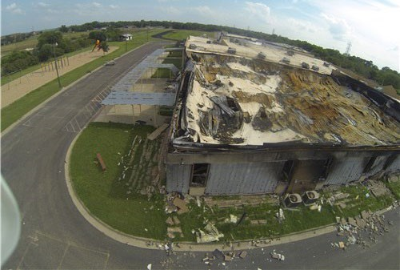
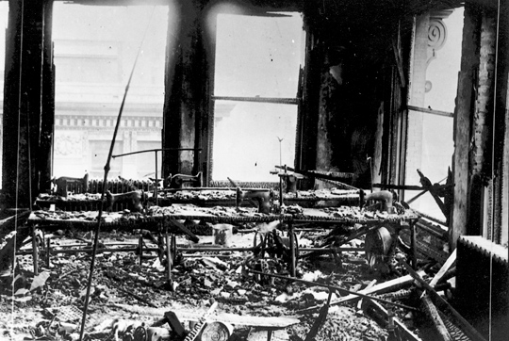
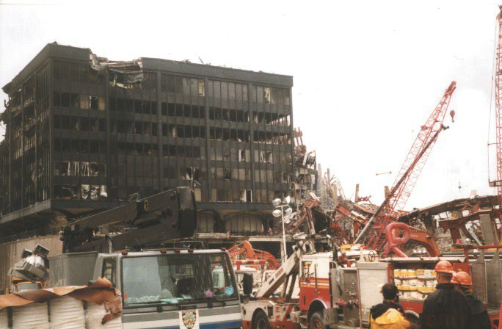
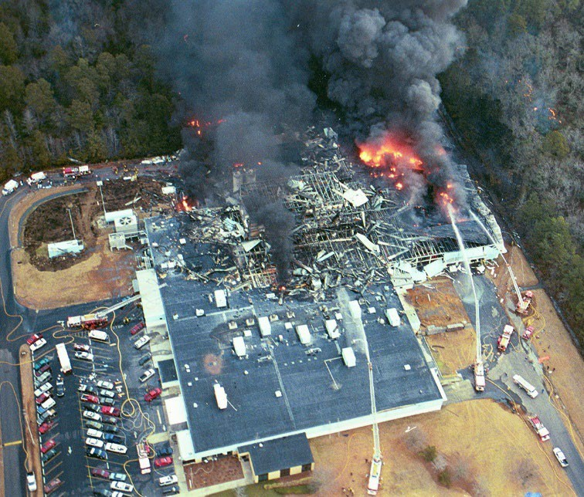
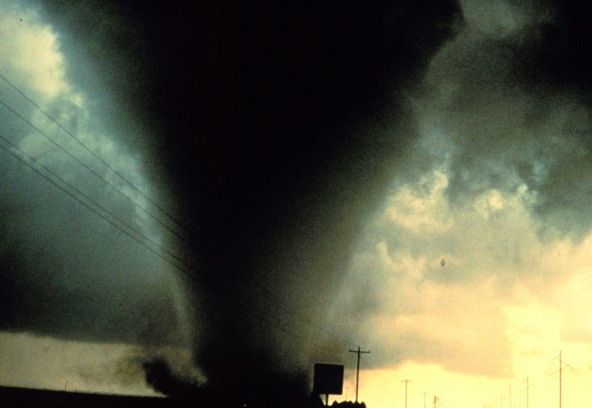
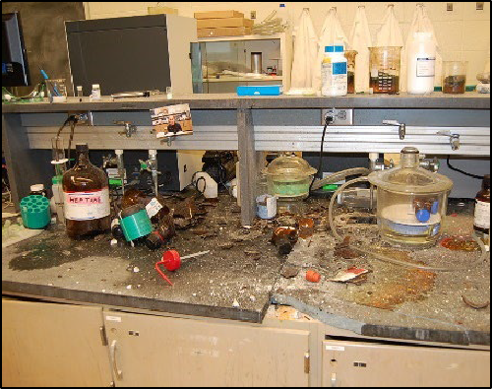
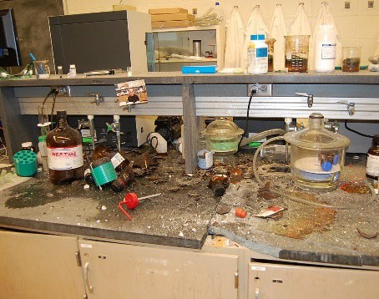
Introduction
Source: CSB
Source: National Archives
Source: CSB
Source: National Archives
Source: OSHA
Source: OSHA
Source: CSB
Source: CSB
Source: NOAA
Source: NOAA
Source: CSB
Source: CSB
Fires and explosions, as well as other workplace incidents, may require emergency actions and evacuations to protect employees.

Slide 3
Introduction
Lesson objectives:
Recognize benefits of an Emergency Action Plan.
Identify elements of Fire Protection Plan.
Identify conditions under which evacuation actions may be necessary in an emergency situation.
Identify conditions under which shelter-in-place may be necessary in an emergency situation.

Slide 4
Introduction
Identify characteristics of an effective emergency escape route.
Recognize the five types of fire extinguishers, including the types of fires they can extinguish.
Review requirements for proper maintenance of portable fire extinguishers.

Slide 5
Emergency Action Plans
Benefits of an EAP:
Written document that facilitates and organizes employer and employee actions during workplace emergencies
Fewer and less severe injuries
Less structural damage
Reduce confusion

Slide 6
Emergency Action Plans
Purpose of an EAP:
Describes actions to be taken to ensure employee safety during an emergency
Uses floor plans/maps to show emergency escape routes
Tells employees what actions to take
Covers reasonably expected emergencies

Slide 7


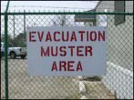
Emergency Action Plans
Required elements of plan:
Means of reporting
Evacuation procedures and emergency escape routes
Procedures for critical operations
Accounting of employees
Rescue and medical duties
Contact persons
Source of graphics: OSHA

Slide 8

Emergency Action Plans
Training employees on the EAP
  Review plan with each employee
    Initial development of plan
    Initial assignment of employee to job
    Changes to plan or employee actions/responsibilities
  Annual retraining with drills to practice evacuation and gathering in assembly area
  Educate/train
    Types of emergencies
    Course of actions
    Functions and elements of EAP
    Special hazards
Fire hazards and fire prevention plan
Source: OSHA

Slide 9
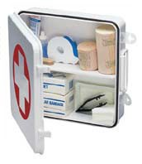

Emergency Action Plans
General training
  Roles and responsibilities
  Threats, hazards, protective actions
  Notification, warning, communications
  Locating family members
  Location/use of emergency equipment
  Procedures
    Emergency response
    Evacuation and shelter-in-place
    Assembly and accounting of employees
    Emergency shut-down
Source of graphics: OSHA

Slide 10

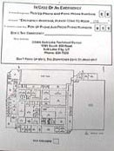

Emergency Action Plans
Examples of procedures:
Methods of reporting an emergency
Instructions for exit
Instructions for limited mobility
Source of graphics: OSHA

Slide 11
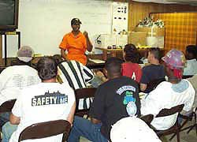
Fire Prevention Plan
FPP requirements:
Must be
  In writing
  Kept in the workplace
  Available to employees for review
Employer must
Source: OSHA
Inform employees of fire hazards when initially assigned to a job
Review with each employee applicable FPP parts

Slide 12
Fire Prevention Plan
Included in FPP
  Lists of all major fire hazards, proper handling and storage of hazardous materials, ignition sources/controls, and fire protection equipment
  Procedures to control flammable/combustible wastes
  Procedures for maintenance of safeguards on heat-producing equipment
  Name/job titles of employees with responsibilities for maintenance of equipment and control of hazards

Slide 13
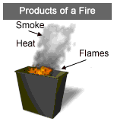

Fire Prevention Plan
Preventing fires hazards:
Understanding fires
  Rapid chemical reaction between oxygen and a combustible material
  Results in release of heat, light, flames, and smoke
  Requires four elements:
    Oxygen
    Ignition source (heat)
    Fuel
    Chemical reaction
Source of graphics: OSHA

Slide 14
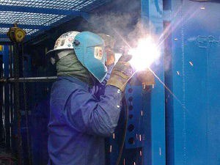
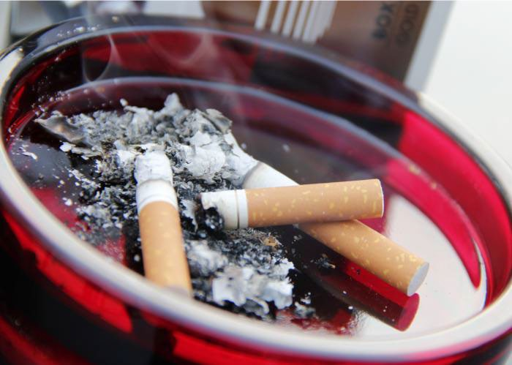
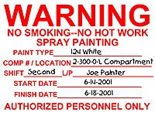
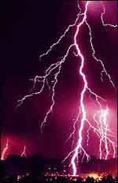
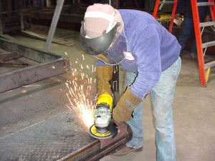
Fire Prevention Plan
Ignition sources
  Open flames
  Smoking
  Static electricity
  Hotwork
  Hot surfaces
  Electrical and mechanical sparks
  Lightning
Source: CDC
Source of graphics: OSHA

Slide 15
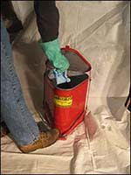
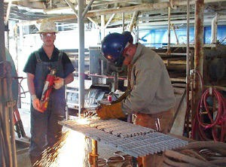
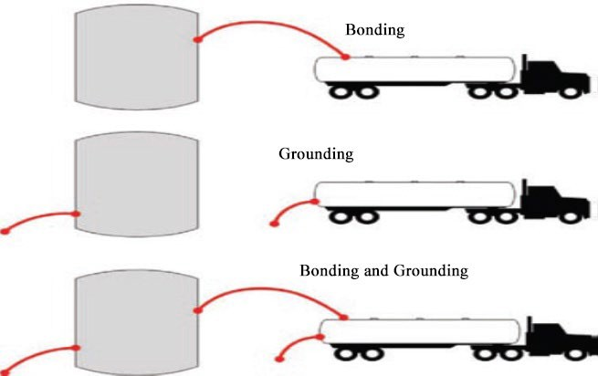
Fire Prevention Plan
Tasks that require fire protection and examples of hazards
  Hotwork – 30-minute fire watch
  Dispensing flammables and combustibles: gasoline, diesel, or natural gas
  Flammable wastes: solvent waste, oily rags, and flammable liquids
Source of graphics: OSHA

Slide 16
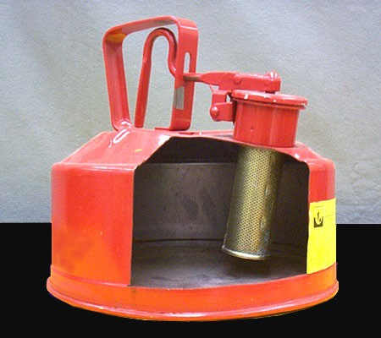
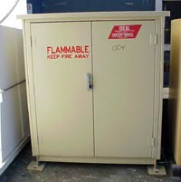
Fire Prevention Plan
Handling of flammable hazards
  Only use approved metal safety containers or original manufacturer’s containers for storage
  Practice good housekeeping
  Keep containers closed when not in use
  Store away from exits or passageways
  Keep away from ignition sources
Source of graphics: OSHA

Slide 17
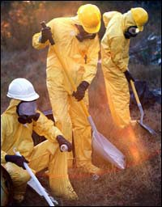
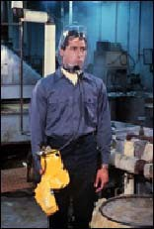
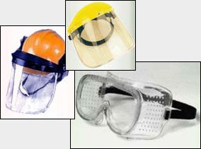
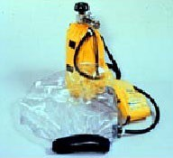
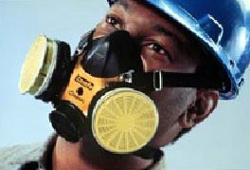
Fire Prevention Plan
Fire protection equipment
  PPE
  Fire Suppression
    Portable fire extinguishers
    Fixed systems
Source of graphics: OSHA

Slide 18
Conditions Requiring Evacuation
Workplace evacuation may be required for:
Man-made emergencies
  Fires
  Explosions
  Toxic material releases
  Radiological/biological incidents
  Civil disturbances
  Workplace violence
Natural emergencies
  Floods
  Earthquakes
  Hurricanes
  Tornadoes
  Wildfires
  Winter weather

Slide 19
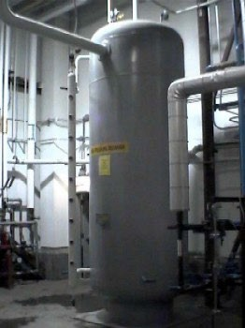
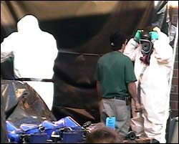
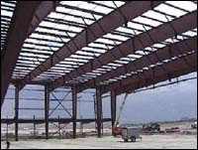
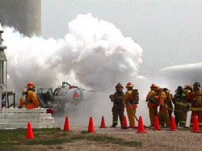
Conditions Requiring Evacuation
Factors affecting response to emergencies:
Type/extent of emergency
Location of emergency
Type of building in which workplace is located
Shutting down critical operations
Source of graphics: OSHA

Slide 20

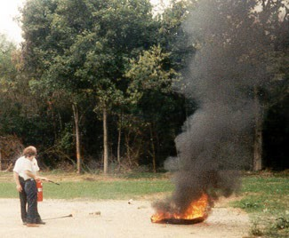
Conditions Requiring Evacuation
Fire emergencies:
Fight or Flee?
Options for evacuation
  Total evacuation
  Designated employees authorized to fight fire; all others evacuate
  All employees authorized to fight fire
  Extinguishers provided but not intended for employee use
Source of graphics: OSHA

Slide 21
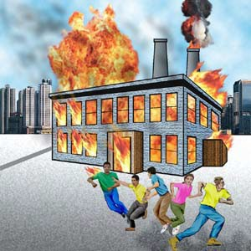
Conditions Requiring Evacuation
Fire emergencies:
Fight or Flee?
Performing a risk assessment
  Is the fire too big?
  Is the air safe to breathe?
  Is the environment too hot or smoky?
  Is there a safe evacuation path?
Source: OSHA

Slide 22
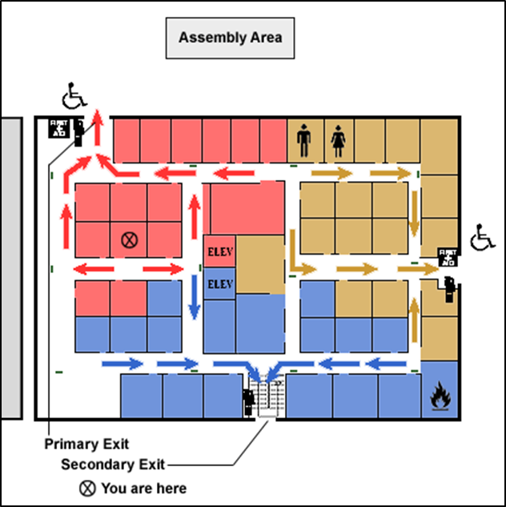
Conditions Requiring Evacuation
Evacuation maps show:
Exits: to, thru, and away
At least two ways out
  Primary exit
  Secondary exit
Assembly area
Location on the map
Additional information –
Location of fire extinguishers
Source: OSHA

Slide 23
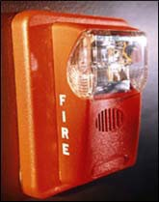

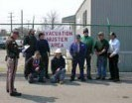
Conditions Requiring Evacuation
Evacuation actions:
Alerting employees to evacuate
  Alarm
  Enunciator panel/speaker
Accounting for who has exited
  How is that accomplished
Keeping employees informed
  All clear, re-enter, or remain at assembly point
  Clear to leave workplace
Source of graphics: OSHA

Slide 24


Conditions Requiring Shelter-in-Place
Incidents that may require shelter-in-place:
Release of chemical, biological, or radiological contaminants
Severe weather – tornadoes
Other situations occurring outside the workplace
Source: CDC
Source: FEMA Region VI

Slide 25
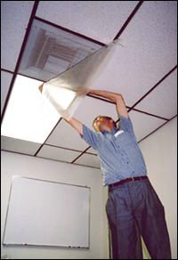
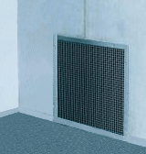

Conditions Requiring Shelter-in-Place
Shelter-in-place:
Means taking refuge in interior room(s) with no/few windows
Local authorities often issue shelter-in-place advice via TV or radio
Procedures specific to worksite
Source of graphics: OSHA

Slide 26


Conditions Requiring Shelter-in-Place
Planning shelter-in-place actions:
Alerting employees – shelter-in-place
Accounting for who is in refuge
Keeping employees informed
Source of graphics: OSHA

Slide 27

Emergency Escape Routes
Exit routes:
Continuous and unobstructed path of exit travel from any place in workplace to safety
Exit access, exit, exit discharge
Should be:
  Clearly marked
  Well-lit
  Appropriate width
  Unobstructed/clear
Source: TEEX

Slide 28

Emergency Escape Routes
Basic exit route requirements:
  Permanent
  Separated by fire-resistant materials
  Limited openings
  Adequate number of exit routes
  Discharge leading directly outside or to a place with access to outside
  Exit door unlocked from inside and side-hinged
  Adequate capacity
  Minimum height and width
Source of graphics: OSHA

Slide 29

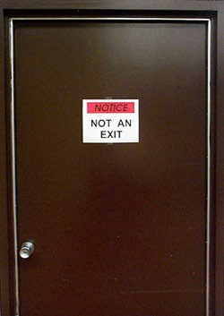

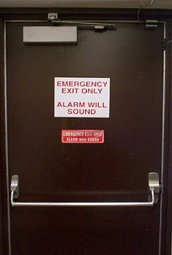

Emergency Escape Routes
Clearly communicate 3 elements of escape route
  Exit access pathway
  Nearest exits from all points of building
  Pathway away from building structure
Source of graphics: OSHA

Slide 30
Designate an
as
sembly area
ts into narrow passages
Indicate exits
No emergency
No emergency exits in restrooms
_{exi} with wheelchair
access
No use of elevators to reach an emergency exit
Exit nea
signs indicating the rest emergency exit
D
esignate primary d secondary exits
Exit away from rooms with hazardous
an
Indicate the employee’s current location

Slide 31
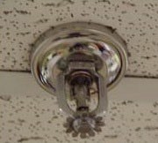
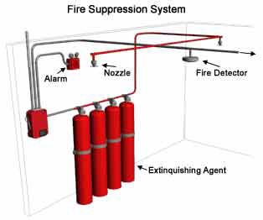
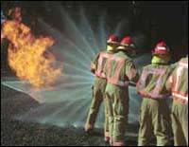
Extinguishing Fires
Methods of fire protection:
Fixed extinguishing systems
Fire brigades
Fire extinguishers
Source of graphics: OSHA

Slide 32
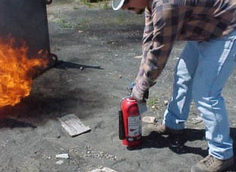
Extinguishing Fires
Portable fire extinguisher training and education
  Required for employees authorized to use fire extinguishers
  General principles of fire extinguisher use
  Hazards of incipient stage fire fighting
  Operation of equipment (instruction and
hands-on practice)
  Required upon initial
employment/assignment
and at least annually thereafter
Source: OSHA

Slide 33




Extinguishing Fires
Classes of fires:
Class A – ordinary combustibles
Class B – flammable liquids and gases
Class C – energized electrical equipment
Class D – combustible metals
Class K – cooking oils and greases
A C D K
B
Source: OTIEC

Slide 34
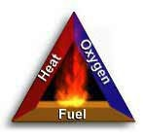
Extinguishing Fires
How fire extinguishers work
  Remove heat
  Displace/remove oxygen
  Stop chemical reaction
Source: OSHA

Slide 35
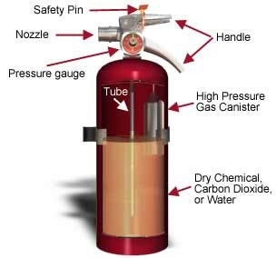
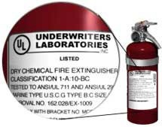
Extinguishing Fires
Parts of a fire extinguisher and labels
Source of graphics: OSHA

Slide 36
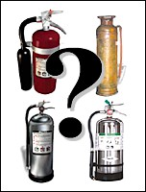
Extinguishing Fires
Types of extinguishers:
Water
Carbon Dioxide
Dry Chemical
Source: OSHA

Slide 37
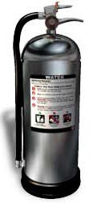

Extinguishing Fires
Water or air-pressurized water (APW) extinguishers
  Designed for Class A fires only
  Large silver container, 2 to 3 ft. tall, weighing about 25 lbs. when full
  Filled 2/3 with ordinary water, then pressurized with air
  Detergents may be added
  Cool the surface to remove the heat
  Never use to extinguish flammable liquid fires or electrical fires
Source of graphics: OSHA

Slide 38
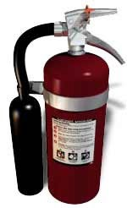

Extinguishing Fires
Carbon Dioxide (CO₂) extinguishers
  Designed for Class B and Class C fires only
  Red cylinders, ranging from 5 to 100 lbs. or larger, with a hard horn and no pressure gauge
  Filled with Carbon Dioxide (CO₂), under extreme pressure
  Displace oxygen; dry ice pieces also have cooling effect
  Never use in confines space without respiratory protection
Source of graphics: OSHA

Slide 39


Extinguishing Fires
Dry Chemical extinguishers (Multi-purpose)
  May be used on Class A, Class B, and/or Class C fires (check label)
  Red cylinders, ranging in size from 5 to 20 lbs.
  Fire-retardant powder is the extinguishing agent and is propelled by a compressed, non-flammable gas
  Separates fuel from oxygen; powder also interrupts chemical reaction
Source of graphics: OSHA

Slide 40

Extinguishing Fires
Class K – dry and wet chemical extinguishers
  Designed for kitchen fires
  Only intended to be used after activation of built-in hood suppression system
  Filled with electrically conductive extinguishing agents; use only after electrical power to appliance has been shut off
  Potassium bicarbonate may be used in dry types; wet chemical extinguishers spray a fine mist
Source of graphics: OSHA

Slide 41
Extinguishing Fires
Using a fire extinguisher:
Steps to follow
  Sound alarm; call fire department
  Identify safe evacuation path
  Select appropriate fire extinguisher
  Discharge extinguisher using P.A.S.S. technique
  Back away once extinguished
  Evacuate immediately if necessary
    Extinguisher empty and fire is not out
    Fire progresses beyond incipient stage

Slide 42

Extinguishing Fires
P.A.S.S. technique
  Pull the pin
  Aim at base of fire
  Squeeze handle
  Sweep side-to-side at base of fire until fire appears out
Watch area for re-ignition and repeat steps 2 – 4;
When in doubt, EVACUATE IMMEDIATELY!
Source: OSHA

Slide 43
Maintenance of Extinguisher
Elements of inspection:
Inspect bottle, handle, hose, and gauge for proper working order
Inspection tag
  Month and Year put in service current (annual)
  Monthly visual inspections completed (monthly)
  Extinguisher product still free-flowing inside bottle (turn upside down and/or shake)

Slide 44

What’s Wrong?
Source: OSHA

Slide 45

What’s Wrong?
Source: OSHA

Slide 46
Knowledge Check
Which of the following statements is TRUE regarding Emergency Action Plans (EAPs)?
  EAPs need to be written down only if requested by employees.
  EAPs facilitate and organize actions taken during an emergency.
  EAPs have no effect on the number or severity of injuries during and emergency.
  EAPs increase confusion due to the number of documents required.
Answer: b. EAPs facilitate and organize actions taken during an emergency

Slide 47
Knowledge Check
Fire Prevention Plan (FPP) requirements include all of the following, except .
  it must be written document that is kept in the workplace
  it must be made available to employees for review
  the employer must review with each employee the parts of the FPP necessary for self-protection
  FPPs can be communicated orally if there are more than 10 employees
Answer: d. FPPs can be communicated orally if there are more than 10 employees

Slide 48
Knowledge Check
Which of the following elements are required in order for a fire to occur?
  Sufficient oxygen, fuel, ignition source, and chemical reaction
  Sufficient fuel, carbon dioxide, heat, and chemical reaction
  Combustible materials, spark, heat, and mechanical reaction
  Smoke, heat, flames, and light reaction
Answer: a. Sufficient oxygen, fuel, ignition source, and chemical reaction

Slide 49
Knowledge Check
Only those employees who have received training on the use of a fire extinguisher can be authorized to use a fire extinguisher during a workplace fire.
  True
  False
Answer: a. True

Slide 50
Knowledge Check
Which of the following statements represents an element of a good emergency evacuation floor plan?
  Designates one exit pathway so as not to confuse evacuees
  Indicates locations of elevators used to reach emergency exit
  Directs exits away from rooms with hazardous materials
  Indicates restrooms and windows as potential exits
Answer: c. Directs exits away from rooms with hazardous materials

Slide 51
Knowledge Check
Trash fires involving paper and wood products are fires.
  Class A
  Class B
  Class C
  Class D
Answer: a. Class A

Slide 52
Knowledge Check
Which fire extinguisher is appropriate for use on a fire involving gasoline in a confined space when no respiratory protection is available?
  Water (APW) extinguisher
  Carbon dioxide extinguisher
  Dry chemical extinguisher
  Class K dry-type extinguisher
Answer: c. Dry chemical extinguisher

Slide 53
Knowledge Check
The P.A.S.S. technique for using a fire extinguisher means .
  Position, aim, sweep, slowly
  Pull, aim, squeeze, sweep
  Point, away, side-to-side
  Pin, approach, start, stop
Answer: b. Pull, aim, squeeze, sweep

Slide 54
Knowledge Check
At minimum, how often must maintenance checks be performed on portable fire extinguishers?
  Once a month
  Once a year
  Once every two years
  Once every five years
Answer: b. once a year

