Slide 1
Tools – Hand and Power
10-Hour Construction Outreach

Slide 2
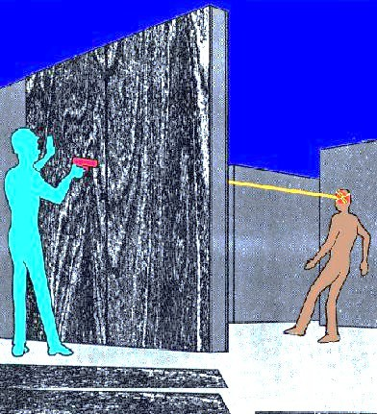
Introduction
Fatal Facts:
Employee killed when struck in head by a nail fired from a powder-actuated tool.
Source: OSHA

Slide 3

Introduction
Tools are part of our everyday lives.
Even simple tools can be hazardous.
Source: OSHA

Slide 4
Introduction
Objectives:
Identify various types of tools.
Describe types of hazards.
Describe guarding requirements.
Describe safe operation methods.
Recognize employer requirements.

Slide 5
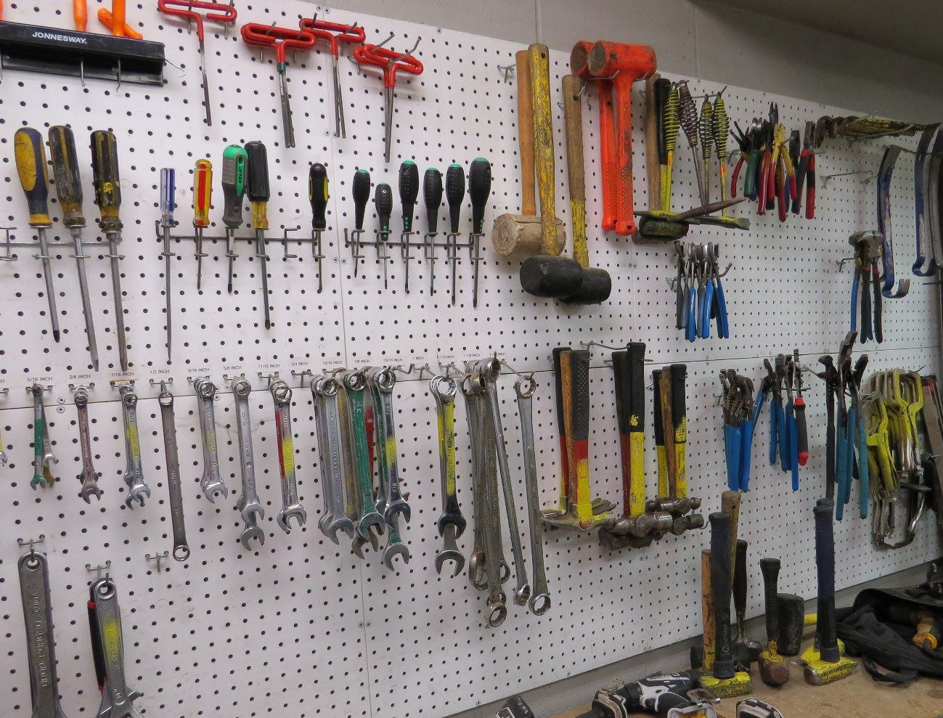
Types of Tools
Manually operated hand tools
Source: TEEX

Slide 6
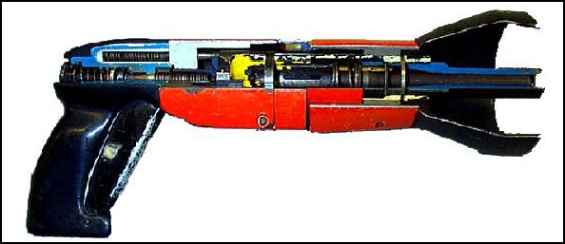

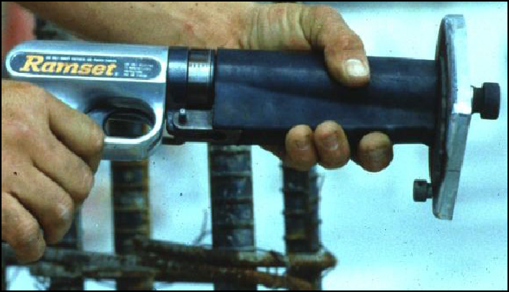
Types of Tools
Power-operated tools
  Electrical
  Pneumatic
  Liquid fuel
  Hydraulic
  Powder-actuated
Source of photos: OSHA

Slide 7
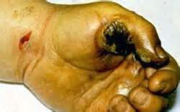

Hand and Power Tool Hazards
Types of hazards
  Struck-by
  Electrical
  Caught-in
Source: OSHA
Source: Susan Harwood Grant Number SH-17792-08-60-F-48 by Compacion Foundation

Slide 8

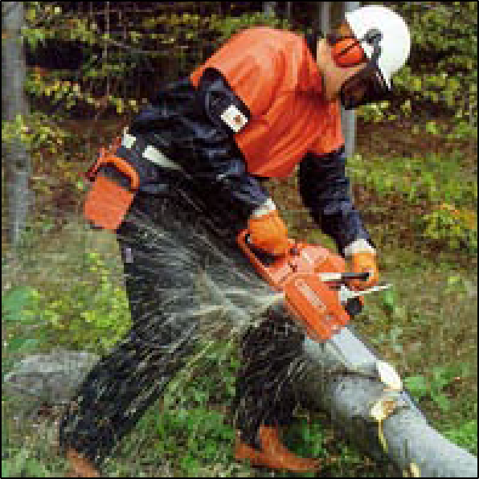
Hand and Power Tool Hazards
Harmful materials
Trips and slips
Sharp edges/protruding objects
Source: OSHA, courtesy of New Jersey Department of Health
Source: OSHA

Slide 9
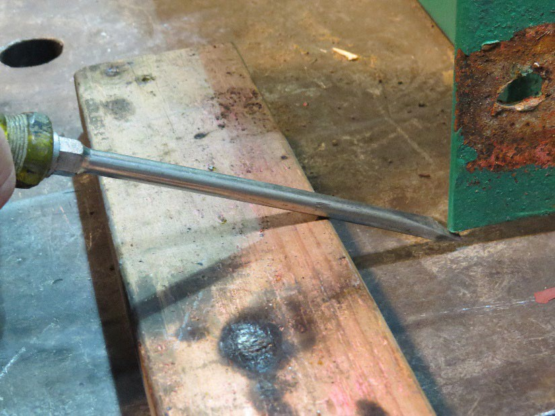
Hand and Power Tool Hazards
Exposure to hazards due to using
  Wrong tool
  Tool wrong way
Source: TEEX

Slide 10
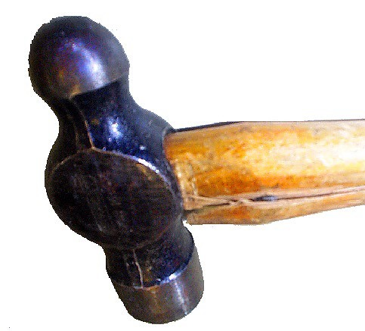
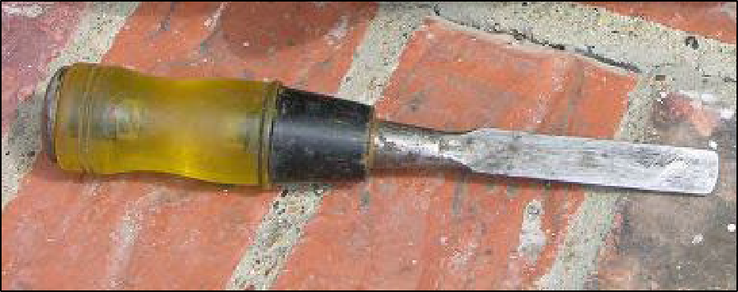
Hand and Power Tool Hazards
Damaged or broken tools
Dull tools
Source: OSHA
Source: TEEX Harwood

Slide 11
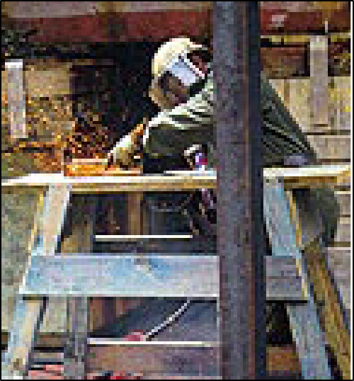
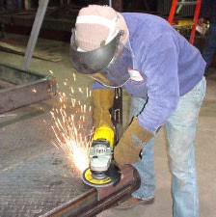

Hand and Power Tool Hazards
Spark-producing tools near flammable sources
Tools not properly guarded
Tools not properly grounded
Inadequate PPE
Source: OSHA
Source: TEEX Harwood
Source: OSHA

Slide 12


Guarding
Use guarding techniques for hazards
  Motions: rotating, in-running nip points, reciprocating, transversing
  Actions: cutting, punching, shearing, bending
Source of photos: OSHA

Slide 13
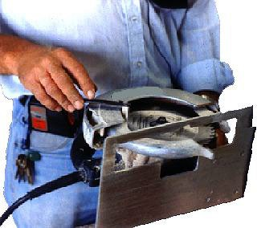
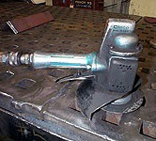
Guarding
Guard
  Exposed moving parts
  Point of operation, in-running nip points, and rotating parts
  Flying chips and sparks
  Abrasive wheels and cutting blades
  Never remove guards when tool is in use
Source of photos: OSHA

Slide 14
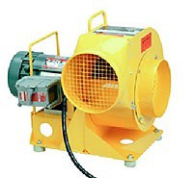
Guarding
Properly guarded blower
Source: OSHA

Slide 15
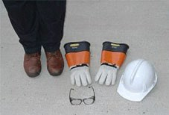
Precautions for Safe Use
General hand and power tool safety practices
  Keep tools clean and well-maintained.
  Use the right tool and use it the right way.
  Follow manufacturer’s instructions.
  Wear proper PPE
Source: OSHA

Slide 16
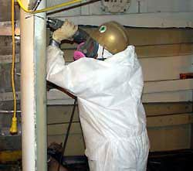
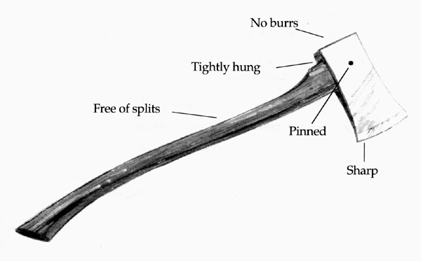
Precautions for Safe Use
Practice good housekeeping.
Keep work areas well lit.
Inspect tools; remove from service if needed.
Keep all cutting tools sharp
Source: OSHA

Slide 17
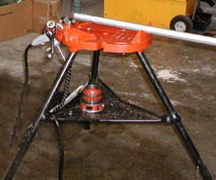
Precautions for Safe Use
Precautions for power tools
  Disconnect from power source.
  Keep people at safe distance.
  Secure work.
Source: OSHA

Slide 18
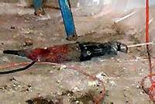
Precautions for Safe Use
Avoid accidental start-ups.
Fit with guards and safety switches.
Maintain good footing and balance.
Wear proper clothing for task.
Safeguard exposed moving parts
Source: OSHA

Slide 19

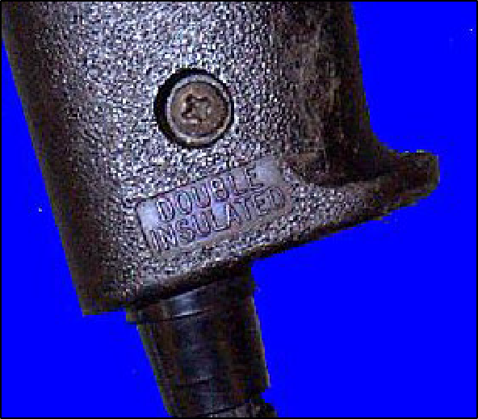
Precautions for Safe Use
Electrical tools:
  Remove from service and tag damaged tools
  Protect against shock
  Never remove third prong
Source: NIOSH
Source: OSHA

Slide 20
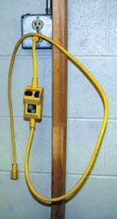
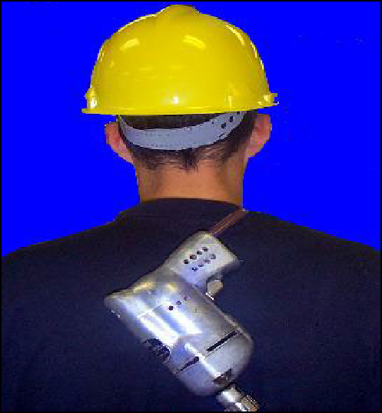
Precautions for Safe Use
Protect cords
Store properly
Use GFCI or AEGC
Source: OSHA
Source: NIOSH

Slide 21
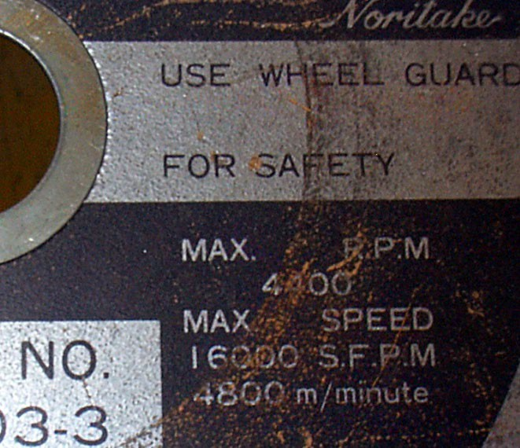
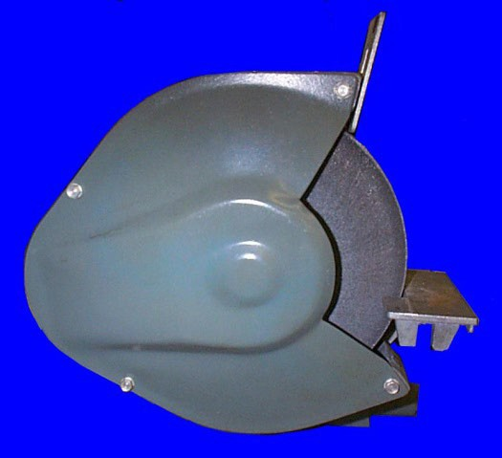
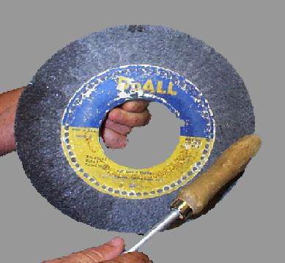
Precautions for Safe Use
Abrasive wheels and tools
  Equip with guards.
  Before mounting, inspect and test.
  Follow manufacturer recommendations for operating speeds.
Source of photos: OSHA

Slide 22
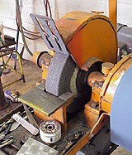
Precautions for Safe Use
Accelerate wheel to operating speed before beginning task.
Do not stand in front of grinding wheel as it comes up to speed.
Properly adjust (1/8” opening) and use work rest.
Source: OSHA

Slide 23
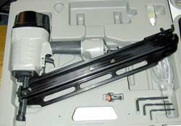
Precautions for Safe Use
Pneumatic tools
  Use same precautions with air hose as with electric cords
  Securely fasten air hose to tool and safeguard with a positive locking device
Source: OSHA

Slide 24
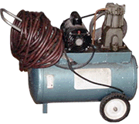
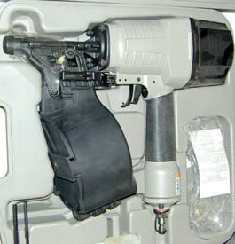
Precautions for Safe Use
Equip tool with device to keep fasteners from accidently being ejected.
Use screens to protect nearby workers.
No not use compressed air for cleaning off clothing.
Source of photos: OSHA

Slide 25
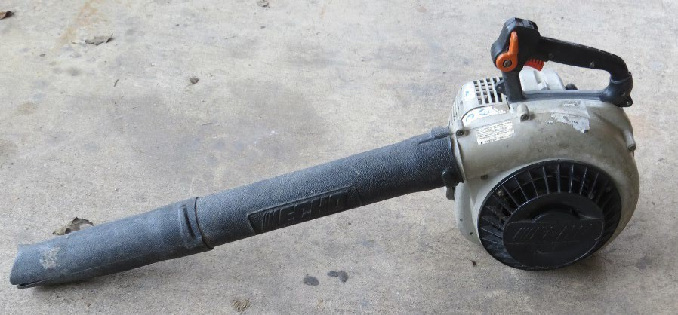
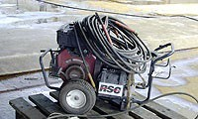
Precautions for Safe Use
Fuel-powered tools
  Handle, transport, and store gas or fuel in approved containers.
  Shut down and allow engine to cool before refilling fuel tank.
  Use ventilation and respiratory protection as needed.
Source: TEEX
Source: OSHA

Slide 26
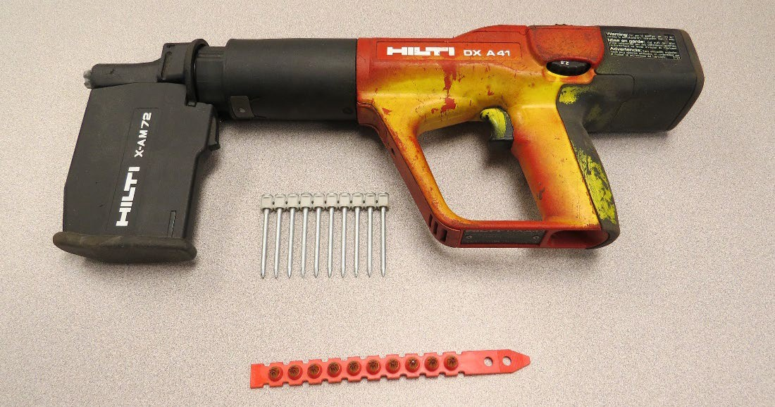
Precautions for Safe Use
Powder-actuated tools
  Treat with extreme caution
  Must be trained
  Only employees trained in the operation of the particular tool in use shall be allowed to use
  Wear suitable PPE
Source: TEEX

Slide 27
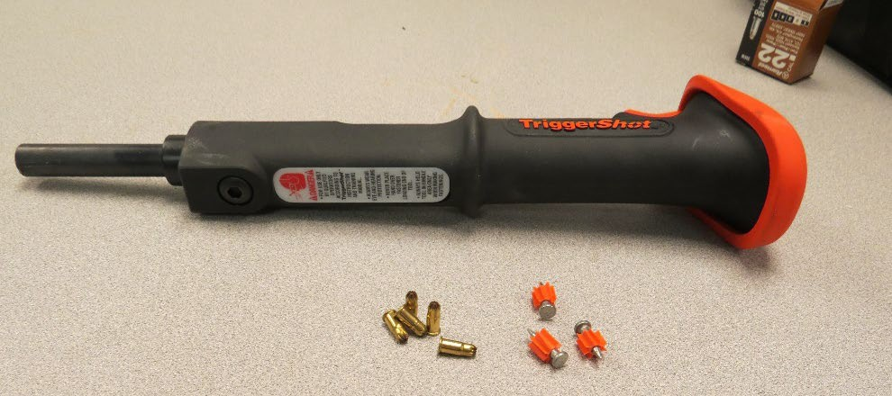
Precautions for Safe Use
Select appropriate powder level for tool and task
Test tool to ensure safety devices work
Inspect tool
Do not use defective tools
Source: TEEX

Slide 28
Precautions for Safe Use
Do not load tools until just prior to use
Never point tool at anyone
Keep hands clear of open barrel end
Never leave loaded tool unattended
Do not drive fasteners into materials that are very hard, brittle, or easily penetrated
Do not drive fastener into a spalled area
Use manufacturer-recommended shields, guards, or attachments.
Store unloaded in a locked box.

Slide 29
Employer Requirements
Comply with OSHA standards
  Training
  Inspection
Comply with manufacturer’s requirements and recommendations

Slide 30
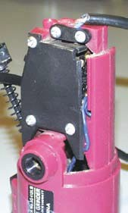
Identify Hazards
Hand-held sander with exposed wires should not be used.
Source: NIOSH

Slide 31
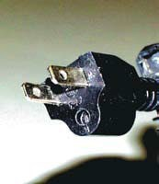
Identify Hazards
This three-prong grounding plug has the ground prong broken off.
Source: NIOSH

Slide 32
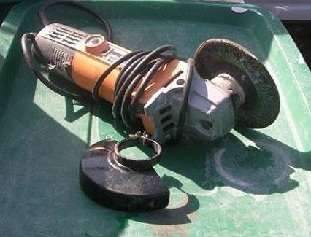
Identify Hazards
Grinder guard removed to accommodate larger wheel.
Source: TEEX Harwood

Slide 33
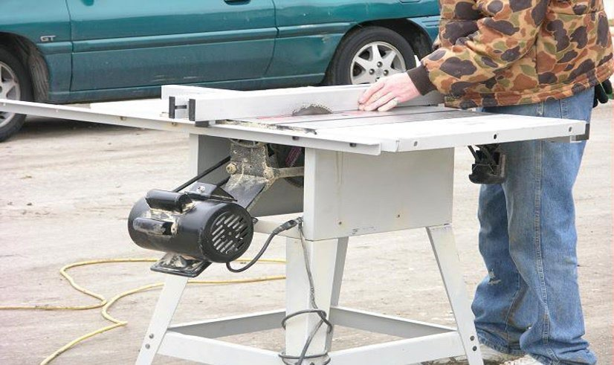
Identify Hazards
Working in street with power cords potentially exposed to traffic.
Guard removed from saw blade.
Power take-off guard is missing.
Source: TEEX Harwood

Slide 34
Knowledge Check
Which of the following is an example of an unsafe practice regarding the use of tools?
  Keeping cutting tools sharp
  Wearing eye and face protection while operating a grinder
  Using a screwdriver to carve or cut wood
  Following manufacturer’s instructions when using a tool
c. Using a screwdriver to carve or cut wood

Slide 35
Knowledge Check
Which term describes a tool that is powered by compressed air?
  Hydraulic
  Powder-actuated
  Electrical
  Pneumatic
d. Pneumatic

Slide 36
Knowledge Check
Which of the following actions may expose workers to electrical shock hazards and should be avoided?
  Removing the grounding pin on a three-prong plug
  Using double-insulated tools
  Using a grounded adaptor to accommodate a two- prong receptacle
  Removing damaged tools from service and tagging them “Do Not Use”
a. Removing the grounding pin on a three-prong plug

Slide 37
Knowledge Check
Which of the following statements about guarding techniques is true?
  Guard the point of operation, in-running nip points, and rotating parts of tools.
  Remove guard from tool while it is in use, then replace when the job is completed.
  Adjust guard on abrasive wheel to allow maximum exposure of the wheel surface.
  Wear PPE because guards will not protect operator from flying chips and sparks or moving parts of tool.
a. Guard the point of operation, in-running nip points, and rotating parts of tools.

Slide 38
Knowledge Check
Employers must satisfy all of the following requirements, except:
  Provide PPE necessary to protect employees who are operating hand and power tools and are exposed to hazards.
  Comply with OSHA training and inspection standards related to hand and power tools.
  Determine which manufacturer’s requirements and recommendations for a tool shall be followed or ignored.
  Do not issue or permit the use of unsafe hand tools.
c. Determine which manufacturer’s requirements and recommendations for a tool shall be followed or ignored.

