Slide 1
Stairways and Ladders
10-hour Construction Outreach

Slide 2
Introduction
Lesson Overview
  Basic types of ladders and stairways
  Stairs and ladders hazards
  Methods to prevent stairway and ladder hazards.
  Employer requirements

Slide 3
Introduction
Falls are the leading cause of fatalities in constructions
Falls from ladders make up about one-third of these fatalities
Approximately 25,000 injuries per year due to falls from stairways and ladders
Falls are preventable

Slide 4
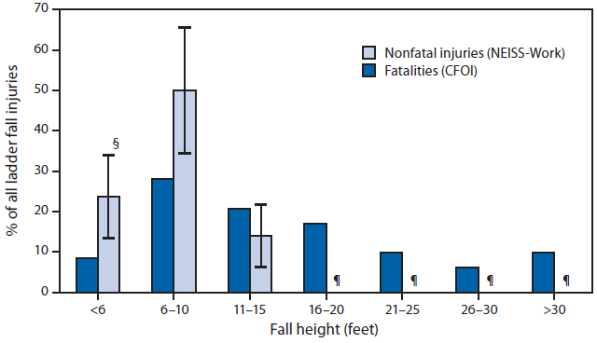
Introduction
Percentage of ladder fall fatalities* and nonfatal ladder fall injuries treated in emergency departments,† by fall height (when documented) — United States, 2011
Source: CDC

Slide 5
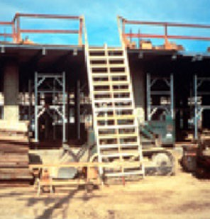
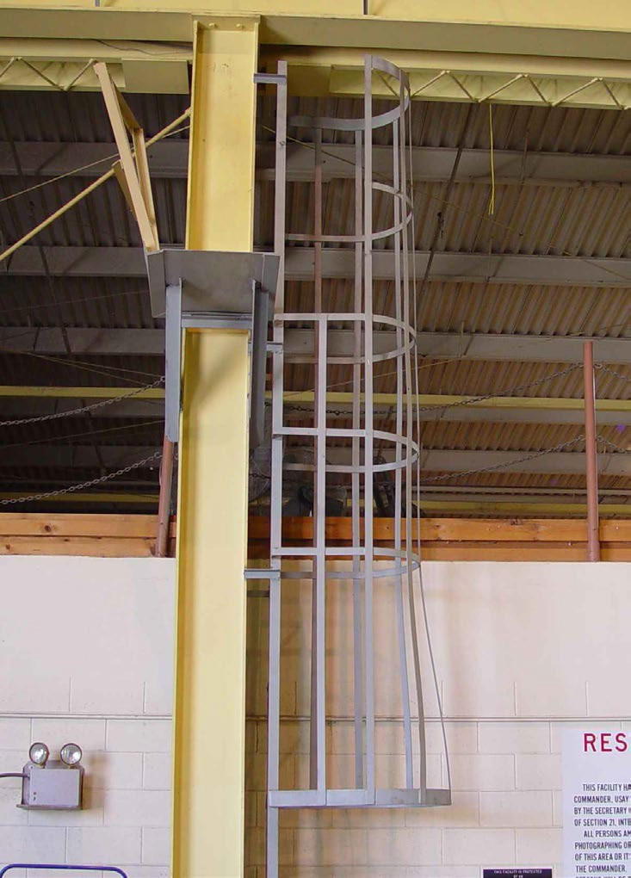
Types of Ladders and Stairways
Basic types of ladders
Source: OSHA
Source: TEEX Harwood

Slide 6
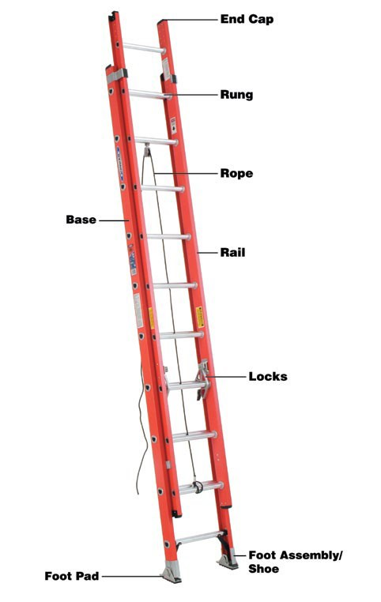
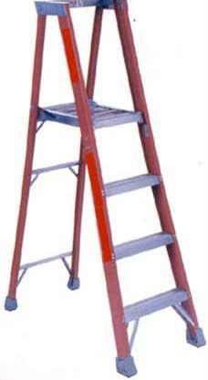
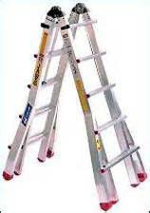


Types of Ladders and Stairways
Basic types of ladders
Source of photos: OSHA

Slide 7
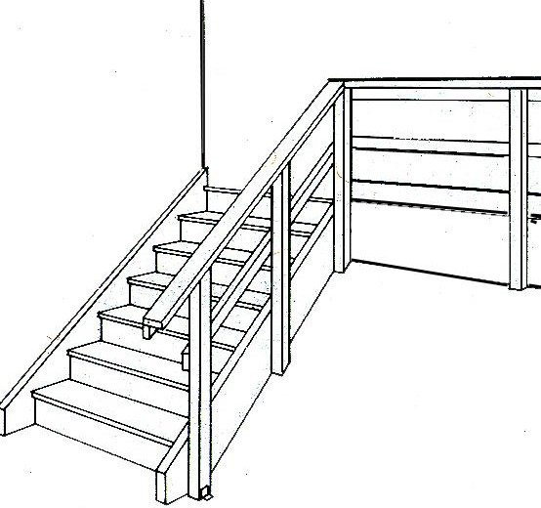
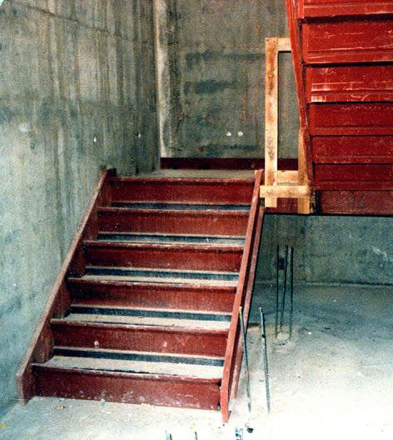
Types of Ladders and Stairways
Basic types of stairways
Source of graphics: OSHA

Slide 8
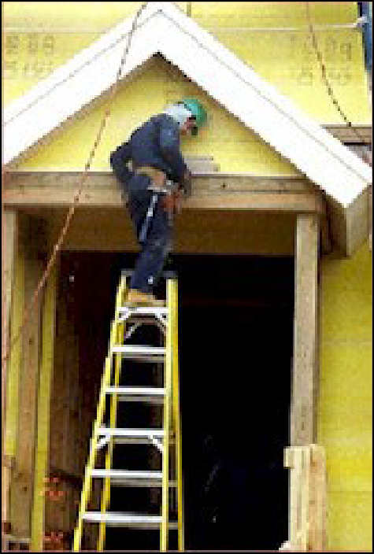
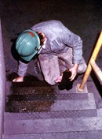
Hazards Associated with Stairs and Ladders
Slips
Trips
Falls
Improper use of the top rung of a step ladder
Source of photos: OSHA

Slide 9
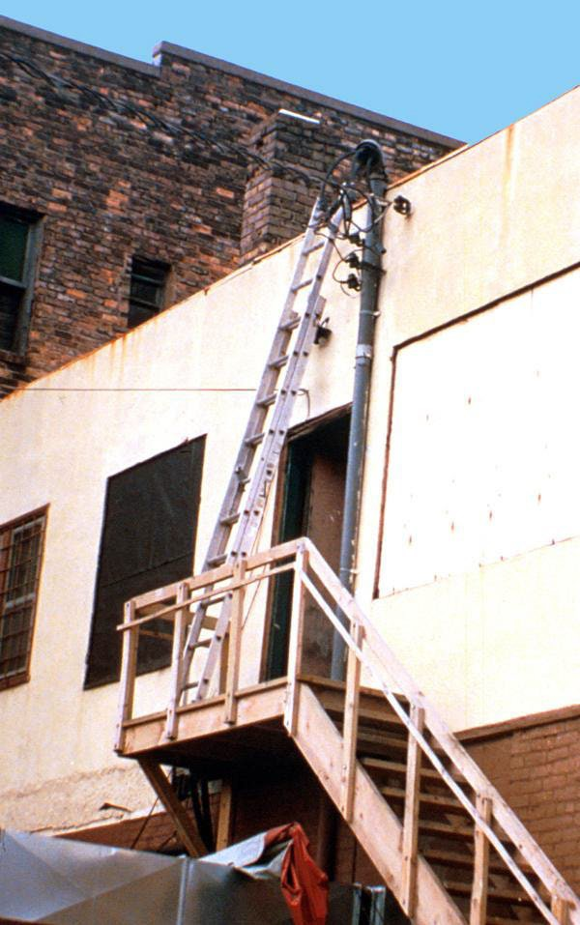
Hazards Associated with Stairs and Ladders
Electrical Hazards
Falling Objects
Protruding objects, sharp edges, or rough spots
This is an unsafe condition.
Source: OSHA

Slide 10

Reducing or Eliminating Hazards
Ladders
  Safe practices
  Ladder requirements
  Structural defects
Source: OSHA

Slide 11
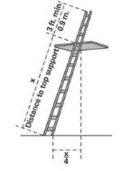
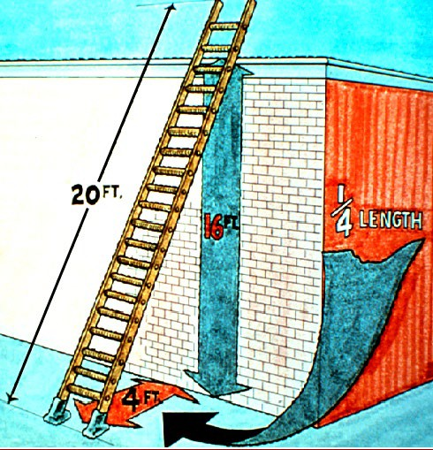
Reducing or Eliminating Hazards
Ladder-use practices
  Extend side rails 3 feet above the upper landing surface
  Don’t exceed load/capacity
  Use only as designed
  Angle ladder so the horizontal distance of bottom is ¼ the working length of the ladder
Source of graphics: OSHA

Slide 12
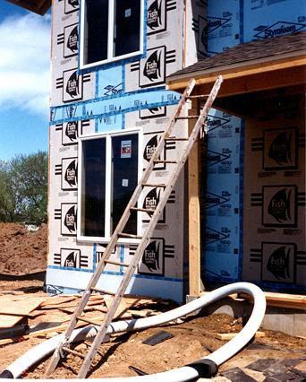
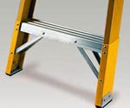
Reducing or Eliminating Hazards
Pitch fixed ladders no more than 90 degrees from the horizontal
Avoid use of ladder on surfaces that are:
  Unstable
  Not level
  Slippery
Secure ladders to prevent movement
This ladder is not on a stable surface and is not properly positioned.
Source of photos: OSHA

Slide 13
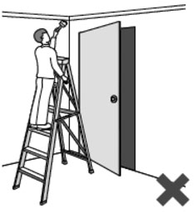
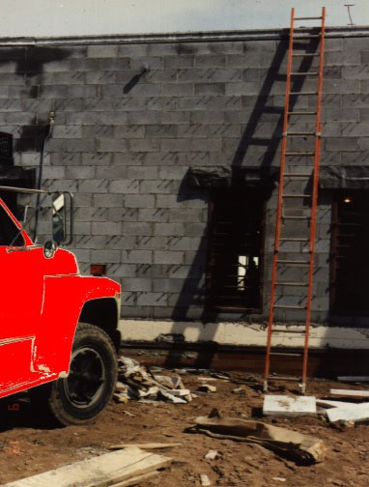
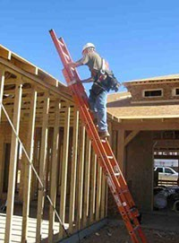
Reducing or Eliminating Hazards
Prevent movement/displacement
  Secure
  Barricade
Keep clear areas around top and bottom.
Equally support rails of non-self-supporting ladder at the top.
Source of photos: OSHA

Slide 14

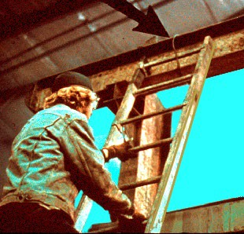
Reducing or Eliminating Hazards
Ascending or descending ladder
  Maintain 3-point contact
  Face ladder
  Stay inside side rails
  Never carry tools/objects in hands
  Be extra careful getting on or off
Source: OSHA
Source: OSHA

Slide 15
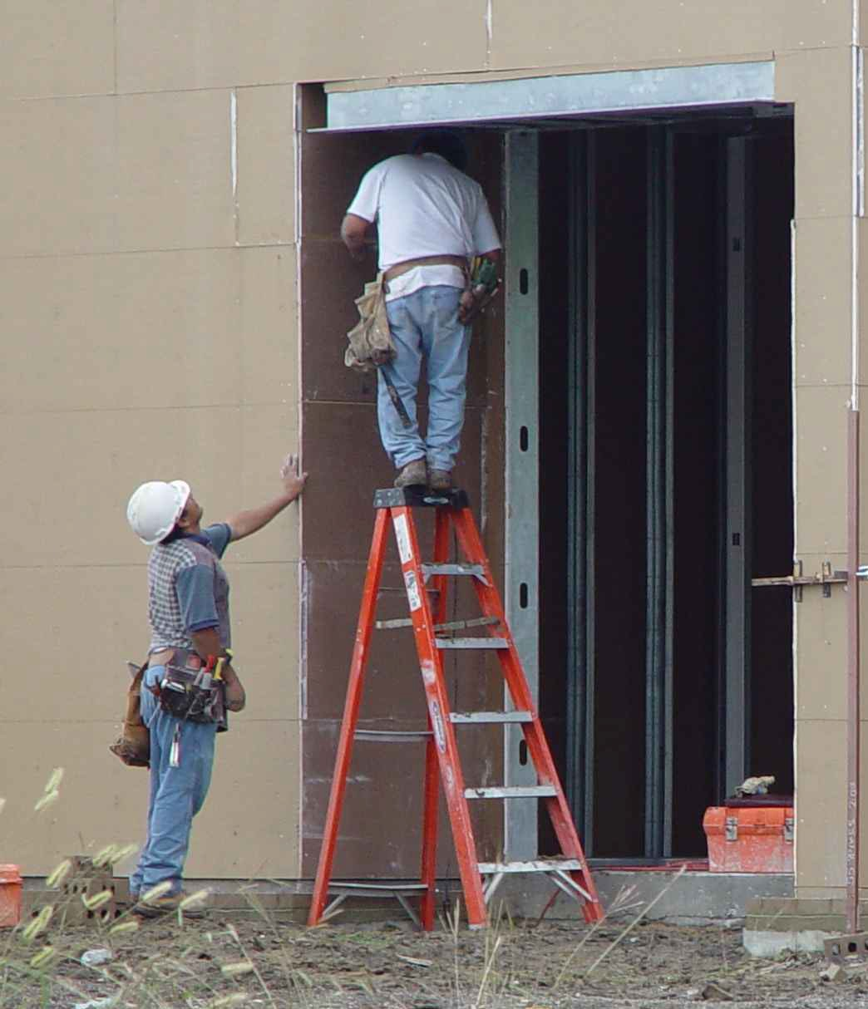
Reducing or Eliminating Hazards
Don’t move, shift, or extend while in use.
When exposed to energized electrical equipment, use nonconductive side rails.
Don’t use the top step of a stepladder.
Don’t climb the cross-bracing on the rear section of a stepladder.
Source: TEEX – Harwood

Slide 16
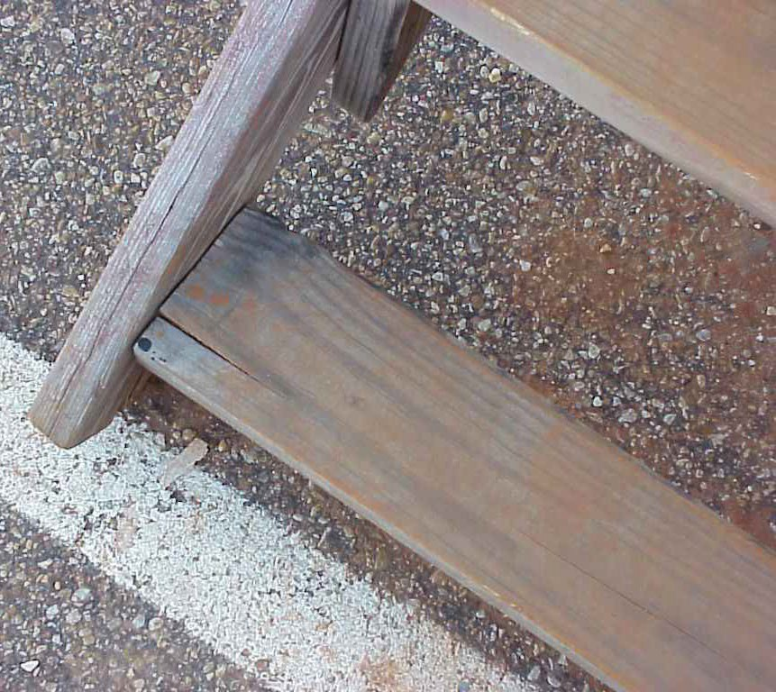
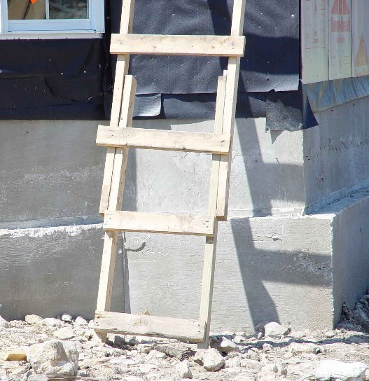
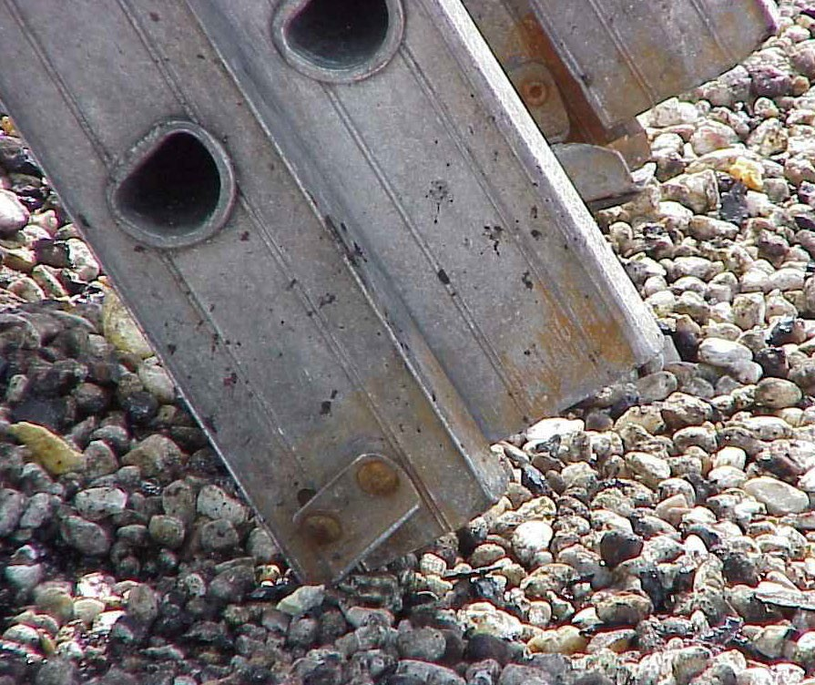
Reducing or Eliminating Hazards
Don’t use single-rail ladders.
Inspect (competent person)
  visible defects periodically
  and after any incident
  that could affect their safe use.
Source of photos: TEEX - Harwood

Slide 17
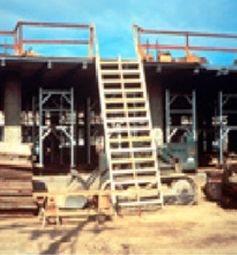
Reducing or Eliminating Hazards
Ladder requirements:
  Provide double-cleated ladder or two or more ladders:
    when having 25 or more employees using as only means of access to work area;
    when serves two-way traffic.
Source: OSHA

Slide 18
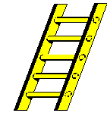
Reducing or Eliminating Hazards
Rungs, cleats, and steps:
  Parallel, level, and uniformly spaced
  Spacing
    Along portable or fixed ladder side rails – 10 to 14 inches apart
    Between center lines on step stools – 8 to 12 inches apart
    Between center lines on extension trestle ladders – 8 to 18 inches apart;
extension section 6 to 12 inches
Source: OSHA

Slide 19
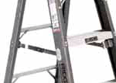
Reducing or Eliminating Hazards
Don’t tie or fasten together to create longer sections, unless design allows
Side rail of spliced side rails must have strength equal to one-piece side rail
Stepladder must have a metal spreader or locking device
to hold in open position.
Source: OSHA
Source: OSHA

Slide 20
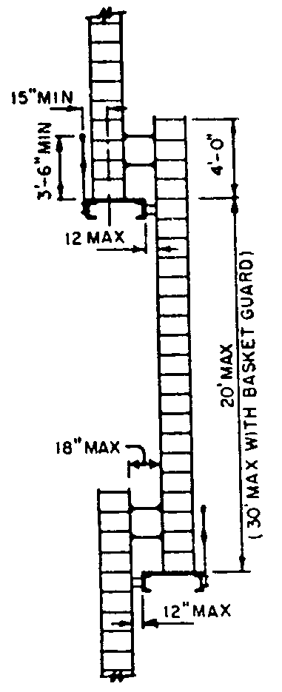
Reducing or Eliminating Hazards
Platforms or landings - offset two or more separate ladders used to reach an elevated work area.
Ladder surface - free of projections, sharp edges, or abrasive materials that could puncture or cut user, or snag clothing.
Wood ladders - not coated with any opaque covering, except for identification or warning labels only on one face of a side rail.
Source: OSHA

Slide 21
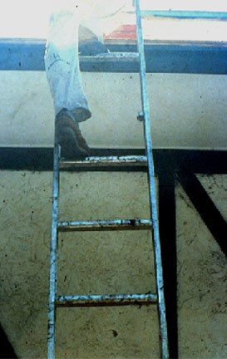
Reducing or Eliminating Hazards
Remove defective ladders from service
  Broken or missing parts
  Corrosion
  Other faulty or defective components
“Do Not Use”
Repair to original design criteria
Source: OSHA

Slide 22
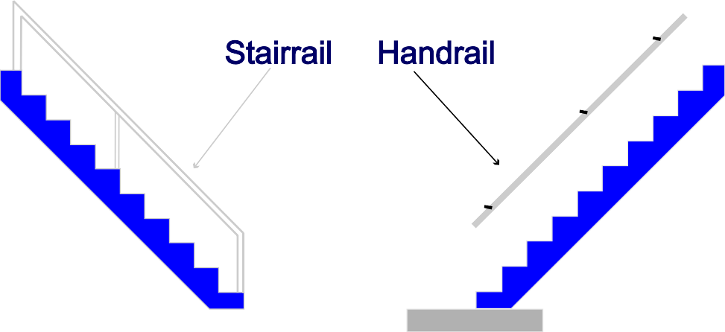
Reducing or Eliminating Hazards
Stairs
  Handrails
  Stair rail systems
  Stair requirements
  Temporary pan stairs
Source: OSHA

Slide 23
Reducing or eliminating hazards
Install handrail on stairways
  4 or more risers
  30 inches of rise

Slide 24
Reducing or eliminating hazards
Install stair rail system
  Toprail, mid-rail, and sometimes a toeboard
  Unprotected sides and edges of stairs with rise of 6 or more feet

Slide 25
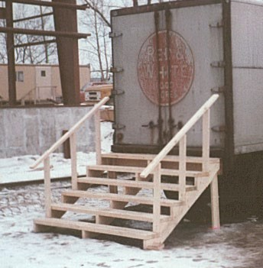

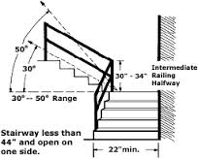

Reducing or eliminating hazards
Build/maintain stairs that meet OSHA requirements
  Uniform riser height and tread depth
  30 to 50 degrees angle
  Landings every 12 feet
  Remove projections
  Correct slippery conditions
Source: OSHA
No more than 1/4 inch variation in any stairway system
Source: OSHA

Slide 26
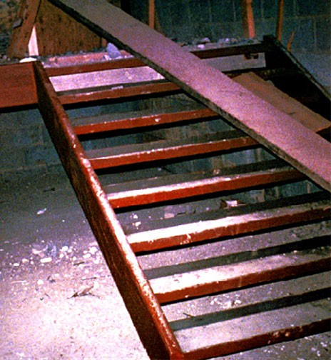
Reducing or eliminating hazards
Temporary pan stairs
  Secure in place before filling
  Fill to top edge
  Replace worn treads and landings
Source: OSHA

Slide 27
Employer requirements
Comply with OSHA standards related to stairs and ladders
  Training
  Inspection
Comply with manufacturers’ requirements and recommendations for all ladders.

Slide 28
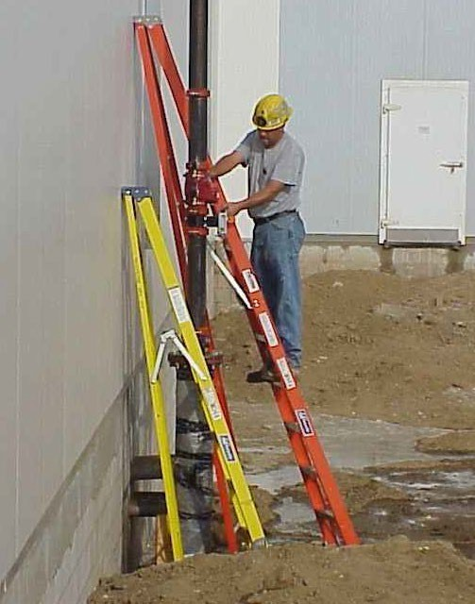
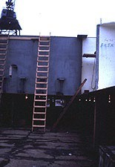
Hazard Recognition - Ladders
Identify ladders hazards and solutions
Source: TEEX – Harwood
Source: OSHA

Slide 29
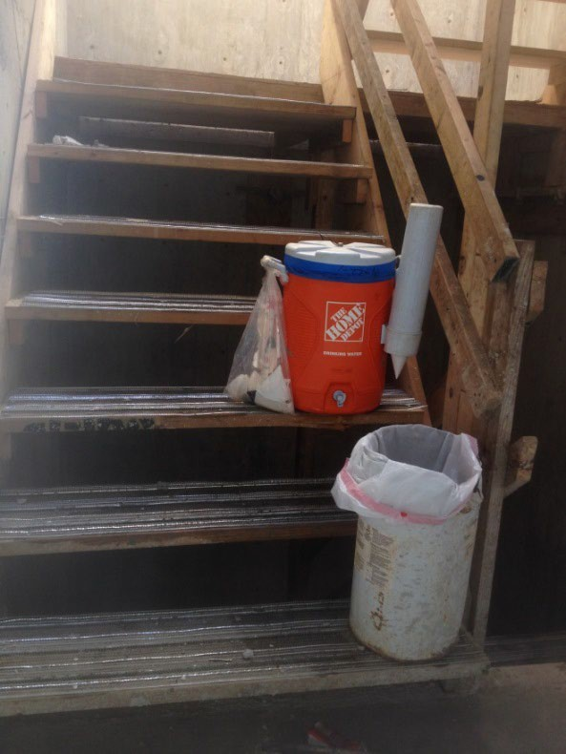
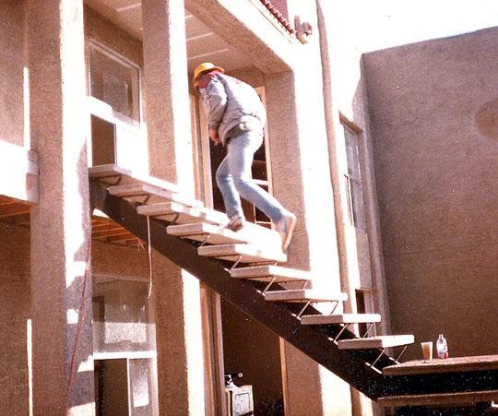
Hazard Recognition - Stairs
Identify stairs hazards and solutions
Source: Luis Diaz
Source: OSHA

Slide 30
Summary
Key components for ladder safety:
  A competent person must inspect
  Use the correct ladder for the job
  Use the correct angle, supports, treads, cross braces, and rails
  Don’t overload
  Your employer must train you in proper use of a ladder

Slide 31
Summary
Key components for stairway safety
–Treads
  Rails
    Handrails
    Stair rails
    Guardrails
  Landings and Platforms

Slide 32
Knowledge Check
When portable ladders are used for access to an upper landing surface, how many feet above the upper landing must the side rails extend?
  2 feet
  3 feet
  4 feet
  5 feet
b. 3 feet

Slide 33
Knowledge Check
You can use metal ladder around power lines or exposed energized electrical equipment.
  True – but only if there isn’t any other option to get the work done.
  False – you should never use a metal ladder in this circumstance.
b. False – never use a metal ladder in this circumstance

Slide 34
Knowledge Check
Handrails must be able to withstand, without failure, how many pounds of weight applied within 2 inches of the top edge in any downward or outward direction?
  300 pounds
  250 pounds
  200 pounds
  175 pounds
c. 200 pounds

Slide 35
Knowledge Check
Stairways that have four or more risers MUST have a stair rail.
  True
  False
a. True

Slide 36
Knowledge Check
A non-self-supporting ladder should be set up at (horizontal distance/working length of ladder).
  90 degree angle
  30 degree angle
  1:2 angle
  1:4 angle
d. 1:4 angle

