Slide 1
Scaffolds
10-Hour Construction Outreach

Slide 2
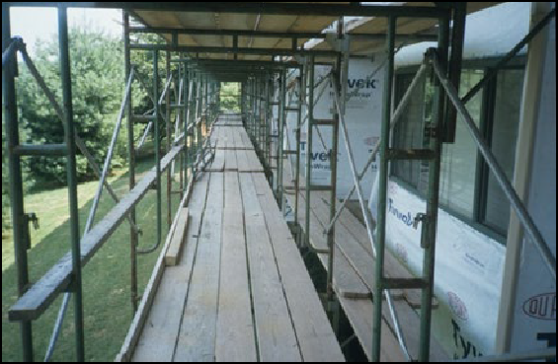
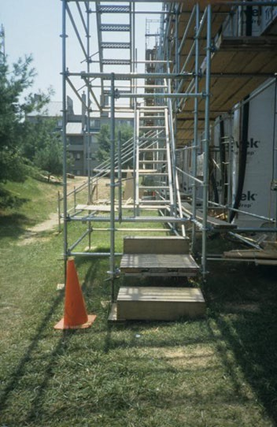
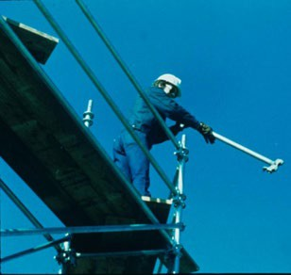
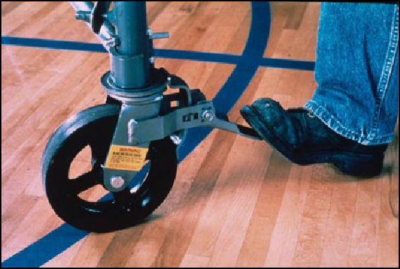
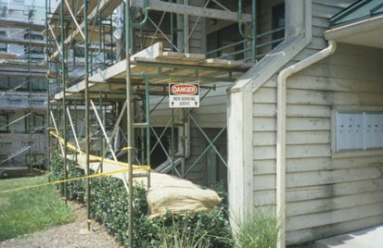
Scaffolds
source: www.elcosh.org/NIOSH/John Rekus

Slide 3
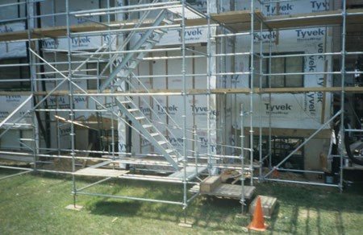
Scaffolds
Lesson Overview
  Competent person
  Basic types of scaffolds
  Scaffold hazards
  Methods of protecting against scaffold hazards
  Employer requirements
NIOSH/John Rekus/elcosh.org

Slide 4
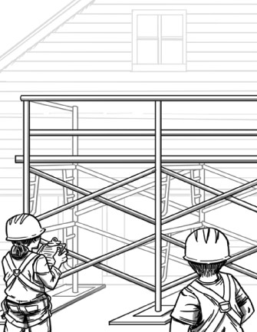
Competent Person
Oversees assembly, disassembly, inspection, and safe use of scaffolds
Trains all employees who erect, disassemble, move, operate, repair, maintain, inspect, or work on scaffolds
Source: OSHA

Slide 5
Competent Person
Process for designating an employee as the competent person:
  Employer appointed
  Capability to identify hazards
  Executes qualified person design
  Authority to take prompt corrective action

Slide 6
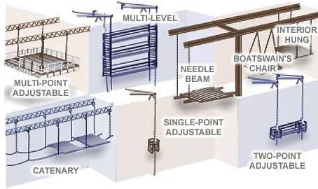
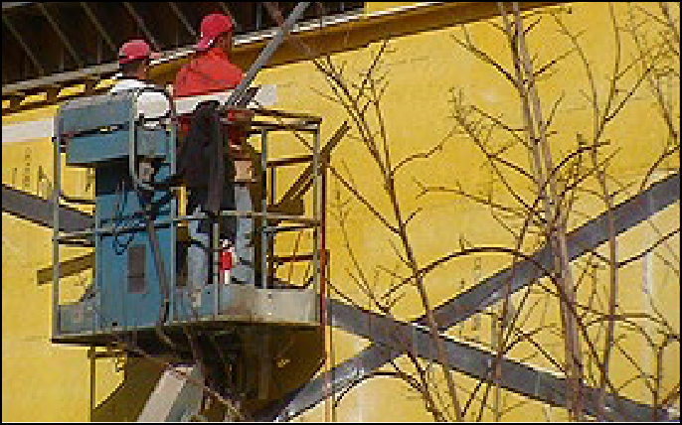
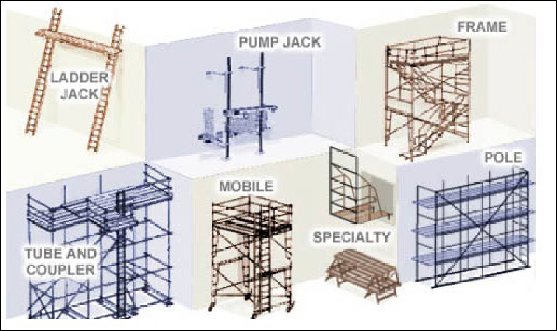
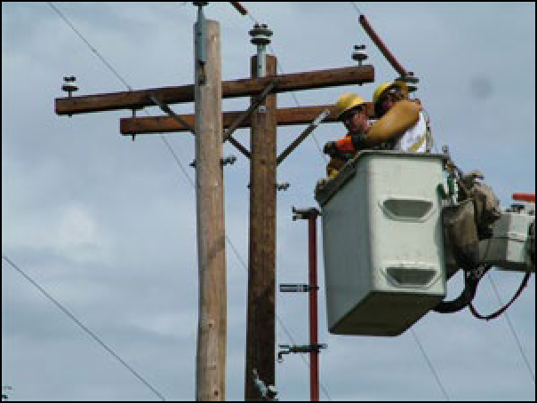
Basic Types of Scaffolds
Suspended
Supported
Aerial lifts
Source: OSHA

Slide 7


Hazards Associated with Scaffolds
Falls
Falling object(s)
Electrical hazards
Collapse hazards
Planking hazards
Weather conditions
Collisions or struck-by
Source: OSHA

Slide 8
Reducing and Eliminating Hazards
Proper access
Guardrails
Personal Fall Arrest System (PFAS)
Protection from falling objects
Protection from electrical hazards
Precautions for moving scaffolds
Safe scaffold construction and disassembly

Slide 9
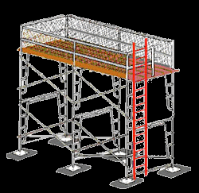
Proper Access
Required when platforms are more than two feet above or below a point of access
Examples of permitted access - ladders, stair towers, ramps, walkways
Do not use crossbraces or
unapproved ladder-like ends for access
Source: OSHA

Slide 10
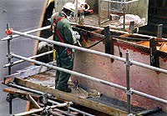
Guardrails
Must be installed on open sides and ends of scaffolds
If front edge (working edge) is more than 14 inches from work, guardrail and/or PFAS system must be used
Source: OSHA

Slide 11
Guardrails
Toprails
  Supported scaffolds manufactured or placed in service after 1/1/2000 must be 38-45” above platform
Midrails
  When used
  Halfway between toprail and scaffold platform
  Crossbracing, when used as a toprail or midrail, must meet certain height requirements

Slide 12
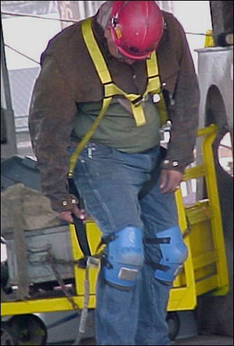
Personal Fall Arrest System (PFAS)
Components
Selection of fall protection
Engineering or qualified person design
When to inspect
Free-fall limit
Source: OSHA

Slide 13
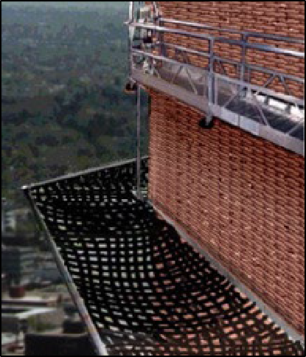
Protection From Falling Objects
Protection must be provided when there is potential of being struck by falling objects
Methods of protection
– Barricades, toeboards, screens
or paneling, canopy or mesh nets, placement of large, heavy objects
Wear a hardhat when working around or below scaffolds
Source: OSHA

Slide 14
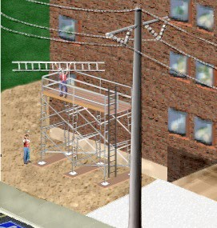
Protection From Electrical Hazards
Minimum distance based on voltage
  Insulated lines
  Uninsulated lines
When exceeding minimum distance as necessary to perform work, utility company must be notified to
  De-energize or relocate line
OR
  Install protective coverings to prevent contact
Source: OSHA

Slide 15
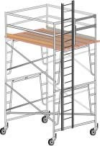
Moving Scaffolds
Workers may only be on moving scaffold when
  Level ground surface
  Height to width ratio
  Outriggers installed on both sides
  Standing inside the wheel base
  Competent person onsite
Source: OSHA

Slide 16
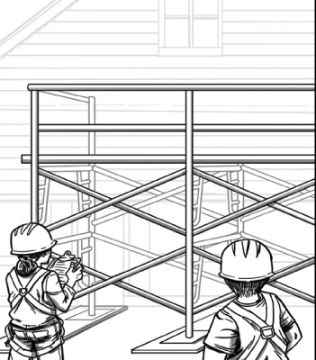
Safe Scaffold Construction and Disassembly
Appropriate scaffold construction methods
Provide proper scaffold access
Use a competent person
Manufacturers’ instructions
Source: OSHA

Slide 17
Employer Requirements
Comply with OSHA standards related to scaffolds
  Training
  Inspection
  Designating competent person
Comply with manufacturers’ requirements and recommendations
Follow plans designed by qualified person

Slide 18

Scaffold Hazard Recognition
Identify hazards and solutions
Source: www.elcosh/org/OTI/Southwest Education Center

Slide 19
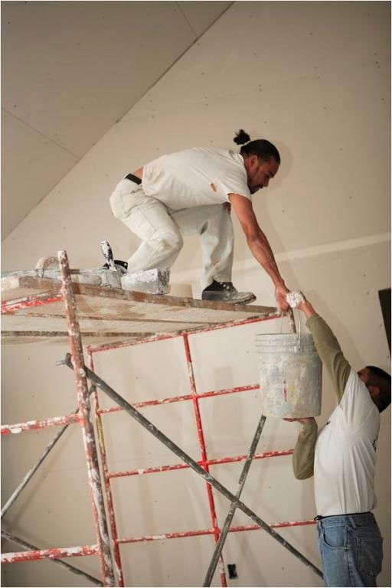
Scaffold Hazard Recognition
Identify hazards and solutions
Source: www.elcosh/org/OTI/Southwest Education Center

Slide 20
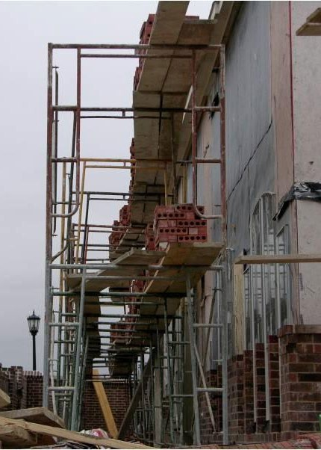
Scaffold Hazard Recognition
Identify hazards and solutions
Source: www.elcosh/org/OTI/Southwest Education Center

Slide 21

Scaffold Hazard Recognition
Identify hazards and solutions
Source: www.elcosh/org/OTI/Southwest Education Center

Slide 22
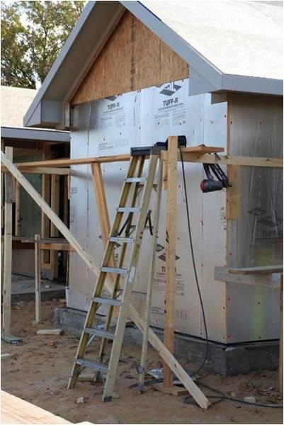
Scaffold Hazard Recognition
Identify hazards and solutions
Source: www.elcosh/org/OTI/Southwest Education Center

Slide 23
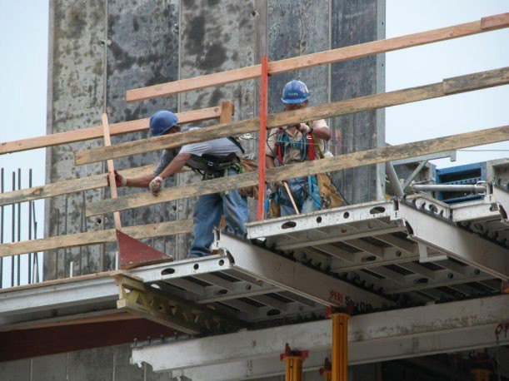
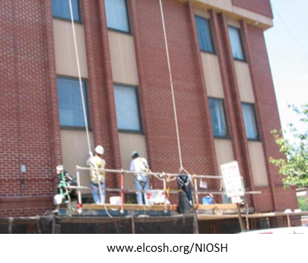
Always Remember
Employers must
  Designate a competent person for scaffold
  Ensure that employees are trained in proper assembly, disassembly, and use of scaffolds
  Utilize strategies to prevent and reduce scaffold hazards
www.elcosh.org/Steve Clark/Laborers

Slide 24
Knowledge Check
Who trains employees that work on scaffolds?
  Employees do not need training
  Employees are responsible for their own training
  Fellow employees who have experience
  Employer-designated competent person
d. Employer-designated competent person

Slide 25
Knowledge Check
Scaffolds must be designed by a .
  Competent person
  Construction site manager
  Qualified person
  Experienced scaffold worker
c. Qualified person

Slide 26
Knowledge Check
Which of the following is NOT an example of proper access?
  Ladders
  Crossbraces
  Stair towers
  Walkways
b. Crossbraces

