Slide 1
Personal Protective Equipment
10-Hour Construction Outreach

Slide 2
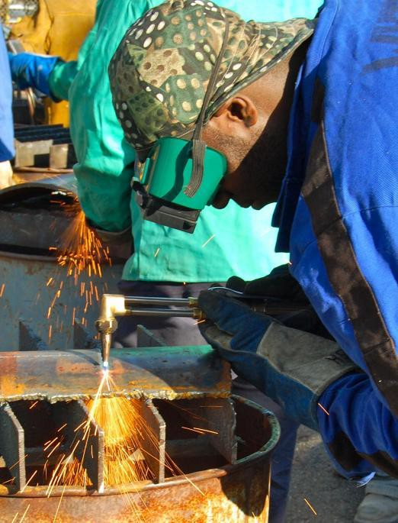
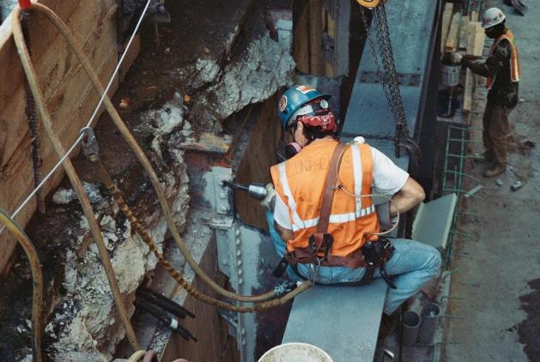
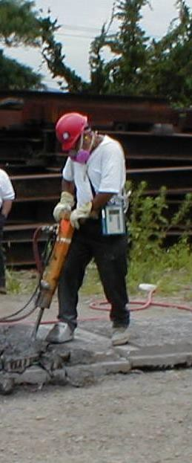
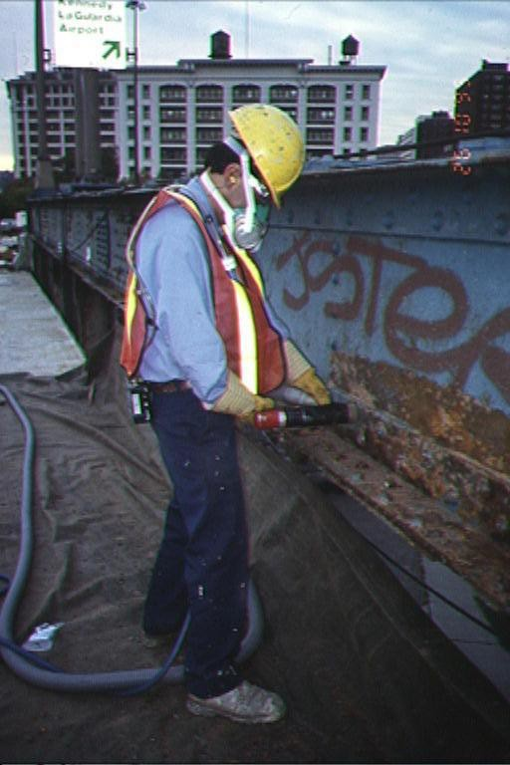
Personal Protective Equipment
Source of photos: Mount Sinai/CHEP/elcosh.org

Slide 3
Personal Protective Equipment
Lesson Overview
Hierarchy of controls
Types of PPE
PPE Training Requirements
Employer and Employee Responsibilities
Hazard Recognition Activity

Slide 4
Protecting Employees
Employers must protect employees:
Assess workplace
Eliminate and reduce hazards using engineering and administrative controls
Then use appropriate personal protective equipment (PPE)
Remember, PPE is the last level of control!

Slide 5
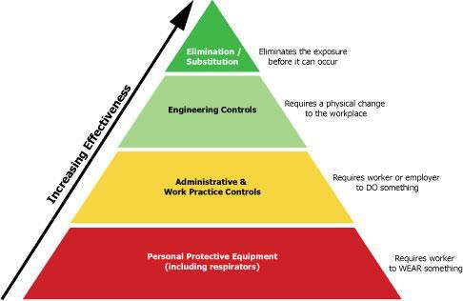
Protecting Employees
Source: OSHA

Slide 6
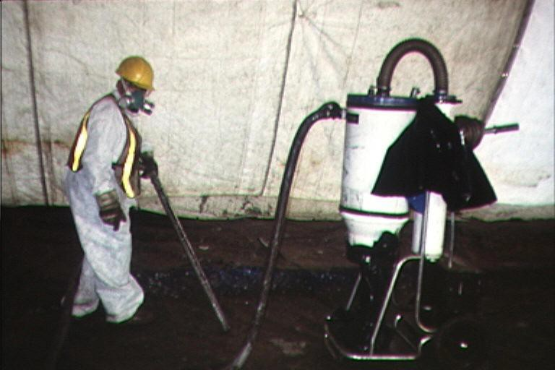
Engineering Controls
Physical changes to workplace
Isolation
Ventilation
Equipment modification
Others
Mount Sinai/CHEP/elcosh.org

Slide 7
Administrative Controls
Requires worker to do something
Proper procedures
Inspection and maintenance
Housekeeping
Supervision
Regulated areas
Limit exposure by time or distance

Slide 8
Administrative Controls
Example: Noise Exposure
  Operate noisy machines during shifts when fewer people are exposed
  Limit the amount of time a person spends at a noise source
  Provide quiet areas where workers can gain relief from hazardous noise sources
  Control noise exposure through distance

Slide 9
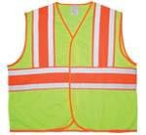

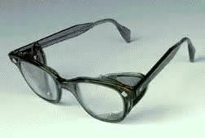
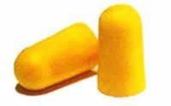
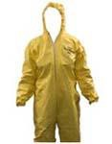
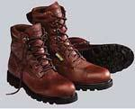
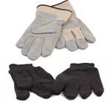
Types of PPE
Source of photos: OSHA

Slide 10

Head Protection
Frequent Causes of Head Injuries:
  Object striking head
  Head striking object
  Contact with exposed, energized electrical conductors
Source: OSHA

Slide 11
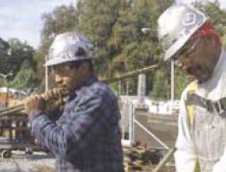
Classes of Hard Hats
Class G (General)
  General service (e.g., building construction, shipbuilding, lumbering, and manufacturing)
  Good impact protection
  Limited voltage protection (proof-tested at 2,200 volts)
Source: OSHA

Slide 12
Classes of Hard Hats
Class E (Electrical)
  Electrical work
  Protect against falling objects
  Protect against high-voltage shock/burns (proof-tested at 20,000 volts)

Slide 13
Classes of Hard Hats
Class C (Conductive)
  Designed for comfort, offers limited protection
  Protects heads that may bump against fixed objects
  Does not protect against falling objects or electrical hazards

Slide 14
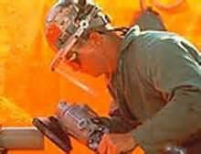
Eye and Face Protection
Common Causes of Eye Injuries
Dust
Flying particles
Harmful chemicals
Intense light
  Welding
  Lasers
Source: OSHA

Slide 15
Safety Glasses
Selecting eye and face protection:
  Meet requirements of ANSI Z87
  Elements to consider
    Ability to protect
    Fit and comfort
    Vision and movement not restricted
    Durable and cleanable
    Other PPE not restricted

Slide 16
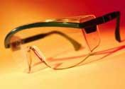
Safety Glasses
Protect against:
  Flying particles from wood, metal, cement, plastics, or other materials
  Airborne particulates such as ashes, dust, embers, sand blast, grit, paint, or other materials
Source: OSHA

Slide 17
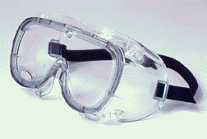
Goggles
Protect eyes, eye sockets and facial area around eyes from impact, dust, & splashes
Goggles or other eye protection
  may fit over corrective lenses
  may not interfere with the function of the glasses
Source: OSHA

Slide 18
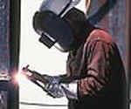
Welding Shields
Protect eyes from burns
  Infrared light
  intense radiant light
Protect face and eyes from
  flying sparks
  metal spatter slag
Source: OSHA

Slide 19
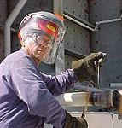
Face Shields
Protect face from nuisance dusts and potential splashes or sprays of hazardous liquids
Shields do not protect from impact hazards unless so rated
Source: OSHA
Shields are for face protection, not eye protection. To protect the eyes, wear safety glasses with side shields under the face shield.

Slide 20
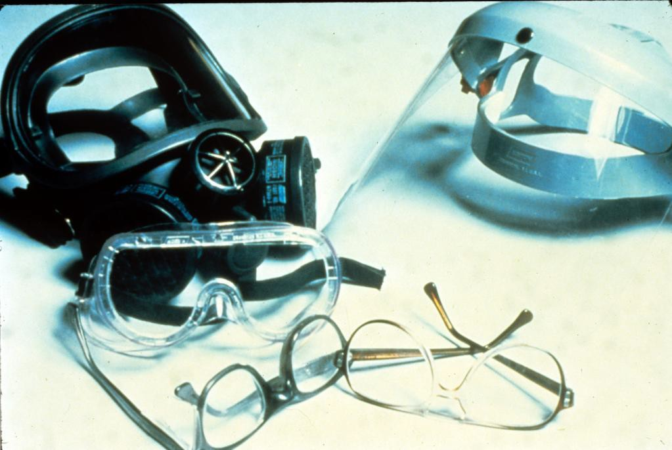
Warning: Employees Who Wear Corrective Lenses
Workers who wear prescription glasses must also wear required eye protection.
NIOSH/John Rekus/elcosh.org

Slide 21
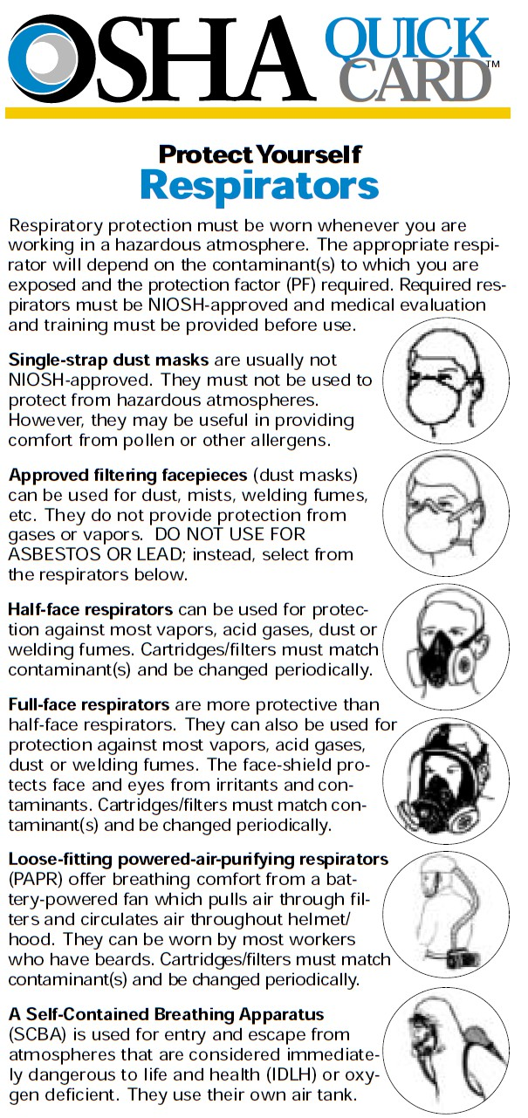
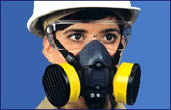
Respiratory Protection
Source: OSHA
21

Slide 22
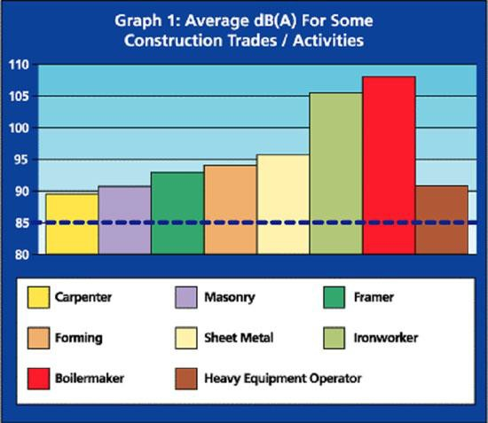
Hearing Protection
Exposure to over 85 dB can cause hearing loss
Hearing protection required at 90 dB
Effective Hearing Conservation Program
Source: Construction Safety Association of Ontario

Slide 23
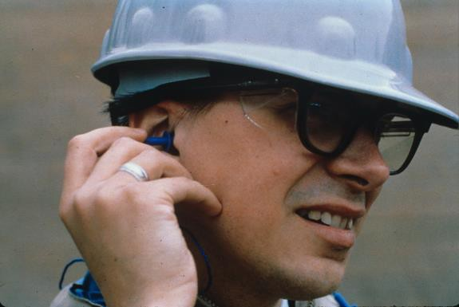
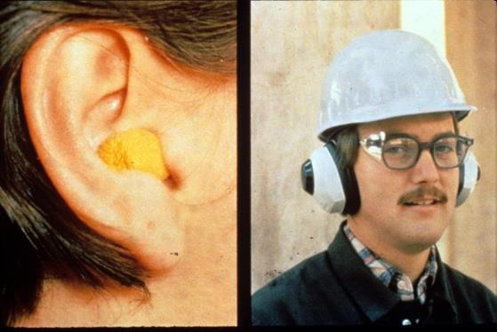
Hearing Protection
Examples
  Disposable foam plugs
  Molded ear plugs
  Noise cancelling ear plugs
  Ear muffs
Consider Noise Reduction Rating (NRR) of devices
NIOSH/John Rekus/elcosh.org
NIOSH/John Rekus/elcosh.org

Slide 24
Hand and Arm Protection
Employers must provide hand protection when employees are exposed to hazards
  Skin absorption of harmful substances
  Severe cuts or lacerations
  Severe abrasions
  Punctures
  Chemical and thermal burns
  Harmful temperature extremes

Slide 25
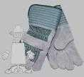
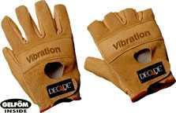
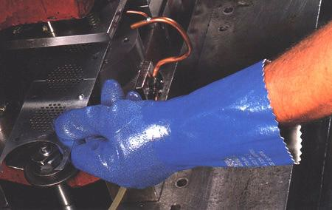
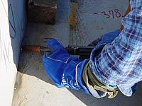
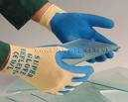
Types of Gloves
Anti-vibration
Leather Palm
Heat Resistant
Permeation Resistant
Cut Resistant
Source of photos: OSHA

Slide 26
Foot and Leg Protection
Causes of Foot Injuries
  Heavy objects
  Sharp objects
  Molten metal
  Hot surfaces
  Slippery or wet surfaces
  Electrical hazards

Slide 27
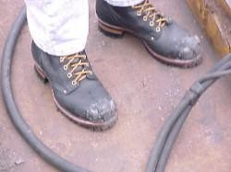
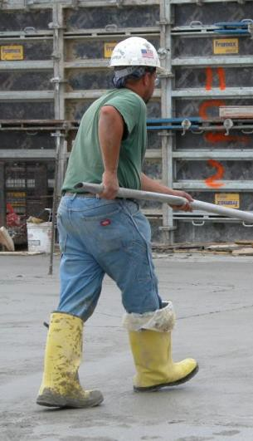
Foot and Leg Protection
Examples
  Impact-resistant toe and/or instep
    Steel
    Composite
  Heat-resistant soles
  Metal shanks
Source: OSHA
Specialty footwear may be needed
  Metatarsal guards
  Liquid or chemical resistant
  Conductive or nonconductive
Steve Clark/Laborers/elcosh.org

Slide 28
Body Protection
Causes of bodily injuries
  Intense heat
  Splashes of hot metals or hot liquids
  Impacts from tools, machinery, or materials
  Sharp objects
  Hazardous chemicals
  Contact with potentially infectious materials
  Radiation

Slide 29
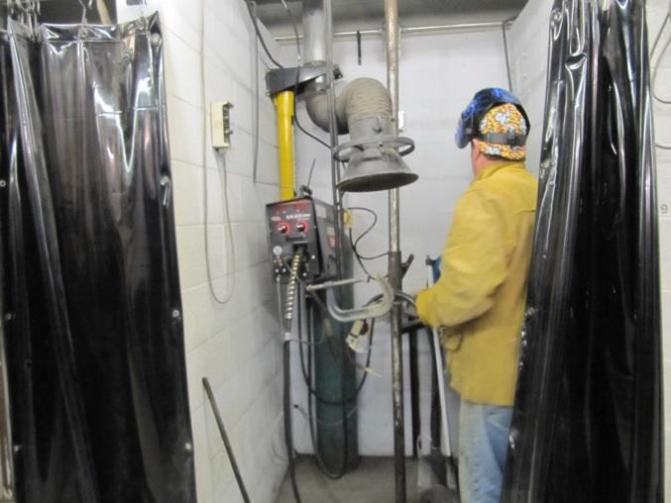
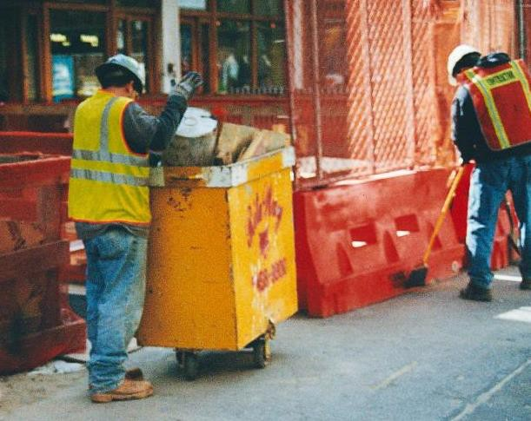
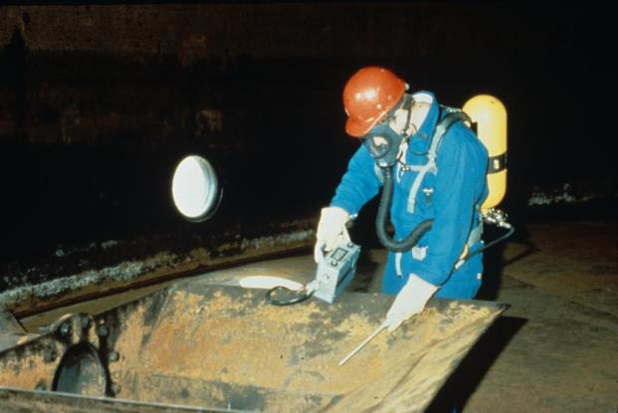
Body Protection
Mount Sinai/CHEP/elcosh.org
Mount Sinai/CHEP/elcosh.org
NIOSH/John Rekus/elcosh.org

Slide 30
Training
Why PPE is necessary
How PPE will protect the employee
What PPE can and cannot do
When and how to wear PPE
How to identify signs of wear and tear
How to clean and disinfect PPE
When PPE is worn out and how to properly dispose of PPE

Slide 31
Responsibilities
Employers must:
‒ Assess hazards
‒ Select appropriate PPE and determine when to use
‒ Provide some PPE at no cost to employee
‒ Make sure that employee-owned PPE is adequate, properly maintained and sanitary
‒ Train employees and enforce use of PPE

Slide 32
Responsibilities
Employees must:
  Actively participate in training
  Consistently use PPE as prescribed
  Properly maintain, inspect, clean, and store PPE
  Immediately replace damaged PPE

Slide 33
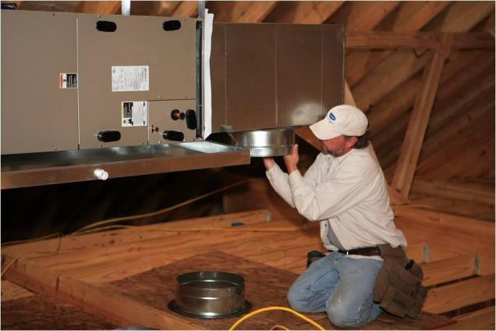
Hazard Recognition
Identify hazards and PPE needed
Southwest OSHA Training Institute Education Center/elcosh.org

Slide 34
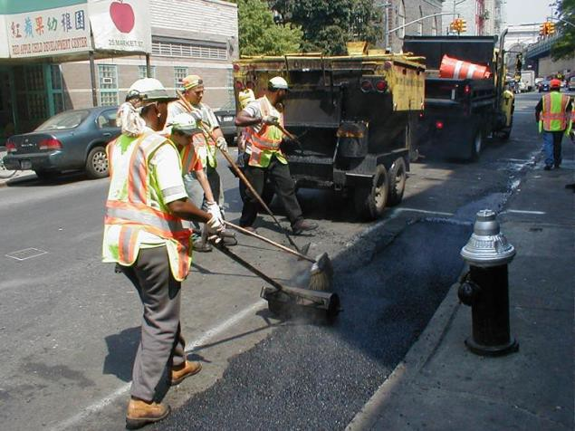
Hazard Recognition
Identify hazards and PPE needed
Mount Sinai/CHEP/elcosh.org

Slide 35
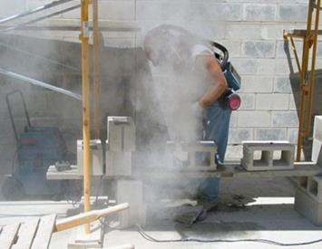
Hazard Recognition
Identify hazards and PPE needed
Source: OSHA

Slide 36
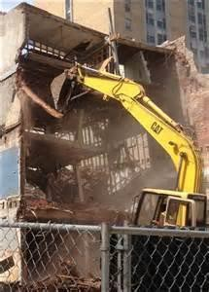
Hazard Recognition
Identify hazards and PPE needed
Source : OSHA

Slide 37
Always Remember
Employers must:
‒ Assess the workplace for hazards
‒ Use engineering and work practice controls to eliminate or reduce hazards
‒ Select and provide appropriate PPE at no cost to employees to protect them

Slide 38
Knowledge Check
Who is responsible for providing PPE?
  The employer
  The employee
  OSHA
  Workers’ Compensation
    The employer

Slide 39
Knowledge Check
Common causes of foot injuries include: crushing, penetration, molten metal, chemicals, slippery surfaces, and sharp objects.
  True
  False
    True

Slide 40
Knowledge Check
Safety controls must meet the following order of priority:
  Substitution, PPE, workaround, and administrative
  Workaround, stop work, PPE, and engineering
  Stop work, PPE, engineering, and substitution
  Substitution, engineering, administrative, and PPE
d. Substitution, engineering, administrative, and PPE

Slide 41
Knowledge Check
Which type of hard hat would provide the most protection from electrical hazards?
  Class A
  Class C
  Class E
  Class G
c. Class E

Slide 42
Knowledge Check
The need for hearing protection is triggered at which decibel level?
  When it exceeds 80 decibels
  When it exceeds 90 decibels
  When it exceeds 100 decibels
  When it exceeds 110 decibels
b. When it exceeds 90 decibels

Slide 43
Knowledge Check
Who is responsible for providing specialized work footwear?
  The employer
  The employee
  OSHA
  Insurance companies
    The employer

Slide 44
Knowledge Check
Which of the following is considered approved eye protection?
  Sun glasses
  Prescription glasses
  Reading glasses
  Glasses meeting ANSI standard Z87
d. Glasses meeting ANSI standard Z87

Slide 45
Knowledge Check
Which of the following is not considered PPE?
  Rubber gloves
  Glasses meeting ANSI Z87
  Sports shoes
  Hearing muffs
c. Sports shoes

