Slide 1
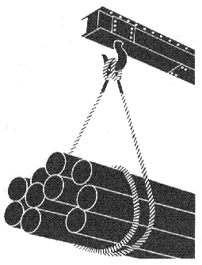
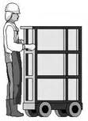
Materials Handling, Storage, Use, and Disposal
10-Hour Construction Outreach

Slide 2
Materials Handling, Storage, Use, and Disposal
Lesson Overview
  Types of material handling equipment.
  Hazards associated with material handling activities
  Prevention of hazards associated with material handling equipment
  Employer requirements to protect workers from material handling hazards

Slide 3

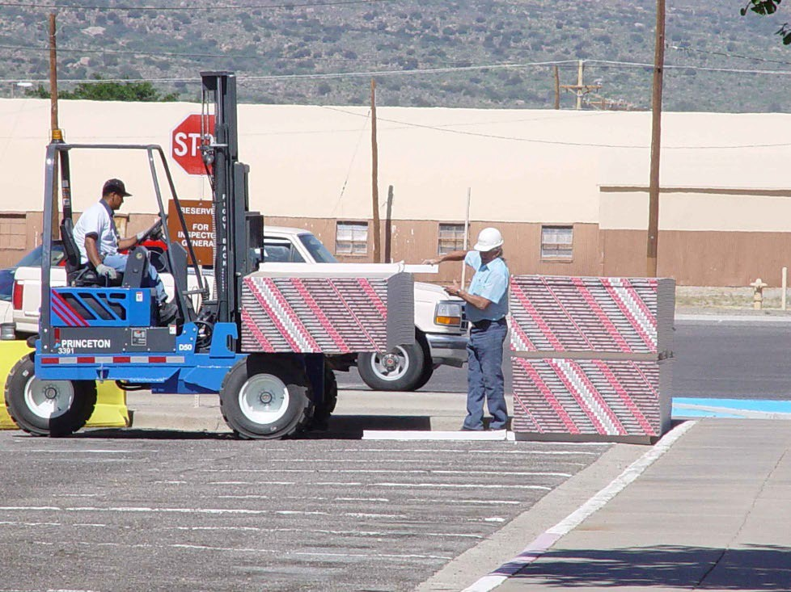
Types of Equipment
Powered Industrial Trucks
Conveyors
Source: OSHA
Source: TEEX-Harwood

Slide 4
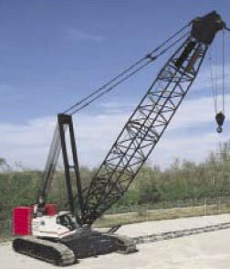
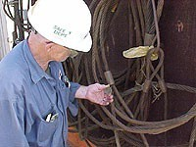
Types of Equipment
Cranes
Slings
Source: OSHA
Source: OSHA

Slide 5
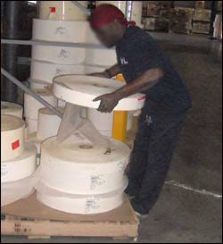
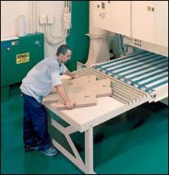
Factors Contributing to Injuries
Weight and bulkiness of objects
Bending, twisting, turning movements
Source: OSHA
Source: OSHA

Slide 6
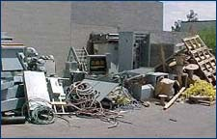
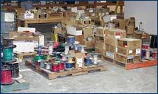
Hazards
Improper operation of equipment
Accumulated materials or clutter
Source of photos: OSHA

Slide 7
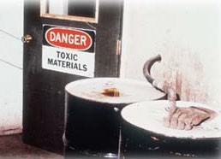
Hazards
Unsafe conditions of materials or containers
Flammability or toxicity of some materials
Source: OSHA

Slide 8
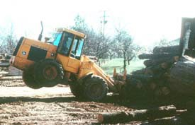
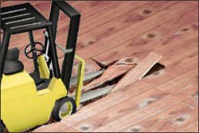
Hazards
Weight of materials
Binding ties or other devices that secure bundles or
bound materials
Source: OSHA
Source: OSHA

Slide 9
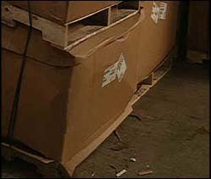
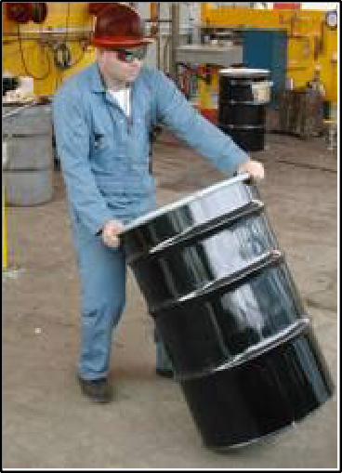
Hazards
Falling objects
Lifting, pushing, pulling, or otherwise manually moving large, heavy items
Source: OSHA
Source: OSHA

Slide 10
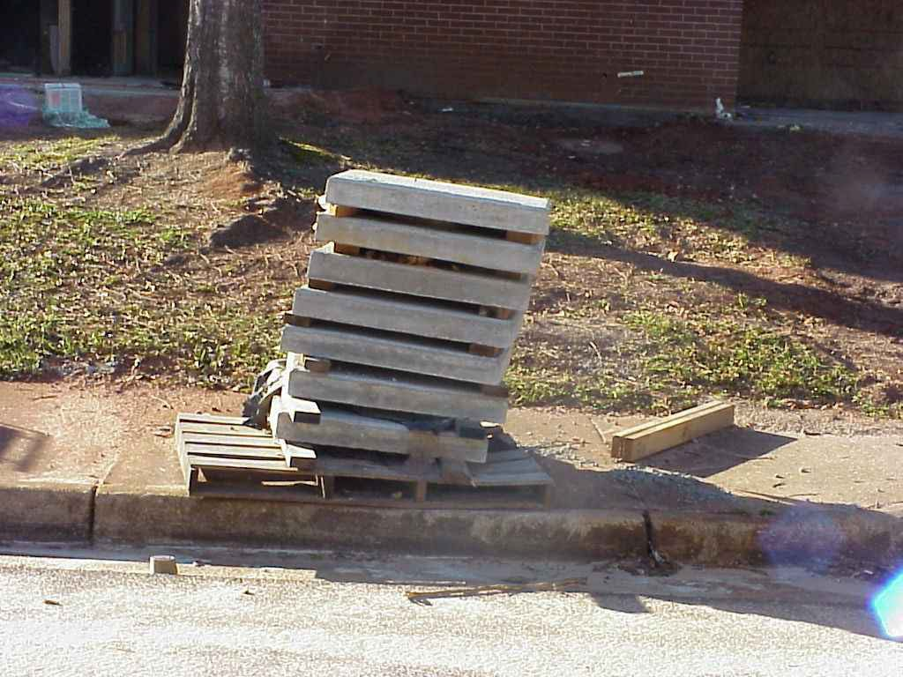
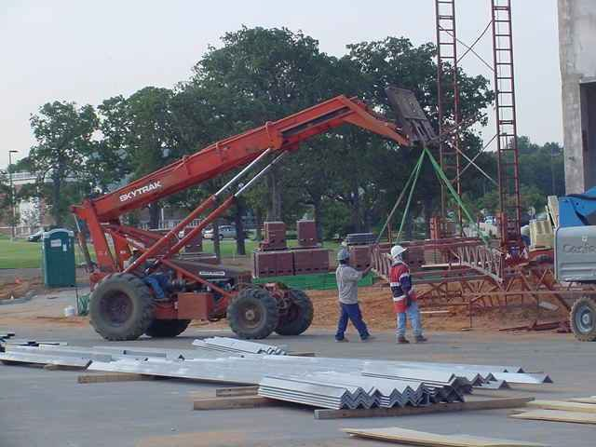
Hazards
Improperly stacked materials
Struck-by or caught-in/-between hazards
Source of photos: TEEX - Harwood

Slide 11

Injuries
Types of injuries commonly reported
  Sprains, strains, tears
  Soreness and pain
  Bruises and contusions
  Cuts, lacerations, and punctures
Source: OSHA

Slide 12
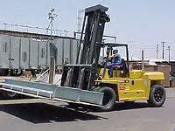
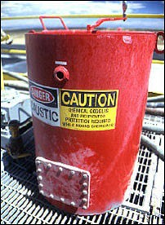
Injuries
Examples of events or exposures leading to injuries
  Contact with objects and equipment
  Transportation incidents
Source: OSHA
– Exposure to harmful substances or environments
Source: OSHA

Slide 13
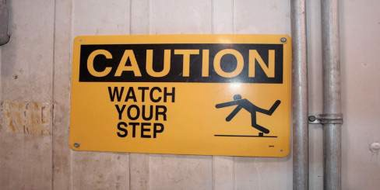
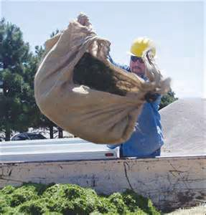
Injuries
Falls, slips, trips, or loss of balance
Repetitive motion
Overexertion
Source: OSHA
Source: OSHA

Slide 14
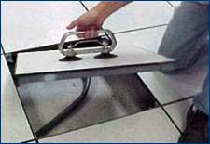
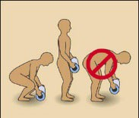
Preventing Hazards
Moving materials manually
  Use devices to assist with holding loads
  Wear PPE
  Use proper lifting technique
  Seek help for oversized loads
  Use blocking materials
Source of photos: OSHA

Slide 15
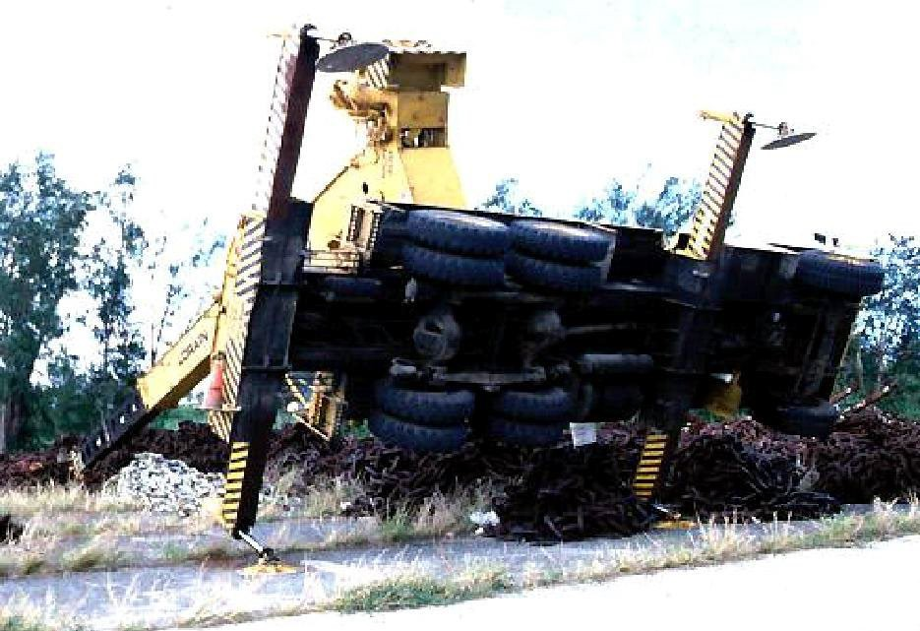
Preventing Hazards
Cranes
  Major types of crane accidents
    Contact with power lines
    Overturns
    Falls
    Mechanical failure
Source: OSHA

Slide 16
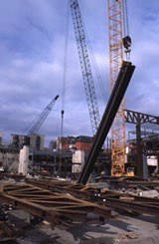
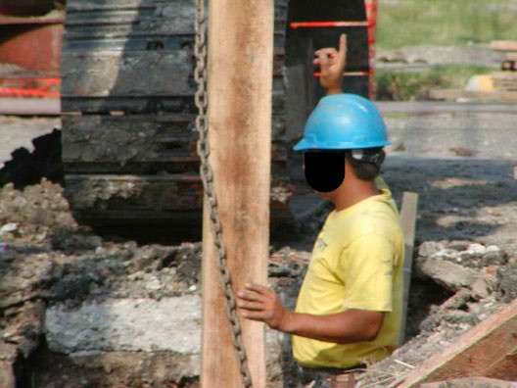
Preventing Hazards
Hoisting tons of material, steel, and concrete with cranes
Operated only by thoroughly trained
and competent workers
Source: OSHA
Source: TEEX - Harwood

Slide 17
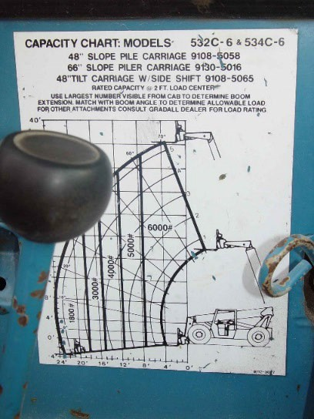
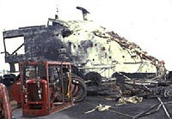
Preventing Hazards
Eliminate/reduce crane hazards by:
  Knowing
    Load
    Capacity of the crane
    When the load is safe to lift
  Always checking crane load chart and never exceed load limits
Source: TEEX - Harwood

Slide 18
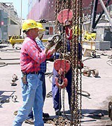
Preventing Hazards
Inspection of crane by a qualified person
  Modified, repaired, or adjusted
  Post-assembly
  At least every 12 months
  Equipment not in regular use
Visual inspection by a competent person
  Prior to each shift
  Monthly
Source: OSHA

Slide 19

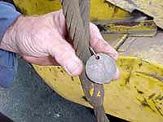
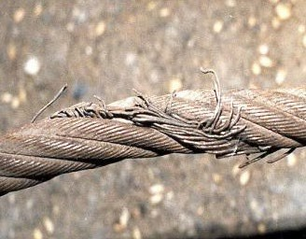
Preventing Hazards
Slings
  Connect a crane hook to a load
  Proper selection
  Inspection
Source of photos: OSHA

Slide 20
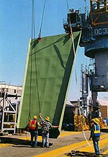
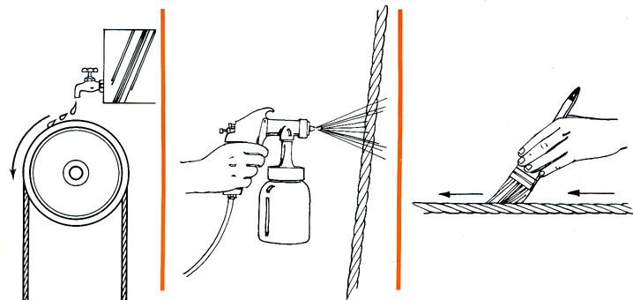
Preventing Hazards
Reduce sling hazards by:
  Lubricated
  Do not shorten with knots, bolts, or other devices,
or kink legs
  Keep clear of loads
  Avoid sudden movement
Source: OSHA
Source: OSHA

Slide 21
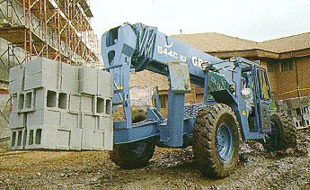
Preventing Hazards
Forklifts
  Main causes of injuries
    Forklift overturns
    Forklift striking workers on foot
    Persons crushed by forklifts
    Persons falling from forklifts
Source: OSHA

Slide 22

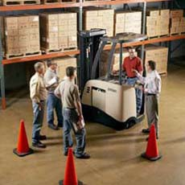
Preventing Hazards
Illegal forklift operators
  Anyone under 18
  Anyone not properly trained and certified
Source of photos: OSHA

Slide 23
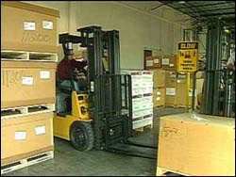
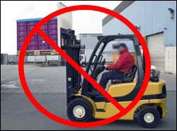
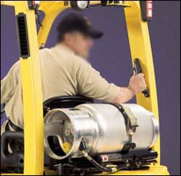
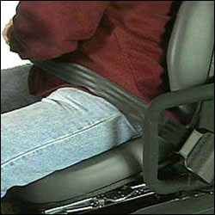
Preventing Hazards
Driving the forklift
  Obstructed vision
  Travel path
  Approaching people
  Elevated platform
  Seat belts and ROPS
  Raising/lowering forks
  Safe distance
Source of photos: OSHA

Slide 24
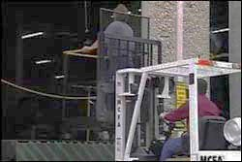
Preventing Hazards
Elevating workers with forklift
  Standing on forks
  Lifting personnel
  Approved lift platform
  Restraining means
Source: OSHA

Slide 25
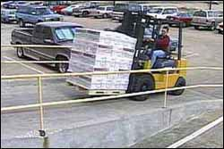
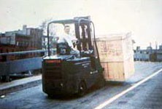
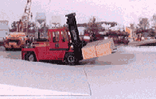
Preventing Hazards
Driving forklift on Grades/Ramps
  Use extreme caution
  No turns
  Tilting and raising load
  Point load up the incline
Source of photos: OSHA

Slide 26
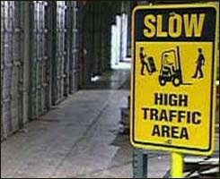
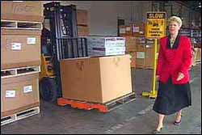
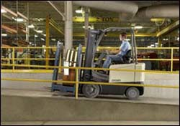
Preventing Hazards
Forklift operating speed
  Tip-overs
  Turning
  Avoiding collisions
  Wet and slippery floors
  Ascending/descending
  Obstructed vision
Source of photos: OSHA

Slide 27
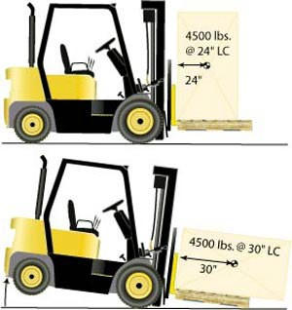
Preventing Hazards
Avoiding Excess Weight
  Do not exceed weight capacity of forklift.
  Center loads and secure to keep from shifting to maintain balance of weight
Source: OSHA

Slide 28
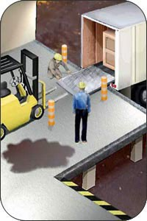
Preventing Hazards
Use of Dock Boards for Loading/Uploading
  Bridging space
  Securing portable dock boards
  Handholds for dock boards
Source: OSHA

Slide 29
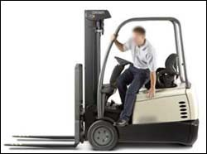
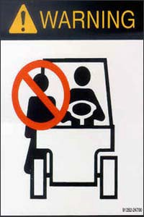
Preventing Hazards
Exiting the Forklift
  Set brake, lower forks/lifting carriage, neutralize controls
  Stand-up type forklift
Riding the forklift
  No passengers allowed
  Exception – seat is provided
Source of photos: OSHA

Slide 30
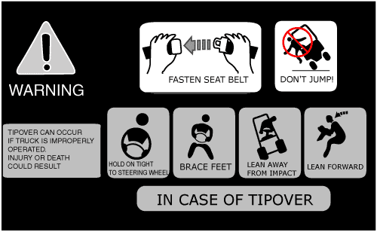
Preventing Hazards
Avoiding Struck-by/Crushed-by
  Don’t jump from an overturning, sit-down type forklift.
  Stay with the truck, hold on firmly, and
lean in the opposite direction of the overturn.
Source: OSHA

Slide 31
Preventing Hazards
Forklift Training – do not operate a forklift without proper training and licensing.
Reporting Damage – any damage or problems that occur to a forklift during a shift should be reported to the supervisor.
Source: OSHA

Slide 32



Preventing Hazards
Earth-Moving Equipment
  Scrapers
  Loaders
  Crawlers
  Bulldozers
  Off-highway trucks
  Graders
  Tractors
Source of photos: TEEX - Harwood

Slide 33

Preventing Hazards
Earth-Moving Equipment
  Seatbelts
  Reverse gear not used unless that piece of equipment has:
    Back-up signal alarm or
    Signaler
  Operator properly trained
Source: OSHA

Slide 34


Employer Requirements
Comply with OSHA standards related to materials handling, including:
  Training requirements, including requirements for forklift training.
  Inspection requirements
Source of photos: OSHA

Slide 35

Employer Requirements
Comply with manufacturers’ requirements and recommendations for materials handling equipment.
Source : OSHA

Slide 36


Recognizing Hazards
Identify potential hazards and possible solutions:
Source of photos : OSHA

Slide 37


Recognizing Hazards
Identify potential hazards and possible solutions:
Source: OSHA
Source: TEEX - Harwood

Slide 38


Recognizing Hazards
Identify potential hazards and possible solutions:
Source of photos : TEEX Harwood

Slide 39
Knowledge Check
How old do you have to be to operate a forklift, regardless of training?
  16
  18
  21
  25
b. You must be at least 18 years old to operate a forklift.

Slide 40
Knowledge Check
One good way to prevent materials handling hazards is to .
  refuse to allow personnel to ride equipment without a seat and seatbelt
  report all damaged equipment immediately
  operate within manufacturer’s specifications
  All of these.
d. All of these are good ways to prevent materials handling hazards.

Slide 41
Knowledge Check
Which of the following is a method for eliminating or reducing crane operation hazards?
  Operators should know how much they are lifting as well as the rated capacity of the crane.
  A competent person should visually inspect the crane once a year.
  Never exceed the load limit by more than 10%.
  All of these.
a. Crane operators should know how much they are lifting and the rated capacity of the crane.

Slide 42
Knowledge Check
Employers must comply with OSHA standards related to materials handling, including training and .
  equipment
  operations
  inspection
  All of these.
c. Employers must comply with OSHA standards for training and inspection.

