Slide 1
Health Hazards in Construction
10-Hour Construction Outreach

Slide 2
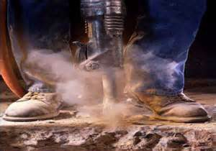
Health Hazards
Potential exposures to health hazards:
Worker on the job
Worker’s family
Source: OSHA

Slide 3
Objectives
Identify common health hazards.
Describe types of common health hazards.
Apply health hazard protection methods.
Recognize employer requirements to protect workers from health hazards in construction, including hazards communication program.

Slide 4
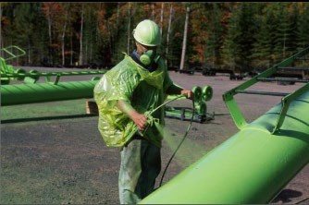
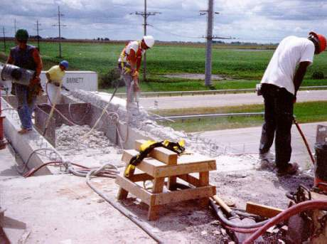
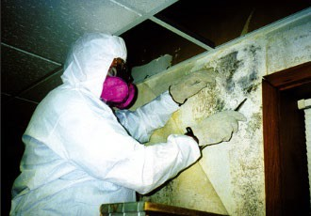
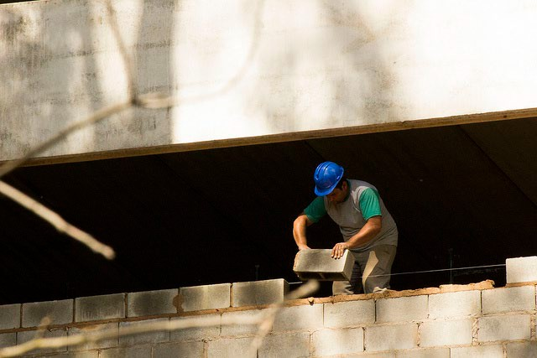
Common Health Hazards
Chemical Physical
Source: OSHA
Source: OSHA
Biological
Ergonomic
Source: OSHA
Source: Arlosvaldo Gonzáfoles (Flickr.com)

Slide 5

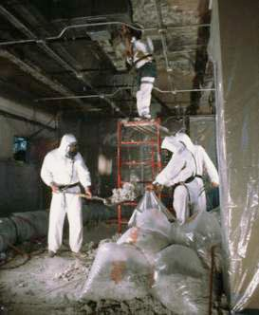
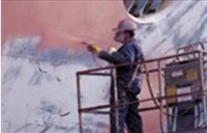
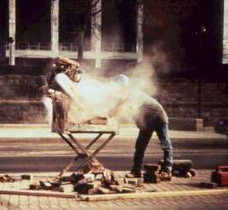

Common Ways Workers Encounter Chemical Hazards
Solids
Liquids
Gases and vapors
Aerosols
– Dust, Mist, Fumes
Welding Fumes
Asbestos
Source: U.S. Navy
Source: OSHA
Spraying Chemicals
Silica
Lead
Source: OSHA
Source: OSHA
Source: OSHA

Slide 6

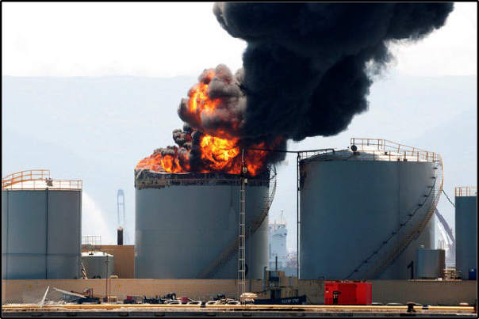
Effects of Chemical Exposure
May put workers at risk of developing health problems:
Health Problems
Heart Ailments | Lung Damage | Sterility
CNS Damage | Kidney Damage | Burns
Cancer | Liver Damage | Rashes
May pose risk of fire and explosion hazards:
Fire
Explosion
Source: Virginie Moerenhout (Flickr.com)
Source: Jonathan Perera (Flickr.com)

Slide 7
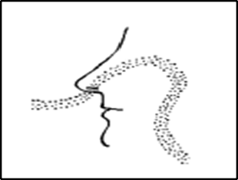
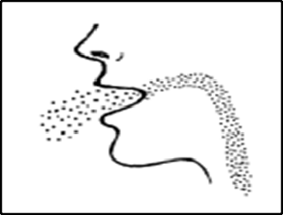
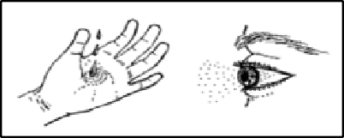
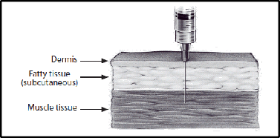
Routes of Entry
Inhalation: Breathed in (Most common route)
Source: OSHA
Ingestion: Swallowing via eating or drinking
Source: OSHA
Absorption: Drawn through skin or eye surface
Source: OSHA
Injection: Punctures through skin
Source: CDC

Slide 8
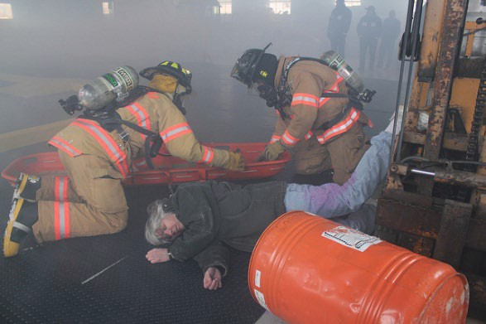
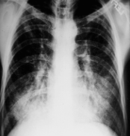
Health Effects
Exposure Condition |  | Exposure | Example
ACUTE | Immediate | Short-term, high concentration | H₂S exposure within a confined space
CHRONIC | Delayed; generally for years | Continuous; for long periods of time | Asbestosis
Acute
Chronic
Source: U.S. Army Corps of Engineers
Source: OSHA

Slide 9
Chemical Hazard Protection
Eliminate
Substitution
Engineering
Administrative
PPE

Slide 10
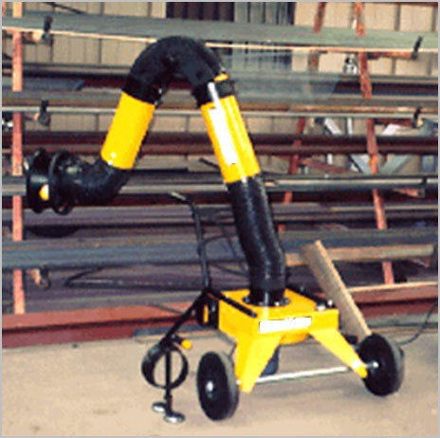
Chemical Hazard Protection
Engineering
  Ventilation (local/general)
  Process and equipment modification
  Isolation/automation
Administrative
  Monitor/measure exposure levels
  Inspections and maintenance
  Develop SOPs
PPE
  Respirators
  Gloves
  Safety glasses
  Protective clothing
Local Exhaust Ventilation
Source: OSHA

Slide 11
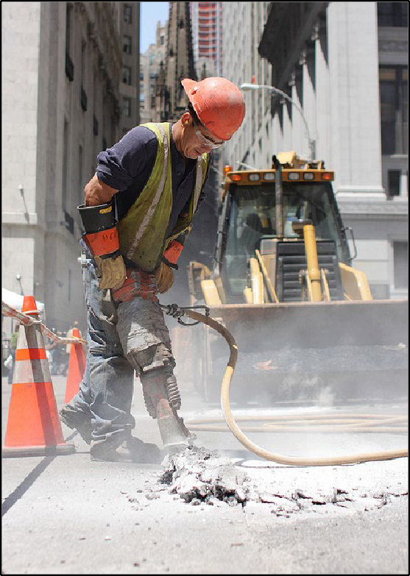

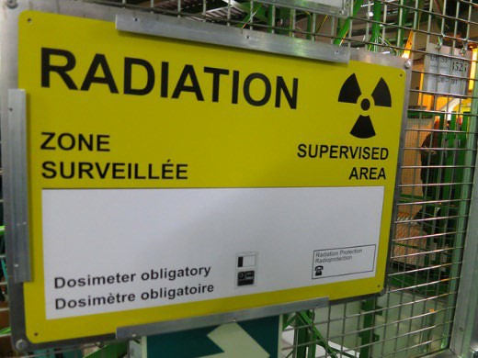
Physical Hazards in Construction
Noise
Temperature extremes
Vibration
Radiation
Noise and Vibration
Temperature
Radiation
Source: OSHA
Source: Alper Çuğun (Flickr.com)
Source: Nick Allen (Flickr.com)

Slide 12
Effects of Exposure to Physical Hazards
Temperature | Radiation | Vibration | Noise
Rash; Cramps | Burns | Fatigue | Interferences
Exhaustion | Sickness | Strains | Stress
Stroke | Aging | Carpal tunnel | Tinnitus
Hypothermia | Cancer | HAVS | Headaches
Frostbite | DNA mutations | Raynaud’s | Hearing loss

Slide 13
Noise
Common Construction Noise Sources
Equipment | Noise (dB)
Backhoe | 85
Bulldozer | 87
Router | 90
Front end loader | 90
Chop saw | 92
Welding equipment | 92
Nail gun | 97
Jackhammer | 102
Grader/scraper | 107
Source: U.W. Dept. of Environmental & Occupational Health Services – Rick Neitzel July, 2005
Prolonged exposures to 85 dB can lead to hearing loss

Slide 14
Protection Against Physical Hazards
Hazard | Engineering Controls | Administrative Controls | PPE
Temperature | Heaters; AC; windshields; ventilation | Water; Rest; Shade | Hoods; cooling vests; hard hat liners
Vibration | Vibration reduction equipment | Train not to grip too tightly; Job rotation | Anti-vibration gloves
Noise | Silencers; mufflers; enclosures; sound barriers | Increase distance between source and worker | Ear plugs; muffs
Eliminate or substitute hazard, whenever feasible

Slide 15
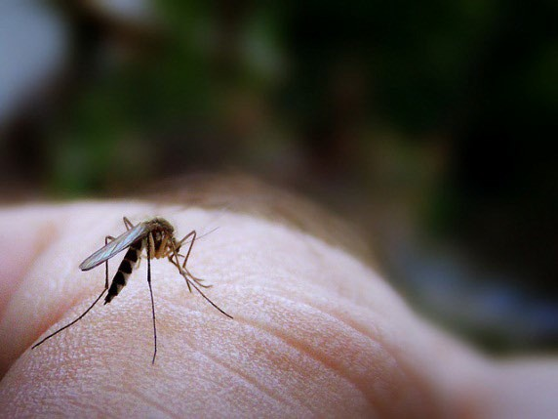

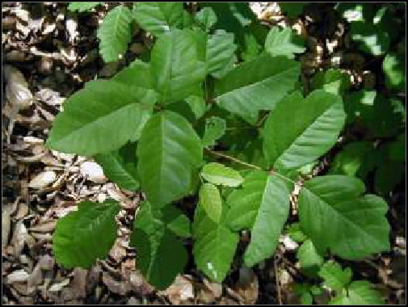
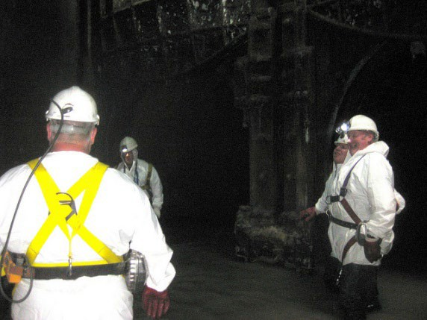

Biological Hazards in Construction
Insects Animals Mold
Source: James Jordan (Flickr.com)
Source: Jean-Jacques Boujot (Flickr.com)
Source: OSHA
Plants
Water/Sewage
Blood
Source: OSHA
Source: Matt Brown (Flickr.com)
Source: Monsleur Gordon (Flickr.com)

Slide 16

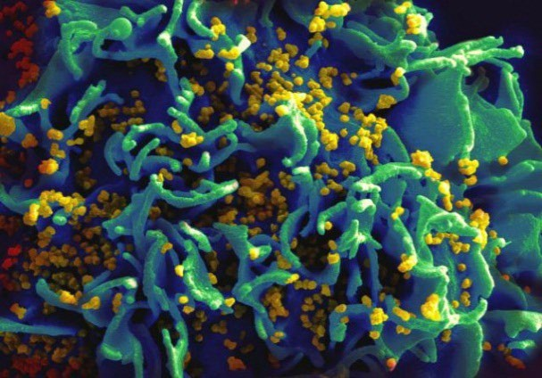
Effects of Exposure to Biological Hazards
Hepatitis C
Mild
  Allergic reaction
Serious
  Tetanus
  Swine Flu
  SARS
  Avian Flu
  West Nile
  Lyme Disease
Chronic/Terminal
  HIV
  Hepatitis B & C
Source: OSHA
HIV-infected H9 T cell
Source: NIAID

Slide 17
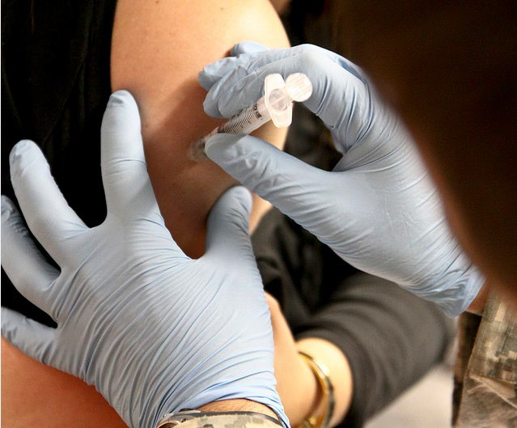
Protection Against Biological Hazards
Practice precaution with:
– Blood
Bodily fluids
Animals
Insects
Personal hygiene
Proper first aid
– Cuts/Scratches
Proper PPE
Vaccinations – schedule
Source: U.S. Army Corps of Engineers

Slide 18

Ergonomic Hazards in Construction
Lifting and pushing
– Heavy
Awkward
Repetitive
Awkward grips and postures
Reaching
Using wrong tool or using tool improperly
Using excessive force
– Overexertion
Source: OSHA

Slide 19
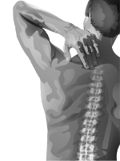
Effects of Exposure to Ergonomic Hazards
Musculoskeletal Disorders (MSDs)
Mild
Joint pain
Swelling
Sciatica
Acute lower back pain
Serious
  Epicondylitis (Tennis Elbow)
  Raynaud’s Phenomenon (White finger)
  Thoracic Outlet Syndrome
  Carpal Tunnel Syndrome
  Chronic lower back pain
  Tears (Rotator cuff is common)
Source: OSHA

Slide 20
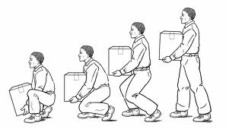
Protection Against Ergonomic Hazards
Use ergonomically designed tools
Use correct work practices
  Proper lifting techniques
  Work station setup
Ask for help when handling:
  Heavy loads
  Bulky/Awkward materials
Proper PPE
Source: Boston University (bu.edu/wellness/workplace/ergonomic)

Slide 21

Employer Requirements
Abide by OSHA regulations
  Permissible Exposure Limits (PELs) for all chemicals
  Monitoring and protection programs
  Hazard Communication Program (HAZCOM)
    Worker right to know
    Hazardous chemical training
    Written plan (Who, What, Where)
    Proper chemical labeling
SDS
Source: OSHA

Slide 22
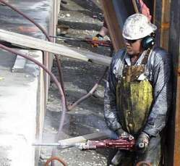
Multiple health hazards
In some cases, workers can be exposed to several health hazards at the same time or on the same worksite over time.
Source: OSHA
This worker is simultaneously exposed to noise, silica dust, vibration, and ergonomic hazards.

Slide 23
Knowledge Check
Which of the following is a common type of health hazard:
  Chemical hazards
  Economic hazards
  Electrical hazards
  Fall hazards
    Chemical hazards

Slide 24
Knowledge Check
Which of the following is an example of a physical health hazard:
  Asbestos
  Noise
  Silica
  Lead
b. Noise

Slide 25
Knowledge Check
Which is an appropriate engineering control for protection against noise exposures:
  Audiograms
  Earplugs
  Increasing distance between source
  Constructing sound barriers
d. Constructing sound barriers

Slide 26
Knowledge Check
Which is a requirement of the employer:
  Determine if workers’ exposures exceed OSHA PELs
  Perform medical evaluations on all employees
  Develop silica training programs for all employees
  Provide all workers with safety toe protective footwear
a. Determine if workers exposures exceed OSHA PELs

Slide 27
Health Hazards in Construction
Questions?

