Slide 1
Excavations
10-Hour Construction Outreach

Slide 2

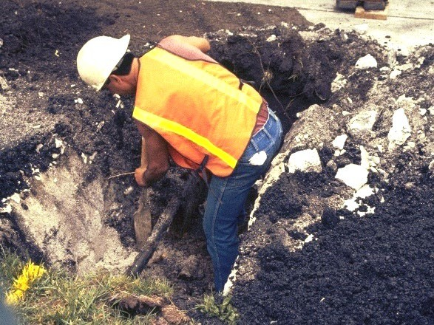
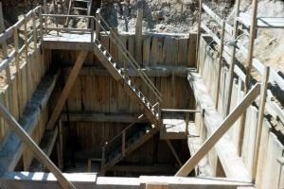
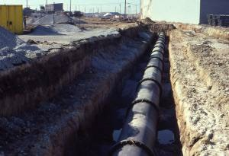
Excavations
Source of photos: NIOSH /John Rekus

Slide 3
Excavations
Lesson Overview
  Role of Competent Person
  Excavation Hazards
  Protection from Cave-ins
  Protection from other Excavation Hazards
  Employer Requirements

Slide 4
Role of Competent Person
Required training and knowledge
  Soil classification
  Use of protective systems
  OSHA’s requirements for excavation
Able to identify hazards and have the authority to eliminate hazards

Slide 5
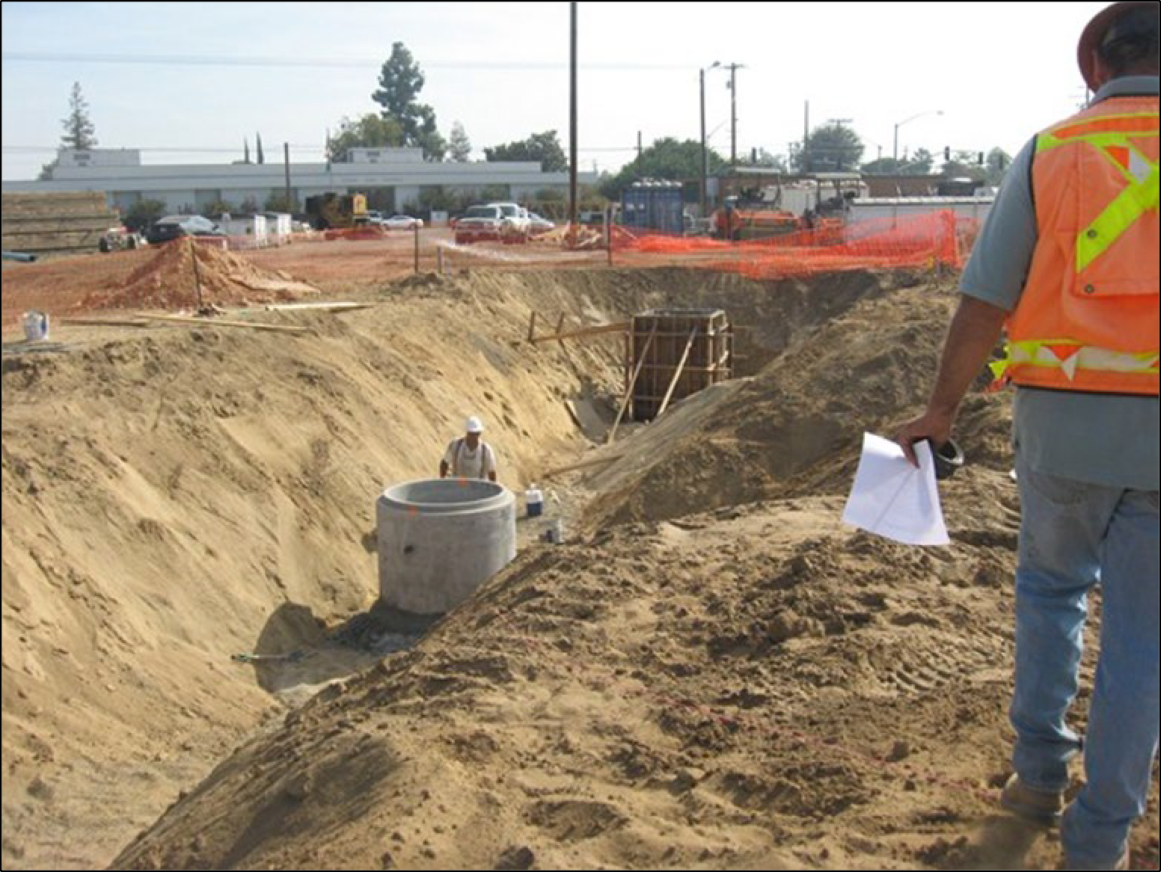
This competent person is inspecting the excavation, surroundings and protective system. If a hazard is identified, they will remove the worker and take prompt corrective action.
Source of photo: OTIEC Chabot Las Positas

Slide 6
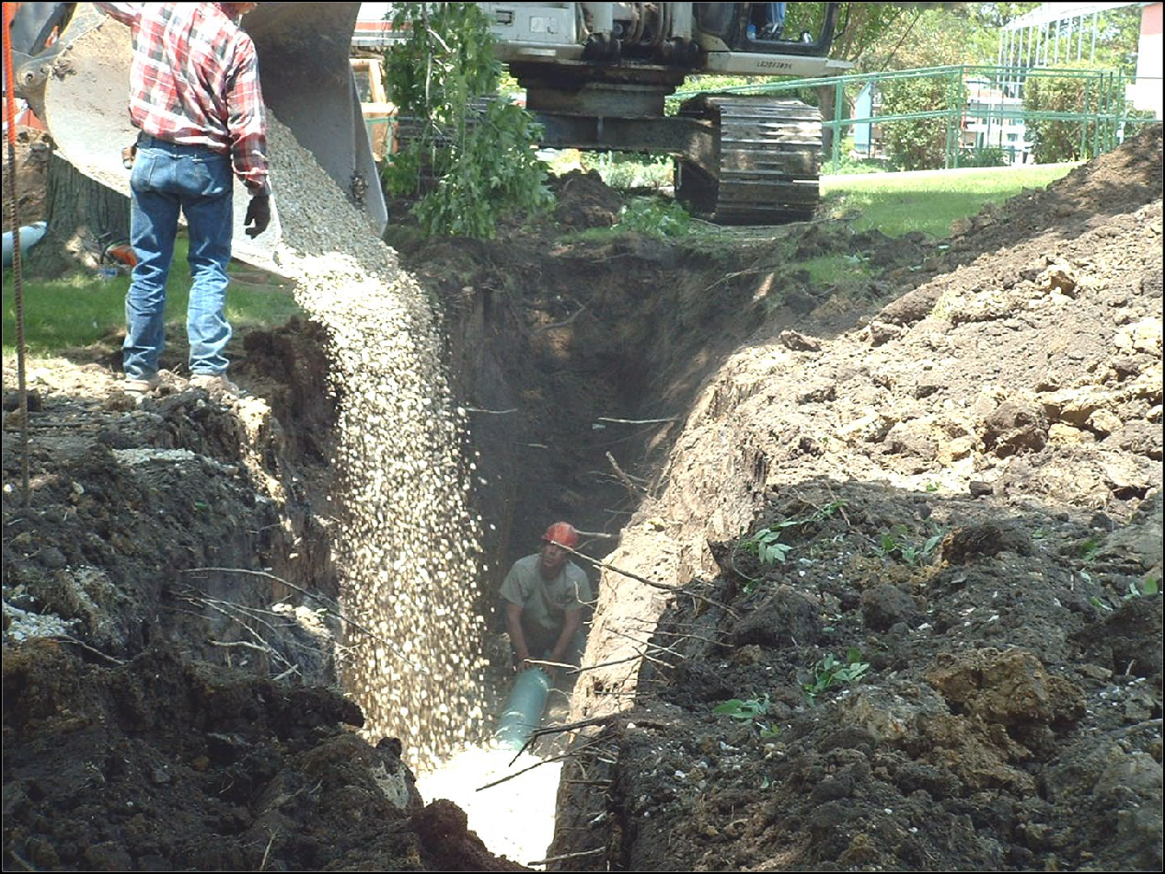
Excavation Hazards
This is a very dangerous situation!
Cave-ins
Falls
Falling Loads
Hazardous Environment
Mobile Equipment
Underground Utilities
Source of photo: OSHA

Slide 7
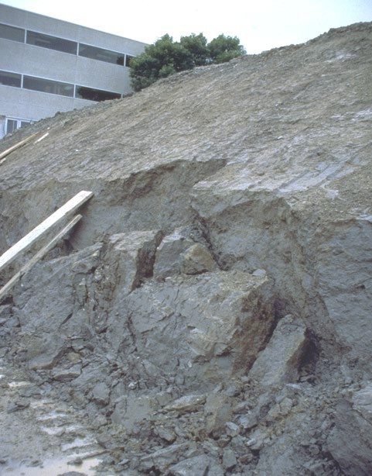

Cave-Ins
Greatest hazard
It is natural for a trench to try to fill itself
One cubic foot of soil weighs between 90-
130 lbs.
It will entrap, bury, or otherwise injure you

Slide 8
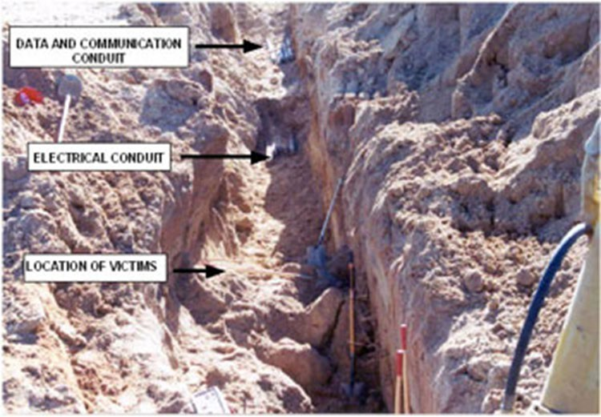
They Both Died
A crew was installing conduit in an 8’ deep by 2’ wide trench.
The trench collapsed.
Two workers were buried.
They both died!
Source of photo: CDC/NIOSH/FACE

Slide 9
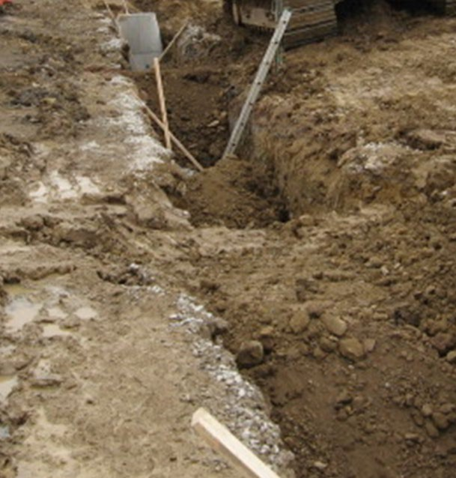
Protection is Required
Never enter an unprotected trench that is 5 or more in depth
The competent person must first choose and implement a protective system
Even excavations less than 5 feet deep need to be deemed safe by the competent person
Cave-ins can happen without warning
This 6 foot deep vertical- sided, unprotected trench is dangerous!
Source of photo: OTIEC NRC WVU

Slide 10
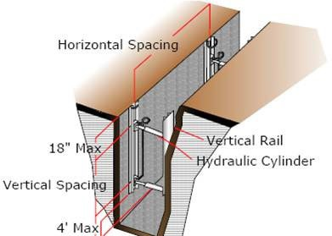
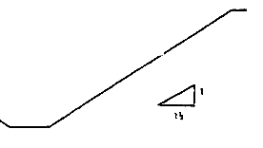
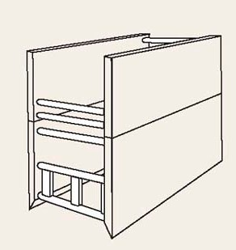
Protective Systems
Support/shoring systems
Sloping and benching
Shielding systems (trench boxes)
Shoring
Sloping
Shielding

Slide 11
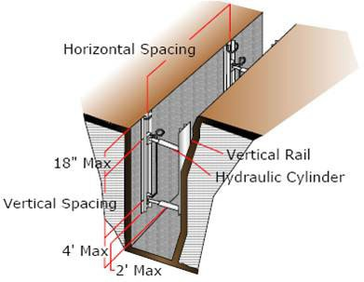
Support/shoring Systems
Source of photos: NIOSH /John Rekus

Slide 12
The Theory of Shoring
Shoring prevents cave-ins
Shoring, if designed and installed correctly, prevents movement of the excavated wall.
In order for the shoring to do its job, you must stay within the protection of the shoring even when entering and exiting

Slide 13
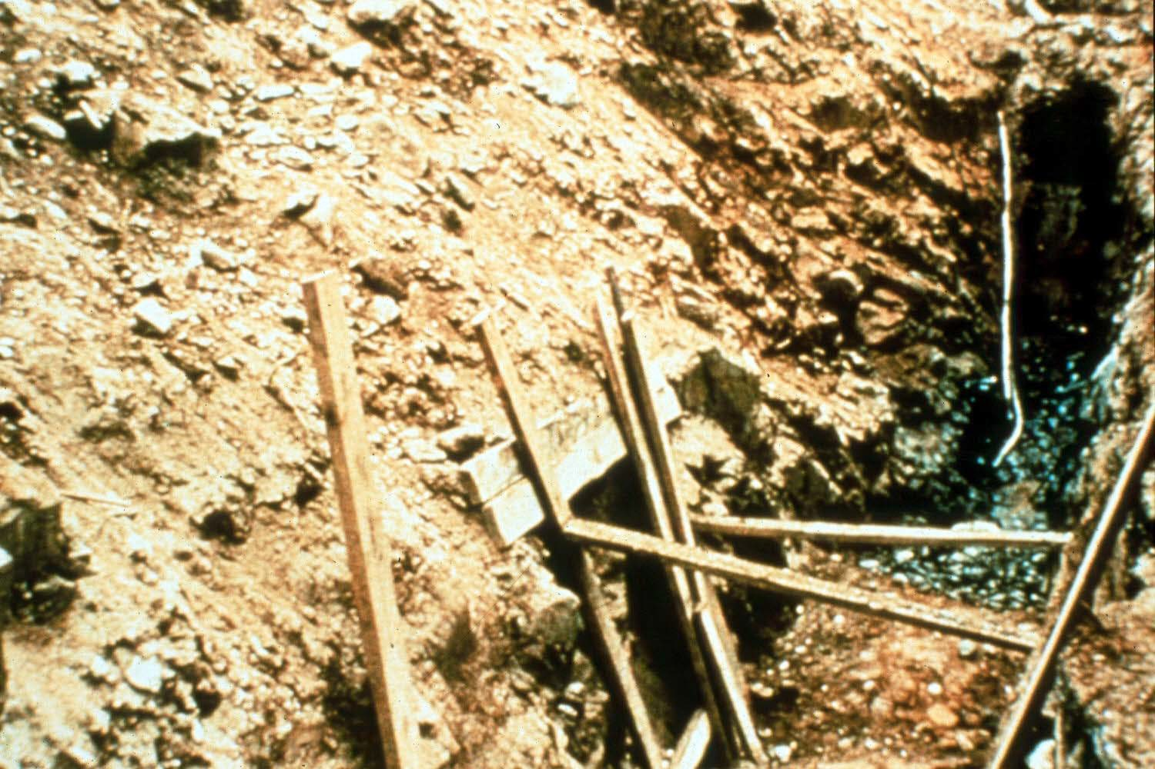
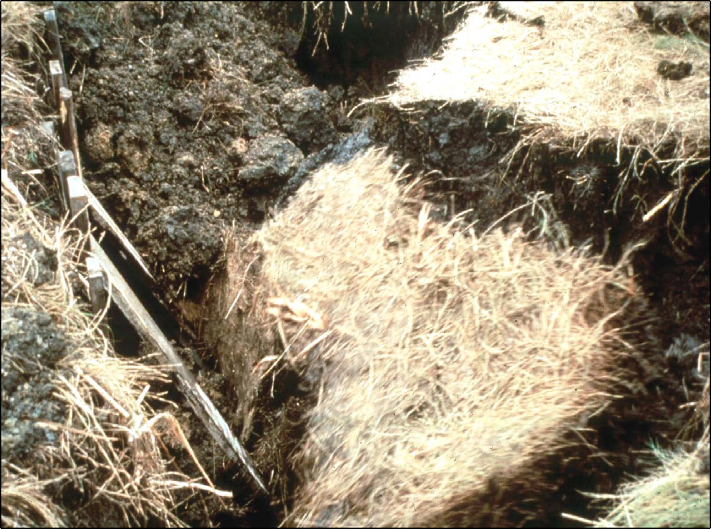
Improper Shoring
Make-shift, improperly designed shoring does little other then provide a false sense of security!
Source of photos: OSHA

Slide 14
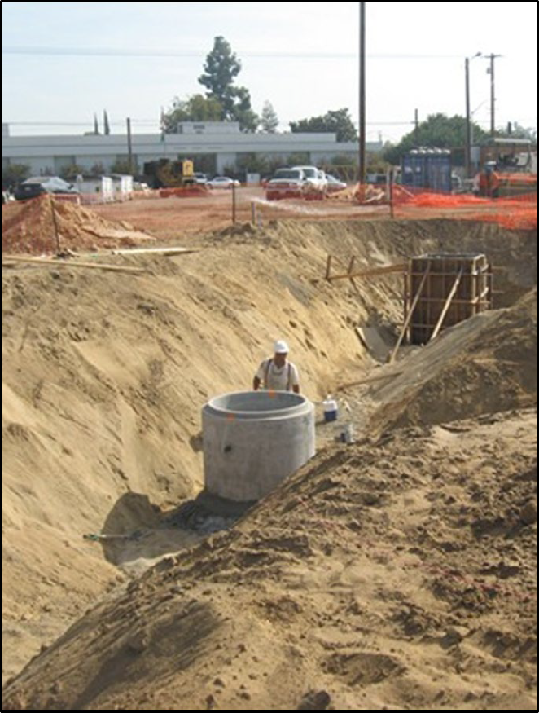
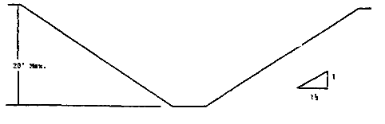
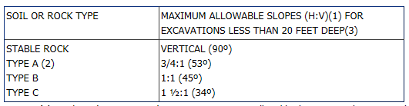
Sloping and Benching
This slope is safe for any soil classification!
Is this a 1 ½ to 1 slope?

Slide 15
The Theory of Sloping
Sloping prevents cave-ins
Sloping, if done correctly, removes the risk of cave-ins by sloping the soil of the trench back from the trench bottom
Source of photo: OTIEC NRC WVU

Slide 16
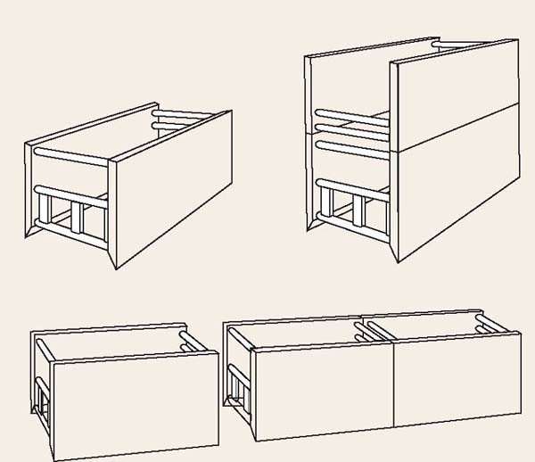
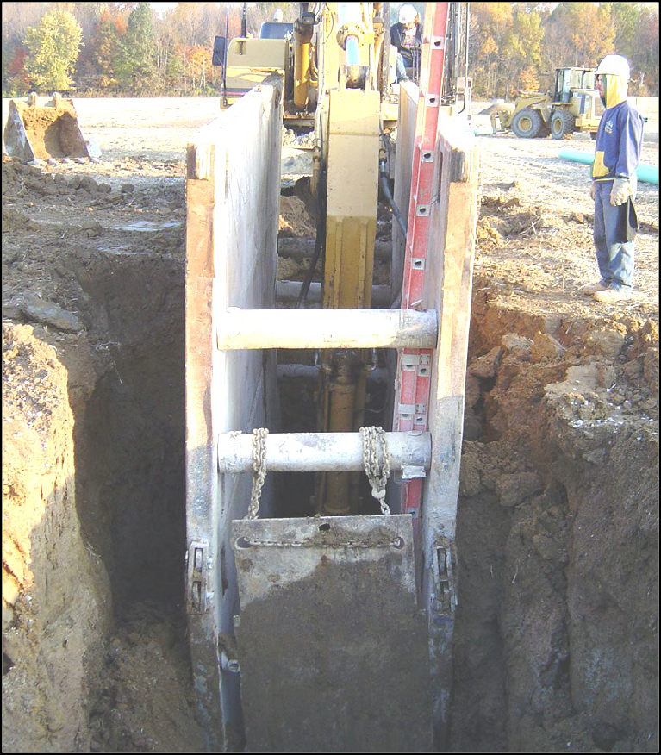
Shield System
How many hazards can you find ?
Source of photo: OSHA

Slide 17
The Theory of Shielding
Trench shields and boxes, if installed correctly, are designed to protect workers from the forces of a cave-in
In order for the shield to do its job, you must stay within the protection of the shield even when entering and exiting

Slide 18
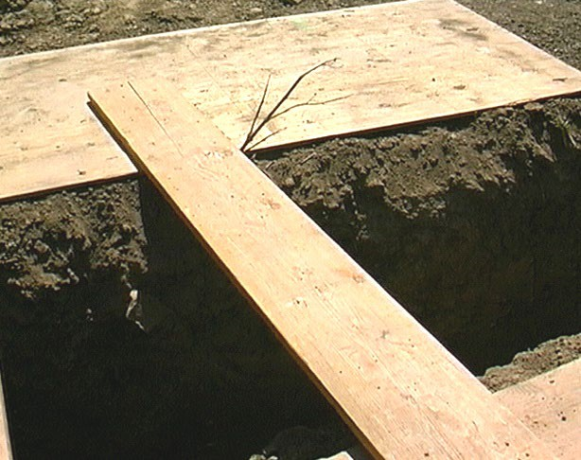
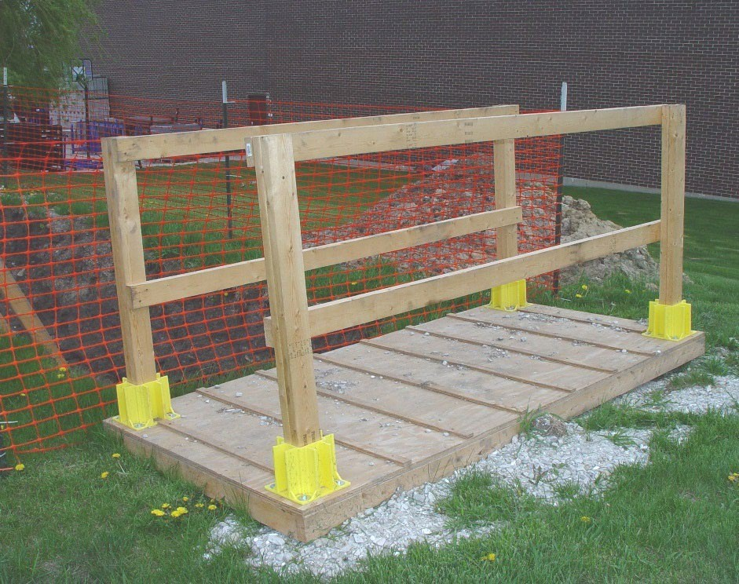
Falls
Safe Alternative
Source of photos: OSHA

Slide 19
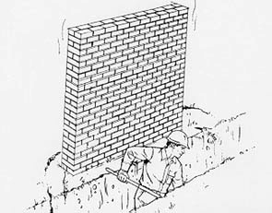
Adjacent Structures
Structures become unstable when earth next to them is removed
For your safety, they must be supported
A competent person must ensure precautions are implemented.

Slide 20

Underground Utilities
As required, this worker’s employer used their state’s one call system to locate under ground utilities before breaking ground. Now he is hand digging to find the exact location.
Source of photo: OSHA

Slide 21
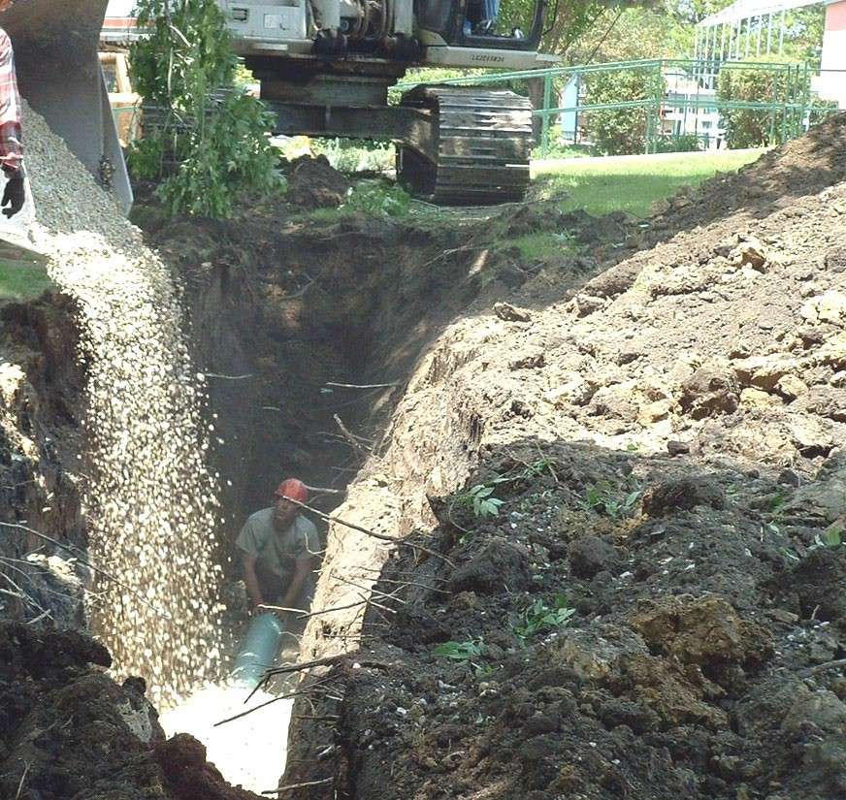
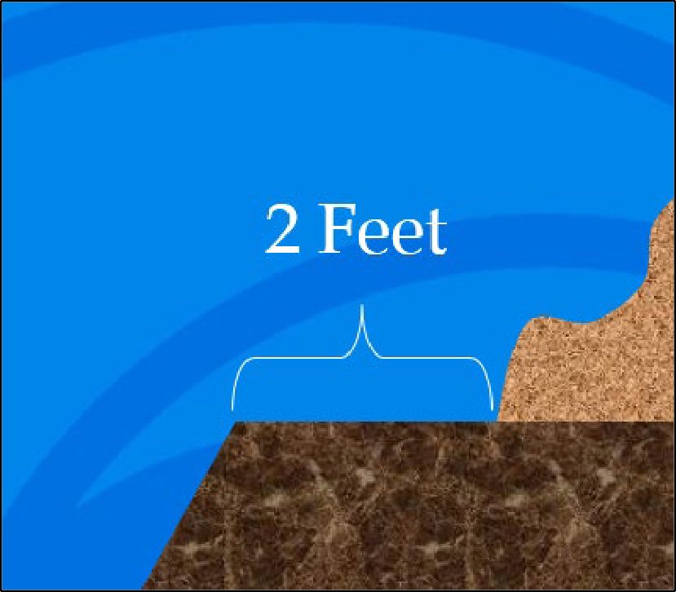
Spoil Pile
Minimum
Source of photo: OSHA

Slide 22
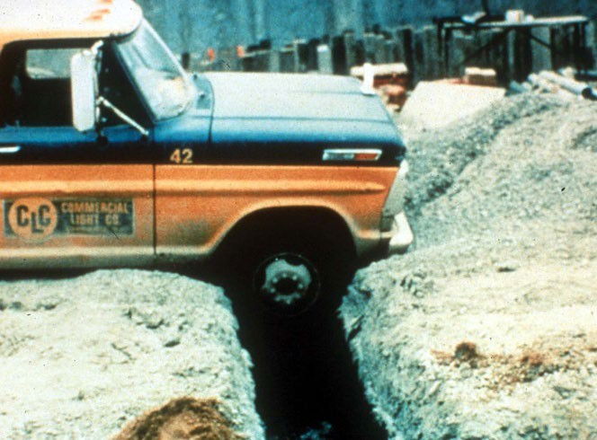
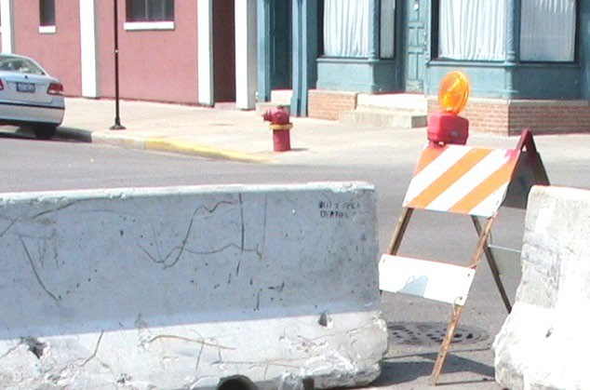
Mobile Equipment
Safe Alternative
Source of photos: OSHA

Slide 23


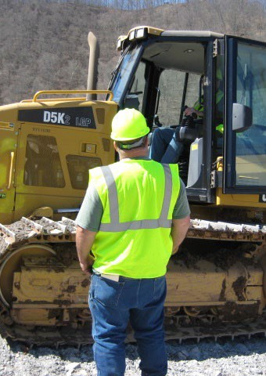
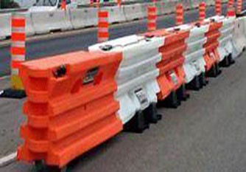

Vehicular or Traffic Hazards
Source of photos: OSHA

Slide 24
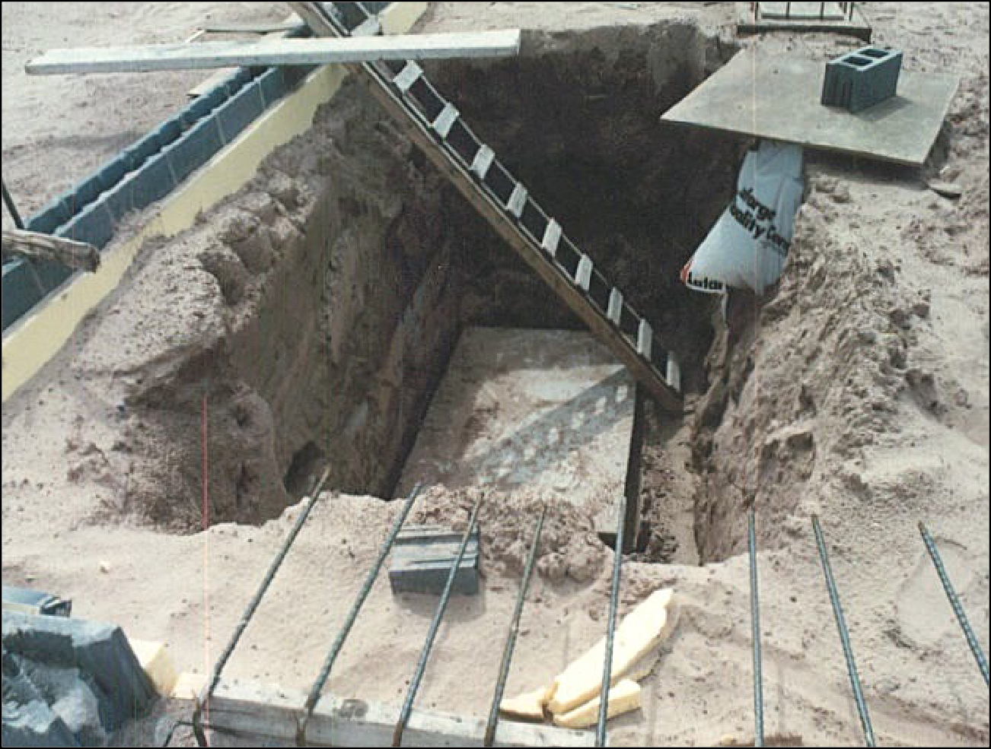
Falling Loads
Do you see any other hazards?
Source of photo: OSHA

Slide 25
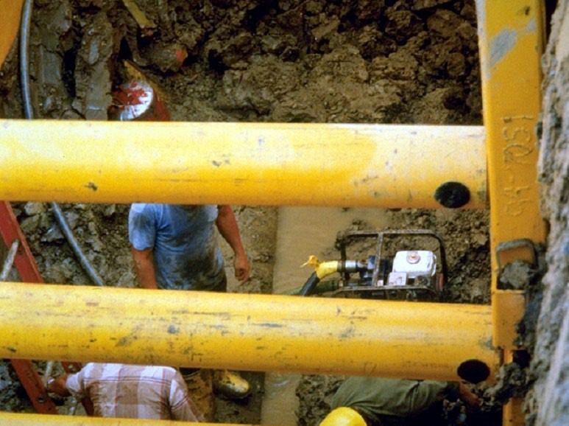
Hazardous Atmospheres
Source of photo: OSHA

Slide 26
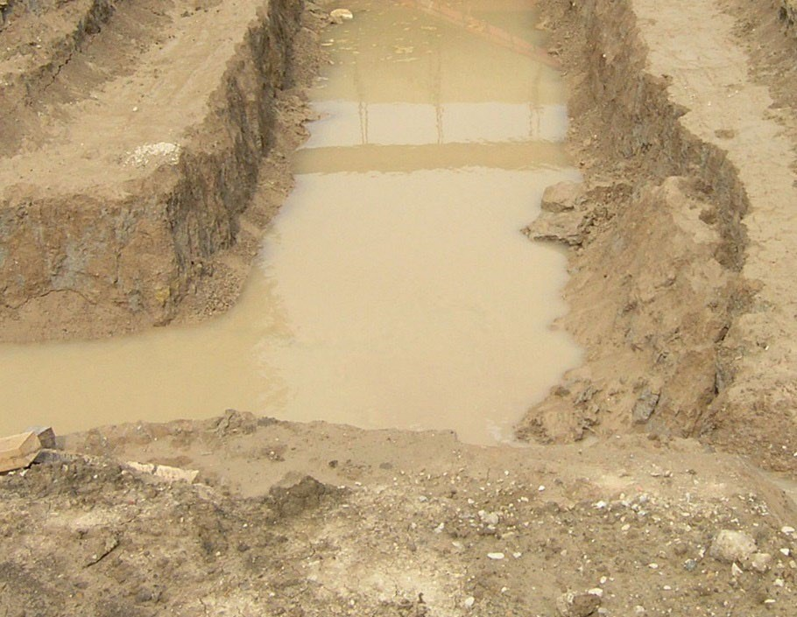
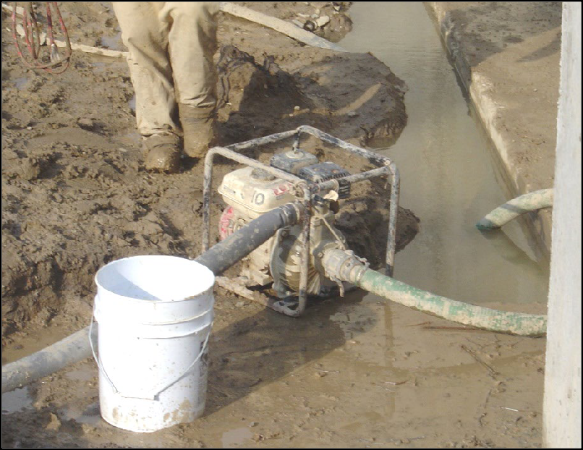
Water Accumulation
Source of photos: OSHA

Slide 27
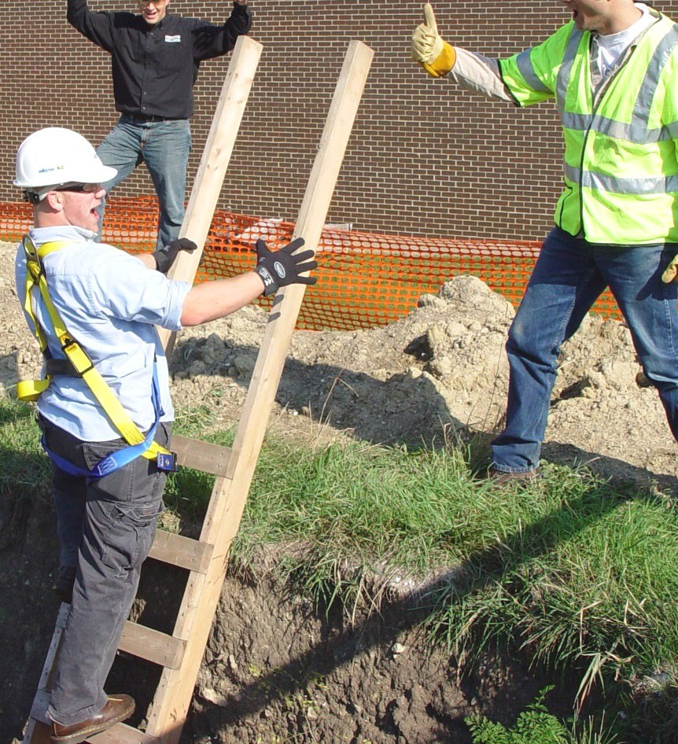
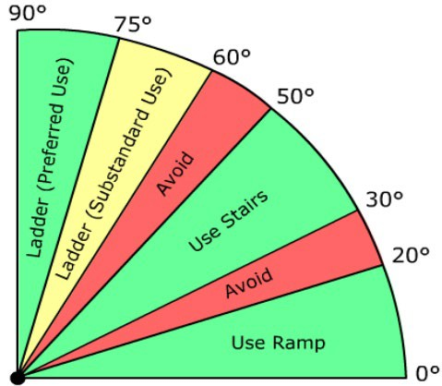
Access/Egress
Source of photo: OSHA

Slide 28
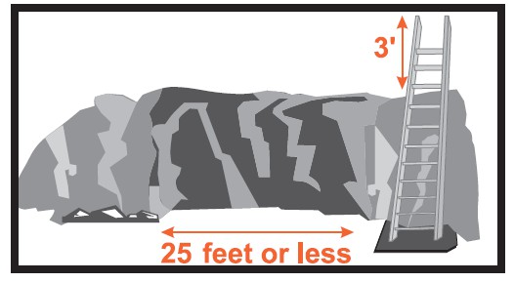
Ladders

Slide 29
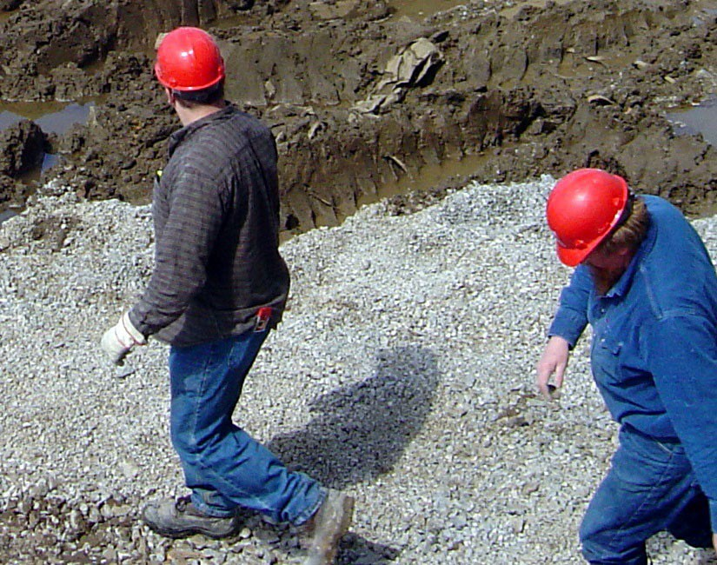
Hard Hats
Working below grade, overhead hazards exist
Hard hats must be worn in excavations because of overhead hazards
Source of photo: OSHA

Slide 30
Responsibilities: Employer
Employers must:
‒ preplan the work and use the one-call system to identify underground utilities
‒ protect you from cave-ins and other excavation- related hazards
‒ inspect the excavation at least daily and throughout the shift as needed
‒ take prompt corrective action when a hazard is identified
‒ respond to and correct hazards pointed out by you, the worker

Slide 31
Responsibilities: Employer
Employers must:
‒ make sure a ladder is within 25’ of your work area when deeper than 4’
‒ keep excavated dirt, rocks and other materials back 2’ from the excavation’s edge
‒ Test and monitor the air within the trench in areas suspect to atmospheric hazards

Slide 32
Responsibilities: You
You must:
‒ work defensively
‒ Follow you company’s excavation and trenching safety rules
‒ correct the hazards you are able to correct
‒ report to your supervisor the hazards you are unable to correct

Slide 33
Case Study

Slide 34
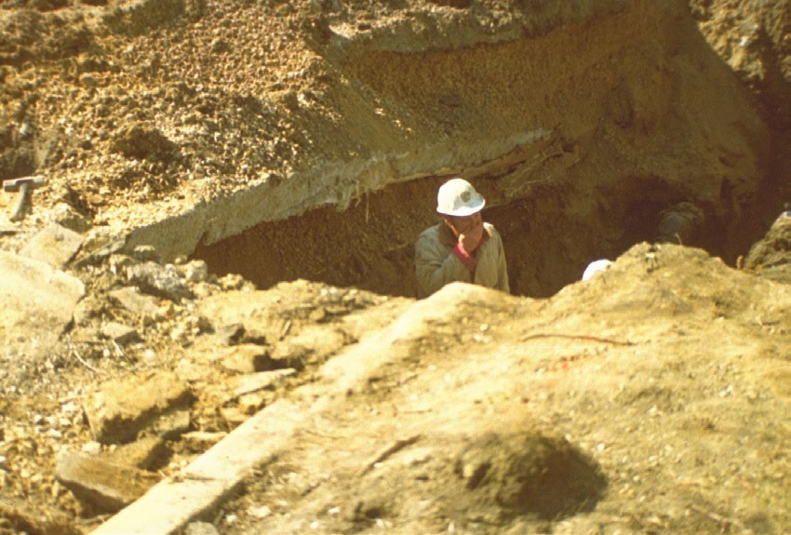
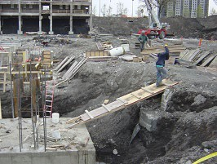
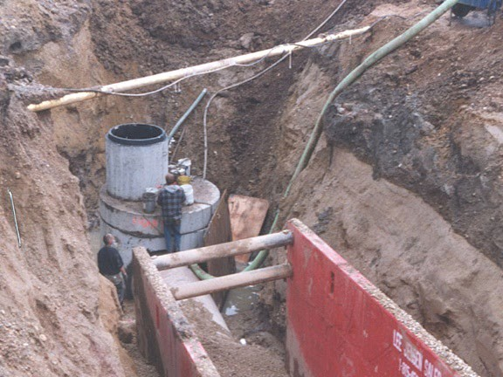
Hazard Recognition
Identify hazards and what should be done
Source of photos: OSHA

Slide 35
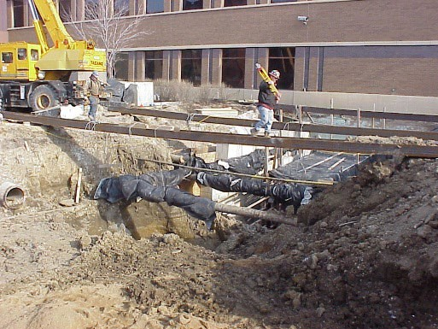
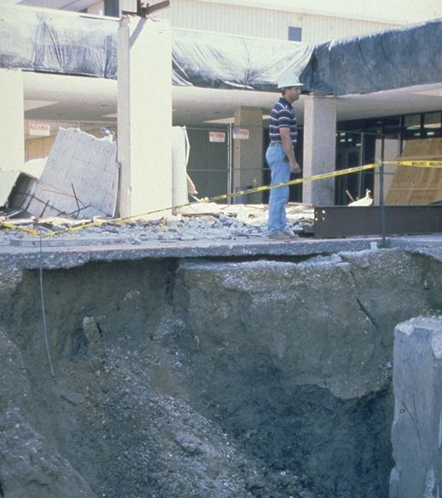
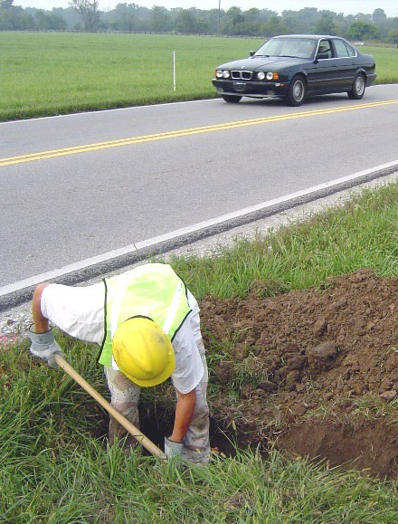
Hazard Recognition
Identify hazards and what should be done
Source of photos: OSHA

Slide 36
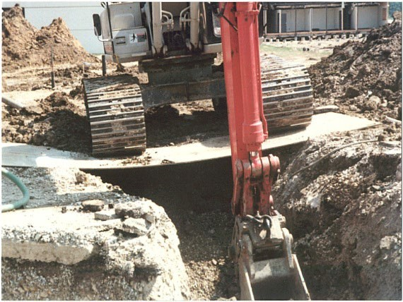
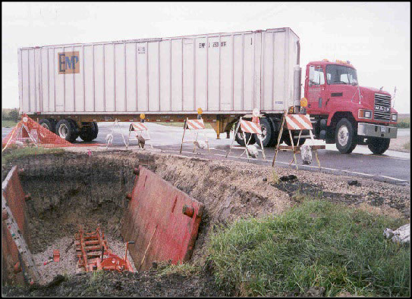
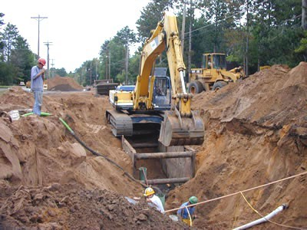
Hazard Recognition
Identify hazards and what should be done
Source of photo: OSHA

Slide 37
Always Remember
Never enter a trench 5’ or greater in depth unless a protective system is in place.
Trenches less than 5’ deep still require the competent person’s “OK”
If a trench box or shoring is used, never leave its protection while in the trench

Slide 38
Knowledge Check
What is the minimum distance that excavated materials, tools, and other supplies be kept back from the excavation’s edge?
1 foot
2 feet
7.5 feet
25 feet
b. 2 feet

Slide 39
Knowledge Check
At what depth must a ladder, ramp, steps, or runway be present for quick worker exit:
4 feet
5 feet
10 feet
It is never required
  4 feet

Slide 40
Knowledge Check
What is the greatest hazard facing a worker while working in a trench:
Hazardous atmospheres
Falls
Cave-ins
Falling Objects
c. Cave-ins

Slide 41
Knowledge Check
Unless made in entirely stable rock, at what depth is a protective system required for a trench:
Any depth if the competent person says so.
5 feet deep and greater
Both a and b
A protective system is never required in trenches
c. Both a and b

Slide 42
Excavations in Construction
Questions?

