Slide 1
Cranes
10-Hour Construction Outreach

Slide 2
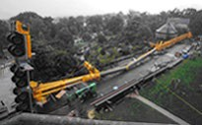
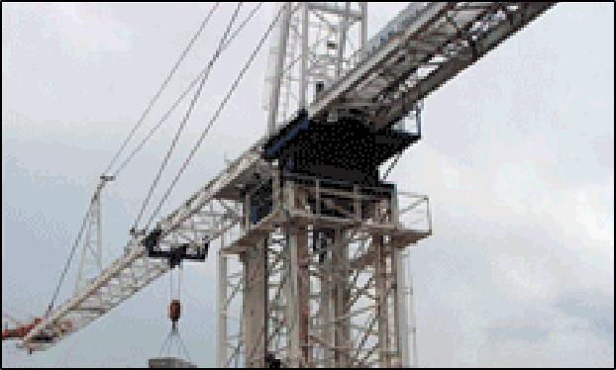
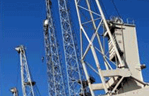
Cranes
Source of photos: OSHA

Slide 3
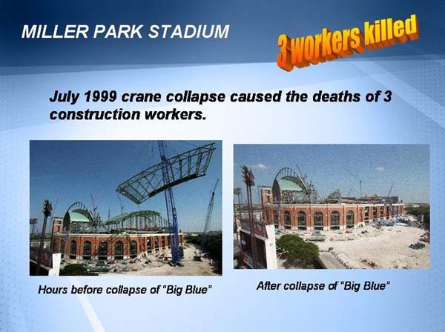
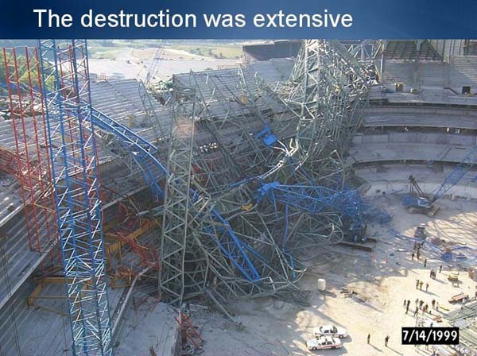
Cranes
Discuss “Big Blue” crane collapse
Case Study
https://www.osha.gov/dcsp/success_stories/compliance_assistance/ abbott/abbott_casestudies/slide30.html

Slide 4
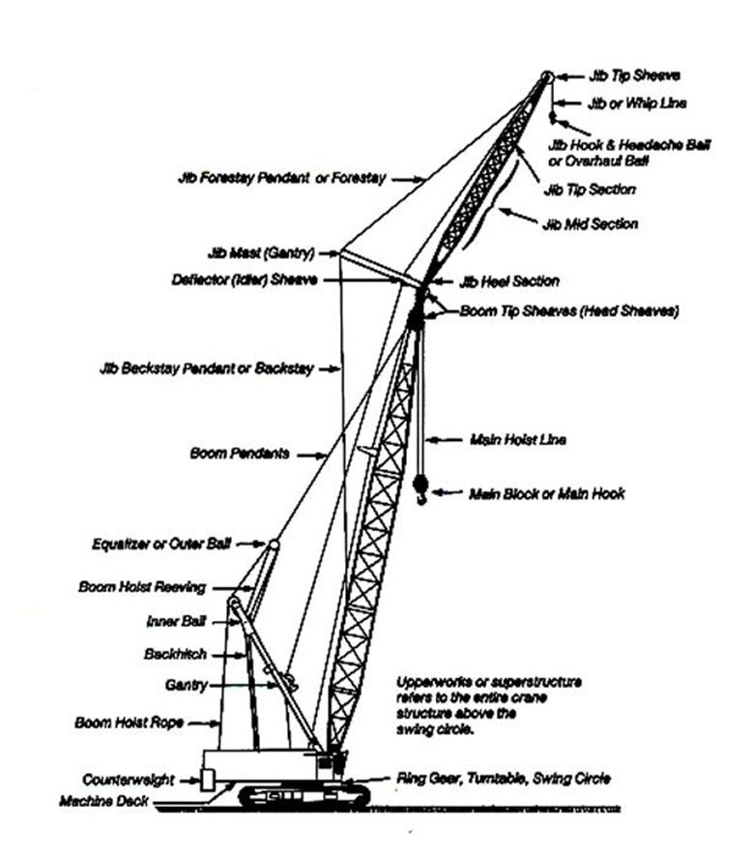
Cranes
Source: OSHA

Slide 5
Cranes
Lesson Overview
Common Causes of Crane Accidents
Crane Use
Crane Use Near Power Lines
Employer Requirements
Training Requirements

Slide 6
Common Causes of Crane Accidents
Four Major Types of Crane Accidents
Contact with power lines
Overturns
Mechanical Failures
Falls

Slide 7
Common Causes of Crane Accidents
Reasons accidents occur:
Poor Load Planning/Instability
Lack of communication
Lack of training
Inadequate maintenance or inspection of equipment

Slide 8
Hazardous Environments for Crane Operations
Improper loading rating
Excessive speeds
No hand signals
Inadequate inspection and maintenance
Unguarded parts
Unguarded swinging radius
Working too close to power lines
Improper exhaust systems
Shattered windows
No steps or guardrails on walkways
No boom angle indicator
Not using outriggers

Slide 9
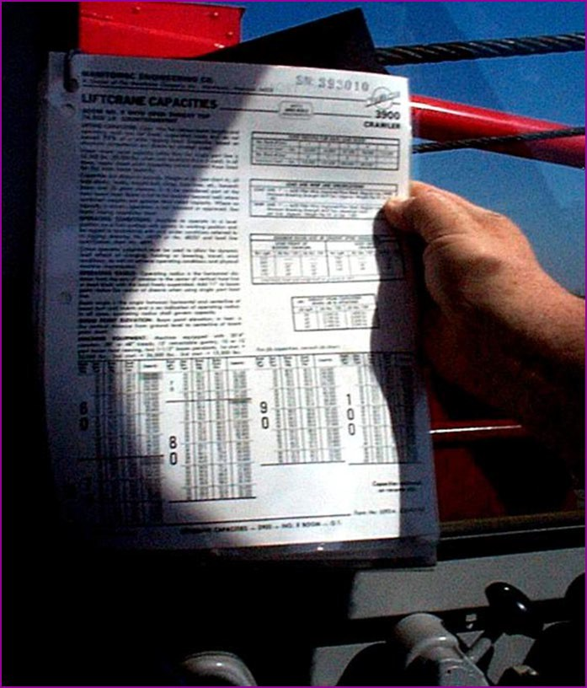
Load Capacity – Speed - Warnings
Make sure the crane operator can see the:
  Rated Load Capacities
  Operating Speeds
  Special Hazard Warning
  Instructions
  Operator’s manual
Source: OSHA

Slide 10
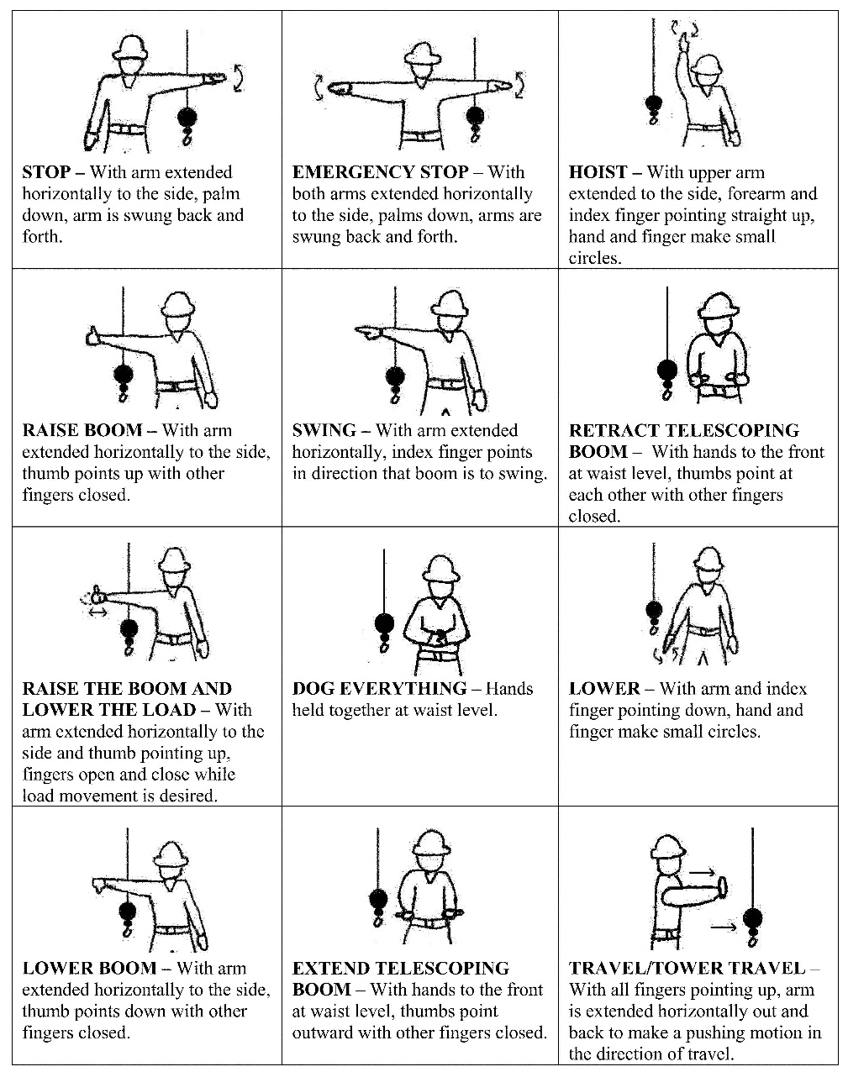
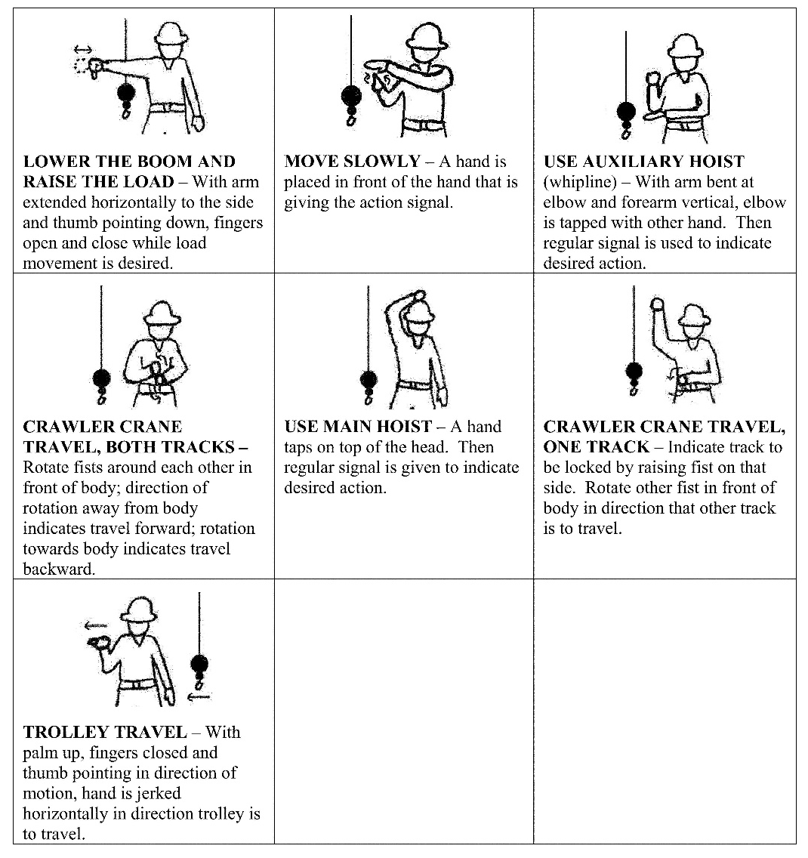
Hand Signals
Source: Federal Register - OSHA

Slide 11
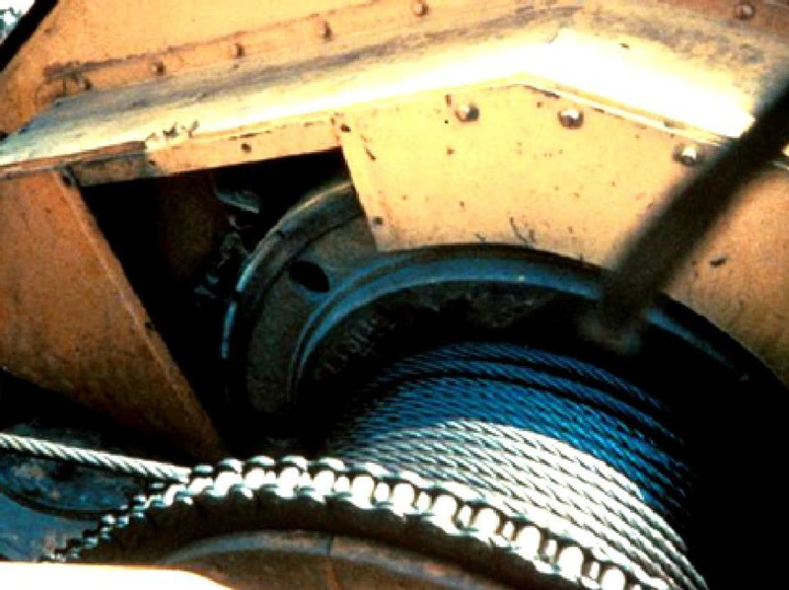
Guard Moving Parts
Source: OSHA

Slide 12
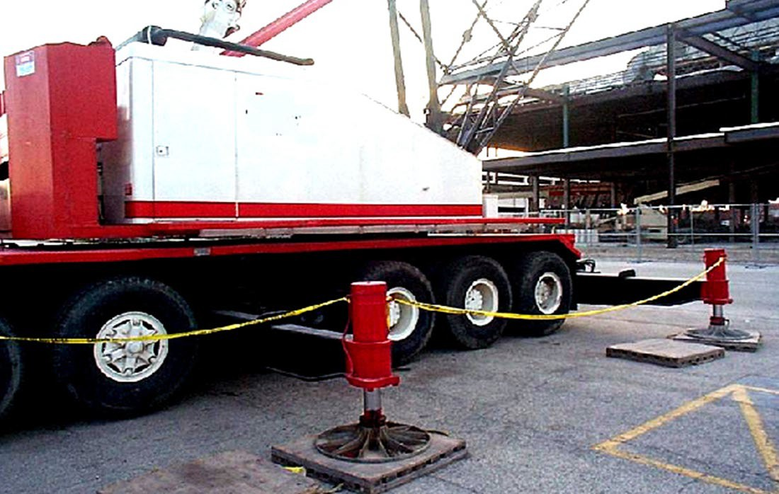
Swing Radius
Stay out of the swing radius of the crane.
Make sure there are barrier guards showing the swing radius.
Source: OSHA

Slide 13
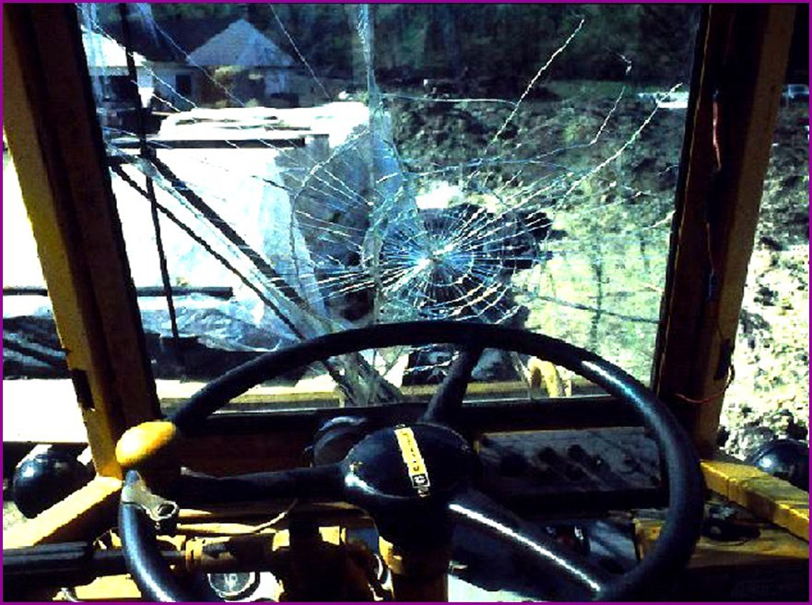
Operator Visibility
Make sure broken windows or other obstructions do not prevent the operator from seeing.
Source: OSHA

Slide 14
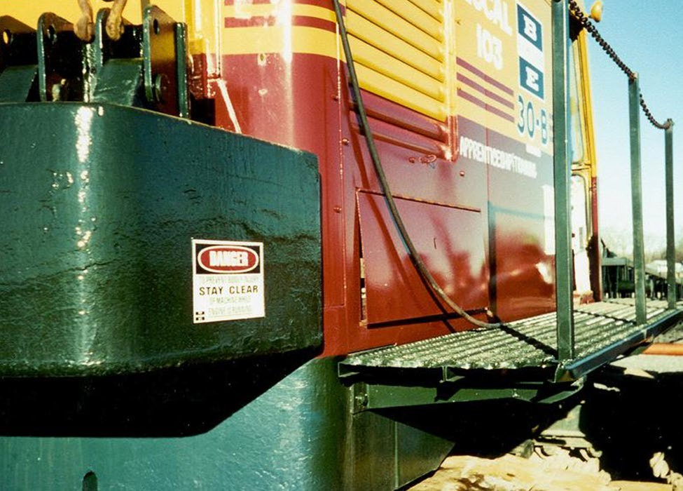
Guardrails
Runways and steps need to have guardrails, handholds and slip resistant surfaces.
Source: OSHA

Slide 15
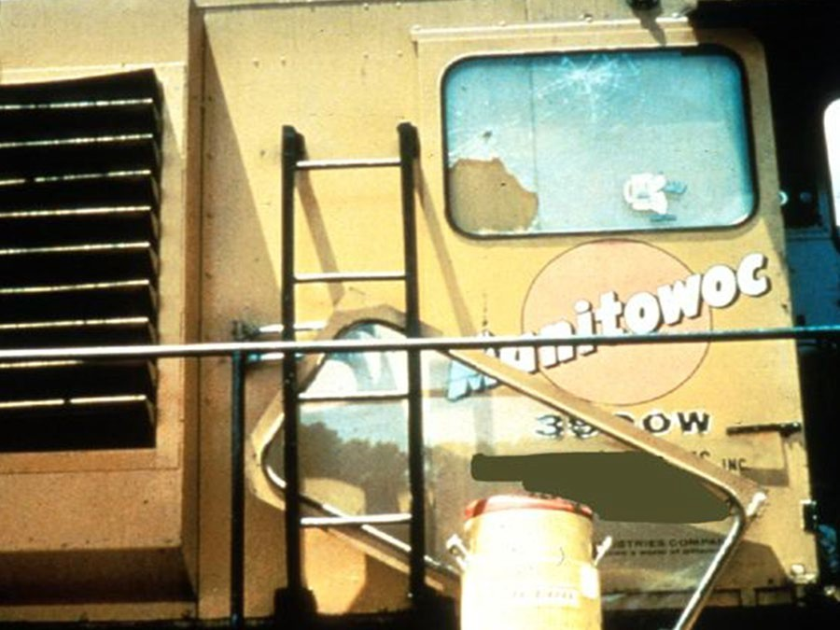
Guardrails
Use ladders to get to the upper portion of the cab.
Source: OSHA

Slide 16
Crane Use
Capacities and limitations of the crane and job site restrictions.
Operators, signal persons, and riggers – qualifications/certifications
Level the crane and check the support surface
Check for power line precautions
Communicate hoisting activities in work area
Barricade swing area
Maintenance and inspection
Identify safe store and pick up/put down area for materials and machinery

Slide 17
Crane Operations
Load capacity/speed of operation
Weight of load
Basic lifting principles
Hand signals
Power lines
Swing radius
Suspended loads

Slide 18
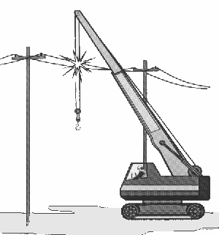
Crane Use Near Power Lines
Boom or crane contact with energized power lines accounts for nearly 45% of crane accidents.
Source: NIOSH

Slide 19
Crane Use Near Power Lines
Pre-operational requirements:
Identify work zone
Determine proximity to power lines, if closer than 20 feet, if so, must do one of the following three:
  De-energize and ground
  Ensure no part of equipment, load line, or load gets closer than 20 feet to power line
  Determine line’s voltage and minimum approach distance permitted under Table A.

Slide 20
Crane Use Near Power Lines
Pre-operational requirements:
TABLE A – MINIMUM CLEARANCE DISTANCES
Voltage (nominal, kV, alternating current) | Minimum Clearance Distance (feet)
up to 50 | 10
over 50 to 200 | 15
over 200 to 350 | 20
over 350 to 500 | 25
over 500 to 750 | 35
over 750 to 1,000 | 45
Over 1,000 | (as established by the utility owner/operator or qualified registered professional engineer who is a qualified person with respect to electrical power transmission and distribution)

Slide 21
Employer Requirements
Comply with all applicable employer requirements.
Designate a competent person to inspect all machinery and equipment prior to each use.

Slide 22
Training Requirements
Employer must provide training
Training administration

Slide 23
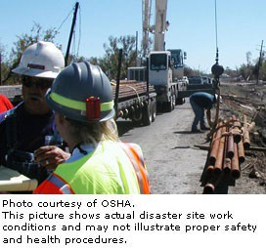
Hazard Recognition

Slide 24
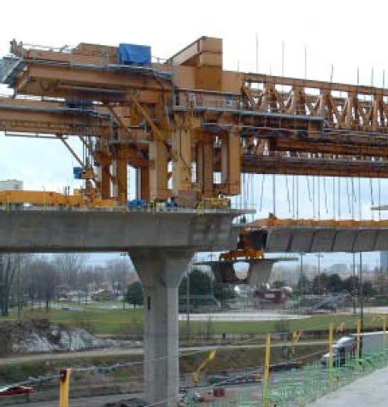
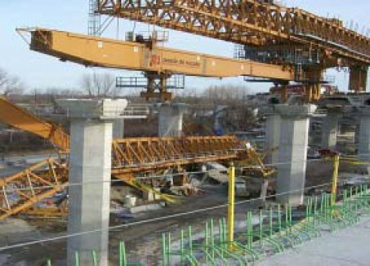
Hazard Recognition
Photo source: OSHA

Slide 25
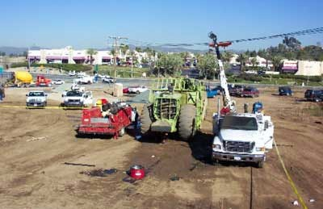
Hazard Recognition
Photo source: NIOSH

Slide 26
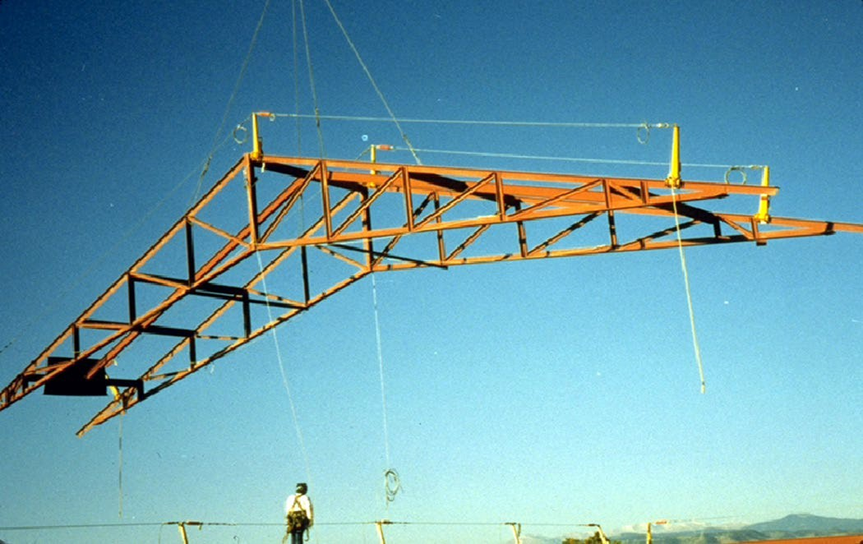
Hazard Recognition
Photo source: OSHA

Slide 27
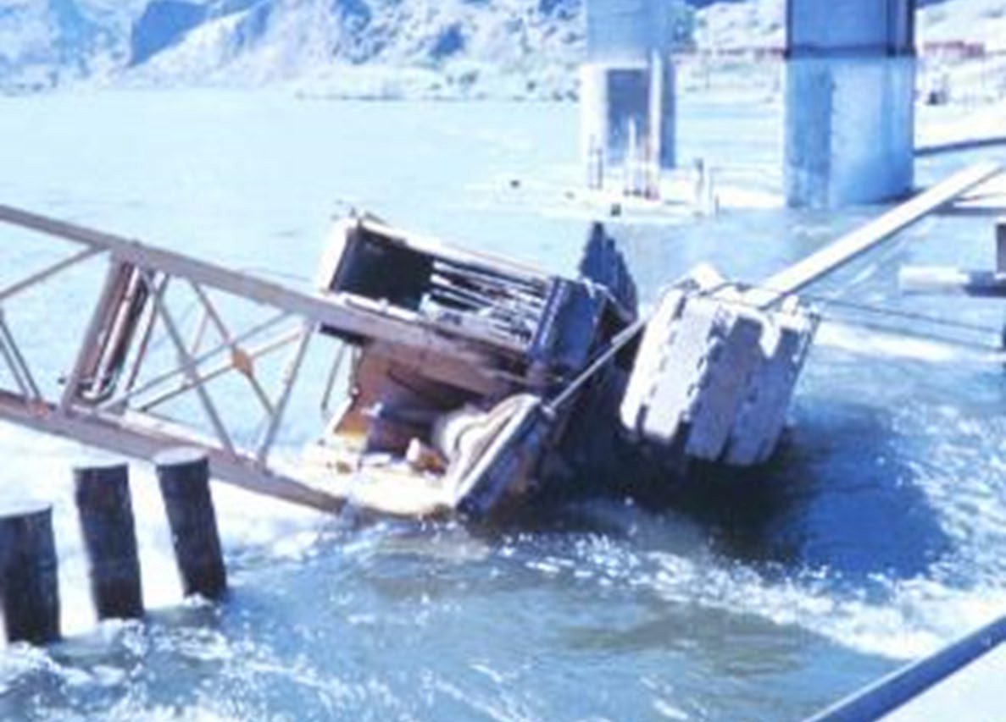
Hazard Recognition
Photo source: OSHA

Slide 28
Knowledge Check
Nearly 45% of crane accidents are the result of the boom or crane making contact with .
  other cranes
  work zone barricades
  energized power lines
  workers on the ground
c. energized power lines

Slide 29
Knowledge Check
Before beginning equipment operations, the employer must .
  identify the work zone and determine proximity to power lines
  notify utility company of lift and estimate voltage of power lines
  locate the fall zone and test load by lifting it at least 20 feet off the ground
  remove hazard area barriers and observe weather conditions
a. identify the work zone and determine proximity to power lines

Slide 30
Knowledge Check
A broken window that distorts the operator’s visibility of the task is acceptable for operation.
  True
  False
b. False

Slide 31
Knowledge Check
Which of the following must be readily available to the crane operator for use at all times?
  Load charts and recommended operating speeds
  Special hazard warnings
  Instructions and operator’s manual
  All of the above
d. All of the above

Slide 32
Knowledge Check
Who is responsible for inspecting all machinery and equipment prior to each use and during use, to make sure it is in safe operating condition?
  Certified person
  Qualified person
  Proficient person
  Competent person
d. Competent person

