Slide 1
Bloodborne Pathogens
OSHA 10-hour Outreach Training General Industry

Slide 2
Introduction
Lesson objectives:
Define bloodborne pathogens.
Identify workers who are at risk of exposure to bloodborne pathogens.
Identify key aspects of a Bloodborne Pathogen Exposure Control Plan;
Describe methods for controlling exposure to bloodborne pathogens.
Describe steps to take when exposed to a bloodborne pathogen.

Slide 3
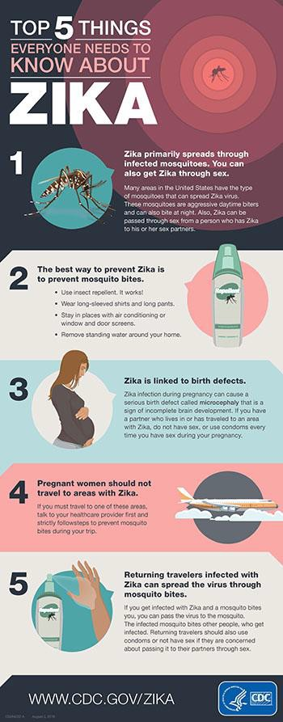
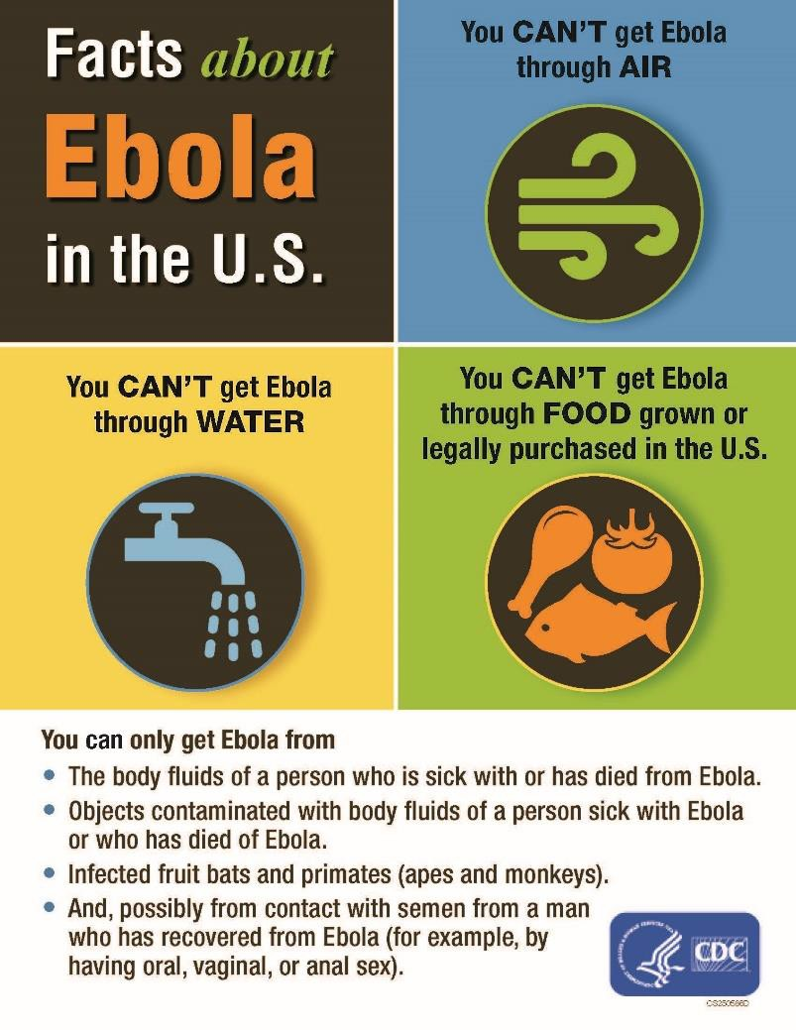
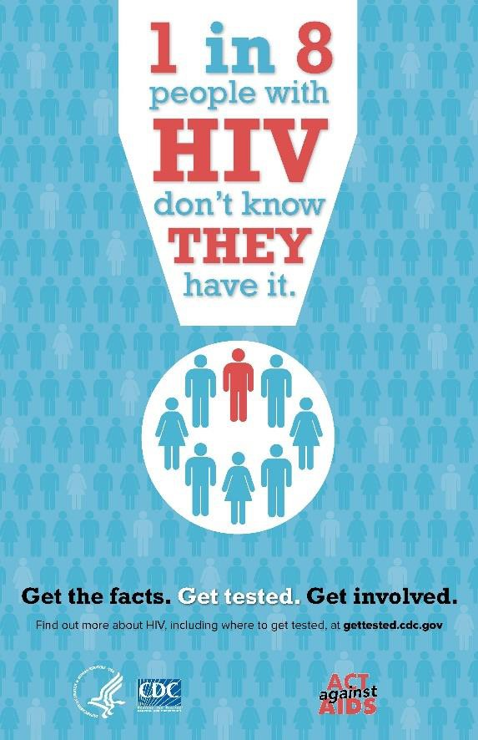
2016
Introduction
2014
1981

Slide 4
Bloodborne Pathogens
What are bloodborne pathogens?
Pathogenic microorganisms present in human blood that can lead to diseases
Examples of primary concern
  Hepatitis B (HBV)
  Hepatitis C (HCV)
  Human Immunodeficiency Virus (HIV)

Slide 5
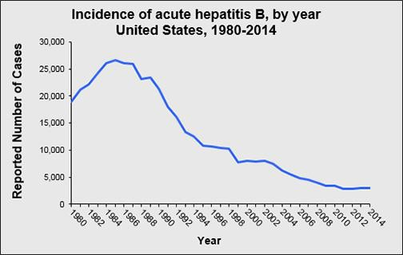
Bloodborne Pathogens
Hepatitis B (HBV)
  Over 12 million Americans are infected (1 in 20)*
  Silent infection; symptoms include jaundice, fatigue, abdominal pain, loss of appetite, intermittent nausea, vomiting; may lead to chronic liver disease,
liver cancer, and death
HBV can survive for at least one week in dried blood
Up to 40,000 people in US will become newly infected each year*
*Source: Hepatitis B Foundation
Reported cases of hepatitis B in the U.S. have generally declined from 1980 to 2014.
Source: CDC

Slide 6
Bloodborne Pathogens
Hepatitis C (HCV)
  Hepatitis C is the most common chronic
bloodborne infection in the U.S.
  Symptoms include: jaundice, fatigue, abdominal pain, loss of appetite, intermittent nausea, vomiting
  May lead to chronic liver disease and death

Slide 7
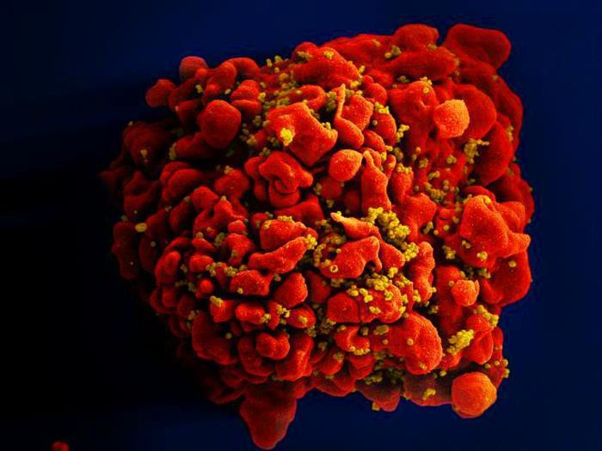
Bloodborne Pathogens
Human Immunodeficiency Virus (HIV)
  HIV is the virus that leads to AIDS
  HIV affects the body’s immune system
  HIV does not survive well outside the body
  Estimated >1.1 million people living with HIV
  Infected for life
Single, red-colored H9-T cell infected by numerous mustard-colored HIV
particles which are attached to the cell’s surface membrane. Source: NIAID.

Slide 8
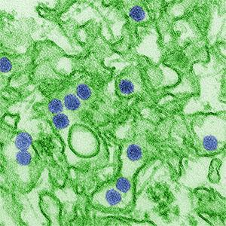
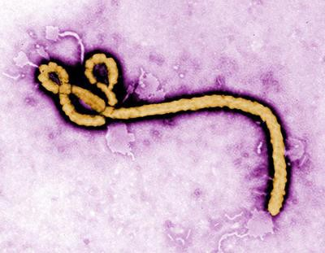
Bloodborne Pathogens
Other bloodborne diseases
  Caused by viruses or bacteria
  Circulate in blood at some phase; capable of
being transmitted
  Most are rare in the U.S.
Zika Virus (left) and Ebola Virus (right) can be spread to workers through contaminated blood or infectious body fluids.
Source: CDC / C.Goldsmith
Source: CDC / F. Murphy

Slide 9
Bloodborne Pathogens
Examples
  Hepatitis D (HDV)
  Syphilis
  Malaria
  Babesiosis
  Brucellosis
  Leptospirosis
  Arboviral Infections
Relapsing fever
Creutzfeldt-Jakob Disease
Human T-Lymphotropic Virus Type I
Viral Hemorrahagic Fever

Slide 10

Risk of Exposure
Contamination sources:
Blood
Other potentially infectious materials (OPIM)
– Human body fluids
Source: OSHA
Any unfixed tissue or organ from human
Cultures, culture mediums, or other solutions
Experimental animal blood, tissues, or organs
infected with HIV or HBV

Slide 11
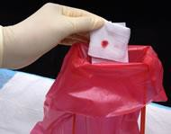
Risk of Exposure
Spread of bloodborne pathogens occurs through:
Direct contact
Indirect contact
Respiratory transmission
Vector-borne transmission
Source: NIOSH

Slide 12

Risk of Exposure
How exposure occurs:
Needlesticks
Cuts from other contaminated sharps
Contact of mucous membrane or broken skin with contaminated blood or OPIM
Source: OSHA DTE

Slide 13

Risk of Exposure
Occupational exposures:
Occupations at risk
  First responders
  Housekeeping personnel
in some industries
  Nurses and other
healthcare personnel
Source: OSHA
CDC estimates 5.6 million workers in healthcare and related occupations are at risk
All occupational exposure to blood or OPIM places workers at risk

Slide 14
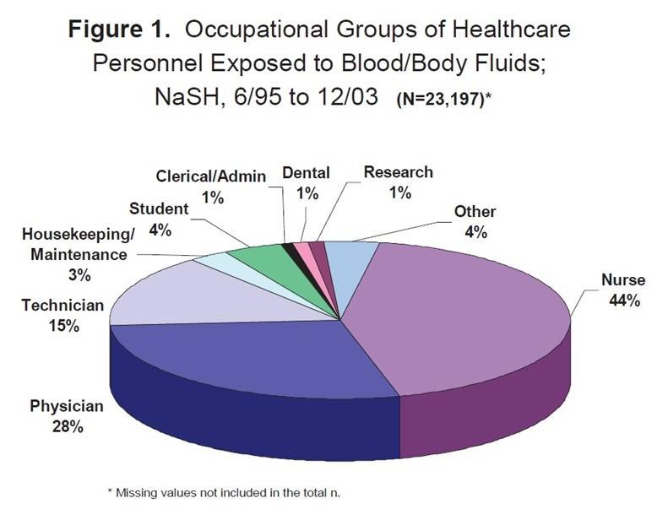
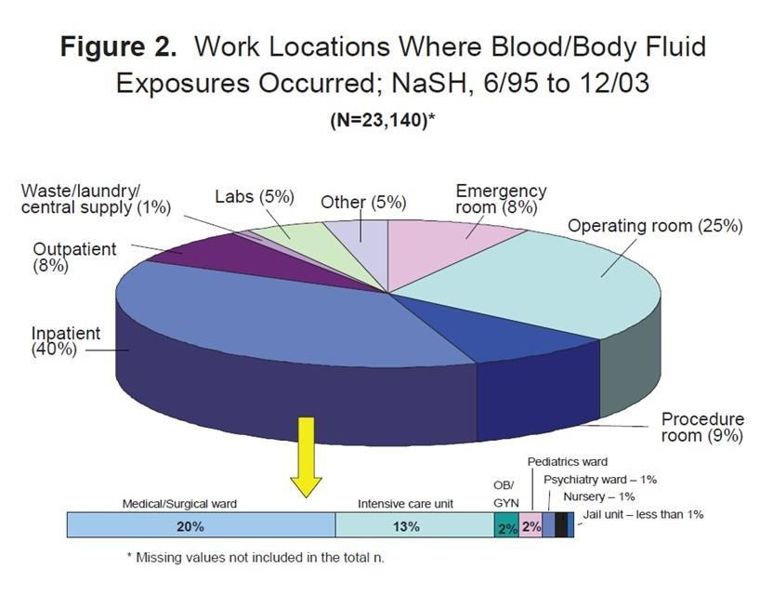
Risk of Exposure
The figure on left shows percent of occupational groups of healthcare workers exposed to blood or body fluids, with nurses (44%), physicians (28%), and technicians (15%) accounting for most of the incidents. The figure on the right shows healthcare work locations where exposures occurred, with inpatient facilities, such as the medical or surgical ward (20%) and intensive care unit (13%), and operating rooms (25%) accounting for the majority of exposure sites. Source: CDC (2008)

Slide 15
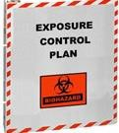
Exposure Control Plan (ECP)
Establish an Exposure Control Plan
Written plan
Review and update plan

Slide 16
Exposure Control Plan (ECP)
Required elements of Exposur Control plan include:
Exposure determination
Schedule and method of implementation
Procedure for evaluation of exposure incidents
e

Slide 17
Exposure Control Plan (ECP)
Accessible to employees
Review and update
  Annually
  When new or modified
tasks/procedures are implemented

Slide 18
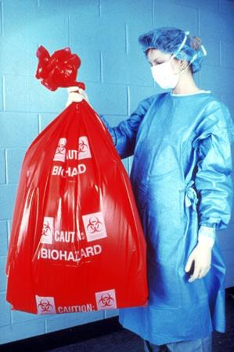
Controlling Exposures
Observe standard precautions, such as:
Treating all blood and bodily fluids as if they are contaminated
Proper cleanup and decontamination
Source: OSHA DTE

Slide 19
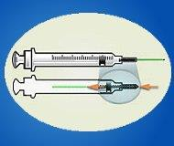
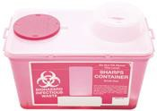

Controlling Exposures
Engineering and work practice controls:
Safer medical devices
Sharps disposal containers
Hand hygiene
Source: OSHA DTE
Source: NIOSH
Source: NIOSH

Slide 20
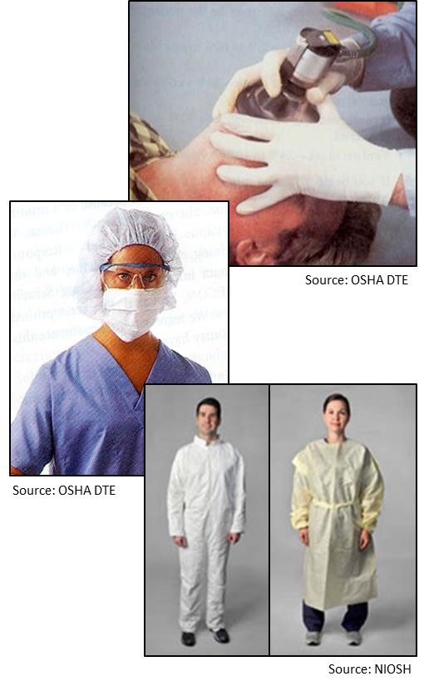
Controlling Exposures
PPE examples:
Gloves
Masks
Aprons/Smocks/Gow ns
Face shields
Mouthpieces
Safety glasses
CPR pocket masks

Slide 21
Controlling Exposures
Employer’s responsibilities:
Perform hazard assessment
Identify and provide appropriate PPE to employee at no cost
Train employees on use and care
Maintain/replace PPE
Review, update, evaluate PPE program

Slide 22
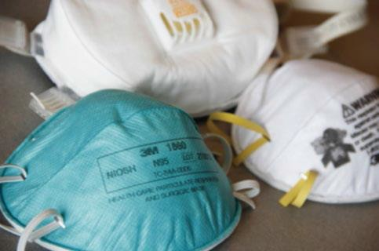
Controlling Exposures
PPE selection
  Safe design and construction
  Fit comfortably
Required PPE training
  When it is necessary
  What kind is necessary
Source: CDC
Proper donning, adjusting, wearing, doffing
Limitations
Proper care, maintenance, useful life, disposal

Slide 23
Controlling Exposures
Employee’s responsibilities:
Properly wear PPE
Attend training
Care for, clean, and maintain
Notify when repairs/replacement needed

Slide 24

Controlling Exposures
Housekeeping:
Written schedule for cleaning and decontamination
Picking up broken glass
  Not picked up by hands
  Mechanical means only
Source: OSHA DTE

Slide 25
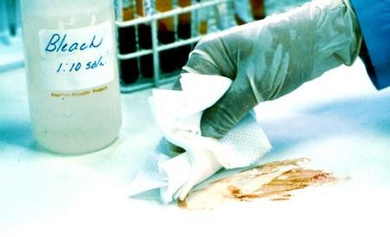
Controlling Exposures
Clean-up and decontamination:
Wear protective gloves
Use appropriate disinfectant
Clean and disinfect contaminated equipment and work surfaces
Thoroughly wash up immediately after exposure
Source: OSHA DTE
Properly dispose of contaminated PPE, towels, rags, etc.

Slide 26
Controlling Exposures
Regulated waste disposal:
  Dispose of regulated waste in closable, leak-proof red or biohazard labeled bags or containers
  Dispose of contaminated sharps in closable, puncture-resistant, leak- proof, red or
Source: OSHA DTE

Slide 27
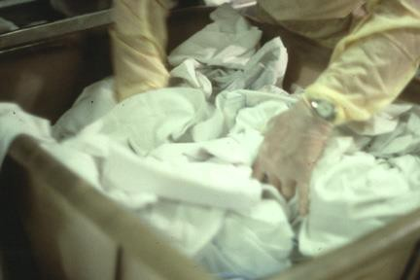
Controlling Exposures
Laundry
– Contaminated laundry must be bagged or containerized at the location where it was used.
Source: OSHA DTE

Slide 28

Controlling Exposures
Training:
Who
– All employees with occupational exposure to blood
Source: OSHA DTE
or other potentially infectious material (OPIM)
– Employees who are trained in first aid and CPR
No cost; during working hours
When
  Initial assignment
  Annually; or with new/modified tasks

Slide 29
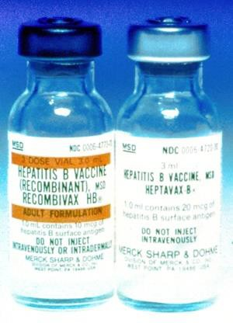
Controlling Exposures
Hepatitis B vaccination:
Offered to all potentially exposed employees
Provided at no cost to employees (within 10 days to employees with occupational exposure)
Declination form
Source: OSHA DTE

Slide 30
Controlling Exposures
No vaccinations for:
Hepatitis C
HIV

Slide 31
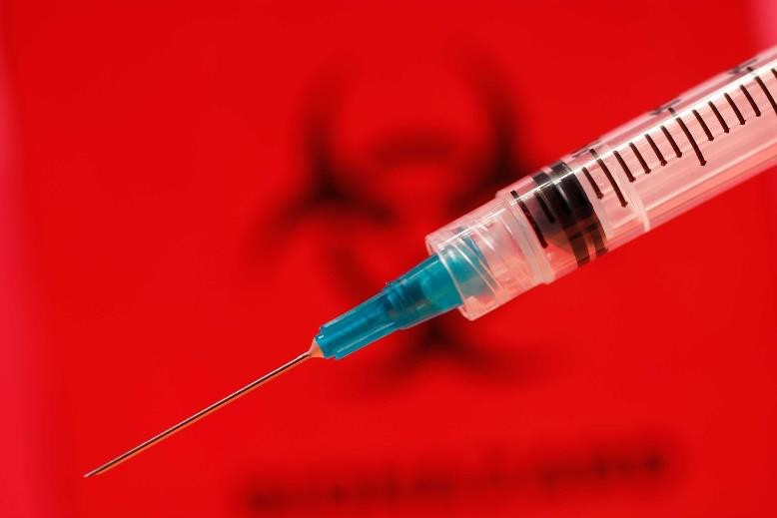
When Exposure Occurs
Exposure incident:
Specific eye, mouth, or other mucous membrane, non-intact skin, parenteral contact with blood or OPIM that results from the performance of an
employee’s duties.
Source: CDC

Slide 32
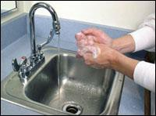
When Exposure Occurs
Immediate actions
  Wash exposed area with soap and water
  Flush splashes to nose, mouth, or skin with water
  Irrigate eyes with water and saline
Source: OSHA

Slide 33
When Exposure Occurs
Report exposure immediately
Direct employee to healthcare professional for treatment

Slide 34
When Exposure Occurs
Confidential medical evaluation and follow-up
  Route(s) of exposure and circumstances
  Source individual
  Collect/test blood for HBV and HIV serological status
  Post exposure prophylaxis (when medically indicated)
  Counseling
  Evaluation

Slide 35
What Questions Do You Have?
?

Slide 36
Knowledge Check
Bloodborne pathogens can be transmitted by .
  sexual intercourse or intravenous drug use
  rubbing an eye after coming in contact with potentially infectious material
  potentially infectious material coming in contact with inflamed acne or sunburn blisters
  all of the above
Answer: d. All of the above

Slide 37
Knowledge Check
Employees should use PPE when .
  there is a reasonable anticipation of contact with blood or OPIM
  cleaning up spills
  responding to an emergency
  all of the above
Answer: d. all of the above

Slide 38
Knowledge Check
Which of the following is an example of a work practice control?
  Spill kits
  Accessible handwashing stations
  Proper decontamination of spill areas
  Red hazardous waste bags
Answer: c. Proper decontamination of spill areas

Slide 39
Knowledge Check
Which of the following is a standard precaution for workers exposed to bloodborne pathogens?
  Treat all liquids as hazardous for HIV
  Treat all blood and bodily fluids of patients as potentially infectious materials
  Test all blood and unknown bodily fluids for HIV after spills
  Label unknown liquids with hazard signs
Answer: b. Treat all blood and bodily fluids of patients as potentially infectious materials

Slide 40
Knowledge Check
Hepatitis B is an inflammation of which body organ?
  Kidney
  Lungs
  Larynx
  Liver
Answer: d. Liver

Slide 41
Knowledge Check
In the event of an exposure incident, which following action should be taken first?
  Notify appropriate personnel
  Wash the area thoroughly
  Seek medical treatment
  Complete an incident or accident report
Answer: b. Wash the area thoroughly

Slide 42
Knowledge Check
Which of the following actions can help prevent exposure to bloodborne pathogens?
  Wearing latex gloves
  Wearing goggles
  Washing hands
  All of the above
Answer: d. All of the above

Slide 43
Knowledge Check
A vaccine is only available for which of the following major bloodborne pathogen viruses?
  HIV
  Hepatitis B
  Hepatitis C
  No vaccines are available for any of the three major BBP viruses
Answer: b. Hepatitis B

Slide 44
Knowledge Check
Which of the following are potential routes of entry for bloodborne pathogens?
  Mucous membranes of the eyes, nose, and mouth
  Non-intact skin
  Penetration by a contaminated sharp object
  All of the above
Answer: d. All of the above

